Slide 1
Ms. Pac Man vs Ghost Team
Wong Hao Shan
17122789/1(WID170054)
Lecturer: Dr. Loo Chu Kiong

Slide 2
Topic [ Monte Carlo Tree Search ]
Expansion | Simulation | Backpropagation | Selection
Add new node to the search tree, to represent a position of pacman that the AI will explore and investigate. | For each expanded node, simulate the game play, the process can continue for certain tree depth. The simulation is repeatedly takes random moves follow by select the best child with highest score. For my implementation, I applied new rules instead of completely random. | Update the child node of the search tree depending on the result of simulation. | Based on all visited child nodes, let the AI select the best child and which one to investigate further.
The reason to choose MCTS is because it is a powerful algorithm the allows AI to solve problem in open ended enviroments, which is very suitable for pacman game due to its high branching factor. The statistics tree generated by MCTS using simulation helps to determine favorable moves and guides its own self-improvement as well.

Slide 3
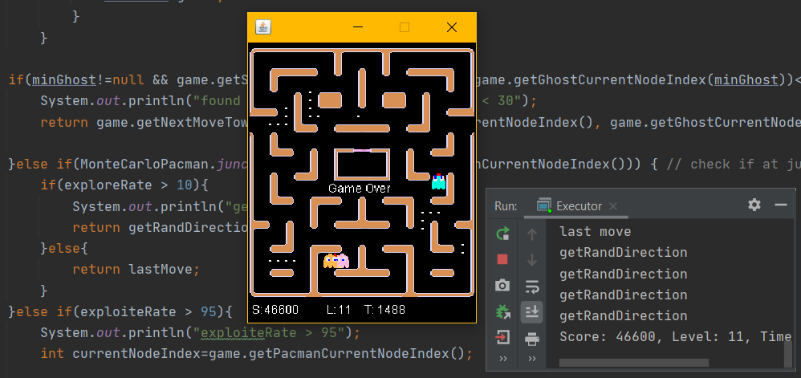
Result [ Level 11, Score: 46600 ]

Slide 4
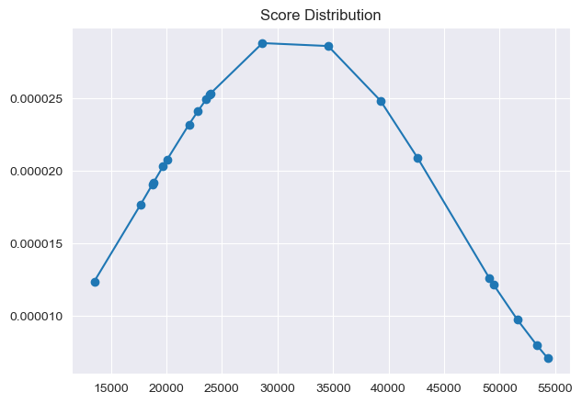
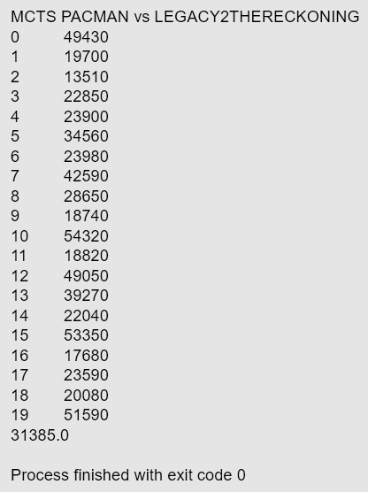
Experiment Summary
Number of Trials : 20
Average Score: 31385
Maximum Score: 54320
Notes:
MCTS PACMAN vs LEGACY2THERECKONING
0 49430
1 19700
2 13510
3 22850
4 23900
5 34560
6 23980
7 42590
8 28650
9 18740
10 54320
11 18820
12 49050
13 39270
14 22040
15 53350
16 17680
17 23590
18 20080
19 51590
31385.0
Process finished with exit code 0

Slide 5
Pacman Rollout Strategy [ ExplorationPacman.java ]
Get random exploration and exploitation rate.
Check if editable ghost is nearby (min. distance < 30), moves toward.
Else if current position == junction, turn randomly when exploration rate > 10, remain last move otherwise.
Else if exploitation rate > 95, moves towards nearest pills.
Otherwise, keeps the last move direction.
For each simulation, repeat step 1 to 5.

Slide 6
Demo
System.out.println("MCTS PACMAN vs LEGACY2THERECKONING");
exec.runGame(new MonteCarloPacman(), new Legacy2TheReckoning(), visual, delay);
public class MonteCarloPacman extends Controller<MOVE> {
...
public int rolloutSimulateExperiment(MonteCarloNode node, int steps) {
Controller<MOVE> pacManController = new ExplorationPacman();
...
return score;
}
}

Slide 7
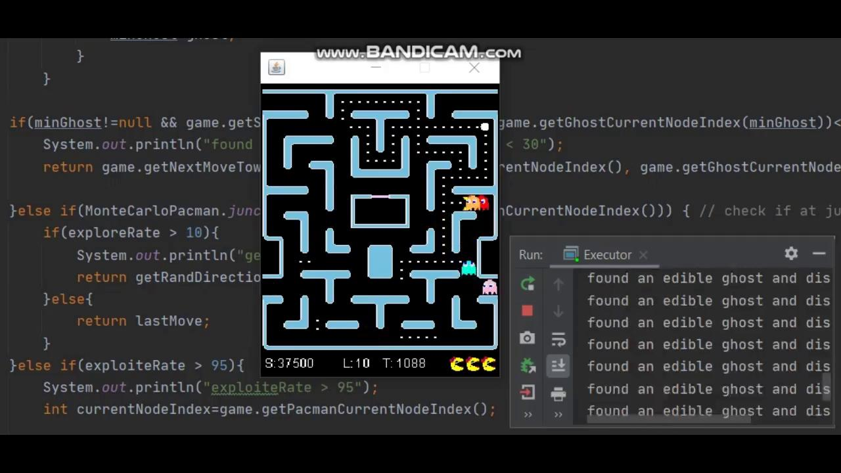
Demo
Video Link: https://drive.google.com/file/d/1LYinQ5lNLchgLXEw3ed63OgUBoCQx9Dz/view?usp=sharing
-Code Setup : 00:00 - 00:38
-Game Run : 00:39 - 01:09

Slide 8
Appendix
-Paman Source Code: http://gameaibook.org/wp-content/uploads/2016/10/mspacman-master.zip
-MCTS Reference: https://github.com/njustesen/ms-pacman-ai

