Slide 1

Biomolecular Phase Separation: From Molecular Driving Forces to Macroscopic Properties
Annual Review of Physical Chemistry
Presented by li jiaqi
2020.7.31
Dignon, G. L., Best, R. B., & Mittal, J. (2020). Biomolecular Phase Separation: From Molecular Driving Forces to Macroscopic Properties. Annu Rev Phys Chem, 71, 53-75. doi:10.1146/annurev-physchem-071819-113553

Slide 2
content
1. INTRODUCTION
2. STRUCTURE VERSUS DISORDER
2.1. Role of Intrinsic Disorder in Phase Separation
2.2. Role of Folded Domains in Phase Separation
2.3. Interactions Between Folded and Disordered Domains
3. SEQUENCE-LEVEL DRIVING FORCES
3.1. Amino Acid Interaction Modes
3.2. Sequence and Arrangement of Interactions
3.3. Stimulus Responses of Different Interaction Modes
4. MULTICOMPONENT PHASE SEPARATION
4.1. Modes of Two-Phase Systems with Two Components
4.2. Multiple Condensed Phases
4.3. Phase Separation with Many Components

Slide 3
2. STRUCTURE VERSUS DISORDER
2.1. Role of Intrinsic Disorder in Phase Separation
The proteome for MLOs has a significantly greater fraction of proteins containing intrinsically disordered regions (IDRs) than the overall proteome.
IDPs form many contacts with one another simultaneously, due to their high multi-valency.
The amino acids are more exposed and therefore more accessible to posttranslational modification (PTM). ---regulation
IDPs have liquid-like properties. ---folded domains may drastically slow down dynamics

Slide 4
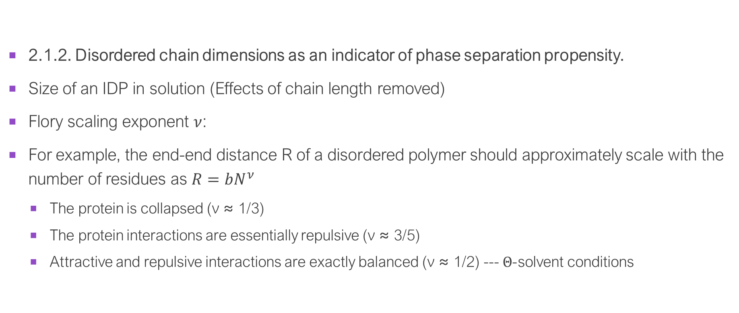
Size & phase separation
2.1.2. Disordered chain dimensions as an indicator of phase separation propensity.
Size of an IDP in solution (Effects of chain length removed)
Flory scaling exponent $ν$:
For example, the end-end distance R of a disordered polymer should approximately scale with the number of residues as $R=bN^{ν}$
The protein is collapsed (ν ≈ 1/3)
The protein interactions are essentially repulsive (ν ≈ 3/5)
Attractive and repulsive interactions are exactly balanced (ν ≈ 1/2) --- $Θ$-solvent conditions

Slide 5
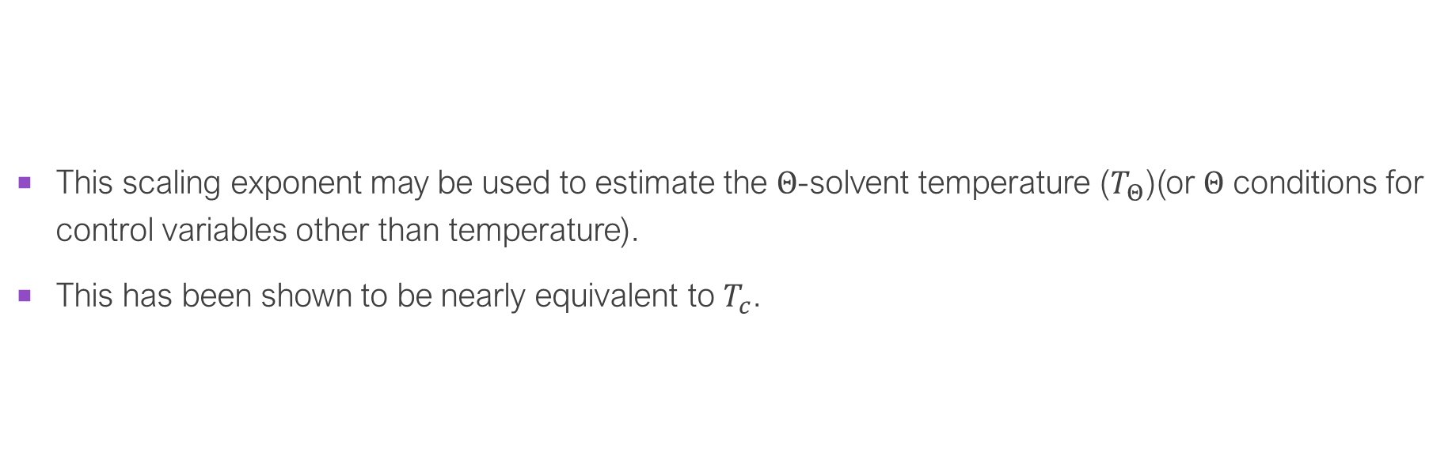
Size & phase separation
This scaling exponent may be used to estimate the $Θ$-solvent temperature ($T_{Θ}$)(or $Θ$ conditions for control variables other than temperature).
This has been shown to be nearly equivalent to $T_{c}$.

Slide 6
Folded domains
Folded proteins may aggregate or crystallize, leaving only a small window of conditions in which LLPS may occur.
Oligomerizing multiple protein molecules and effectively increasing the multi-valency and number of interactions a single particle is able to form.
RNPs (ribonucleoproteins) selectively bind to particular regions of RNA and can promote LLPS in the presence of these particular RNA sequences.
Partially folded structures may also contribute to phase separation through folding upon binding to specific binding partners or promotion of secondary structure upon self-association.
Inclusion of short helical motifs within an ELP (elastin-like polypeptides) also contributes to phase separation with significant hysteresis.
Folded domains carry out orthogonal functions.
Interactions Between Folded and Disordered Domains

Slide 7
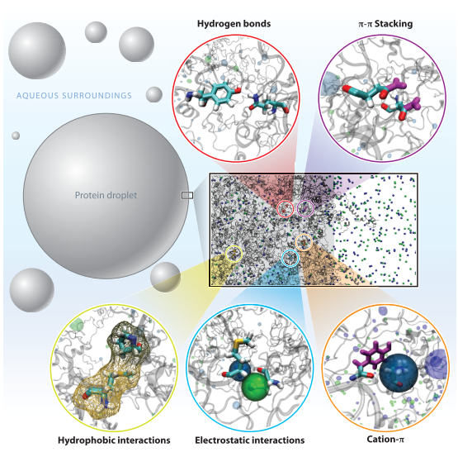
3.1. Amino Acid Interaction Modes
3.1.1. Charge-charge interactions.
3.1.2. π-Interactions.
3.1.3. Hydrophobic contacts.
3.1.4. Hydrogen bonds.
3.1.5. Summary of interactions.

Slide 8
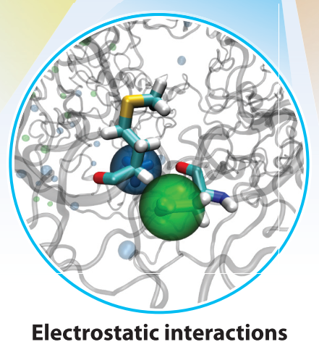
3.1.1. Charge-charge interactions.
A high net charge may allow a single protein to exist at high concentrations without undergoing LLPS.
PH
PTMs
The polarity of the environment

Slide 9
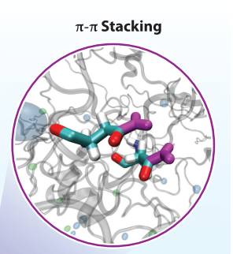
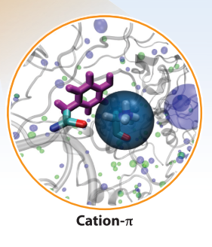
3.1.2. π-Interactions
sp2-hybridized atoms
π-π interactions
aromatic groups of phenylalanine, tyrosine, and tryptophan
backbone peptide bond with a partial π-bond
Cation-π
particularly between arginine and tyrosine residues

Slide 10
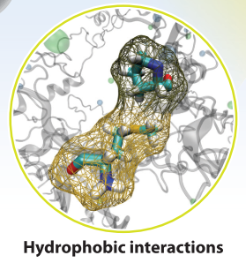
3.1.3. Hydrophobic contacts.
The lower fraction of hydrophobic residues likely allows for the chains to remain disordered and for the assemblies to be liquid-like rather than solid.
Hydrophobic amino acids may also interact strongly with aromatic amino acids

Slide 11
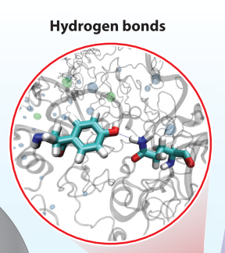
3.1.4. Hydrogen bonds.
Most amino acids contain both hydrogen bond donors and acceptors, suggesting that hydrogen bonding could be very common within the densely packed proteinaceous condensates.
Hydrogen bonds may also contribute to biomolecular phase separation more indirectly through the formation of secondary structure in proteins (8), the hybridization and secondary structure of nucleic acids, and the incorporation of water into the condensate.

Slide 12

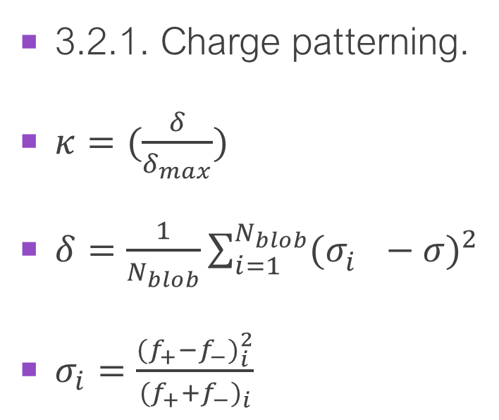
3.2. Sequence and Arrangement of Interactions
3.2.1. Charge patterning.
$κ=(\frac{δ}{δ_{max}})$
$δ=\frac{1}{N_{blob}}\sum_{i=1}^{N_{blob}}{{(σ_{i}^{}−σ)}^{2}}$
$σ_{i}=\frac{{(f_{+}−f_{−})}_{i}^{2}}{{(f_{+}+f_{−})}_{i}}$
Nblob is the number of “blobs” or segments of five or six residues of the sequence in a moving window;
f+/ − is the fraction of positive or negative residues within the blob;
σ is calculated over the full sequence;
δmax is the maximum possible δ value for all sequences of the given composition.
$$κ\sim 0$$
strictly alternating sequence (KEKEKEKEKE…)
---more extended
$$κ\sim 1$$
block copolymer (KKKKKKKEEEEEE…)
---more collapsed

Slide 13
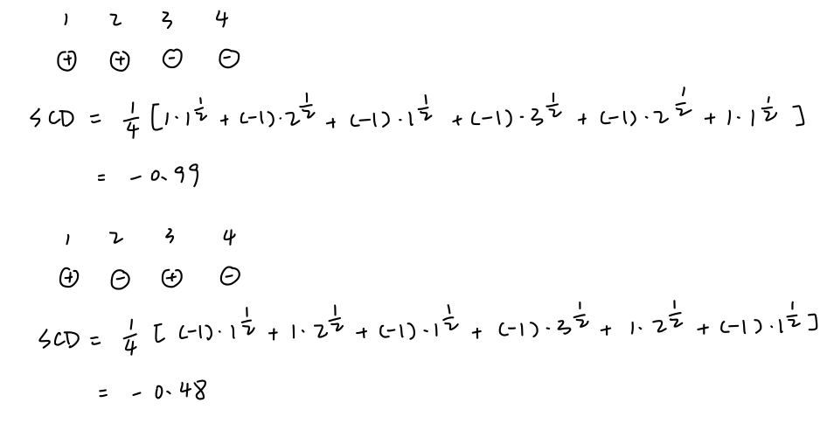
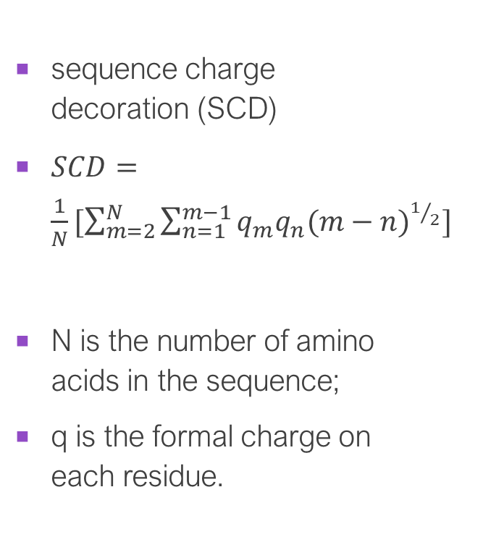
3.2.1. Charge patterning.
sequence charge decoration (SCD)
$SCD=\frac{1}{N}[\sum_{m=2}^{N}{\sum_{n=1}^{m−1}{q_{m}q_{n}{(m−n)}^{1/2}}}]$
N is the number of amino acids in the sequence;
q is the formal charge on each residue.
large negative value ---a block copolymer
near 0 ---an alternating sequence
Positive ---nonzero net charge

Slide 14
3.2.2. Hydrophobic/aromatic patterning.
similarly to the SCD and κ metrics
dispersion of aromatic amino acids prevents hydrophobic collapse or folding
3.2.3. Patterning as mode of recognition.
Different sequence of patterning
different separation behavior
Recognition ---additional selectivity

