Slide 1
capstone project – battle of neighborhoods
Detecting promising neighborhoods for the next boba storefront in Toronto
Jiaqi Chen
November 4, 2019

Slide 2
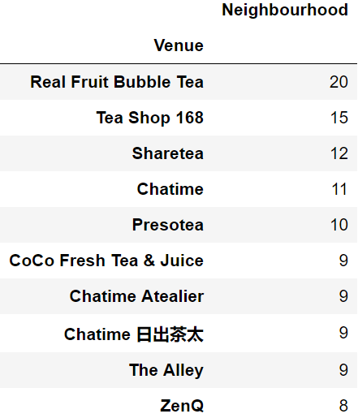
making effective decision on the location of new storefronts is crutial
Growing boba market
Low cost of storefronts
Fierce market competition
simple equipment
low labour cost
In 2019, at least 20 bubble tea brands have emerged on the Toronto Market
The global bubble tea market size was valued at USD 1.89 Billion in 2018 and is projected to reach USD 3.49 Billion by the end of 2026.^{[1]}
[1] https://www.fortunebusinessinsights.com/industry-reports/bubble-tea-market-101564

Slide 3
Data acquisition and cleansing
1. names of Toronto neighborhoods will be obtained from Wikipedia by using BeautifulSoup
2. coordinate of neighborhoods will be obtained from cousera in case of the disconnection of geocoder
3. number and coordinate of existing boba storefronts will be obtained using Foursquare API
4. number and coordinate of universities and colleges and their location in every neighborhood will be obtained using Foursquare API
5. number and coordinate of shopping places and their location in every neighborhood will be obtained using Foursquare API
* The exploring radius of above venues of each neighborhood is set to be 1km.

Slide 4
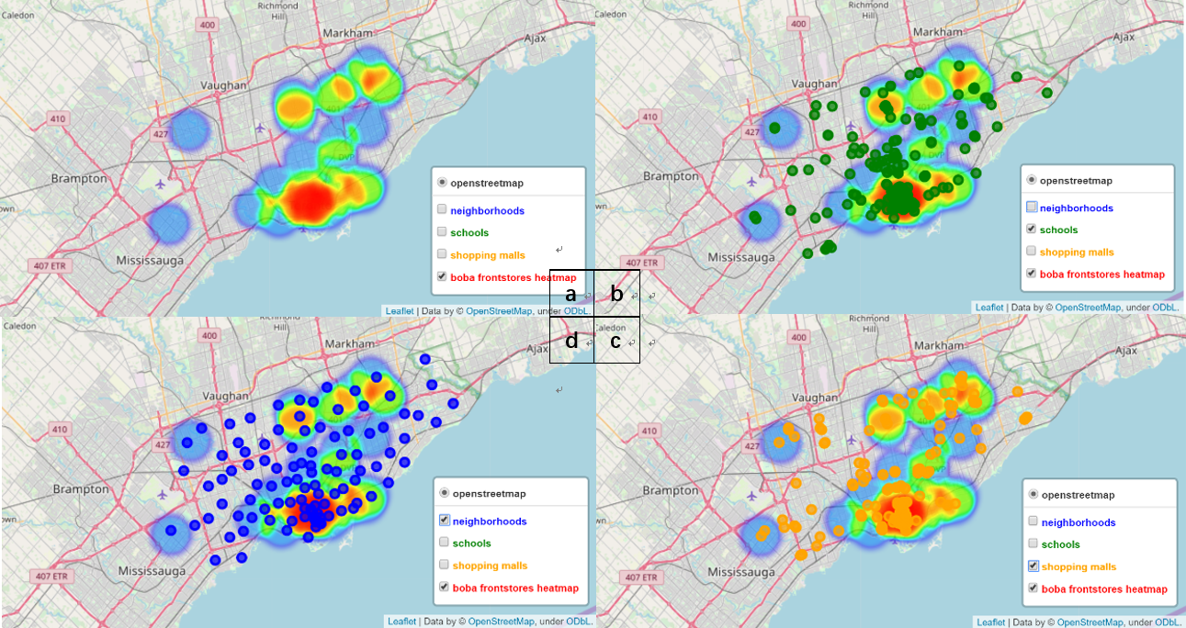
DATA VISUALIZATION ON MAP
heatmap of boba storefronts
b. heatmap of boba storefronts and distribution of schools
c. heatmap of boba storefronts and distribution of neighborhoods
d. heatmap of boba storefronts and distribution of shopping places.

Slide 5
1. The distribution of bubble tea shops, schools and shopping malls are highly correlated.
2. Bubble tea shops mainly focus on old Toronto and North York.
3. Boba market competition is milder in the west and the northeast of Toronto than old Toronto.

Slide 6
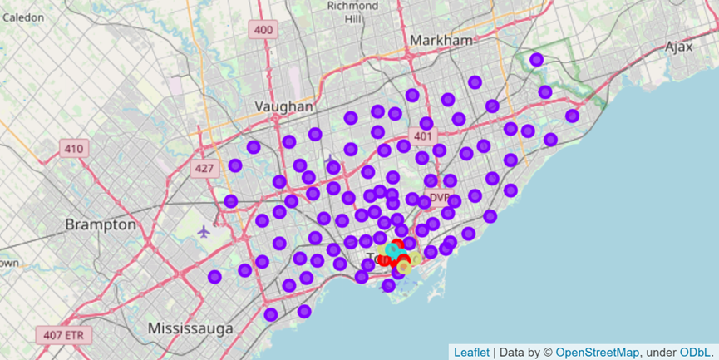
Performance of Model
Color - Cluster Number | Number of neighborhoods | Mean number of boba shops | Mean number of schools | Mean number of shopping places
cluster0 | 7 | 20.43 | 24.14 | 15.58
cluster1 | 88 | 0.81 | 1.55 | 1.37
cluster2 | 3 | 36.0 | 35.67 | 14.00
cluster3 | 4 | 4.00 | 19.75 | 5.00

Slide 7
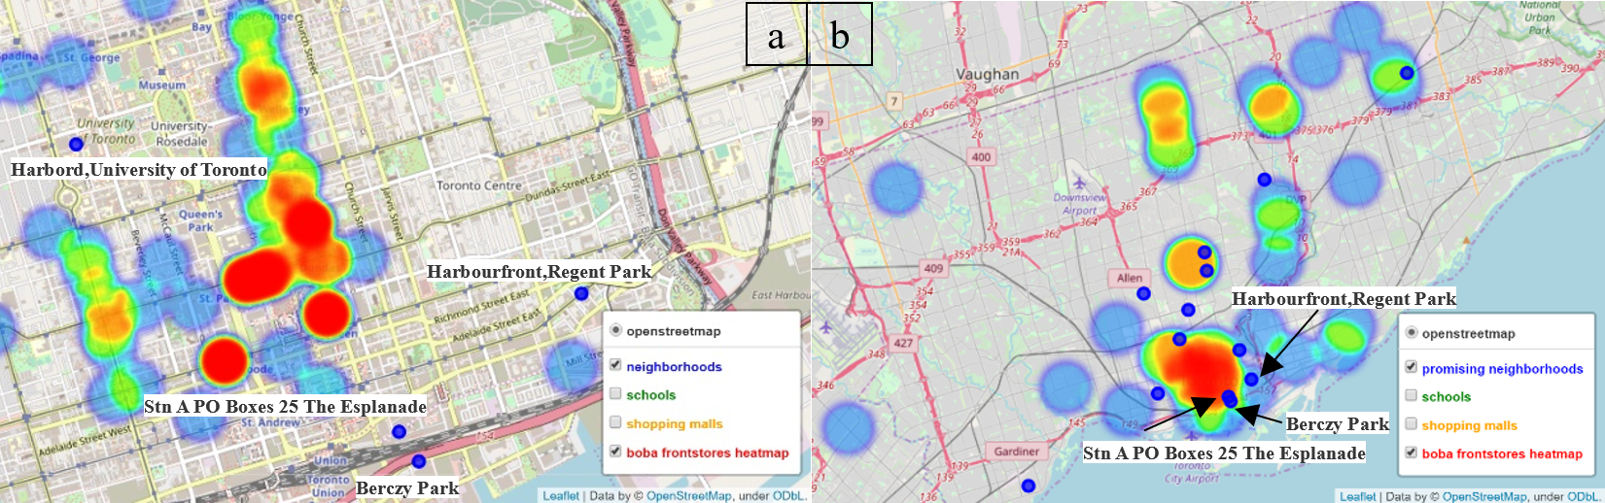
contrast between k-means and manual selection
a. map of cluster3 b. map of manual selection
Berczy Park, Harbourfront,Regent Park, Stn A PO Boxes 25 The Esplanade are shared by both approaches, and they all situate in the south of old Toronto near the seashore.

Slide 8
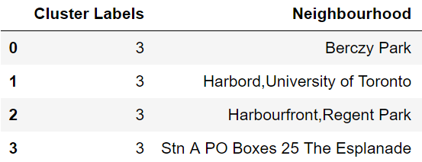
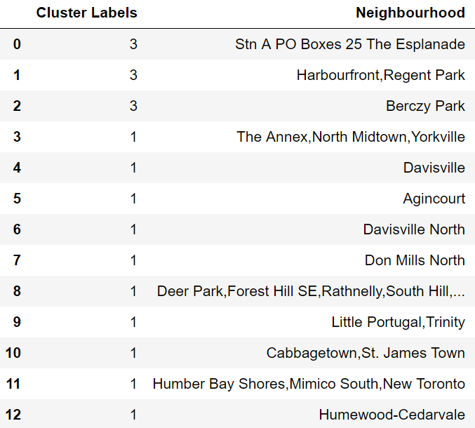
contrast between k-means and manual selection
neighborhoods in cluster3
neighborhoods in manual selection

Slide 9
Conclusions and Future directions
CONCLUSIONS
Used k-means to detect promising neighborhoods in Toronto for new storefronts
Inspected the result of k-means by contrast with manual filtration
FUTURE DIRECTIONS
The ultimate goal of a boba shop owners is reducing cost and increasing profitability. There is improving room for this project
More accurate division of neighborhood boundary
Consideration on more factors
rental costs
local consumption level
transportation
business hours

