Slide 1

Predicting Current and Future Psychological Health from Childhood Essays
----CLPsych 2018
Jiaqi He | Shilu Jiang | Shulin Cao
June 7th, 2018

Slide 2
Problem Definition
The unprecedented data for this task comes from the National Child Development Study, (NCDS), also known as the 1958 British Birth Cohort Study, which follows a cohort of all children born in a single week in Great Britain in March 1958 until the present day. They have been followed since their birth and have been surveyed at various points in their life to monitor their health and socioeconomic status. At age 11, the participants wrote short essays on where they saw themselves at age 25, fourteen years in the future; these essays will be used to predict aspects of their mental health at ages 11, 23, 33, 42, and 50. Additional non-linguistic variables, including gender and childhood parental social class, will be made available as well (Power & Elliot, 2005). ---- CLPsych 2018

Slide 3
Data Preparation
Case ID: 'N18166S'
Essay: "My name is (name) and I am 25 years old. I am not married and I have a little boy. My life I am leading is not so good just now. My interests are gardening and jig-saw making I mak*e a jig-saw when I have notheng to do. My home life is not very intressting I just sit and watch the tv on Monday I watch Blue Petter. My work is an Builder and I have to build a 9 story flat, a factor, a school and for all thess job`s and a lot of outher`s. I need a scafflding to stand on to get to the top of the building. I have to go up and down the scalfflding to get some bricks and cement. I have sore legs going up and down the scalfflding. By this time I have got good exersice . When I go home I am as fit as a fiddle for my dinner. I come back after my dinner up the scafflding for more buillding and exersice. I go hom with my week's wages on my poket and I have got 10xxxx 15s and 6d for the week. My little boy (name) is staying with my next door neabour when I am at work . He has a train set their and it works by battery it only cost me 39. and 11 for it. My Garden is quite nice and I have a prize wining melling . I ceep it in a green house. When my favouret tv program comes on witch is How I go and watch it . It shown you how to left 8 brick with one hand last week. I do my Garden in the wonteh when the ground is soft. I *out my potatoes in the ***** and cover them ap so the frost dose not get them. After that I plant the onion's and shalots Words: 318.”
Anxiety: 1.0
Depression: 1.0

Slide 4
Data Preprocessing
Remove numbers and meaningless words like connection words (stop words)
Remove other structures like words count in the essay
Correct misspelled words
An example of essay after preprocessing:
'name name years old married little boy life leading good interests gardening jigsaw making make jigsaw nothing home life interesting sit watch monday watch blue letter work builder build story flat factor school jobs lot others need scaffolding stand get top building go scaffolding get bricks cement sore legs going scaffolding time got good exercise go home fit fiddle dinner come back dinner scaffolding building exercise go weeks wages pocket got week little boy name staying next door labour work train set works battery cost garden quite nice prize dining telling deep green house favoured program comes witch go watch shown left brick one hand last week garden wonted ground soft potatoes cover frost dose get plant onions shots '

Slide 5
Data Preparation
Case ID: 'N18166S'
Essay:
=>Process: delete [...] =>Delete punctuations => Delete stopwords
=> Delete numbers and word count
My name is (name) and I am 25 years old. I am not married and I have a little boy. My life I am leading is not so good just now. My interests are gardening and jig-saw making I mak*e a jig-saw when I have notheng to do. My home life is not very intressting I just sit and watch the tv on Monday I watch Blue Petter. My work is an Builder and I have to build a 9 story flat, a factor, a school and for all thess job`s and a lot of outher`s. I need a scafflding to stand on to get to the top of the building. I have to go up and down the scalfflding to get some bricks and cement. I have sore legs going up and down the scalfflding. By this time I have got good exersice . When I go home I am as fit as a fiddle for my dinner. I come back after my dinner up the scafflding for more buillding and exersice. I go hom with my week's wages on my poket and I have got 10xxxx 15s and 6d for the week. My little boy (name) is staying with my next door neabour when I am at work . He has a train set their and it works by battery it only cost me 39. and 11 for it. My Garden is quite nice and I have a prize wining melling . I ceep it in a green house. When my favouret tv program comes on witch is How I go and watch it . It shown you how to left 8 brick with one hand last week. I do my Garden in the wonteh when the ground is soft. I *out my potatoes in the ***** and cover them ap so the frost dose not get them. After that I plant the onion's and shalots. Words: 318
Anxiety: 1.0
Depression: 1.0

Slide 6
Data Preparation
Case ID: 'N18166S'
Essay:
=>Process: delete [...] =>Delete punctuations => Delete stopwords
=> Delete numbers and word count
My name is name and I am 25 years old I am not married and I have a little boy My life I am leading is not so good just now My interests are gardening and jigsaw making I make a jigsaw when I have notheng to do My home life is not very intressting I just sit and watch the tv on Monday I watch Blue Petter My work is an Builder and I have to build a 9 story flat a factor a school and for all thess jobs and a lot of outhers I need a scafflding to stand on to get to the top of the building I have to go up and down the scalfflding to get some bricks and cement I have sore legs going up and down the scalfflding By this time I have got good exersice When I go home I am as fit as a fiddle for my dinner I come back after my dinner up the scafflding for more buillding and exersice I go hom with my weeks wages on my poket and I have got 10xxxx 15s and 6d for the week My little boy name is staying with my next door neabour when I am at work He has a train set their and it works by battery it only cost me 39 and 11 for it My Garden is quite nice and I have a prize wining melling I ceep it in a green house When my favouret tv program comes on witch is How I go and watch it It shown you how to left 8 brick with one hand last week I do my Garden in the wonteh when the ground is soft I out my potatoes in the and cover them ap so the frost dose not get them After that I plant the onions and shalots Words 318
Anxiety: 1.0
Depression: 1.0

Slide 7
Data Preparation
Case ID: 'N18166S'
Essay:
=>Process: delete [...] =>Delete punctuations => Delete stopwords
=> Delete numbers and word count
name name 25 years old married little boy life leading good interests gardening jigsaw making make jigsaw notheng home life intressting sit watch tv monday watch blue petter work builder build 9 story flat factor school thess jobs lot outhers need scafflding stand get top building go scalfflding get bricks cement sore legs going scalfflding time got good exersice go home fit fiddle dinner come back dinner scafflding buillding exersice go hom weeks wages poket got 10xxxx 15s 6d week little boy name staying next door neabour work train set works battery cost 39 11 garden quite nice prize wining melling ceep green house favouret tv program comes witch go watch shown left 8 brick one hand last week garden wonteh ground soft potatoes cover ap frost dose get plant onions shalots words 318
Anxiety: 1.0
Depression: 1.0

Slide 8
Data Preparation
Case ID: 'N18166S'
Essay:
=>Process: delete [...] =>Delete punctuations => Delete stopwords
=> Delete numbers and word count
name name years old married little boy life leading good interests gardening jigsaw making make jigsaw notheng home life intressting sit watch tv monday watch blue petter work builder build story flat factor school thess jobs lot outhers need scafflding stand get top building go scalfflding get bricks cement sore legs going scalfflding time got good exersice go home fit fiddle dinner come back dinner scafflding buillding exersice go hom weeks wages poket got week little boy name staying next door neabour work train set works battery cost garden quite nice prize wining melling ceep green house favouret tv program comes witch go watch shown left brick one hand last week garden wonteh ground soft potatoes cover ap frost dose get plant onions shalots
Anxiety: 1.0
Depression: 1.0

Slide 9


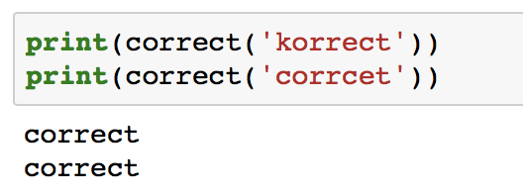
Data Preprocessing
Spelling Corrector - Model: Bayes' theorem
The four parts of this expression are:
Selection Mechanism: argmax
Candidate Model: c ∈ candidates
Language Model: P(c)
Error Model: P(w|c)
simplify
by Peter Norvig in 2007
https://norvig.com/spell-correct.html

Slide 10
Data Preprocessing
Spelling Corrector - Candidate Model: Edit Distance
Given two strings a and b on an alphabet Σ (e.g. the set of ASCII characters, the set of bytes [0..255], etc.), the edit distance d(a, b) is the minimum-weight series of edit operations that transforms a into b. One of the simplest sets of edit operations is that defined by Levenshtein in 1966:^{[2]}
Insertion of a single symbol. If a = uv, then inserting the symbol x produces uxv. This can also be denoted ε→x, using ε to denote the empty string.
Deletion of a single symbol changes uxv to uv (x→ε).
Substitution of a single symbol x for a symbol y ≠ x changes uxv to uyv (x→y).
https://en.wikipedia.org/wiki/Edit_distance
1
'something', 'soothing'
somthing
2
'loathing', 'nothing', 'scathing', 'seething', 'smoothing', 'something', 'soothing', 'sorting'

Slide 11
Data Preprocessing
Spelling Corrector - Language Model
The probability of a word: P(word)
big.txt
Project Gutenberg
Wiktionary
British National Corpus
Spelling Corrector - Error Model
Produce the priority of candidates:
The known original word
The known words at edit distance one away with highest probability P(word)
The list of known words at edit distance two away with highest probability
The unknown original word

Slide 12
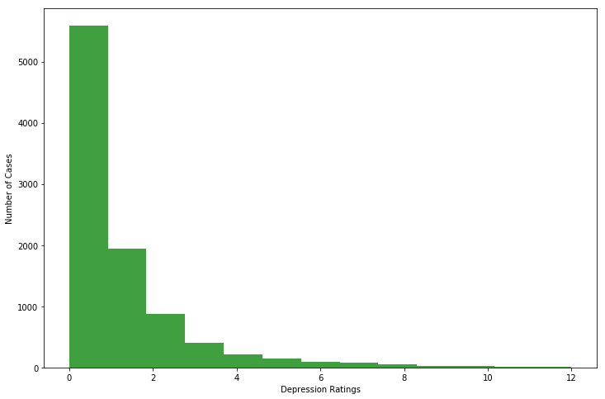
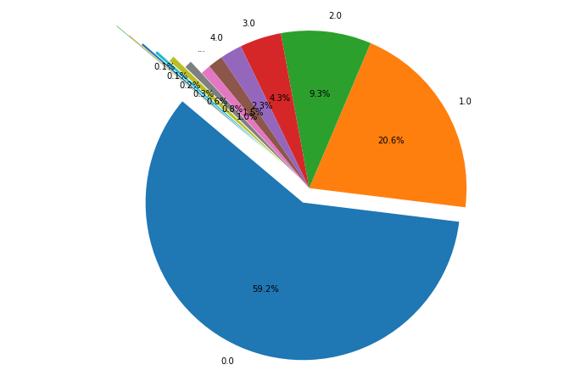
Data Preprocessing
Labels in range between 0 and 12 with distribution showing on the left
In the project, we will label all data essay with two groups:
0: all depression rating 0
1: all other depression ratings

Slide 13
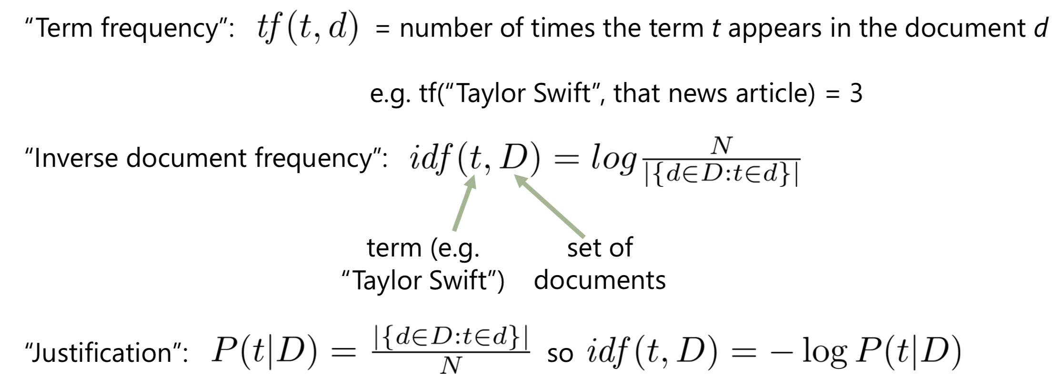
Feature
In this model, a text (such as a sentence or a document) is represented as the bag (multiset) of its words, disregarding grammar and even word order but keeping multiplicity [1]
Feature Choice:
Bag of Words
Count
TF-IDF
Word Embedding
Word2Vec
Counts: word frequency vector composed of top n frequent words in the whole data set (bag of words)
[1] wikipedia--bag_of_words

Slide 14
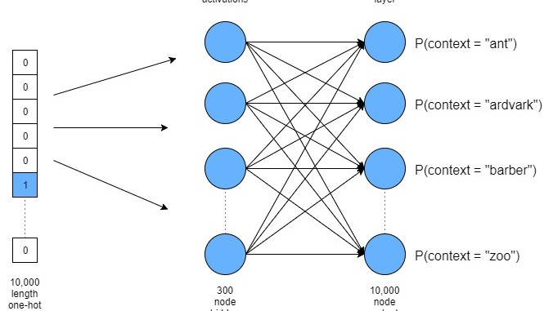
Feature
Feature Choice:
Bag of Words
Count
TF-IDF
Word Embedding
Word2Vec

Slide 15
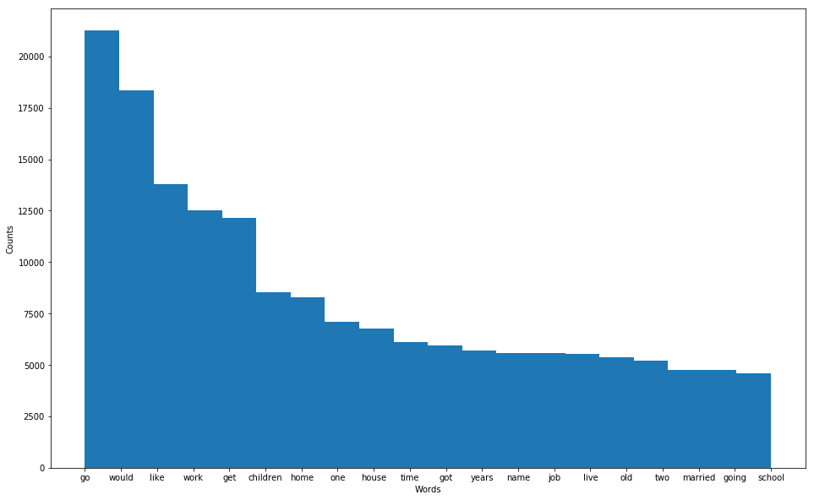
Feature
Top 20-frequent words in the whole dataset

Slide 16
(1) Model performance (counts+logistic regression)
Accuracy\Words | 20 | 200 | 2000
Training | 58.87% | 63.91% | 78.13%
Test | 58.25% | 60.56% | 57.10%

Slide 17
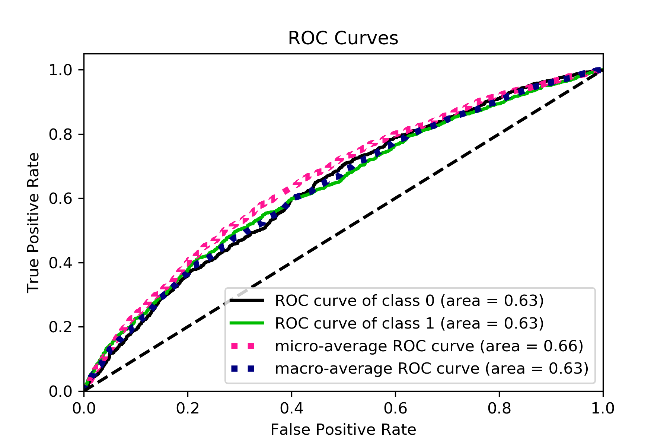
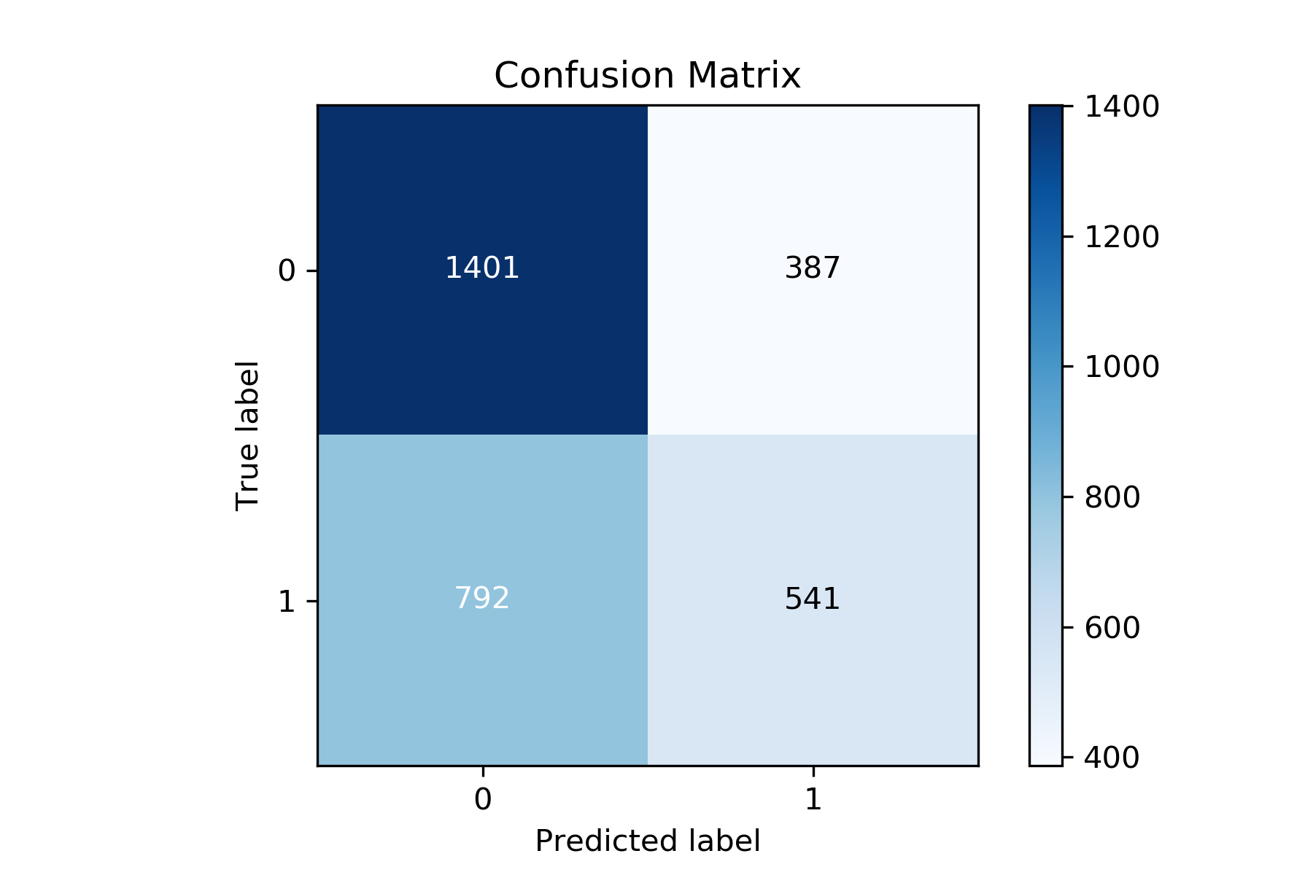
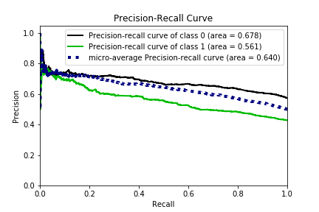
(2) Model performance (counts+svc): Top 200 words
accuracy: 62.223646 %
Recall R = TP/(TP+FN) = 0.41
Precision P = TP/(TP+FP) = 0.58
F1 score = 2*R*P/(R+P) = 0.48

Slide 18
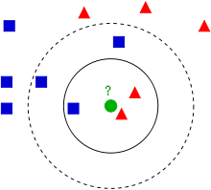
Models intro: knn
KNN(K-Nearest Neighbors Algorithm) is one of the simplest classification algorithm and it is one of the most used learning algorithms.The training examples are vectors in a multidimensional feature space, each with a class label. The training phase of the algorithm consists only of storing the feature vectors and class labels of the training samples.
In the classification phase, k is a user-defined constant, and an unlabeled vector (a query or test point) is classified by assigning the label which is most frequent among the k training samples nearest to that query point.
Example of k-NN classification. The test sample (green circle) should be classified either to the first class of blue squares or to the second class of red triangles. If k = 3 (solid line circle) it is assigned to the second class because there are 2 triangles and only 1 square inside the inner circle. If k = 5 (dashed line circle) it is assigned to the first class (3 squares vs. 2 triangles inside the outer circle).
https://en.wikipedia.org/wiki/K-nearest_neighbors_algorithm

Slide 19
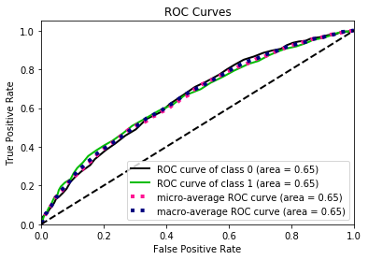
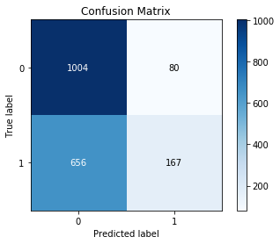
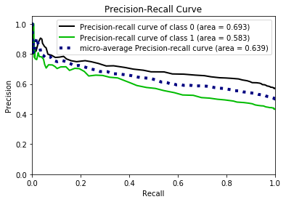
(3) Model performance ( tf-idf + knn)
KNN classifier accuracy: 61.405349 %
Recall R = TP/(TP+FN) = 0.20
Precision P = TP/(TP+FP) = 0.68
F1 score = 2*R*P/(R+P) = 0.31

Slide 20
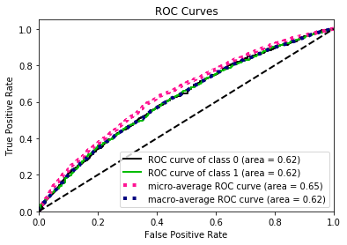
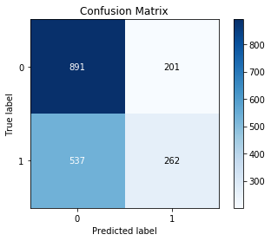
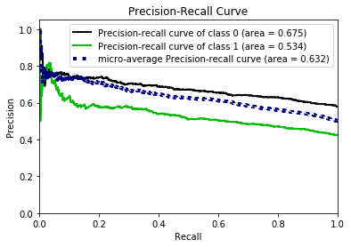
(4) Word2Vec + Random Forest
Training accuracy: 0.99524
Test accuracy: 0.60973
Recall R = 0.33
Precision P = 0.57
F1 score = 0.42

Slide 21
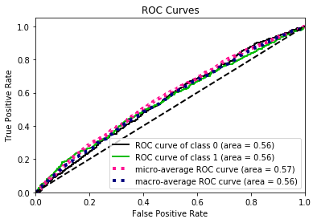
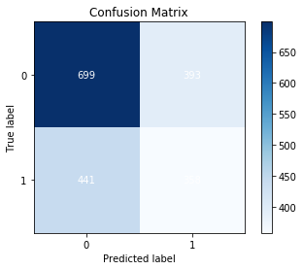
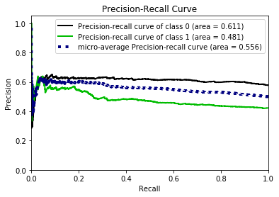
(5) Word2Vec + AdaBoost
Training accuracy: 1.00000
Test accuracy: 0.55896
Recall R = 0.45
Precision P = 0.48
F1 score = 0.46

Slide 22
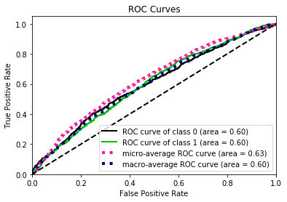
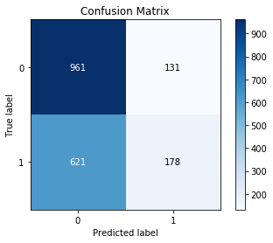
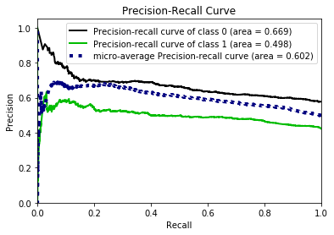
(6) Word2Vec + Neural Network
Training accuracy: 0.64485
Test accuracy: 0.60232
Recall R = 0.22
Precision P = 0.58
F1 score = 0.32

Slide 23
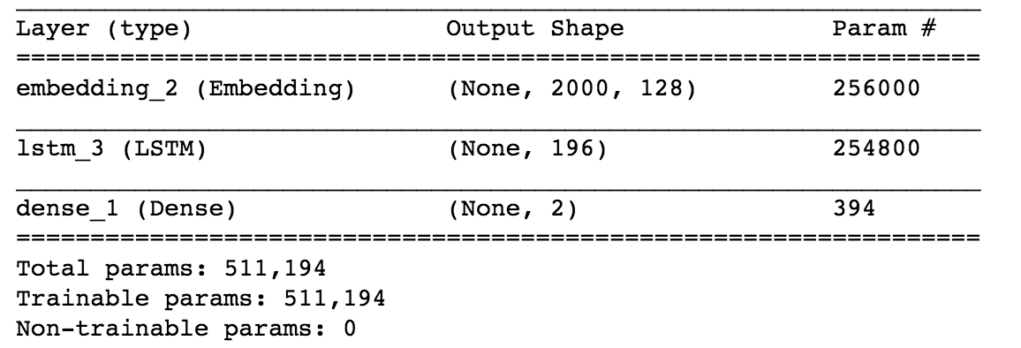
LSTM model

Slide 24
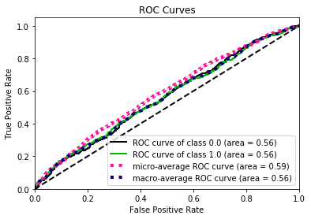
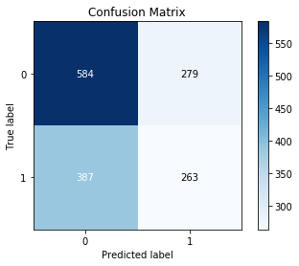
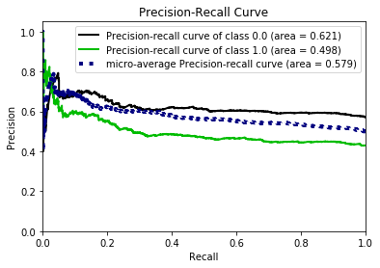
LSTM
Training accuracy: 0.64619
Test accuracy: 0.55981
Recall R = 0.40
Precision P = 0.49
F1 score = 0.44

Slide 25
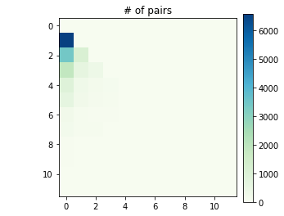
There are 6576 pairs where one is labeled as 0 and the other labeled as 1, but they are highly similar
Analysis - Inspecting the data
If we use the vectors from Word2Vec to represent the data, and compute the cosine similarity amongst data:
Pick out pairs where two data is highly similar (cosine similarity > 0.95) and yet have different “depression” labels.
[ 0, 0, 0, 0, 0, 0, 0, 0, 0, 0, 0, 0], [6576, 0, 0, 0, 0, 0, 0, 0, 0, 0, 0, 0], [3430, 1123, 0, 0, 0, 0, 0, 0, 0, 0, 0, 0], [1852, 600, 341, 0, 0, 0, 0, 0, 0, 0, 0, 0], [ 881, 269, 146, 83, 0, 0, 0, 0, 0, 0, 0, 0], [ 628, 211, 122, 63, 24, 0, 0, 0, 0, 0, 0, 0], [ 212, 61, 40, 26, 8, 11, 0, 0, 0, 0, 0, 0], [ 178, 72, 52, 22, 10, 10, 2, 0, 0, 0, 0, 0], [ 49, 11, 15, 1, 3, 1, 0, 1, 0, 0, 0, 0], [ 38, 9, 6, 1, 1, 1, 1, 0, 0, 0, 0, 0], [ 7, 2, 1, 0, 0, 0, 1, 0, 0, 0, 0, 0], [ 14, 3, 4, 0, 1, 0, 0, 0, 0, 0, 0, 0]]

Slide 26
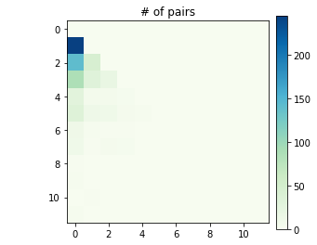
Even if we set cosine similarity threshold to be 0.97:
[ 0, 0, 0, 0, 0, 0, 0, 0, 0, 0, 0, 0], [245, 0, 0, 0, 0, 0, 0, 0, 0, 0, 0, 0], [141, 44, 0, 0, 0, 0, 0, 0, 0, 0, 0, 0], [ 87, 31, 19, 0, 0, 0, 0, 0, 0, 0, 0, 0], [ 28, 5, 5, 3, 0, 0, 0, 0, 0, 0, 0, 0], [ 34, 12, 10, 4, 2, 0, 0, 0, 0, 0, 0, 0], [ 11, 2, 1, 1, 0, 0, 0, 0, 0, 0, 0, 0], [ 10, 1, 4, 3, 0, 0, 0, 0, 0, 0, 0, 0], [ 1, 0, 0, 0, 0, 0, 0, 0, 0, 0, 0, 0], [ 2, 0, 0, 0, 0, 0, 0, 0, 0, 0, 0, 0], [ 0, 1, 0, 0, 0, 0, 0, 0, 0, 0, 0, 0], [ 2, 0, 0, 0, 0, 0, 0, 0, 0, 0, 0, 0]
➡️ The original “depression” marks are problematic!

Slide 27
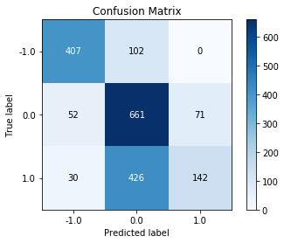
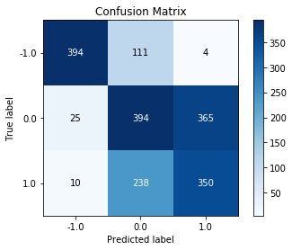
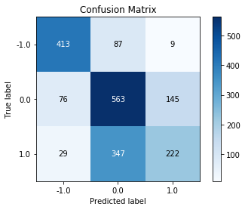
After we tune the labels and retry the models:
Random Forest (2) AdaBoost (3) Neural Network
Test accuracy: 0.640
Test accuracy: 0.602
Test accuracy: 0.634

Slide 28
Conclusion
Our model performance can achieve 70% accuracy, and from confusion matrix we can see s high true negative rate but a relatively low true positive rate.
Our dataset shows 59% labeled 0 and others labeled more than 1 (NOT WELL BALANCED)
This dataset from age 11 children who may have limited vocabulary, which limit our choice of word features
Unable to represent the true meanings from them though correcting the words and spelling (LOSS)
Preprocessing for essays still leaves some useless words which may have higher frequent appearance.
Probably the correlations between the essays and their depression degrees may not be highly related. So in the future we hope that we can get better features so that we can perform better models for children’s mental health.

