Slide 1
Development history of electric vehicles
Jiaqi Li
2025719 Jiaqi Li Analysing the history of electric vehicles

Slide 2
Outlines
Outlines
IEA Global EV Data 2024
Data Visualization
K-means clustering
Hierarchical clustering
GEO 2023
Topic Modeling with LDA
Word clouds
Regression Analysis

Slide 3
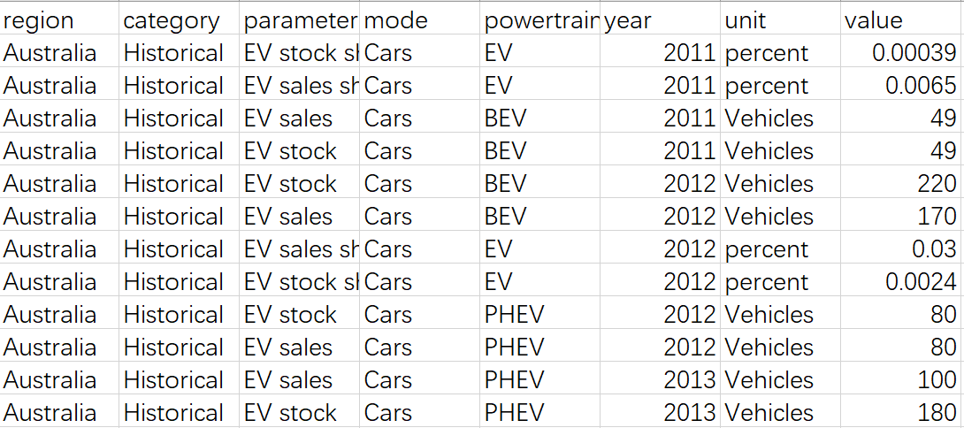
2010-2023 EV Global trend:Data Description
Data Visualization
Electric vehicle related indicators for 50 countries/regions
Yearly data from 2009 to 2024,

Slide 4
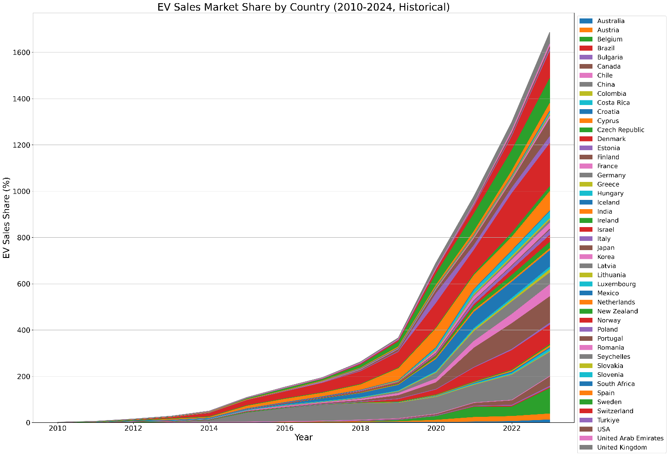
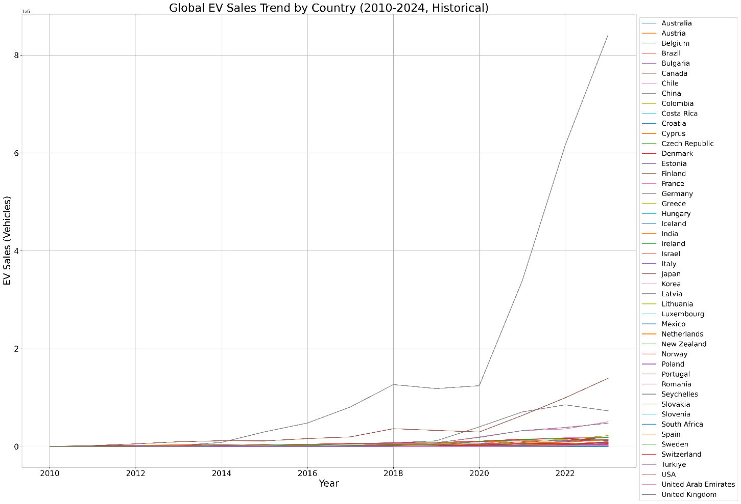
2010-2023 EV Global trend
Data Visualization
Global EV sales and EV sales market share in all countries has risen steadily from nearly 0% in 2010, with a notable acceleration after 2018, indicating a shift from slow initial growth to rapid expansion.
The global electrification trend is irreversible.All countries (including "Rest of the World") show an upward trend, proving that electrification has evolved from pilot projects in a few nations to a worldwide industrial transformation.

Slide 5
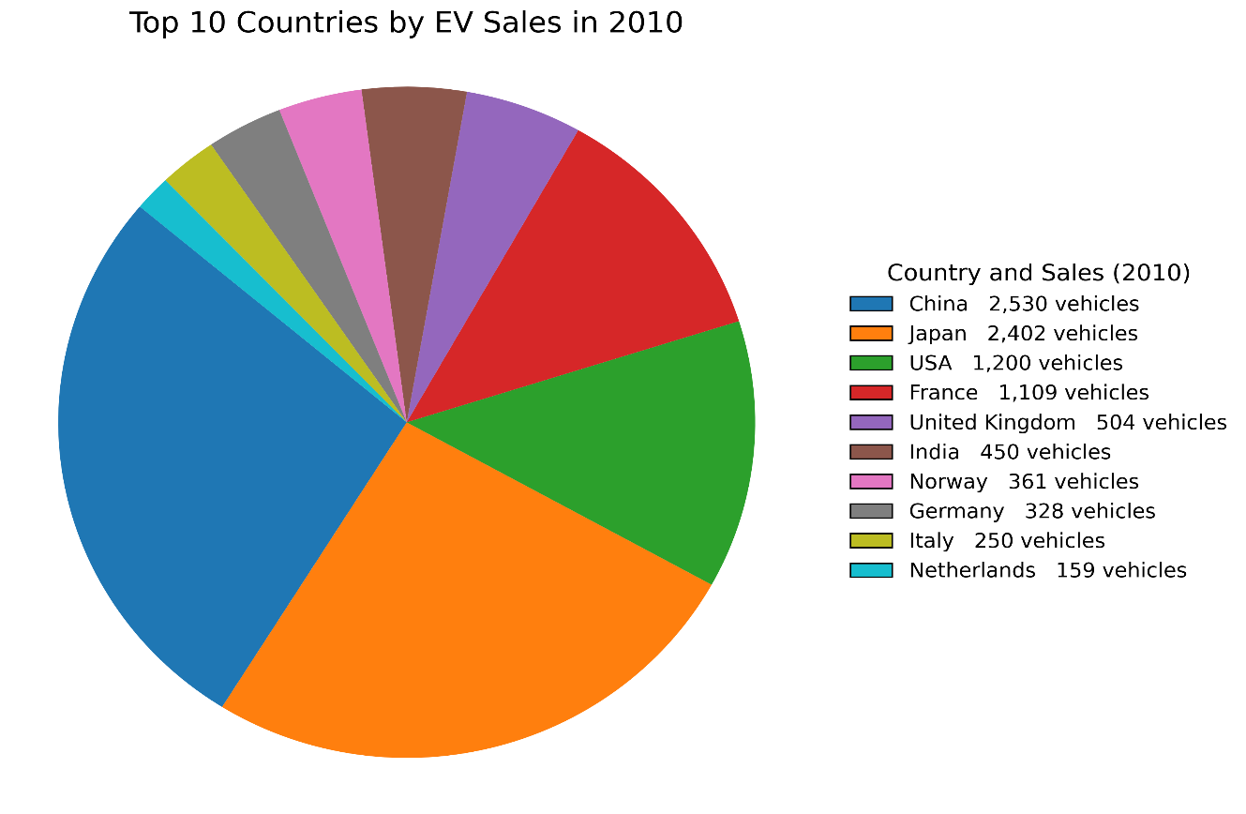
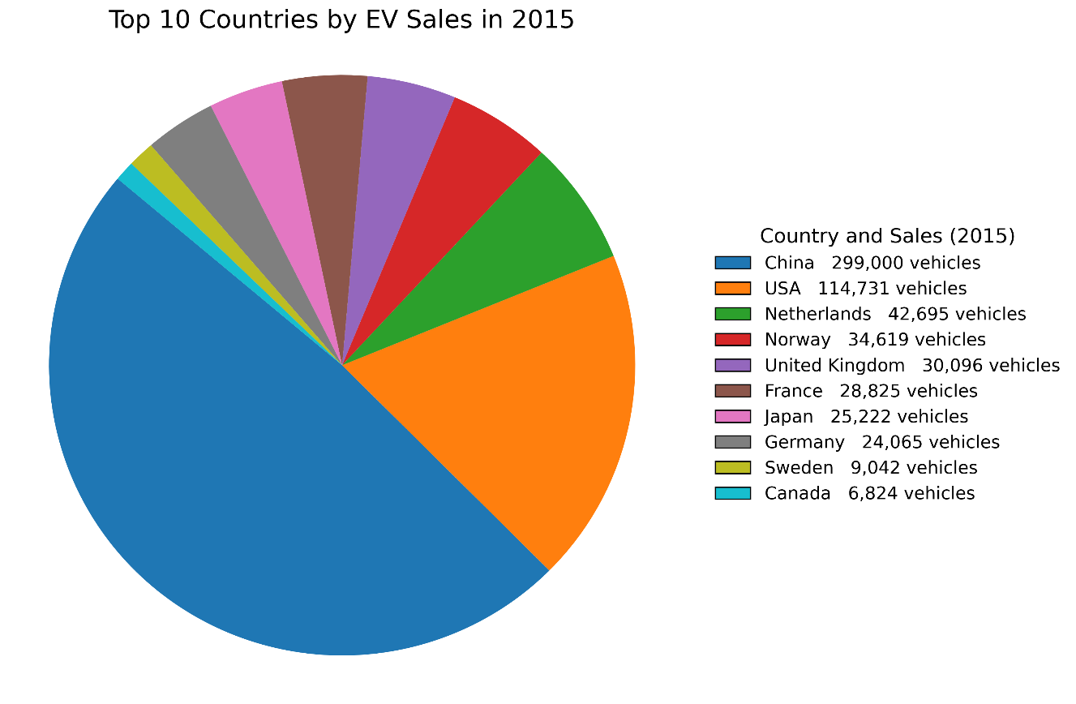
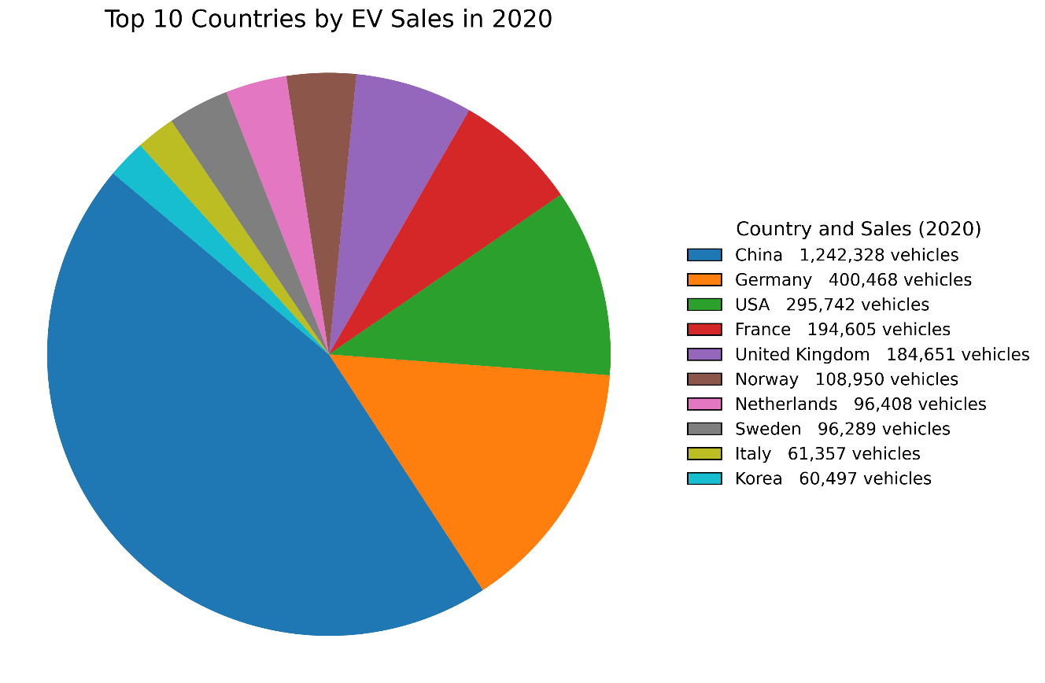
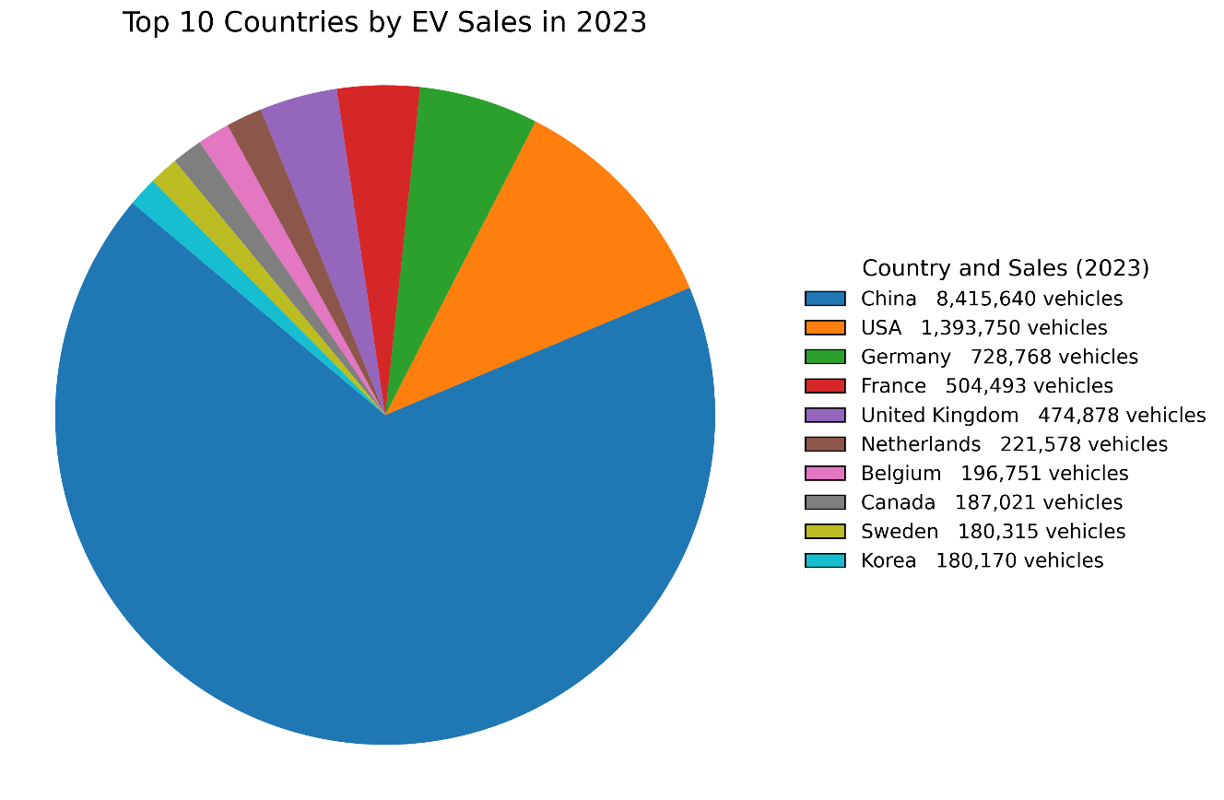
2010-2023 EV Global trend
Data Visualization

Slide 6
2010-2023 EV Global trend
Data Visualization
Regional pattern evolution
In 2010, China and Japan led the market, with the United States in third place. Europe hold a position in the global EV market
In 2015, China emerged as the dominant market, with the United States in second position. The Netherlands and Norway became notable European players, while Germany, France, and the UK followed closely. Canada entered the market for the first time.
In 2020, China maintained its leading position, with Germany and the United States competing closely for second place. France, the UK, and Norway showed strong growth, Korea entered the top markets for the first time.
In 2023, maintained its leading position in global EVmarket. The United States held a significant but smaller share compared to China. Germany, France, and the UK continued to grow, while the Netherlands, Belgium, Canada, Sweden, and Korea expanded their presence, replacing slower-growing markets like Japan.

Slide 7
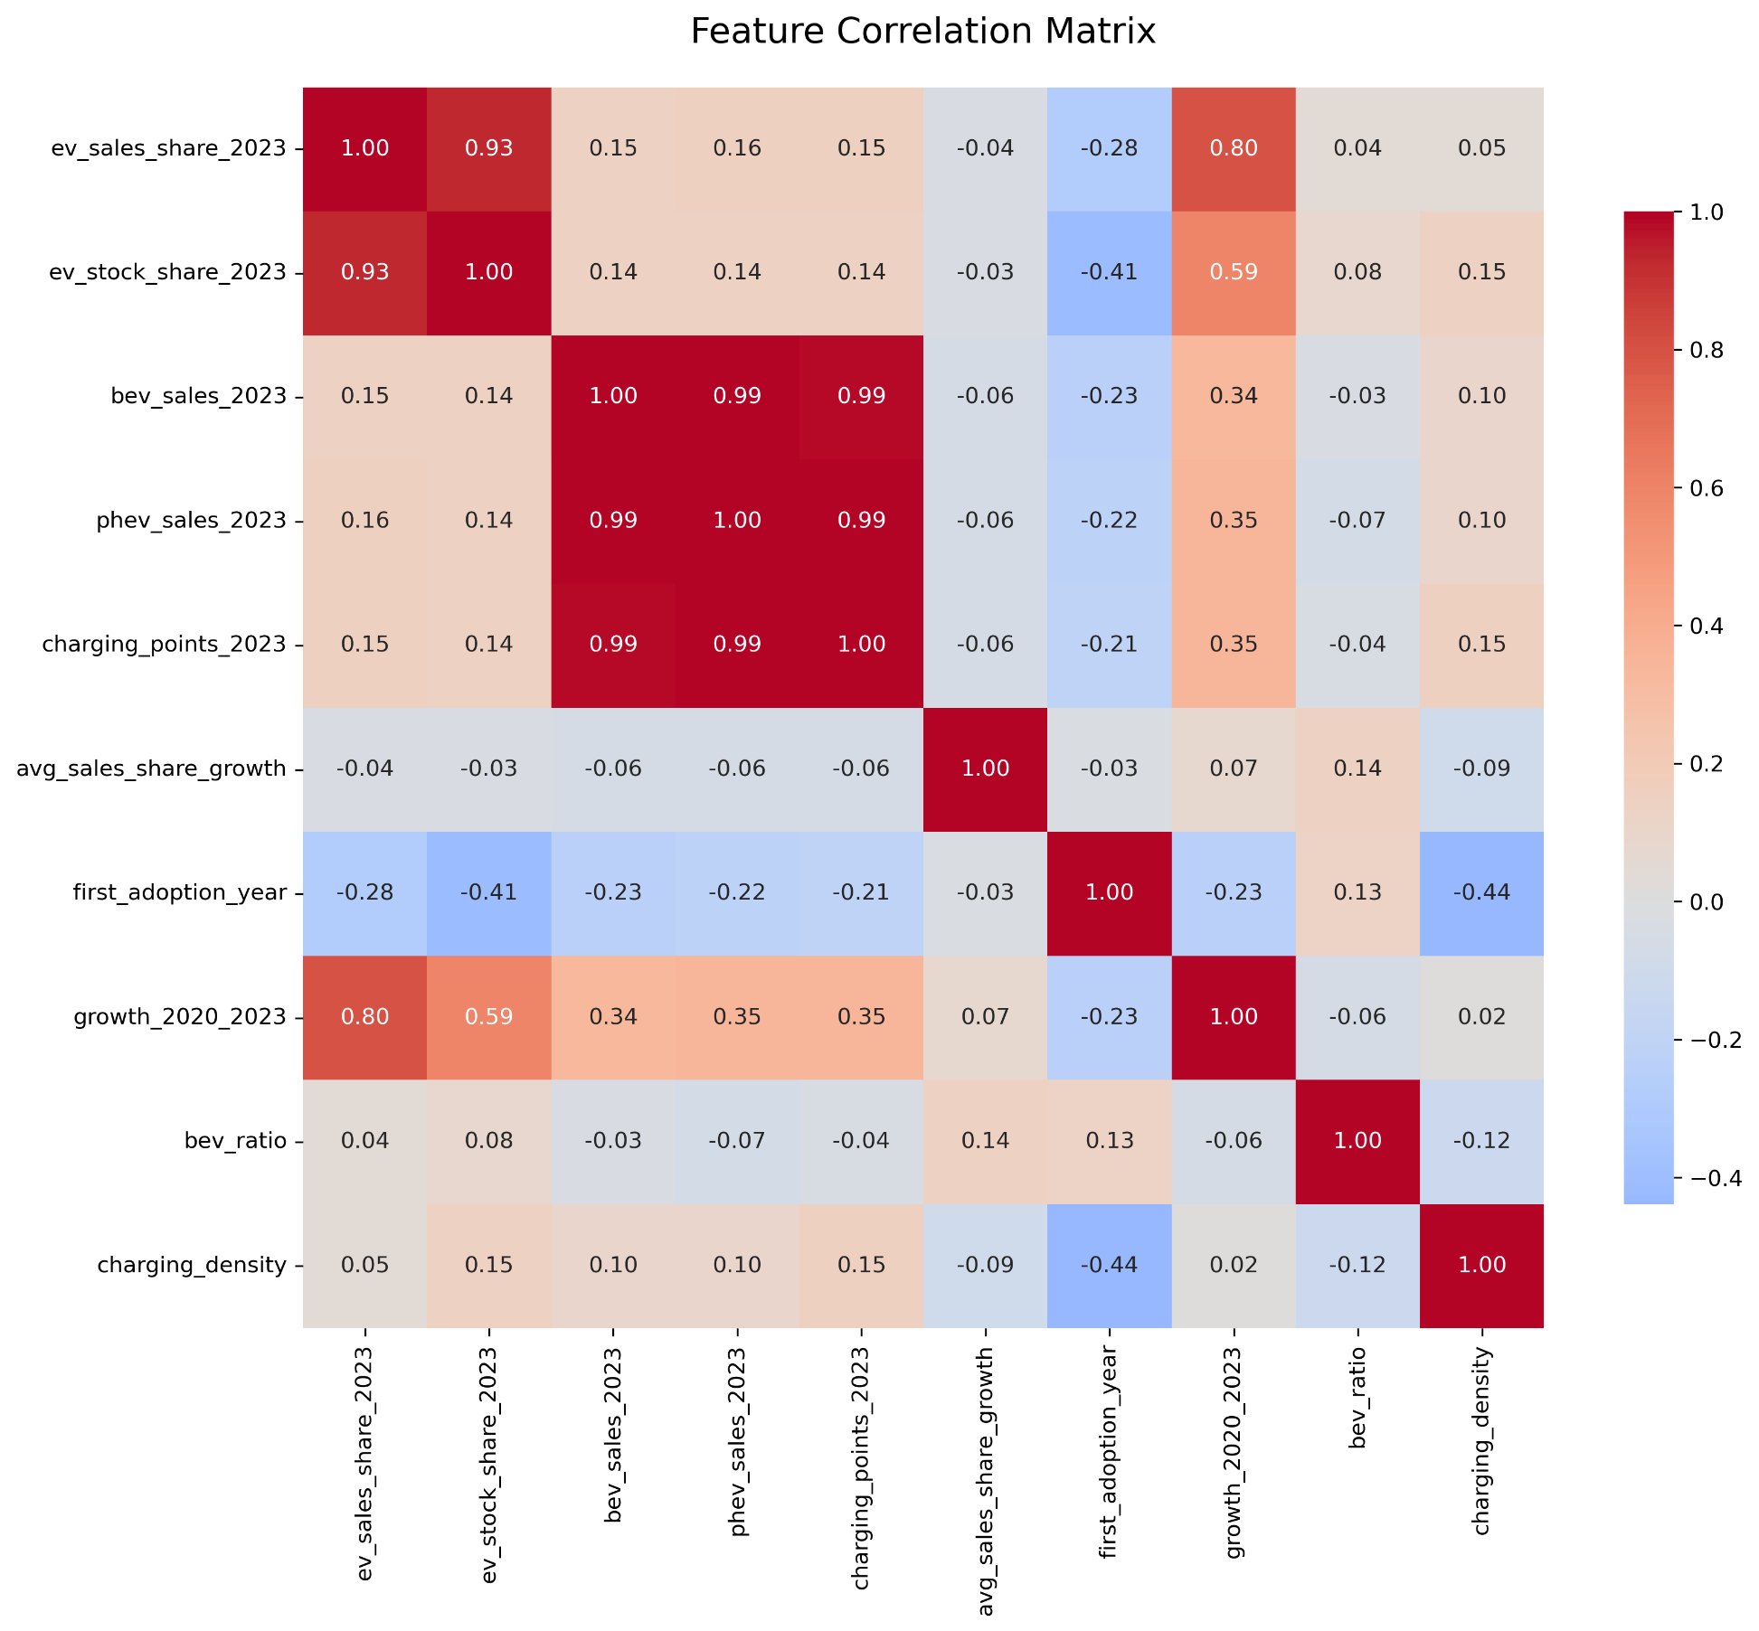
Feature Correlation Matrix
clustering

Slide 8
Feature Correlation Matrix
clustering
Highly correlated feature pairs:
('ev_sales_share_2023' 'ev_stock_share_2023')
('bev_sales_2023', 'phev_sales_2023')
('bev_sales_2023', 'charging_points_2023')
('phev_sales_2023', 'charging_points_2023')
Final features for clustering:
'ev_sales_share_2023'
'bev_sales_2023'
'charging_points_2023'
'avg_sales_share_growth'
'first_adoption_year'
'bev_ratio'
'charging_density'

Slide 9
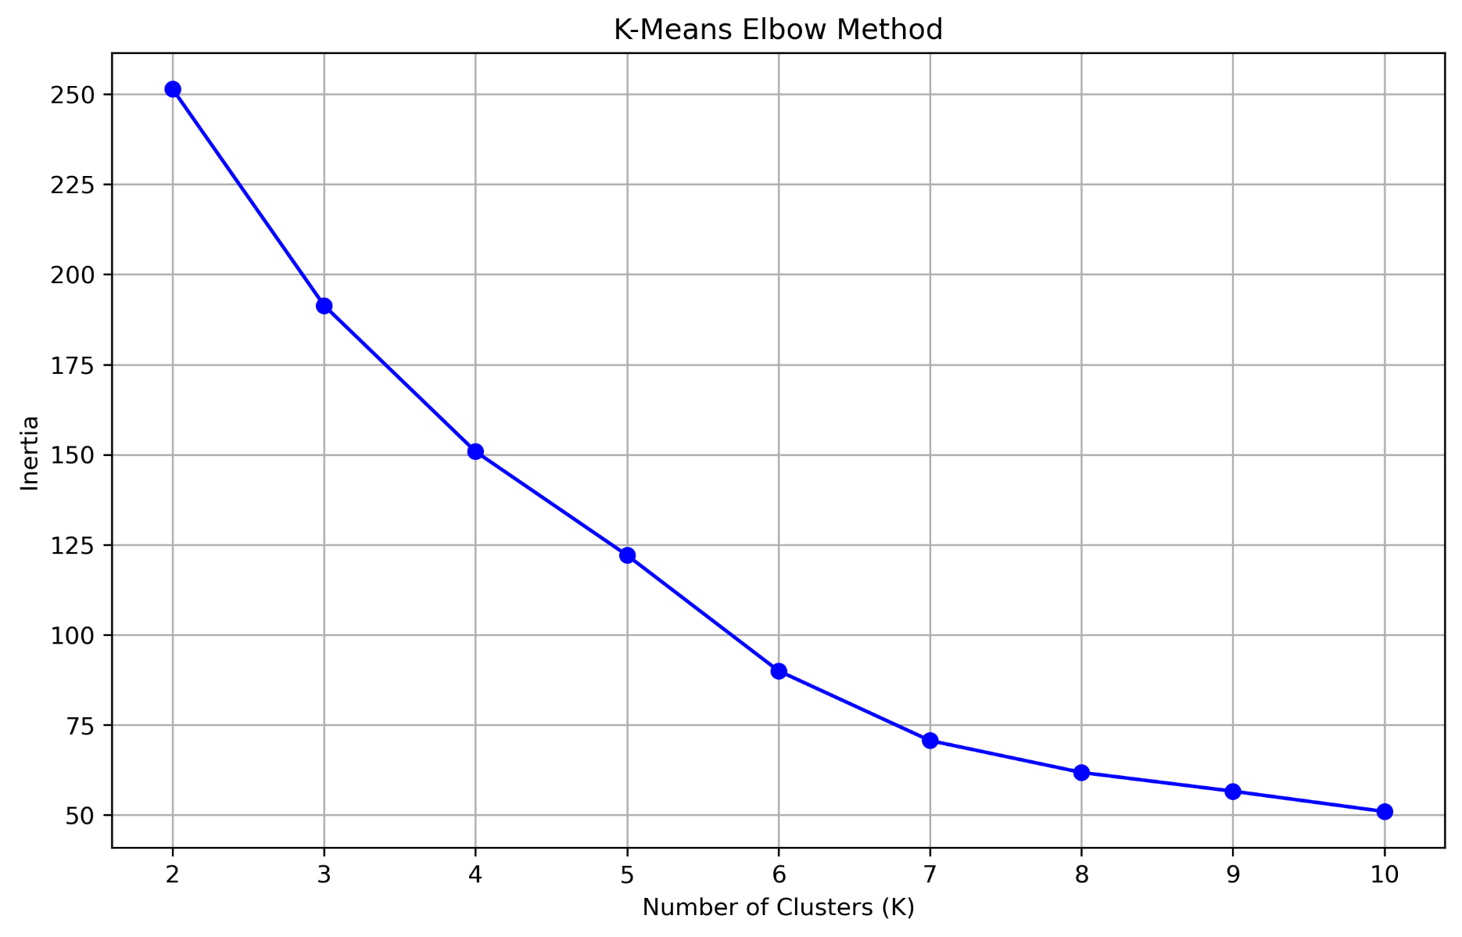
K-means
clustering
The elbow method indicates that the optimal number of clusters K is 4 for K-means clustering.

Slide 10
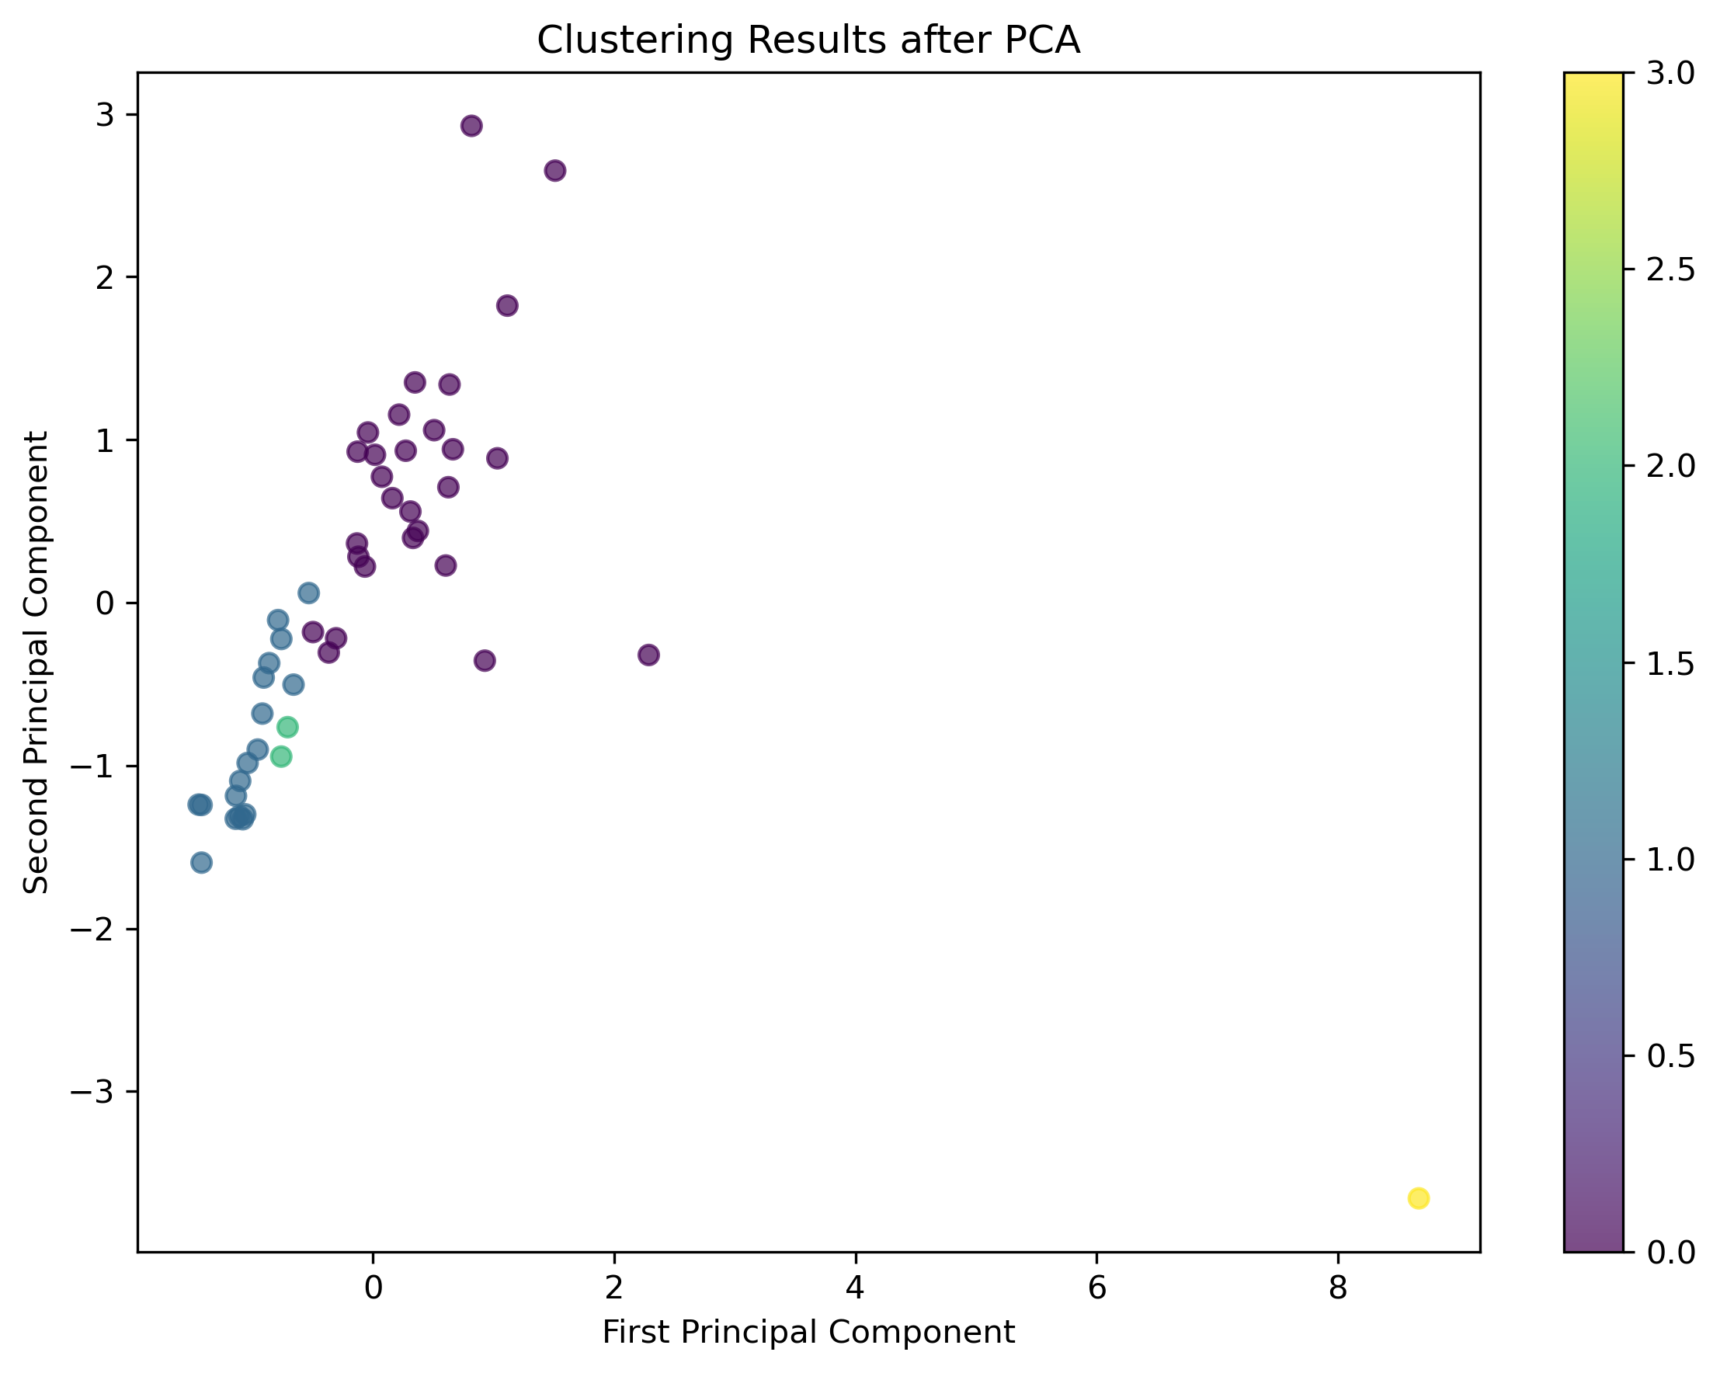
K-means
clustering

Slide 11
K-means
clustering
Cluster 0 :['Australia', 'Austria', 'Belgium', 'Brazil', 'Canada', 'Chile', 'Denmark', 'EU27', 'Finland', 'France', 'Germany', 'Greece', 'Iceland', 'India', 'Italy', 'Japan', 'Korea', 'Mexico', 'Netherlands', 'New Zealand', 'Norway', 'Poland', 'Portugal', 'Spain', 'Sweden', 'Switzerland', 'United Kingdom', 'USA']
Cluster 1 :['Bulgaria', 'Colombia', 'Costa Rica', 'Croatia', 'Cyprus', 'Czech Republic', 'Estonia', 'Hungary', 'Ireland', 'Latvia', 'Lithuania', 'Luxembourg', 'Romania', 'Seychelles', 'Slovakia', 'Slovenia', 'South Africa', 'United Arab Emirates']
Cluster 2 :['Israel', 'Turkiye']
Cluster 3 :['China']

Slide 12
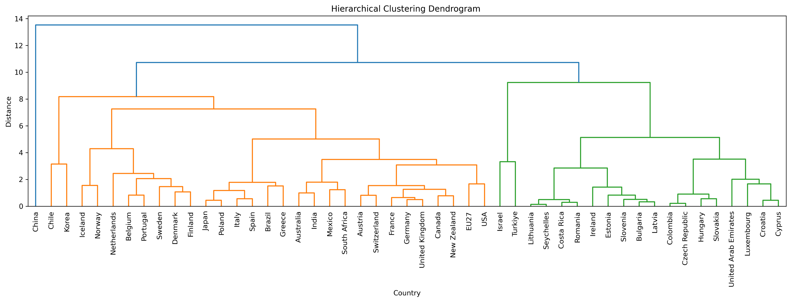
Hierarchical Clustering
clustering

Slide 13
Hierarchical Clustering
clustering
Cluster 0 :['Australia', 'Austria', 'Belgium', 'Brazil', 'Canada', 'Chile', 'Denmark', 'EU27', 'Finland', 'France', 'Germany', 'Greece', 'Iceland', 'India', 'Italy', 'Japan', 'Korea', 'Mexico', 'Netherlands', 'New Zealand', 'Norway', 'Poland', 'Portugal', 'South Africa', 'Spain', 'Sweden', 'Switzerland', 'United Kingdom', 'USA']
Cluster 1 : ['Israel', 'Turkiye']
Cluster 2 :['Bulgaria', 'Colombia', 'Costa Rica', 'Croatia', 'Cyprus', 'Czech Republic', 'Estonia', 'Hungary', 'Ireland', 'Latvia', 'Lithuania', 'Luxembourg', 'Romania', 'Seychelles', 'Slovakia', 'Slovenia', 'United Arab Emirates’]
Cluster 3 : ['China']

Slide 14
conclution
clustering
Similarities of the two result:
Both hierarchical clustering and K-means produce ​​4 distinct clusters​​.
Both Cluster 0​​ in hierarchical clustering and K-means, consisting of major developed countries (e.g., EU nations, US, Japan, Australia) and key regions (e.g., EU27, Rest of the World), representing ​​mainstream EV markets​​.
Differences of the two result:
Hierarchical clustering’s Cluster 2 excludes ​​South Africa​​ but includes ​​United Arab Emirates (UAE)​​.K-means’ Cluster 2 includes ​​South Africa​​ but excludes ​​UAE​​.

Slide 15
conclution
clustering
kmeans and hierarchical clustering get the similar results, the results are accurate.
Two clusters shows four different kinds of EV markets in the past 10 years :
Leader(China):holds an absolute leading position in EV sales share , with market size and penetration rate, significantly ahead of other countries.
Fast Followers(Australia, Austria, Belgium, Brazil,etc.): relatively large proportion in EV sales share
Emerging Market(Israel, Türkiye): great growth potential, infrastructure still needs to be improved.
Laggard(Bulgaria, Colombia, Croatia): EV market not been scaled up yet , lack of EV infrastructure

Slide 16
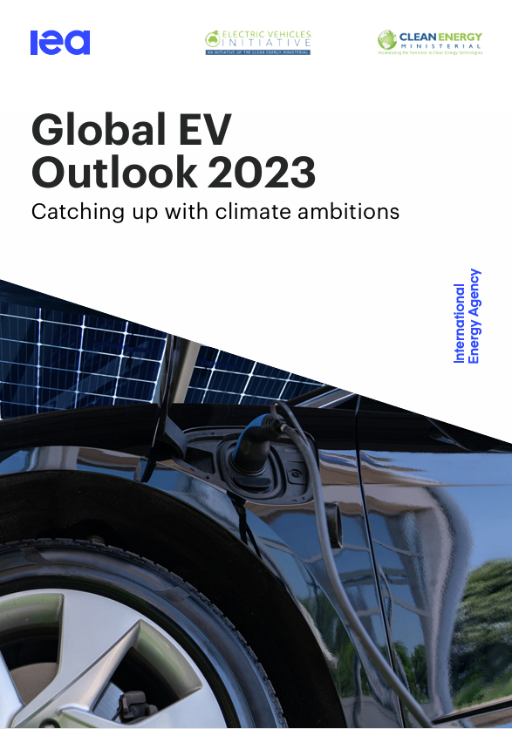

GEO2023:Data Description
Topic Modeling with LDA
A report from the International Energy Agency (IEA) examines the latest trends in EV market developments, policy frameworks, and climate ambitions, with data and projections spanning 2022 to 2030.
Covers record EV sales, charging infrastructure expansion, battery demand, supply chain policies, and the electrification of heavy-duty vehicles

Slide 17
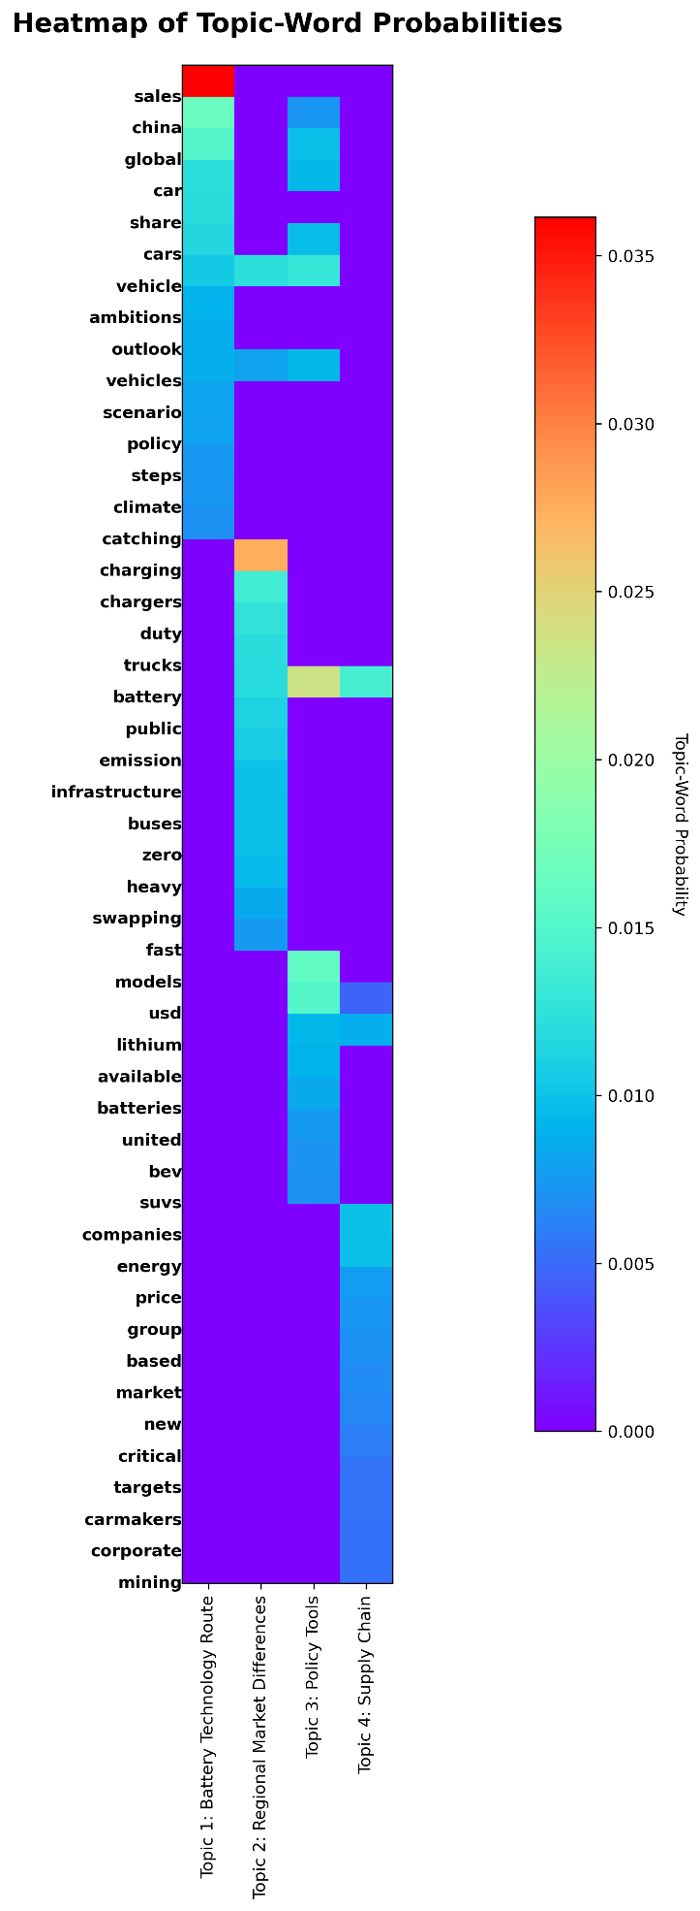
GEO2023:Topic Modeling with LDA
Topic Modeling with LDA
The heatmap with keywords and topics.
Eight topic:
Battery Technology Route
Regional Market Differences
policy Tools
Supply Chain

Slide 18
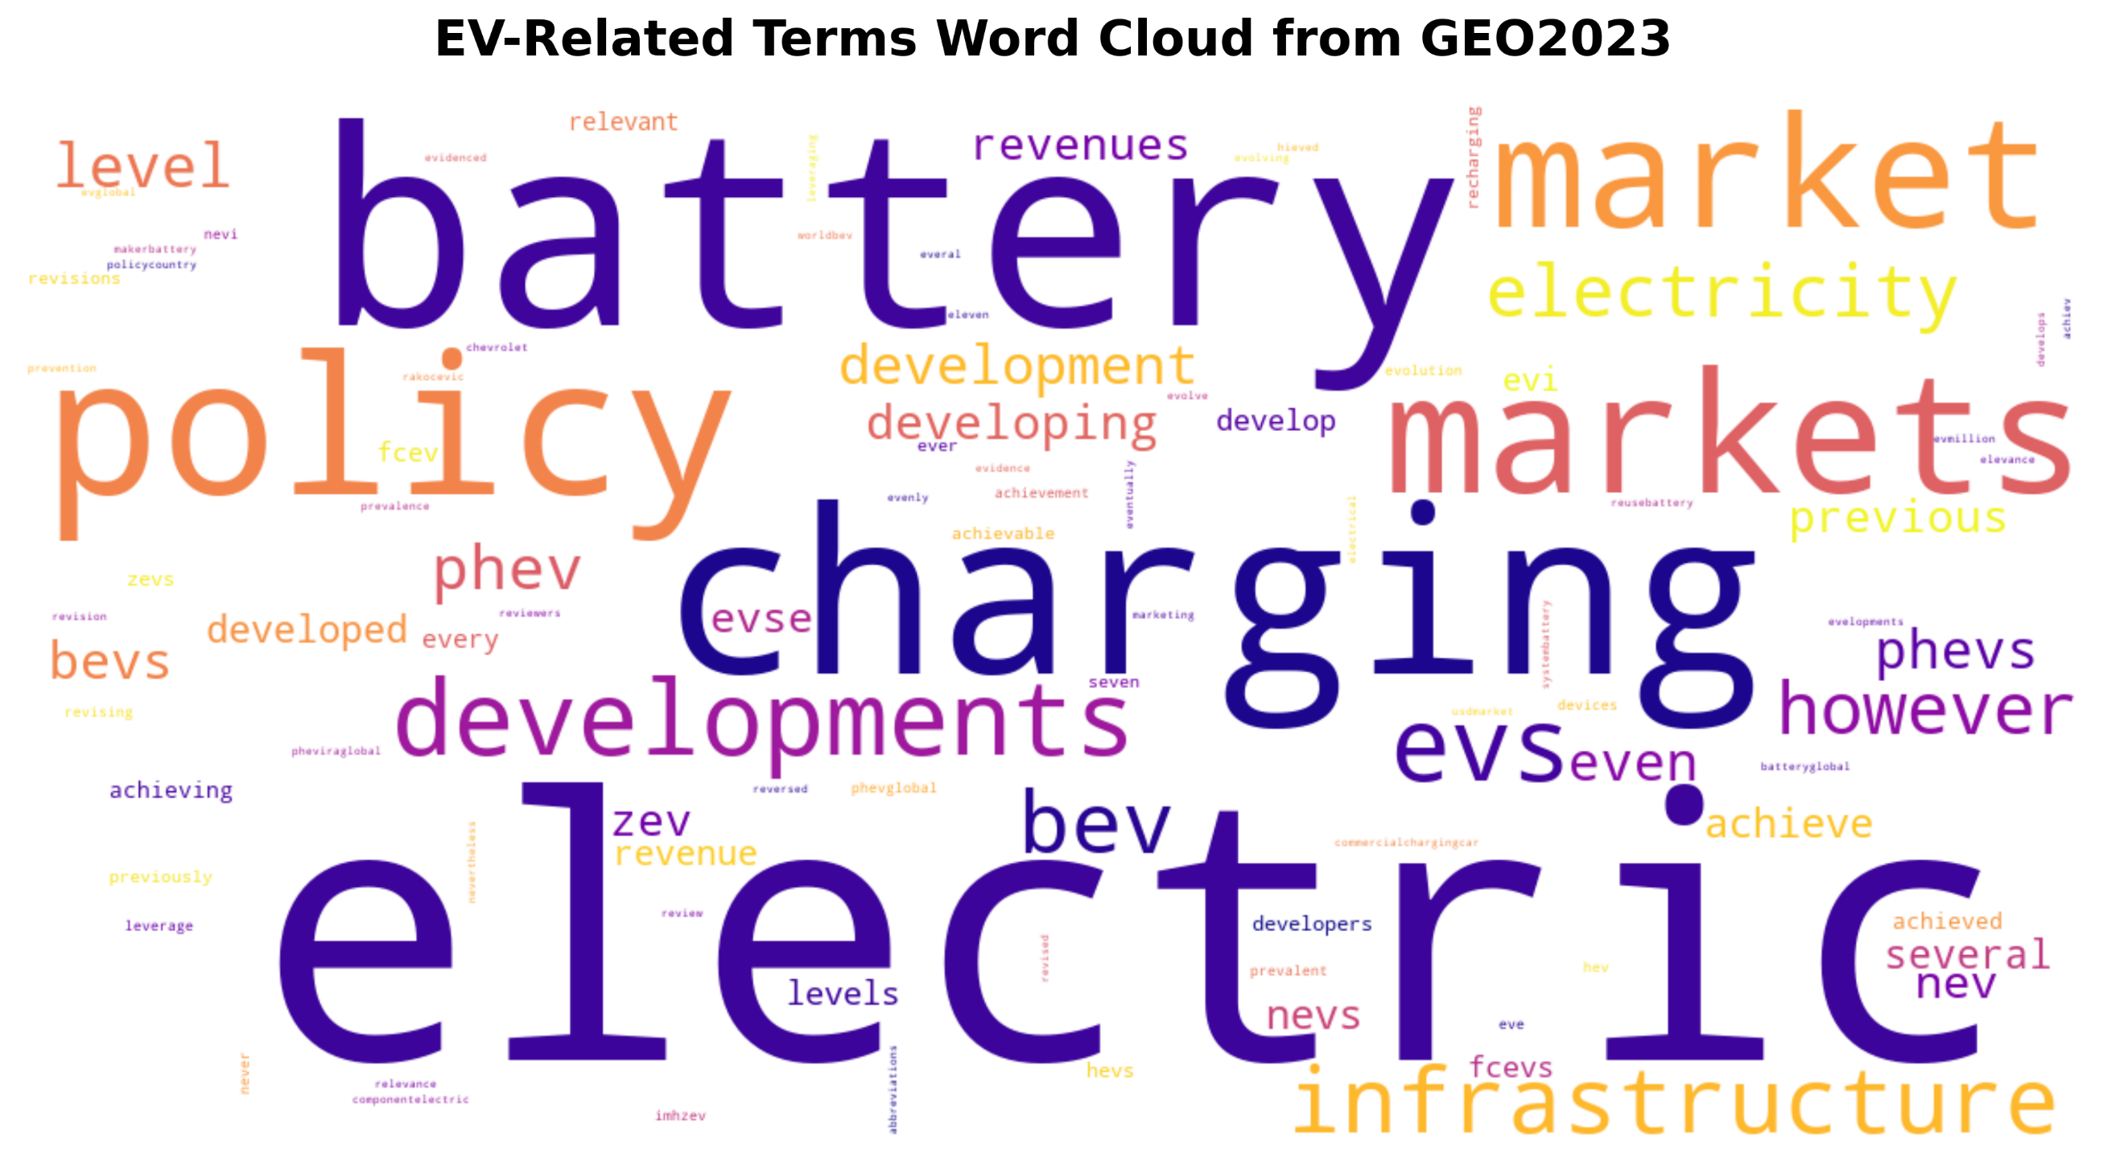
GEO2023:Topic Word clouds
Word clouds

Slide 19
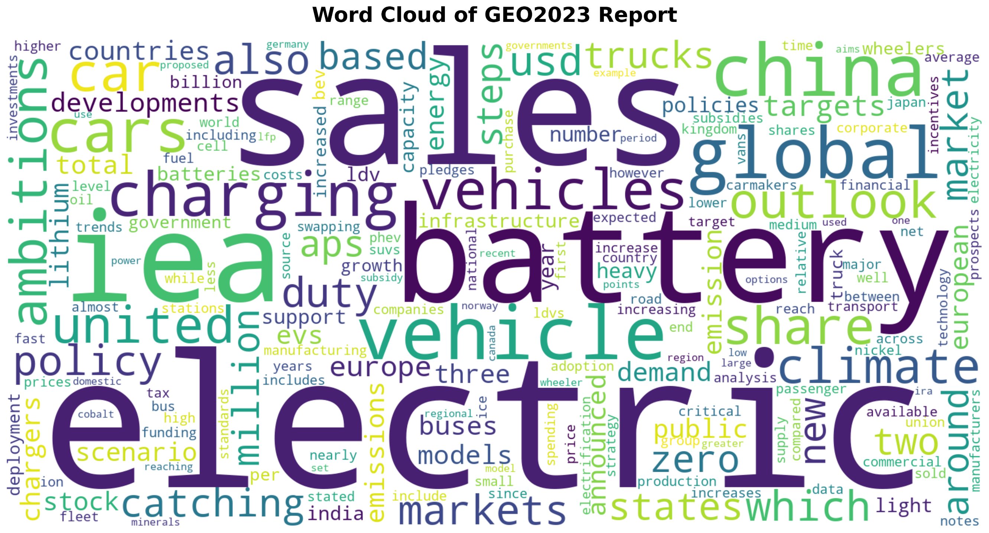
GEO2023:Topic Word clouds
Word clouds

Slide 20
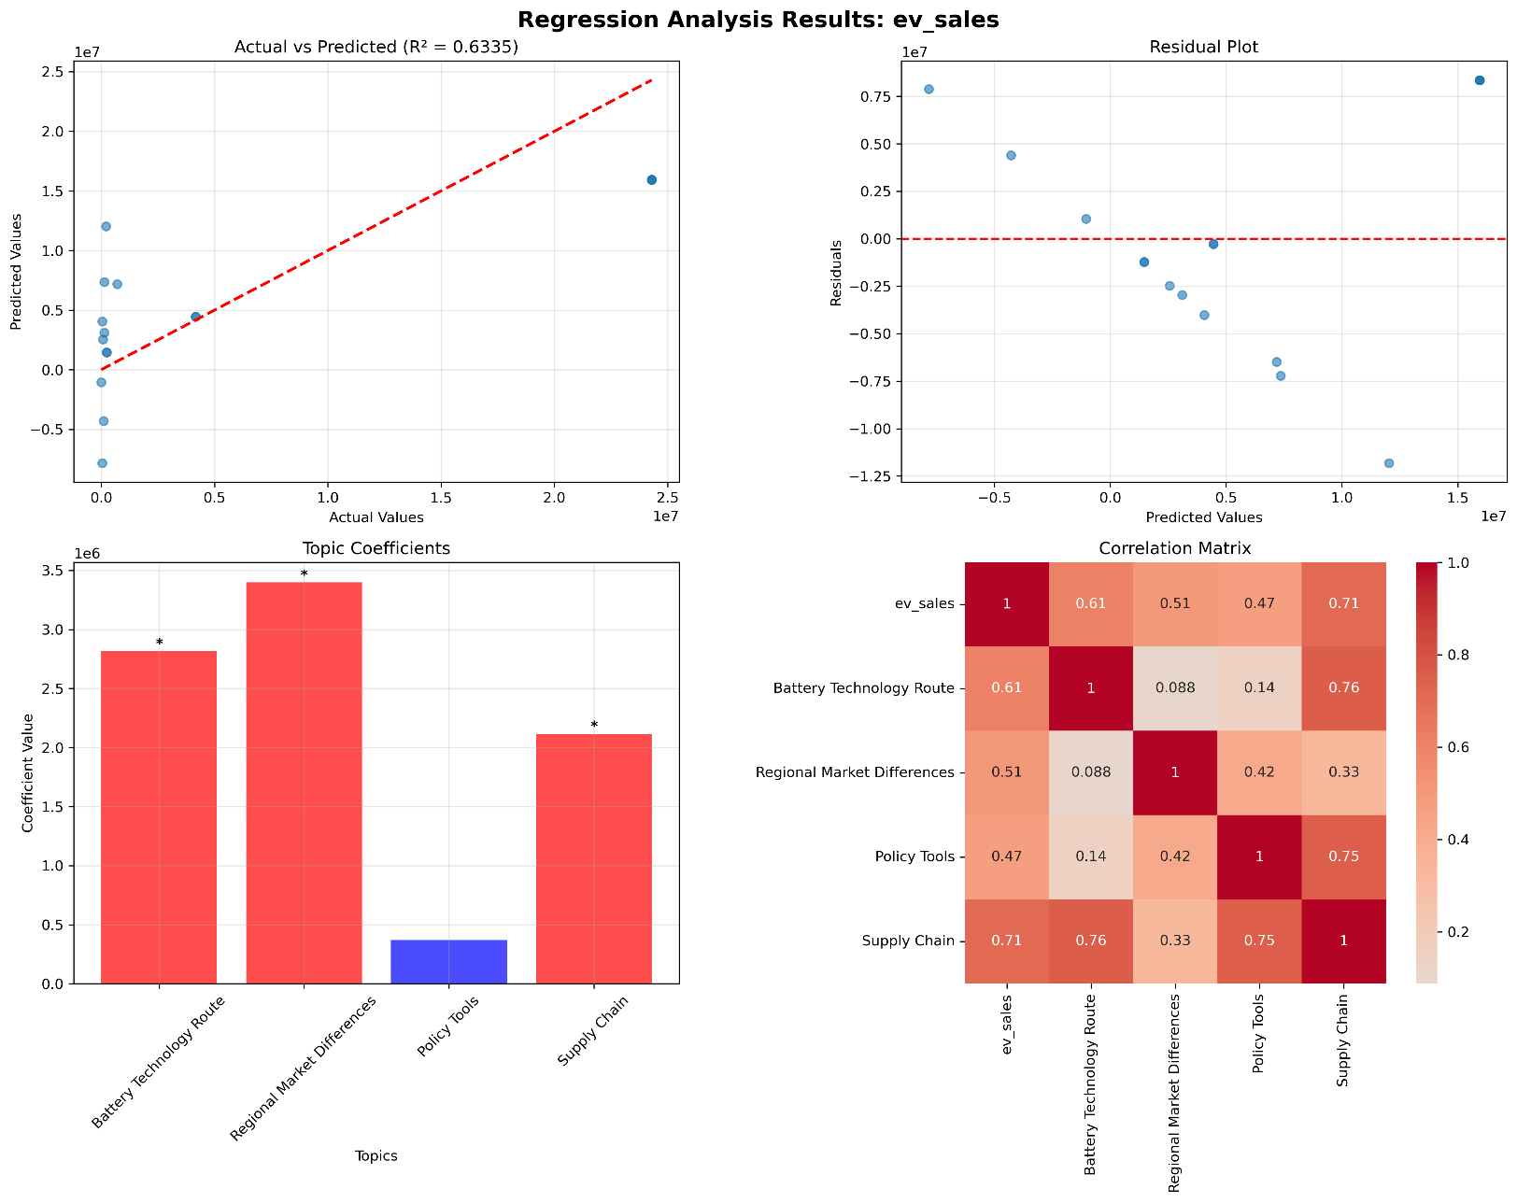
Regression Analysis:EV sales
Regression Analysis
Regression Analysis Result:
The battery technology route has the greatest impact on EV sales.
Regional market differences, such as charging infrastructure density, have a positive impact on sales.

Slide 21
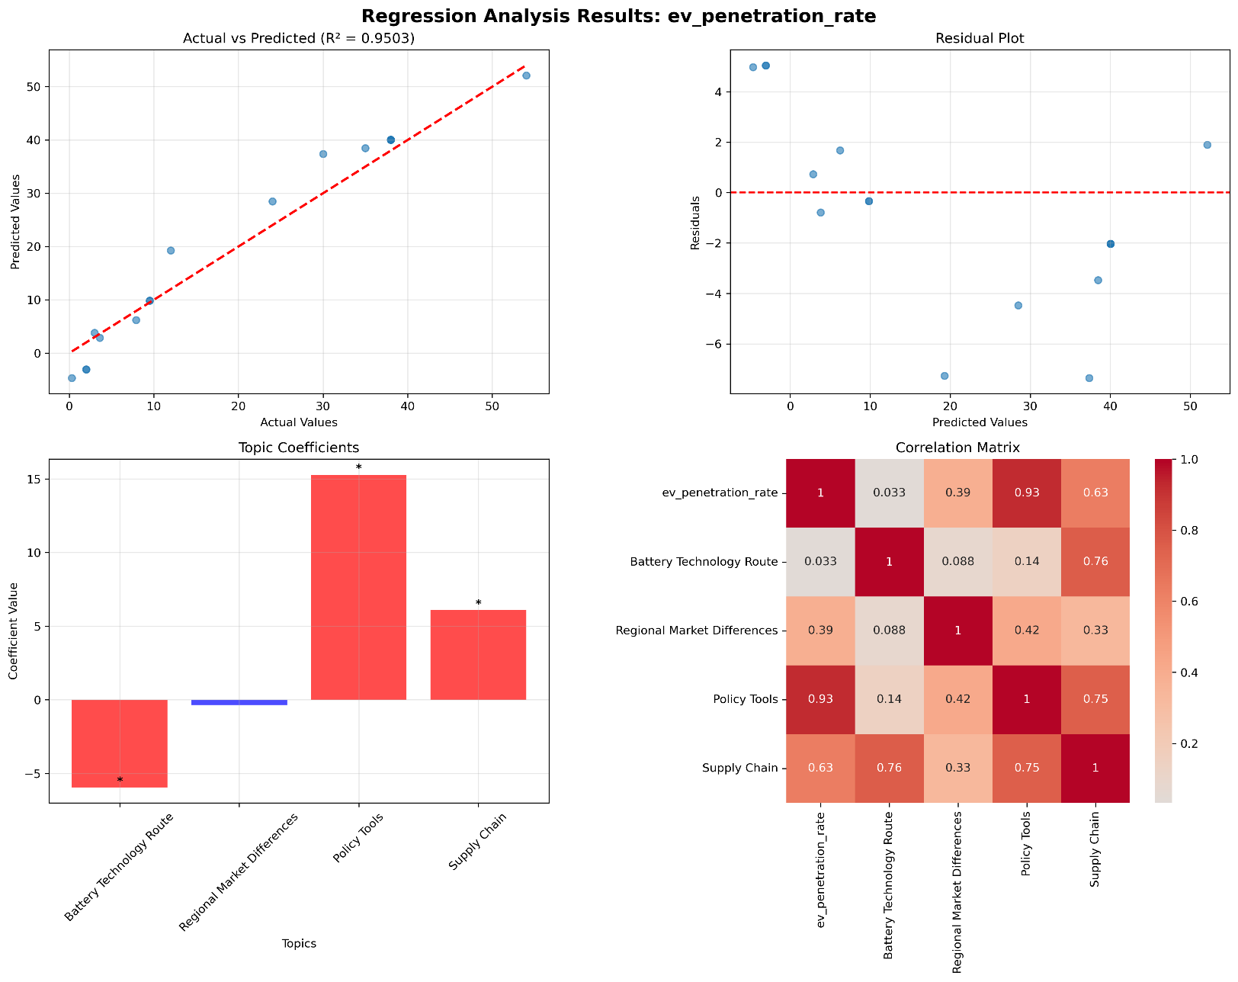
Regression Analysis:EV penetration rate
Regression Analysis
Regression Analysis Result:
Policy tools are the core driving force and have a significant impact on EV penetration rates
The more comprehensive and powerful the policy tools are, the significantly higher the EV penetration rate

Slide 22
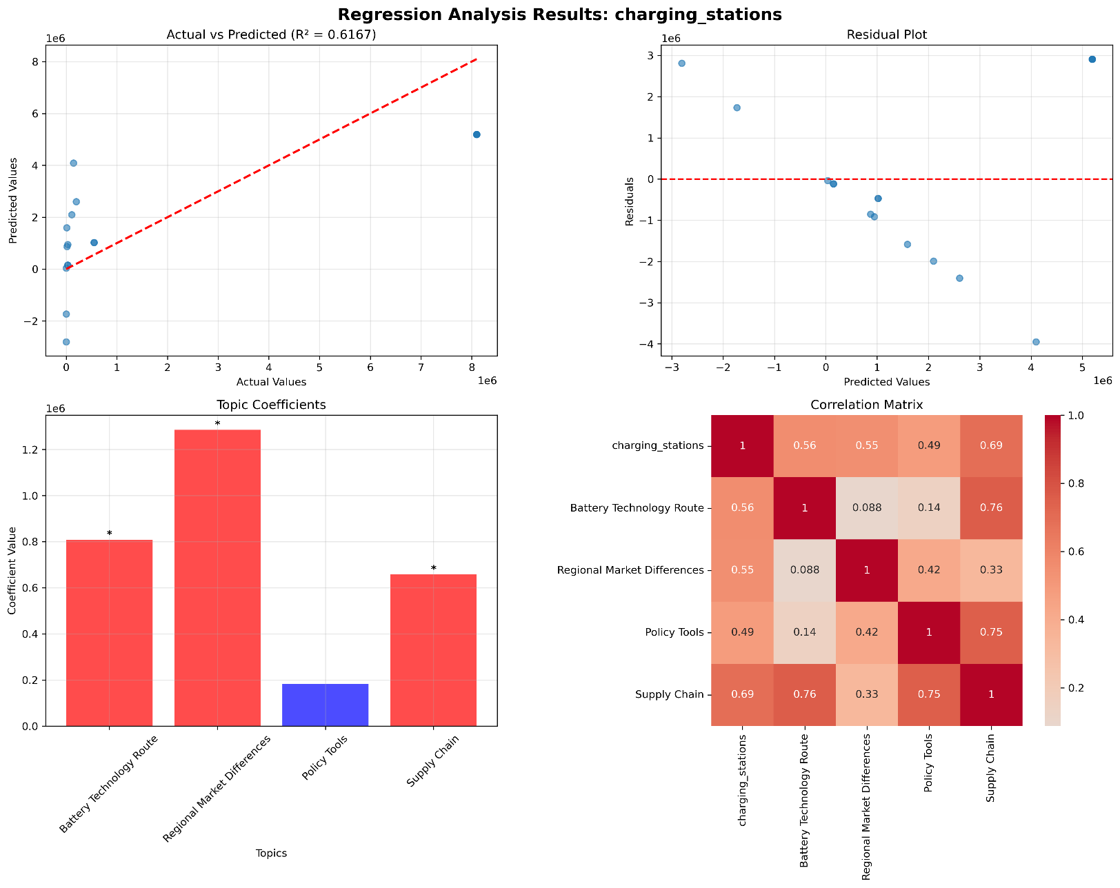
Regression Analysis:charging_stations
Regression Analysis
Regression Analysis Result:
Regional Market Differences, Battery Technology Route, and Supply Chain are the main factors affecting the number of charging stations.
The impact of policy tools is relatively small.

Slide 23
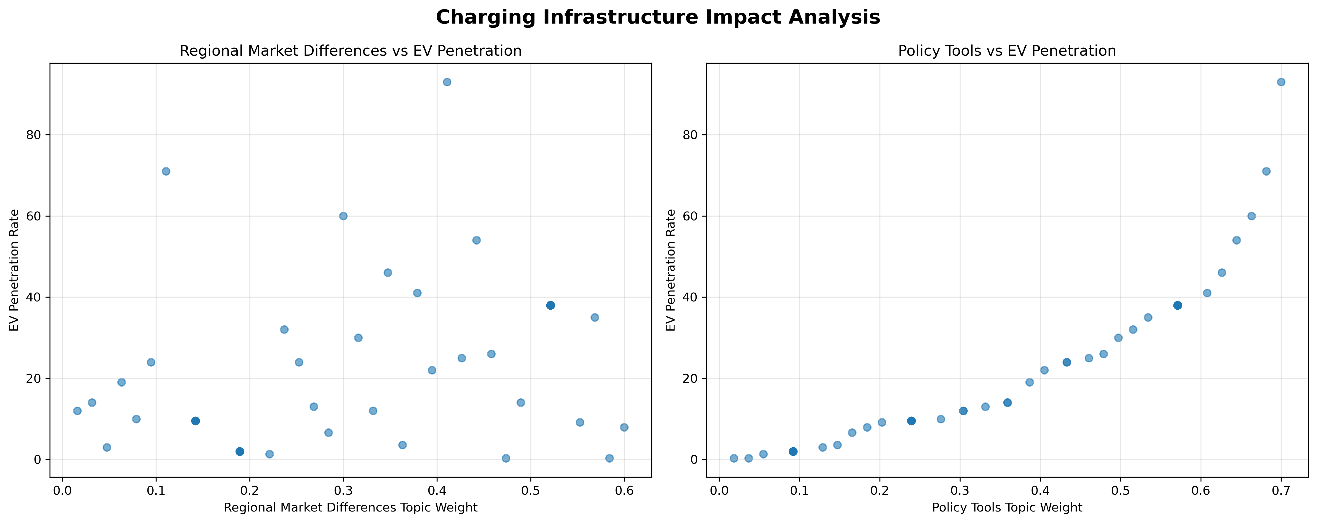
Regression Analysis: charging infrastructure impact
Regression Analysis

Slide 24
Regression Analysis: charging infrastructure impact
Regression Analysis
Relationship between the penetration rate of ev and three predictive variables :
Policy Tools is the most significant predictor of EV penetration.
Charging Infrastructure shows a ​​negative but non-significant​​ relationship
Regional Market Differences has no significant impact

Slide 25
Regression Analysis:conclution
Regression Analysis
The Battery Technology Route showed a significant positive effect in both EV_stales and Chargeing_Stations analyses, while the coefficient was negative but not significant in the EV_penetration rate analysis. The Battery Technology Route has a clear driving effect on EV_stales and Chargeing_Stations, but its direct impact on EV_penetration rate is limited.
Policy Tools showed significant positive effects in the analysis of the three target variables, indicating that policies have a significant impact on the EV industry.
Regional Market Differences have a significant positive impact on EV_stales and Chargeing_Stations, but have no significant effect on EV_penetration rate
In the regression of popularity rates, Charging Infrastructure shows a marginal negative trend, which has no clear linear relationship with the popularity scatter plot and may reflect layout or usage efficiency issues.

Slide 26
Development history of electric vehicles
Jiaqi Li
20241118 Gao Si Li Chen Capturing the Baijiu Industry Landscape.key

