Slide 1

Predicting Spotify Song Streaming Success
COSC 5931
Kayley Reith & Violet Wang

Slide 2
Magnitude of Problem
$14.69 billion in revenue in 2023 (Iqbal 2023)
12.9% increase year-on-year (Iqbal 2023)
626 million monthly active users (Singh 2024)
Project Goal: Develop a predictive model that identifies the characteristics of songs likely to achieve high streaming numbers based on their features
Notes:
Spotify with revenue growing year-over-year and a massive user base, it’s important to understand what drives streaming success is more important than ever. Our project is to uncover the characteristics of songs that consistently perform well based on the features

Slide 3
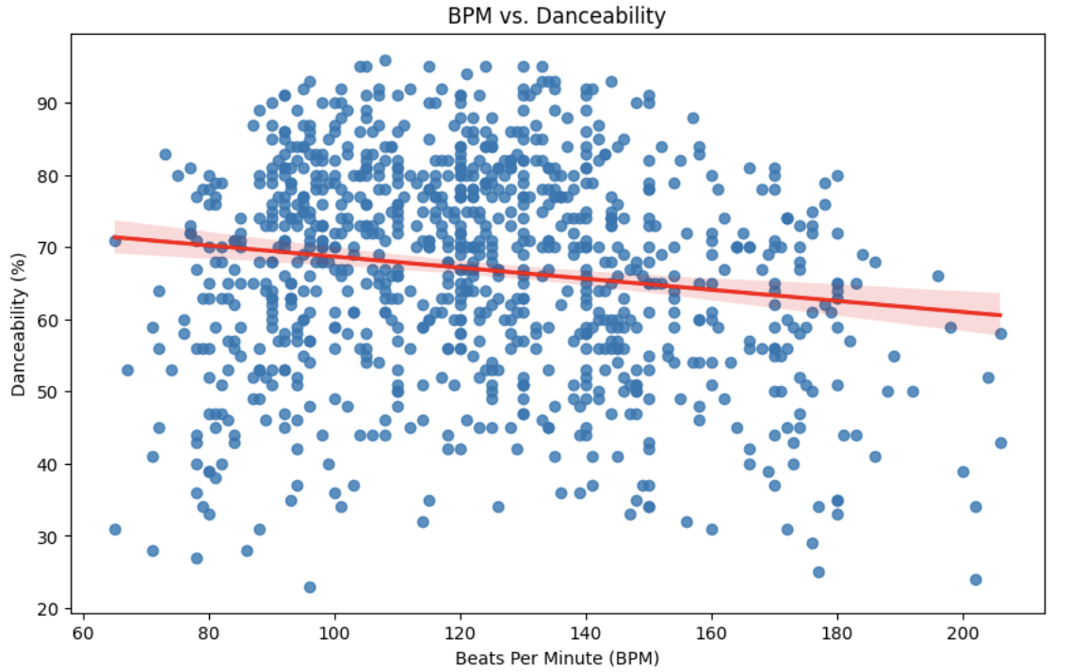
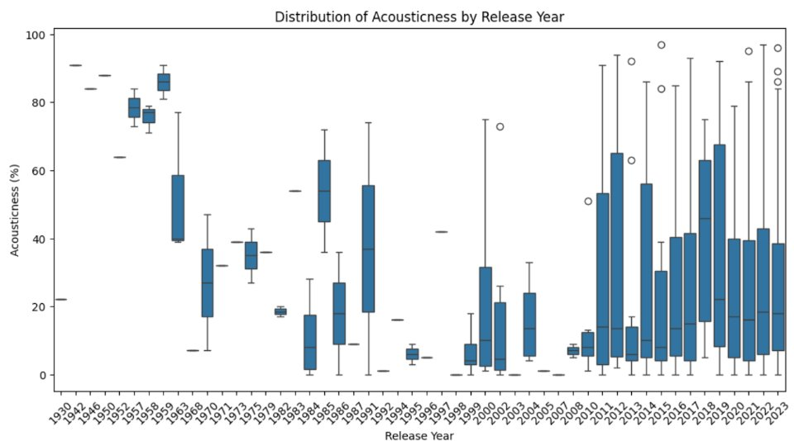
Exploratory Data Visualizations
Notes:
From the visualizations we found a slight negative correlation between BPM and danceability. Songs with BPM between 60-100 generally have higher danceability. Songs from the 1930s – 1950s consistently had high acousticness values, but show sharp decline from 1960s – 1970s. Modern songs have lower acousticness reflecting diverse production trends.

Slide 4
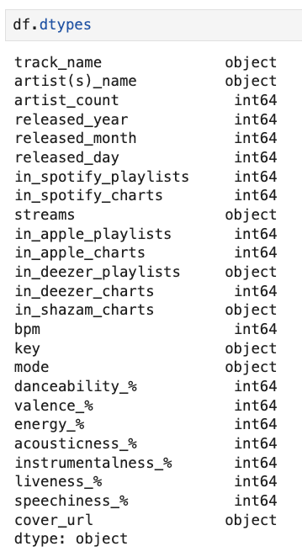
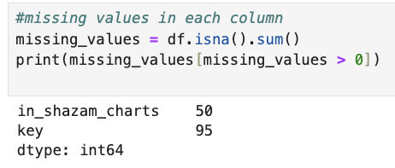
Data Preprocessing
Observations: 924 songs
Features: 24
Numerical & Categorical Data
Missing values and normalized features for consistency (omit values)
Feature selection (most impactful attributes)
Disregard cover_urls and keys features
Notes:
Worked with 924 songs and 24 features including both numerial and categorical data. We normalized features, addressed missing values, and selected impactful attributes like playlist presence while excluding less relevant features like cover URLs.

Slide 5
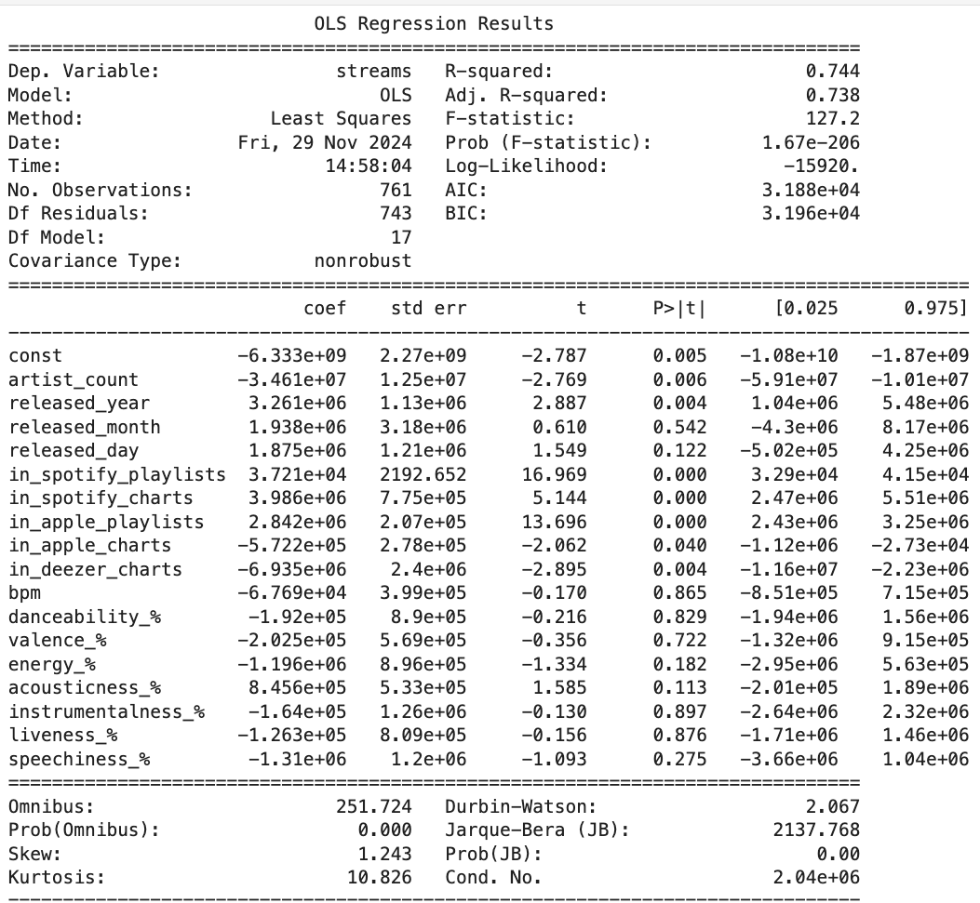
Linear Regression
Results Analysis
Model Fit: The R-squared value of 0.744 shows that 74.4% of the variance in streams is explained by the model, and the model is statistically significant with a F-statistic of 127.2 (p-value < 0.0001).
Significant Predictors: Variables like in_spotify_playlists, in_apple_playlists, and released_year are significant (p-values < 0.05), indicating their strong impact on streams, while other variables like bpm and danceability_% are not significant.
Notes:
Linear regression shows 74.4% of the variance in streaming numbers is explained by the model's predictors and the model is statistically significant with 127.2 F-statistic score. Significant predictors include 'in_spotify_playlists' , 'in_apple_playlists' and 'released_year,' showing these factors heavily influence streams.

Slide 6
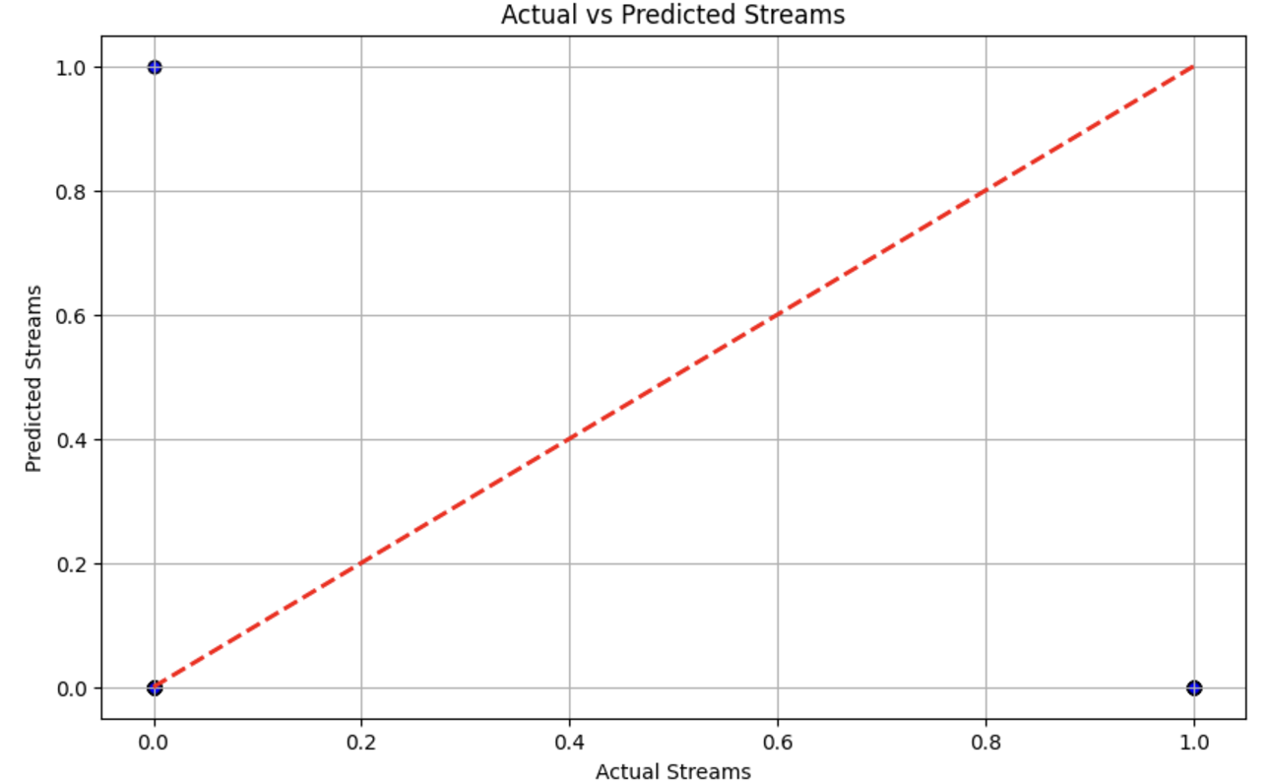
Linear Regression
Notes:
We compared the actual and predicted streaming success for this model, all the blue points lie directly on the red line indicate that the model accurately predicted all instances in this dataset. It’s also important to consider potential class imbalance in the dataset, which could affect the model’s ability to generalize.

Slide 7
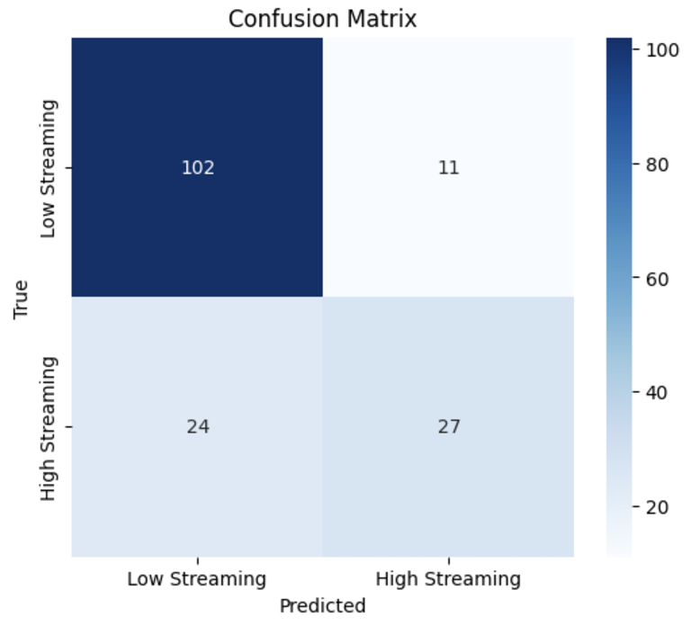
Logistic Regression
Binary Classification (0,1) for high vs low streaming based on the average of song streams
Class imbalance issue persists
Notes:
Logistic regression classifies songs into high or low streaming categories. However, there was a significant class imbalance
features_1 = ['artist_count', 'released_year', 'bpm']
features_2 = ['released_month', 'danceability_%', 'energy_%']
features_3 = ['in_spotify_playlists', 'in_spotify_charts', 'valence_%']

Slide 8
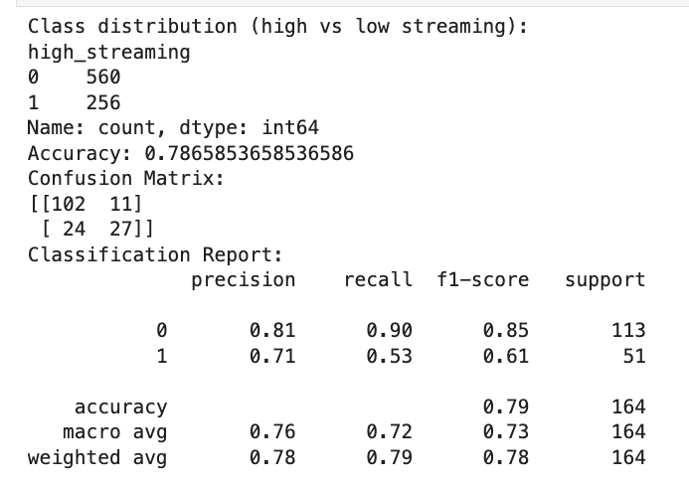
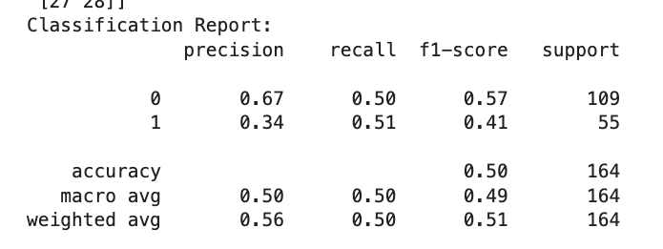
Logistic Regression
Deployed class weighting to give more importance to the minority class of high streaming.
Notes:
Initially, the model struggled with class imbalance with poor performance for high streaming predictions: precision was 0.34, and the overall accuracy was just 50%. After applying class weighting, shown on the right, accuracy improved to 78.65%, and precision for high streaming increased to 0.71, with a better F1-score of 0.61."

Slide 9
Logistic Regression
Results
Accuracy: The model achieves an accuracy of 78.65%, correctly predicting streaming success for most instances, but with room for improvement in the minority class.
Class Imbalance Impact: There is a significant class imbalance (651 low vs. 301 high), affecting the model’s ability to predict the high streaming class accurately.
Precision & Recall: Precision for low streaming (0) is 81%with high recall 90% while precision for high streaming (1) is 71% with recall at 53%, indicating weaker performance for high streaming predictions.
F1-Score: The F1-score is 85% for low streaming (class 0) and 65% for high streaming (class 1), highlighting the model’s struggle with the high streaming class.

Slide 10
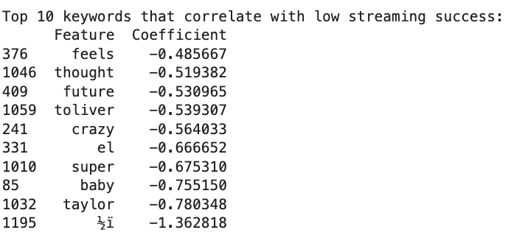
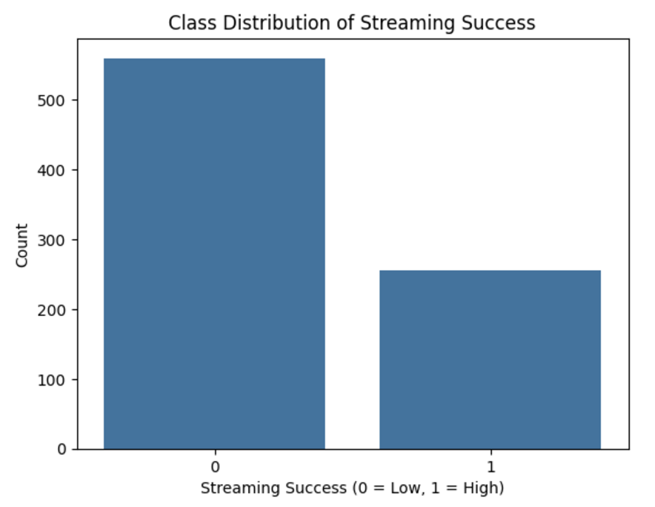
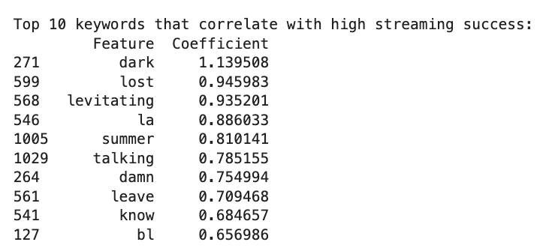
Bag of Words Model
Notes:
The Bag of Words model analyzes lyrics to identify keywords associated with streaming success. Positive keywords like 'dark,' 'remix,' and 'summer' correlate with high streaming success, while 'baby' and 'thought' correlate with low success.

Slide 11
Bag of Words Model
Results
Accuracy:
65.2%, but the model struggles with identifying high-streaming success songs, as shown by precision and recall of 0 for high streaming.
Class Imbalance:
The model is biased towards predicting low streaming success (class 0), as indicated by a recall of 98% for class 0, while it fails to predict high streaming success.
Positive Keywords for High Streaming:
Keywords like "dark," "summer," "remix," and "levitating" are positively associated with high streaming success, suggesting themes of energy, vibe, and popular trends.
Negative Keywords for Low Streaming:
Keywords like as "feels," "thought," "baby," and "crazy" correlate with low streaming success, potentially reflecting less popular or niche themes.

Slide 12
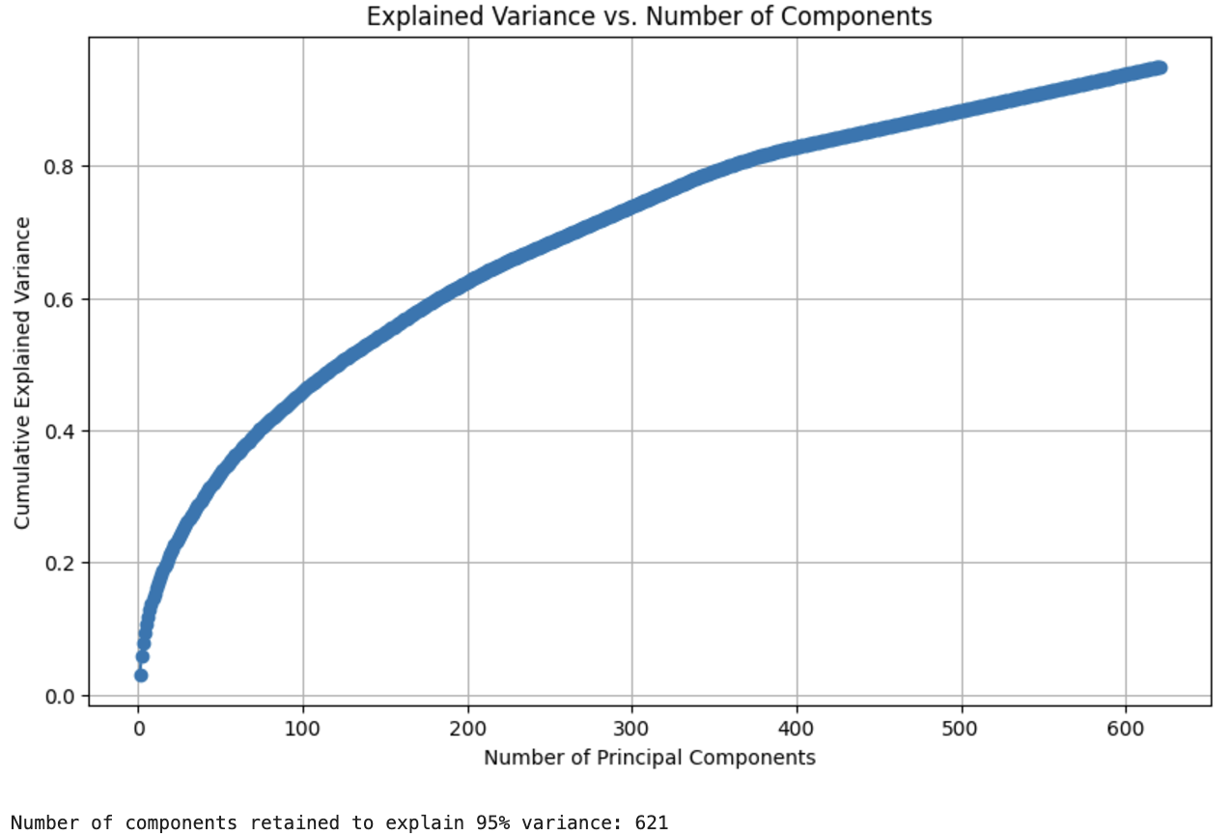
Principal Component Analysis
Model Predicts Majority Class Only: The PCA-based model has a moderate accuracy of 60.37% by predicting the majority class (0) well
Fails to identify any instances of the minority class (1), resulting in low precision and recall
Imbalance Skews Results: Class imbalance heavily influences the model's performance, where the negative class (0) dominates the outcomes with high recall of 96%

Slide 13
Key Takeaways
Playlist presence is a critical predictor of streaming success
Class imbalance significantly affects model performance, highlighting the need for balanced datasets
Future improvements could include advanced models like neural networks or ensemble methods to better handle imbalanced data​​
Insights into song features provide valuable guidance for artists and producers aiming for high streaming success​​
Logistic Regression was the optimal model with the highest accuracy of 78% after class weighting
​

Slide 14
Sources
Iqbal, Mansoor. "Spotify Revenue and Usage Statistics (2024)." Updated October 1, 2024. Business of Apps.
Singh, Shubham. "Spotify Statistics (2024) – User Growth, Top Artists & More." September 17, 2024. Demand Sage.

