Slide 1
INFO-6250 Web Development Tools and Methodology
Spring 2021

Slide 2




Topics
Spring MVC
Handler Mapping
Annotations
Interceptor

Slide 3

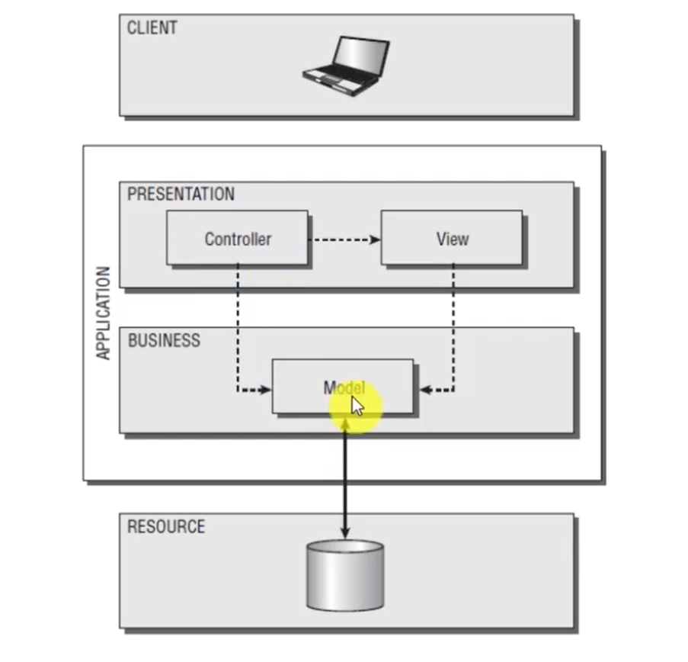

Slide 4
Spring Framework
Spring framework is a lightweight web framework that provides many benefits like:
follows MVC design pattern
clear separation of roles
dependency injection

Slide 5
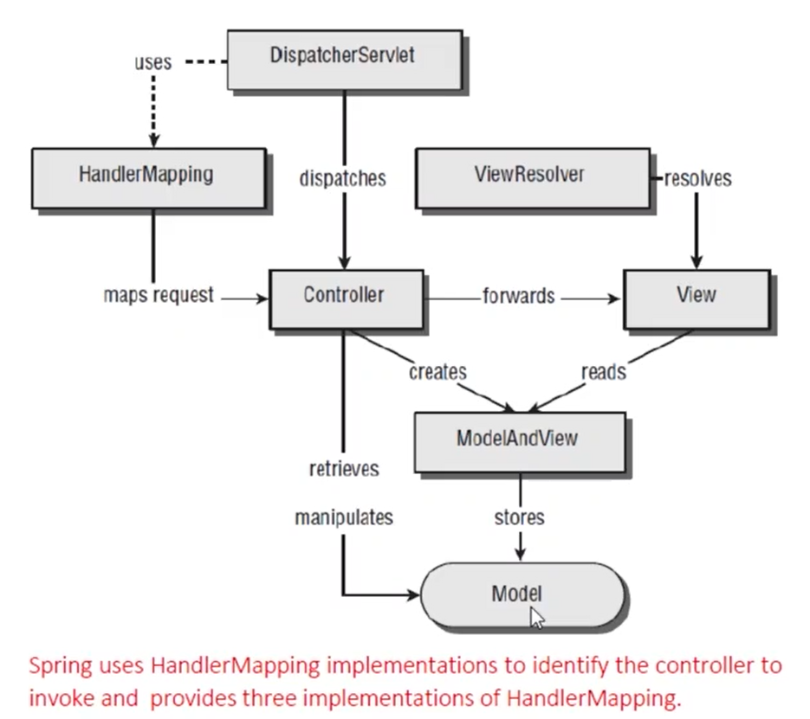
Spring MVC

Slide 6
Handler Mapping
BeanNameUrlHandlerMapping
Maps request URLs to beans with the same name.
Support for direct name matching and for pattern matching using the “*” pattern.
SimpleUrlHandlerMapping
Direct and declarative mapping between either bean instances and URLs or between bean names and URLs.
ControllerClassNameHandlerMapping (removed in Spring 5)
The ControllerClassNameHandlerMapping maps URL to a registered controller bean (or a controller annotated with the @Controller annotation) that has, or starts with, the same name.

Slide 7
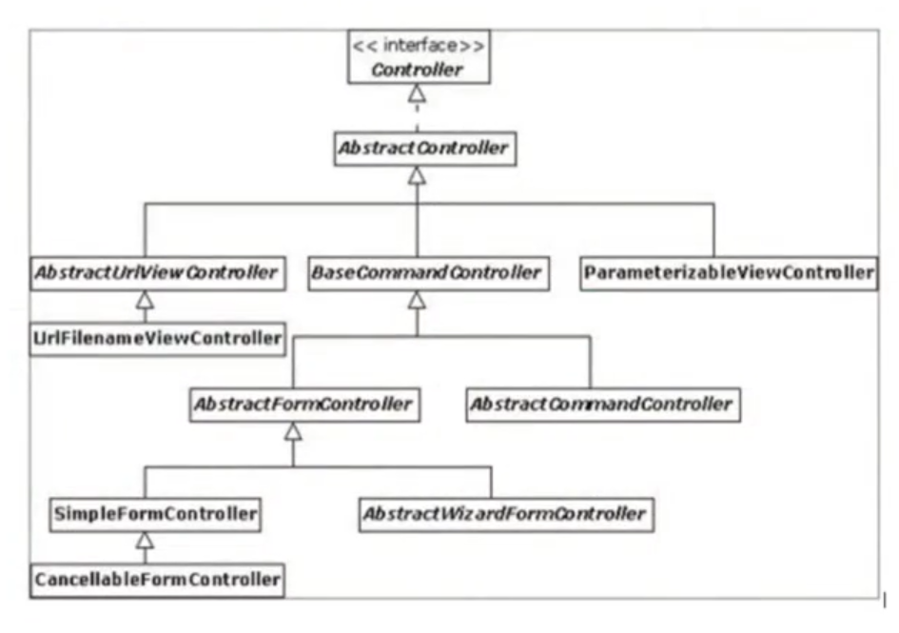

Slide 8
Interceptors
Spring Interceptor are used to intercept client requests and process them.
Sometimes we want to intercept the HTTP Request and do some processing before handing it over to the controller handler methods.
That’s where Spring MVC Interceptor come handy.

Slide 9
Reference link for Spring doc
https://docs.spring.io/spring-framework/docs/current/javadoc-api/

