Slide 1
INFO-6250 Web Development Tools and Methodology
Spring 2021

Slide 2

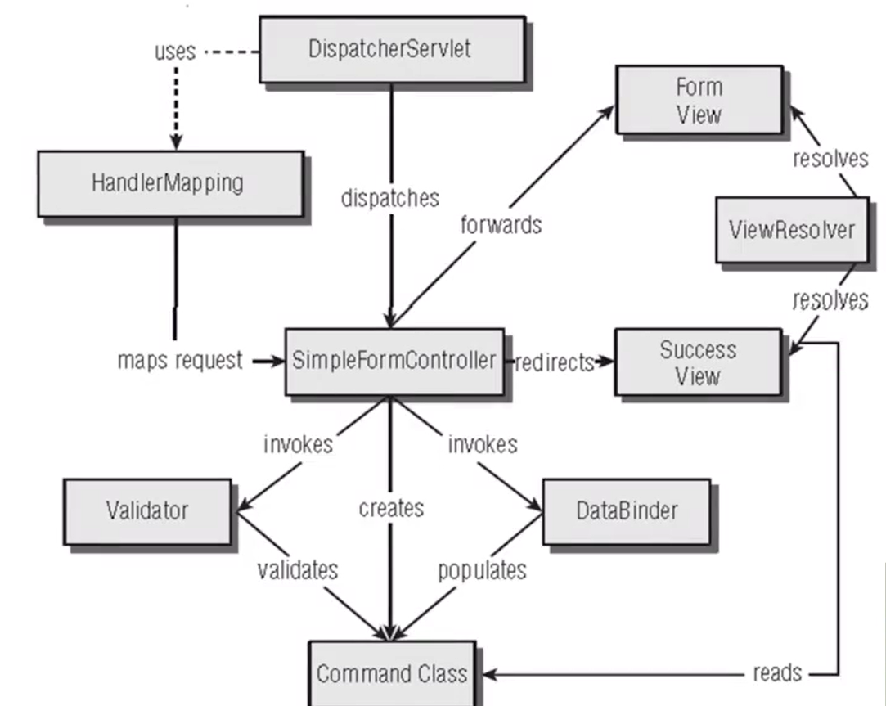



SimpleFormController

