Slide 1
Movie Recommendation System
TEAM 2:
Zongyao Li, 002191556
Xuliang Mei, 001305818
Jiaqi Wang 001023711

Slide 2
PROJECT GOAL
This system is designed to:
Let users get the content they need faster and better
Let content be pushed faster and better to users who like it
Let the website (platform) more effectively retain user resources

Slide 3
Use Case
Recommend movies for users based on:
All-time popular movies
Recent popular movies
Popular movies in different genres
Build personalized movie recommendation list based on user activities:
Analyze user real time ratings of movies and build recommendation
Analyze activity history and build recommendation
Show similar movies based on movie properties:
Name
Genres

Slide 4
Scala Version
Used 2.11.* to be compatible with other packages
Problem with the latest 2.13.*/3.* version:
Package consistency issue
Tool incompatibility
Dependency confliction
System environment stability

Slide 5
Methodology
For Statistic, we will first store all the data into Spark, then do all the statistics via Spark SQL
For Personalized Recommendation, we will use Collaborative Filtering, take all the rating data into consideration.
For Similar Movie, we will use TD-IDF algorithm to calculate the similarity between movies

Slide 6
Project Organization
Used Maven to organized the project for:
Module management
Package dependencies
Program structure
Easier workload division

Slide 7
Modules
Movie Recommendation
|_ Recommender
|_ Data Loader # Load data to database for future use
|_ Content Recommender # Recommend movies based on genre
|_ Statistics Recommender # Recommend movies based on popularity
|_ Offline Recommender # Recommend movies based on historical activities
|_ Streaming Recommender # Recommend movies based on real time rating activities
|_ Kafka Log Manager # Logger and processor
|_ User Interface
|_ Web Page # Not yet implemented properly

Slide 8
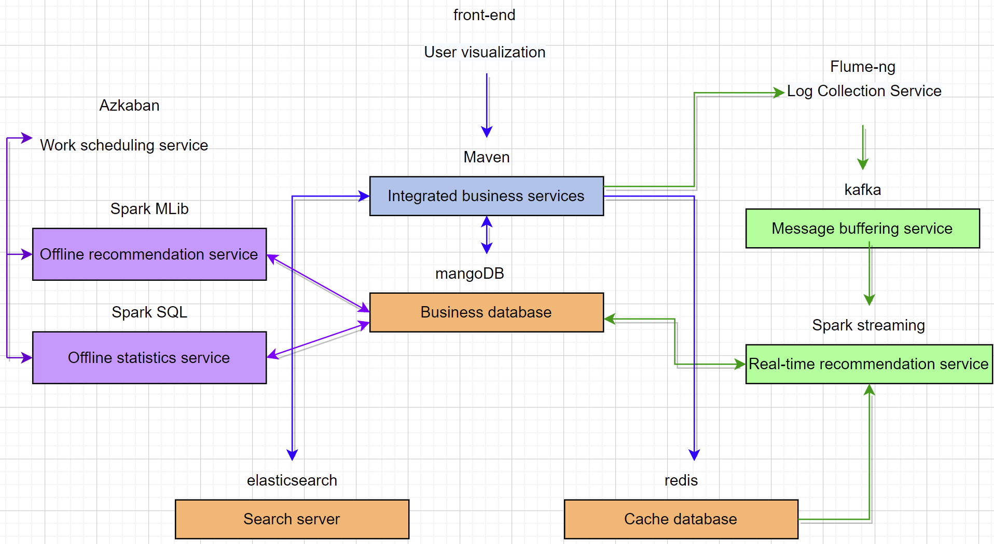

Slide 9
Data sources
The data source is Kaggle’s MovieLens 20M Dataset
The magnitude
genome_scores.csv: 11.7m
genome_tags.csv: 1128
link.csv: 27.3k
movie.csv: 27.3k
rating.csv:20.0m
tag.csv: 466k

Slide 10
Data processing (Example: Movie.csv)
/**
* Movie data file format
*
* 260 Movie_id
* Star Wars: Episode IV - A New Hope (1977) Movie_name
* Princess Leia is captured and held hostage Detailed description
* 121 minutes length of the movie
* September 21, 2004 time of issue
* 1977 time of shoot
* English type of language
* Action|Adventure|Sci-Fi genres
* Mark Hamill|Harrison Ford|Carrie Fisher list of actors
* George Lucas name of directors
*
*/

Slide 11
Dataframe or Dataset?
Used dataframe for:
The main container of data during operation
Reading data from files
Reading data from database
Writing new datas into database.
Used dataset for:
Column selection (filter out unwanted columns)

Slide 12
Milestones
Week 9: learn about the missing part of the new tech and adjust the Dev environment
Week10: define the data format, preprocess the data, add dependencies and construct the framework of the project
Week11: compose the recommendation algorithm, complete the recommendation algo and train models
Week12: set up the front-end(if have time) and manage the flow control
Week13: final adjustment

Slide 13
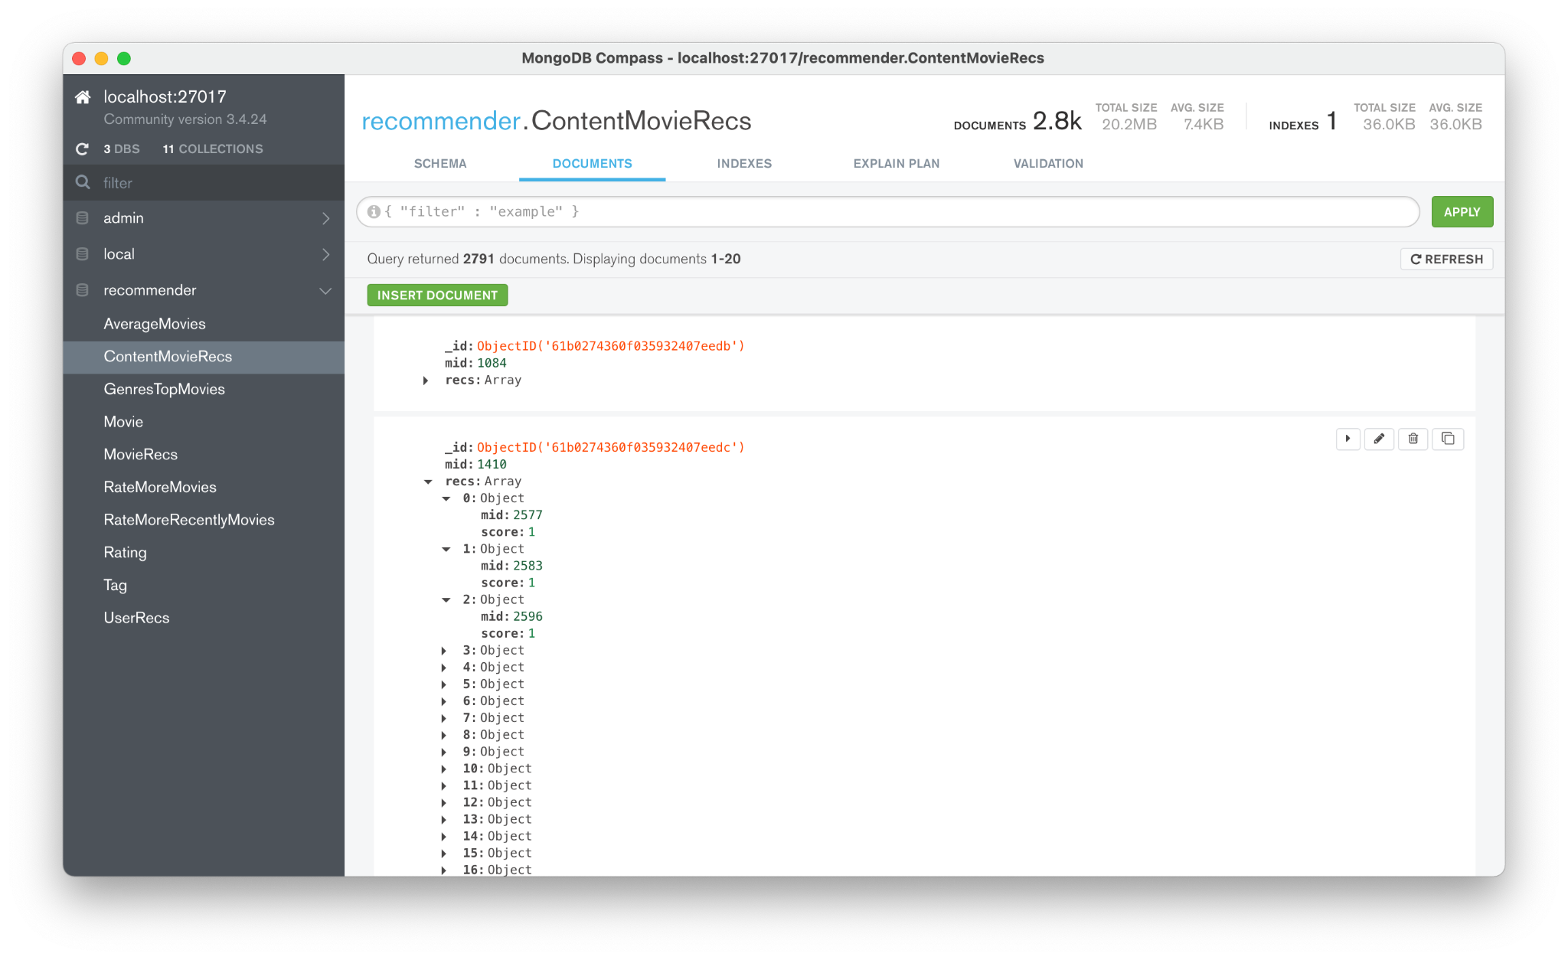
Demo (content based recommendation)

Slide 14
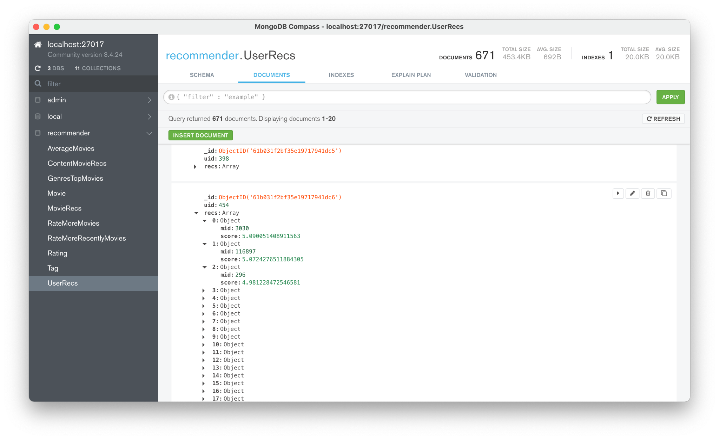
Demo (offline recommendation)

Slide 15
Acceptance criteria
1s
Display all the statistic lists as soon as it’s requested
5s
Display the user personalized recommendation in reasonable time(maybe below 5s)
3s
Display the similar movies in reasonable time(maybe below 3s)

Slide 16
Workload Division
Xuliang Mei
System Structure Design
Data Collector
Content Module
Database Management
Technical Selection
Zongyao Li
System Structure Design
Module Build Up
Statistics Module
Kafka Module
Code Review
Framework Deployment
Organizer
Jiaqi Wang
System Structure Design
Data Loading
Algorithm Implementation
ALS model training
Offline Module
Real Time Module

Slide 17
Summary & Reflection
Achievements
Known Shortage
Achieved the overall goal–attain various level of recommendation
Got familiar with common big data technologies and tools
Strengthened the programming ability of scala
Lack of proper deployment of the front-end

Slide 18
Thanks! Any questions?

