Slide 1
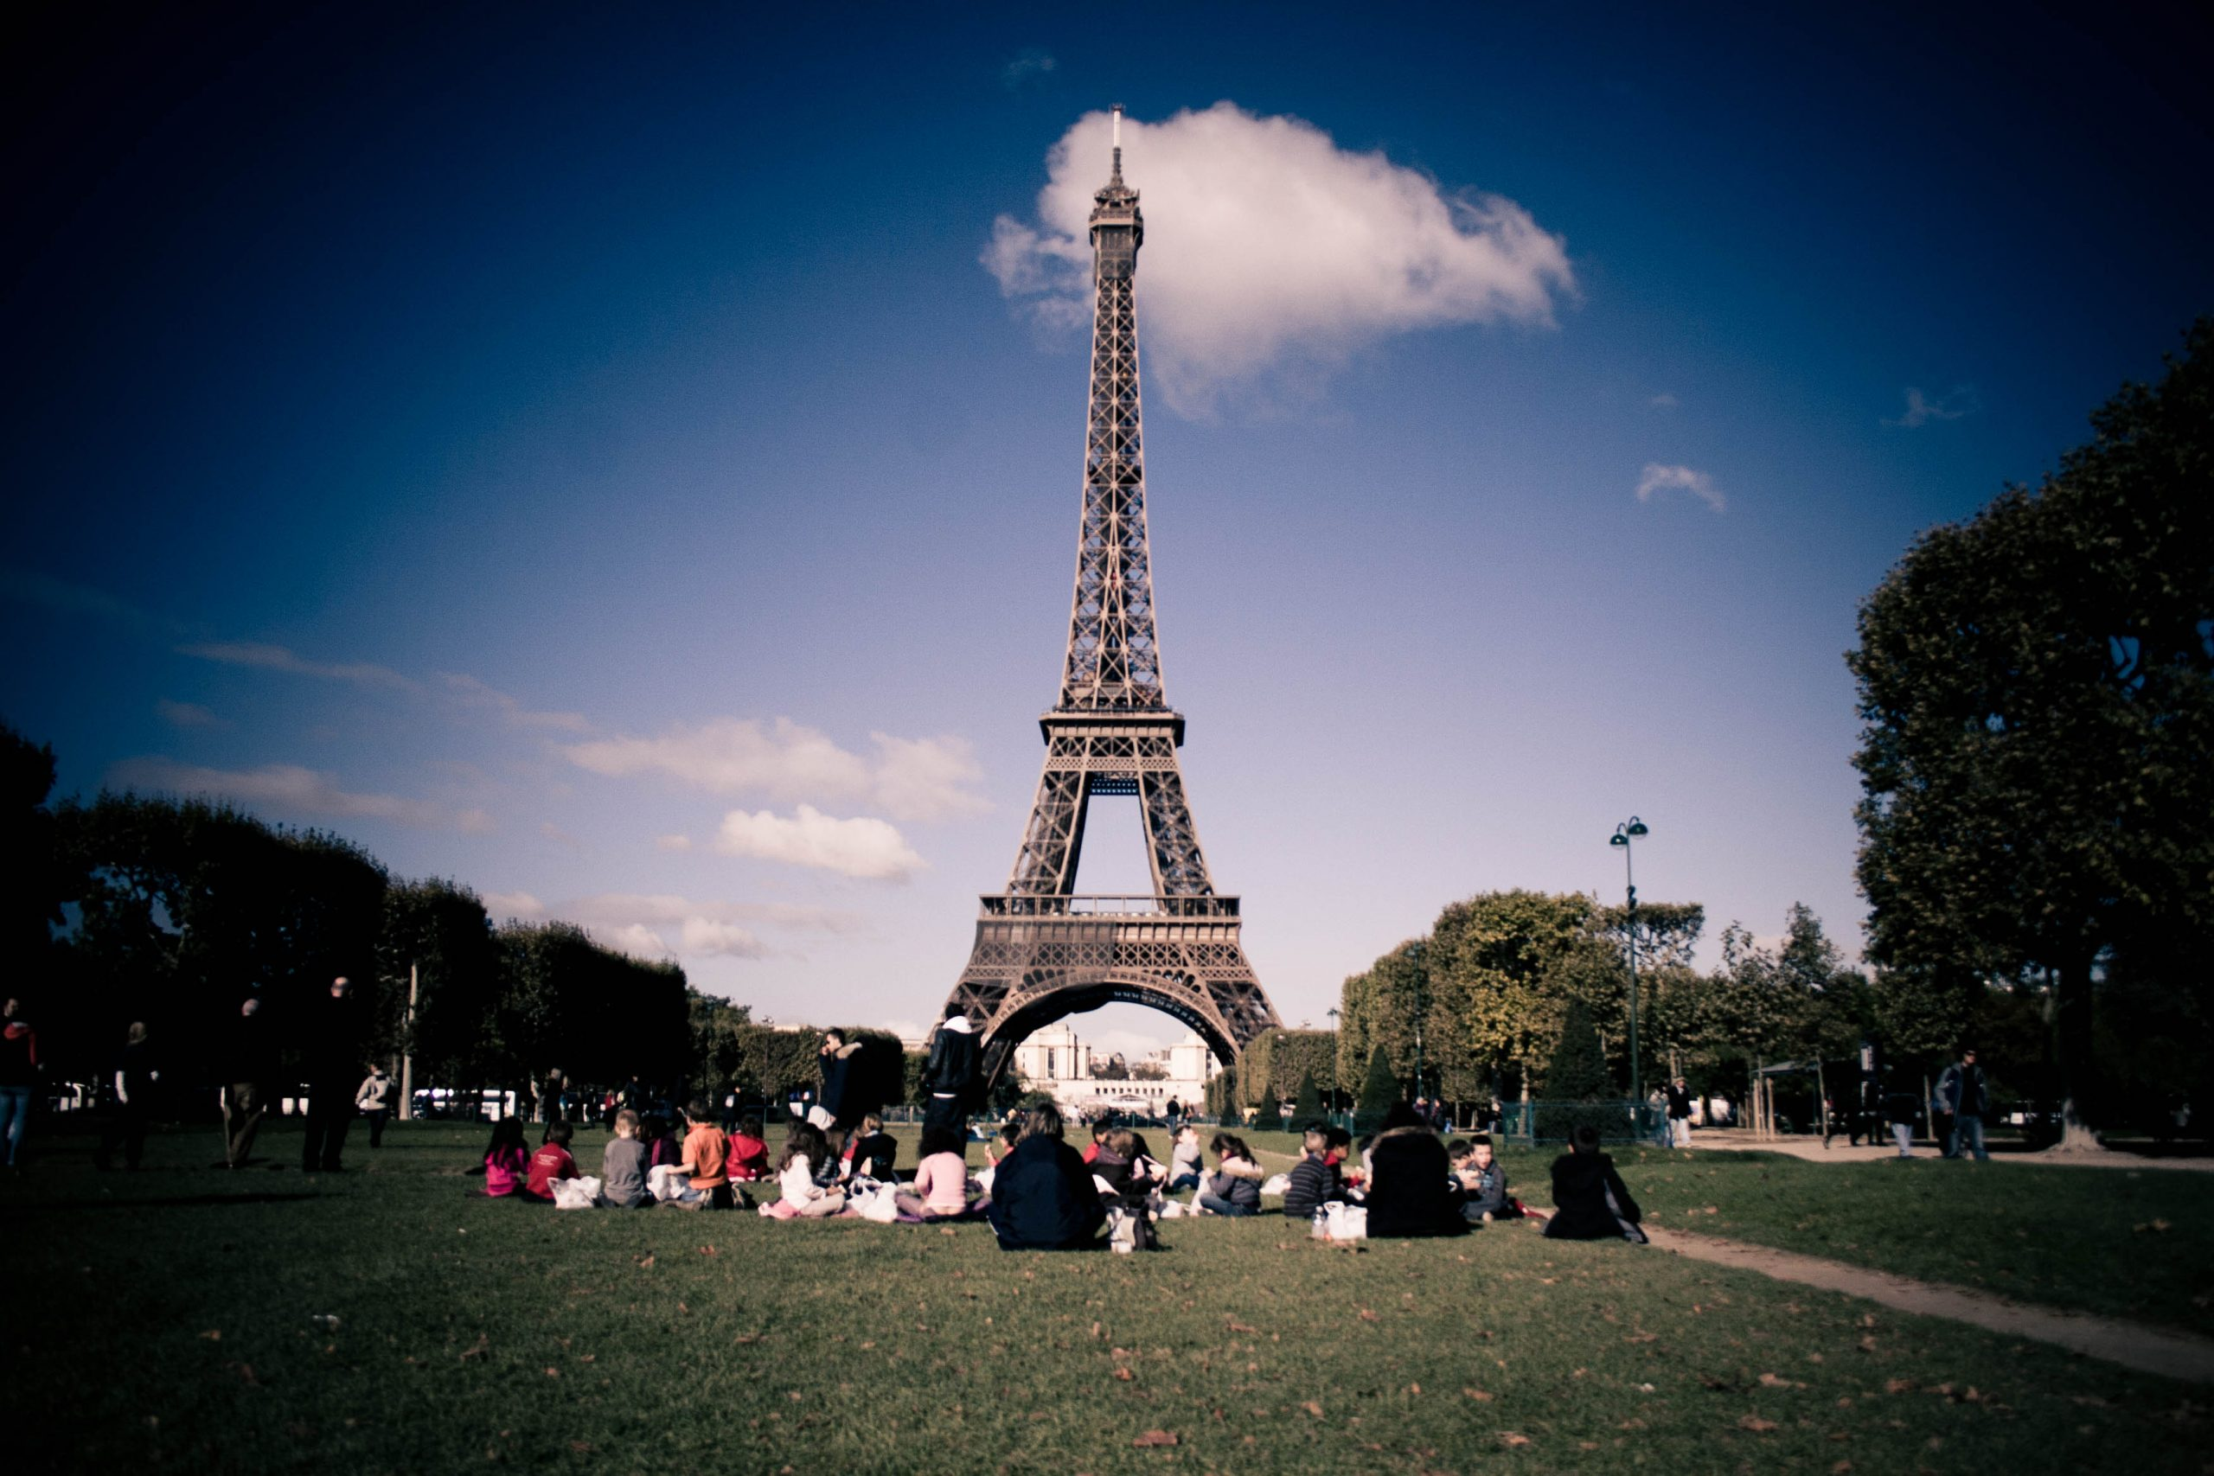
Global Communications
EUROPE
Presentation by:
Hanbo Huang (001539865) Jiaqi Wang (001023711) Madhurima Chatterjee (001003806)
Srushti Manojkumar Desai (002117465)

Slide 2
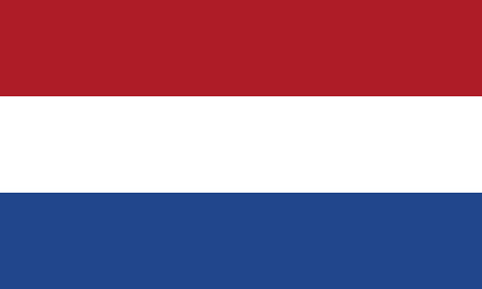



Communication Style
Netherlands
United Kingdom
Germany
Punctuality, Direct Communication
Diplomatic language, self-deprecating, value politeness
Straightforward, organized, dislike taking risks and analytical
‘Time is money’
'PLEASE, THANK YOU, SORRY'
'I will just wing it'

Slide 3
European bussiness communication approaches
Europeans have a strong sense of integrity and time, so if you make an appointment with a customer, you must be punctual.
For European customers, we must not judge people by their appearance, treat people with orders, and treat every European customer sincerely.
Pay attention to social etiquette in different countries.
Europeans pay attention to quality, even if it is some small items.

Slide 4
Pros and cons of working in europe
Pros:
One month (or longer) paid leave
Great work-life balance - It may be a crime to contact someone after office hours
Not asked to start work on Friday and finish by Monday
Very supportive of research and startups
Customary to have at least one coffee a day with the team
Cons:
France, Italy, Spain, Portugal – Knowing English isn't enough
High competition in research and startups

Slide 5
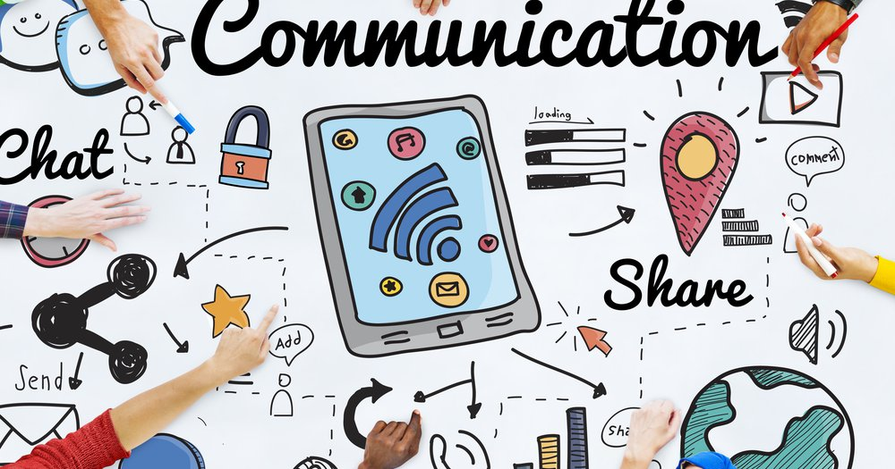
Tips for better communication
Be confident and don't be afraid to make mistakes.
Sincerity and courtesy have always been a very important part.
Listen carefully to other people's questions or answers
Don't keep talking about unhappy things, or even start complaining

Slide 6
