Slide 1
Convolutional Neural Network for Face Recognition Based on LFW dataset
Presented by: Jiaqi Wu
UFID: 09582676

Slide 2
Introduction of the Problem
Face Recognition
Verification
= Is that you?
distinguish if the two faces are from one person
Identification
= Who are you?
see which person the given face belongs to in the database
This project focuses on Identification problem
using Labeled Faces in the Wild (LFW) dataset

Slide 3

Introduction of the Problem
Common idea:
detect the faces extract the features train the models
Problems:
the sizes and formats of the images can be different
We need to : preprocess the images
faces of the same person can vary a lot: Pose, Illumination, Expression, and etc.
We need to : design the features and extract the features that are robust

Slide 4
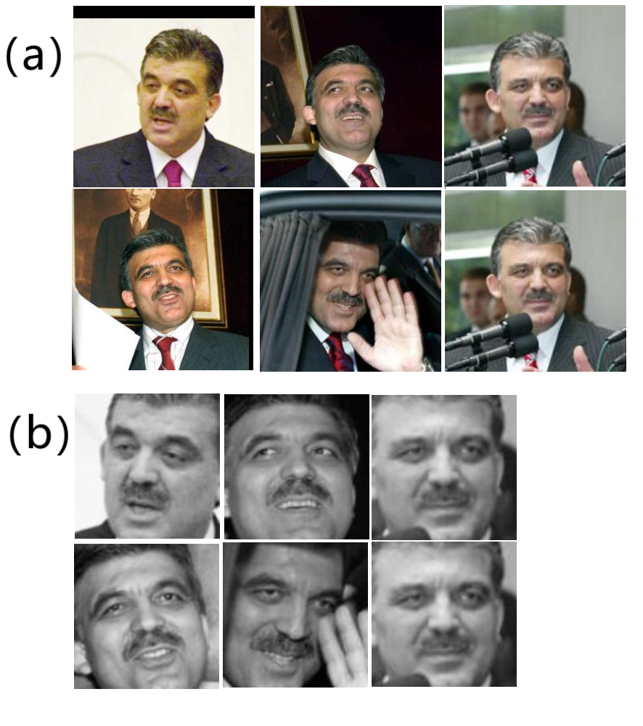
Introduction of the Problem
Preprocess the images
Using OpenCV library:
This library is very convenient and useful to develop
image processing, computer vision, and pattern
recognition problems
The scheme:
1) Convert the images from RGB to Gray level
Because the difference of RGB level of a person’s face
is small, the gray level is more easier and convenient
for training.
2) Cut the face from the images
Filter the useless background
3) Resize the face to uniform input size
Convenient for training the model

Slide 5
Introduction of the Problem
Convolutional Neural Network (CNN)
One of the most common used deep learning algorithms while solving the problems about images
Advantages:
we don’t need to design the features and extract the features that are robust
These features can be learnt through learning process after being trained with a large amount of data
Weakness:
1) A large amount of data that contains enough variance is needed.
LFW dataset is used: It includes 13233 face images that are assigned to 5749 different person names.
The images are captured in uncontrolled environments.
2) Training time is too long because of the large scale training dataset.
we just use the first 1000 images of the dataset for quickly evaluate

Slide 6
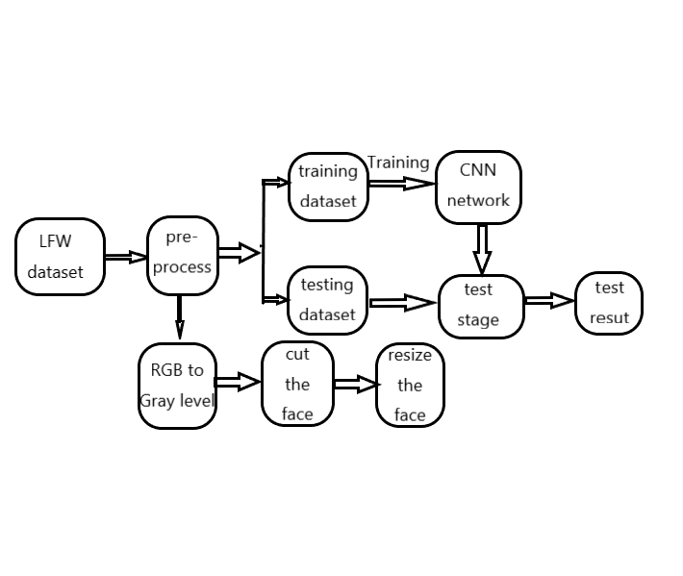
Overall design scheme of the project
1) Image preprocessing;
2) Convolutional neural network designing;
3) Model training and testing;
4) Evaluation

Slide 7
Overall design scheme of the project
Factors that can influence the performance
Training dataset;
CNN structure;
Optimizer

Slide 8
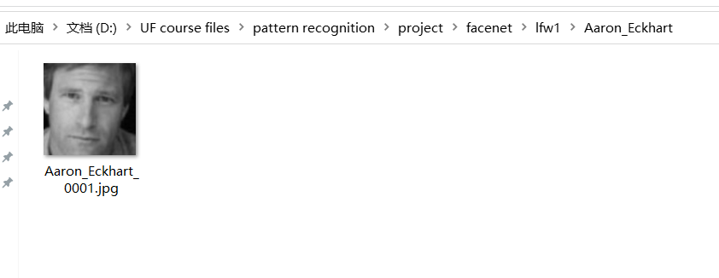
1) Training dataset
Problems:
Large amount of images are needed in one class.
This class only has one image!

Slide 9
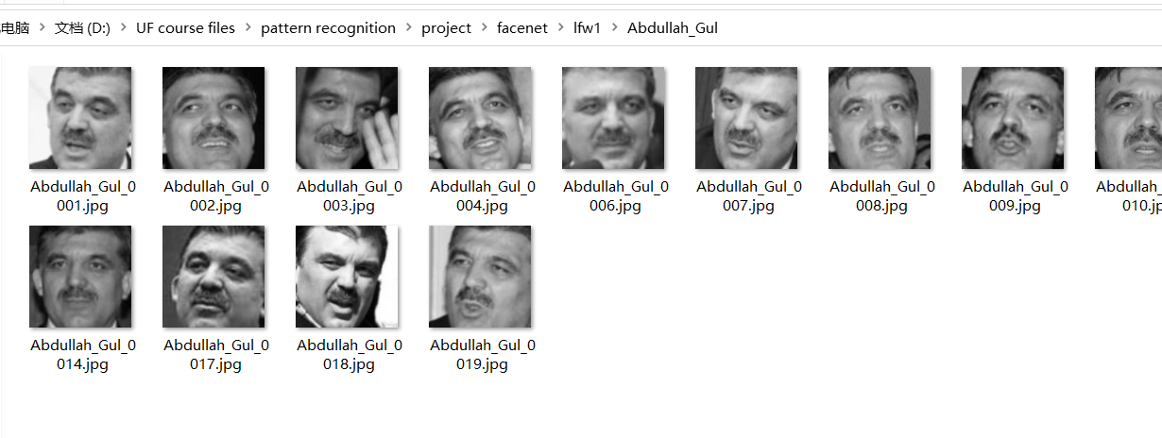
1) Training dataset
Problems:
Large amount of images are needed in one class.
This class has many images.

Slide 10
1) Training dataset
Problems:
Large amount of images are needed in one class.
Solution:
Choose the classes that the number of images are larger than the threshold.

Slide 11
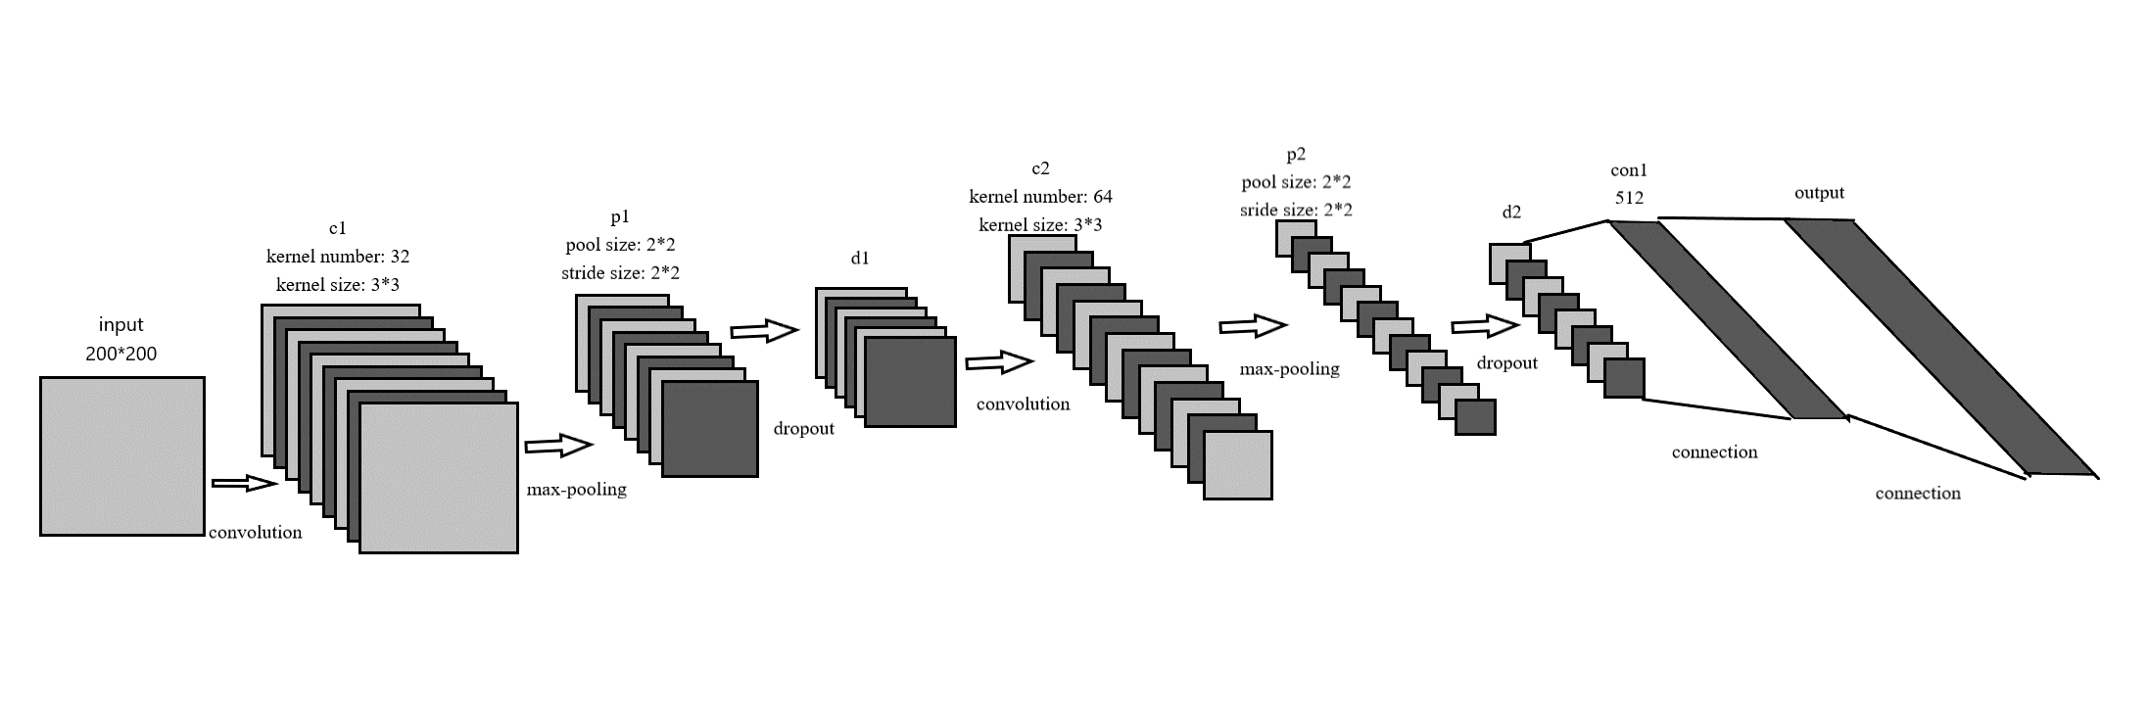
2) CNN structure

Slide 12
3) Optimizer
RMSprop
GSD
Adam

Slide 13
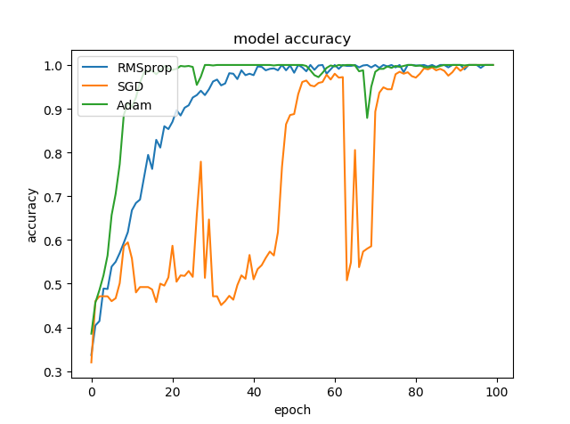
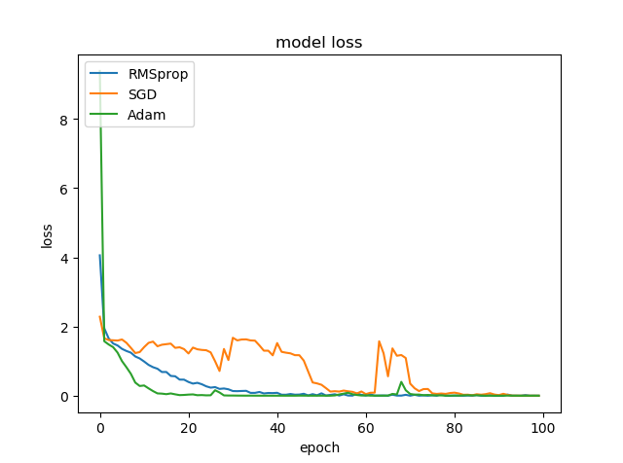
Evaluation
Choose different optimizers and compare the accuracy and the loss of the model.

Slide 14
Evaluation
The SGD optimizer is not stable
because the accuracy and loss curves are volatile.
The accuracy and the loss of
RMSprop model and Adam model
is comparative
The convergence rate of Adam
model is faster

Slide 15
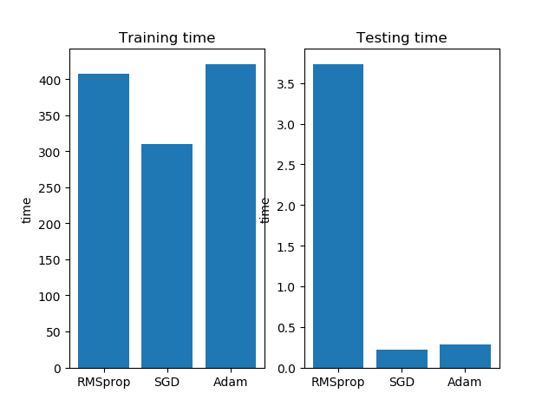
Evaluation
Running time:
Training time:
Training time is long.
SGD has the minimum training time.
RMSprop and Adam has similar training
time.
Testing time:
Testing time is short.
RMSprop has the largest testing time.
SGD and Adam has similar testing time.

Slide 16
Evaluation
Considering the accuracy, stability, convergence rate and the running time,
the optimizer of Adam is the best choice.

Slide 17
Evaluation
Then change the threshold when filter the dataset
Threshold: the number of images in the same class should be larger than the threshold.
Threshold | Accuracy | Loss
1 | 19.0% | 35.082
5 | 56.0% | 3.651
30 | 82.9% | 0.841
100 | 89.0% | 0.351
The number of images used for training should be larger for larger accuracy

Slide 18
Conclusion
Convolutional neural network is useful for face recognition problem
In this closed-set identification task, two convolutional layers are built and the best optimizer is the Adam optimizer.
The accuracy of the model can be up to 89% and if more images are trained in one class, the accuracy will keep improving.

