Slide 1
How to improve the star rating of FastFood restaurants in US?
Module 3–Group 11
Jiaqi Xia, Yutong Zhang, Midhun Satheesh

Slide 2
Goals & Data Cleaning

Slide 3
Goals
What attributes do successful fastfood restaurants have?
Offer delivery/ takeout service?
Suitable for kids?
Price?
Location?
Whether have Wi-Fi?
What aspects do customers care mostly when they write reviews for fastfood restaurants?
delivery service?
location?
cleanliness?
Type of food?
Our group are interested in Fastfood restuarants, we want to give some suggestions to owners of Fastfood restuarants in US based on Yelp review.

Slide 4
Data Cleaning
Original Data
About 150k businesses & 7 million reviews
Final Data
5218 businesses & about 190k reviews after removing reviews which are not in English.
Data Processing Procedures
We only keep the businesses that are still open and select states in US.
And then we exact rows containig "Fast Food", remove rows that have no attributes (attributes == "NA")
We merge the Review.json and Business.json file based on business_id

Slide 5
Attribute Analysis

Slide 6
Attributes Selection
Attributes | Count
RestaurantsDelivery | 5173
RestaurantsTakeOut | 5114
RestaurantsPriceRange2 | 4797
BusinessAcceptsCreditCards | 4725
RestaurantsReservations | 4544
GoodForKids | 4336
RestaurantsGoodForGroups | 4316
BusinessParking | 4210
We count the attributes provided by Fastfood restaurants using the "business.json" file. It turns out to be 38 attributes in total.
To avoid bias in our analysis, we choose attributes that are provided by at least 80% of the businesses.

Slide 7
Attributes Processing & ANOVA
We then transformed the attributes to a dataframe format.
"BusinessParking" has 5 types: Garage/Street/Validated/Lot/Valet, so we split them into 5 columns.
We conducted the one-way ANOVA for attributes to find attributes that significantly affect rating stars.
All attributes we selected are significant.
Attributes | P-value
RestaurantsDelivery | 4.512e-61
RestaurantsTakeOut | 7.997e-36
RestaurantsPriceRange2 | 8.328e-61
BusinessAcceptsCreditCards | 1.399e-05
RestaurantsReservations | 1.549e-22
GoodForKids | 1.153e-15
RestaurantsGoodForGroups | 4.334e-14
BusinessParking | all < 0.05

Slide 8
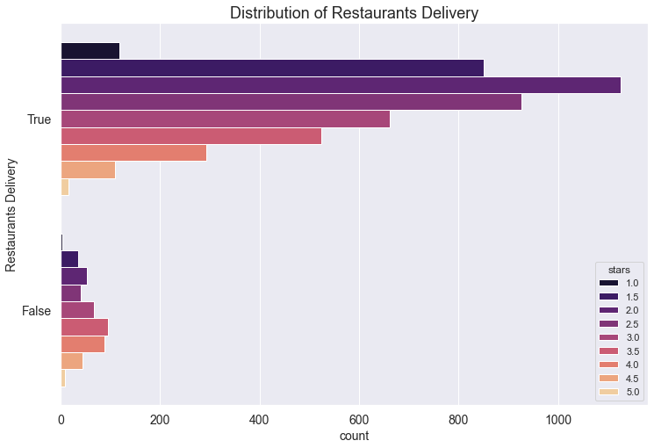
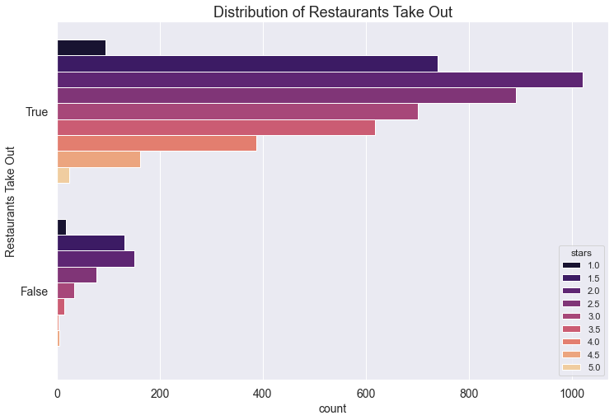
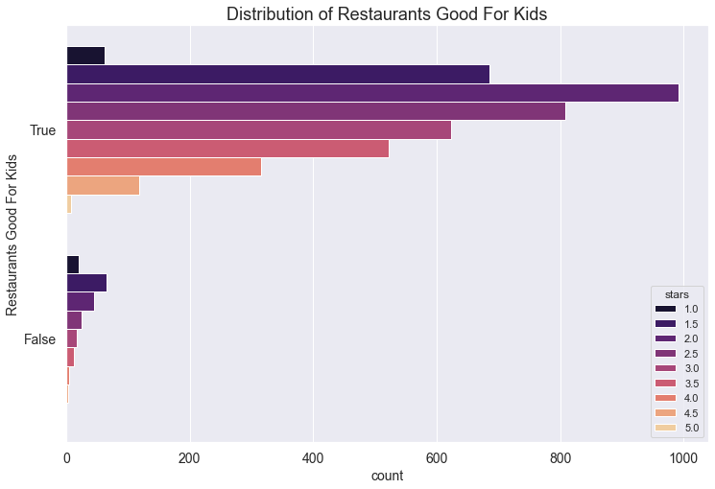
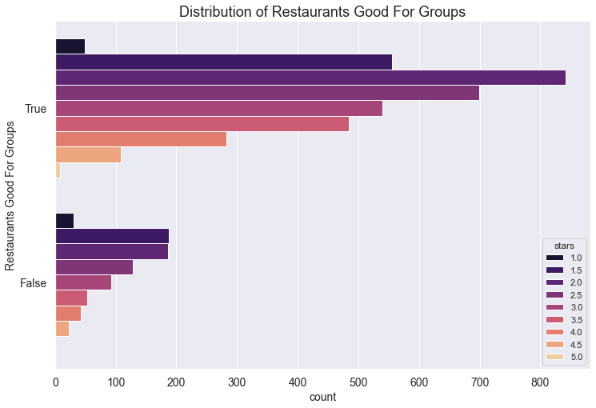
Distribution of Attributes
Most of fast food restaurants offer take out or delivery.
Most fast food restaurants are good for groups and kids.

Slide 9
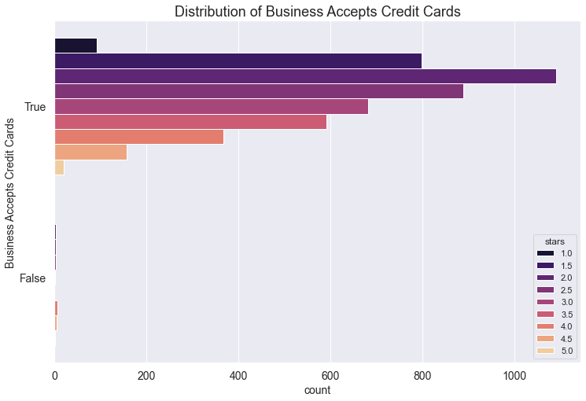

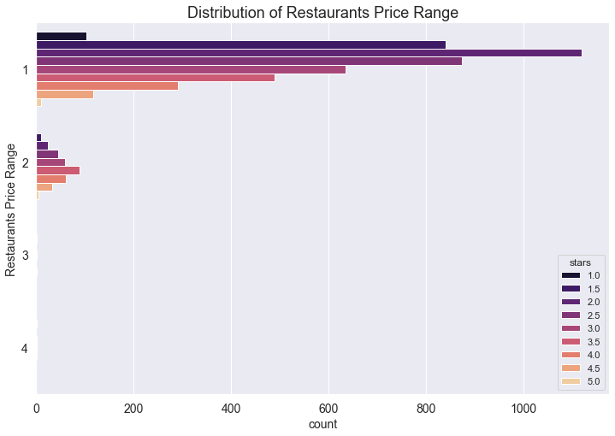
Distribution of Attributes
For payment, they mostly accept credit cards.
Mostly do not accept reservations.
The price are mostly in range 1 or 2, which is an affordable price for most of the customers.

Slide 10
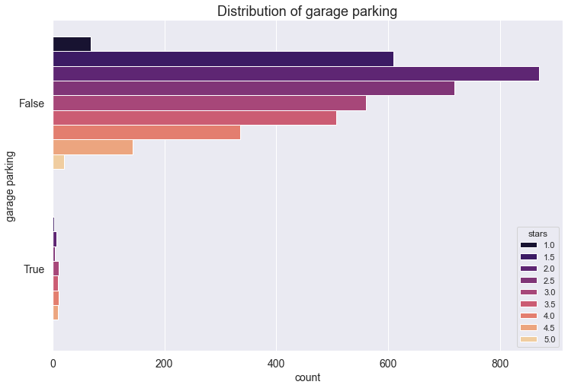
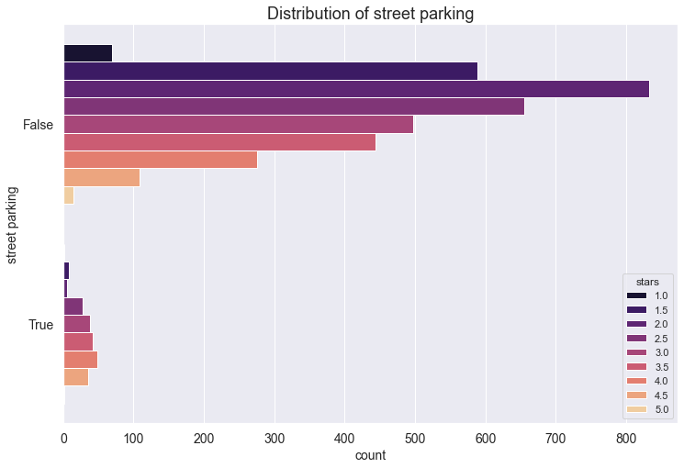
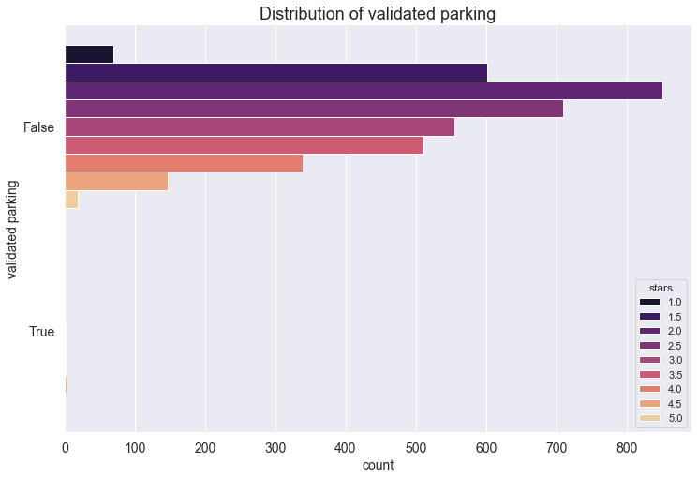
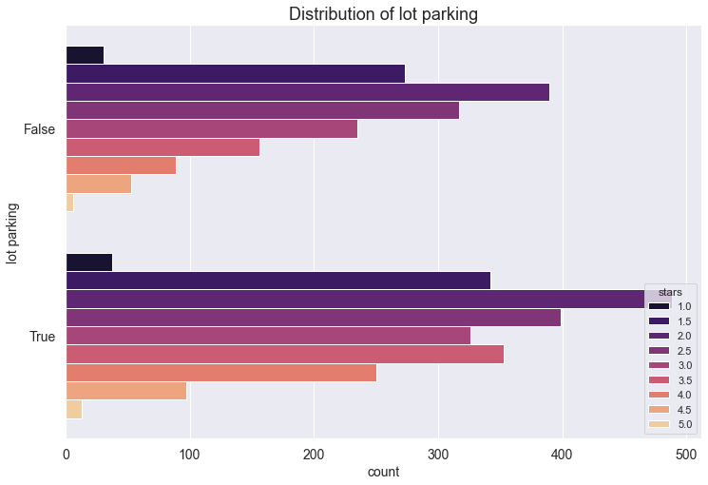
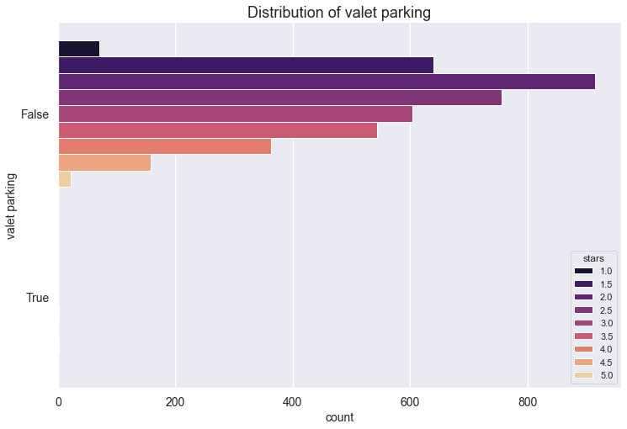
Distribution of Attributes
Most fast food restaurants do not offer garage, street, and validated parking
No fast food restaurant has valet parking
Lot parking is the most common way of parking for fast food restaurants.

Slide 11
Review Analysis

Slide 12
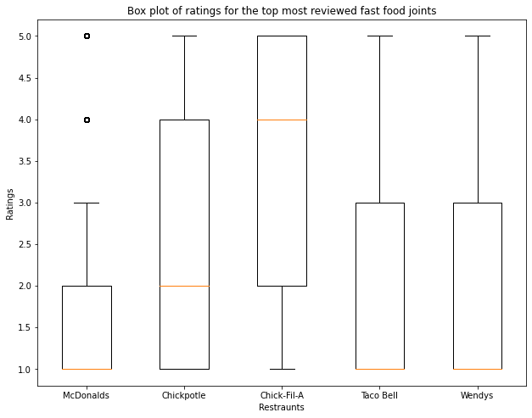
Reviews of the top 5 most reviewed Fastfood joints

Slide 13
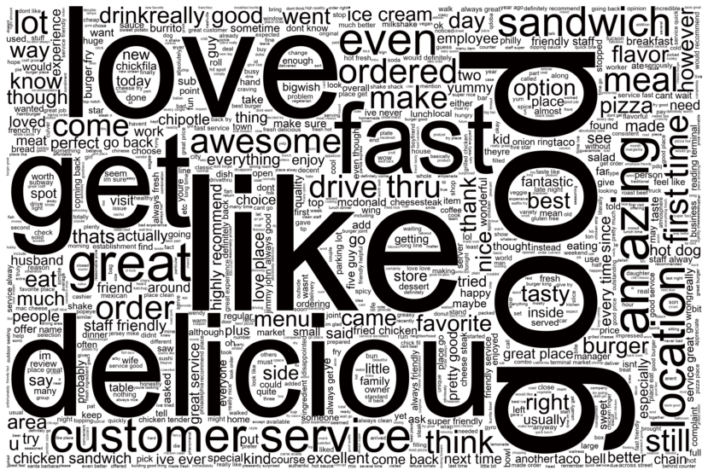
WordCloud
Wordcloud for data with reviews rating stars ≥ 4
Cleaned the review after tokenization, removing stopqords, stemming, and lemmatization.

Slide 14
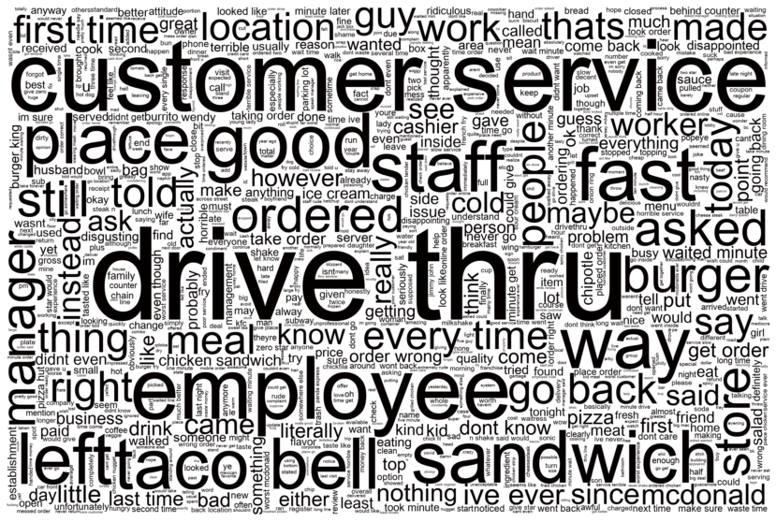
WordCloud
Wordcloud for data with reviews star rating ≤ 2
Should focus more on customer service, faster order placement, including drive thru

Slide 15
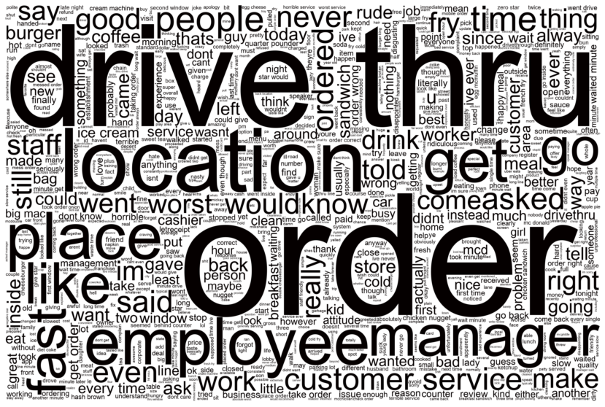
Example WordCloud for a fast food joint- McDonalds

Slide 16
Future Work
Conduct the sentiment analysis
Build a linear model
Create a Shiny App

Slide 17
Thank you！

