Slide 1
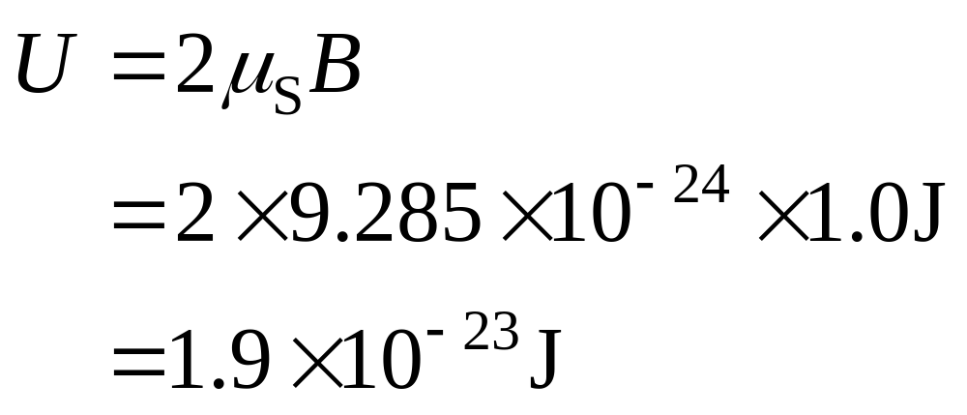
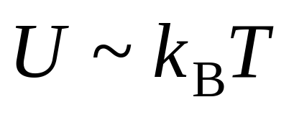
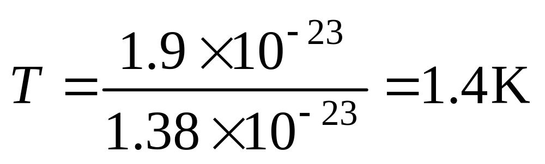
Problem 19.6

Slide 2
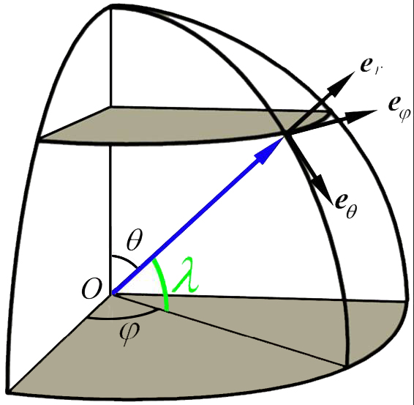
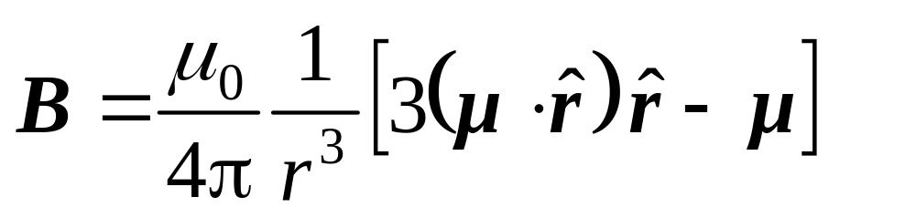
*Problem 19.11
μ
no θ component
Notes:
Horizontal and vertical in local meaning should be expressed in spherical coordinates.

Slide 3
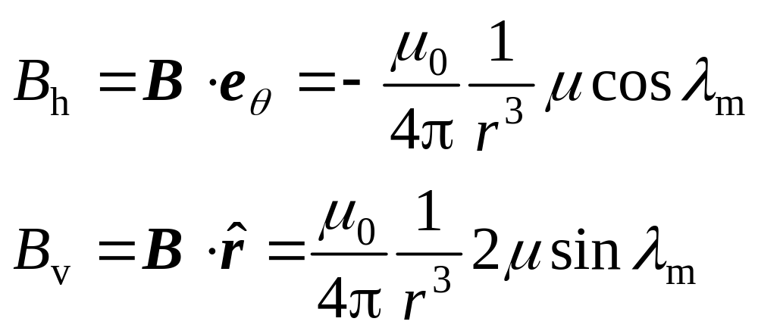
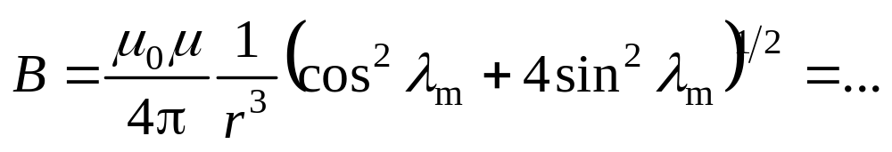
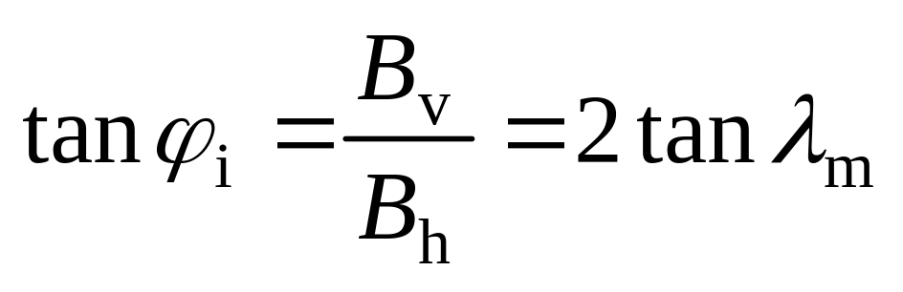
(a)
(b)
(c)

Slide 4
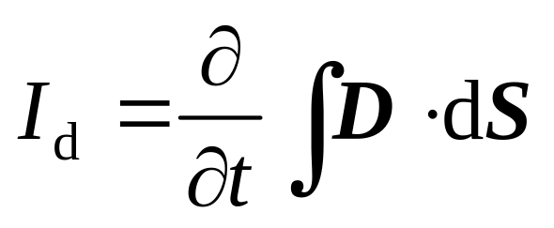
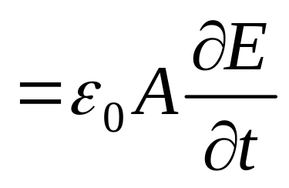
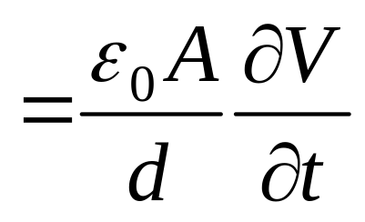
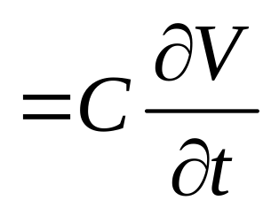
Problem 20.1

Slide 5
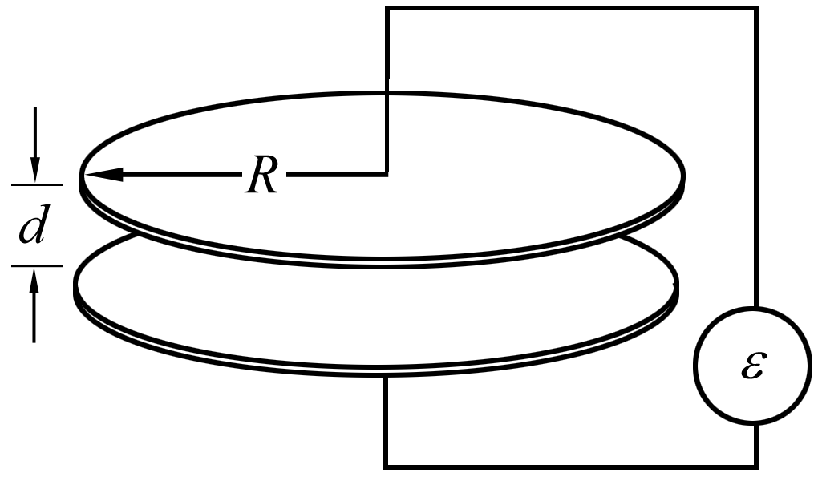
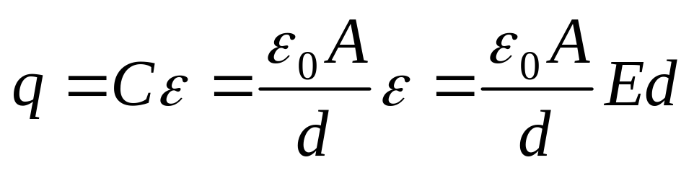
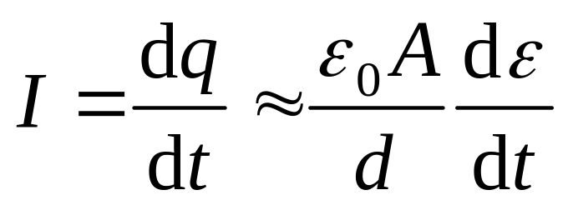
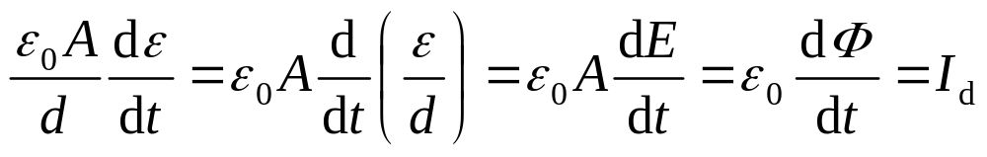
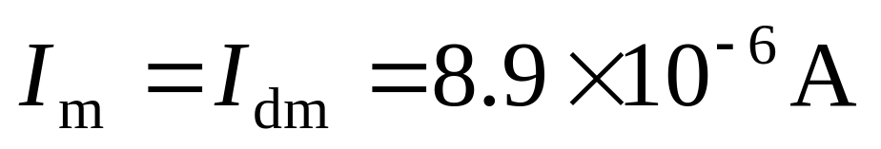
Problem 20.2
(a)
while
known
Notes:
E=epsilon0 sigma is for static case. E in wire also contributes to flux.
Charging-discharging current and displacement current.

Slide 6
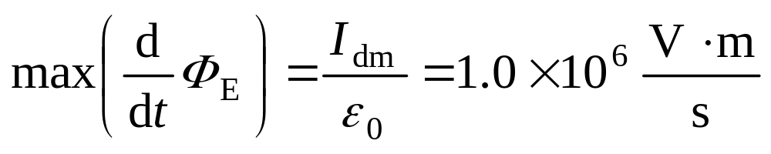
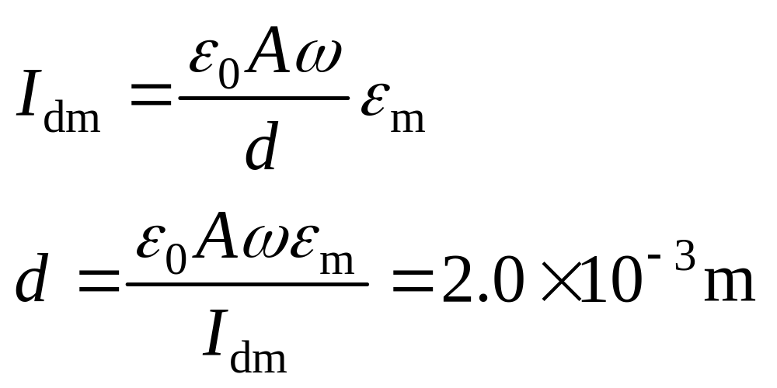
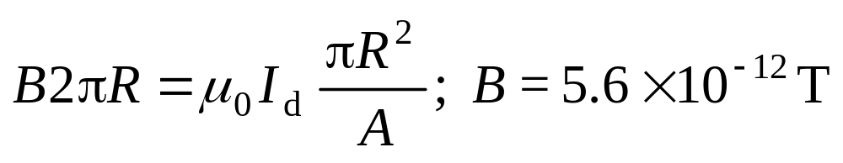
(b)
(c)
(d)
Notes:
(c)when sinωt = 1

Slide 7
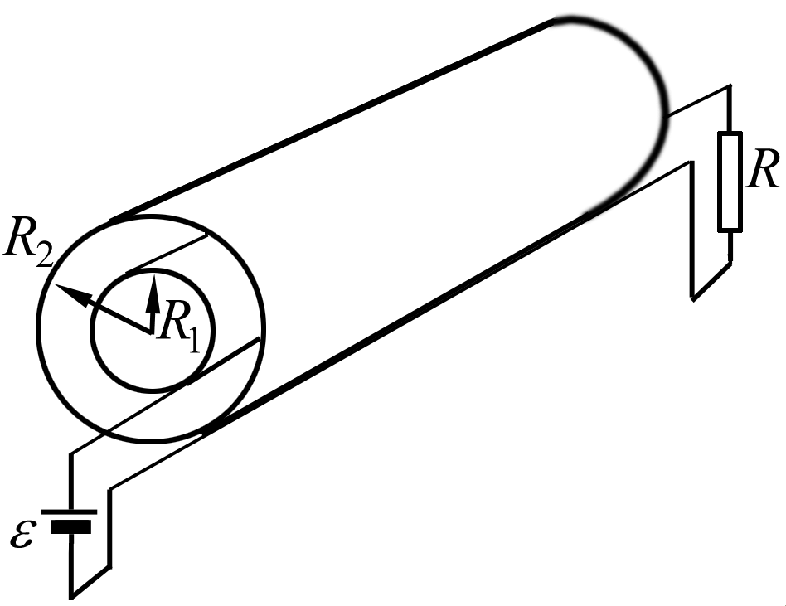
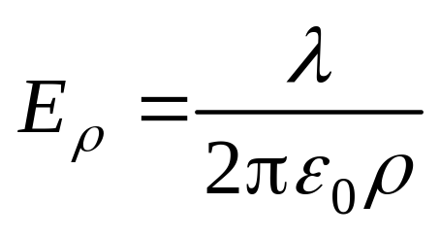
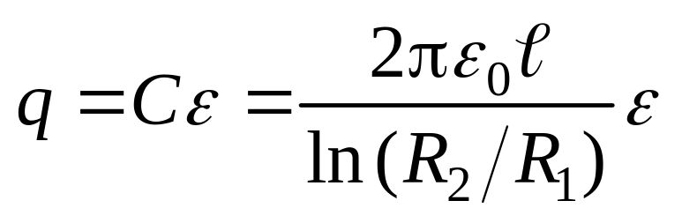
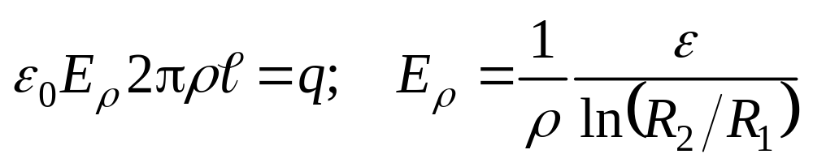
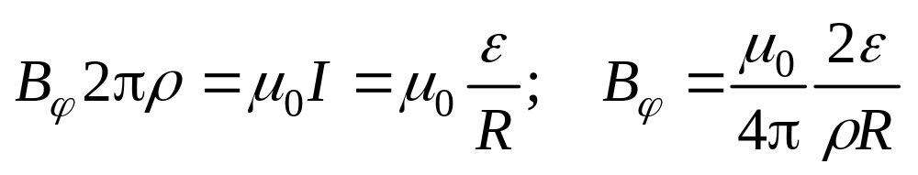
Problem 20.4
p16.4
(a)
Notes:
20.4. A coaxial cable (inner radius R1, outer radius R2 ) is used as a transmission line between a battery e and resistor R, as shown in the figure. (a) Calculate E, B for R1 < r < R2, (b) Calculate the Poynting vector for R1 < r < R2. (c) By suitably integrating the Poynting vector, show that the total power flowing across the annular cross section R1 < r < R2 is e 2/R. Is this reasonable?

Slide 8
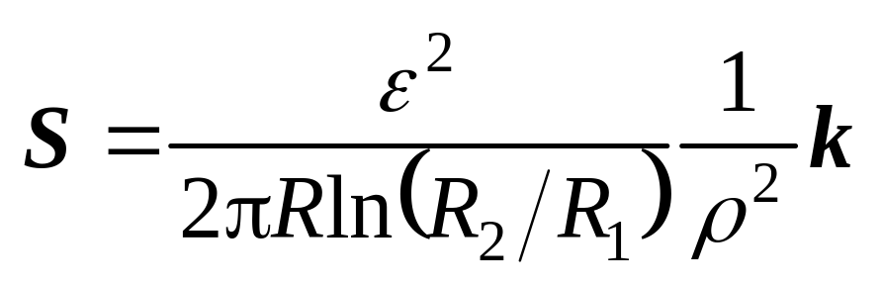
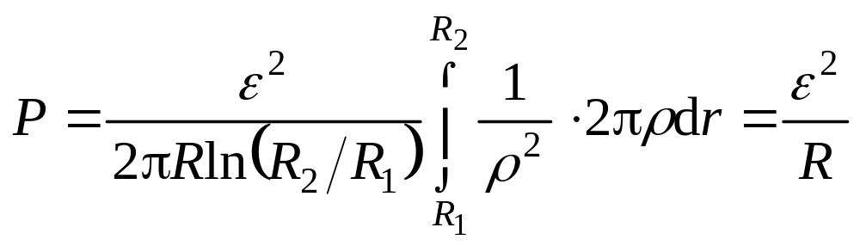
(b)
(c)
reasonable

Slide 9
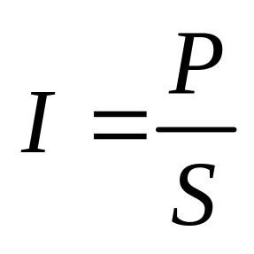
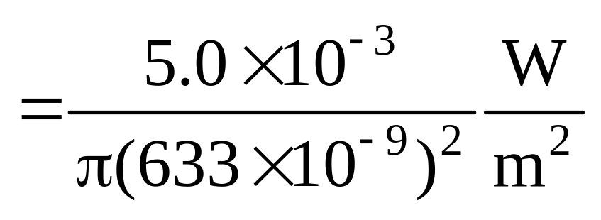
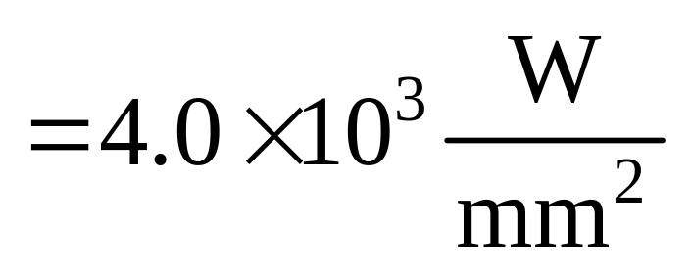
Problem 20.7
(a)
Notes:
20.7. For a He-Ne laser of wavelength 633 nm, power 5.0mW, effective diameter of beam 2.0 wavelengths, find (a) beam intensity, (b) the radiation pressure on a sphere of same diameter and of ideal absorption. (c) the force acting on the sphere. Assume the density of the sphere is 5.0 × 103 kg /m3.

Slide 10
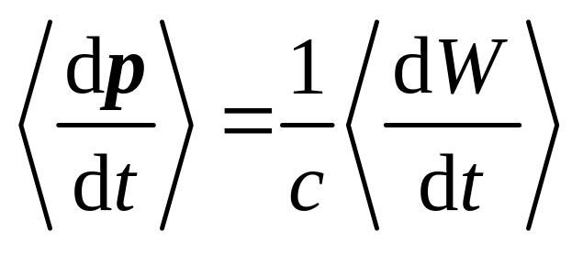
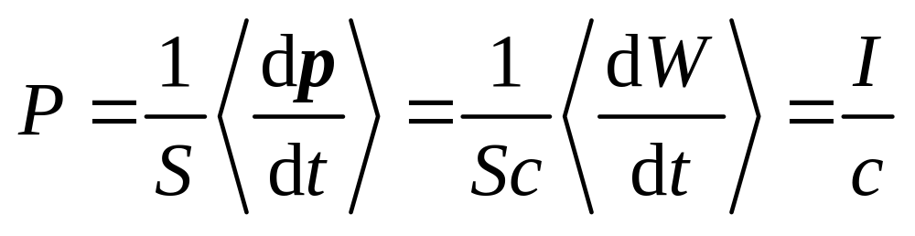
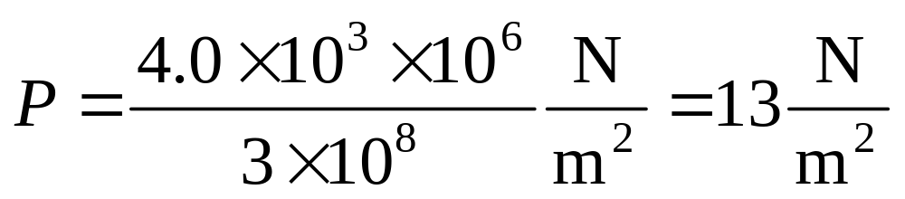
(b) For complete absorption and normal incident, the momentum change rate is
The radiation pressure is

Slide 11
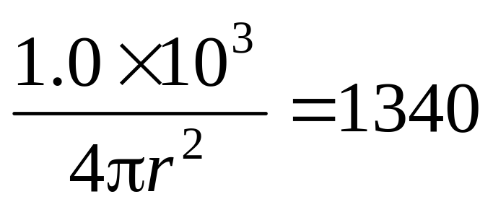
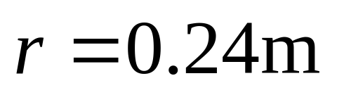
Problem 21.1

Slide 12
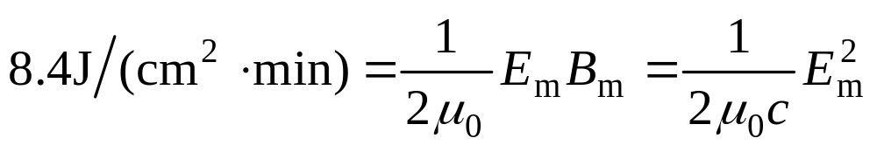
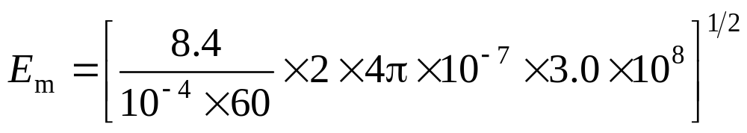
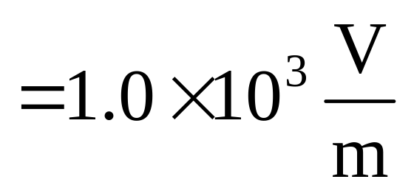
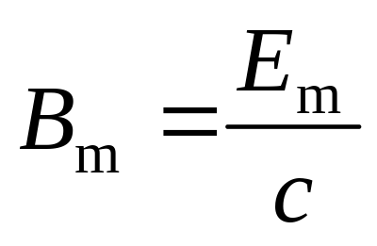
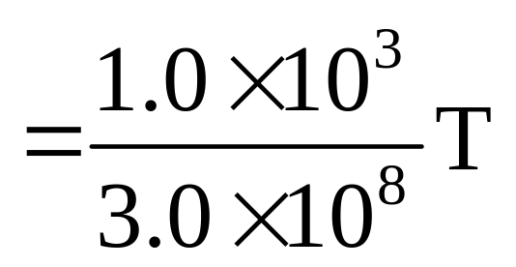
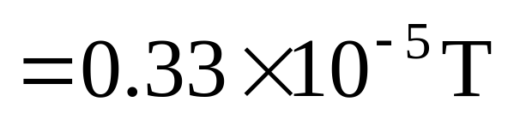
Problem 21.2

Slide 13
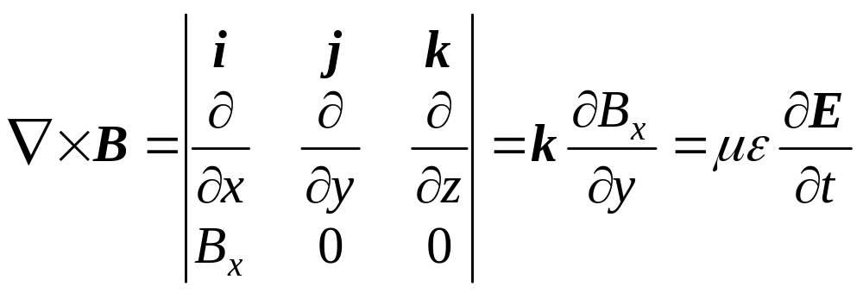
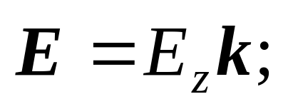
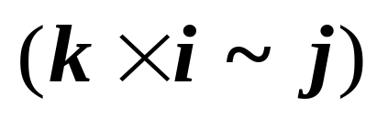
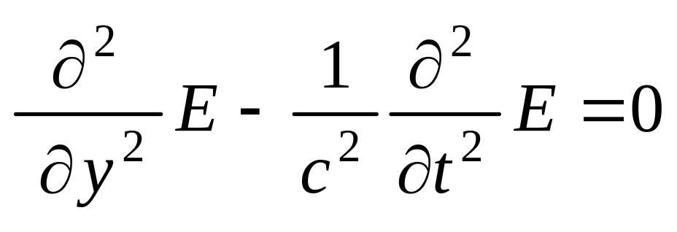
B_{x} = B sin(ky +ω t)
Problem 21.4
(a)
So the direction of propagation is y
(b)

