Slide 1
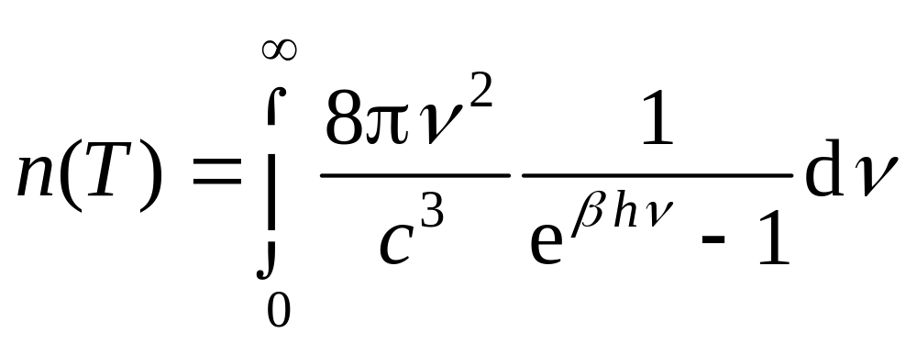
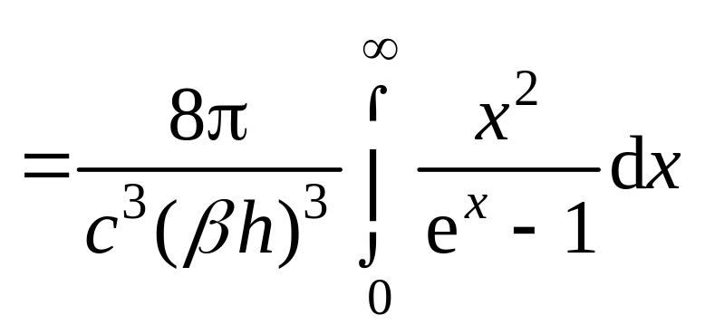
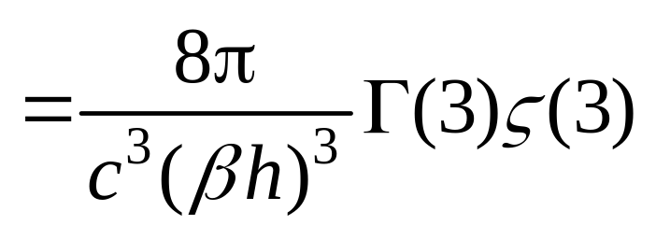
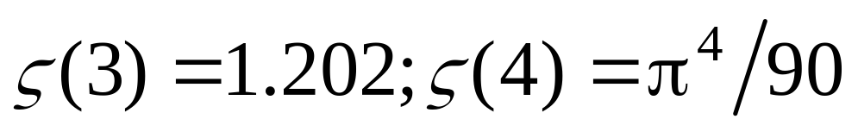
Problem 22.1
Appendix J
Notes:
22.1. The cosmic microwave background radiation proves a Planck spectrum of temperature 2.7 K. Calculate the density of photons and energy.

Slide 2
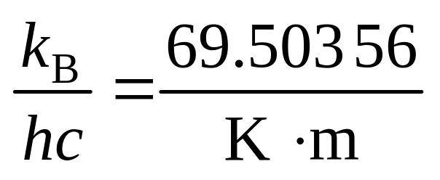
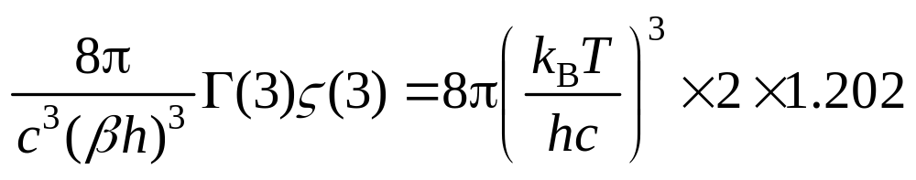
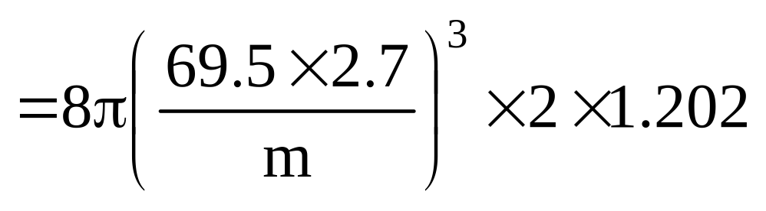
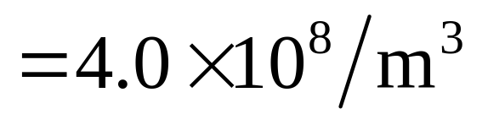
For T = 2.7K

Slide 3
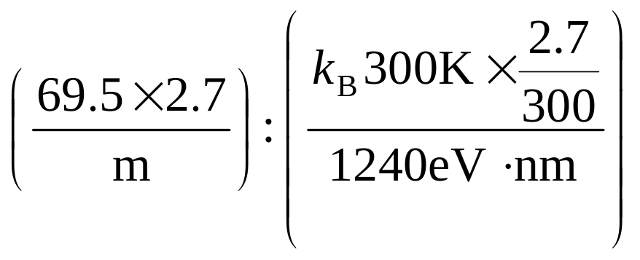
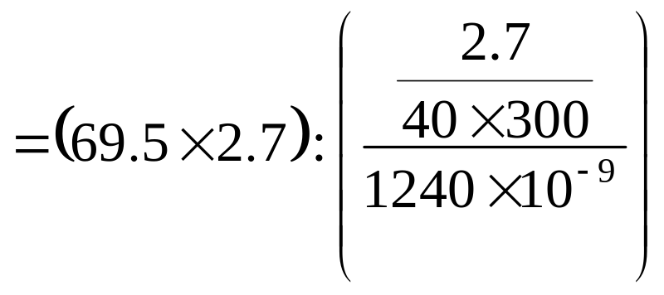
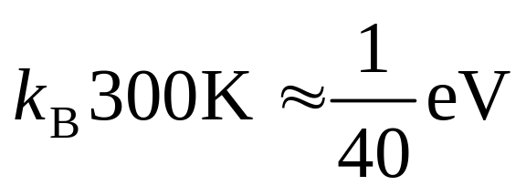
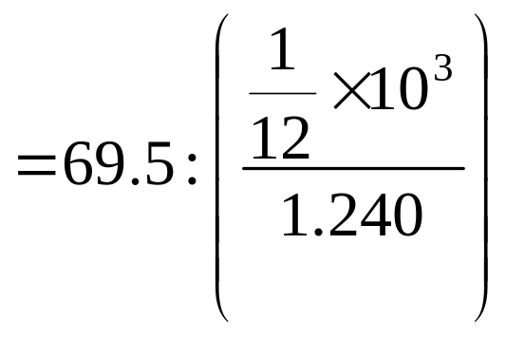

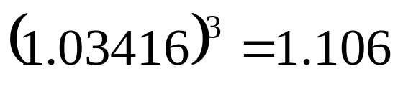

Slide 4
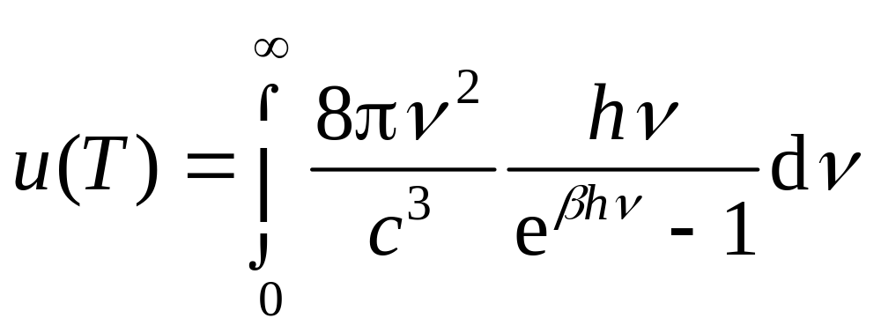
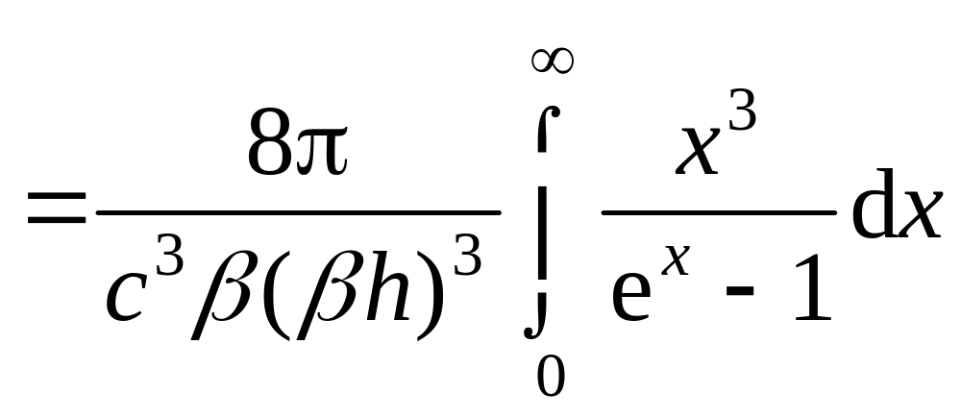
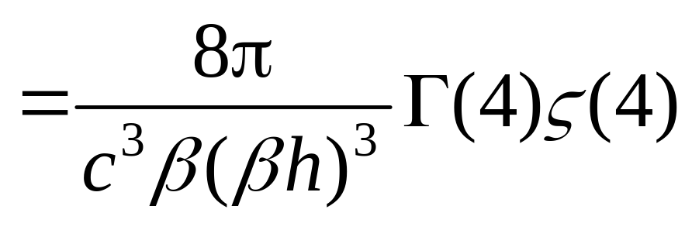
hν

Slide 5
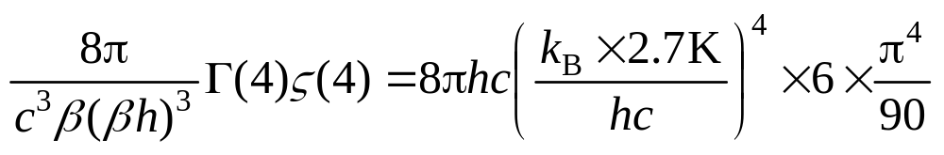
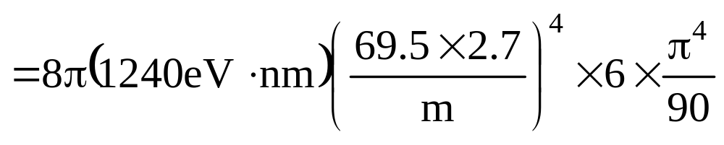
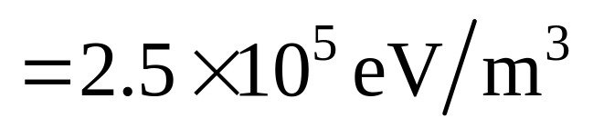

Slide 6
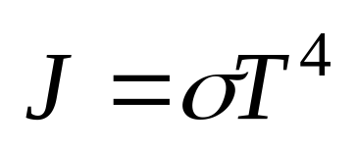
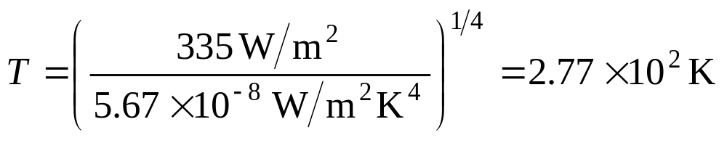
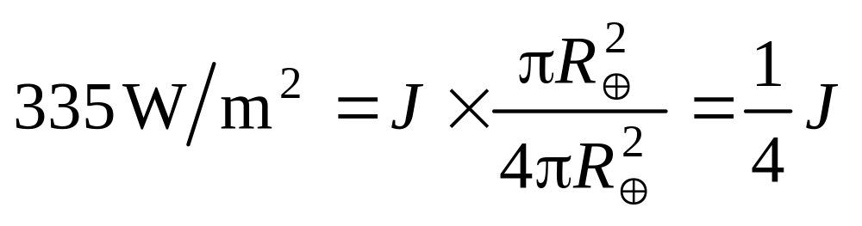
Problem 22.4(a)
(b)
Notes:
22.4. Average over the earth’s surface, the rate per unit area at which solar radiation falls on the earth (measured above the atmosphere) is 335 W/m 2. (a) Consider the earth is a blackbody radiating energy into space at this same rate. What surface temperature would the earth have under these circumstances? (b) How does the average rate given above differ from the solar constant.

Slide 7
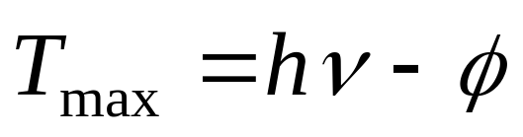
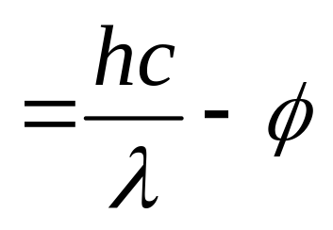
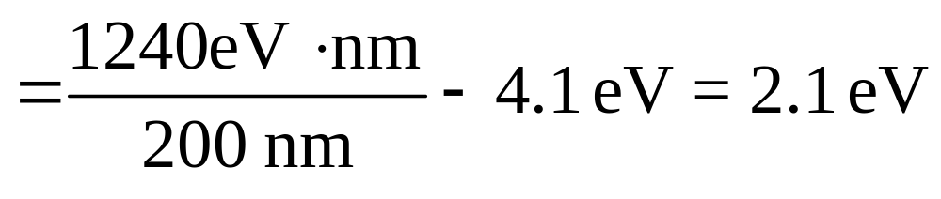
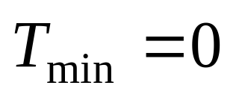
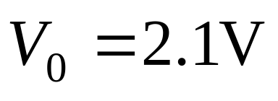
Problem 22.5(a)
(b)
Notes:
22.5. Light of wavelength 200 nm falls on aluminum surface. In metallic aluminum 4.1eV are required to remove an electron. (a) What are the kinetic energy of the fastest and the slowest emitted photoelectrons? (b) What is the stopping potential for this wavelength? (c) What is the cutoff wavelength for aluminum? (d) If the intensity of the incident light is 2.0 W/m 2, what is the average rate per unit area at which photons strike the aluminum surface?

Slide 8
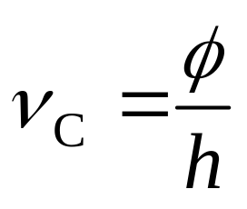
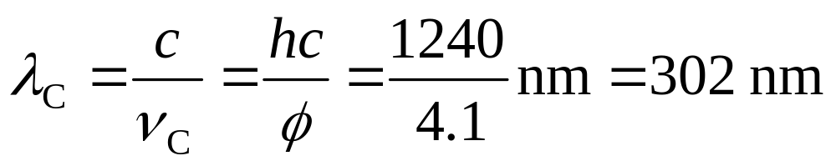
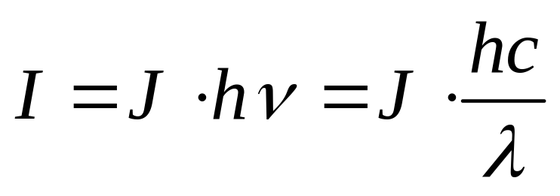
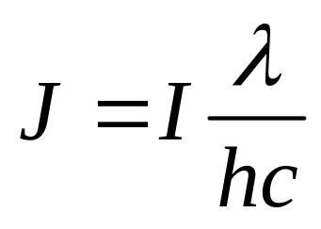
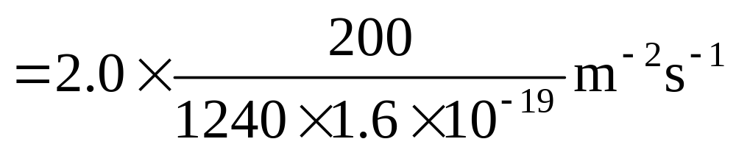
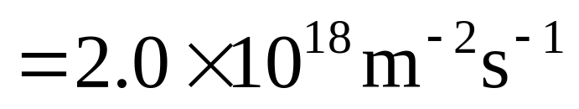
(c)
(d)

Slide 9
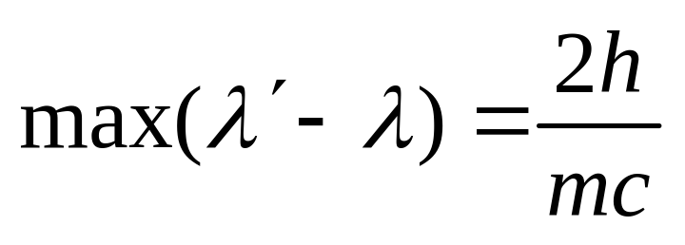
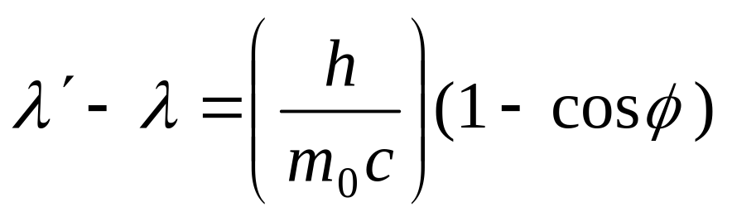
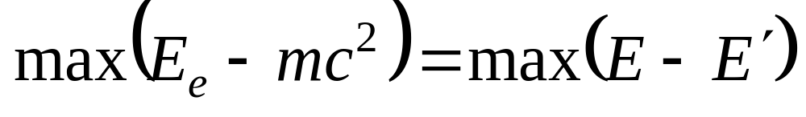
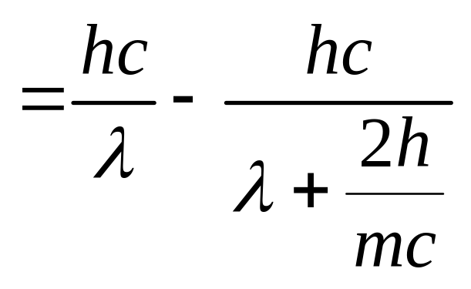
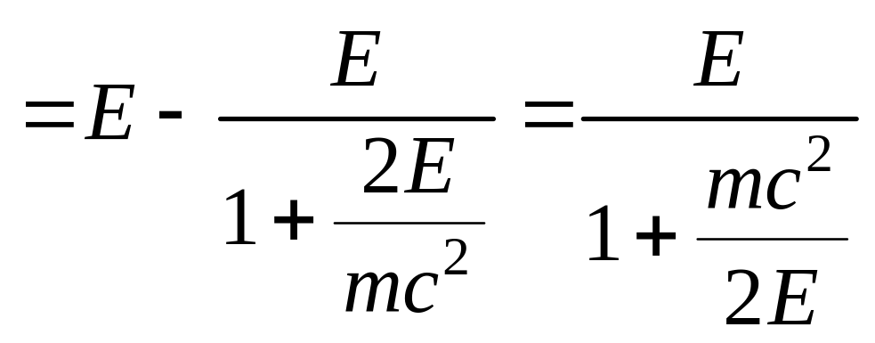
Problem 22.9
One way:
Notes:
22.9. In Compton scattering, calculate the maximum kinetic energy given to the scattered electron for a given photon energy.

Slide 10
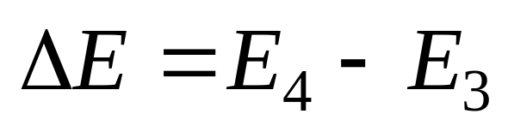
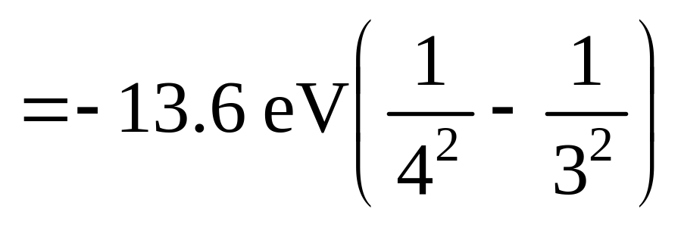
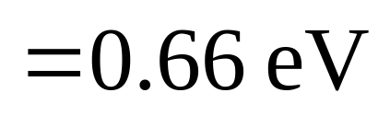
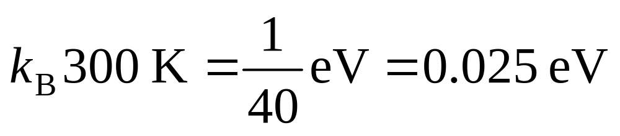
Problem 22.12
Notes:
22.12. What energy is required to excite a hydrogen atom from the state with n = 3 to the state with n = 4 ? Is this greater or less than a typical energy of thermal motion for atoms in a gas at room temperature?

Slide 11
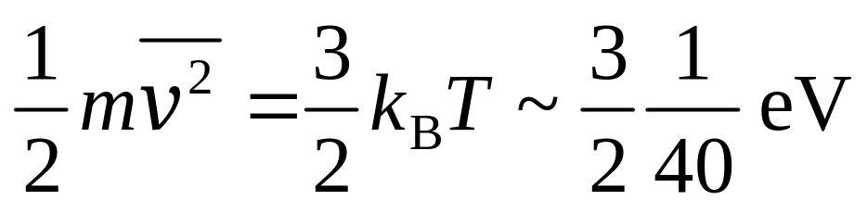
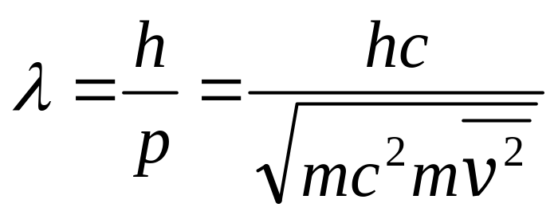
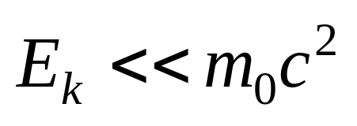
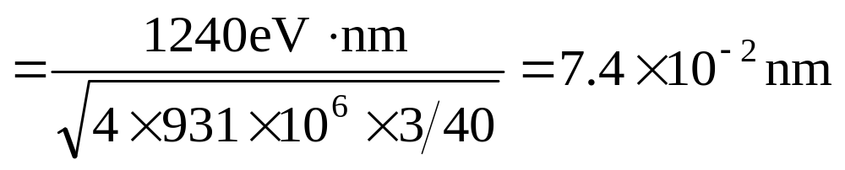
Problem 23.6
The molar volume at STP is
V_{m}= 22.4×10^{–3}m³/mol.
Notes:
23.6. Consider a balloon filled with helium gas at room temperature and pressure. (a) Calculate the average de Broglie wavelength of the helium atoms and the average distance between atoms under these conditions. (b) Can the molecules be treated as particles under these conditions?

Slide 12
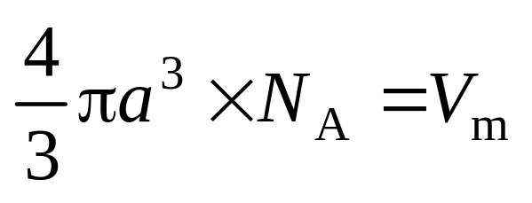
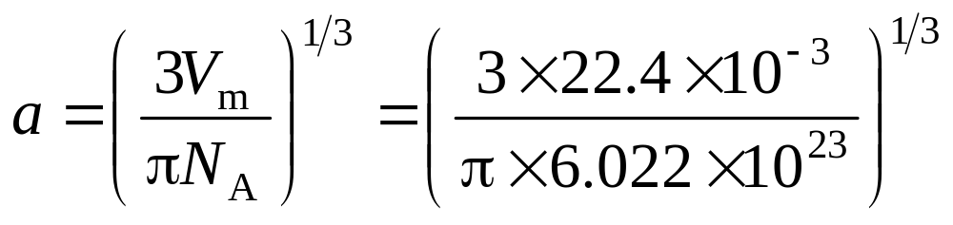
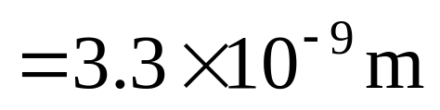
If average spacing is a.
So the wavelength is about 2% of the spacing. Fairly the helium atoms can be treated as particles

Slide 13
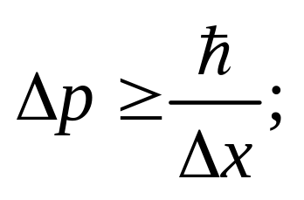



Problem 23.8
In a spherical region of diameter 1m, uncertainty in x, Δx, is 1m
It is quite smaller than daily speed.
Notes:
23.8. A proton is known to be located within a spherical region of diameter 1m. Estimate the minimum speed of the proton that is consistent with its localization within this region.

Slide 14




Known |ψ |² = c,
the normali-zation requires
Problem 24.3
while
Notes:
24.3. A particle has an equal probability to be anywhere within the interval 0 ≤ x ≤ a and a zero probability to be outside this interval. (a) Find ⟨x⟩ the mean value of the particle’s position. , (b) Find Dx, the uncertainty of its position.

Slide 15


(b) For symmetric coordinates, the solutions of Schrödinger equation are divided as two groups:
Problem 24.4
So the quantum number is n = 1.
Notes:
24.4. The wave function of a particle in a one-dimensional box is Acos(pix/a)…
(a) Sketch a graph of this wave function, (b) what is the quantum number n of the particle in this state?
(c) Show that the uncertainty of the position of the particle is

Slide 16



(c)
(odd function)
So

