Slide 1
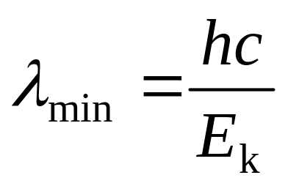
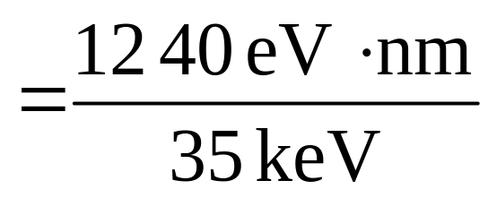
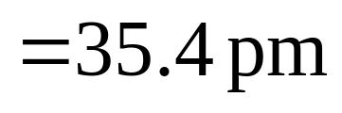
Problem 25.10

Slide 2
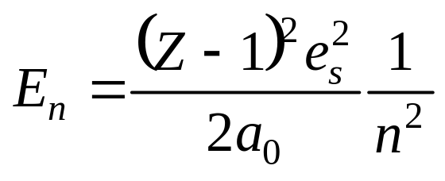
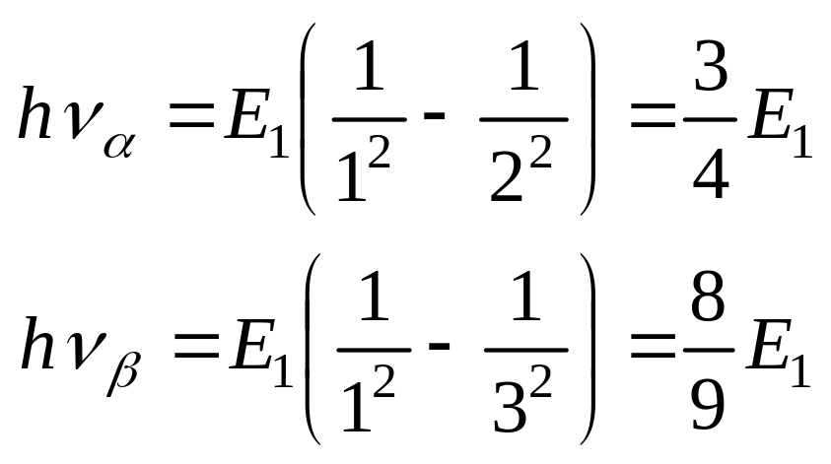
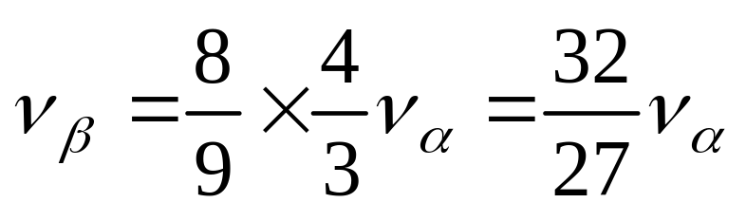
Problem 25.11
For x-ray energy levels:
For K_{α}, K_{β}, the frequencies are respectively
So

Slide 3
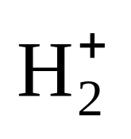
Problem 26.1
For hydrogen molecule, the binding energy is
the binding energy of H₂⁺ is 2.7eV
4.5eV
H₂
H + H
2.7eV
e +
13.6eV
p + H
+ e
H + H
?

Slide 4
4.5 = x + 2.7 – 13.6
x = 4.5 – 2.7 +13.6 = 1.8 +13.6 = 15.4

Slide 5
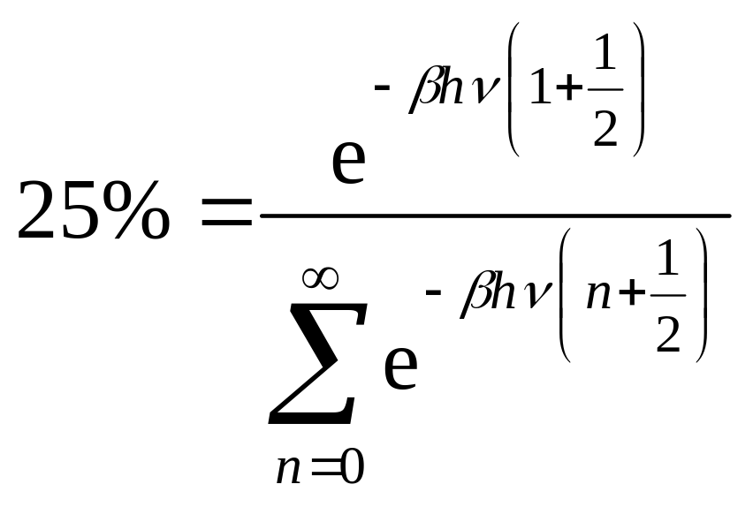
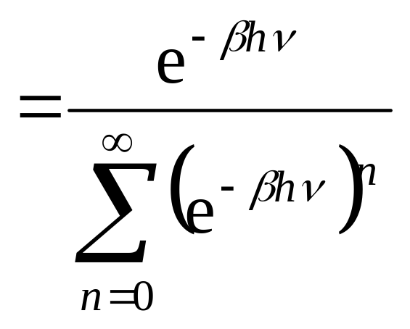
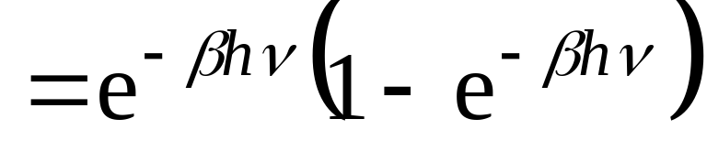
Problem 26.9
25% HCl in 1st excited state.

Slide 6
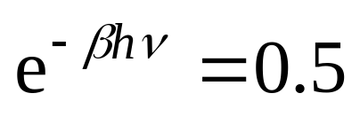
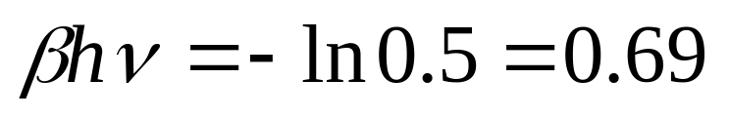
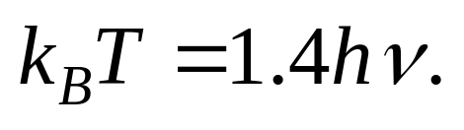
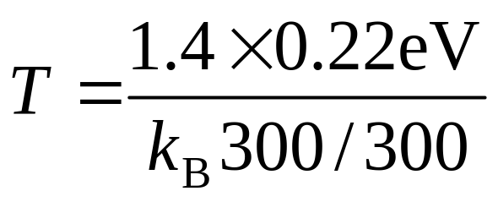
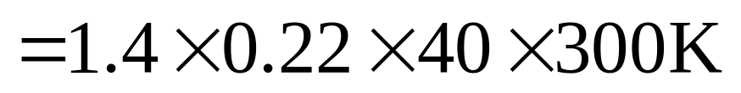
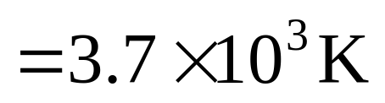

Slide 7
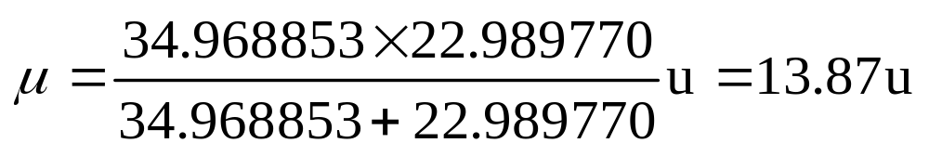
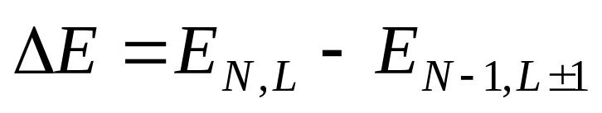
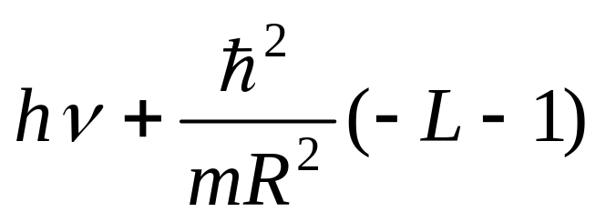
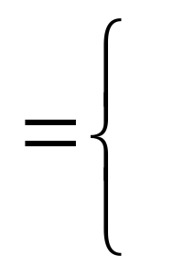
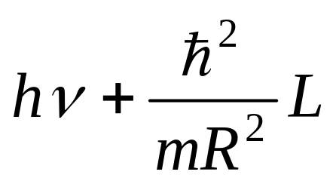
Problem 26.11
(a) The reduced mass is
(b)Transition of rotational-vibrational spectrum (for emission) r₀ = 0.236nm, hν = 0.063eV

Slide 8
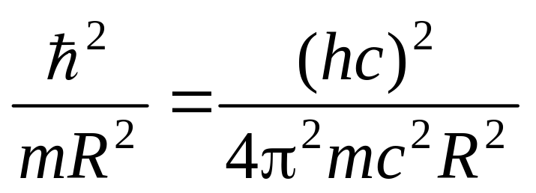
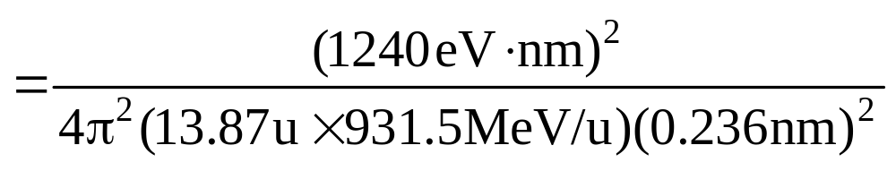
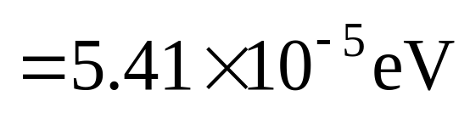

Slide 9
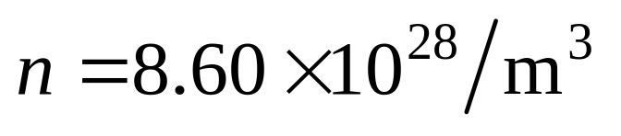
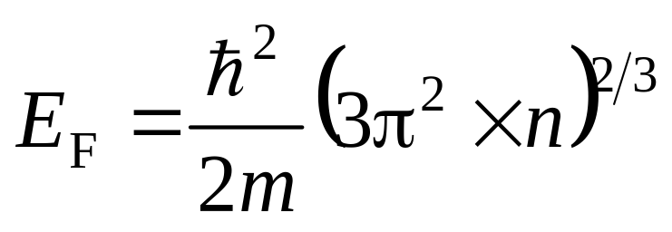
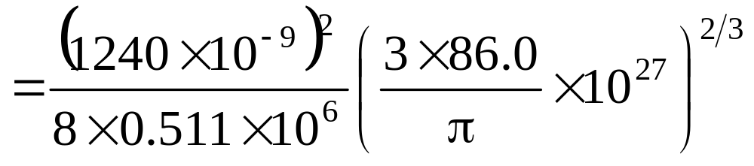
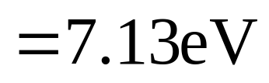
Problem 27.2
( not given!)

Slide 10
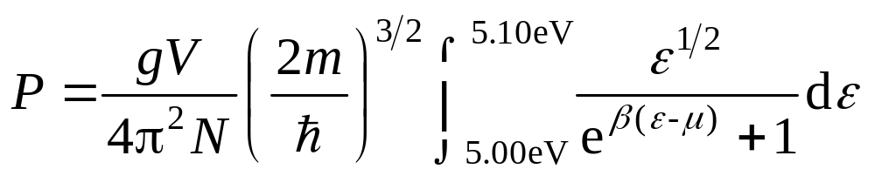
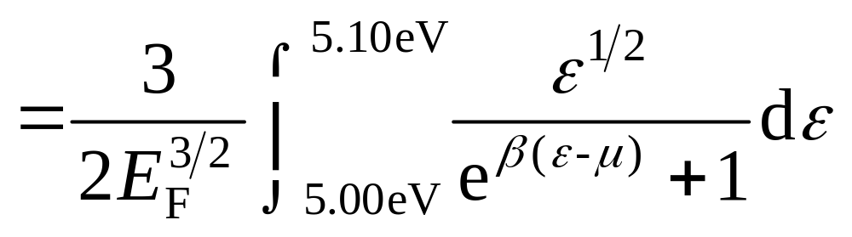
E_{F} = 3.00eV, Find the probability of energy between 5.00eV to 5.10eV for T = 295K, 2500K
Problem 27.4

Slide 11
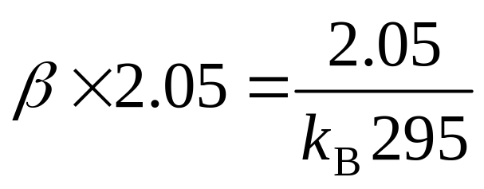
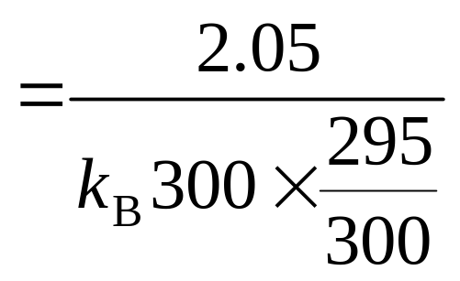
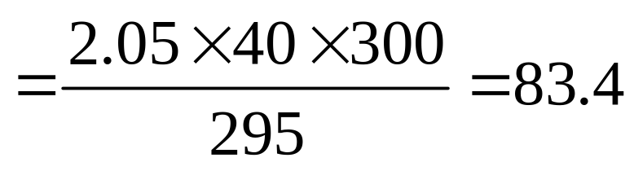
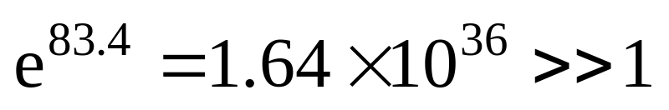
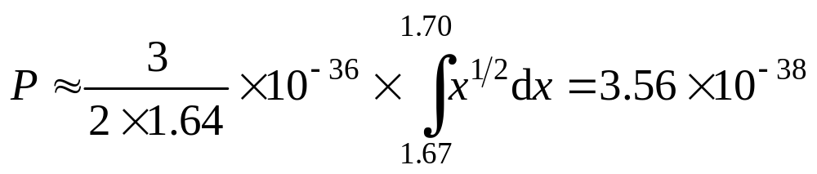
For 295K

Slide 12
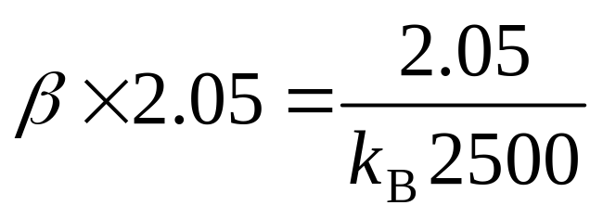
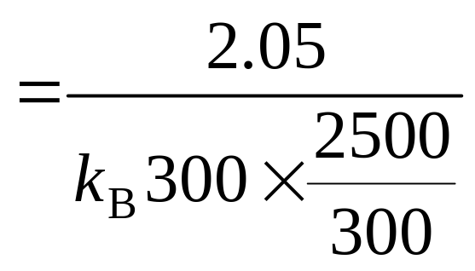
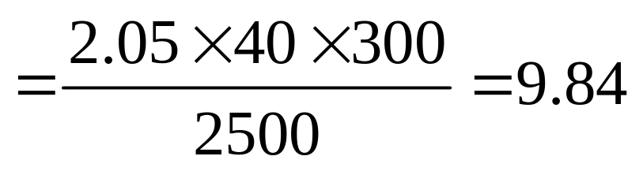
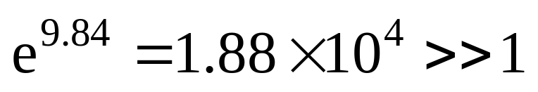
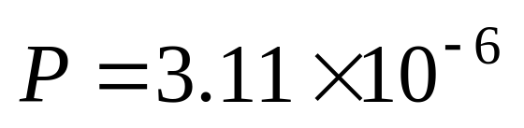
For 2500K

Slide 13
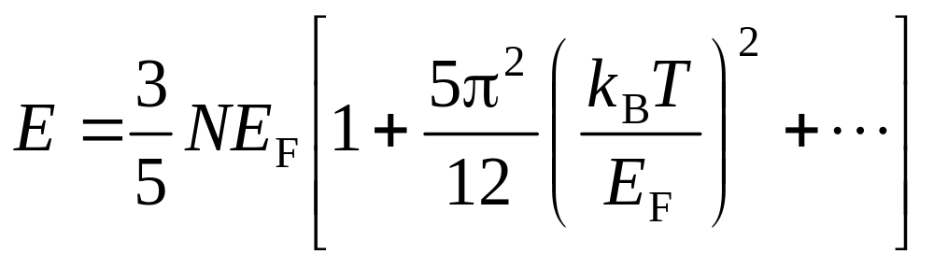
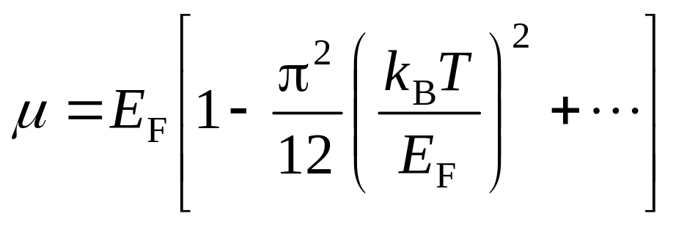
Better results are 4.37×10^{–36} and 6.00×10^{–6}.
Sommerfeld expansion may be appealed

Slide 14
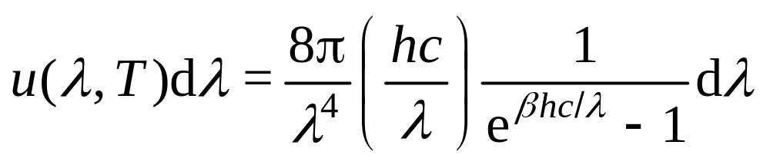
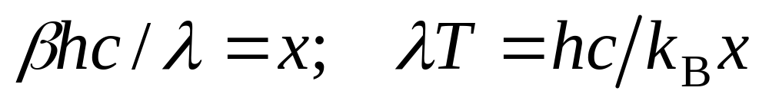
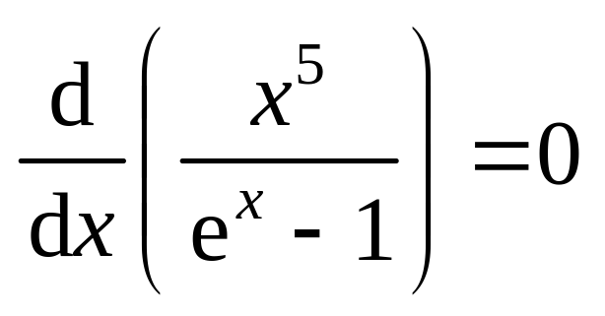
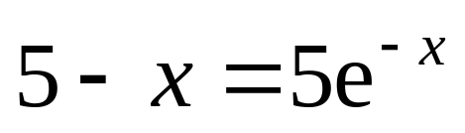
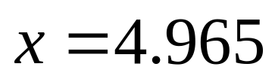
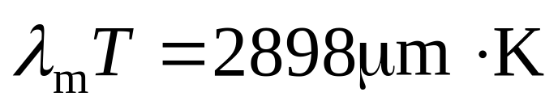
Problem 27.10
Eq.(22.1.11)
Set

Slide 15
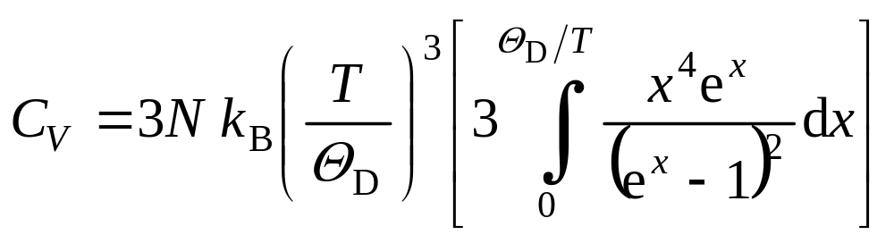
Problem 27.14
Set Θ /T = x → 0 for high temperature. Repeat use of L’Hospital rule will yield

Slide 16
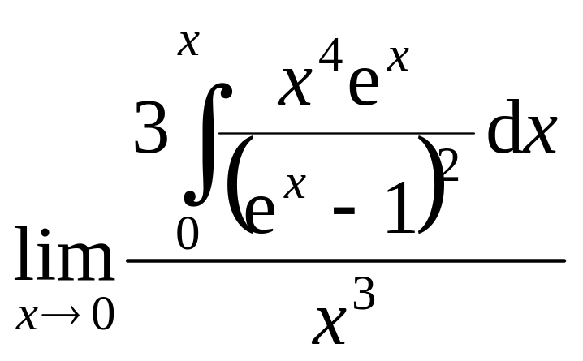



So C →3R.

Slide 17




Problem 28.2
After 1st step, we get 3 triangles(8 squares), each has a area of 1/4=(1/2)² [1/9=(1/3)^{2]}

Slide 18



Problem 28.3
After 1st step, we get we get 20 cubes, each has a volume of 1/27=(1/3)³

Slide 19



Problem 28.7(a) (b)
(a)

Slide 20




(b)
Replace W in Eq.(28.4.3) with U_{max} and we have (no quantum tunneling considered):

