Slide 1

Notes:
Today I am going to talk about notability

Slide 2
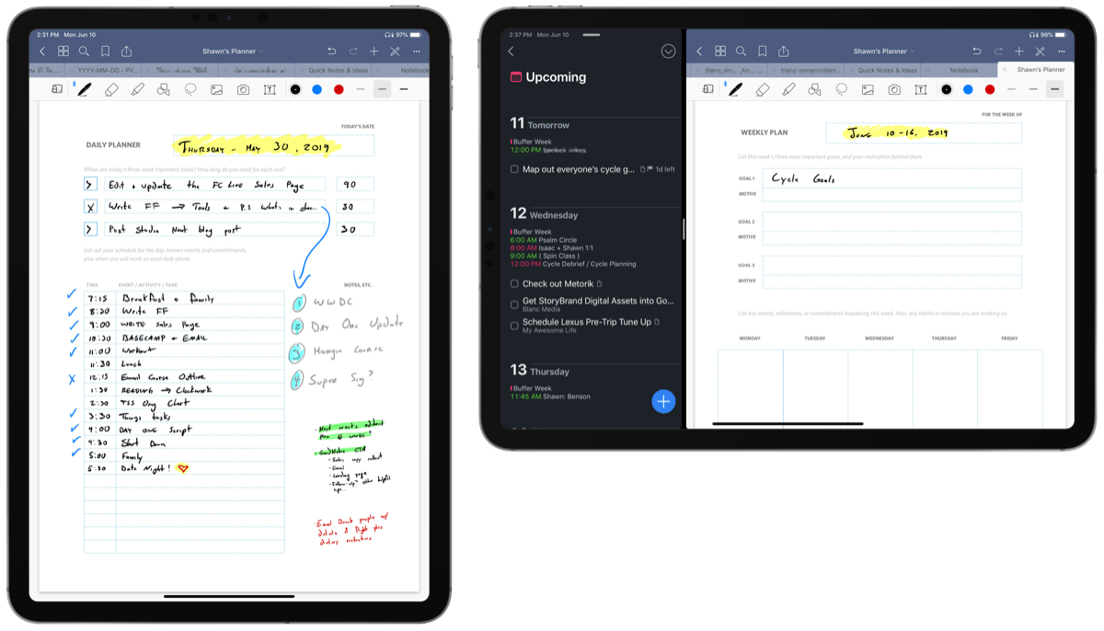
Abstraction
Modularity
States
Notes:
I am going to discuss notability in the following concepts: Abstraction, modularity, states.

Slide 3
Abstraction
Simplifying key features to understand what is going on in a system
Notes:
So What is abstraction?
An abstraction is a simplifying key feature to understand what is going on in a system, not in detail but to provide you an overall observation of the program.

Slide 4
What Is NOTABILITY?
App
Information recording software
Note taking
Note sharing
Mainstream OS
Mac OS
Windows
Linux
ARM based OS
iOS
Android
Notes:
Notability, an application allows you to record formats like photo, drawing, text, handwriting and voice recording to create notes. You can note-taking and share through cross platforms like MAC, Windows, Linux and ARM-based iOS and Android.

Slide 5
Abstraction Data Representation
Store:
.note
Export:
.PDF
.RTF
.Note
.DOC
.PPT
.XLS
Notes:
When creating a note, the information is stored in .note format. A .note format is a format that Notability has created to store information resources. User can export the information to other formats like .PDF, .RTF, .DOC, .PPT, and .XLS for their own intentional purposes. (Importing, Exporting, and Sharing Notes (Mac), 2019) Although, it seems that the data is store digitally but they are stored physically on a hard drive can be locally and/or remotely somewhere in a database. The advantage of storing data on a hard drive rather on paper because it can be space-efficient, last longer and cost-efficient.

Slide 6
Modularity
Modularity is about creating systems that are made up of simple modules that interact with each other。

Slide 7
Modularity
Importing Notes
Notability can import PDF, RTF, Note, DOC, PPT, and XLS files.
Drag-and-drop a file into your note list or a subject to make a new note for that file.
Drag-and-drop a PDF onto an open note to add the PDF to the end of the note.
Click "File > Import" at the top of your Mac's screen and select the files you'd like to import. The files will be added to the currently selected subject.
Exporting Notes
To export a single note:
Click the thumbnail of the note you'd like to export.
Click "File > Export" at the top of your Mac's screen.
Click PDF, ZIP (PDF + Recording), RTF, or Note.
Zip files can be unzipped to access audio recordings.
Note format files can only be read by Notability.
Select a destination folder for your note.
Notes:
https://support.gingerlabs.com/hc/en-us/categories/200300917-Notability-for-Mac
module

Slide 8
Data Flow management and
synchronization
Server
Respond connection to client.
Establish a secure connection back to client
Server
Stores the data.
(Client)
Creating .note files,
Exporting to Dropbox in native format
(Client)
Importing/uploading .note files,
With graphic .pdf and audio .m4a,
Identifying, renaming, sorting information
Notes:
Reference: https://www.slideshare.net/uladzimir/notability-data-management-paddatamgmt
https://blog.51cto.com/yuanbin/107672
In Notability the backup module is very simple and it happens without user’s consent once it’s being correctly set up. To set up is very simple and all the user need to do is enter the notability setting and backup function and login with their iCloud storage account like google drive.
First, the client (user) create a note, the data is being stored as .note format which contains all the information whether is graphics, pdf, audio. These data are first stored locally on that machine. machine and can be accessed locally. However, for the client to be able to manage information across multiple devices the Client will need to use the backup function to back up and “Cloud storing” the date on network machine whether is local land or over the internet. To connect the storage machine, it uses TCP connection. Client send a request to the server to saying “hi I want to connected with you so I can store information on you” but to do so they need to establish a connection so they send a SYN to the server. Once the server received a request it respond it back to the client with a SYN ACK and at last the client respond it back to the server with ACK saying “Hi we are successfully connected”. This is a typical 3 way “handshake”. However, If the server requires a user name and password there will be further handshakes to be made to establish a much more secure tunnel.
After establish connection with the server data can be transferred between the client and the server. (Access control user privilege) To access and edit the data on the server, client can download the file and edit it on local machine. This means files that are on the sever does not get edited directly by client. After the client complete the changes to the data/file, file gets upload back to the server and the file that’s been downloaded and edited will get replaced.
The benefit of this data flow is that it can save storages on the local client and because the data is store on cloud it can be access by multiple clients at the same time as long as they have connection to the server.

Slide 9
States
It is a temporary configuration of a computer system that affects how it responds to interaction.
Notes:
It is a temporary configuration of a computer system that affects how it responds to interaction.

Slide 10
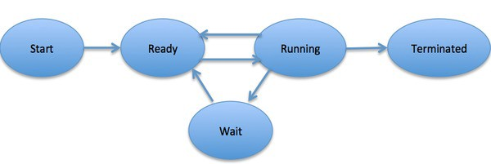
States: Launching app
Process states:
Notes:
https://medium.com/cracking-the-data-science-interview/how-operating-systems-work-10-concepts-you-should-know-as-a-developer-8d63bb38331f
Process states when a process executes. It passes through different states. These states maybe differ in different OS and named differently but there are 5 general states from start, ready, running, wait and terminate, among them ready, within these stages ready, running and wait can be cycled multiple times if needed.
Start: The initial state when a process is first started/created.
Ready: The process is waiting to be assigned to a processor. Ready processes are waiting to have the processor allocated to them by the operating system so that they can run. A process may come into this state after the Start state, or while running it by but getting interrupted by the scheduler to assign CPU to some other process.
Running: Once the process has been assigned to a processor by the OS scheduler, the process state is set to running and the processor executes its instructions.
Waiting: the process moves into the waiting state if it needs to wait for a resource, such as waiting for user input, or waiting for a file to become available.
Terminated or Exit: Once the process finishes its execution, or it is terminated by the operating system, it is moved to the terminated state where it waits to be removed from main memory.

Slide 11
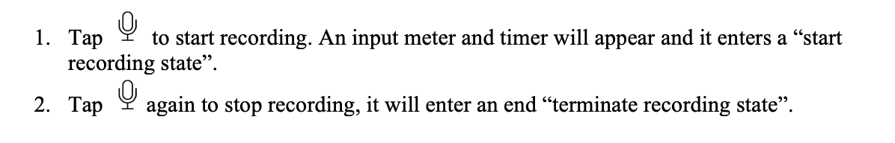
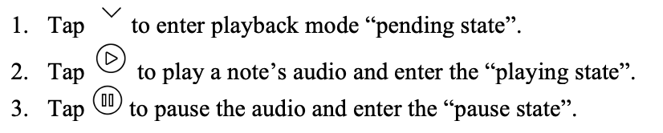
States: recording and playback
Example: Recording Audio
Example: playing Audio

Slide 12
References:
https://medium.com/cracking-the-data-science-interview/how-operating-systems-work-10-concepts-you-should-know-as-a-developer-8d63bb38331f
https://blog.51cto.com/yuanbin/107672
https://www.slideshare.net/uladzimir/notability-data-management-paddatamgmt
https://support.gingerlabs.com/hc/en-us/categories/200300917-Notability-for-Mac

Slide 13
Thanks

