Slide 1
Analysis of CDFI Lending in the Single-Family Mortgage Market:
To Whom Are CDFIs Lending? Who Benefits? What are the Products Offered? Who are the Investors? What is Next?
October 2024
Kara Ward, Shareholder
Baker Donelson, Bearman, Caldwell & Berkowitz, PC
Jiaqin Wu,
Graduate Student,
Georgetown University

Slide 2
CDFI’s are categorically exempt from the CFPB’s “Qualified Mortgage Rule” (QM)
QM Rules govern all other single-family mortgages and restrict product and pricing/underwriting abuses
Product exclusions: Negative amortization, +30 years, Pts and Fees > 3%
Underwriting: Fully documented, debt-to-income determined, balloon loan increases accounted
May not exceed typical interest rate by more than 2.25%
QM Rules + Bank Capital Requirements Shifted mortgage lending to non-banks (“IMBs” or “Loan Funds”) in the mainstream market.
CDFI Fund recent instituted threshold guidelines for “Responsible Lending”
The value of the QM Exemption to CDFIs = ~80bps
CDFI Fund Guidelines
Responsible Lending Overview

Slide 3
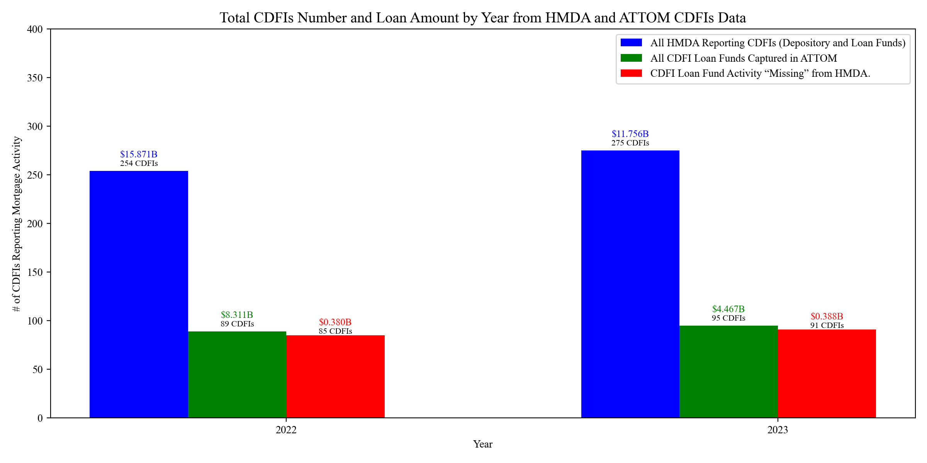
Who Are the CDFIs in the Mortgage Market
Single family, first lien, purchase, owner-occupied, principal residence, $3MM-$70k
Home Mortgage Disclosure Act (HMDA) captured Depositories, but not (many) Loan Funds
“Missing” mortgages in national HMDA analysis = 85-90 CDFIs
More Loans made by Depositories than Loan Funds
Scale is important- high concentration of loans in a few players.

Slide 4
Credit Unions Outperform Peers
2022 CDFI Single-Family Mortgage Lending Data
182 Credit Unions | 25,957 loans
88 Loan Funds | 20,476 loans
68 Banks | 15,510 Loans
2023 CDFI Single-Family Mortgage Lending Data
190 Credit Unions | 22,854 loans
94 Loan Funds | 10,563 loans
82 Banks | 8,137 loans
More Credit Unions are Making More Loans than their Bank Peers
~82% of all Depositories are offering mortgages vs ~17% of the Loan Funds.
The typical Depository CDFI is doing about 94 loans/year (2023) vs. Loan Funds doing about 12 loans/year
Very Large players dominate the Loan Fund space – dispersion is significant.
Year | CDFI | Number of Loans | CDFI Headquarter State | Average Loan Size | Bank, Credit Union or Loan Fund: B/C
2022 | CHANGE LENDING | 7029 | CA | $ 478,095.75 | LOAN FUND
2023 | CHANGE LENDING | 4907 | CA | $ 459,911.35 | LOAN FUND
2022 | VERIDIAN CREDIT UNION | 2705 | IA | $ 223,905.73 | B
2022 | QUONTIC BANK | 2547 | NY | $ 444,713.39 | B
2022 | LOCAL GOVERNMENT FEDERAL CREDIT UNION | 2125 | NC | $ 229,607.06 | C
2023 | VERIDIAN CREDIT UNION | 1942 | IA | $ 223,403.71 | C
2022 | ROYAL CREDIT UNION | 1845 | WI | $ 278,777.78 | C
2023 | ROYAL CREDIT UNION | 1798 | WI | $ 291,440.49 | C
2023 | SUNCOAST CREDIT UNION | 1350 | FL | $ 309,140.74 | C
2023 | LOCAL GOVERNMENT FEDERAL CREDIT UNION | 1183 | NC | $ 243,191.04 | C
2022 | SUNCOAST CREDIT UNION | 1126 | FL | $ 277,158.08 | C
2022 | COMMERCE BANK | 1066 | MS | $ 345,422.14 | B
2022 | COVANTAGE CREDIT UNION | 976 | WI | $ 164,385.25 | C
2022 | VYSTAR CREDIT UNION | 938 | FL | $ 302,249.47 | C
2023 | COMMERCE BANK | 922 | MS | $ 382,472.89 | B
2022 | DUPACO COMMUNITY CREDIT UNION | 848 | IA | $ 201,827.83 | C
2022 | EMPOWER FEDERAL CREDIT UNION | 823 | NY | $ 168,669.50 | C
2022 | BANKPLUS | 819 | MS | $ 338,565.32 | B

Slide 5
CDFI Loan Funds Serve Modest Means Borrowers
CDFI Loan Funds are Not Radically Different Single-Family Lenders than Mainstream Unless…
CDFI Loan Funds Serve Modest Means Borrowers
Year
Year | National Avg Single-Family Mortgage Size[1] | CDFI Loan Fund Average Mortgage Loan Amount
2021 | ~$409,000 | $351,556
2022 | ~$460,000 | $405,898
2023 | ~$440,000 | $422,877
Jan-May 2024 | ~$ 405000 | $427,269
[1] Source for National Data: https://tradingeconomics.com/united-states/average-mortgage-size
CDFI Loan Funds were making slightly smaller loans than the mainstream market
Assumptions:
NATIONAL Market: FTHB: 3-11% downpayment for the National Avg, 4 X household salary for “affordability”
$121,000 annual salary in 2023
CDFI Market: 3% downpayment, 5 X household income for “affordability”
$86,932 annual salary in 2023
Median household income in 2023 = $80,610.
* FTHB = First-Time Homebuyers

Slide 6
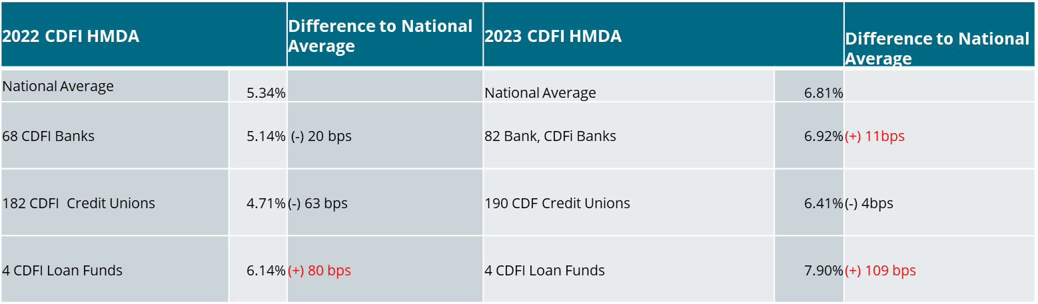
Interest Rate Comparison
CDFI Loans Funds were more expensive for consumers
CDFI Loan Funds may have higher costs of capital and more vulnerability to interest rate fluctuations than depositories.
Unknown: adjustments for credit risk
Secondary market participation (limited data)

Slide 7
Secondary Market Participation May Matter
Graph 7: CDFIs Participating in the Government-Related Secondary Market
Purchaser Type | CDFI Bank | CDFI Credit Union | CDFI Loan Fund | Total
0 - Not applicable | 2022: 8301 | 2022: 18579 | 2022: 678 | 2022: 27558
 | 2023: 3557 | 2023: 14202 | 2023: 395 | 2023: 18154
1 - Fannie Mae | 2022: 812 | 2022: 3250 | 2022: 1240 | 2022: 5302
 | 2023: 444 | 2023: 2424 | 2023: 969 | 2023: 3837
2 - Ginnie Mae | 2022: 259 | 2022: 101 | 2022: 1376 | 2022: 1736
 | 2022: 0 | 2023: 290 | 2023: 974 | 2023: 1264
3 - Freddie Mac | 2022: 166 | 2022: 410 | 2022: 644 | 2022: 1220
 | 2023: 64 | 2023: 917 | 2023: 209 | 2023: 1190
4 - Farmer Mac | 2022: 0 | 2022: 1 | 2022: 0 | 2022: 1
 | 2023: 0 | 2023: 0 | 2023: 0 | 2023: 0
5 - Private securitizer | 2022: 2 | 2022: 12 | 2022: 0 | 2022: 14
 | 2023: 2 | 2023: 25 | 2023: 0 | 2023: 27
6 - Commercial bank, savings bank, or savings association | 2022: 1740 | 2022: 942 | 2022: 81 | 2022: 2763
 | 2023: 873 | 2023: 885 | 2023: 159 | 2023: 1917
71 - Credit union, mortgage company, or finance company | 2022: 3056 | 2022: 1828 | 2022: 0 | 2022: 4884
 | 2023: 1252 | 2023: 2277 | 2023: 21 | 2023: 3550
72 - Life insurance company | 2022: 453 | 2022: 1 | 2022: 3557 | 2022: 4011
 | 2023: 6 | 2023: 1 | 2023: 2754 | 2023: 2761
8 - Affiliate institution | 2022: 13 | 2022: 131 | 2022: 0 | 2022: 144
 | 2023: 0 | 2023: 113 | 2023: 0 | 2023: 113
9 - Other type of purchaser | 2022: 708 | 2022: 702 | 2022: 0 | 2022: 1410
 | 2023: 48 | 2023: 1044 | 2023: 0 | 2023: 1092
Banks are selling their loans to other banks = CRA creditable activity
Loan Fund PLS may be underrepresented- Change Lending does not show up here.
GNMA lower than expected- only handful of FHA-lenders (7), but they are prolific.
~ 13% (2022) ~14% (2023) were purchased by GSEs = indicative of mainstream lending.

Slide 8
Check out the Dashboard!
CDFI Residential Loan Dashboard · Streamlit (cdfiloan.streamlit.app)]
https://cdfiloan.streamlit.app

Slide 9
www.bakerdonelson.com
@BakerDonelson
@Baker-Donelson
@Baker_Donelson

