Slide 1


Commuting Local Hamiltonian Problem on 2D beyond qubits
Sandy Irani (UCI) and Jiaqing Jiang (Caltech)
Arxiv: 2309.04910

Slide 2
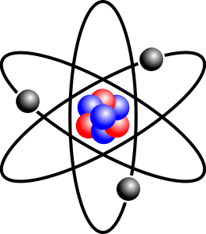

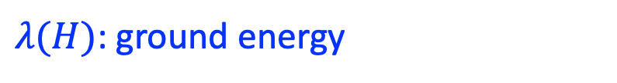
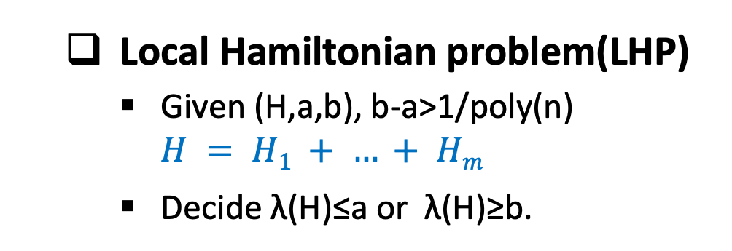

Introduction
Local Hamiltonian problem(LHP)
Given (H,a,b), b-a>1/poly(n)
$H = H1 + … + Hm$
Decide λ(H)≤a or λ(H)≥b.
Local Hamiltonian
Locally interacting many-body system
constant-qubit
$n$-qubit Hermitian
$$H = H1 + … + Hm$$
$λ(H)$: ground energy
Quantum chemistry
Condense matter physics
Interacting electrons

Slide 3
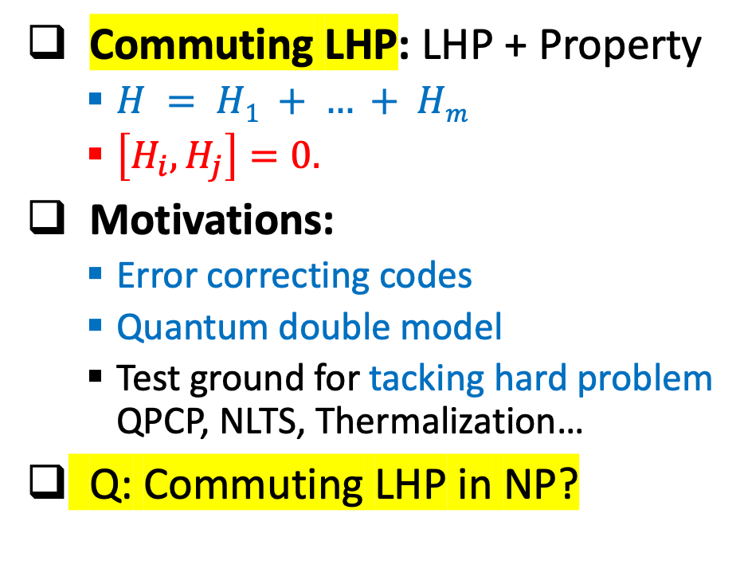
Introduction
Local Hamiltonian problem(LHP)
Given (H,a,b), b-a>1/poly(n)
$H = H1 + … + Hm$
Decide λ(H)≤a or λ(H)≥b.
Commuting LHP: LHP + Property
$H = H1 + … + Hm$
$\left[H_{i}, H_{j}\right]=0.$
Motivations:
Error correcting codes
Quantum double model
Test ground for tacking hard problem QPCP, NLTS, Thermalization…
Q: Commuting LHP in NP?
Classical
Quantum NP
Property
NP-Complete
QMA-Complete
Fundamental Question:
What makes LHP quantum?

Slide 4

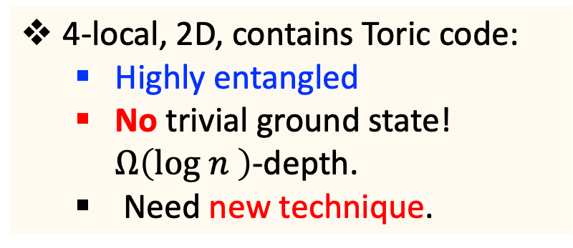
Previous results
Is CLHP “classical” & in NP?
CLHP
SAT
Q: Does CLHP always have trivial ground state & in NP?
Uncertainty principle:
Non-commuting $⇔$ Quantum
4-local, 2D, contains Toric code:
Highly entangled
No trivial ground state! $Ω\left(log n \right)$-depth.
Need new technique.
Trivial ground state: State which can be prepared by constant depth circuit.
Structure Lemma
C*-algebra
2-local, qudit
3-local, qubit
3-local, qutrit on
Nearly Euclidean graph
NP
[BV03]
[AE11]

Slide 5

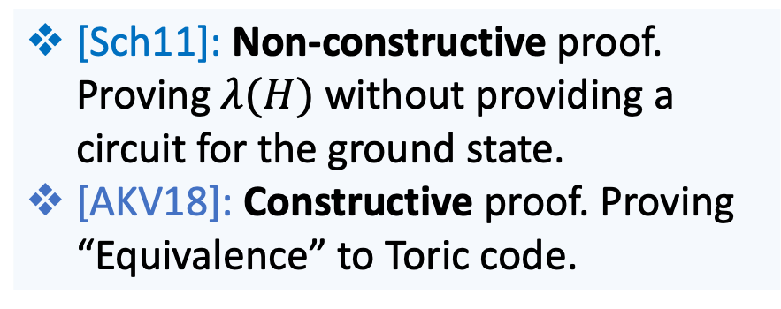


Previous results
Is CLHP “classical” & in NP?
[Sch11] [AKV18]
CLHP
SAT
4-local, 2D, qubit, NP.
Open Q: Qudit case is in NP? Constructive proof to characterize the ground space? We are here.
[Sch11]: Non-constructive proof. Proving $λ(H)$ without providing a circuit for the ground state.
[AKV18]: Constructive proof. Proving “Equivalence” to Toric code.
Trivial ground state: State which can be prepared by constant depth circuit.
Structure Lemma
C*-algebra
2-local, qudit
Others: [BV03] CLHP, any geometry
factorized + qubit $⇒$ NP, non-constructive
Open Q: qudit $⇒$ NP, constructive?
3-local, qubit
3-local, qutrit on
Nearly Euclidean graph
NP
[BV03]
[AE11]

Slide 6
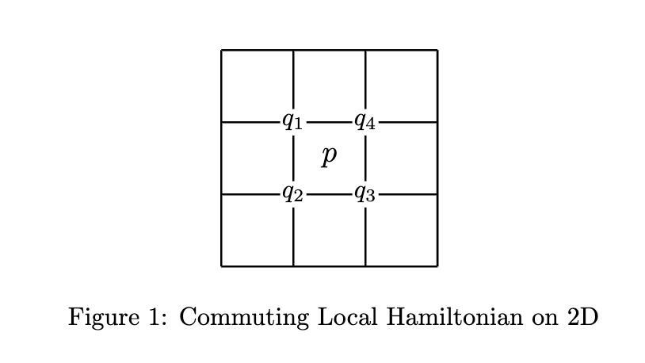
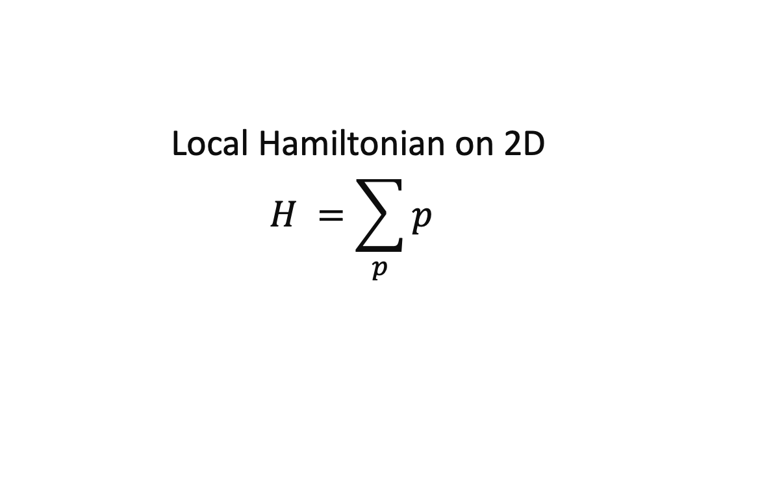
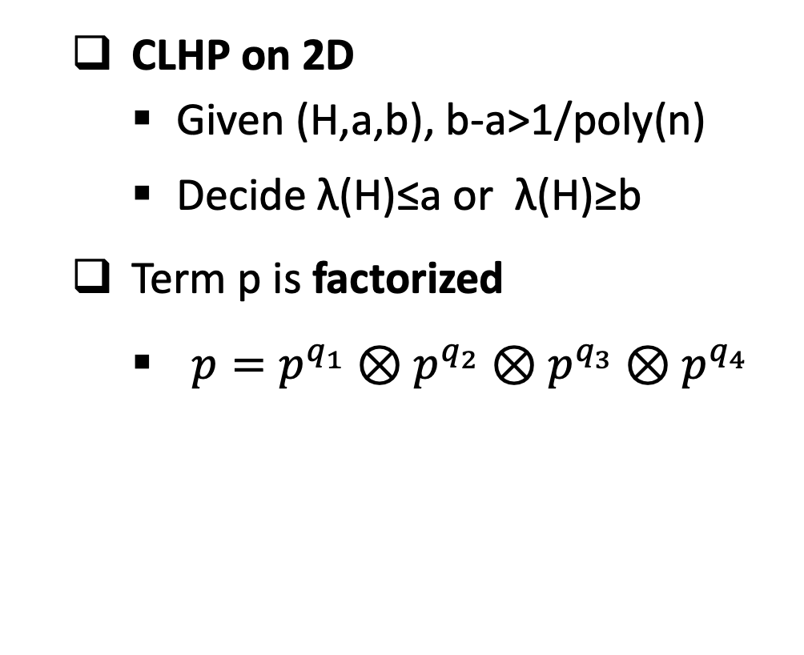
Our setting: Local Hamiltonian Problem on 2D
CLHP on 2D
Given (H,a,b), b-a>1/poly(n)
Decide λ(H)≤a or λ(H)≥b
Term p is factorized
$p=p^{q_{1}}⊗p^{q_{2}}⊗p^{q_{3}}⊗p^{q_{4}}$
qudit
Hermitian term p “plaquette”.
Local Hamiltonian on 2D
$$H =\sum_{p}{p }$$

Slide 7

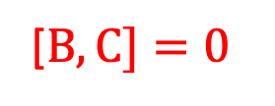
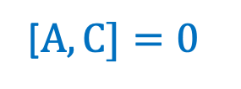
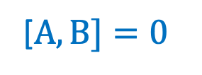
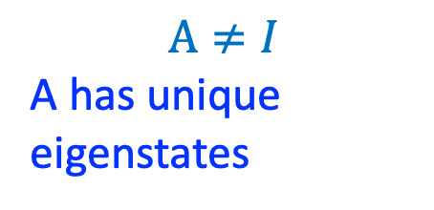
Our results for qudit-CLHP-2D
Improve [Sch11] [AKV18] from qubit to qutrit. Non-constructive.
Qutrit is very different from qubit: +1 dimension introduces degeneracy.
One intuitive example: For qubit, commuting relation is transitive.
[$A,B]=0$
B and C diagonalized in the unique eigenstates as A
$$A≠I$$
A has unique eigenstates
B
Not true for qutrit!
A
[$B,C]=0$
[$A,C]=0$
C
Our key lemma works for qudit.

Slide 8
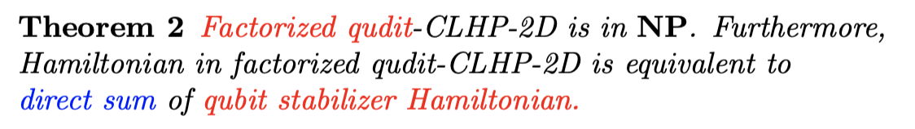

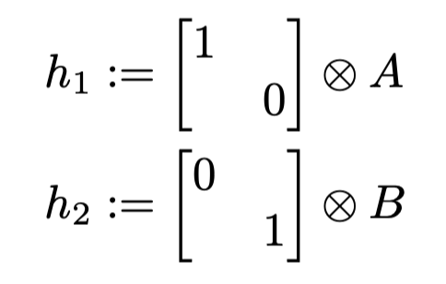
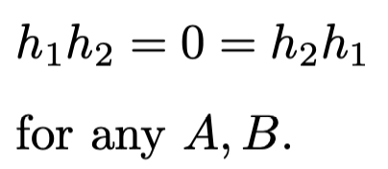
Our results for qudit-CLHP-2D
Factorized Hamiltonian can look very different from stabilizer Hamiltonian.
Stabilizer H: Regular way of commuting
Factorized H: Singular way of commuting
We prove the ground space of factorized-CLHP looks like stabilizer Hamiltonian.

Slide 9
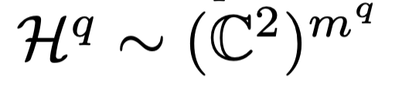
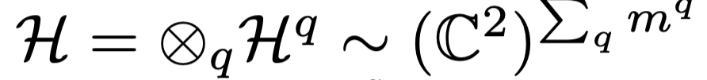

Our results for qudit-CLHP-2D
H is equivalent to qubit stabilizer Hamiltonian
H = summation of Pauli operators up to phases.
Direct sum of qubit stabilizer Hamiltonian
Notes:
(more explanation to Theorem 2, you may choose to delete this slide)

Slide 10
Our results for qudit-CLHP-2D
Previous: [BV03] factorized
Our result: factorized
Any geometry
2D geometry
One may prove non-constructively by [BV03] + [Sch11].
qubit
qudit
non-constructive
constructive
NP
NP

Slide 11

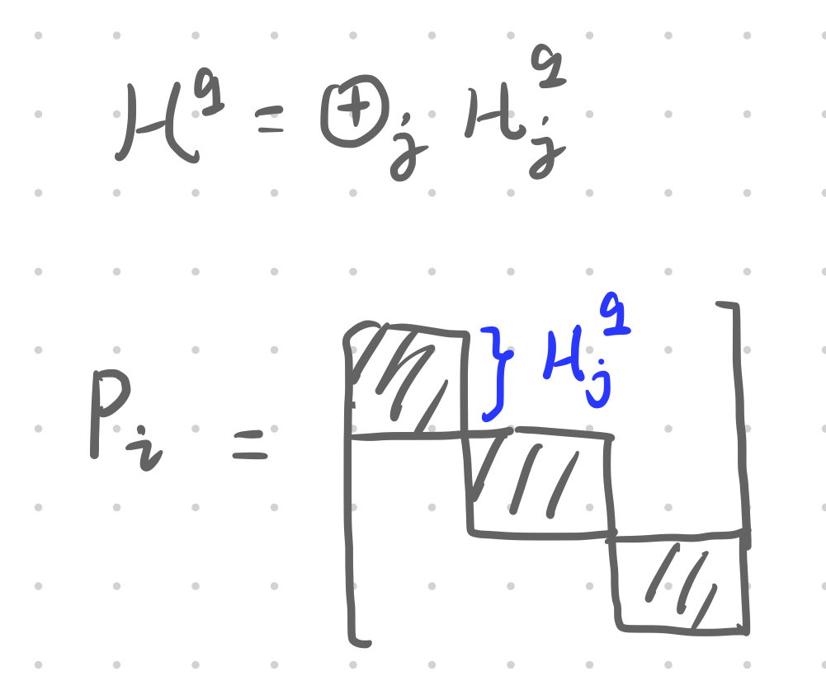
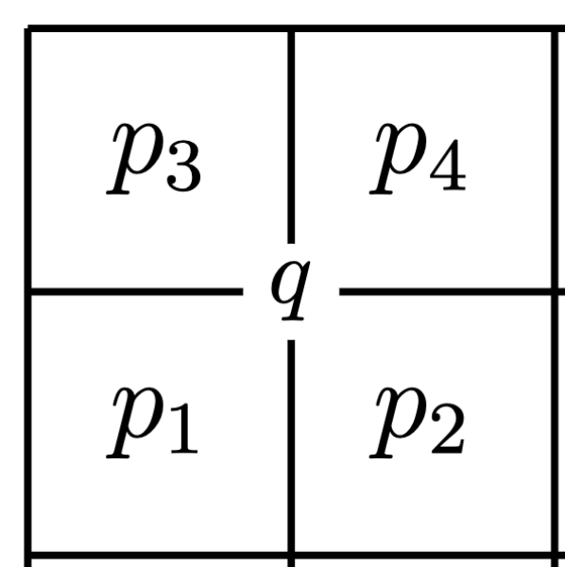
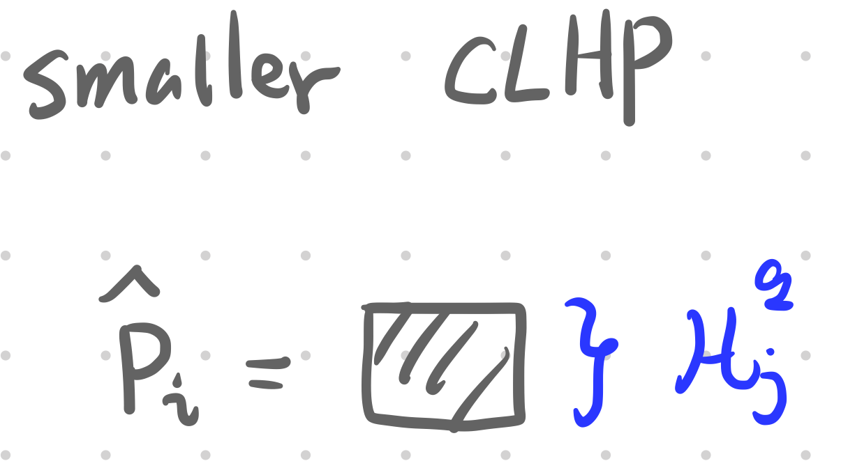
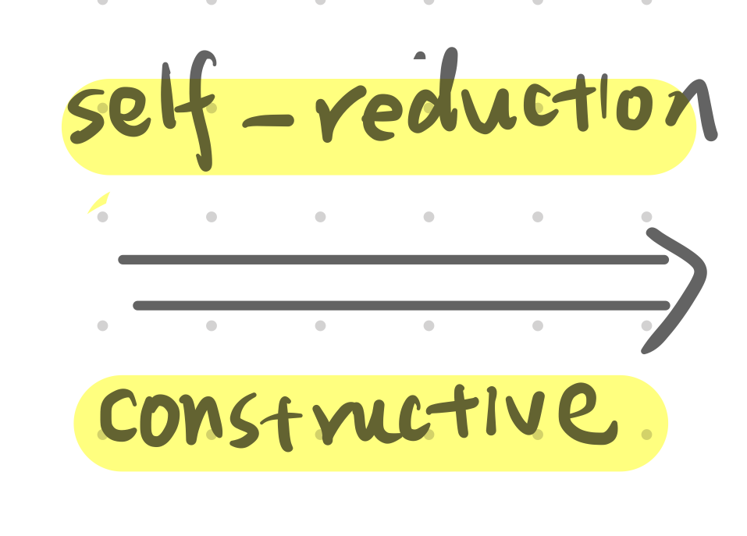
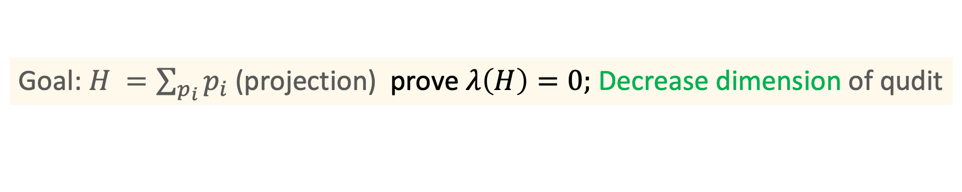
Key technique for Theorem 1 Non-constructive self-reduction for CLHP: qutrit to qubit?
Goal: $H =\sum_{p_{i}}{p_{i} }$(projection) prove $λ\left(H\right)=0;$ Decrease dimension of qudit

Slide 12

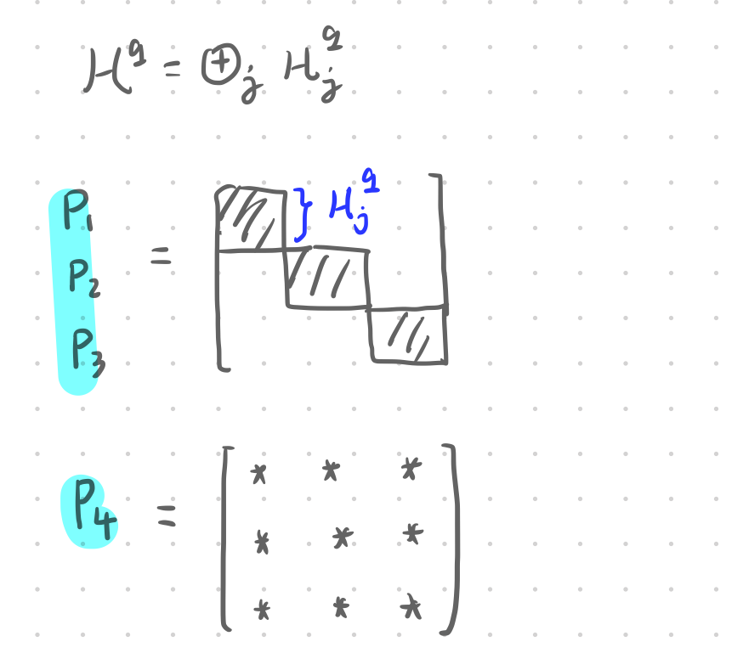
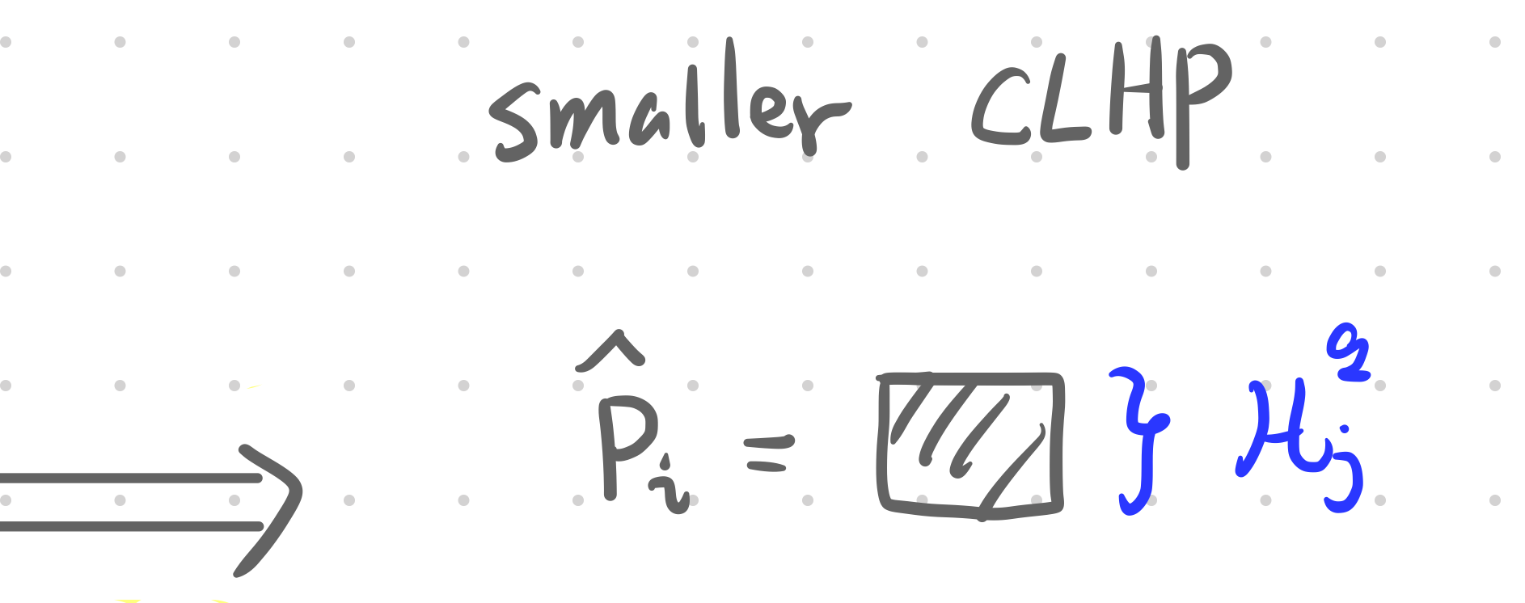
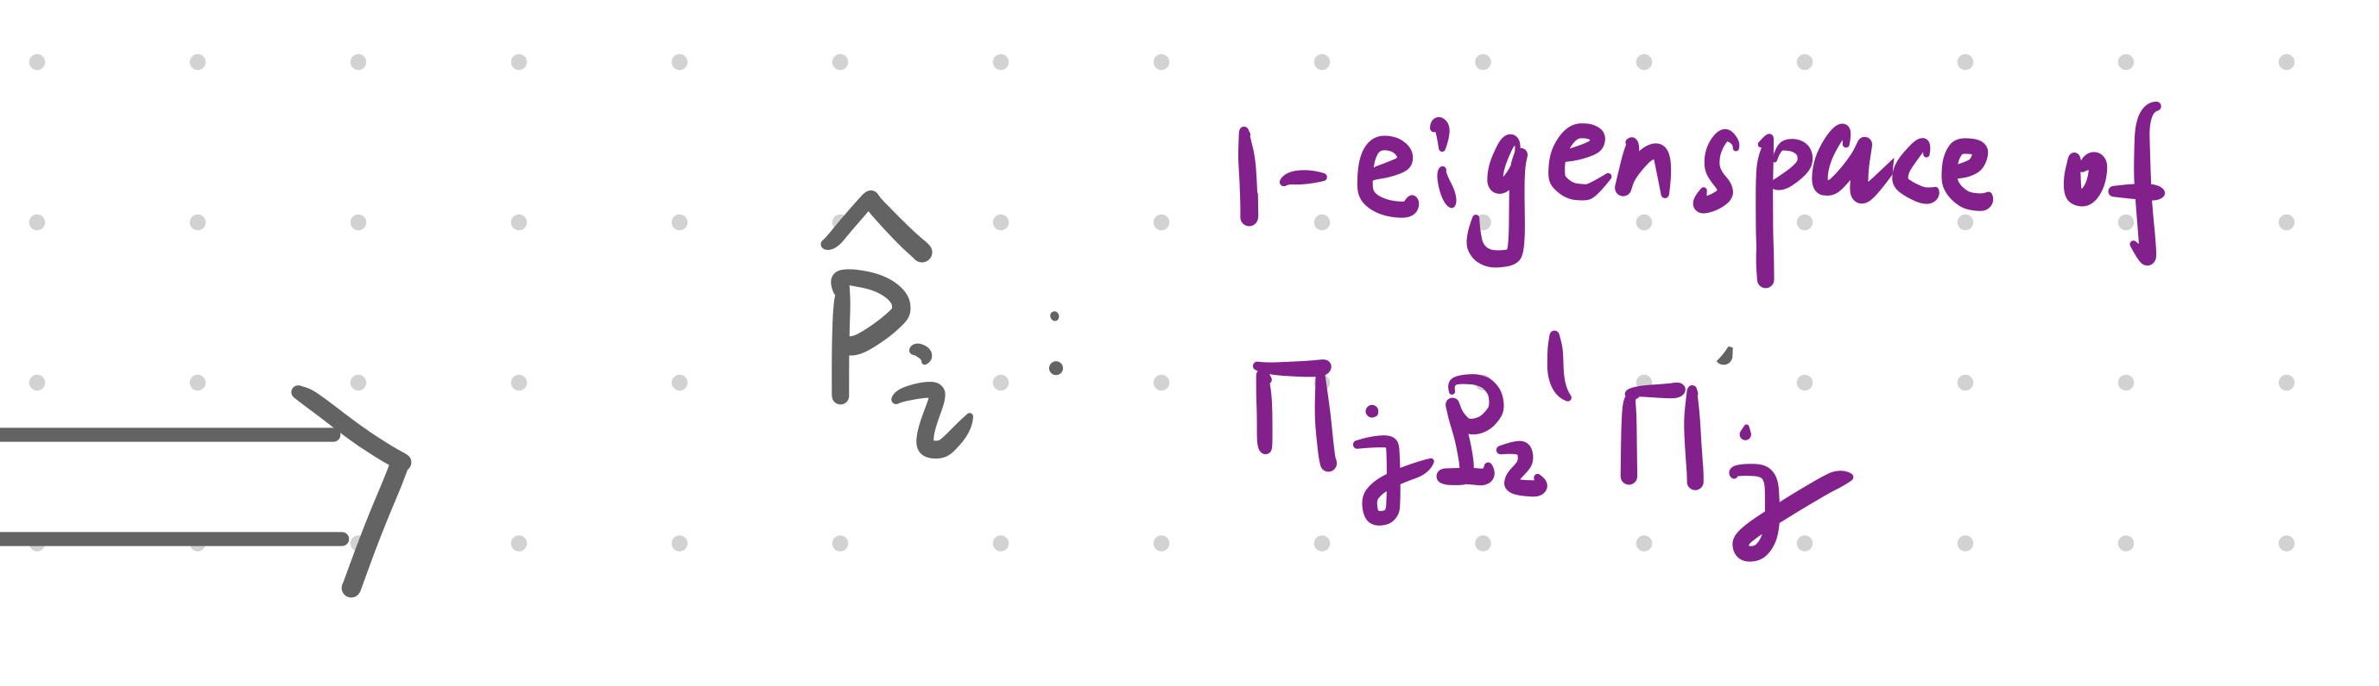
Key technique for Theorem 1 Non-constructive self-reduction for CLHP: qutrit to qubit?
Goal: $H =\sum_{p_{i}}{p_{i} }$(projection) prove $λ\left(H\right)=0;$ Decrease dimension of qudit
For CLHP we can do more!

Slide 13

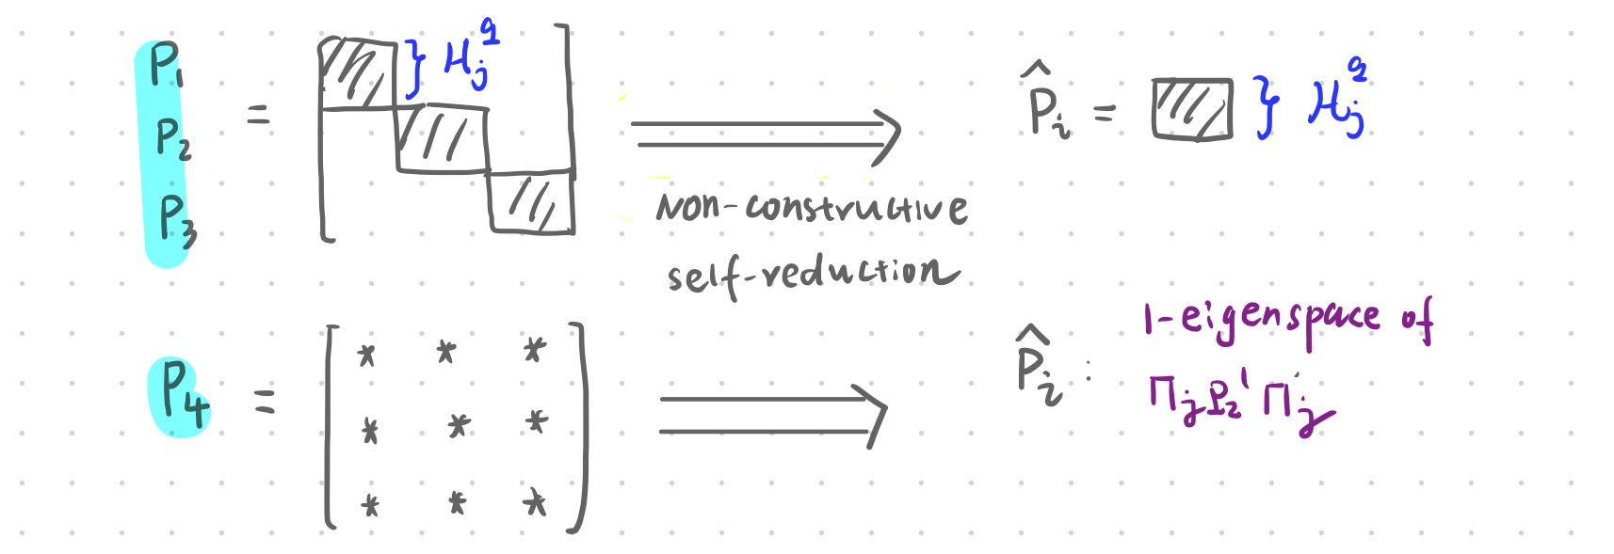
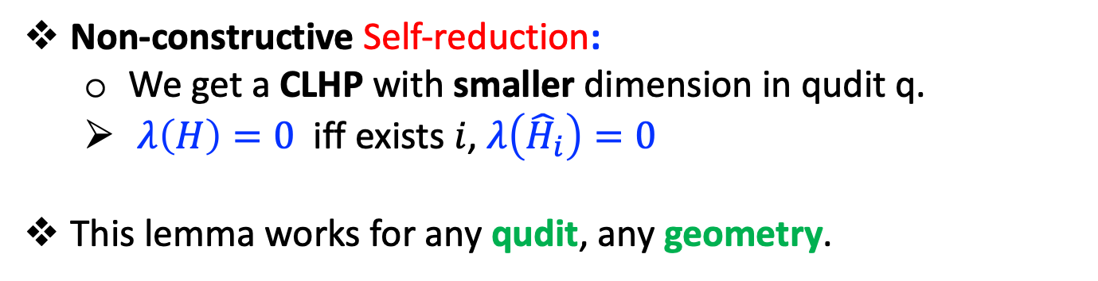
Non-constructive Self-reduction:
We get a CLHP with smaller dimension in qudit q.
$λ\left(H\right)=0$ iff exists $i$, $λ\left({\hat{H}}_{i}\right)=0$
This lemma works for any qudit, any geometry.

Slide 14
Open problems
A constructive proof for qutrit-CLHP-2D is in NP?
It is equivalent to Toric code?
Apply our non-constructive self-reduction to other CLHP?
3-local qutrit-CLHP is in NP?
(Fact) 3-local qubit CLHP is in NP, [AE11b].
Qudit-CLHP-2D is in NP? Or QCMA?
CLHP is harder than NP?

