Slide 1

Local Hamiltonian Problem with succinct ground state
is MA-complete
Jiaqing Jiang
Caltech CMS & IQIM
Arxiv: 2309.10155

Slide 2
Outline
Local Hamiltonian problem
Our setting & Main results
Implication? Dequantizing quantum advantage?

Slide 3

Local Hamiltonian
Math model for locally interacting many-body systems.
Example: Molecules with many interacting electrons.
Quantum Chemistry
Electronic structure
Chemical Reactions…
Condense matter physics
Materials,
Conductor,
Superconductor…

Slide 4
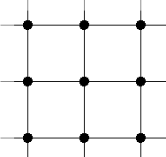

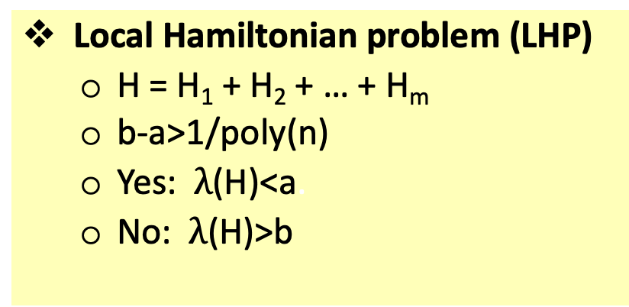




Local Hamiltonian
Math model for locally interacting many-body systems.
$n$-qubit Hermitian matrix
constant-qubit Hermitian matrix
$$H = H1 + … + Hm$$
Estimate the ground energy $λ$(H) within desired precision.
Local Hamiltonian problem (LHP)
H = H₁ + H₂ + … + H_{m}
b-a>1/poly(n)
Yes: $λ$(H)<a.
No: $λ$(H)>b
qubit
$$H_{i}$$

Slide 5
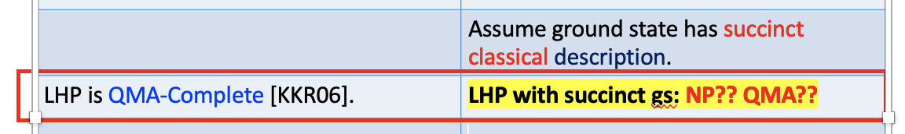
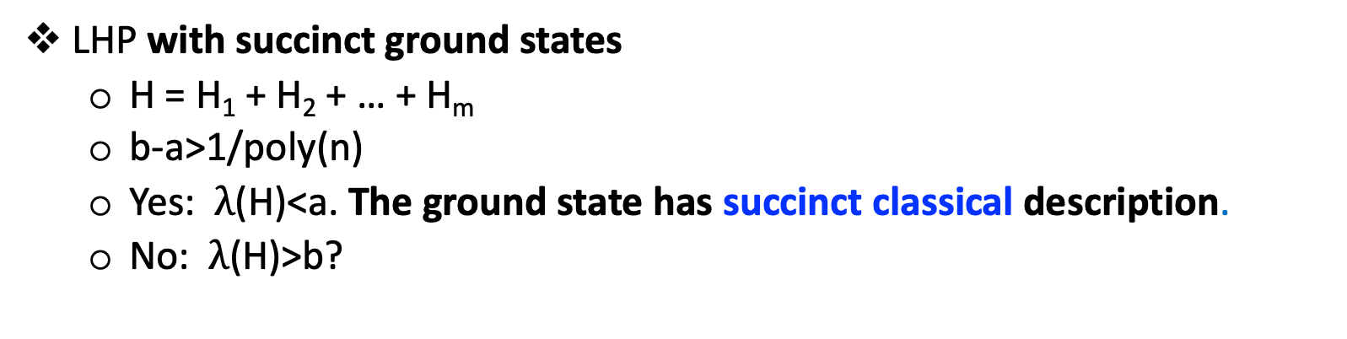
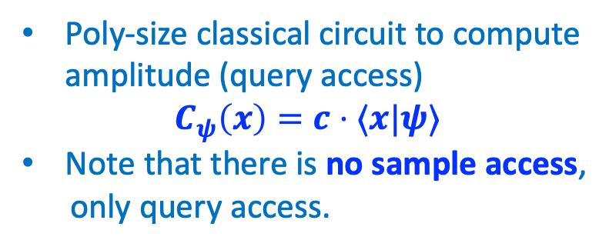
Our setting
Poly-size classical circuit to compute amplitude (query access)
$$C_{ψ}\left(x\right)=c⋅⟨x|ψ⟩$$
Note that there is no sample access,
only query access.
LHP with succinct ground states
H = H₁ + H₂ + … + H_{m}
b-a>1/poly(n)
Yes: $λ$(H)<a. The ground state has succinct classical description.
No: $λ$(H)>b?
In many variational classical algorithms, the ansatz for ground states are succinct.
Matrix product states (DMRG, [Whi92])
Fermionic Gaussian states (Hartree-Fork method [Fis87])
Neural network states [GD17, CTMA19]
Goal: Complexity implication of succinct assumptions.
Notes:
Clarify query access does not imply sample access. They are incomparable.

Slide 6
Our setting & Main result
Our result: LHP with succinct ground state is MA-complete.
MA: Classical + Randomness verifier.
Fact: LHP is QMA-complete. (quantum verifier.)
Dequantizing the verifier from quantum to classical.
Why the MA result is non-trivial?
Technical reason: no sample access.
Implication: Dequantizing LHP with guided states?

Slide 7


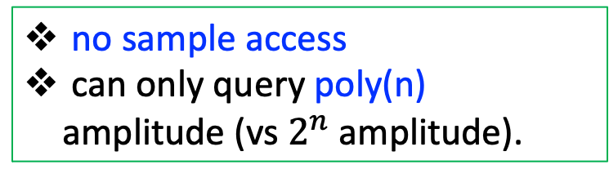
Why non-trivial? Technical reasons
Dequantizing from QMA to MA.
Our result: LHP with succinct ground state is MA-complete.
classical query access to gs.
no sample access
can only query poly(n) amplitude (vs $2^{n}$ amplitude).
Succinct GS
MA-Complete
Verifier has randomness.
poly(n) query + randomness is powerful!
LHP suffers from the sign problem!
Unusual: Continuous-time Markov Chain [BCGL22]
Explain later in the slides.
Notes:
I will give explanations of sign problem soon. "is nontrivial";

Slide 8
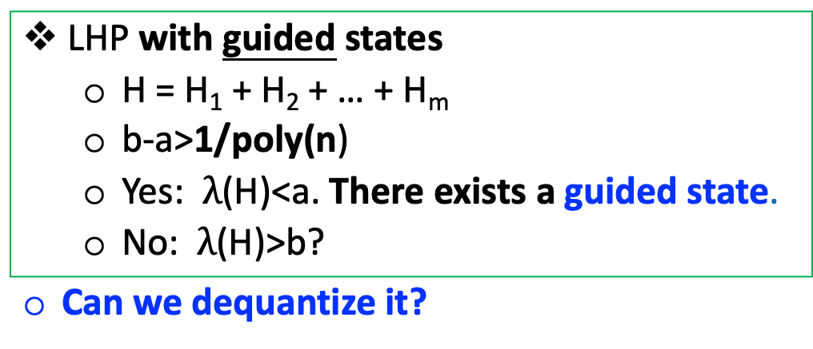
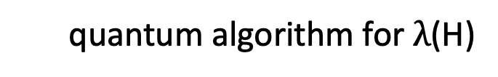
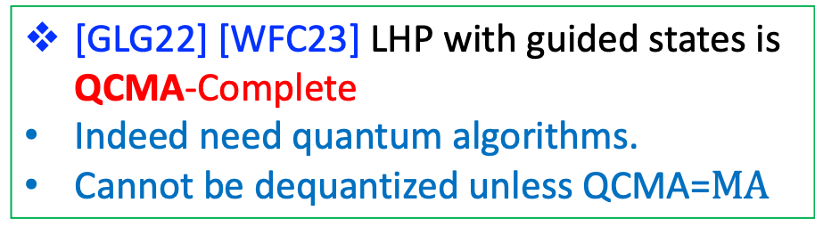

Why non-trivial? Implication:
Try dequantizing LHP + Guided states
LHP + guided states: (informal)
LHP with guided states
H = H₁ + H₂ + … + H_{m}
b-a>1/poly(n)
Yes: $λ$(H)<a. There exists a guided state.
No: $λ$(H)>b?
Can we dequantize it?
quantum algorithm for $λ$(H)
Guided
states
Ground energy
1/poly(n) overlap with ground state
Efficiently prepared by quantum circuit.
[GLG22] [WFC23] LHP with guided states is QCMA-Complete
Indeed need quantum algorithms.
Cannot be dequantized unless QCMA=$MA$
Potential quantum advantage for chemistry since estimating $λ$(H) is hard.
Q: Guided states from classical algorithms are succinct. When can be dequantized?

Slide 9
Try dequantizing LHP + Guided states
Can we dequantize with stronger guided states?
1/poly overlap
1/poly(n) precision | Standard guided states
General | QCMA-Complete [WFC23]
Cannot be dequantized!

Slide 10
Try dequantizing LHP + Guided states
Can we dequantize with stronger guided states?
1/poly overlap
Entry-wise 1/poly overlap with gs
Extremely strong guided states
1/poly(n) precision | Standard guided states | Strong guided states (open problem) | Succinct ground state (Our result)
General | QCMA-Complete [WFC23] | ??? | ???
Cannot be dequantized!

Slide 11
Difficulty for dequantizing: Sign Problem Extremely strong guided states → Circumvent the sign problem
Try dequantizing LHP + Guided states
1/poly overlap
Entry-wise 1/poly overlap with gs
Extremely strong guided states
1/poly(n) precision | Standard guided states | Strong guided states (open problem) | Succinct ground state (Our result)
Stoquastic
General | QCMA-Complete [WFC23] | ??? | ???

Slide 12



Try dequantizing LHP + Guided states
Difficulty for dequantizing: Sign Problem Extremely strong guided states → Circumvent the sign problem
1/poly overlap
Entry-wise 1/poly overlap with gs
Extremely strong guided states
1/poly(n) precision | Standard guided states | Strong guided states (open problem) | Succinct ground state (Our result)
Stoquastic
General | QCMA-Complete [WFC23] | ??? | ???

Slide 13
Try dequantizing LHP + Guided states
Difficulty for dequantizing: Sign Problem Extremely strong guided states → Circumvent the sign problem
1/poly overlap
Entry-wise 1/poly overlap with gs
Extremely strong guided states
1/poly(n) precision | Standard guided states | Strong guided states (open problem) | Succinct ground state (Our result)
Stoquastic | ??? | MA-Complete [Bra14] | MA-complete [BT10] [Liu20]
General | QCMA-Complete [WFC23] | ??? | ???
Can we circumvent
sign problem?

Slide 14
Try dequantizing LHP + Guided states
Difficulty for dequantizing: Sign Problem Extremely strong guided states → Circumvent the sign problem
Entry-wise 1/poly overlap with gs
Extremely strong guided states
1/poly(n) precision | Standard guided states | Strong guided states (open problem) | Succinct ground state (Our result)
Stoquastic | ??? | MA-Complete [Bra14] | MA-complete [BT10] [Liu20]
General | QCMA-Complete [WFC23] | ??? | Our results: MA-Complete
Can we circumvent
sign problem?
Yes! We can

Slide 15
Try dequantizing LHP + Guided states
Difficulty for dequantizing: Sign Problem Extremely strong guided states → Circumvent the sign problem
Entry-wise 1/poly overlap with gs
Extremely strong guided states
1/poly(n) precision | Standard guided states | Strong guided states (open problem) | Succinct ground state (Our result)
Stoquastic | ??? | MA-Complete [Bra14] | MA-complete [BT10] [Liu20]
General | QCMA-Complete [WFC23] | Open problem | Our results: MA-Complete
Can we circumvent
sign problem?
Magical Continuous-time MC?

Slide 16
Try dequantizing LHP + Guided states
Difficulty for dequantizing: Sign Problem Extremely strong guided states → Circumvent the sign problem
Entry-wise 1/poly overlap with gs
Extremely strong guided states
1/poly(n) precision | Standard guided states | Strong guided states (open problem) | Succinct ground state (Our result)
Stoquastic | ??? | MA-Complete [Bra14] | MA-complete [BT10] [Liu20]
General | QCMA-Complete [WFC23] | Open problem | Our results: MA-Complete
More robust Monte Carlo method [Bra14]

Slide 17

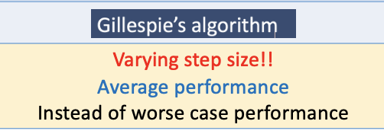

Sketch for LHP with succinct gs is MA-Complete
Stoquastic
Hamiltonian
[BT10]
Discrete-time Monte Carlo
Fixed Node Hamiltonian
[TLHVB+95]
The fixed node Hamiltonian has exponentially large norm.
MA verification protocol
General Hamiltonian
Continuous time Monte Carlo [BCGL22]
Consistency checks in CTMC
We have different task & setting from [BCGL22].
We do not need spectral gap in Hamiltonian and etc.

Slide 18

Summary and open problem
Summary: Extreme strong guided states help to resolve sign problem.
Theorem: LHP with succinct ground state is MA-complete.
Open problem: Strong guided states help to resolve sign problem?
Conjecture: LHP with strong guided states is MA-complete
Open problem:
More classical algorithms based on Continuous-time MC?
More quantum algorithm for LHP?
Via thermalization?
Thanks for listening. Questions ?

