Slide 1


Quantum Metropolis Sampling via Weak Measurement
Jiaqing Jiang (Caltech) and Sandy Irani (UCI)
Arxiv:2406.16023

Slide 2


What are quantum computers good for?
Algebraic Structure
Factoring, Shor’s algorithm
The hidden subgroup problem
Notes:
Motivation, application of quantum computers.

Slide 3
What are quantum computers good for?
Algebraic Structure (rare)
Factoring, Shor’s algorithm
The hidden subgroup problem
Quantum Problems (common)
Notes:
Motivation, application of quantum computers.

Slide 4
What are quantum computers good for?
Algebraic Structure (rare)
Factoring, Shor’s algorithm
The hidden subgroup problem
Quantum Problems (common)
Quantum Chemistry & Physics (electronic structure)
Gibbs states
Ground State

Slide 5
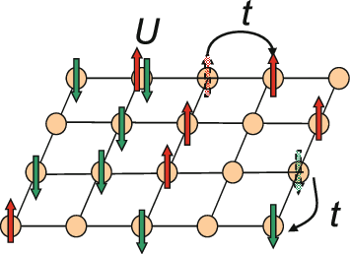

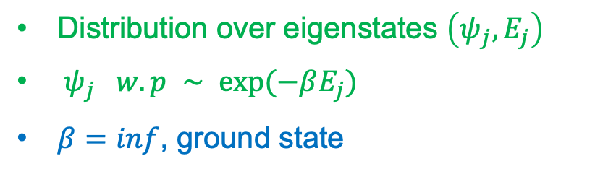
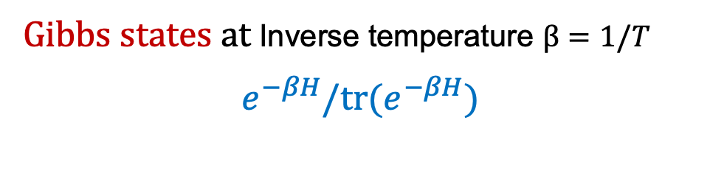
Gibbs States
Math model for many-body systems at finite temperature
Local Hamiltonian:
$$H = H1 + … + Hm$$
Quantum analogy of
Satisfiability problem (SAT)
n-qubit
constant-qubit
Gibbs states at Inverse temperature $β=1/T$
$$e^{−βH}/tr(e^{−βH})$$
Distribution over eigenstates $\left(ψ_{j},E_{j}\right)$
$ψ_{j} w.p ∼ exp⁡(−βE_{j})$
$β=inf$, ground state

Slide 6

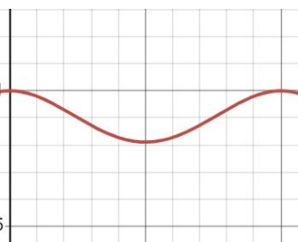
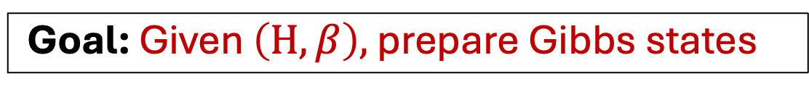
Application of Gibbs states
Goal: Given $\left(H,β\right),$ prepare Gibbs states
Quantum Chemistry & Physics
2D Hubbard model
Super-conductivity…
Machine Learning
Quantum Boltzmann Machine
[HS83, AAR+18]
Sub-routine in Optimization
Semi-define Programming
[BKL+19, VAGGdW17].

Slide 7

Disclaimer
Goal: Given $\left(H,β\right),$ prepare Gibbs states
Correctness Converge to Gibbs states in finite time | Efficiency Converge in poly(n) time
Correctness is the first step.
(Classical) Gibbs sampler works well in practice without an efficiency proof.
Proving efficiency for quantum Gibbs sampling is widely open.

Slide 8
Outline
Classical Metropolis Algorithm
Quantum Metropolis Algorithm & Challenge
Previous work
Our algorithm

Slide 9
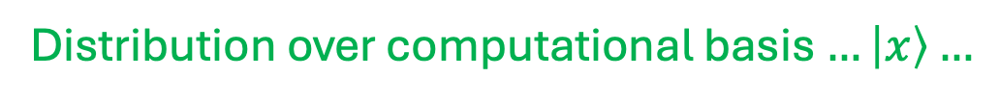

Classical Metropolis Algorithm [MRR+53]
Goal: Given $\left(H,β\right),$ prepare Gibbs states
Classical Hamiltonian
Distribution over computational basis $…\left|x\right\rangle …$

Slide 10
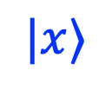
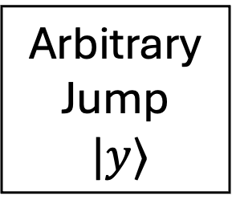
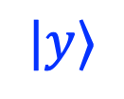
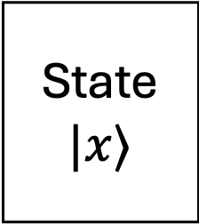
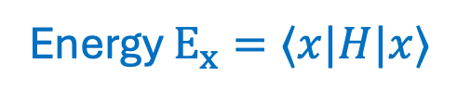
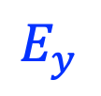

Classical Metropolis Algorithm [MRR+53]
Do something arbitrary, then reject with some probability.
Accept
$$|y⟩$$
State
$$|x⟩$$
Arbitrary
Jump
$|y⟩$
$$E_{x}$$
$$E_{y}$$
Reject
$$|x⟩$$
Energy $E_{x}=⟨x|H|x⟩$

Slide 11


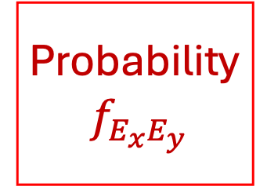

Classical Metropolis Algorithm [MRR+53]
Do something arbitrary, then reject with some probability.
Accept
$$|y⟩$$
State
$$|x⟩$$
Arbitrary
Jump
$|y⟩$
Probability
$f_{E_{x}E_{y}}$
w.p. ${ f}_{E_{x}E_{y}}$
$$E_{x}$$
$$E_{y}$$
$$1−{ f}_{E_{x}E_{y}}$$
Reject
$$|x⟩$$
Energy $E_{x}=⟨x|H|x⟩$
$$f_{E_{x}E_{y}}=min⁡\{ 1,\exp\left(βE_{x}−βE_{y}\right)\}$$

Slide 12
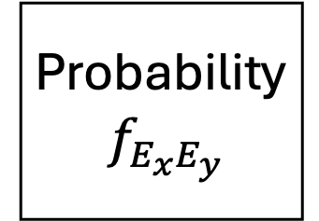
(?) Quantum Metropolis Algorithm
Do something arbitrary, then reject with some probability.
Accept
State
$$|x⟩$$
Arbitrary
Jump
$|y⟩$
Probability
$f_{E_{x}E_{y}}$
$$E_{x}$$
$$E_{y}$$
Reject

Slide 13
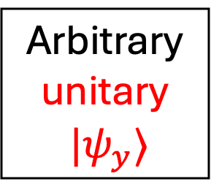
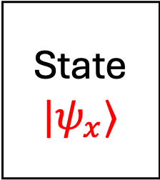
(?) Quantum Metropolis Algorithm
Do something arbitrary, then reject with some probability.
Accept
State
$$|ψ_{x}⟩$$
Arbitrary
unitary
$|ψ_{y}⟩$
Probability
$f_{E_{x}E_{y}}$
$$E_{x}$$
$$E_{y}$$
Reject
QPE: Quantum Phase Estimation

Slide 14
(?) Quantum Metropolis Algorithm
Do something arbitrary, then reject with some probability.
Accept
State
$$|ψ_{x}⟩$$
Arbitrary
unitary
$|ψ_{y}⟩$
Probability
$f_{E_{x}E_{y}}$
$$E_{x}$$
$$E_{y}$$
Reject
QPE: Quantum Phase Estimation
Encode in unitary
and Measure

Slide 15
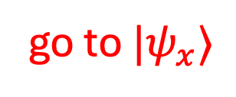
(?) Quantum Metropolis Algorithm
Do something arbitrary, then reject with some probability.
Accept
State
$$|ψ_{x}⟩$$
Arbitrary
unitary
$|ψ_{y}⟩$
Probability
$f_{E_{x}E_{y}}$
$$E_{x}$$
$$E_{y}$$
Reject
go to $|ψ_{x}⟩$
Measure
Practical QPE: Intrinsic errors in energy estimation. Hard to analyze and may explode.
How to revert quantum state after measurement?

Slide 16
Previous trying to handle this challenge
How to revert a quantum state after measurement?
[TOV+11] Quantum Metropolis | [CKBG23] Davies generator Based
Marriott-Watrous rewinding Lemma, Poly(n) complex measurement | Provably correct Black Magic from Davies generator [DV76]
Issues in the proof.
Boosted + Shift-invariant QPE does not exist. [CKBG23]

Slide 17
Previous trying to handle this challenge
How to revert a quantum state after measurement?
[TOV+11] Quantum Metropolis | [CKBG23] Davies generator Based
Marriott-Watrous rewinding Lemma, Poly(n) complex measurement | Provably correct Black Magic from Davies generator [DV76]
Issues in the proof.
Boosted + Shift-invariant QPE does not exist. [CKBG23]

Slide 18
Previous trying to handle this challenge
How to revert a quantum state after measurement?
[TOV+11] Quantum Metropolis | [CKBG23] Davies generator Based
Marriott-Watrous rewinding Lemma, Poly(n) complex measurement | Black Magic from Davies generator [DV76]
Issues in the proof.
Boosted + Shift-invariant QPE does not exist. [CKBG23]

Slide 19
Previous trying to handle this challenge
How to revert a quantum state after measurement?
[TOV+11] Quantum Metropolis | [CKBG23] Davies generator Based
Marriott-Watrous rewinding Lemma, Poly(n) complex measurement | Black Magic from Davies generator [DV76] Lindbladian for Thermalization Gibbs states as fixed point Beautiful formula and symmetric Impossible to implement directly Weighted operator Fourier transform “Weak measurement”
Issues in the proof.
Boosted + Shift-invariant QPE does not exist. [CKBG23]

Slide 20
Previous trying to handle this challenge
How to revert a quantum state after measurement?
[TOV+11] Quantum Metropolis | [CKBG23] Davies generator Based
Marriott-Watrous rewinding Lemma, Poly(n) complex measurement | Black Magic from Davies generator [DV76] Lindbladian for Thermalization Gibbs states as fixed point Beautiful formula and symmetric Original Davies generator is impossible to implement Weighted operator Fourier transform
Issues in the proof.
Boosted + Shift-invariant QPE does not exist. [CKBG23]
Our goal: Directly design Quantum Metropolis.
Less Magic & More flexibility.

Slide 21
Our idea
How to revert a quantum state after measurement?
[TOV+11] Quantum Metropolis | Our algorithm
Marriott-Watrous rewinding Lemma, Poly(n) complex measurement | Weak measurement, single-qubit measurement
Issues in the proof.
Boosted + Shift-invariant QPE does not exist. [CKBG23] | Boosted QPE

Slide 22
Our idea
How to revert a quantum state after measurement?
[TOV+11] Quantum Metropolis | Our algorithm
Marriott-Watrous rewinding Lemma, Poly(n) complex measurement | Weak measurement, single-qubit measurement
Issues in the proof.
Boosted + Shift-invariant QPE does not exist. [CKBG23]

Slide 23
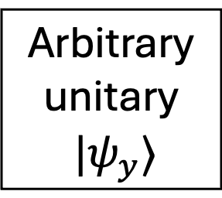
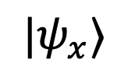
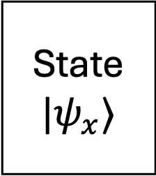
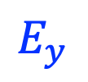

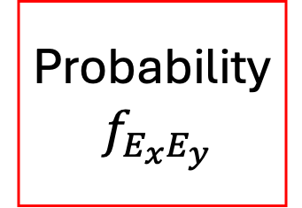
Weak Measurement
Accept
State
$$|ψ_{x}⟩$$
Arbitrary
unitary
$|ψ_{y}⟩$
Probability
$f_{E_{x}E_{y}}$
$$E_{x}$$
$$E_{y}$$
Reject
$$|ψ_{x}⟩$$
Measure
Change $f_{E_{x}E_{y}}$ to ${{ τ}^{2}×f}_{E_{x}E_{y}}, τ=1/poly(n)$
Intuitively weak measurement is easier to revert.

Slide 24
Our idea
How to reverting a quantum state after measurement?
[TOV+11] Quantum Metropolis | Our algorithm
Marriott-Watrous rewinding Lemma, Poly(n) complex measurement | Weak measurement, single-qubit measurement
Issues in the proof.
Boosted + Shift-invariant QPE does not exist. [CKBG23]

Slide 25
Our idea
How to reverting a quantum state after measurement?
[TOV+11] Quantum Metropolis | Our algorithm
Marriott-Watrous rewinding Lemma, Poly(n) complex measurement | Weak measurement, single-qubit measurement
Issues in the proof. | Provably correct
Boosted + Shift-invariant QPE does not exist. [CKBG23] | Boosted QPE

Slide 26
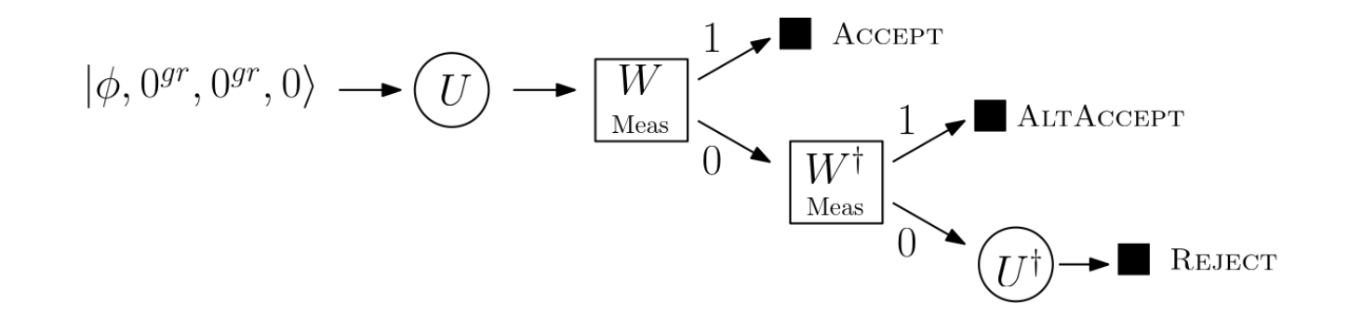

Our algorithm in details
Do something arbitrary, then reject with some probability.
Arbitrary unitary

Slide 27
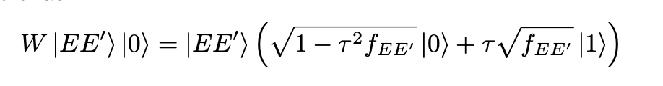
Our algorithm in details
Do something arbitrary, then reject with some probability.
Arbitrary unitary
Weak Measurement

Slide 28
Our algorithm in details
Trace out the last 3 registers
Refresh with 0 states
Do something arbitrary, then reject with some probability.
The state is close to the accept case
Try rewinding
by performing inverse operations

Slide 29
Our algorithm in details
Do something arbitrary, then reject with some probability.
Try rewinding
by performing inverse operations

Slide 30
Remarks
Remarks:
We choose QPE and FQPE randomly to avoid bias in phase.

Slide 31
Remarks
Remarks:
We choose QPE and FQPE randomly to cancel bias in phase.
ALTAccept is essential for simplifying the rewinding even using weak measurement.

Slide 32
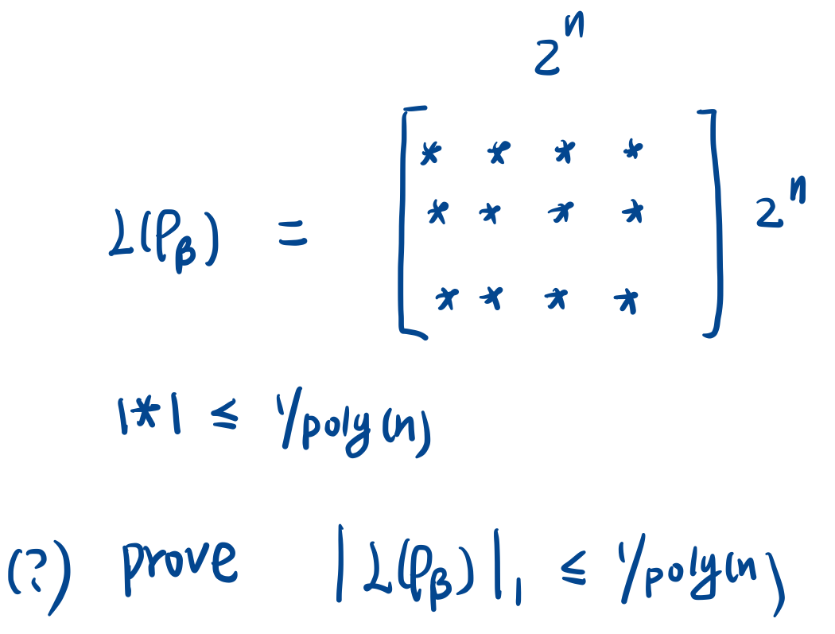
Challenges in proof
Energy-time uncertainty principle:
QPE can only estimate energy up to 1/poly precision.
QPE is non-deterministic
We developed a technique for analyzing non-deterministic QPE by deterministic QPE.

Slide 33
Summary and Future directions
We designed a conceptually simple and provably correct Gibbs sampler, by directly mimicking classical Metropolis.
Adapted existing classical (heuristic/rigorous) techniques to quantum Gibbs state preparation?
New algorithm for Gibbs sampling?
Fast Mixing for quantum Hamiltonian? (1D, 2D high/low temperature)…
Thanks for listening. Questions ?

Slide 34
Appendix

Slide 35
Reference
[GZ03] Alice Guionnet and Boguslaw Zegarlinksi. Lectures on logarithmic sobolev inequalities. Seminaire de probabilities XXXVI, pages 1–134, 2003.
[MRR+53] Nicholas Metropolis, Arianna W Rosenbluth, Marshall N Rosenbluth, Augusta H Teller, and Edward Teller. Equation of state calculations by fast computing machines. The journal of chemical physics, 21(6):1087–1092, 1953.
[MO94] Fabio Martinelli and Enzo Olivieri. Approach to equilibrium of glauber dynamics in the one phase region: Ii. the general case. Communications in Mathematical Physics, 161(3):487–514, 1994
[FGW23] Weiming Feng, Heng Guo, and Jiaheng Wang. Swendsen-wang dynamics for the ferro- magnetic ising model with external fields. Information and Computation, 294:105066, 2023.

Slide 36
[SW87] Robert H Swendsen and Jian-Sheng Wang. Nonuniversal critical dynamics in monte carlo simulations. Physical review letters, 58(2):86, 1987
[RFA24] Cambyse Rouze, Daniel Stilck Fran¸ca, and Alvaro M Alhambra. Efficient thermalization and universal quantum computing with quantum gibbs samplers. arXiv preprint arXiv:2403.12691, 2024
[BLMT24] Ainesh Bakshi, Allen Liu, Ankur Moitra, and Ewin Tang. High-temperature gibbs states are unentangled and efficiently preparable. arXiv preprint arXiv:2403.16850, 2024.
[Dav76] Edward Brian Davies. Quantum theory of open systems. (No Title), 1976

