Slide 1
Federated Learning for Bioimage Classification
Jiarong Liang
Supervisor: Andreas Hellander
Subject Reader: Salman Toor

Slide 2
Overview
Background
Design and Result
Discussion

Slide 3
Machine Learning
Traditional machine learning:
Manual preprocessing and feature extraction,
PCA, random forest, etc.
Deep Learning:
End to end (raw data ->[???] -> label)
AutoML:
Computer can choose optimal model/optimizer/augmentation…
Notes:
Before that there are ‘Expert System’, imitating expert’s logic, needs detailed control / need experts’ experience in that field. Might not be popular today, not sure..

Slide 4
In biological/medical field
Drug screening
Denoising base calls
Sequencing analysis
Biological / medical images
FedML: 2018 brain tumor segmentation
Not many example
Notes:
Many biological/medical researches, especially in drug development pipeline, are using deep learning as an assistant. (as I mentioned in my report).
Not many example for FedML.
Mention that result of ML still need careful analysis/evaluate by experts in medical/biological fields

Slide 5
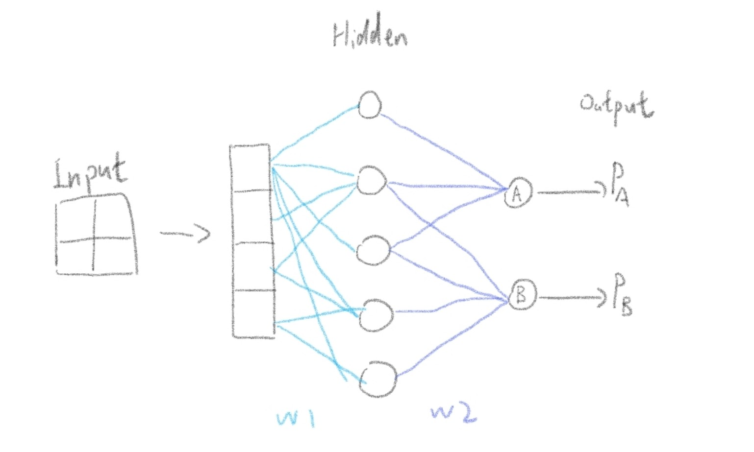
Non-Federated Example
Notes:
Neural Network. Forward propagation is from input to output. Loss will be calculated (difference between output and label).
Gradient will be calculated (aim to minimize the loss), back propagated from output to input, w1 and w2 will be updated accordingly. [like: w1 = w1-gradient*lr]
Optimizers can do, for example, control the learning rate (lr), in later epochs lr to be smaller, etc

Slide 6
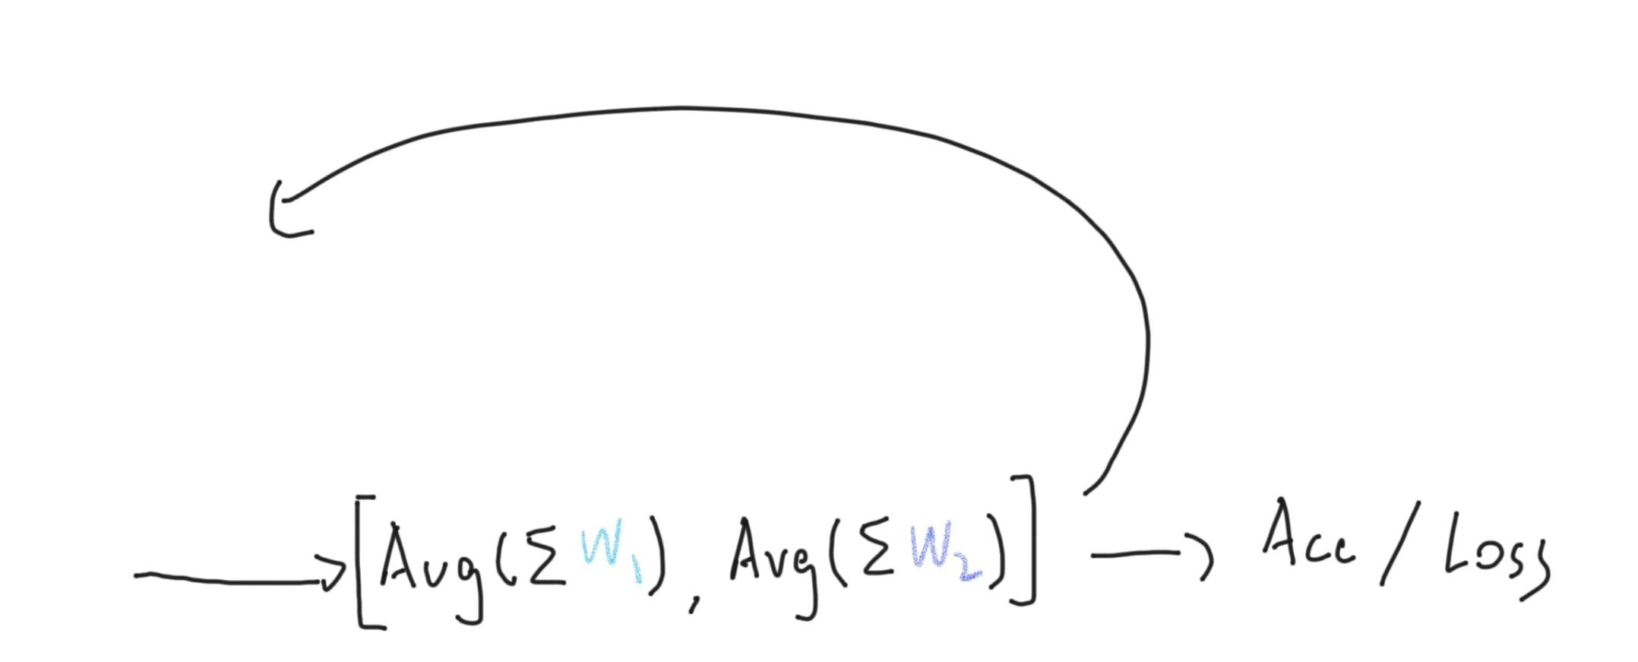
Federated Example
Notes:
Local training is like the centralized one, the system (central) collects only weights/gradients/hidden layer’s representation/… and aggregates them.
This shows FedAvg algorithm, it collects weights, another popular on FedSGD collects and aggregates gradient.

Slide 7
Federated Learning
Protect privacy
Use data that are not allowed to be shared (e.g. EMR)
No need for huge centralized computational / storage resources
Cross-device & Cross-silo
Horizontal & Vertical & Transfer Learning
Notes:
Many device, like 1000000 phone, each will little data, easy to drop off & like 50 Institutes, each with a small dataset
Similar feature space & similar user space & small overlap in both user and feature space

Slide 8
Challenges in FedML
Communication cost
- More local updates steps / compress model
Security and Privacy
- homomorphic encryption, SMC, differential privacy …
- blockchain
Statistical and system heterogeneity
Non-IID data distribution
Asynchronous nodes
- many solutions

Slide 9
FedML Tools/platform
Many still under construction:
TensorFlow Federated, PySyft
Seems to be almost ready:
FATE (traditional & DL)
Notes:
Since we would like to imitate many scenarios, and only want to build an trivial example, plus issues like: not many tutorials found / platform not ready
----- We didn’t use the above tools

Slide 10
In this project
Locally simulate different scenarios of Federated Learning using CIFAR10 dataset.
Deploy a simple bioimage classification example using federated learning on cloud.
Test the extent of the issues, provide a clearer overview
An easy-to-understand example for FedML on cloud

Slide 11
Tools
Python 3.6
TensorFlow 2.0
gRPC/Protobuf
Cloud platform: SNIC or aliyun.com

Slide 12
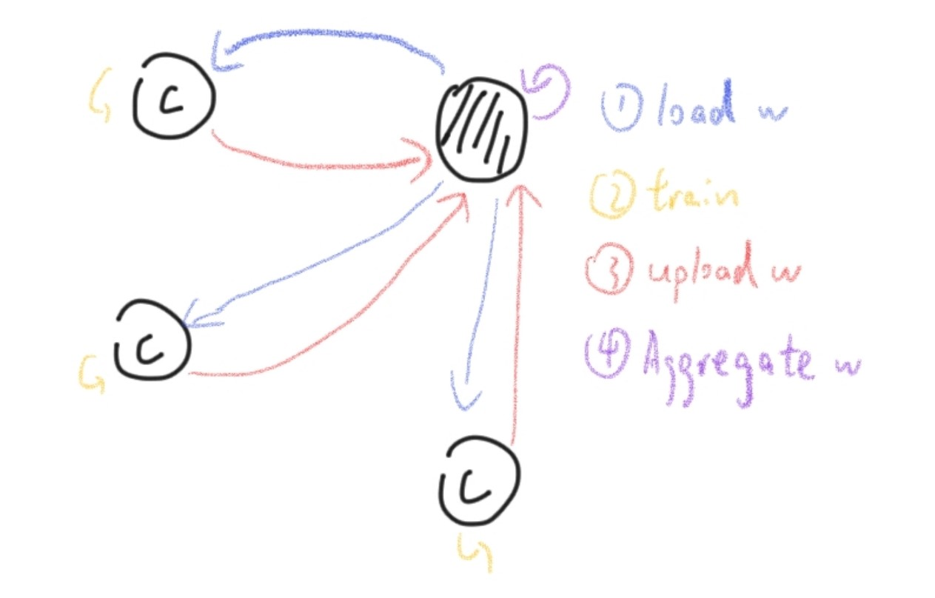
Federated System
Image--> [model] --> Label
Simulation
- locally simulate
Cloud example
- 3 client +1 central
Notes:
Simulation Model looks like: https://github.com/Jiarong000/Thesis2020/blob/master/Cifar10/ANN_model.png
(provided by Mattias Åkesson from Scaleout Systems)
DR task use VGG16, looks like: https://github.com/Jiarong000/Thesis2020/blob/master/DR/VGG16_model.png
Using FedAvg, evaluation done by the central node.

Slide 13
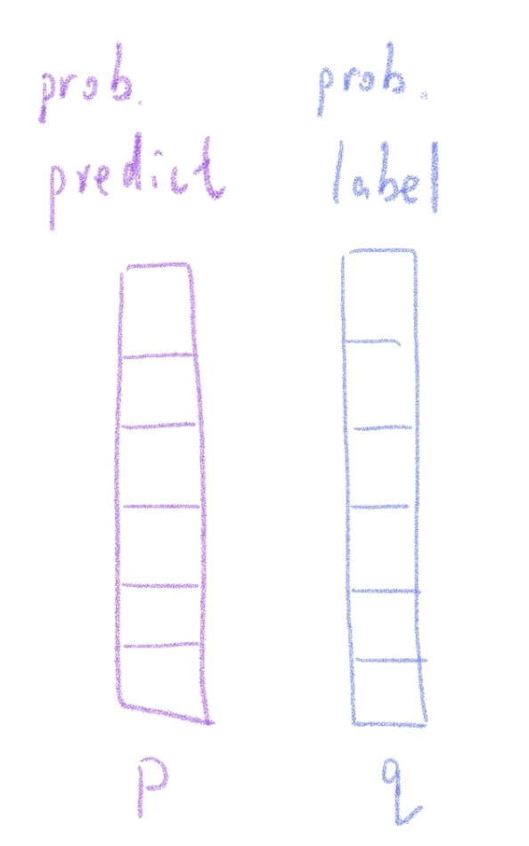
Show model performance
Accuracy: proportion of correctly assigned
Loss: cross-entropy
Windowed Acc/loss (size = 21)
Notes:
Use simply the accuracy curve. I’ve recorded accuracy and loss for both training and testing set, they are available in my GitHub. Also stores the snapshots of the Simu system when each test ends, also can be downloaded from the link provided in GitHub.

Slide 14
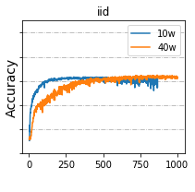
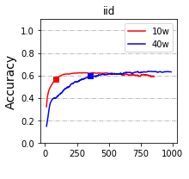
Show model performance
Notes:
Left is an example of testing acc after windowing. The colored point is where windowed loss is the smallest. We will focus on this point in the statistical tests.

Slide 15
Simulation tasks – CIFAR10
CIFAR10: Images of size (32*32*3) in 10 classes
10,000 testing set
4,000 or 40,000 total training set
Divided as 10 or 40 client
2 class / 3 class / 5 class / non-IID + IID
1000+ global rounds, lr = 0.001, batch size 50 or 100
Notes:
In original design I test only 4k dataset with 2/5/IID, with batch size = 50 or other. Later I added test of 40k dataset with 2/3/5/IID, batch size = 100.

Slide 16
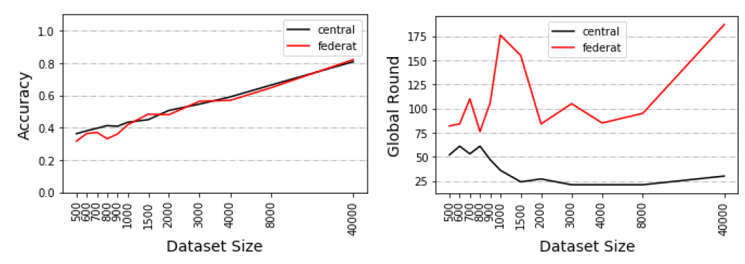
Pilot Test 1/2
IID, different dataset size
Notes:
Run only for 500 epoch and with 10 clients.

Slide 17
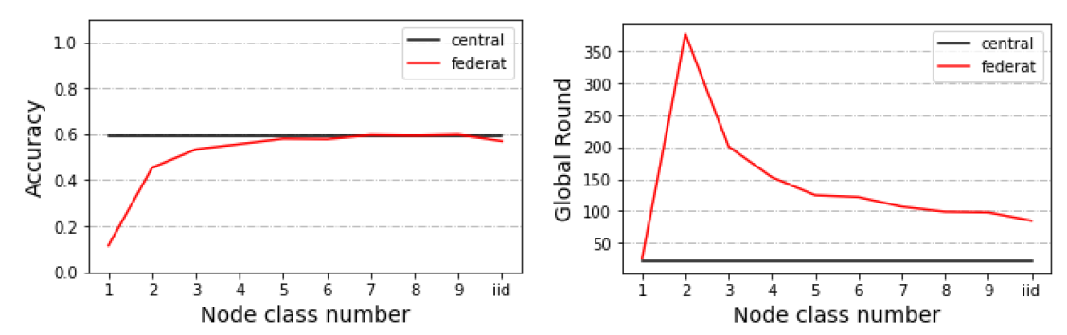
Pilot Test 2/2
4000 dataset, different IID/non-IID

Slide 18
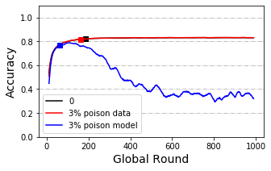
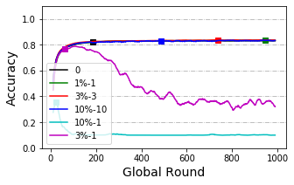
Model Poisoning 1/2
Notes:
40k dataset and under IID condition

Slide 19
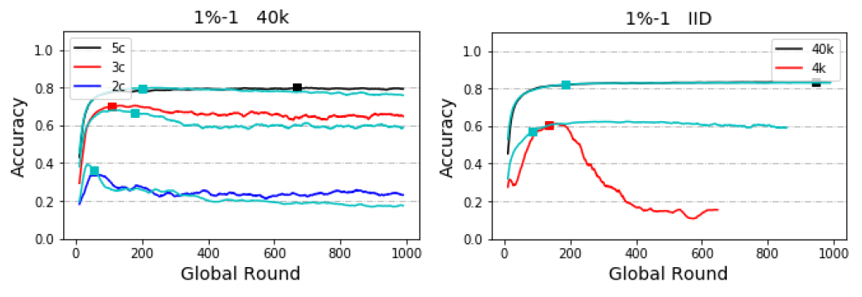
Model Poisoning 2/2

Slide 20
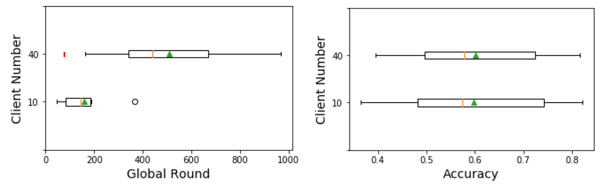
Data Dispersion
Notes:
Statistical difference detected in speed (10 client is way more faster than 40 client)
Records from both 4k and 40k dataset and all IID/non-IID groups

Slide 21
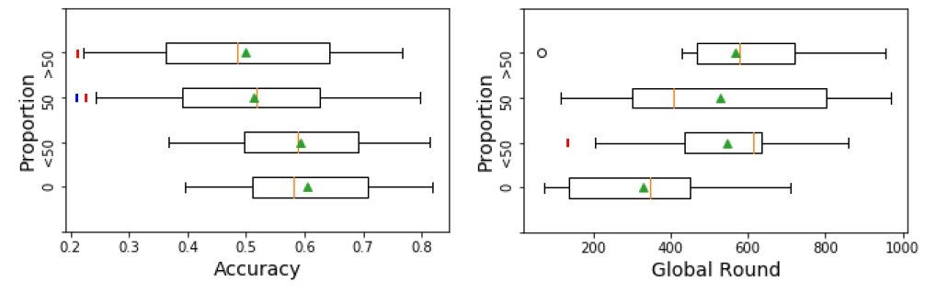
Delayed Update 1/2
Notes:
Red is statistical difference with group 0, blue is with nearby group

Slide 22
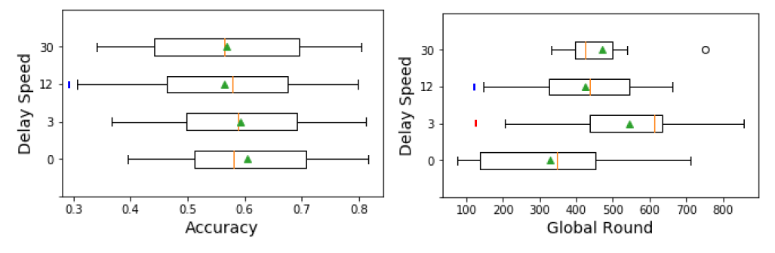
Delayed Update 2/2

Slide 23
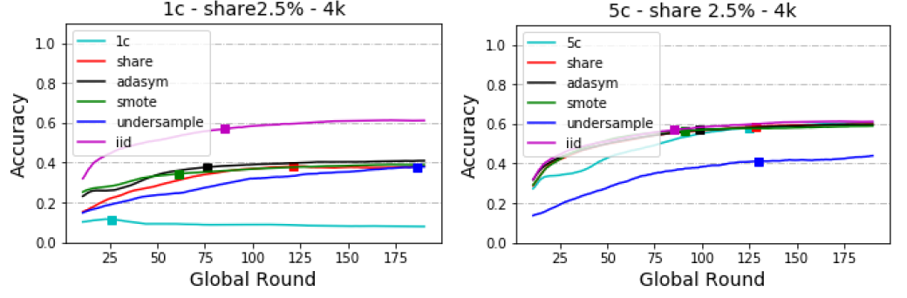
Share data strategy

Slide 24
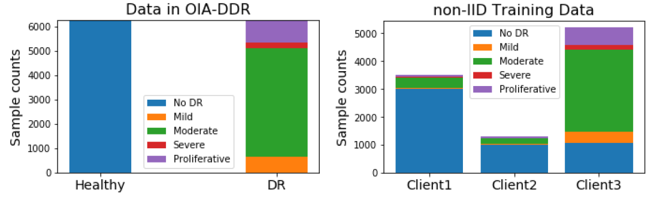
Cloud implementation – OIA-DDR
Images of different sizes prepressed to 224x224x3
2521 testing data, 10000 training data
Notes:
Distribution of DDR dataset Distribution of client’s training set (non-IID version)

Slide 25
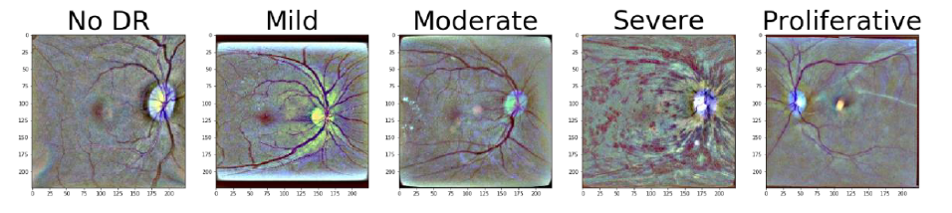
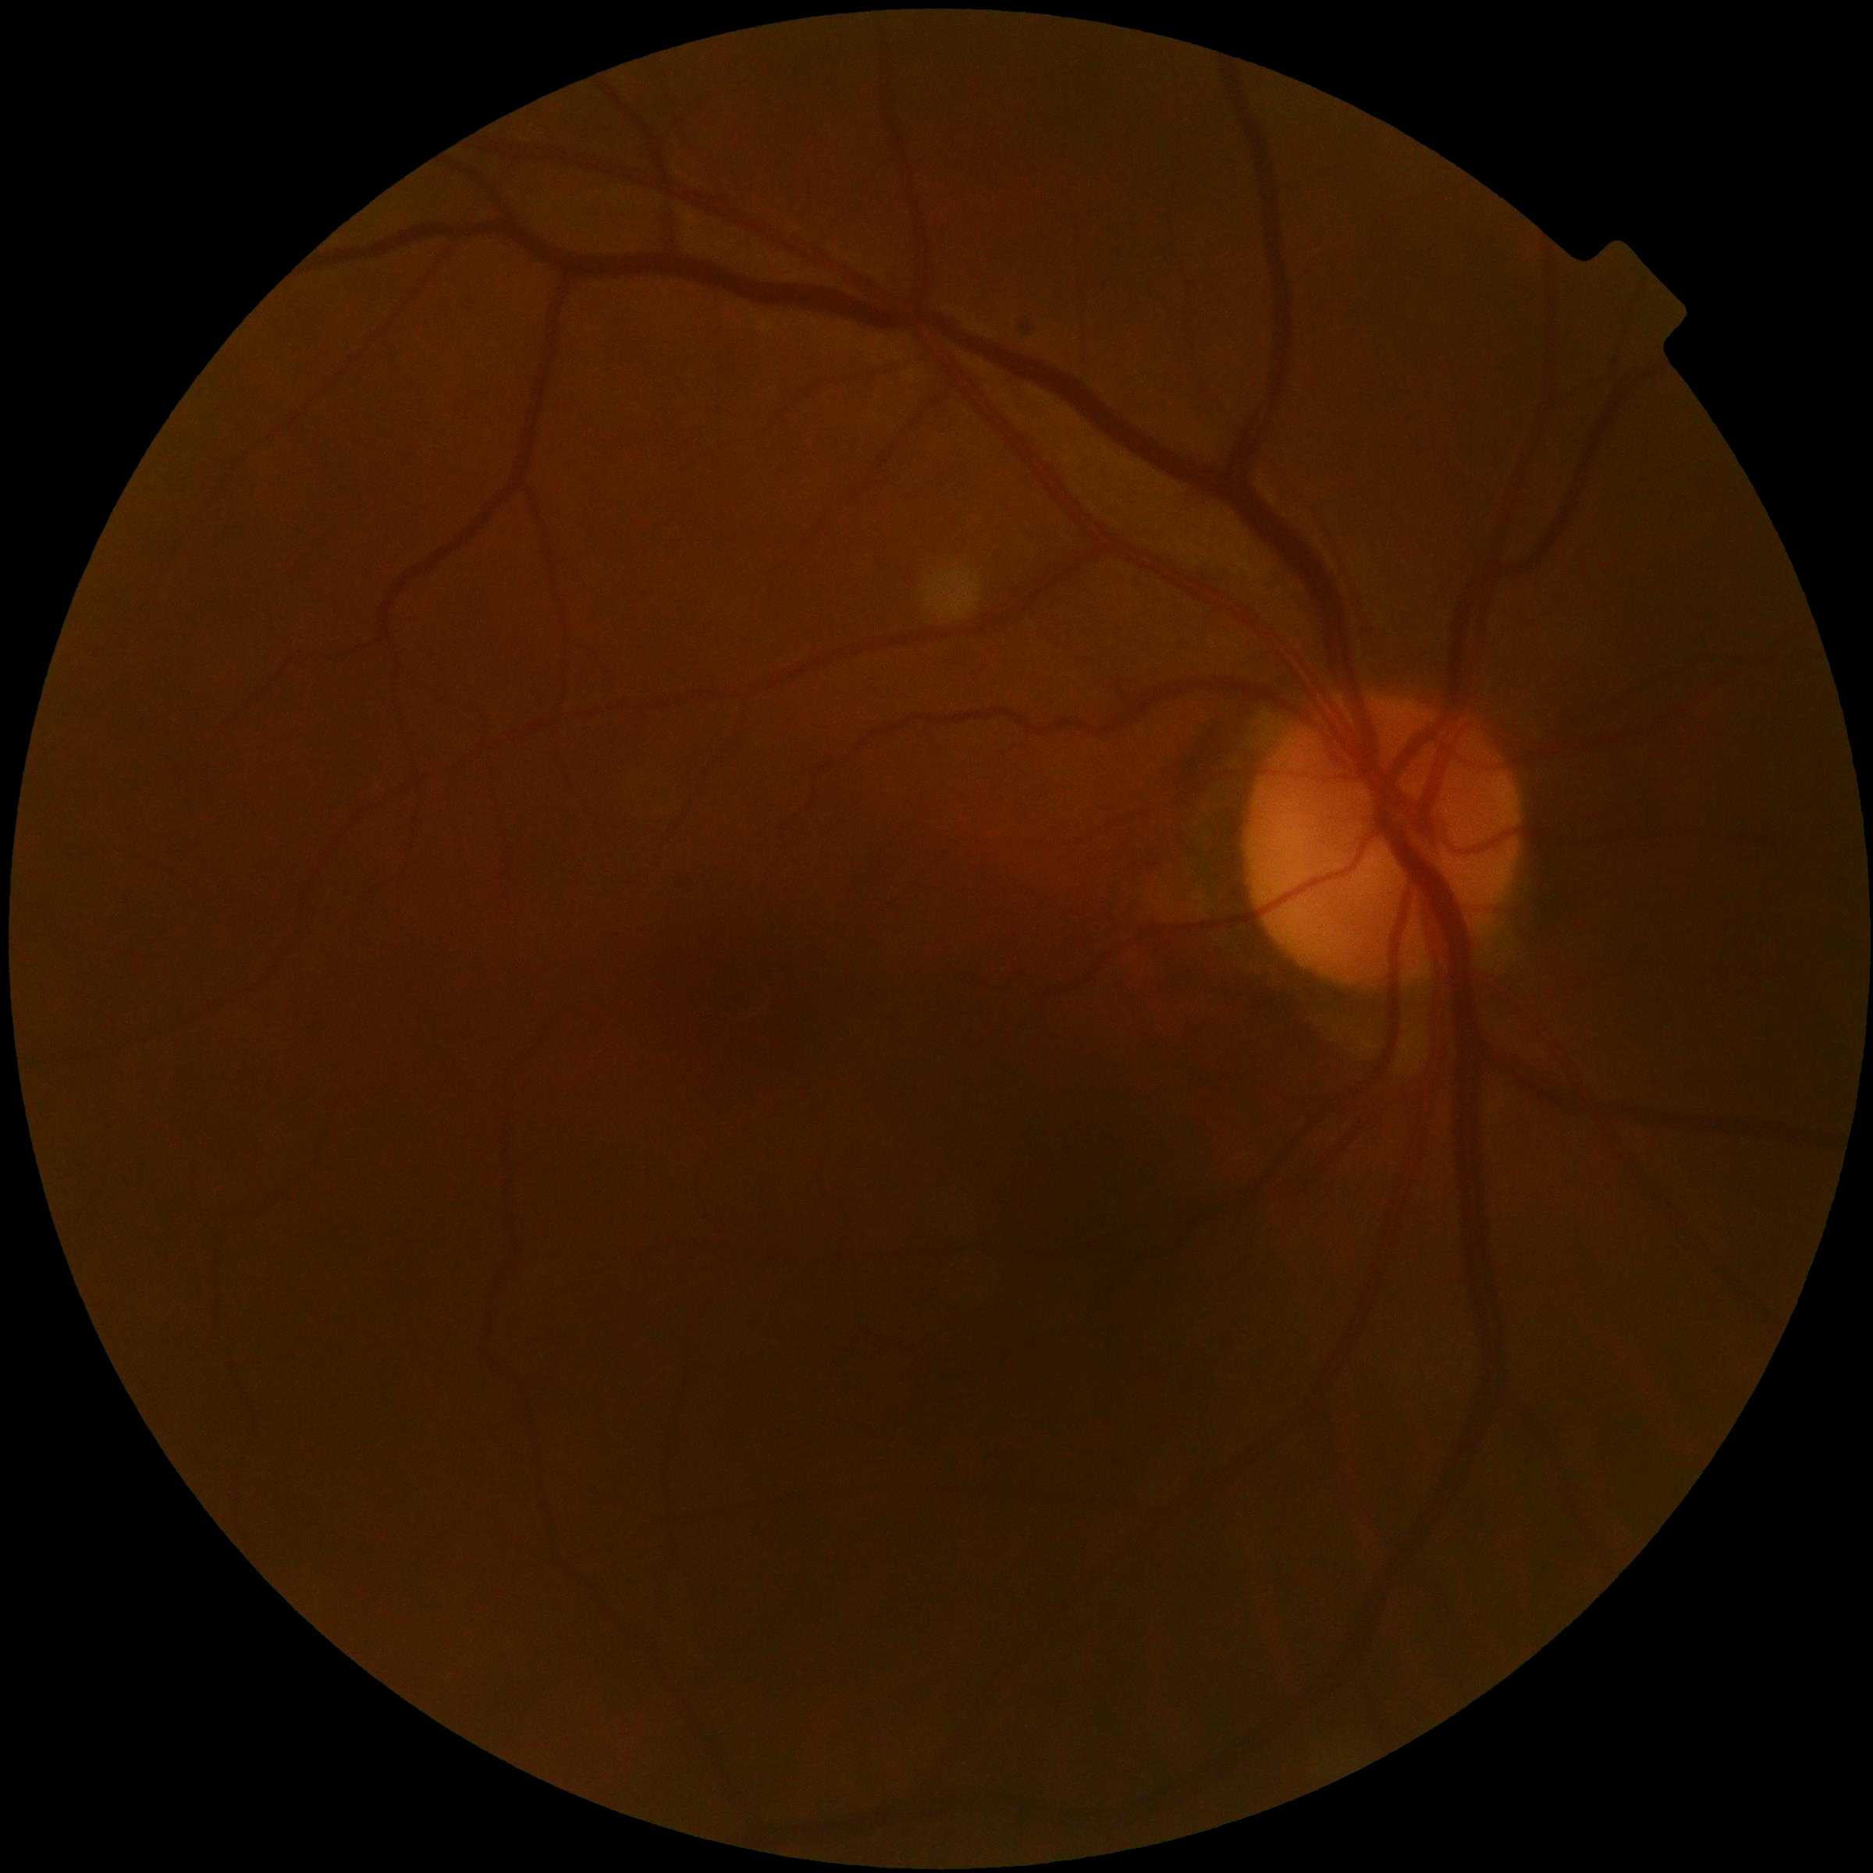
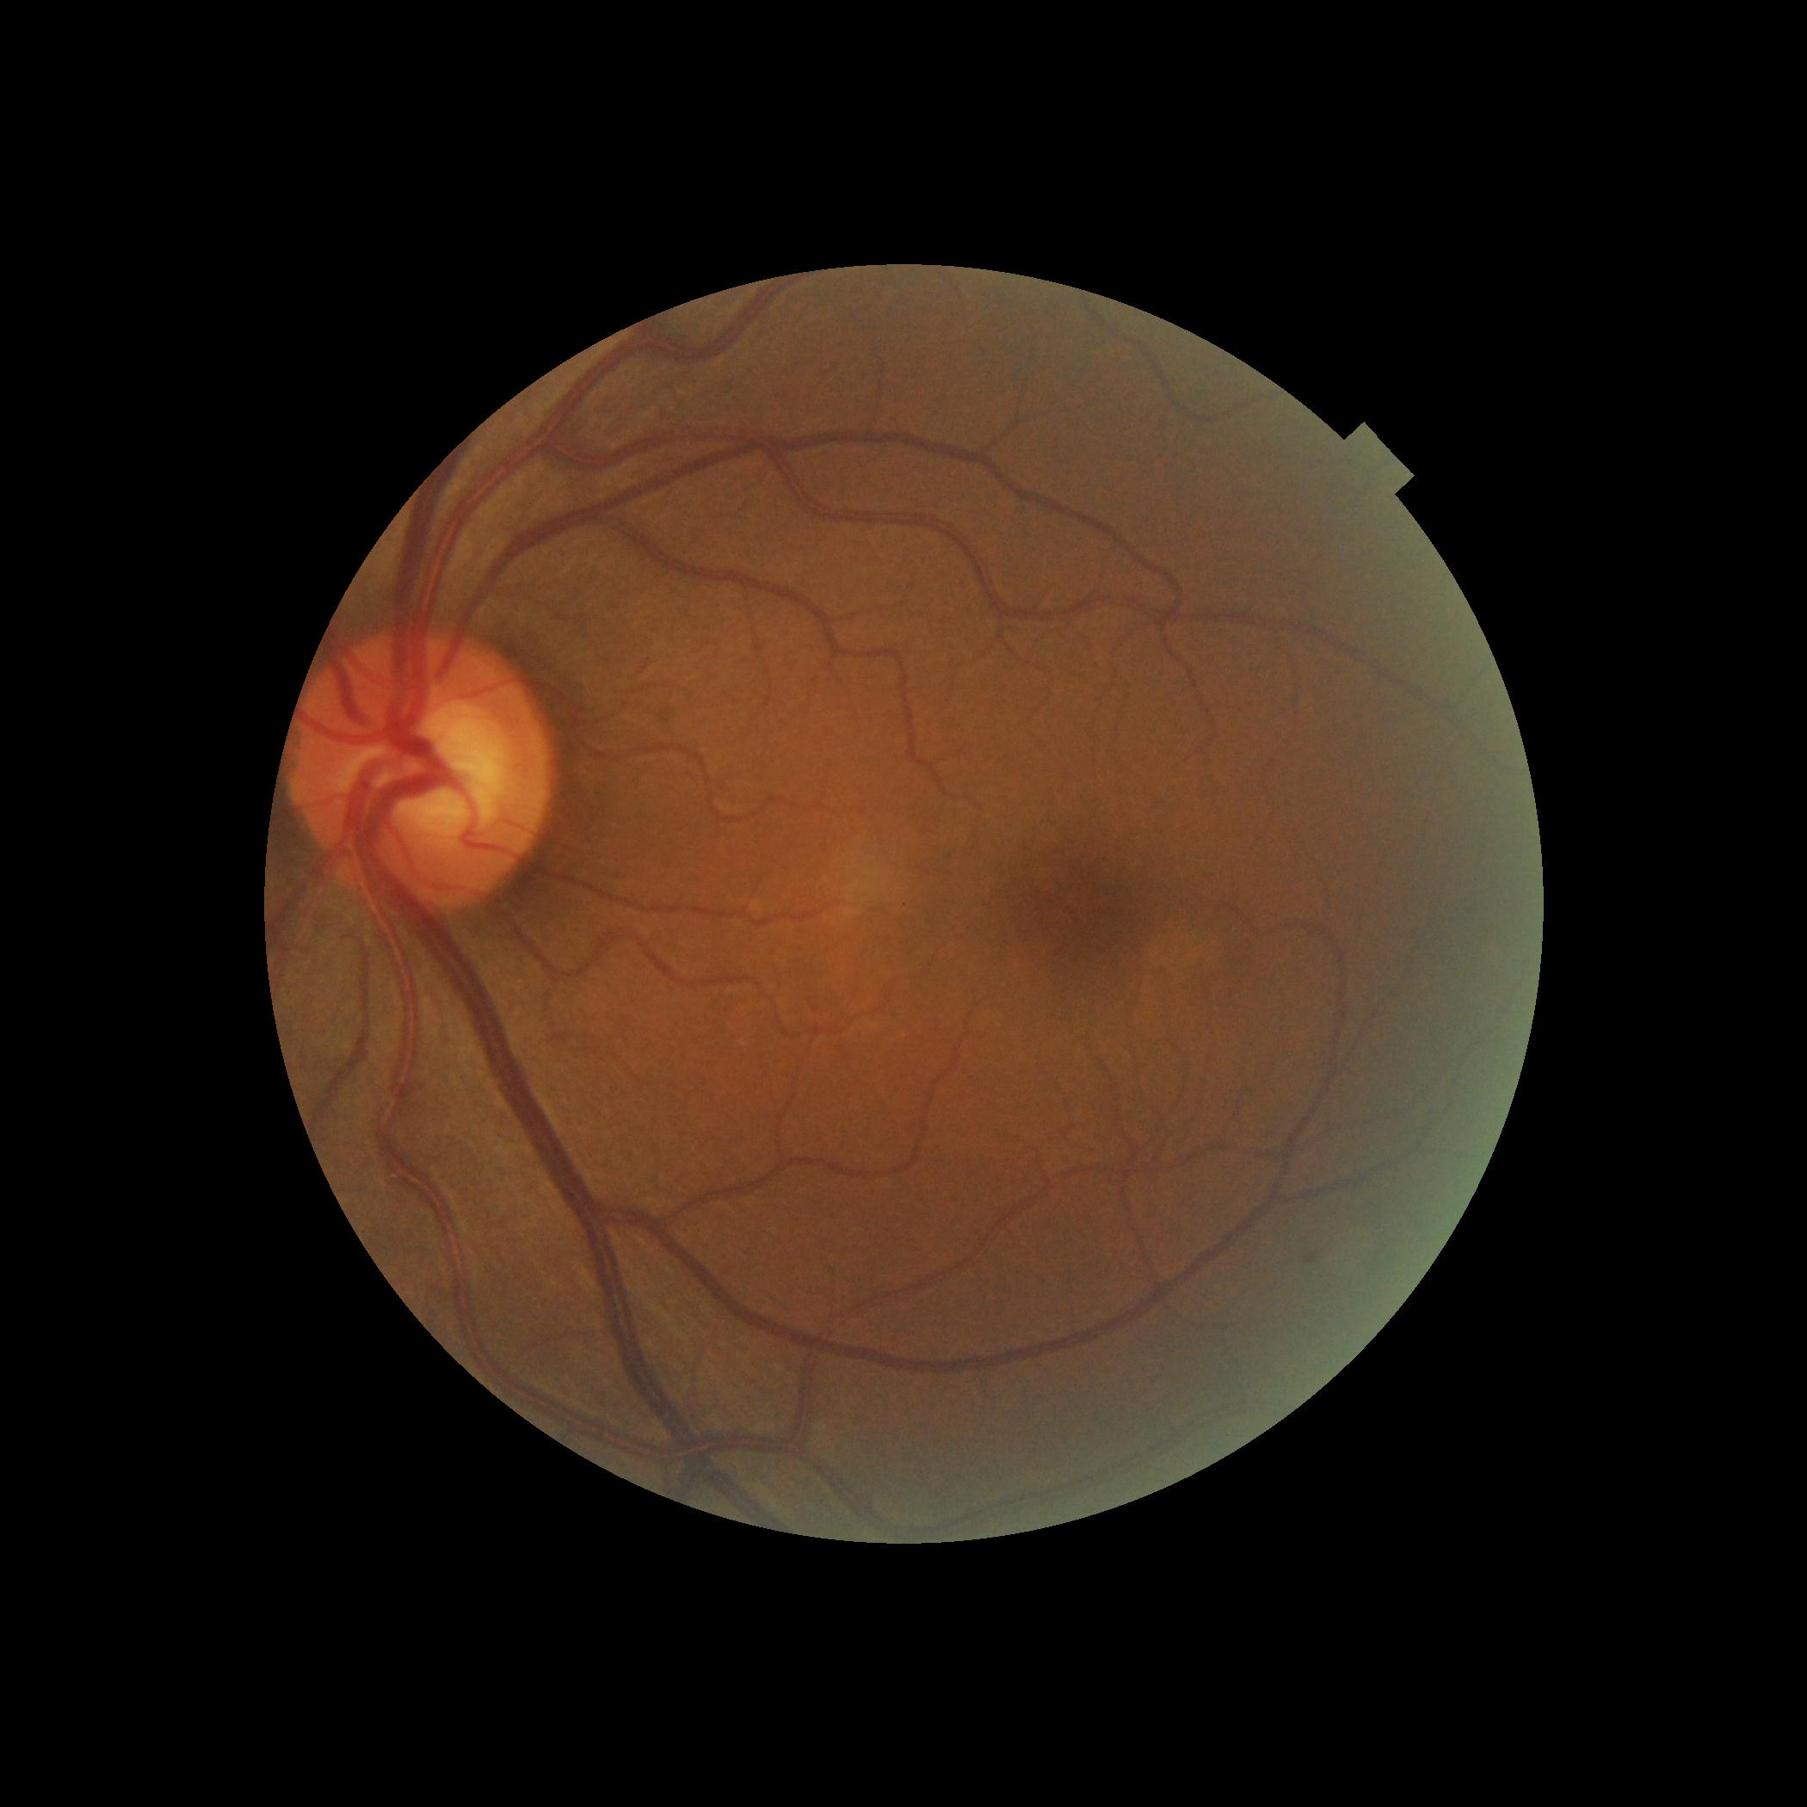
Notes:
Methods from (https://www.kaggle.com/ratthachat/aptos-eye-preprocessing-in-diabeticretinopathy) and (https://www.kaggle.com/titericz/circle-to-rectagle-preprocessing-1) are used for preprocessing original images to our input data.
The original image is of different brightness / size etc.

Slide 26
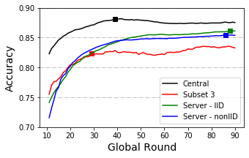
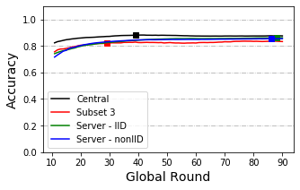
Cloud implementation – Result
Notes:
Zoomed acc curve (left). Pattern similar as simulation tests.
During training augmentation is used, and training start from the weights trained on ImageNet.

Slide 27
Discussion
Better check poisoning nodes, though the system can still have some level of tolerance to them.
Having many small nodes in the system can slower the convergence speed, but have little influence on final accuracy.
Better keep most of the nodes synchronous. The effect of delay nodes’ proportion is more seriously than the extent of delay nodes.
Sharing a small public data can slightly improve the performance of non-IID system. Under-sampling makes situation worse, over- sampling may can help with proper method, but method here is not suitable.

Slide 28
Thanks!

