Slide 1
Test Results

Slide 2
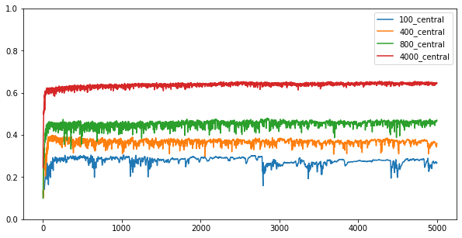
Non – Fed performance

Slide 3
Local steps
10 worker nodes
4000 training data
10000 testing data
Early stop = 500
If iid?
Local Steps
2
1
5
10
iid

Slide 4
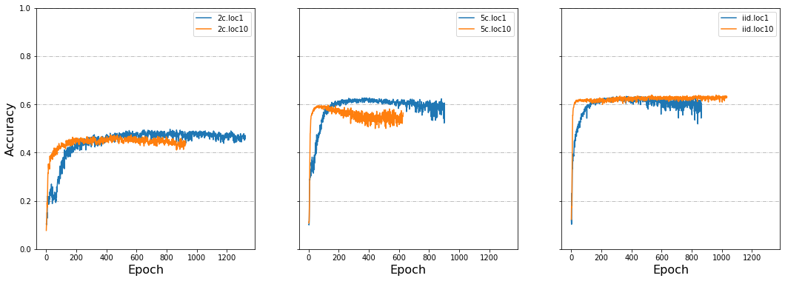
Local steps 1/2

Slide 5
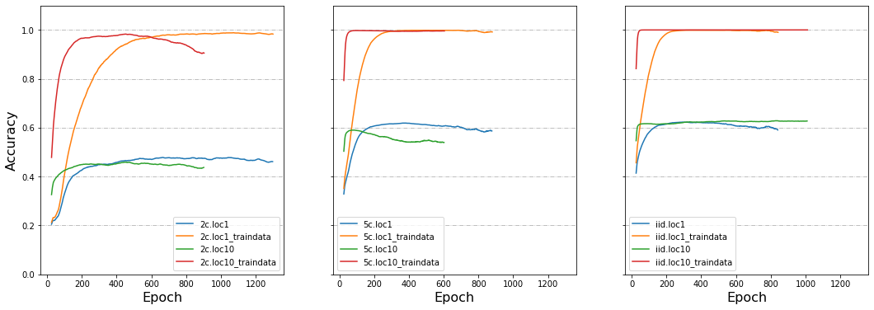
Local steps 2/2

Slide 6
Evaluate methods
10 worker nodes
4000 training data
10000 testing data
Early stop = 500
Local step = 1
If iid?
Evaluate
2
Central
5
Node – this epoch
(before average model)
iid
Node – last epoch
(after average model)

Slide 7
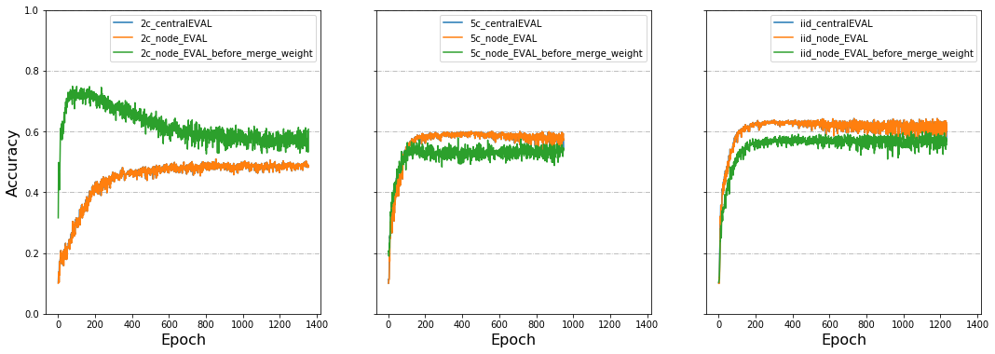
Evaluate methods 1/1

Slide 8
Bad node (return randomized weights)
10 worker nodes
4000 training data
10000 testing data
Early stop = 500
Local step = 1
Bad node: 1
If iid?
Node Size
2
40
5
400
iid

Slide 9
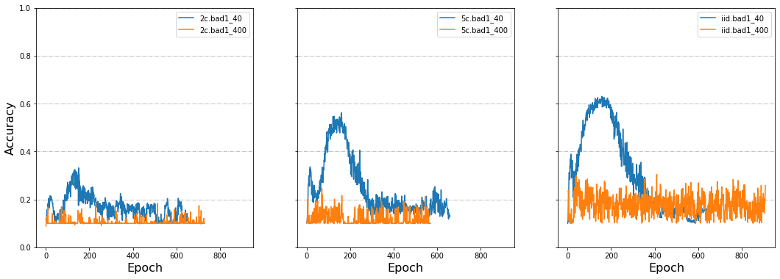
Bad node 1/2

Slide 10
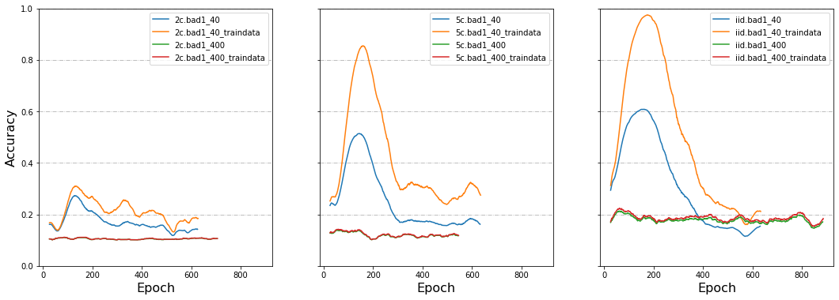
Bad node 2/2

Slide 11
Data Dispersion
4000 training data
10000 testing data
Early stop = 500
Local step = 1
If iid?
Node Number
2
10
5
40
iid
80

Slide 12
Data Dispersion 1/

Slide 13
Share data
40 worker nodes
4000 training data
10000 testing data
Early stop = 500
Local step = 1
If iid?
Share
Set local epoch iid
1
100
Not set local epoch iid
iid
400
800

Slide 14
Share data1 1/

Slide 15
Delayed Update
40 worker nodes
4000 training data
10000 testing data
Early stop = 500
Local step = 1
Delay Proportion
Delay Speed
If iid?
2
20%
3
5
50%
12
iid
80%
30

Slide 16
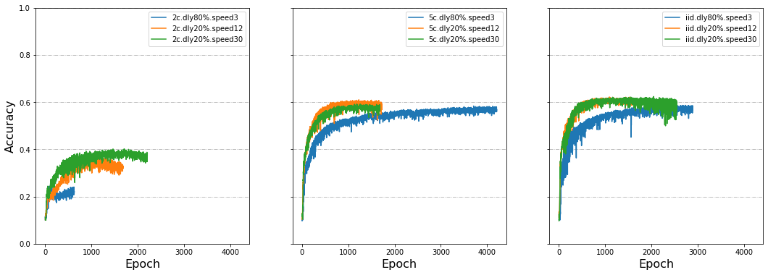
Delayed Update1 1/2

Slide 17
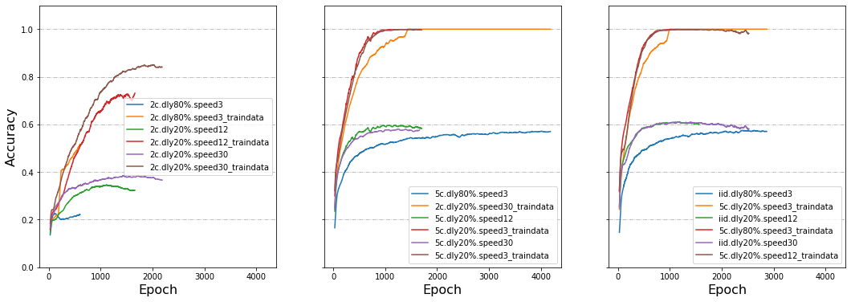
Delayed Update1 2/2

Slide 18
Delayed Update2 1/

