Slide 1
Test Results

Slide 2
Non – Fed performance

Slide 3
Local steps
10 worker nodes
4000 training data
10000 testing data
Early stop = 500
If iid?
Local Steps
2
1
5
10
iid

Slide 4
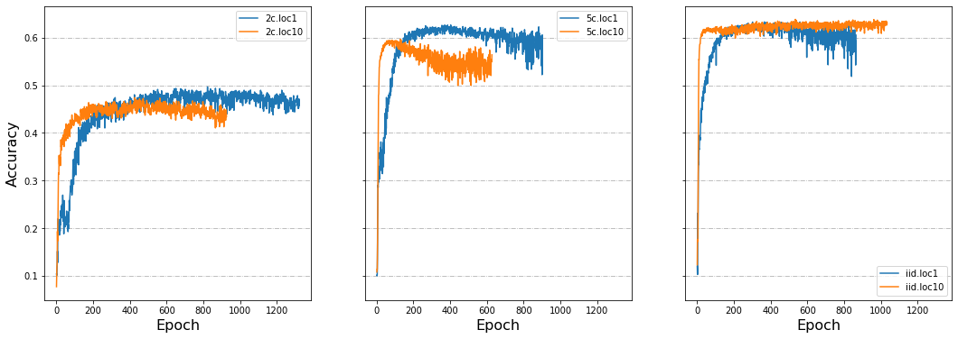
Local steps 1/3

Slide 5
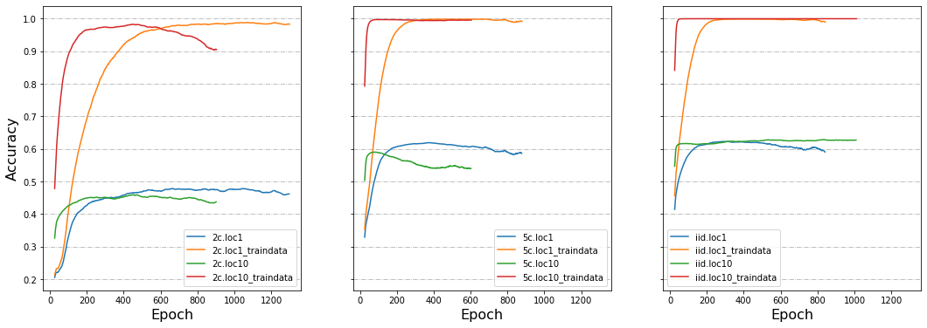
Local steps 2/3

Slide 6
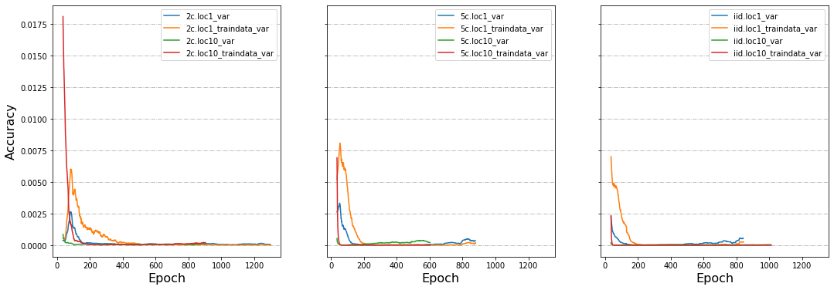
Local steps 2/3
Variance from the 10th window on

Slide 7
Evaluate methods
10 worker nodes
4000 training data
10000 testing data
Early stop = 500
Local step = 1
If iid?
Evaluate
2
Central
5
Node – this epoch
(before average model)
iid
Node – last epoch
(after average model)

Slide 8
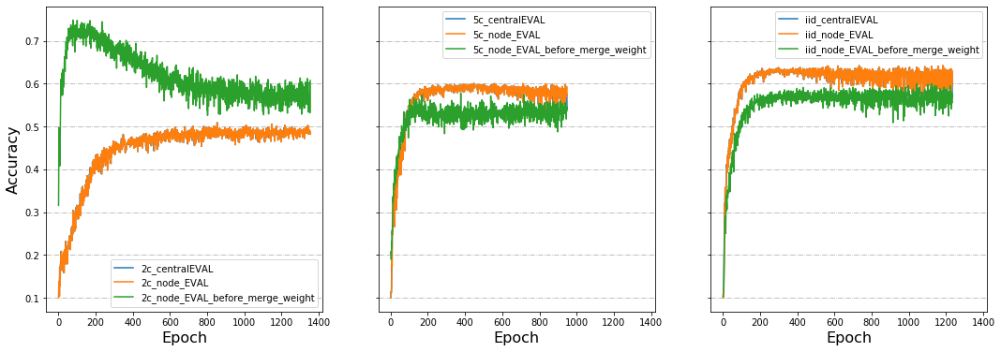
Evaluate methods 1/1

Slide 9
Bad node (return randomized weights)
10 worker nodes
4000 training data
10000 testing data
Early stop = 500
Local step = 1
Bad node: 1
If iid?
Node Size
2
40
5
400
iid

Slide 10
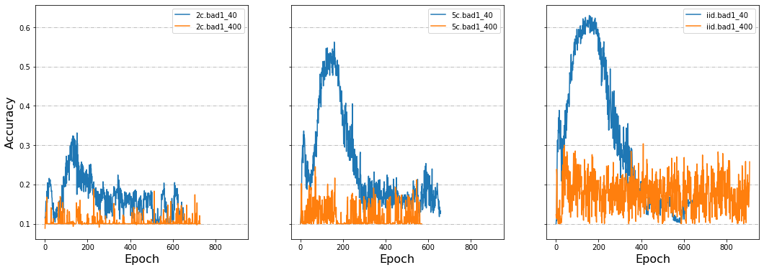
Bad node 1/3

Slide 11
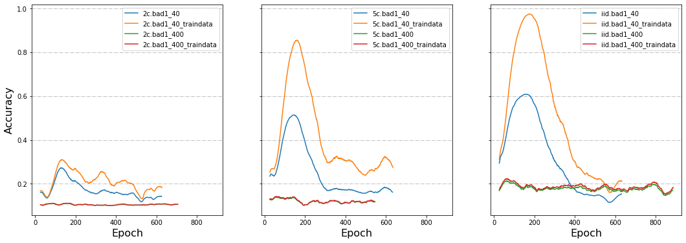
Bad node 2/3

Slide 12
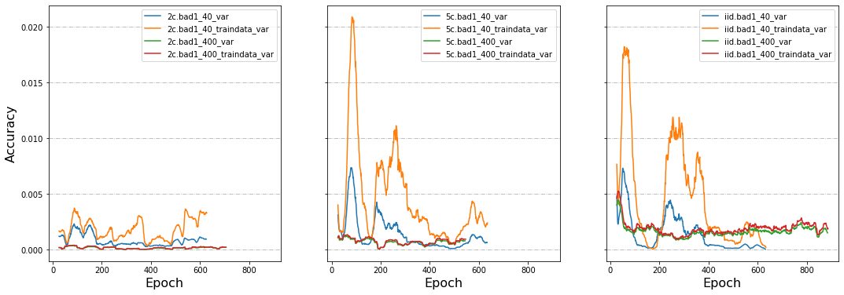
Bad node 3/3

Slide 13
Data Dispersion
4000 training data
10000 testing data
Early stop = 500
Local step = 1
If iid?
Node Number
2
10
5
40
iid
80

Slide 14
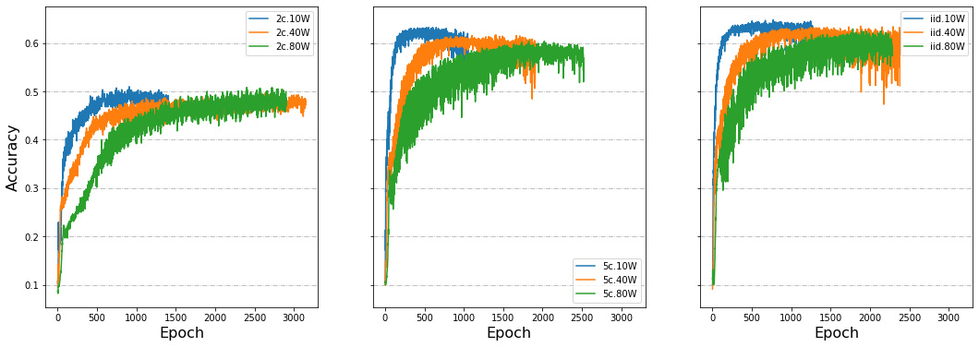
Data Dispersion 1/3

Slide 15
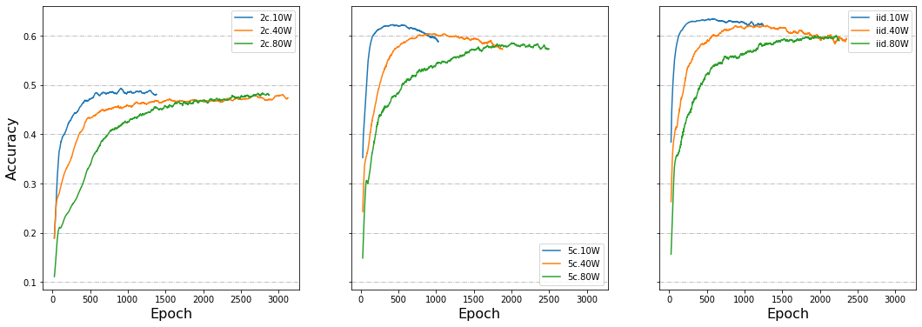
Data Dispersion 2/3

Slide 16
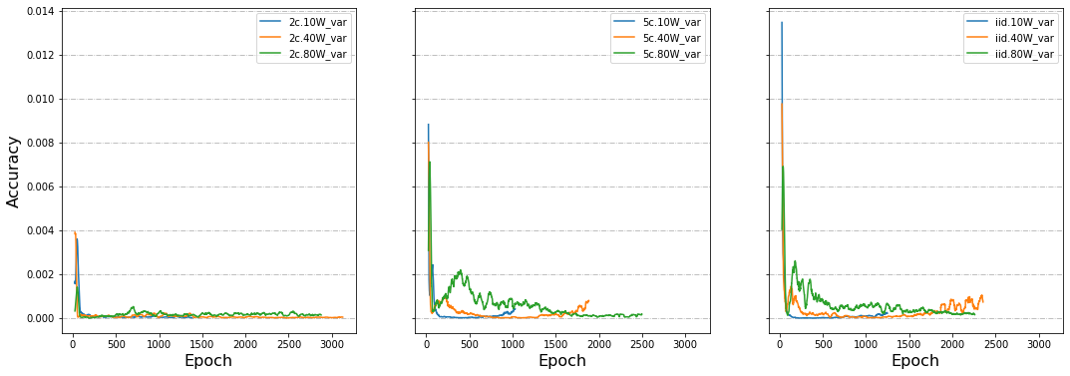
Data Dispersion 3/3

Slide 17
Share data
Early stop = 500
Local step = 1
If iid?
Share
Node
Training data
Set local epo iid
1
100
10
4000
Didn’t set local epoch iid
iid
400
40
8000
800

Slide 18
Delayed Update
40 worker nodes
4000 training data
10000 testing data
Early stop = 500
Local step = 1
Delay Proportion
Delay Speed
If iid?
2
20%
3
5
50%
12
iid
80%
30

