Slide 1
Test Results
2020/5/7

Slide 2
Index
Non – Fed performance
Local steps
Evaluate methods
Bad node (return randomized weights)
Data Dispersion
Share data
Delayed Update

Slide 3
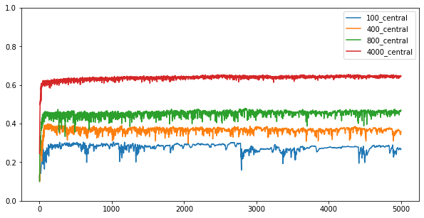
Non – Fed performance

Slide 4
Local steps
10 worker nodes
4000 training data
10000 testing data
Early stop = 500
If iid?
Local Steps
2
1
5
10
If worker size = 400
e.g.
2c means: class[A,B] * 200
5c means class[A,B,C,D,E] * 80
………
iid

Slide 5
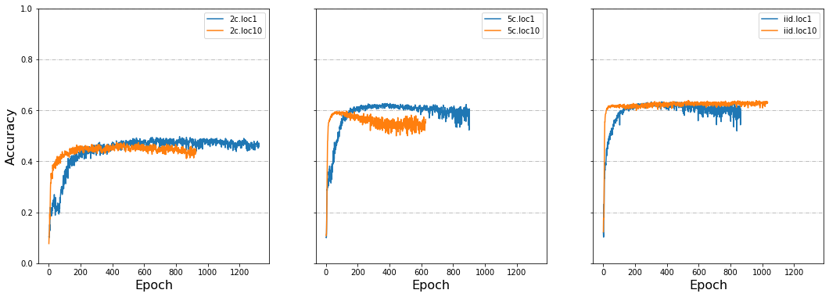
Local steps 1/2

Slide 6
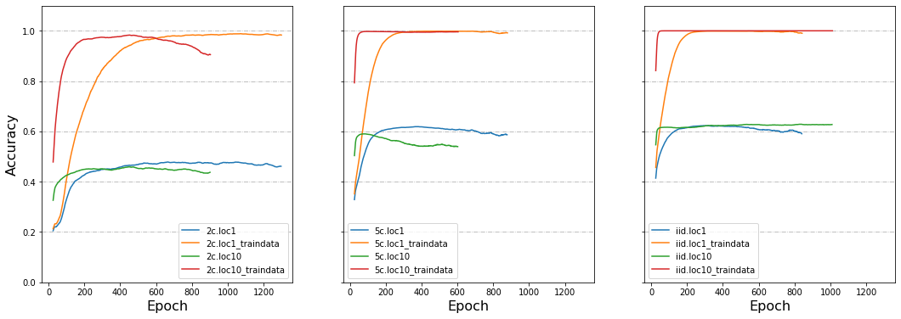
Local steps 2/2

Slide 7
Evaluate methods
10 worker nodes
4000 training data
10000 testing data
Early stop = 500
Local step = 1
If iid?
Evaluate
2
Central
5
Node – this epoch
(before average model)
iid
Node – last epoch
(after average model)
The distributed training data also follows node’s (2c/5c/iid)

Slide 8
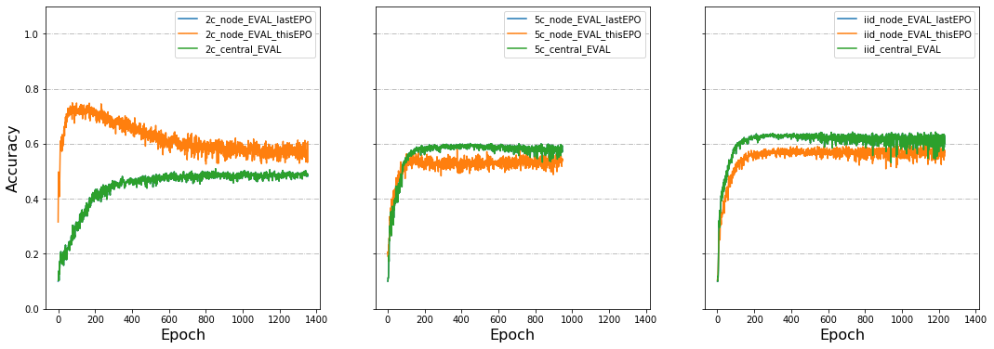
Evaluate methods 1/1
Node_EVAL_lastEPO perfectly covered by central_EVAL

Slide 9
Bad node (return randomized weights)
10 worker nodes
4000 training data
10000 testing data
Early stop = 500
Local step = 1
Bad node: 1
If iid?
Node Size
2
40
5
400
iid

Slide 10
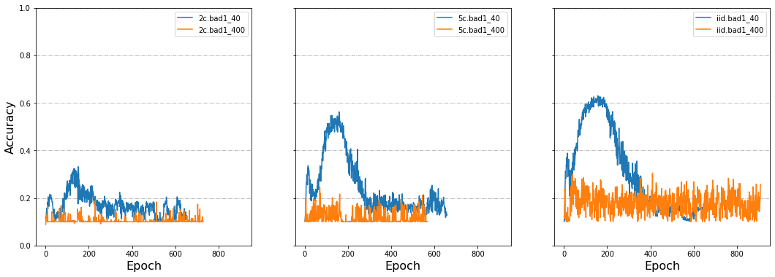
Bad node 1/2

Slide 11
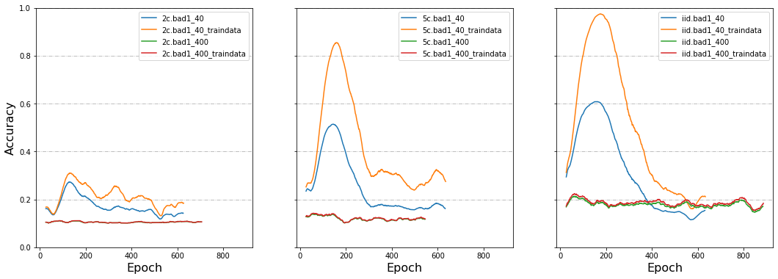
Bad node 2/2

Slide 12
Data Dispersion
4000 training data
10000 testing data
Early stop = 500
Local step = 1
If iid?
Node Number
2
10
5
40
iid

Slide 13
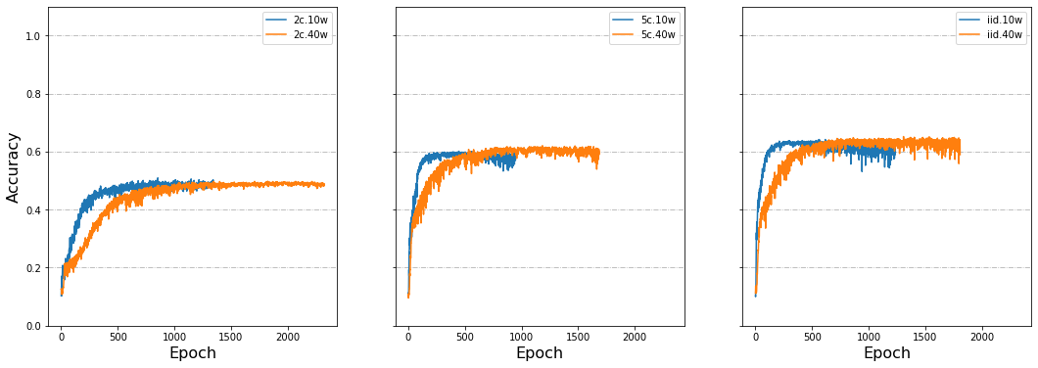
Data Dispersion 1/2

Slide 14
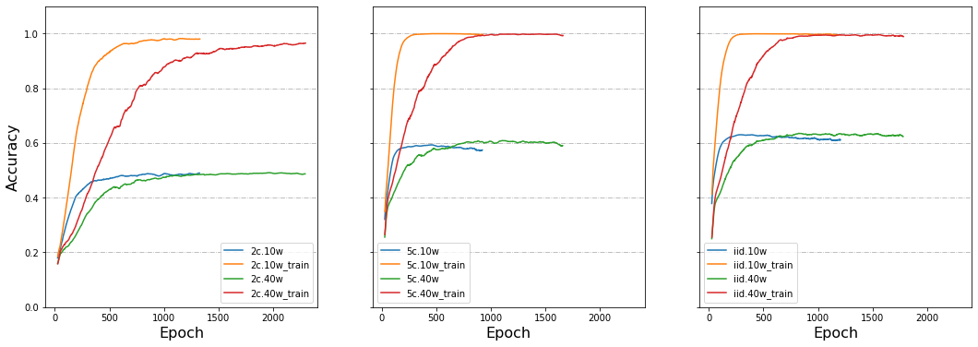
Data Dispersion 2/2

Slide 15
Share data
40 worker nodes
4000 training data
10000 testing data
Early stop = 500
Local step = 1
If iid?
Share
Set local epoch iid
1
100
Not set local epoch iid
iid
400
800

Slide 16
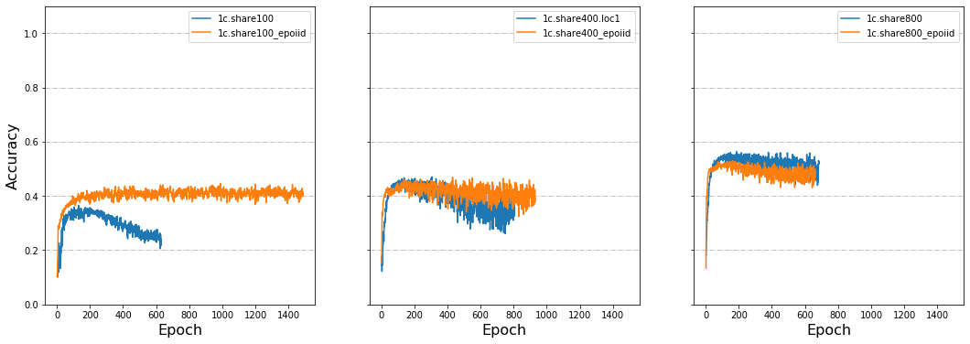
Share data1 1/4

Slide 17
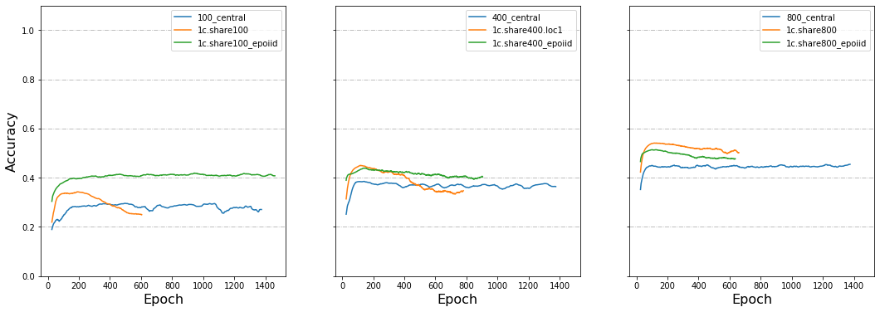
Share data1 2/4

Slide 18
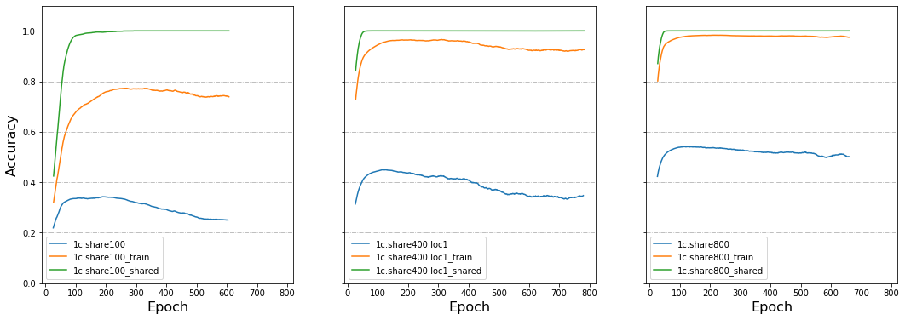
Share data1 3/4

Slide 19
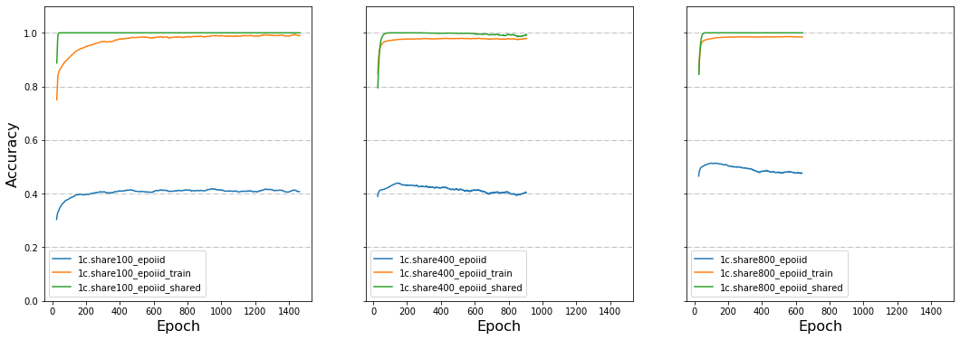
Share data1 4/4

Slide 20
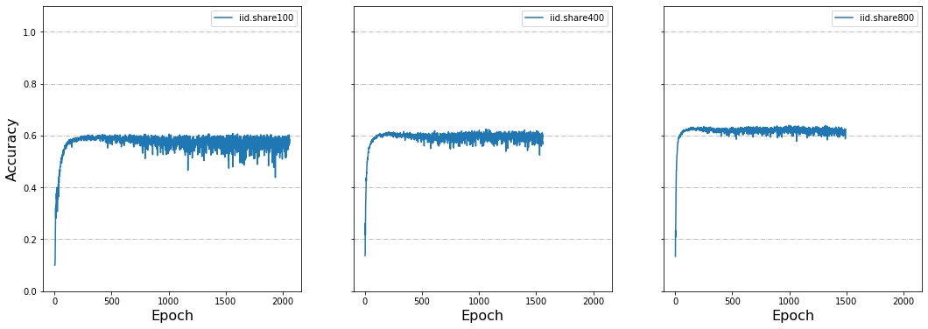
Share data2 1/2

Slide 21
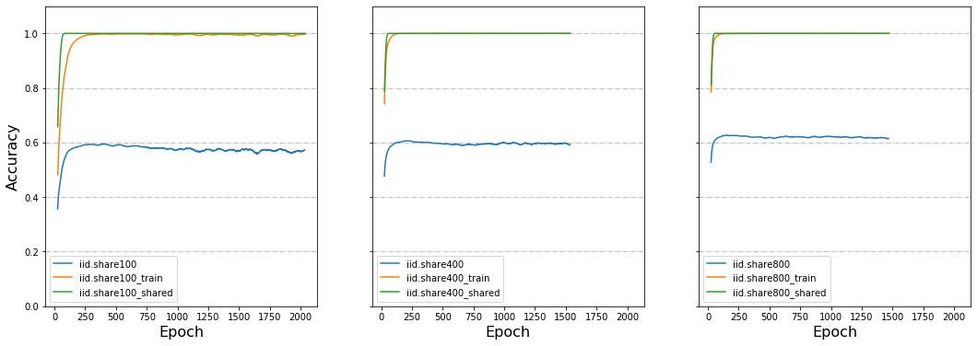
Share data2 1/2

Slide 22
Delayed Update
40 worker nodes
4000 training data
10000 testing data
Early stop = 500
Local step = 1
Delay Proportion
Delay Speed
If iid?
2
20%
3
5
50%
12
iid
80%
30

Slide 23
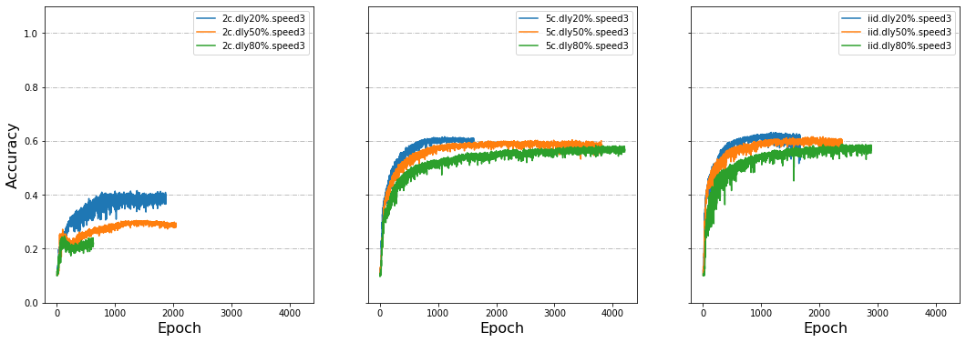
Delayed Update1 1/5

Slide 24
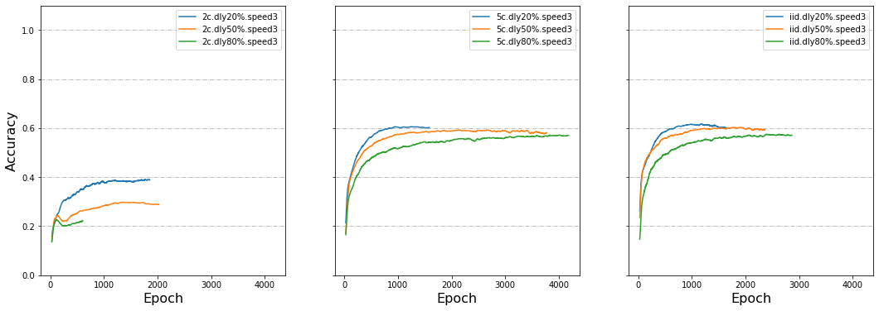
Delayed Update1 2/5

Slide 25
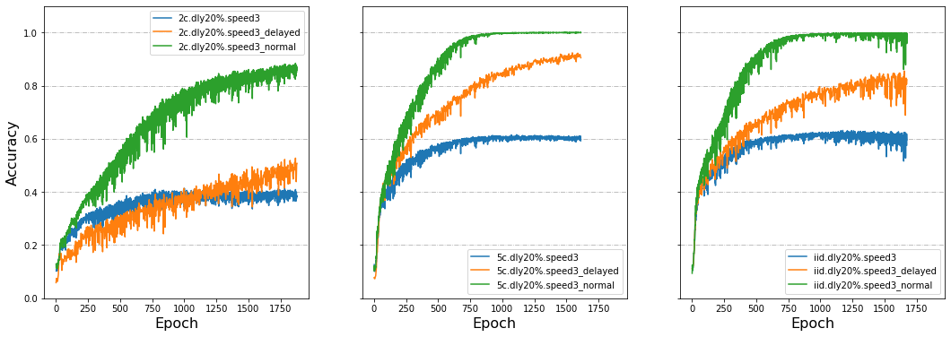
Delayed Update1 3/5

Slide 26
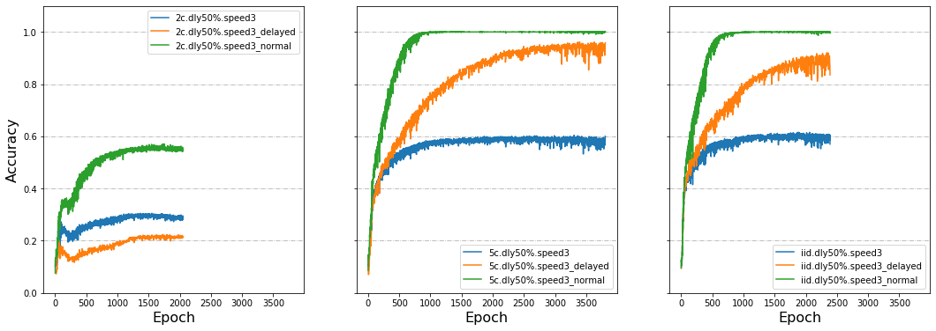
Delayed Update1 4/5

Slide 27
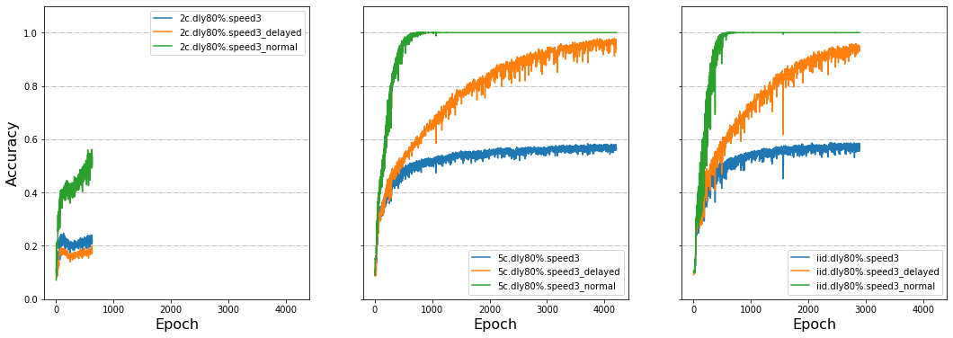
Delayed Update1 5/5
Why 2c behaves differently?

Slide 28
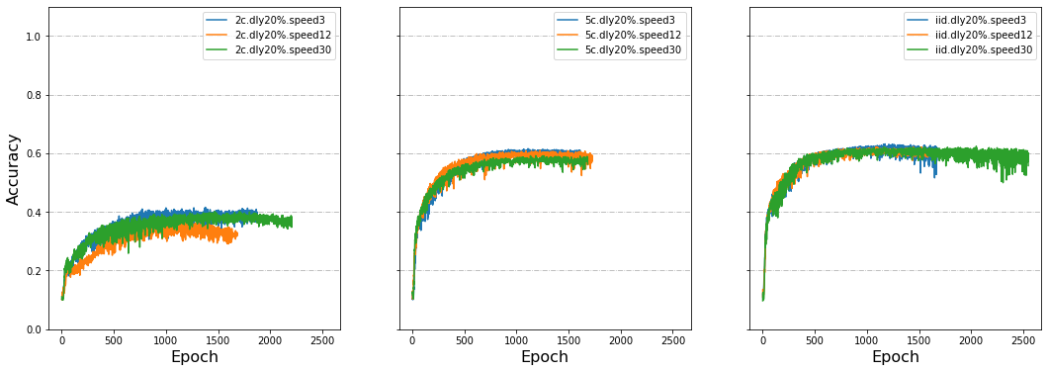
Delayed Update2 1/4
Why 2c.speed12 worse than the other two??

Slide 29
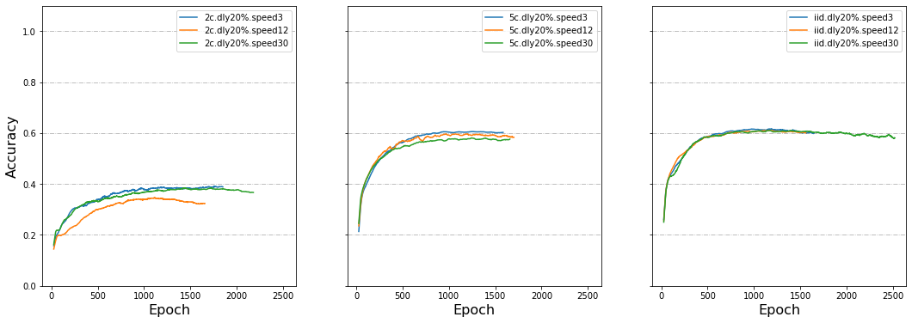
Delayed Update2 2/4
Why 2c.speed12 worse than the other two??

Slide 30
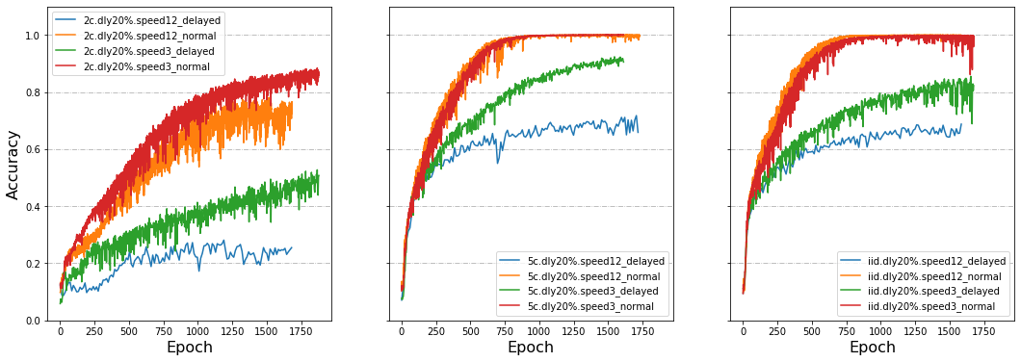
Delayed Update2 3/4
Notes:
3 v.s. 12

Slide 31
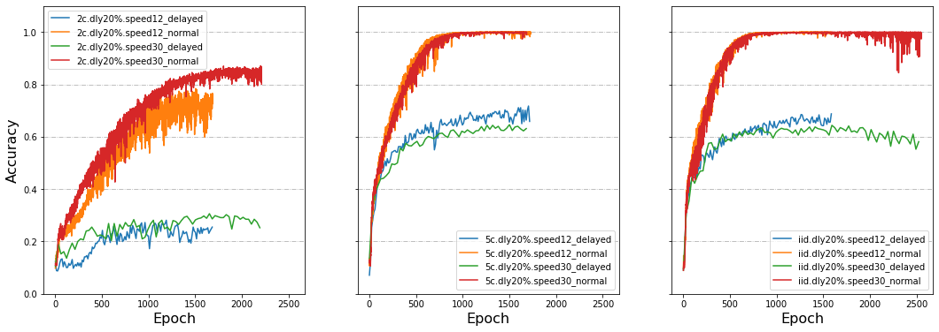
Delayed Update2 4/4
Notes:
30 v.s. 12
Speed 30 less often affected? 5c+10c is fast so this effect can be covered, but 2c is slow so it’s obvious?

Slide 32
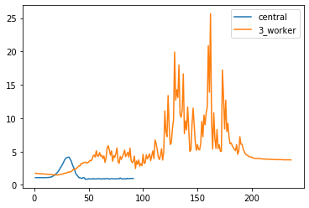
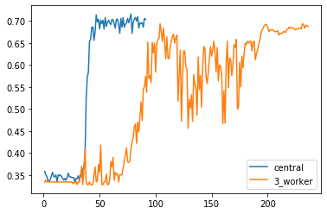
gRPC bioinfo example (3 class)
loss
acc

