Slide 1
CS 6476 Project 6
[Jiarui Xu]
[jxu605@gatech.edu]
[jxu605]
[903617486]

Slide 2
Parts 4 & 5: mIoU of different models
Add each of the following (keeping the changes as you move to the next row):
 | Training mIoU | Validation mIoU
Simple Segmentation Net (no pretrained weights) | 0.2123 | 0.0292
ImageNet-Pretrained backbone | 0.4653 | 0.4938
Data augmentation | 0.5333 | 0.5524
ImageNet-Pretrained PSPNet w/ Data Aug. without PPM | 0.5704 | 0.5958
PSPNet with PPM | 0.5821 | 0.6249
PSPNet with auxiliary loss | 0.5884 | 0.6203

Slide 3
Parts 4 & 5: Per class IoUs
Report your model’s IoU for the 11 Camvid classes (you can find the order they are listed in at dataset_lists/camvid-11/camvid-11_names.txt):
Class Index | Class name | Simple Segmentation Net Class IoU | PSPNet Class IoU
0 | Building | 0.8983 | 0.9402
1 | Tree | 0.9089 | 0.9678
2 | Sky | 0.9175 | 0.9657
3 | Car | 0.7695 | 0.9383
4 | SignSymbol | 0.0000 | 0.0000
5 | Road | 0.9449 | 0.9682
6 | Pedestrian | 0.2943 | 0.7239
7 | Fence | 0.7328 | 0.8605
8 | Column_Pole | 0.0014 | 0.0014
9 | Sidewalk | 0.8222 | 0.9358
10 | Bicyclist | 0.5333 | 0.5826

Slide 4
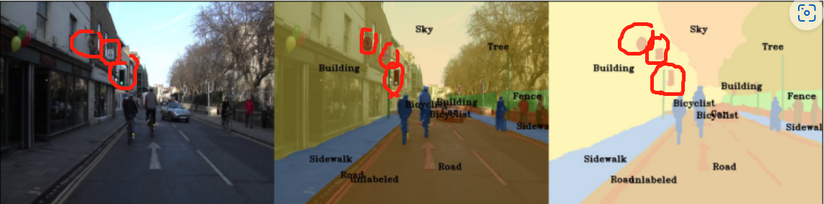
Parts 4 & 5: Most difficult classes
[Which classes have the lowest mIoU? Why might they be the most difficult? Provide an example RGB image from Camvid that illustrates your point]
SignSymbol. Because its shape, size, color are not uniform and most of the sign symbols are full of details which are difficult to recognize, there is no reliable basis for judgment. For example, the red symbols circled in the picture below are signsymbols, but we can't determine whether they are signsymbols or other objects by their shapes and colors, because they come in a variety of colors and shapes.

Slide 5
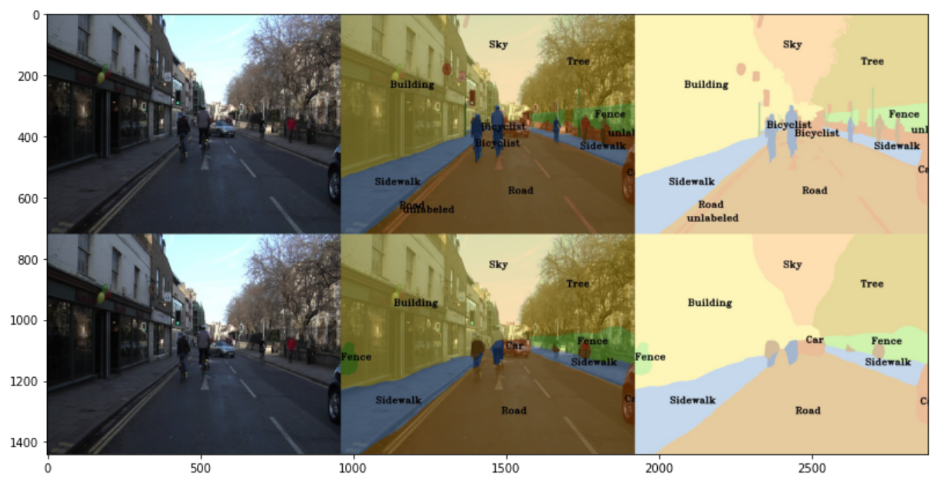
Part 4: Simple segmentation net qualitative results
[Paste a figure of the generated semantic segmentation from Colab. It should be a 2x3 grid, with ground truth on the top row, and your predictions on the bottom row.]

Slide 6

Part 5: PSPNet qualitative results
[Paste a figure of the generated semantic segmentation from Colab. It should be a 2x3 grid, with ground truth on the top row, and your predictions on the bottom row.]

Slide 7
Part 6: Transfer Learning
Report your model’s IoU for the Kitti Dataset.
 | mIoU | mAcc/ | allAcc
Train result | 0.9362 | 0.9664 | 0.9803
Val result | 0.9365 | 0.9618 | 0.9806
Class Index | Class name | iou | accuracy
0 | Road | 0.8962 | 0.9325
1 | Not_Road | 0.9767 | 0.9911

Slide 8
Part 6: Transfer Learning
Compare the training loss generated when training on Kitti dataset and Camvid dataset. Which decreases at a faster rate? If Camvid or Kitti training loss decreases at a faster rate than the other, why do you think this happened? Or, if the loss decreases at a similar rate, why do you think that is so?
Kitti decreases at a faster rate. Because Kitti uses a Pretrained model to do the transfer learning. Transfer learning can save resources and improve efficiency when training new models, so the loss decreases faster.

