Slide 1
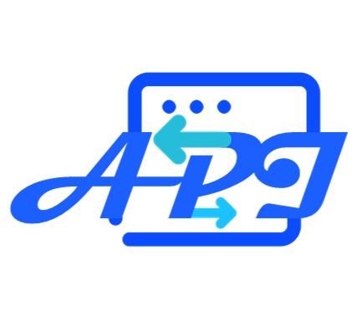
EasyAPI
EasyAccess
CalTable
Tablex
(RESTful API)
(Python Module)
(Data Science Tool)
(GUI - Web Service)
Transfer Protocol
Data Table
Experiment
Transfer Protocol
Connect
Type Inference
HTTP/HTTPS
Data Case
HTTP/HTTPS
MQTT
Websocket
Data Unit
Data Sheet
MQTT
Websocket
Data Protocol
Visual
Web IO
Auto Route
HTTP Hosts
Select
Global Index
Doc
Visual
Toolbox
Data Protocol
Load Balance
WorkBench
Workflows
Rich Protocol
…
Data Protocol
Toolkits Index
Tool
Source
Meta Protocol
Rich Protocol
Workflow
SHARE
GET
Task Queue
Meta Protocol
Parallel Stack
Sharing Pool
Resource Queue
Task Holder
IO Interference
Results
GPU
CPU
Mem
Workflows
Application
CalBlock
Algorithm Port
Python Function
Python Function
Tools
……
Sources
Doc
Data
Doc
Data
Algorithm 1
Algorithm 3
Hot Plug
Algorithm i
Algorithm 2

