Slide 1
CS 111 week 6 Project 2b: Lock contention
Diyu Zhou

Slide 2
Lock contention: the problem
#define MAX_SUM 100000000ul
void * thread_worker(void * unused)
{
int i = 0;
for (i = 0; i < MAX_SUM/thread_num; i++) //thread_num is the total number of threads
{
while (__sync_lock_test_and_set(&lock, 1));
sum++;
__sync_lock_release(&lock);
}
}
Will we gain speedup if we increase the
number of threads?

Slide 3
Project 2B: Overview
Part A: Identify the lock contention problem
1. Starting from lab2a_list, measure throughput in number of ops/seconds
2. Use google profile tool to pinpoint which the line causing the problem
3. Measure the time spent on acquiring mutex
Part B: Resolve the lock contention problem:
Support a new command line option --lists=N, and implement the linked list with N sublists.

Slide 4
Part A: Using the Profile Tool

Slide 5
Profile Tool: motivation
#define MAX_SUM 100000000ul
void * thread_worker(void * unused)
{
int i = 0;
for (i = 0; i < MAX_SUM/thread_num; i++) //thread_num is the total number of threads
{
while (__sync_lock_test_and_set(&lock, 1));
sum++;
__sync_lock_release(&lock);
}
}
How can we design a tool to help us find the bottleneck of the program?
Ideally such a tool needs to be
1. Transparent: Does not require modifications
to the program
2. Low overhead
3. Easy to enable/disable

Slide 6
Profile Tool Key idea: Sampling
Key idea of profile tool: sampling
For every N (say 1,000,000) instructions/cycles, check the program counter, see
which function/LOC it falls in. Aggerate the results when the program exits.
Sampling tool satisfies all the three goals we have mentioned:
Transparent,
Low-overhead: Sampling rate is low
Easy to enable/disable: Explained later

Slide 7
Profile Tool Hardware Support: Performance Coutner
Without hardware support → Maintain a counter records number of instructions
→ increment the counter every instruction → at least 100% overhead!
Performance counter: Generate an interrupt after a specified number of events occur
Performance counter for sampling:
1. Sampling tool program performance counter by writing to specified
registers (e.g. fire an interrupt after 1,000,000 instructions).
2. Program execute and triggers an interrupt after 1,000,000 instructions
3. Sampling tool gets the program counter of the interrupt context.
4. Sampling tool uses program counter to identify functions/lines of code, goto step 1.

Slide 8
Google Profile Tool: Installation
Using package management tool:
With root permission:
apt-get install google-perftools (Ubuntu)
yum install gperftools (Old Version of CentOS, Fedora)
dnf install gperftools (New Version of CentOS, Fedora)
Install from source code:
git clone https://github.com/gperftools/gperftools
./autogen.sh # If encountered error regarding AC_PROG_LIBTOOL, see piazza post
./configure # use --prefix option if install on lnxsrv09
make
make install

Slide 9
Google Profile Tool: Usage
Compile your program with –g
Find where you have installed libprofiler.so and pprof, the below example assume ~/lib/libprofiler.so and ~/bin/pprof
LD_PRELOAD=~/lib/libprofiler.so CPUPROFILE=./raw.gperf my_prog my_argument
# LD_PRELOAD: linker magic, overload existing function in my_prog
# CPUPROFILE: gperf specific environment variable, tells gperf where to store the raw
# profiling data.
4. ~/bin/pprof --text ./my_prog ./raw.gperf
#analyze raw sampling file, show sampling results in functions (i.e. how often does
sampling fall into individual functions)
5. ~/bin/pprof --list=thread_worker ./my_prog ./raw.gperf
# show sampling results in function thread_worker (i.e. how often does sampling fall into each lines of code in thread_worker)

Slide 10
Sampling results
~/bin/pprof --text ./myprog ./raw.gperf
Total: 16187 samples
16187 100.0% 100.0% 16187 100.0% thread_worker
~/gperf/bin/pprof --list=thread_worker ./test ./raw.gperf
1622 1622 17: for (i = 0; i < MAX_SUM/thread_num; i++)
. . 18: {
13794 13794 19: while (__sync_lock_test_and_set(&lock, 1));
769 769 20: sum++;
2 2 21: __sync_lock_release(&lock);
. . 22: }

Slide 11
Part A: Measuring the lock contention time

Slide 12
Code snippet of thread_worker
void * thread_worker(threadNum) {
startIndex = threadNum * iteration;
for (i = startIndex; i < startIndex + iteration; i++)
{
pthread_mutex_lock(&list_lock);
SortedList_insert(listhead, pool[i]);
pthread_mutex_unlock(&list_lock);
}
….
}

Slide 13
Measure lock contention time
void * thread_worker(threadNum) {
startIndex = threadNum * iteration;
for (i = startIndex; i < startIndex + iteration; i++)
{
clock_gettime(CLOCK_MONOTONIC, &start_time);
pthread_mutex_lock(&list_lock);
clock_gettime(CLOCK_MONOTONIC, &end_time);
SortedList_insert(listhead, pool[i]);
pthread_mutex_unlock(&list_lock);
//wait_time is an unsigned long array with length being number of worker threads.
wait_time[threadNum] += calc_diff(&start_time, &end_time);
}
….
}

Slide 14
Part B: Break linked lists into sublists

Slide 15
Part B: overview
SortedListElement_t listheads[], * pool;
pthread_mutex_t locks[];
void * thread_worker(threadNum) {
startIndex = threadNum * iteration;
for (i = startIndex; i < startIndex + iteration; i++) Mul_SortedList_insert(pool[i]);
Mul_SortedList_length(); for (i = startIndex; i < startIndex + iteration; i++) {
e = Mul_SortedList_lookup(pool[i]->key);
SortedList_delete(e);
}
}

Slide 16
Insert of multiple sublists
Note: below is pseudocode
SortedListElement_t listheads[];
pthread_mutex_t locks[];
void Mul_SortedList_insert(SortedListElement_t *element)
{
int list_num = hashkey(element->key);
pthread_mutex_lock(&locks[list_num]);
SortedList_Insert(&listheads[list_num], element);
pthread_mutex_unlock(&locks[list_num]);
}

Slide 17
Lookup of multiple sublists
Note: below is pseudocode
SortedListElement_t listheads[];
pthread_mutex_t locks[];
SortedListElement_t * Mul_SortedList_ lookup(char * key)
{
SortedListElement_t * ret = NULL;
int list_num = hashkey(key);
pthread_mutex_lock(&locks[list_num]);
ret = SortedList_lookup(&listheads[list_num], key);
pthread_mutex_unlock(&locks[list_num]);
return ret;
}

Slide 18
Length of multiple sublists: naïve implementation
Note: below is pseudocode
SortedListElement_t listheads[];
pthread_mutex_t locks[];
int Mul_SortedList_ length(void)
{
int i = 0, length = 0;
for (i = 0; i < num_sub_lists; i++)
{
pthread_mutex_lock(&locks[i]);
length += SortedList_length(listheads[i]);
pthread_mutex_unlock(&locks[i]);
}
return length;
}

Slide 19
int Mul_SortedList_ length(void) {
int i = 0, length = 0, rand =rand() % 2;
if (rand == 0) {
for (i = 0; i < num_sub_lists; i++) {
pthread_mutex_lock(&locks[i]);
length += SortedList_length(listheads[i]);
pthread_mutex_unlock(&locks[i]);
}
}
else {
for (i = num_sublists - 1; i >=0; i--) {
pthread_mutex_lock(&locks[i]);
length += SortedList_length(listheads[i]);
pthread_mutex_unlock(&locks[i]);
}
return length;
}
Is this implementation correct?

Slide 20
Drawing Figures with gnuplot

Slide 21
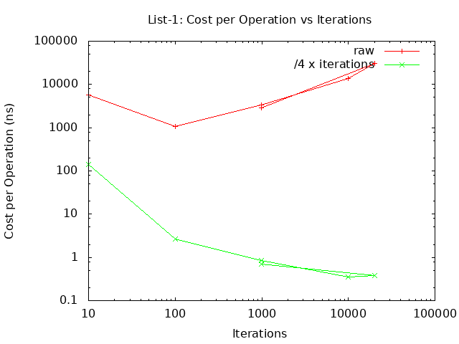
set terminal png
set datafile separator ","
set title "List-1: Cost per Operation vs Iterations"
set xlabel "Iterations"
set logscale x 10
set ylabel "Cost per Operation (ns)"
set logscale y 10
set output 'lab2_list-1.png'
plot \
"< grep 'list-none-none,1,' lab2_list.csv" \
using ($3):($7) title 'raw' with \
linespoints lc rgb 'red', \
"< grep 'list-none-none,1,' lab2_list.csv" \
using ($3):($7)/(4*($3)) \
title '/4 x iterations' with linespoints lc rgb 'green'
list-none-none,1,10,1,30,139945,4664
list-none-none,1,100,1,300,165364,551
list-none-none,1,1000,1,3000,3928455,1309
list-none-none,1,10000,1,30000,495197933,16506
list-none-none,1,20000,1,60000,3054392526,50906
list-none-none,1,1000,1,3000,3879764,1293

