Slide 1
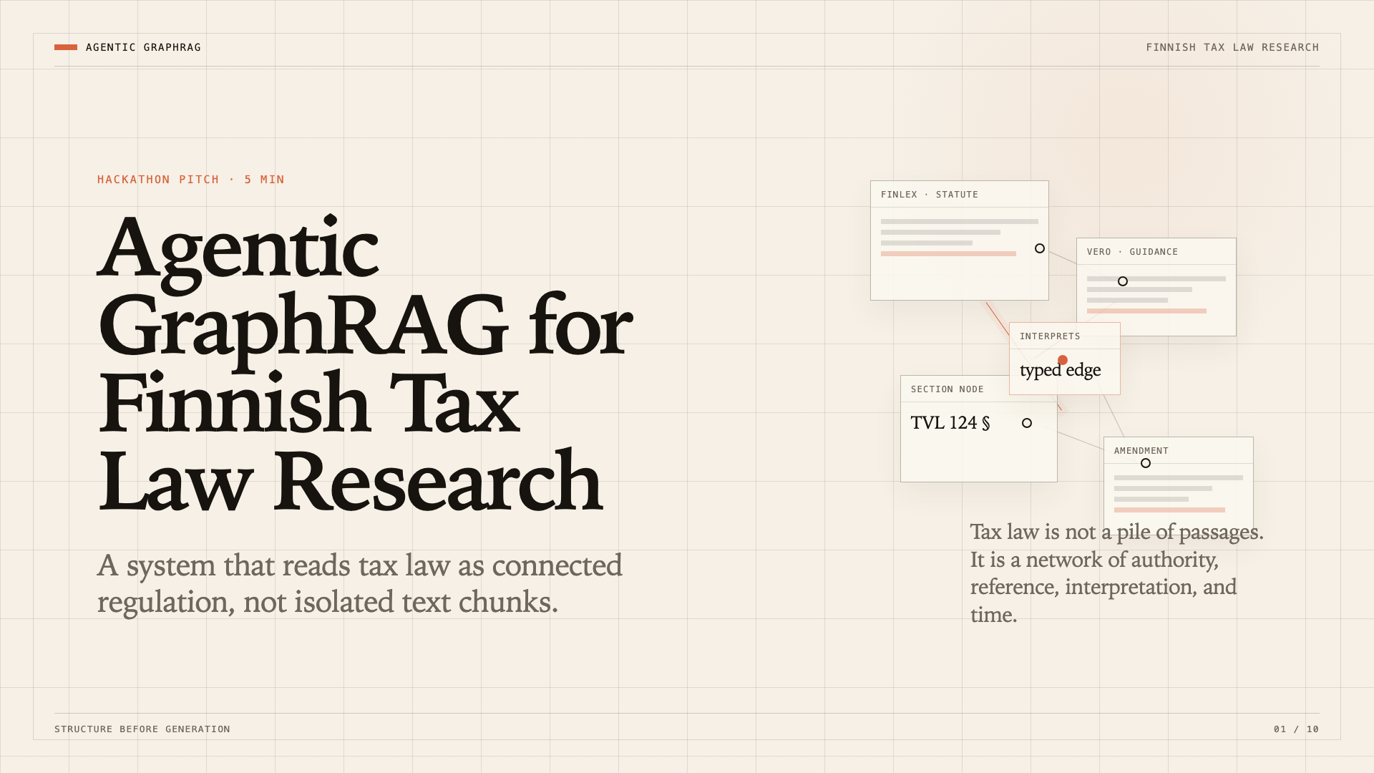

Slide 2
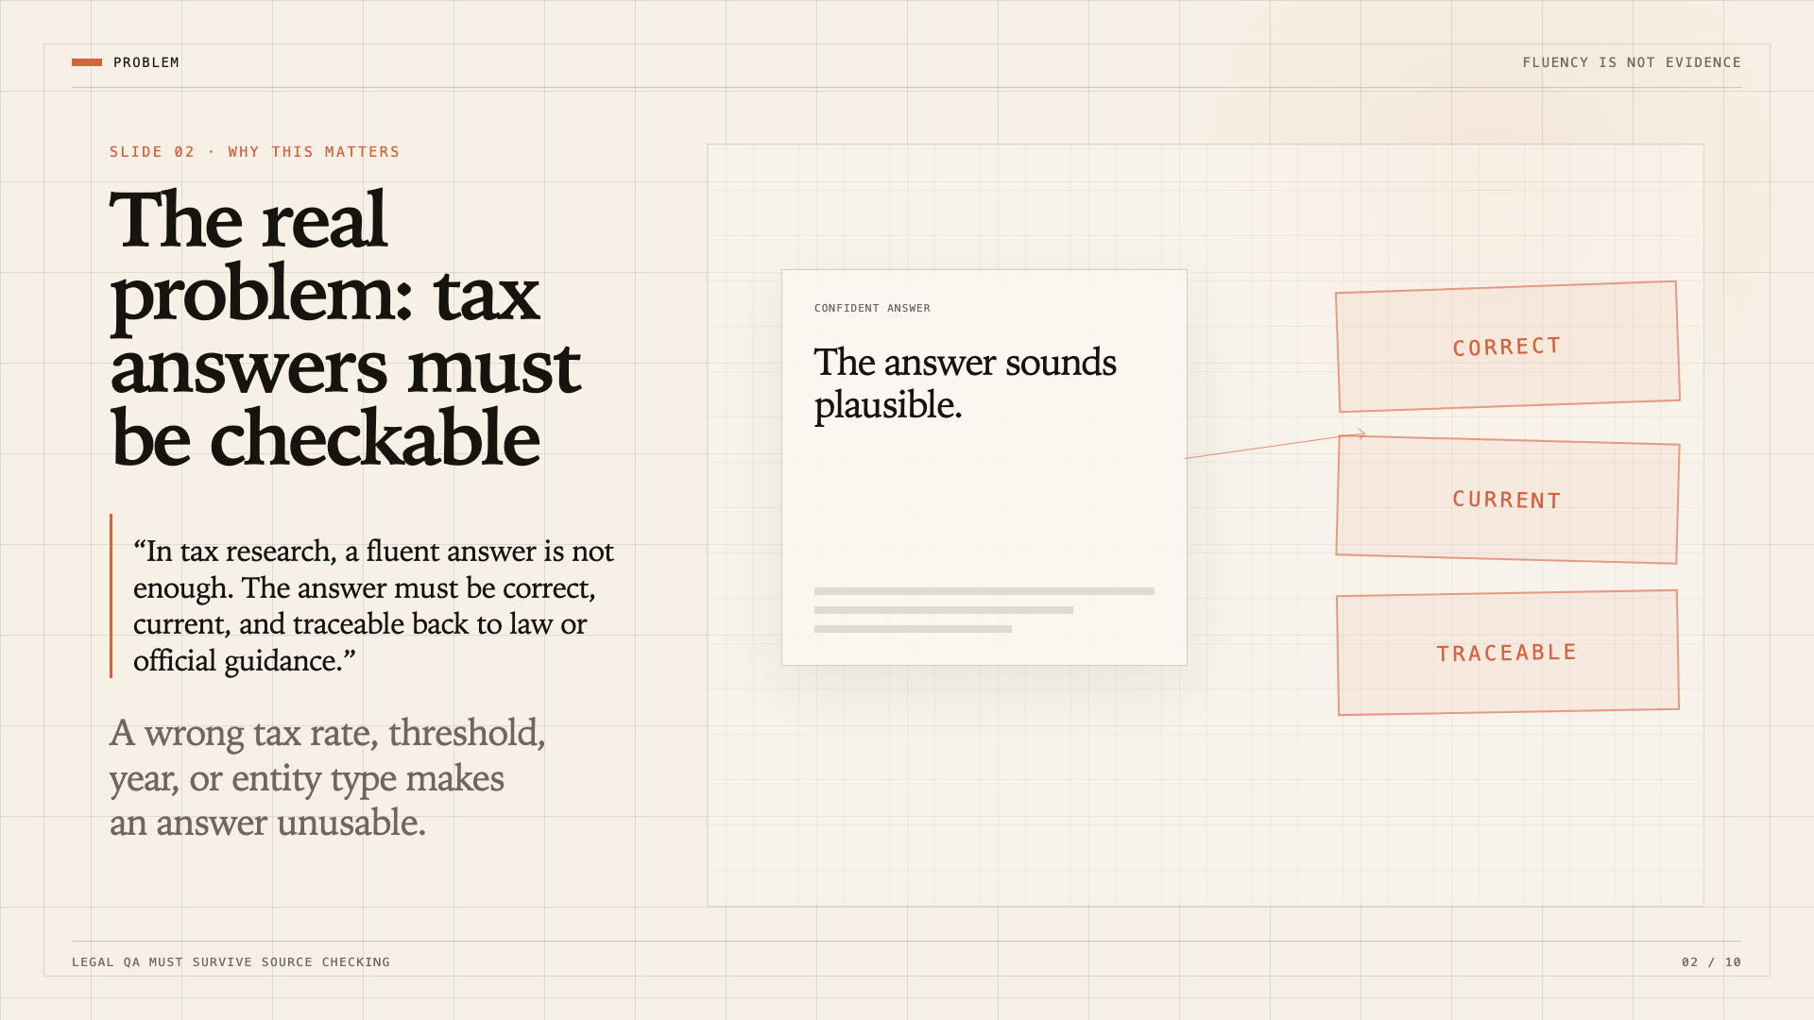

Slide 3
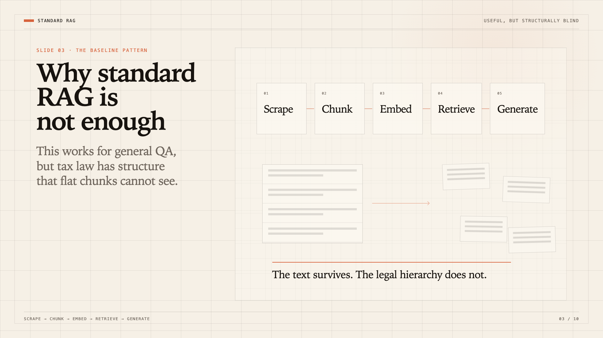

Slide 4
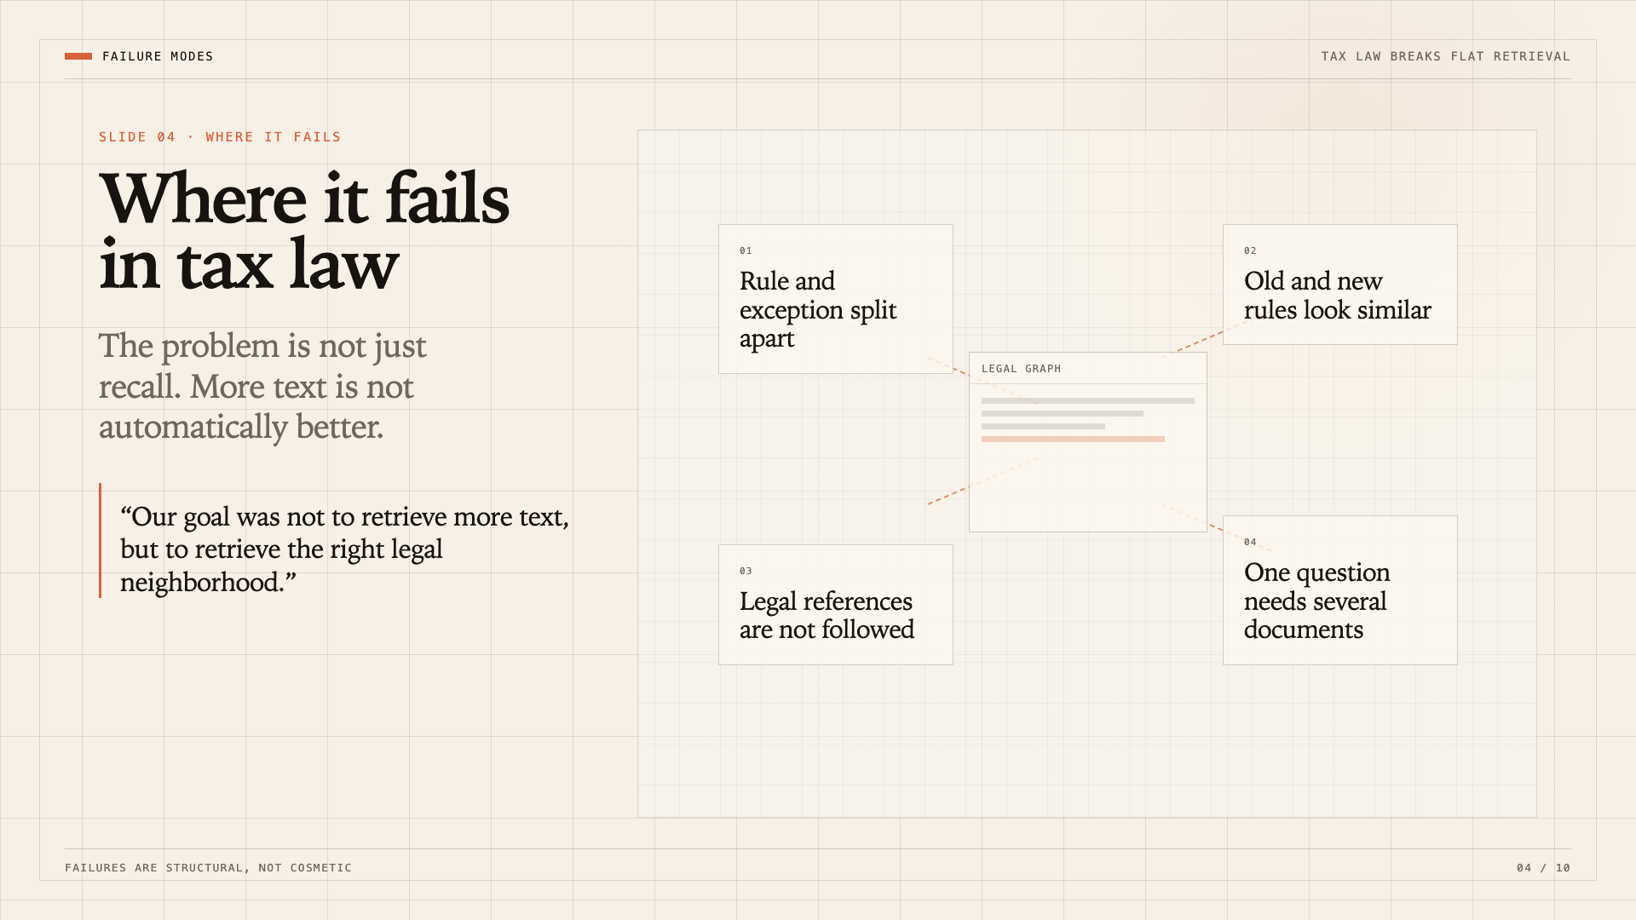

Slide 5
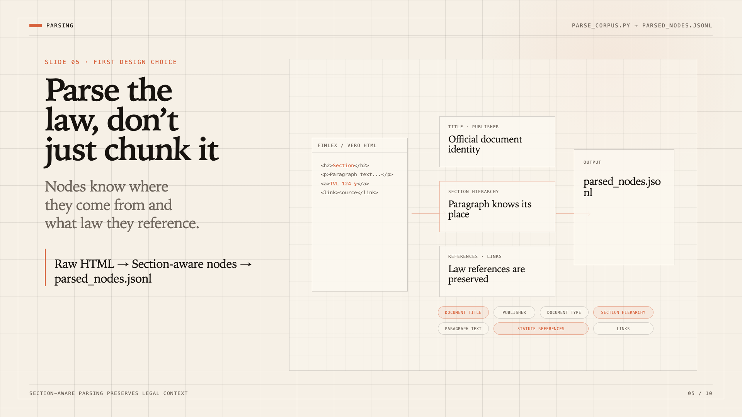

Slide 6
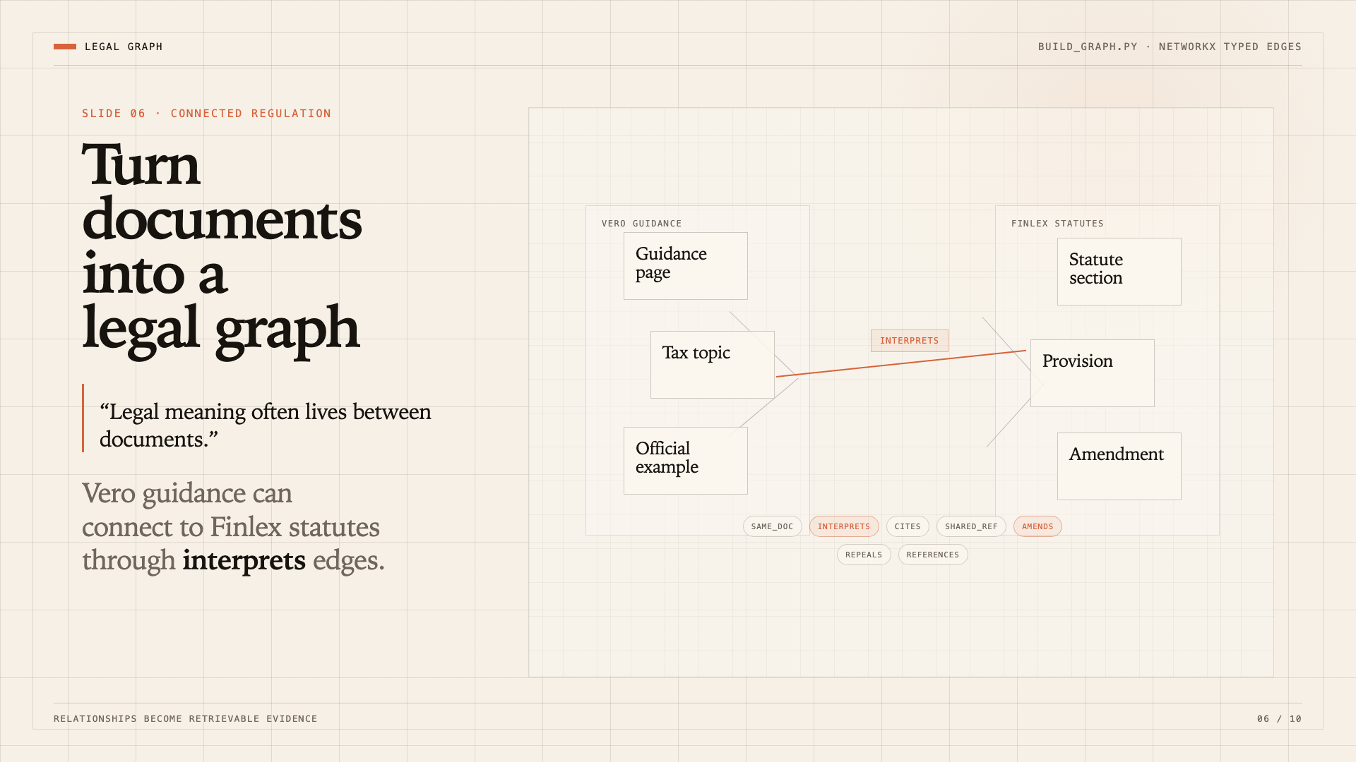
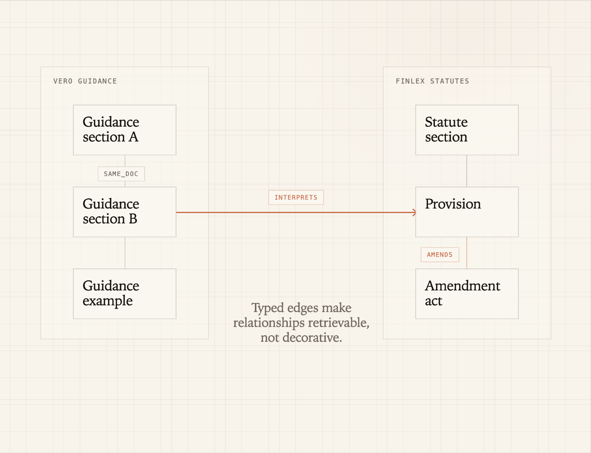

Slide 7
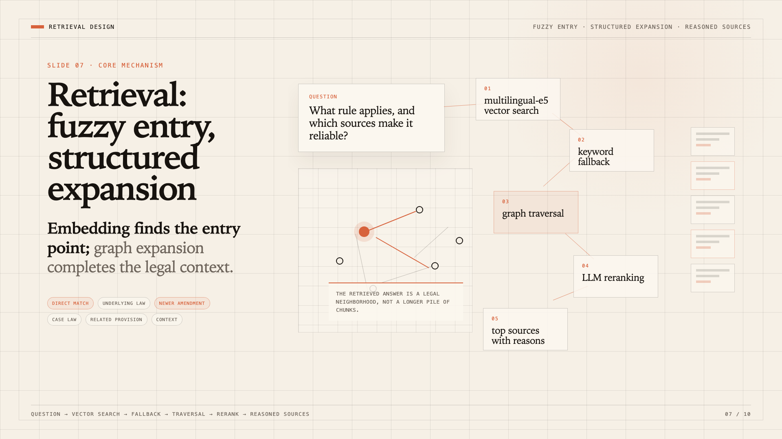
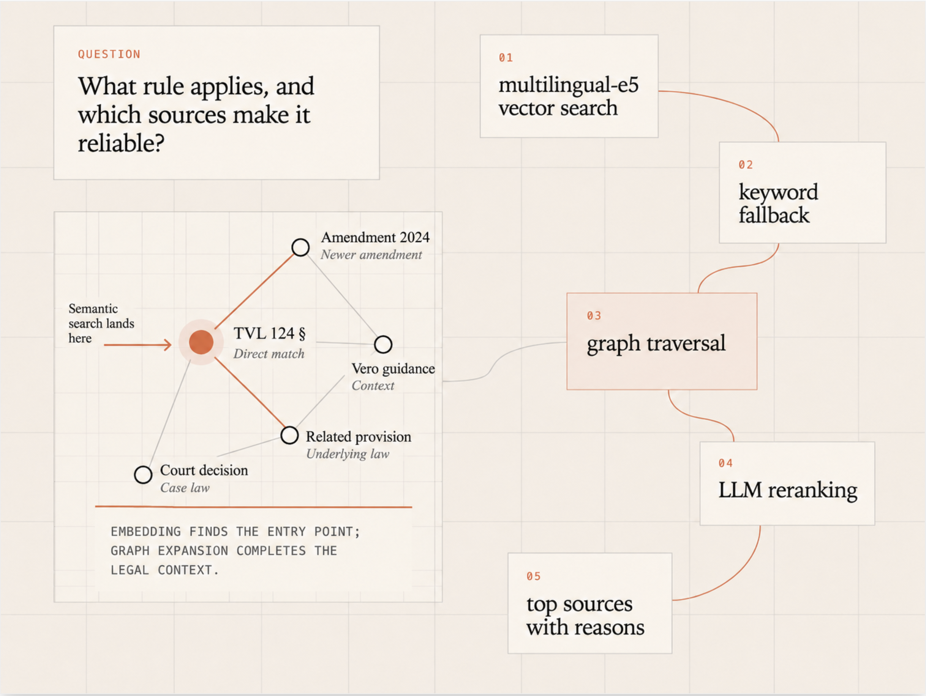
QUESTION
01
multilingual-e5
vector search
03
graph traversal
04
LEGAL NEIGHBORHOOD
05

Slide 8
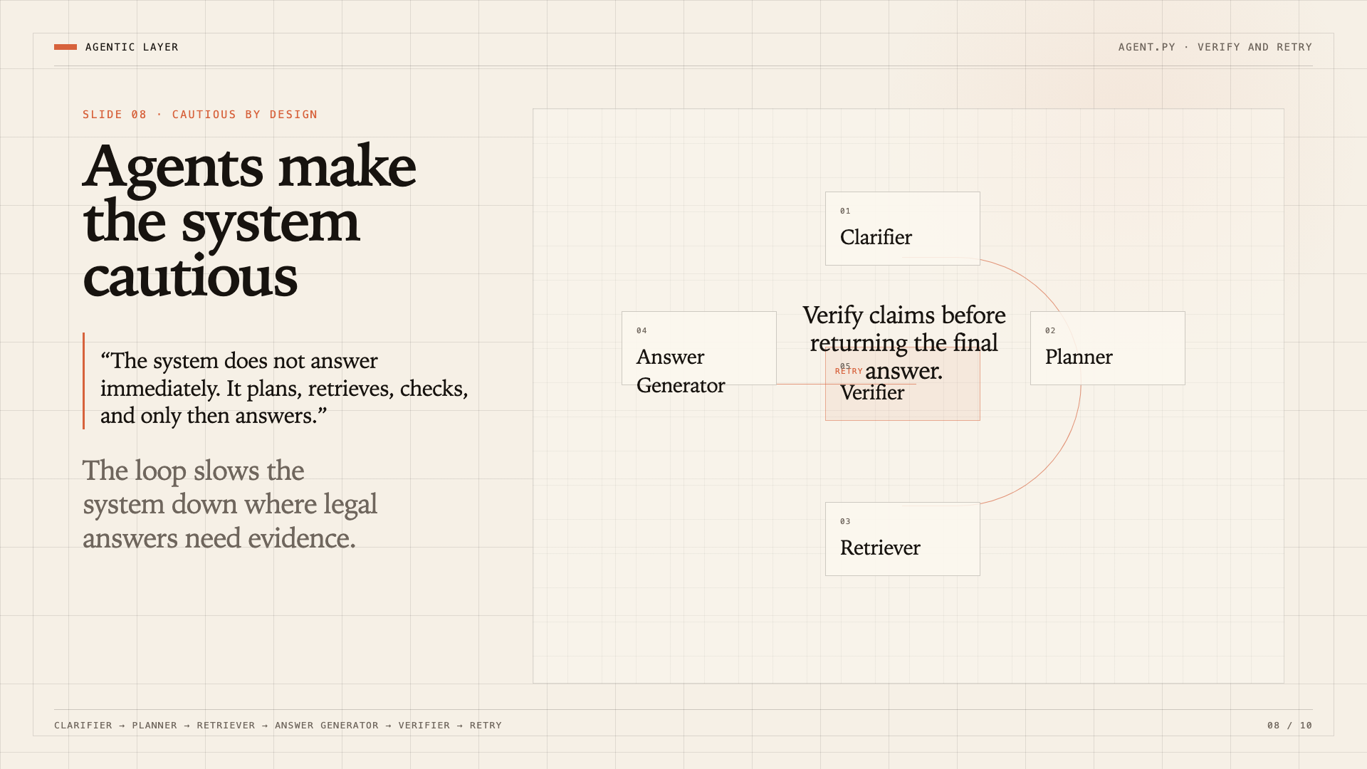
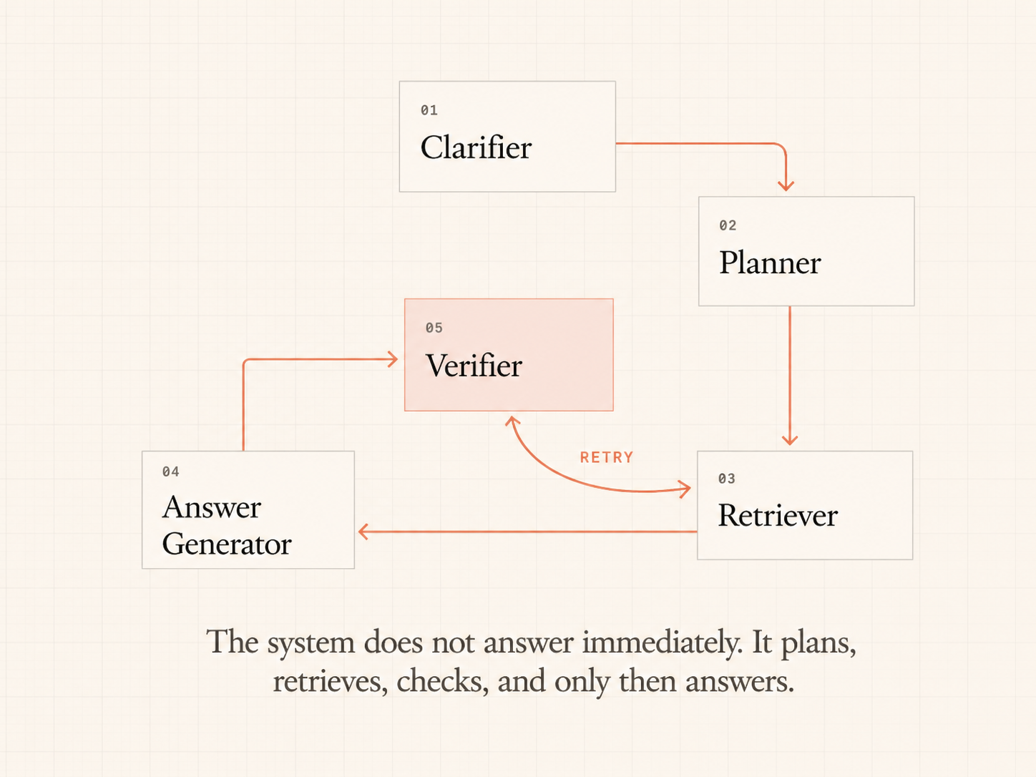
01
Clarifier
04
02
Answer
Generator
RETRY
Planner
05
Verifier
Verify claims before final answer
03
Retriever

Slide 9
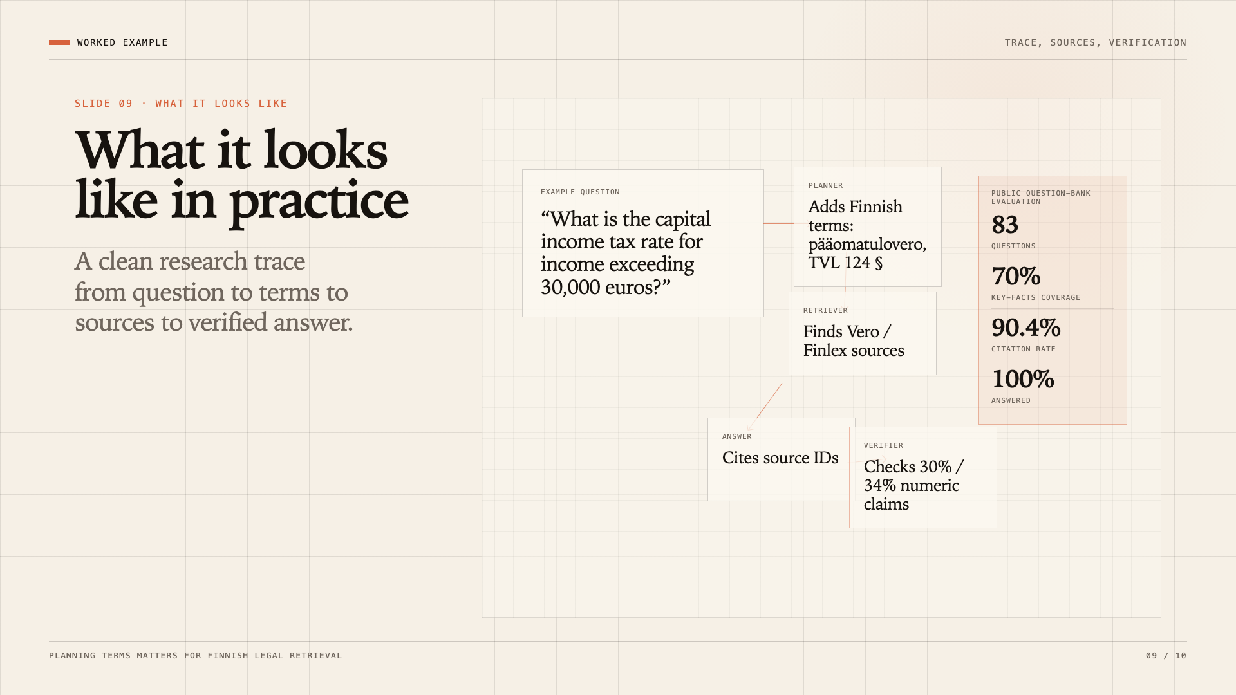
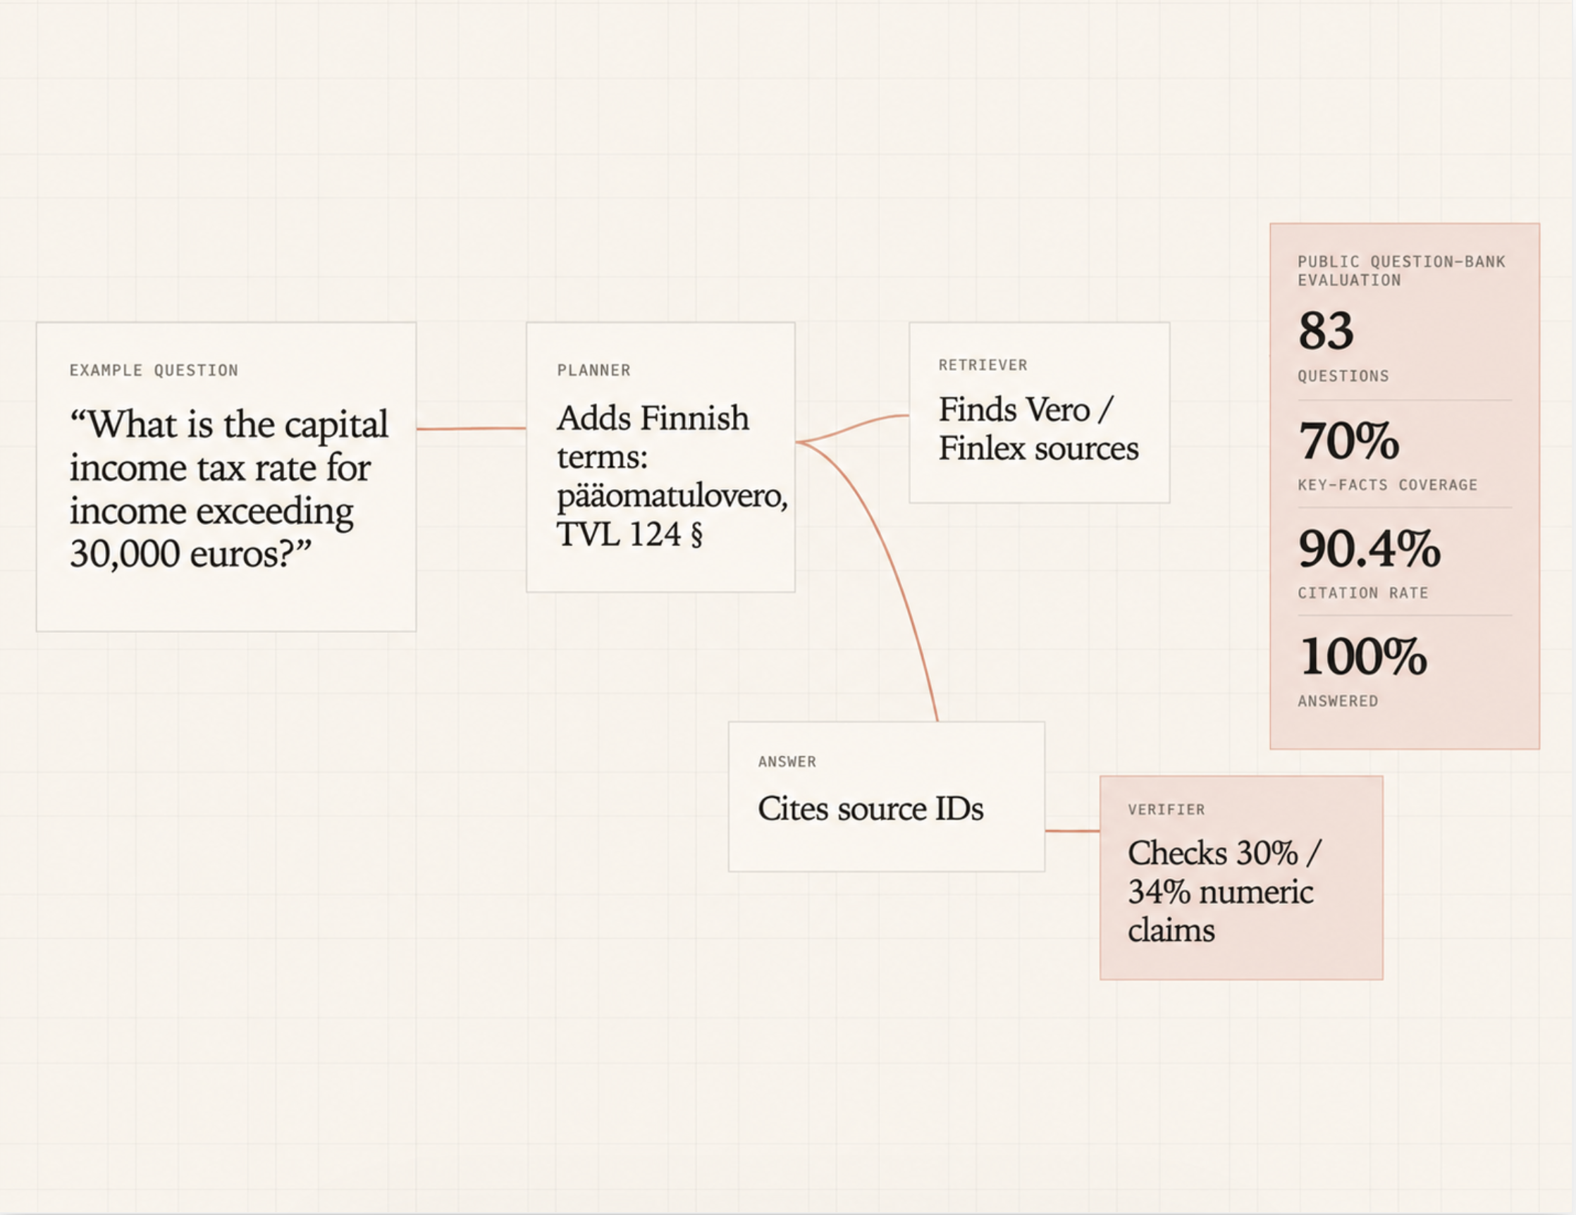
EXAMPLE QUESTION
PLANNER
EVALUATION
“What is the capital income tax rate for income exceeding 30,000 euros?”
Adds Finnish terms:
pääomatulovero,
TVL 124 §
83
questions
70%
key-facts coverage
90.4%
citation rate
100%
answered
RETRIEVER
Finds Vero /
Finlex sources
ANSWER
VERIFIER
Cites source IDs
Checks 30% /
34% numeric
claims

Slide 10
