Slide 1

Converting Casual Riders into Annual Members
Cyclistic Bike-Share Case Study
Presented by: Ho Jia Sheng
For Cyclistic Marketing & Executive Leadership Team

Slide 2
The Core Business Challenge
Objective: Convert casual riders to annual members.
Old hypothesis: daylight drives ridership.
Reality: temperature has a much stronger relationship with casual ridership than daylight.

Slide 3
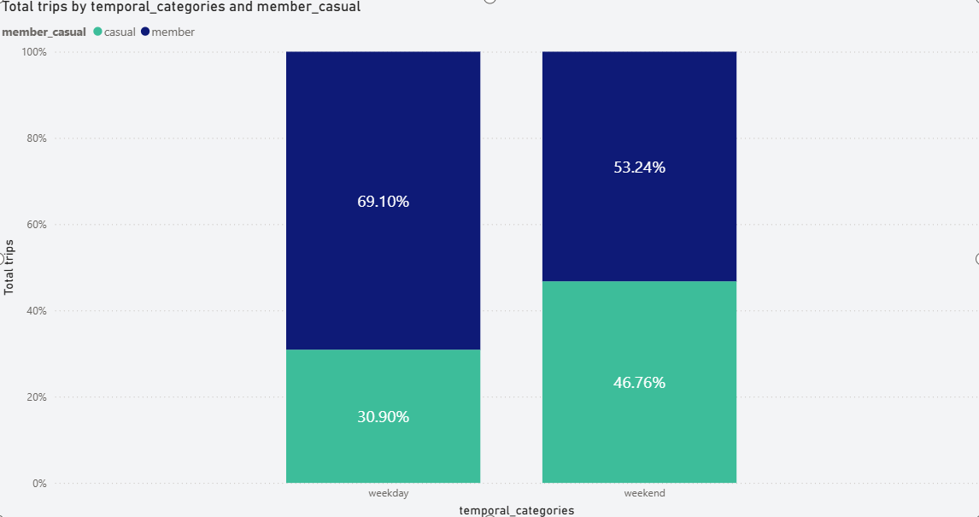
Who Are Our Riders?
70% of weekday rides are by members.
Weekend casual share approaches 50%.
Avg duration: Members 13 min vs Casual 20 min (+54%).
Strategy: Weekday Commuter Trial.

Slide 4
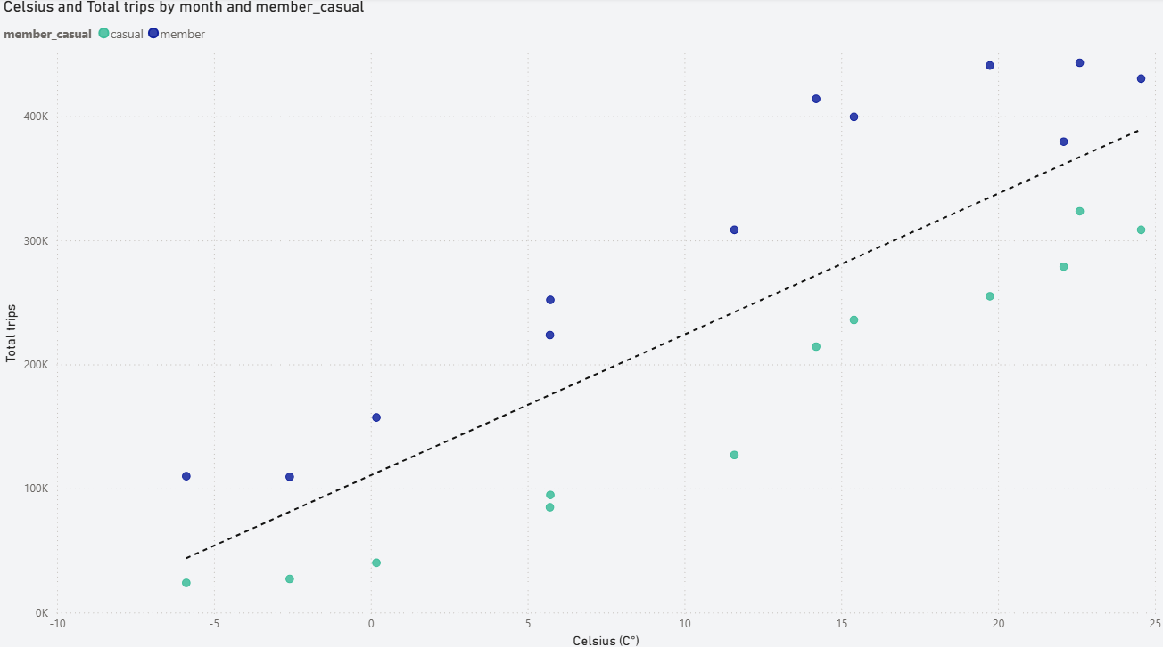
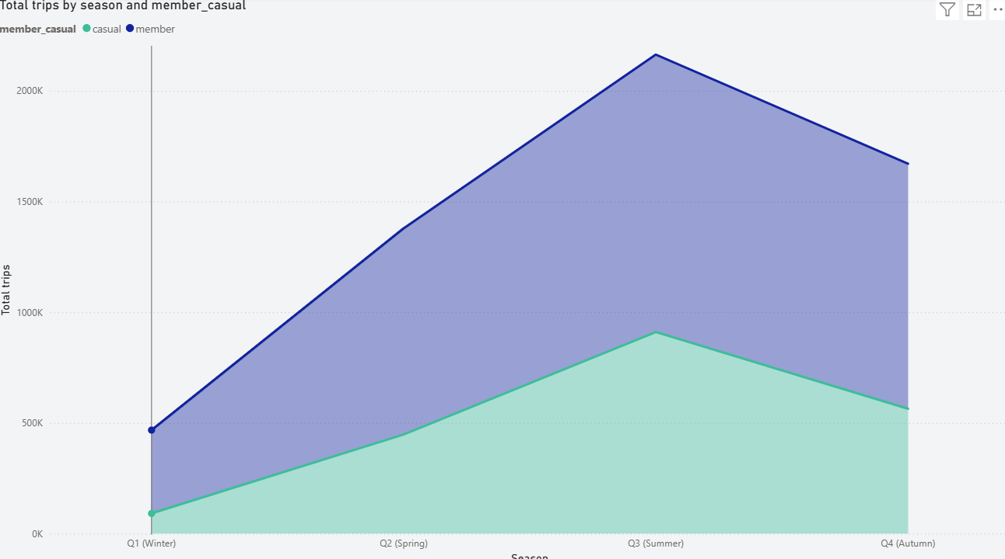
Weather & Seasonal Volume Dynamics
Q3: 2.16M rides, casual share 42.09%.
Q1: 467k rides, casual share 19.47%.
Temperature is the primary catalyst.
Strategy: Weather-triggered summer promotions.

Slide 5
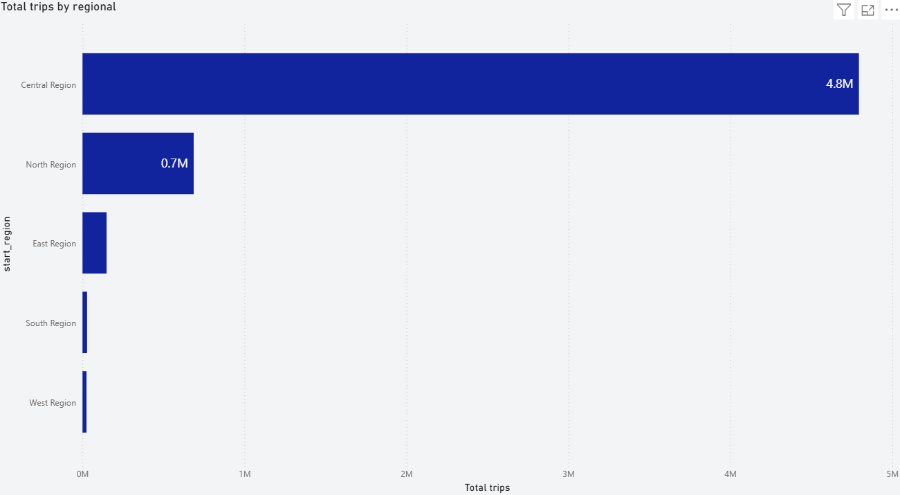
Regional Demand Hotspots
Central Region: 4.7M trips.
South Region: casual riders 55.73%.
North/East: commuter strongholds.
Strategy: Cyclistic Leisure Membership.

Slide 6
Summary of Business Impact
Behavioral marketing.
Remove overage barriers.
Deploy weather and geo-targeted campaigns.
Track 90-day Q3 conversion trial.

