Slide 1
B | P(B)
+b | 0.001
-b | 0.999
E | P(E)
+e | 0.002
-e | 0.998
Burglary
Earthqk
B | E | A | P(A|B,E)
+b | +e | +a | 0.95
+b | +e | -a | 0.05
+b | -e | +a | 0.94
+b | -e | -a | 0.06
-b | +e | +a | 0.29
-b | +e | -a | 0.71
-b | -e | +a | 0.001
-b | -e | -a | 0.999
Alarm
John calls
Marry calls
A | J | P(J|A)
+a | +j | 0.9
+a | -j | 0.1
-a | +j | 0.05
-a | -j | 0.95
A | M | P(M|A)
+a | +m | 0.7
+a | -m | 0.3
-a | +m | 0.01
-a | -m | 0.99

Slide 2
Burglary
Earthqk
Alarm
John calls
Marry calls

Slide 3
Burglary
Earthqk
Earthqk
Burglary
Alarm
Alarm
John calls
Marry calls
John calls
Marry calls
Burglary
Earthqk
Alarm
John calls
Marry calls

Slide 4
R | P(R)
+r | 0.1
-r | 0.9
R: Raining
R | T | P(T|R)
+r | +t | 0.8
+r | -t | 0.2
-r | +t | 0.1
-r | -t | 0.9
T: Traffic
T | L | P(L|T)
+t | +l | 0.3
+t | -l | 0.7
-t | +l | 0.1
-t | -l | 0.9
L: Late for Class

Slide 5
R: Raining
P(R)
X
P(T|R)
P(R, T)
R, T
R | T | P(T|R)
+r | +t | 0.8
+r | -t | 0.2
-r | +t | 0.1
-r | -t | 0.9
R | T | P(T, R)
+r | +t | 0.08
+r | -t | 0.02
-r | +t | 0.09
-r | -t | 0.81
R | P(R)
+r | 0.1
-r | 0.9
X
T: Traffic

Slide 6
P(R)
R: Raining
R | P(R)
+r | 0.1
-r | 0.9
P(R,T)
R | T | P(T, R)
+r | +t | 0.08
+r | -t | 0.02
-r | +t | 0.09
-r | -t | 0.81
Join R
P(T|R)
R | T | P(T|R)
+r | +t | 0.8
+r | -t | 0.2
-r | +t | 0.1
-r | -t | 0.9
R, T
T: Traffic
P(R, T, L)
Join T
R | T | L | P(R, T, L)
+r | +t | +l | 0.024
+r | +t | -l | 0.056
+r | -t | +l | 0.002
+r | -t | -l | 0.018
-r | +t | +l | 0.027
-r | +t | -l | 0.063
-r | -t | +l | 0.081
-r | -t | -l | 0.729
L
P(L|T)
P(L|T)
L: Late for Class
T | L | P(L|T)
+t | +l | 0.3
+t | -l | 0.7
-t | +l | 0.1
-t | -l | 0.9
T | L | P(L|T)
+t | +l | 0.3
+t | -l | 0.7
-t | +l | 0.1
-t | -l | 0.9

Slide 7
P(R, T)
R | T | P(T, R)
+r | +t | 0.08
+r | -t | 0.02
-r | +t | 0.09
-r | -t | 0.81
P(T)
Sum R
T | P(T)
+t | 0.17
-t | 0.83

Slide 8
R, T, L
P(R, T, L)
T, L
L
R | T | L | P(R, T, L)
+r | +t | +l | 0.024
+r | +t | -l | 0.056
+r | -t | +l | 0.002
+r | -t | -l | 0.018
-r | +t | +l | 0.027
-r | +t | -l | 0.063
-r | -t | +l | 0.081
-r | -t | -l | 0.729
P(L,T)
Sum
Out R
T | L | P(L,T)
+t | +l | 0.051
+t | -l | 0.119
-t | +l | 0.083
-t | -l | 0.747
Sum
Out T
P(L)
L | P(L)
+l | 0.134
-l | 0.886

Slide 9
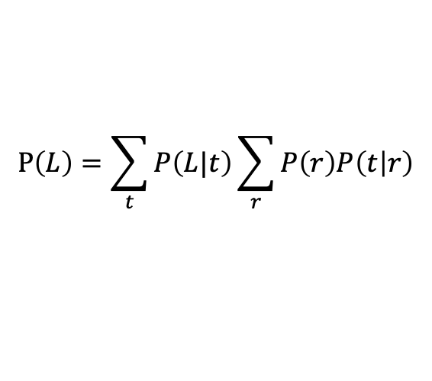
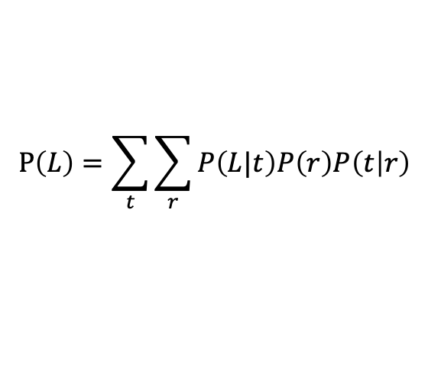
Inference by Enumeration
Variable Elimination
$$P\left(L\right)=\sum_{t}{\sum_{r}{P\left(L|t\right)P\left(r\right)P\left(t | r\right)}}$$
$$P\left(L\right)=\sum_{t}{P\left(L|t\right)\sum_{r}{P\left(r\right)P\left(t | r\right)}}$$
Join on r
Join on r
Join on t
Eliminate on r
Eliminate on r
Join on t
Eliminate on t
Eliminate on t

Slide 10
P(R)
P(R,T)
Join R
R: Raining
R | P(R)
+r | 0.1
-r | 0.9
R | T | P(T, R)
+r | +t | 0.08
+r | -t | 0.02
-r | +t | 0.09
-r | -t | 0.81
P(T|R)
R | T | P(T|R)
+r | +t | 0.8
+r | -t | 0.2
-r | +t | 0.1
-r | -t | 0.9
Sum
Out R
T: Traffic
T, L
P(T)
L
T | P(T)
+t | 0.17
-t | 0.83
P(L,T)
T | L | P(L,T)
+t | +l | 0.051
+t | -l | 0.119
-t | +l | 0.083
-t | -l | 0.747
Sum
Out T
P(L)
Join T
L | P(L)
+l | 0.134
-l | 0.886
P(L|T)
P(L|T)
L: Late for Class
T | L | P(L|T)
+t | +l | 0.3
+t | -l | 0.7
-t | +l | 0.1
-t | -l | 0.9
T | L | P(L|T)
+t | +l | 0.3
+t | -l | 0.7
-t | +l | 0.1
-t | -l | 0.9

Slide 11
P(R)
P(T|R)
P(L|T)
R | P(R)
+r | 0.1
-r | 0.9
R | T | P(T|R)
+r | +t | 0.8
+r | -t | 0.2
-r | +t | 0.1
-r | -t | 0.9
T | L | P(L|T)
+t | +l | 0.3
+t | -l | 0.7
-t | +l | 0.1
-t | -l | 0.9
P(+r)
P(T|+r)
P(L|T)
R | P(R)
+r | 0.1
R | T | P(T|R)
+r | +t | 0.8
+r | -t | 0.2
T | L | P(L|T)
+t | +l | 0.3
+t | -l | 0.7
-t | +l | 0.1
-t | -l | 0.9

Slide 12
P(+r,L)
P(L|+r)
R | L | P(+r, L)
+r | +l | 0.026
+r | -l | 0.074
Normalize
L | P(L|+r)
+l | 0.26
-l | 0.74

Slide 13
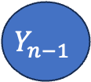
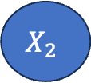
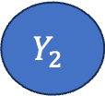
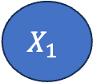
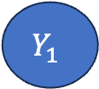
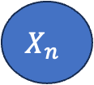
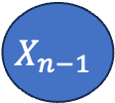
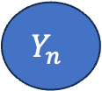
Z
$$X_{1}$$
$$X_{2}$$
…
$$X_{n−1}$$
$$X_{n}$$
$$Y_{1}$$
$$Y_{2}$$
…
$$Y_{n−1}$$
$$Y_{n}$$

Slide 14
C | P(C)
red | 0.6
green | 0.1
blue | 0.3
0 <= u < 0.6, C = red
0.6 <= u < 0.7, C = green
0.7 <= u < 1, C = blue

Slide 15
C | P(C)
+c | 0.5
-c | 0.5
C | S | P(S|C)
+c | +s | 0.1
+c | -s | 0.9
-c | +s | 0.5
-c | -s | 0.5
C | R | P(R|C)
+c | +r | 0.8
+c | -r | 0.2
-c | +r | 0.2
-c | -r | 0.8
Cloudy
Sprinkler
Rain
S | R | W | P(W|S,R)
+s | +r | +w | 0.99
+s | +r | -w | 0.01
+s | -r | +w | 0.90
+s | -r | -w | 0.10
-s | +r | +w | 0.90
-s | +r | -w | 0.10
-s | -r | +w | 0.01
-s | -r | -w | 0.99
WetGrass

Slide 16
C | P(C)
+c | 0.5
-c | 0.5
C | S | P(S|C)
+c | +s | 0.1
+c | -s | 0.9
-c | +s | 0.5
-c | -s | 0.5
C | R | P(R|C)
+c | +r | 0.8
+c | -r | 0.2
-c | +r | 0.2
-c | -r | 0.8
Cloudy
Sprinkler
Rain
S | R | W | P(W|S,R)
+s | +r | +w | 0.99
+s | +r | -w | 0.01
+s | -r | +w | 0.90
+s | -r | -w | 0.10
-s | +r | +w | 0.90
-s | +r | -w | 0.10
-s | -r | +w | 0.01
-s | -r | -w | 0.99
WetGrass
Sample:
+c, +s, +r, +w
……
w = 1.0 * 0.1 * 0.99

Slide 17
R
T
R | P(R)
+r | 0.3
-r | 0.7
R | T | P(T|R)
+r | +t | 0.8
+r | -t | 0.2
-r | +t | 0.1
-r | -t | 0.9
Samples
+r | +t
-r | -t
+r | +t
+r | +t
… | …
T | P(T)
+t | ?
-t | ?
Prior sampling:
In the sample, p(+t) = ¾, it might not be equal to true p(+t). However, it get the 4000 samples, these two numbers will be very close.

Slide 18
R
T
R | P(R)
+r | 0.3
-r | 0.7
R | T | P(T|R)
+r | +t | 0.8
+r | -t | 0.2
-r | +t | 0.1
-r | -t | 0.9
Samples
+r | +t
-r | -t
+r | +t
+r | +t
… | …
R | P(R|+r)
+r | 2/3
-r | 1/3
Rejection sampling:
In the sample, p(+t) = ¾, We reject one sample T=-t.

Slide 19
R
T
R | P(R)
+r | 0.3
-r | 0.7
R | T | P(T|R)
+r | +t | 0.9
+r | -t | 0.1
-r | +t | 0.5
-r | -t | 0.5
Samples |  | W
+r | +t | 0.9
-r | +t | 0.5
+r | +t | 0.9
… | …
R | Sum(w)
+r | 1.8
-r | 0.5
Likelihood weighting:
We do not want to throw away samples, especially when the probability of evidence is small.
Suppose T is an evidential variable, we know T = +t. Assume in the first sample, we first sample R = +r, normally we would then sample T, since T is evidential variable, we set T = +t, and multiply w by P(T = +t | +r) = 0.9.

Slide 20
F
A
P(F|+a)?
F | P(F)
+f | 0.01
-f | 0.99
F | A | P(T|R)
+f | +a | 0.9
+f | -a | 0.1
-f | +a | 0.01
-f | -9 | 0.99
Samples |  | W
-f | +a | 0.01
-f | +a | 0.01
-f | +a | 0.01
-f | +a | 0.01
+f | +a | 0.9
… | …
F | Sum(w)
+f | 0.9/1.1
-f | 0.2/1.1
20
1
Failure case of rejection sampling:
If we use reject sampling, we are going to reject lots of samples.
Failure case of Likelihood weighting:
If we use likelihood weighting, we fixed +a, but the weight will be very small.
Samples we really need is +f, but it will not happen very often. (but the weight of +f, +a will be very high).
It will get the right number in the end, but it takes lots of time to generate rare events in the upstream.

Slide 21
P(R)
P(R,T)
Join R
R: Raining
R | P(R)
+r | 0.1
-r | 0.9
R | T | P(T, R)
+r | +t | 0.08
+r | -t | 0.02
-r | +t | 0.09
-r | -t | 0.81
P(T|R)
R | T | P(T|R)
+r | +t | 0.8
+r | -t | 0.2
-r | +t | 0.1
-r | -t | 0.9
Sum
Out R
T: Traffic
T, L
P(T)
L
T | P(T)
+t | 0.17
-t | 0.83
P(L,T)
T | L | P(L,T)
+t | +l | 0.051
+t | -l | 0.119
-t | +l | 0.083
-t | -l | 0.747
Sum
Out T
P(L)
Join T
L | P(L)
+l | 0.134
-l | 0.886
P(L|T)
P(L|T)
L: Late for Class
T | L | P(L|T)
+t | +l | 0.3
+t | -l | 0.7
-t | +l | 0.1
-t | -l | 0.9
T | L | P(L|T)
+t | +l | 0.3
+t | -l | 0.7
-t | +l | 0.1
-t | -l | 0.9

