Slide 1
Cascade ADRC example
ADRC外环
ADRC内环
ref
NLSEF_1
x2_d
NLSEF_2
P
x1
x2
z22
ESO
z12
z21
ESO
z11

Slide 2
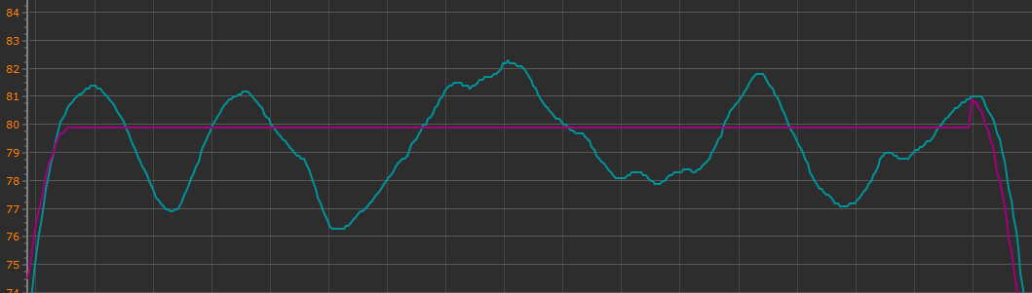
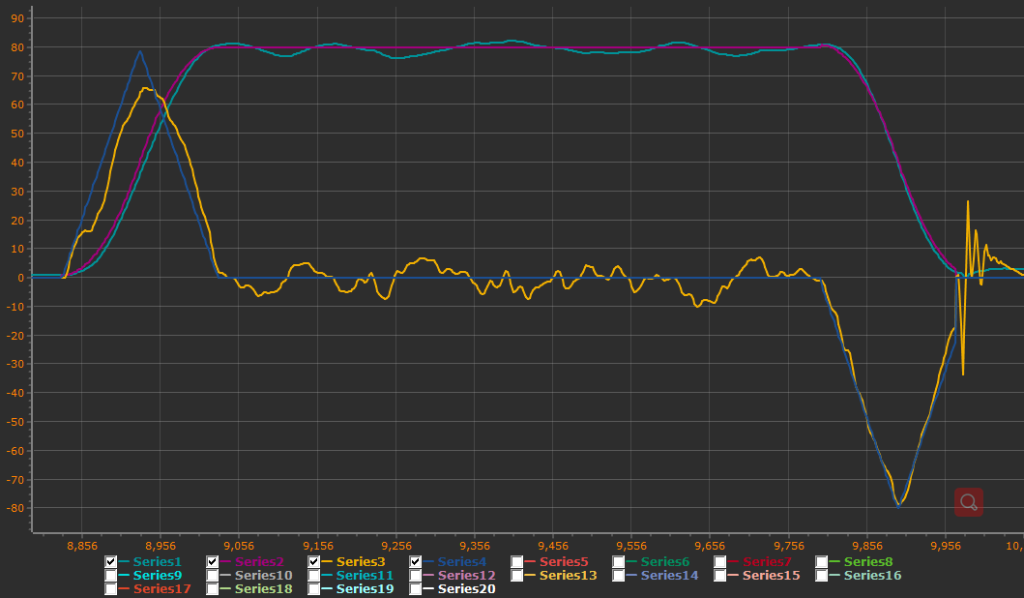
PID_Z
State.position.z
TD
Z_d
ref
VZ_d
e1
NLSEF_VZ
P
x1
x2
aZ_d(TD.fh)
e2
z1
ESO
z2
MBD

Slide 3
The control block diagram
in this program
TD
Z_d
PID_Z
TD
VZ_d’
NLSEF_VZ
setpoint
VZ_d
P
State.position.z
State.velocity.z
VZ_d
aZ_d
b0
State.position.z
State.velocity.z
State.acc
ESO
MBD

Slide 4
The control block diagram
in this program

