Slide 1
Cascade ADRC example
ADRC外环
ADRC内环
ref
NLSEF_1
x2_d
NLSEF_2
P
x1
x2
z22
ESO
z12
z21
ESO
z11

Slide 2
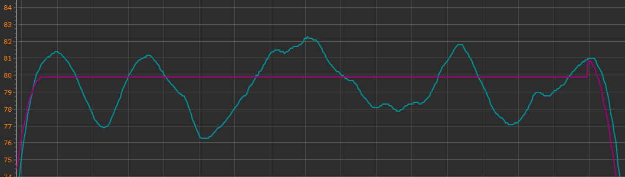
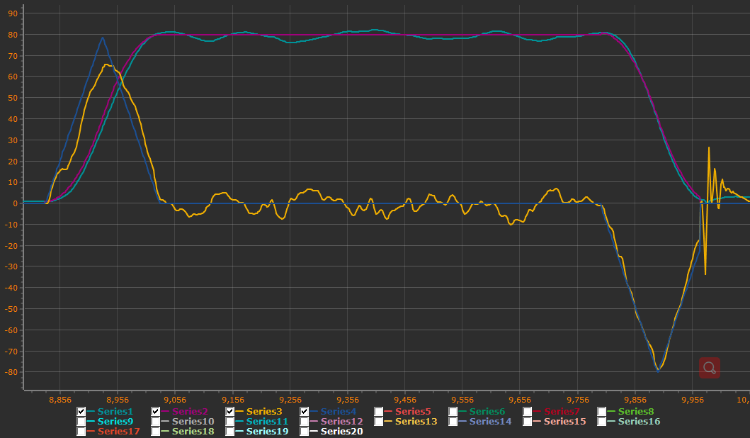
The control block diagram
in this program
PID_Z
State.position.z
TD
Z_d
ref
VZ_d
e1
NLSEF_VZ
P
x1
x2
aZ_d(TD.fh)
e2
z1
ESO
z2
MBD

