Slide 1
DecorRight Market Research
By Jonathan Chang, Yu-Fang Juan, Landry Kezebou, Khanh Ngugen, Pedro Martín Rodriguez-Ponga Eyriès, Jiawei Wang

Slide 2
User Types
Individual Users
Furniture Retailers
Real Estate and Contractors

Slide 3
Individual Users

Slide 4
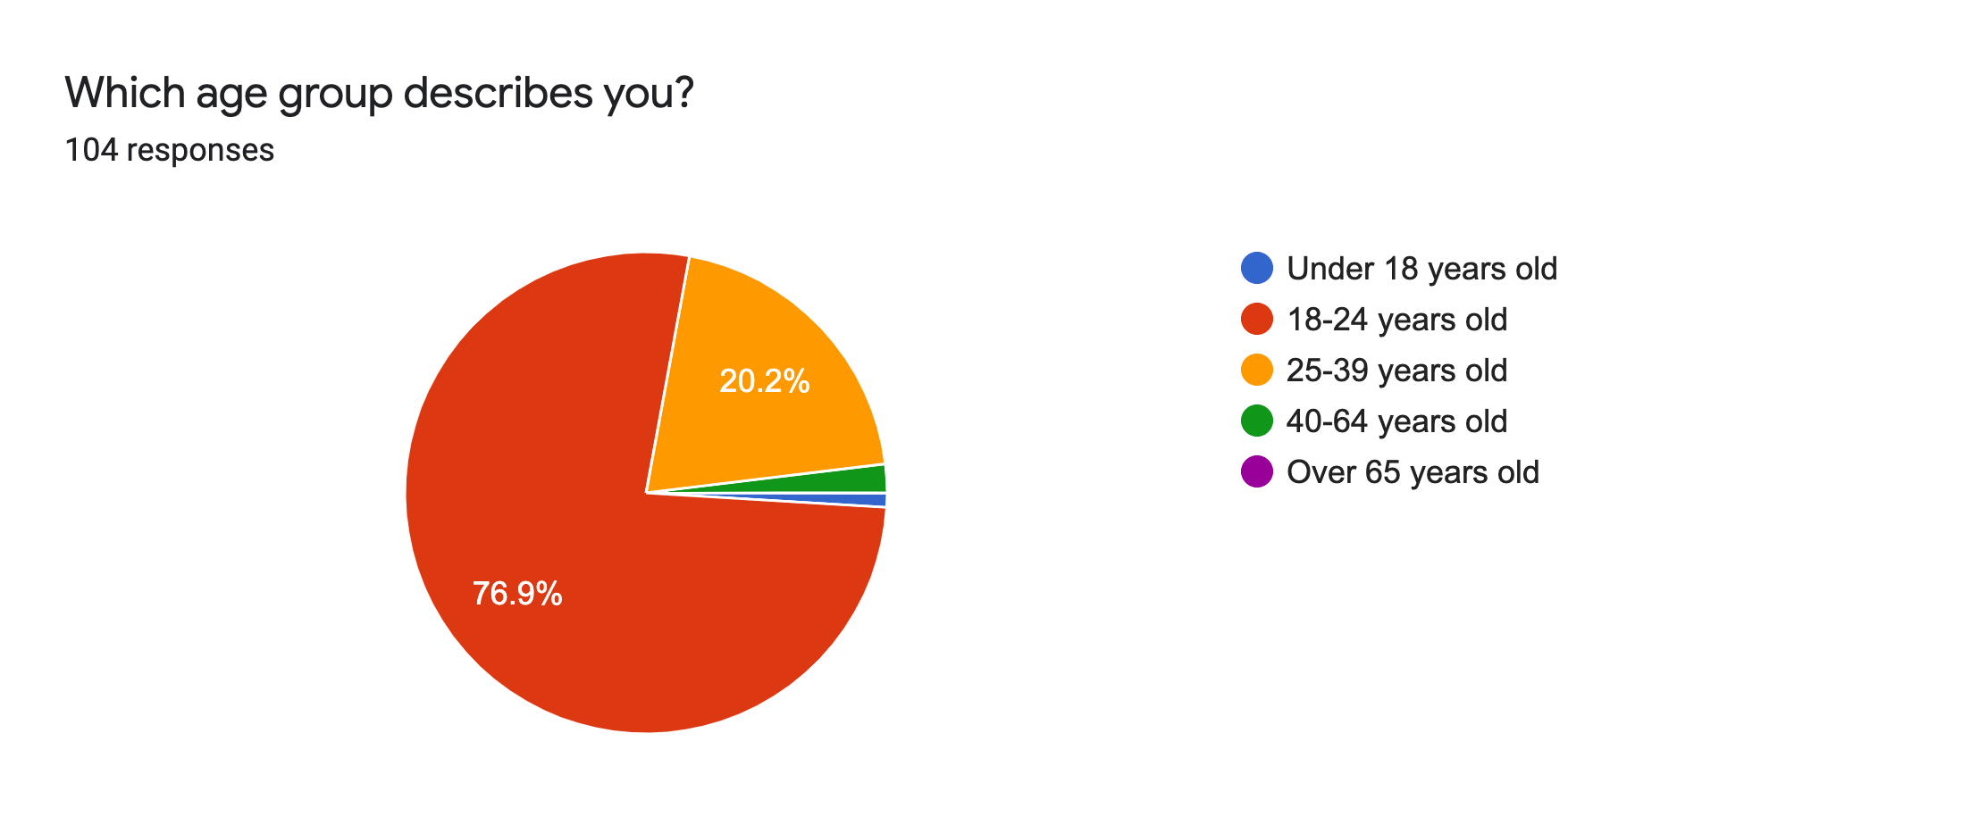
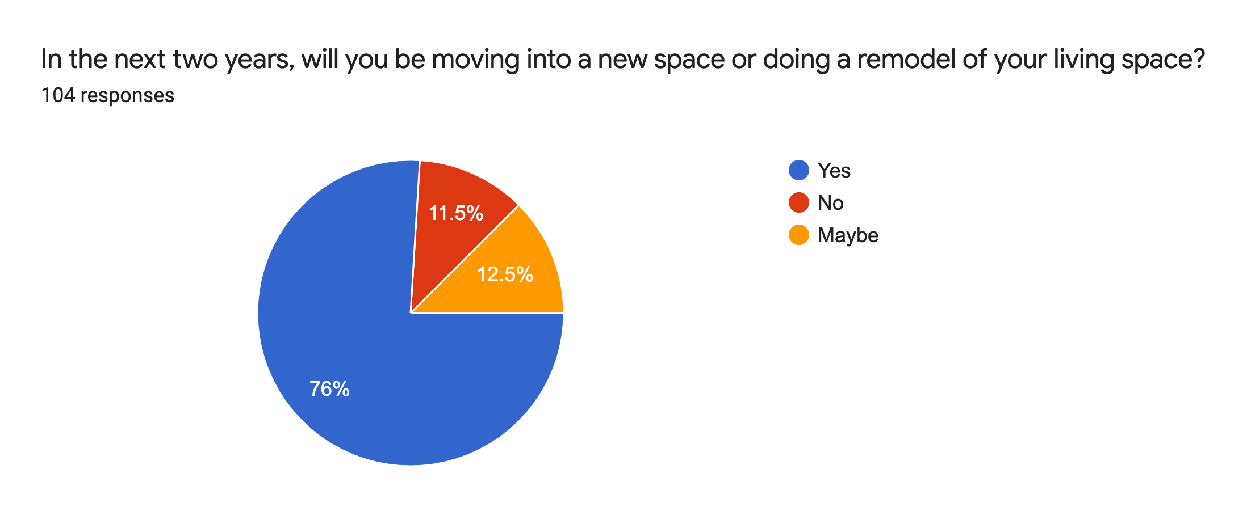
Individual Users- Demographics

Slide 5
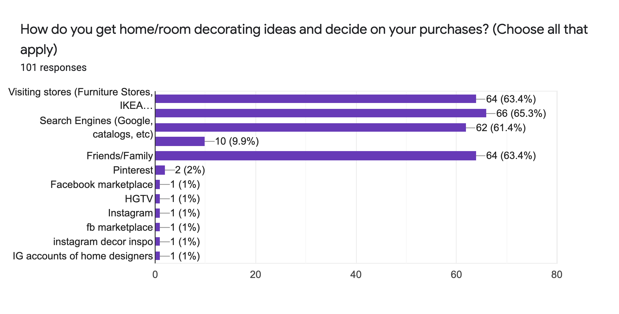
Individual Users- Market

Slide 6
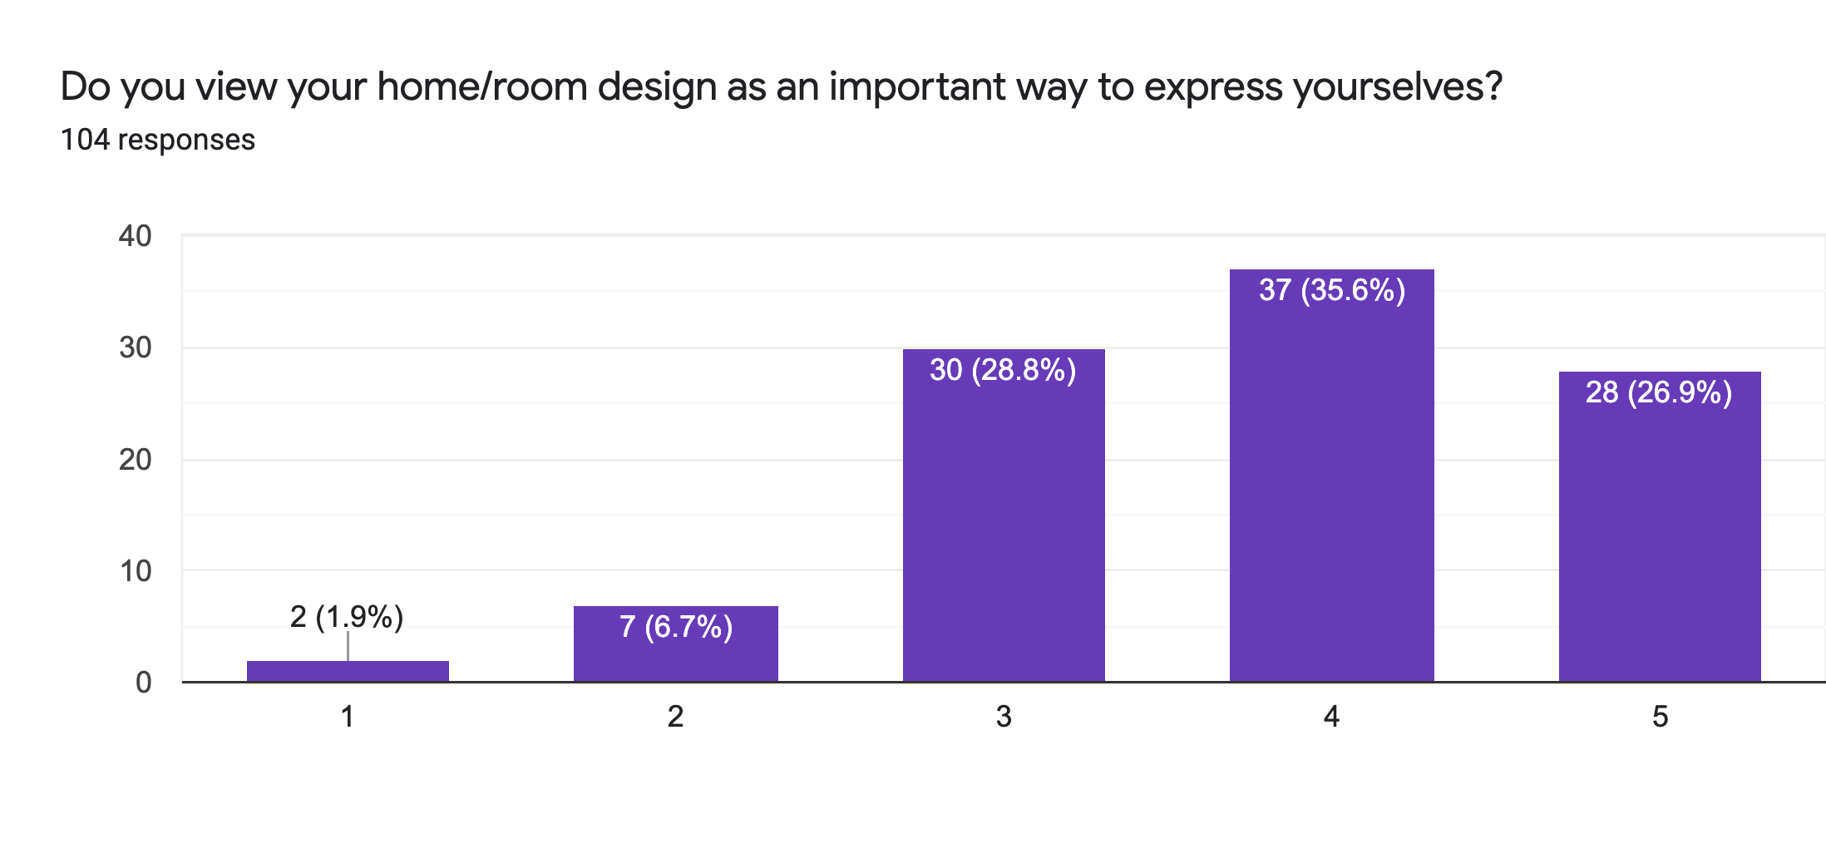
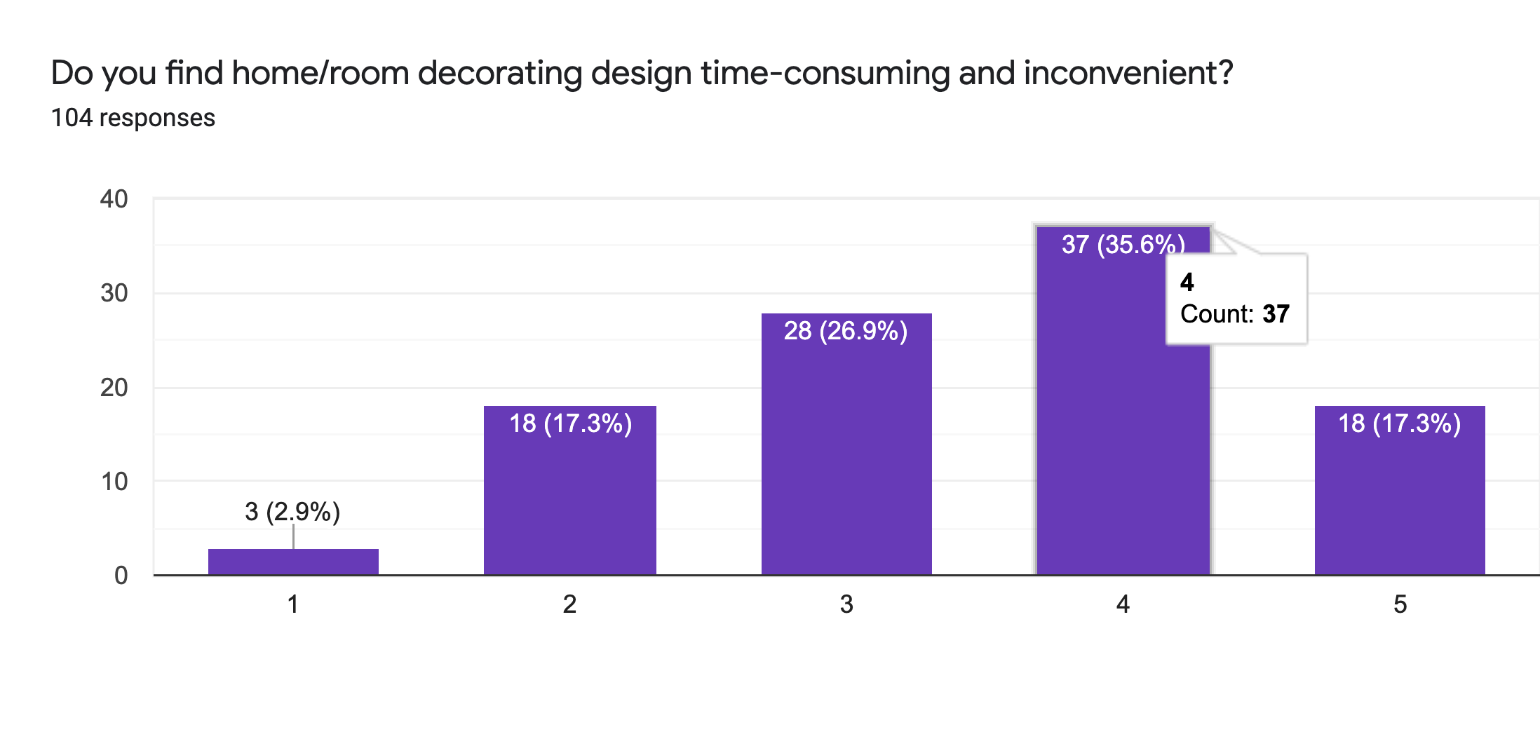
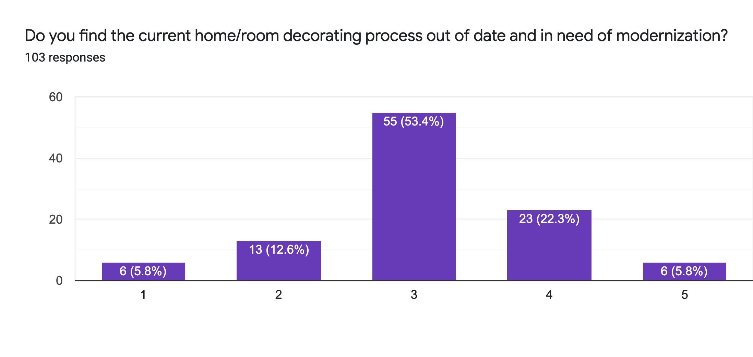
Individual Users- Psychographics

Slide 7
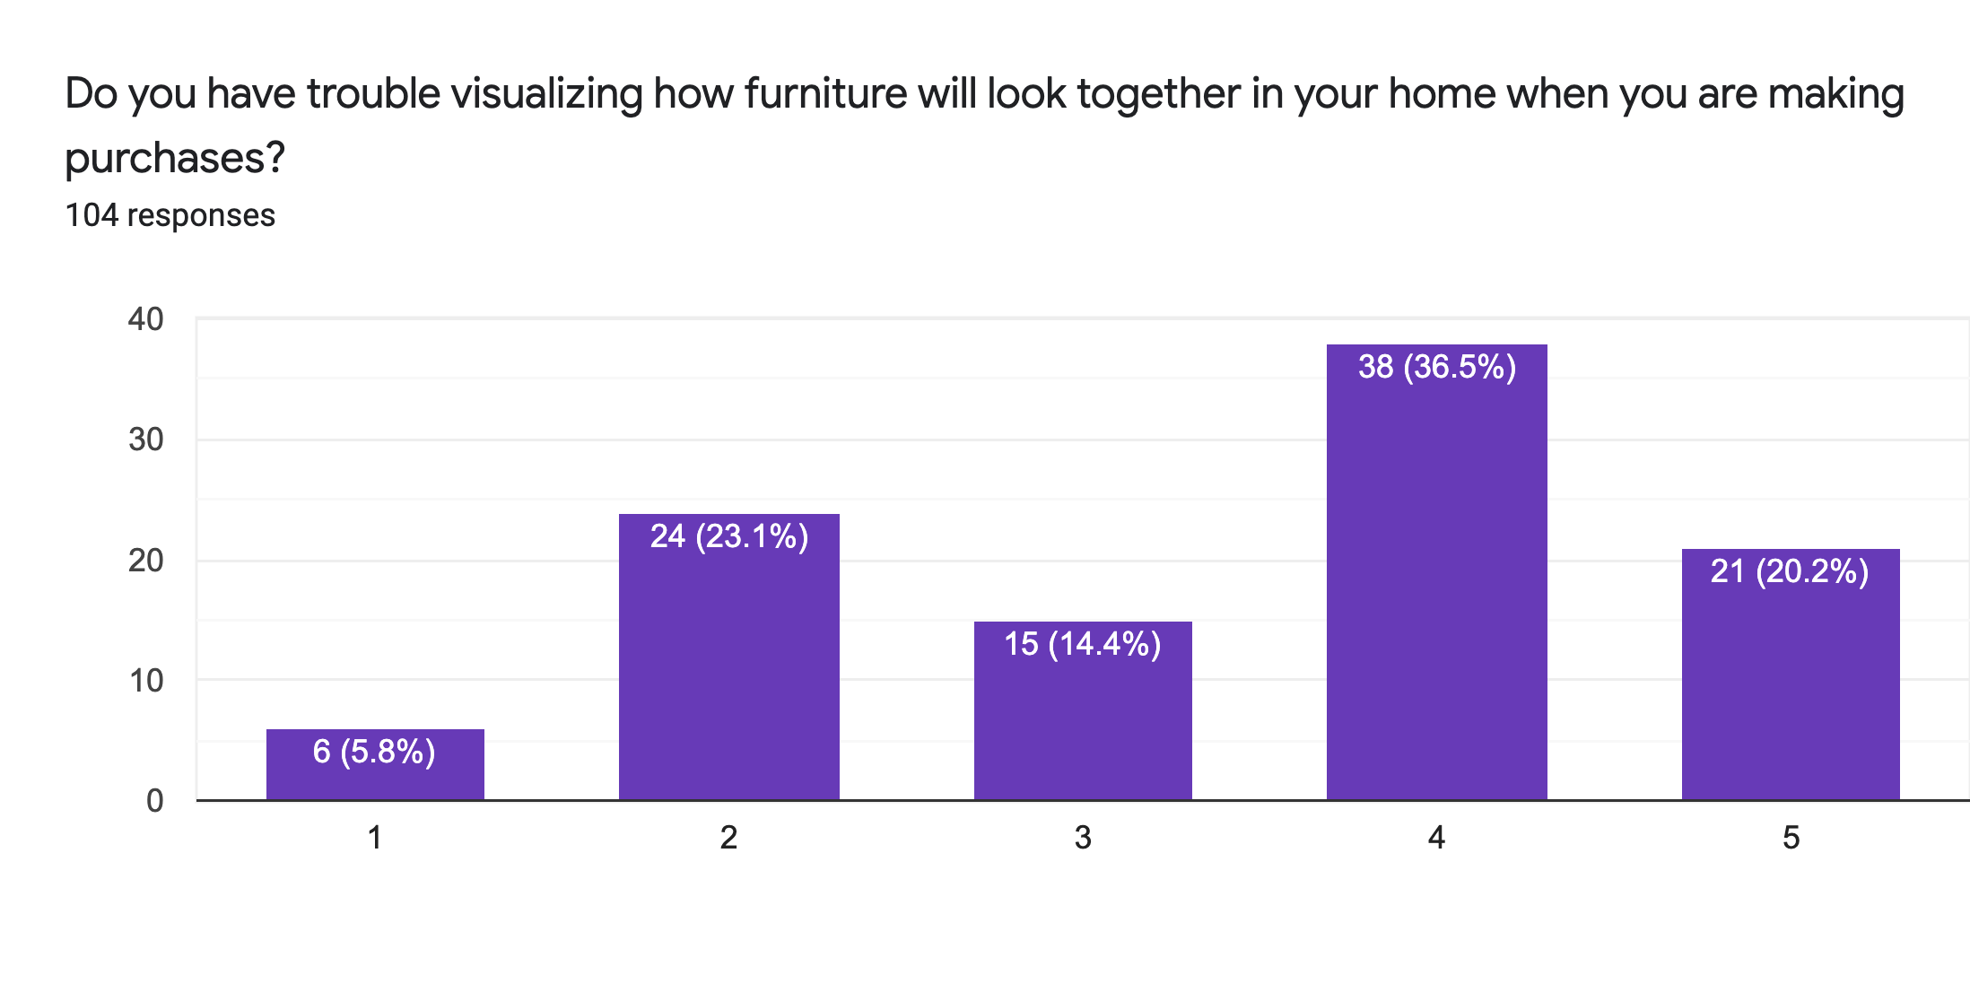
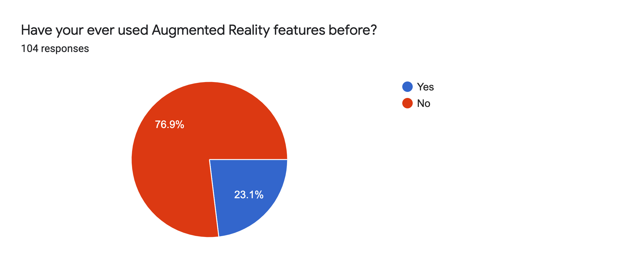
Individual Users- Validation of Technology

Slide 8
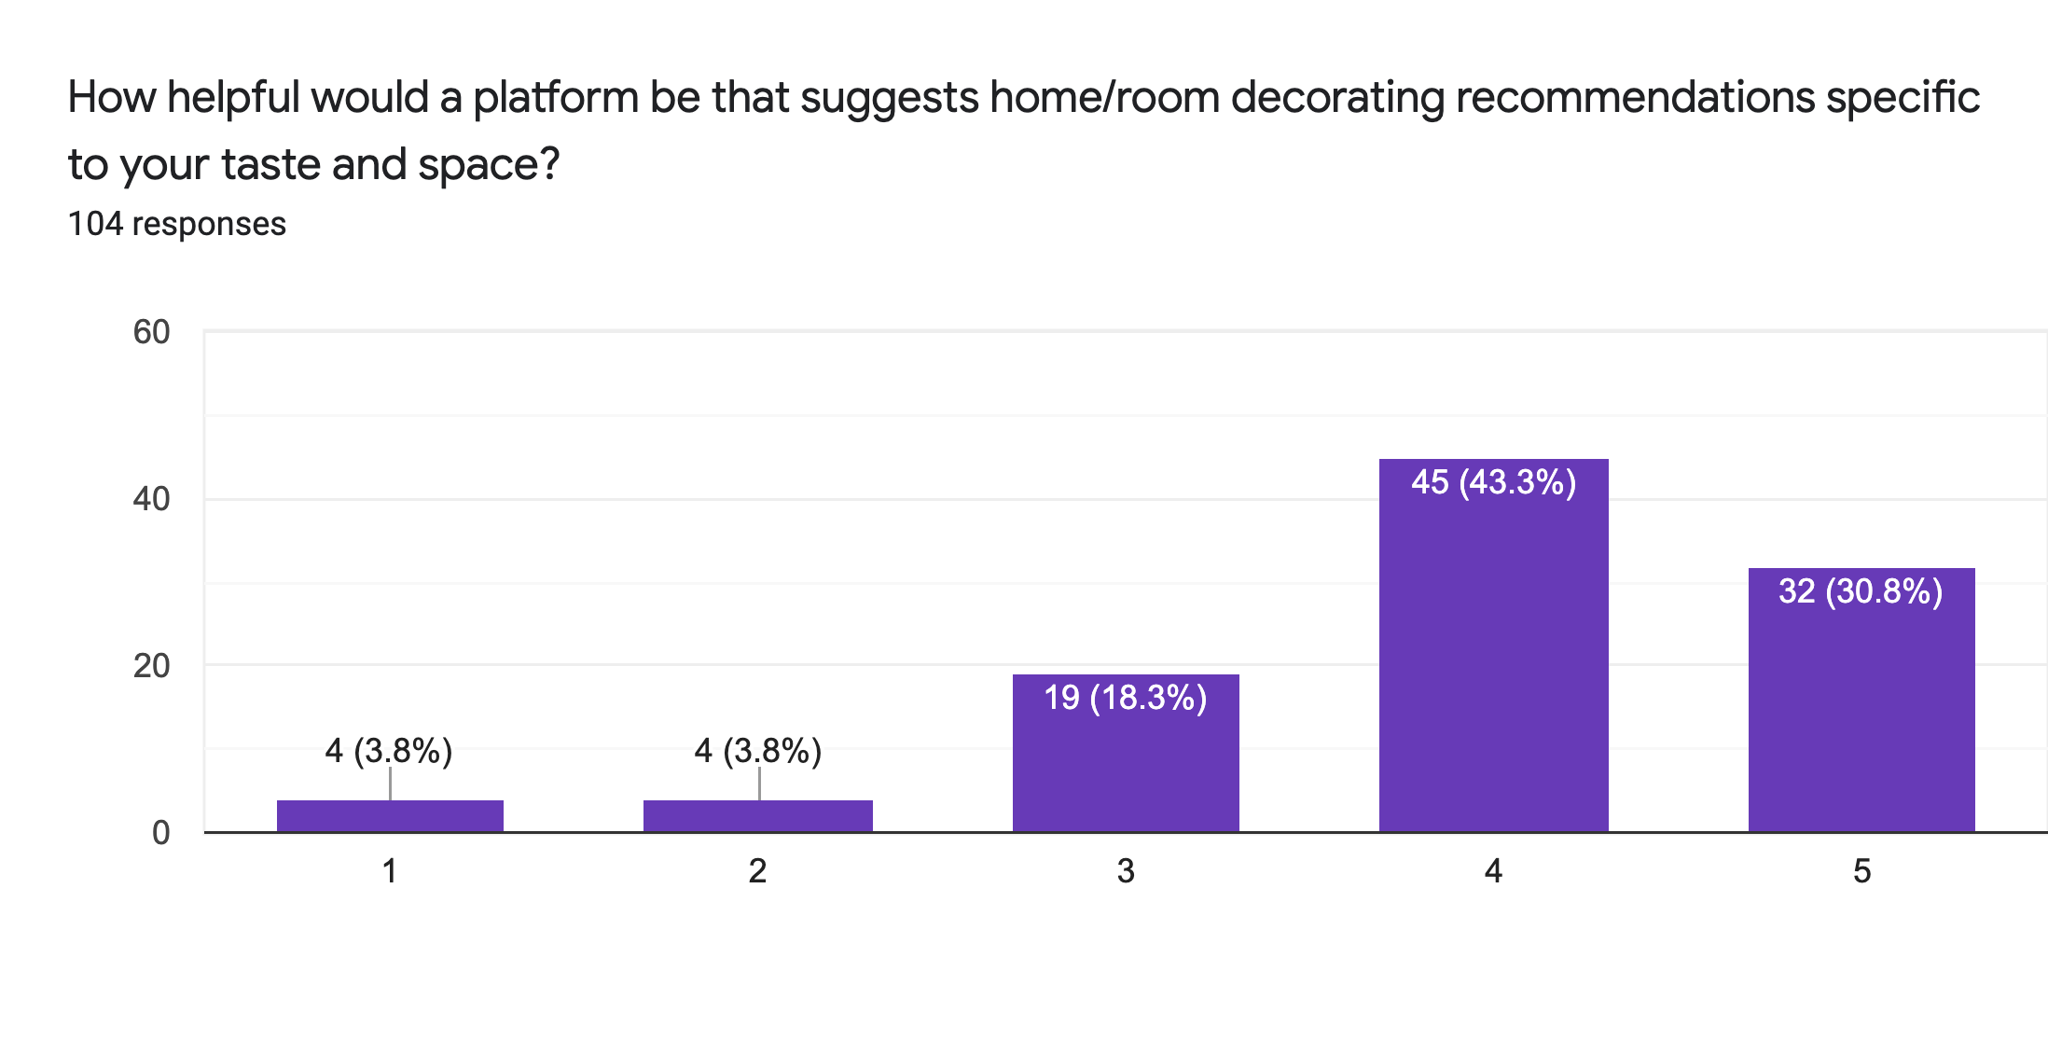
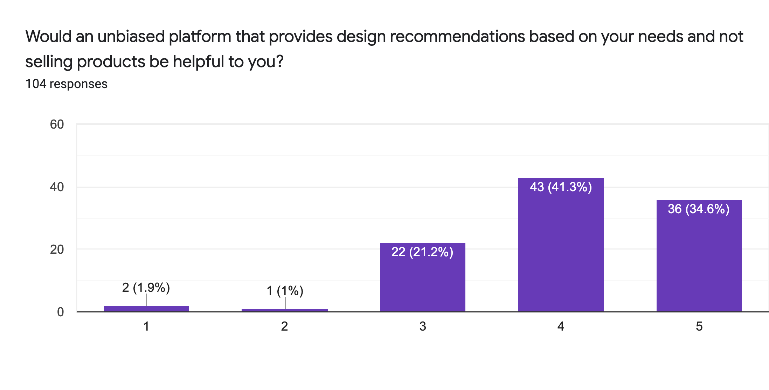
Individual Users- Validation of Platform

Slide 9
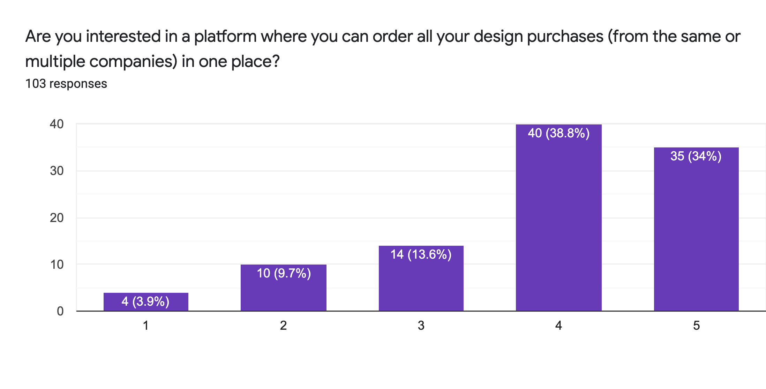
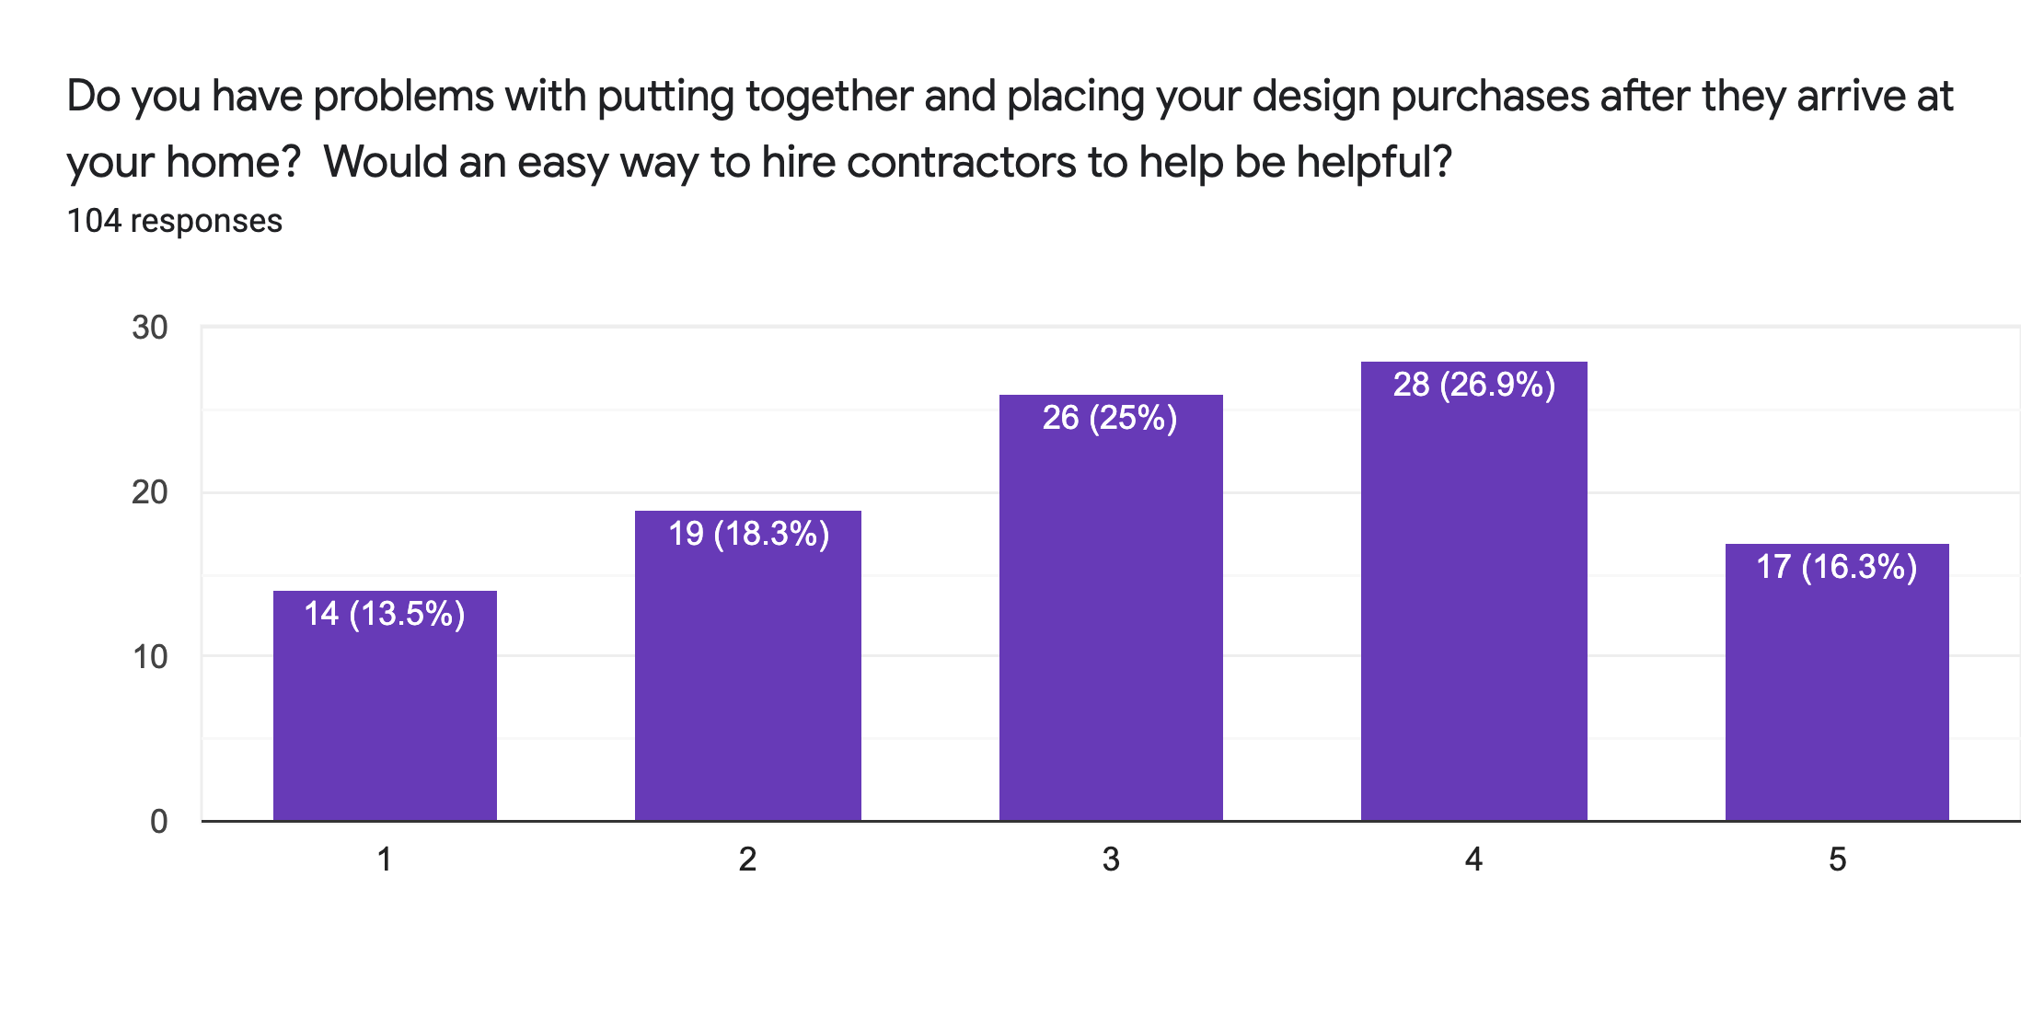
Individual Users- Logistics of Platform

Slide 10
Do you have any opinions on the current home/room decorating community, resources available, and ease of access?
I love the concept!
I don’t think it is possible for you to create an unbiased platform.
Generally not a big concern of mine. Technology could make it easier to find specific items. It could be useful to have a platform that takes in your preference for design and suggests combinations of furniture based on a budget.
I think we are long overdue for some innovation
Wish that it was easier to compare types of furnitures between furnishing companies in one place
I’m relatively new to it but have seen the process before going to college and it seems relatively straightforward, though I’m not too sure on my opinion yet.
Not aware of it being available.
My answers may be biased because I am an architect myself.
Task rabbit may help get assembling labor
I really like decorating homes and giving my opinion. I would love if someone uploaded a picture of their space with furniture/paint/decor options and I could Tinder swipe on the options.
Pinterest is great for decorating vibes, so it would be hard to launch a platform that does something similar. If you could have a tab of websites on the side and you could compare results from all of them that would be more helpful (like ikea, wayfair, urban outfitters, etc)
Love the idea of using AR to see a piece of furniture in my room before I buy. But I think that’s all I need. I’m confident picking out what a want based on my needs and assembling it myself
The poll might need to target people who has experienced pain points which can have more meaningful data
I am looking for a platform that helps people show up on time for meetings
Make sure that we can be offered cheap alternatives to looks that can be expensive!!

Slide 11
Furniture Retailers - Status Quo
Furniture retailers have higher chance of selling once the customers are in the showroom and are able to visualize and experience the products.
However, they have difficulty attracting new customers to come to their showrooms in the first place. The challenge is to convince the customers that their showroom is worth visiting.
This is due to competition from other showrooms and online retailers.

Slide 12
Furniture Retailers - Status Quo
High-end retailers have interior designer groups to ensure that their customers can get the best services. They want to make sure that their users make great buying choices. Interior design services may or may not charge: it depends on projects’ size.
Low-end retailers’ customers care about the price. Their challenge is that when customers come in, they take pictures and buy on Amazon with better prices.

Slide 13
DecoRight and Furniture Sellers
DecorRight can enlarge furniture sellers’ customer base.
For high-end sellers, although they have their own design groups, DecorRight can work as another tool to visualize their design before they really start a new project.

Slide 14
Real Estate Agents
Agents said that it would enhance the experience of the customer as it would make the buying/renting process more visual.
Concerned about how the software would work in houses that are not that attractive or that do not work so well with the software in which cases it might hurt sales.
Generally, not super excited about DecorRight as the effect is not clear other than maybe in the experience. However, they would be willing to use it.

