Slide 1
Yelp Review Analysis for Burger Business
Jiawei Huang, Yiqun Xiao, Shushu Zhang

Slide 2
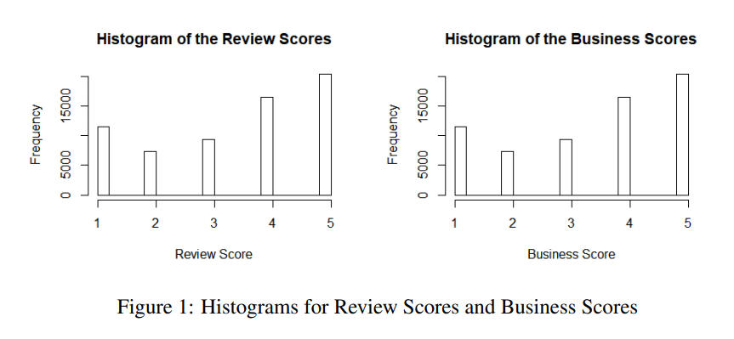
1. Introduction
65154 user reviews for 1405 “burger businesses”
Goal: finding the following two relationships
review scores vs review texts
overall scores for businesses
vs attributes of the businesses

Slide 3
2. Statistical Analysis 2.1 Data Cleaning
Merge ”review.json” and ”business.json” by ”business id”;
Select one ”burger” restaurants’ reviews and remove duplicates lines. After which the total reviews is reduced to 65154;
Remove all the punctuations and changed all words to lower case;
Remove all the typo and non-English words;

Slide 4
2. Statistical Analysis 2.1 Data Cleaning (Cont.)
Tokenize negative words, such as converting ”not clean” to a single word ”no_clean”;
Break the strings into lists of words and remove stop words;
Lemmatize. That is, Convert singular and plural nouns into singular. Unify verbs in different tenses into general present tense;
Count frequency of each words and remove all the words occurring only once or twice, since they are mostly typos or nonsense.

Slide 5
2. Statistical Analysis 2.2 TF-IDF (Term Frequency-Inverse Document Frequency)
Document-Term Matrix (DTM) representation:
row: review
column: word
value: frequencies of the occurance of a word for each text review
a sparse matrix of 65313*21848

Slide 6
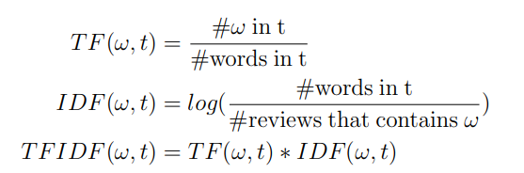
2. Statistical Analysis 2.2 TF-IDF (cont.)
Goal: offset the effect: if a word occurs more often than others in general, it is more likely to occur more frequently in a review
Mathematical Characterization of TF-IDF

Slide 7
2. Statistical Analysis 2.3 Lasso
Goal: Reduce the dimension of the variables (i.e., words)
Based on Lasso, we use Algorithm 1 (next slides) seven times using seven equally spaced thresholds (i.e., 0.6, 0.65, 0.7, 0.75, 0.8, 0.85, 0.9), take the intersect of the return variable set Sˆstable.
Results: select 765 words out of 21848

Slide 8
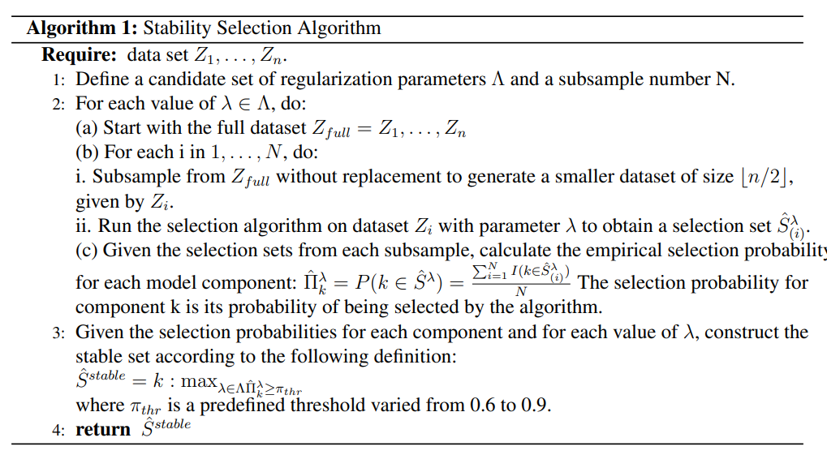
2. Statistical Analysis 2.3 Lasso (cont.)

Slide 9
2. Statistical Analysis 2.4 Model Fitting
Methods: multiple-testing for the 765 words, with the bonferroni correction
Results: 253 words with p = 0.05/765 = 6.54 ∗ 10−5 are considered to be significant to the overall rating scores
Top 10 variables based on p value (next slide)

Slide 10
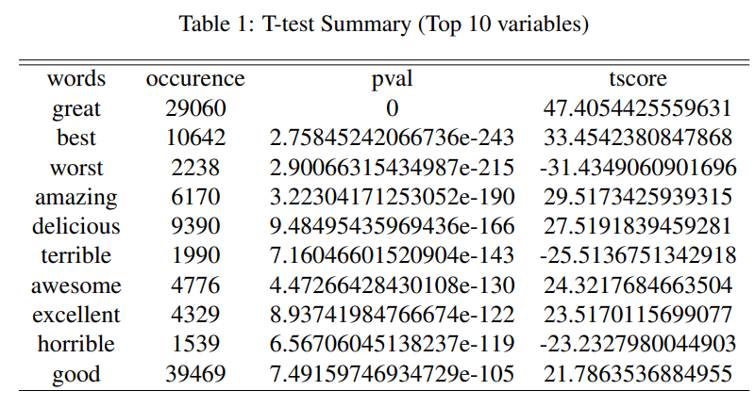
2. Statistical Analysis 2.4 Model Fitting

Slide 11
2. Statistical Analysis 2.4 Model Fitting
30 indicator words into 4 dimensions.
FOOD: cold, awful, mediocre, etc.
ENVIRONMENT: dirty, filthy, stale, etc.
SERVICE: rude, unfriendly, unprofessional, etc.
ETHNICITY: racist.

Slide 12
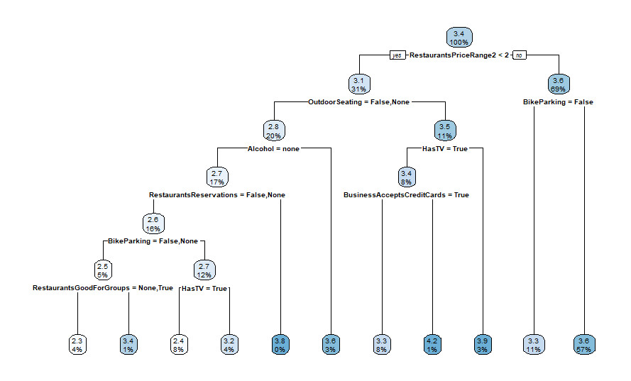
2. Statistical Analysis 2.5 Regression tree on attributes
Regression Tree
10 variables: RestaurantsDelivery, RestaurantsTake-Out, BusinessAcceptCreditCards,
RestaurantsReservations, HasTV, RestaurantsGoodForGroups,
RestaurantsPriceRange, NoiseLevel, Alcohol, OutdoorSeating,
RestaurantsAttire, WiFi, Good-ForKids, BikeParking
t-test
5 variables with high performance:
Price range (3219.1), Outdoor Seating (1500.2),
Whetherhas TV (1344.9), Alcohol (1342.6)
Bike Parking (754.6)

Slide 13
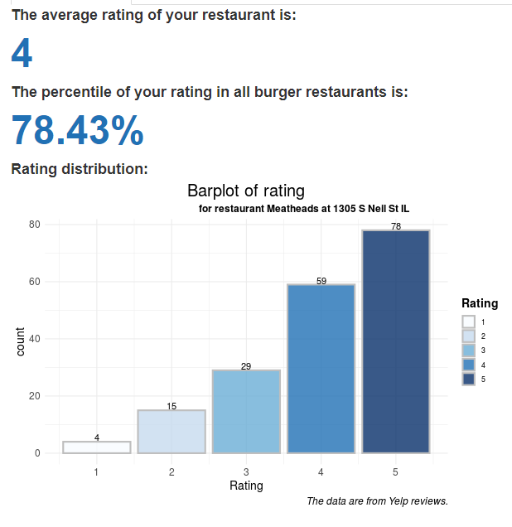
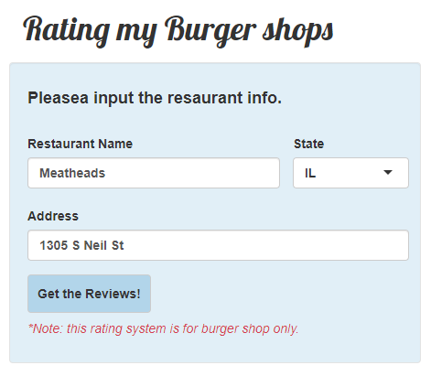
3. Insights & Action Plan 3.1 Overall Ratings
Example: Meatheads at 1305 S Neil St

Slide 14
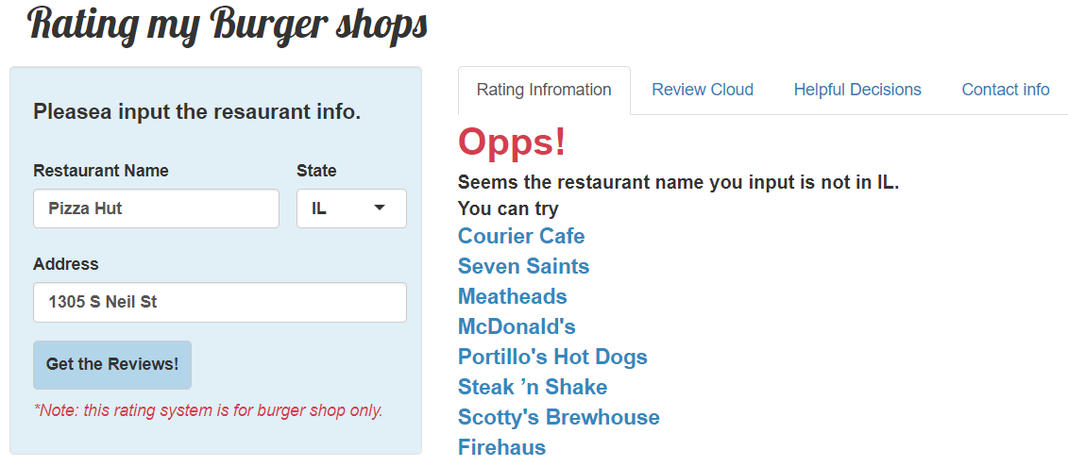
3. Insights & Action Plan 3.1 Overall Ratings
Error free

Slide 15
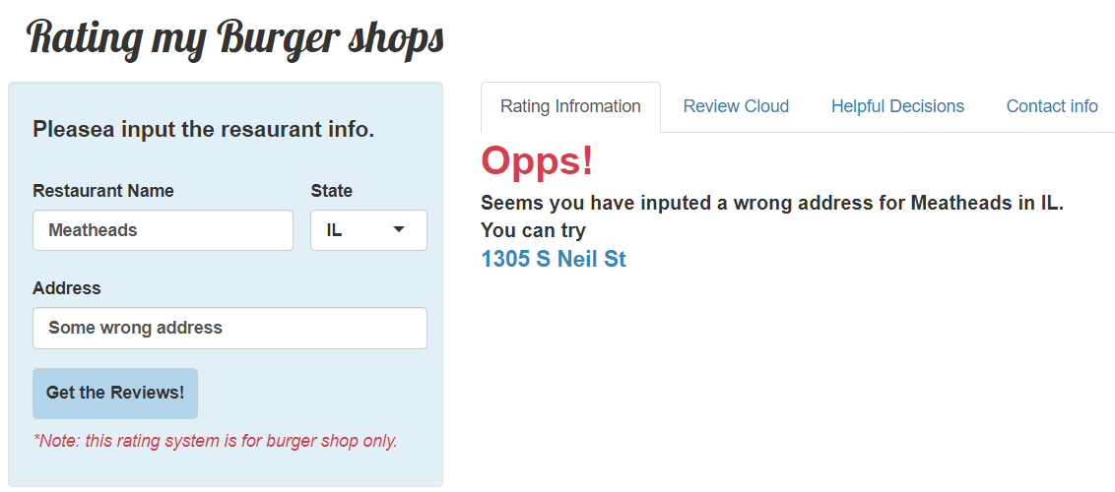
3. Insights & Action Plan 3.1 Overall Ratings
Error free

Slide 16
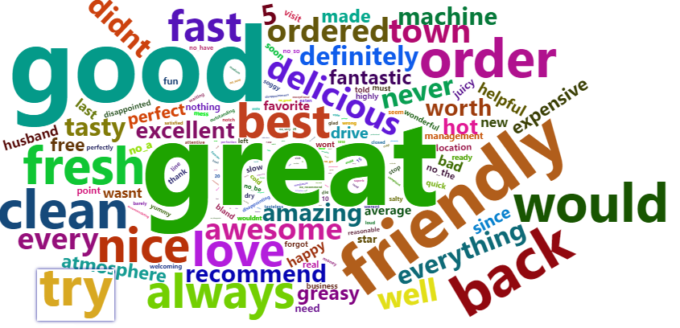
3. Insights & Action Plan 3.2 Cloud plot

Slide 17
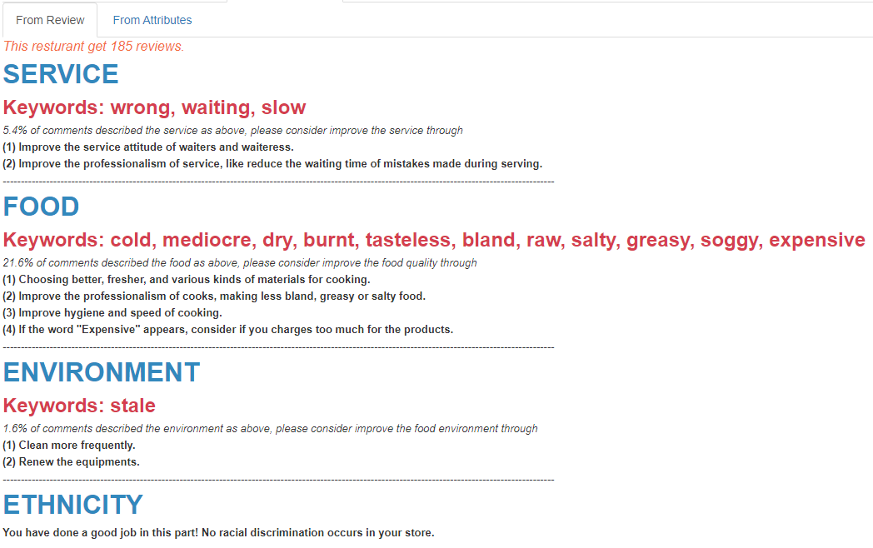
3. Insights & Action Plan 3.3 Helpful Decisions from Reviews

Slide 18
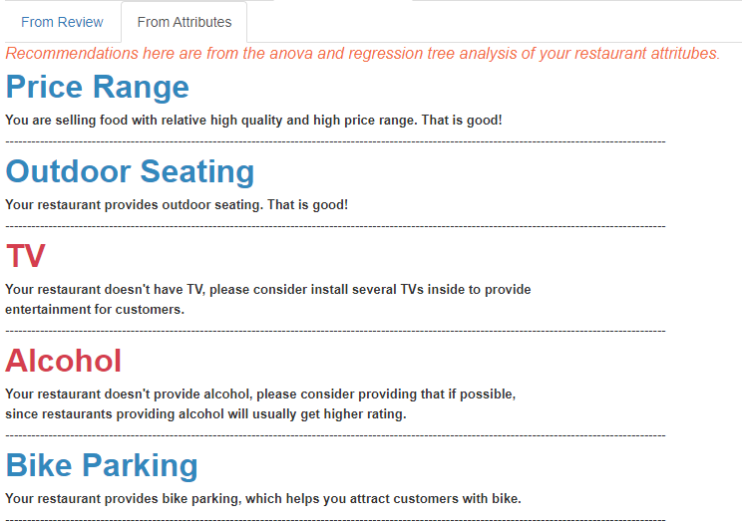
3. Insights & Action Plan 3.3 Helpful Decisions from Attributes

Slide 19
4. Strengths and Weaknesses
Strengths:
We give separate suggestions to individual physical store of the chain stores, since we believe they may perform differently. For example, we give suggestions on providing outdoor seats to the McDonald's at 3051 E Washington Ave, Madison, but not to McDonald's at 4020 Milwaukee St, Madison.
The method is applicable and improvable. We can apply it to larger data sets or data set for other industries.

Slide 20
4. Strengths and Weaknesses
Strengths (cont.):
We selected our indicators from various sources (review, attributes) and using various methods (lasso, t-test and regression tree), which guarantees the significance and accuracy of our model.
Stability selection (based on lasso) improve the performance of penalized regression. By subsampling, it could control the number of falsely discovered variables lower than a pre-defined threshold. Also, it avoid the sensitivity to regularization parameter,

Slide 21
4. Strengths and Weaknesses
Weaknesses:
Due to the size of our data set, the helpful decision can't be useful for all restaurants. For those burger restaurants with 1ess than 20 reviews, the suggestions are usually extracted from less than 5 reviews and suffers from great uncertainty.
Only through separating the sentience, combining some specific words, removing stop words and lemmatizing, some complex hidden information in the sentences is difficult to reveal. To refine the central idea of the review, we might need some deep learning method, however this is another big topic.

Slide 22
4. Strengths and Weaknesses
Weaknesses:
Especially during this pandemic of Covid-19, our advice might be less effective affected by special policies. For example, it is very important for restaurants to provide take-out now and the importance of this aspect (given by regression tree) would increase to a much higher level. Because of the limitation of the data set, all the advice are only for reference under regular circumstances.

