Slide 1

Central South University
ECoFFeS: a software for feature selection using single/multi-objective evolutionary algorithms
Jiawei Huang

Slide 2





CONTENTS
01
04
Introduction
References
02
Features
03
Conclusion

Slide 3
Central South University
01. Introduction

Slide 4
1
Introduction (1/4)
03
MS analysis
02
04
microarray analysis
SNP analysis
Feature Selection is of particular importance to numerous applications in the fields of bioinformatics and cheminformatics.
01
05
sequence analysis
QSAR analysis

Slide 5

1
Introduction (2/4)
feature selection merely selects a feature subset
and does not alter the original representation of the features
preserve the semantics of the features and offer the advantage of interpretability
Compared with other dimensionality reduction techniques
In QSAR analysis, the selected feature subset improves the interpretability of relationship between descriptors and biological activities.

Slide 6
1
Introduction (3/4)
However, feature selection remains a challenging task due to the fact that it is an NP-hard problem, in which the total number of possible feature subsets is 2^{n}-1 (n is the number of features).
Complete search
Most of them tend to suffer from stagnation in a local optimum.
Greedy search
Methods
Heuristic search
Random search
……

Slide 7
1
Introduction (4/4)
Evolutionary computation, as a kind of powerful global search method inspired by nature, has attracted a high level of interest from the feature selection research community.
For the purpose of further boosting evolutionary computation for feature selection, we develop a user-friendly and standalone software named ECoFFeS (Evolutionary Computation For Feature Selection).

Slide 8
Central South University
02. Features of ECoFFeS

Slide 9
2
Features of ECoFFeS (1/7)
ECoFFeS is an easy-to-use software that does not require any knowledge of programming for researchers. Specifically, ECoFFeS integrates a set of evolutionary algorithms with various evaluation combinations for feature selection in an effective manner.
2.1
Graphical User Interface
2.2
Internal Structure
2.3
Parallel Execution

Slide 10
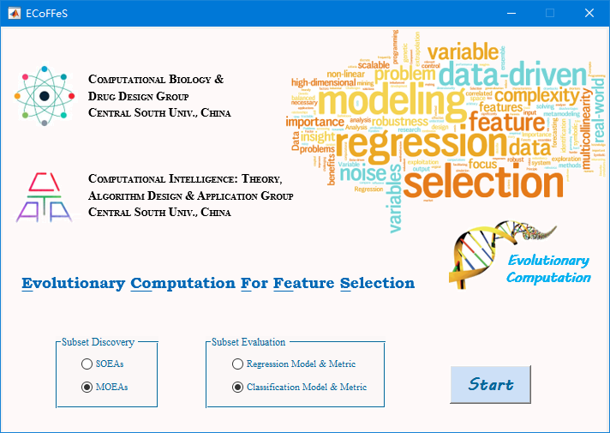
2
Features of ECoFFeS (2/7)
2.1
Graphical User Interface - the main interface of ECoFFeS
1
2
3
4
5
6
7
Notes:
Through combining ‘Subset Discovery’ with ‘Subset Evaluation’, a corresponding secondary interface, namely, ‘SOEAs_Regression’, ‘MOEAs_Regression’, ‘SOEAs_Classification’ or ‘MOEAs_Classification’ can be produced.

Slide 11
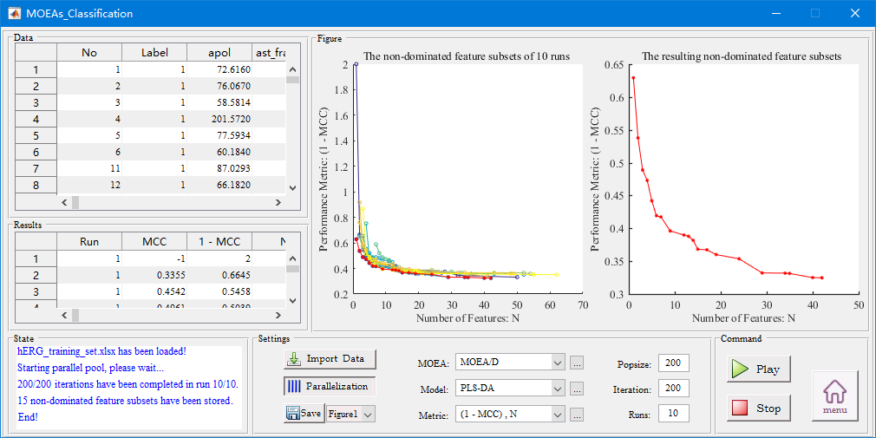
2
Features of ECoFFeS (3/7)
2.1
Graphical User Interface - the secondary interface ‘MOEAs_Classification’
1
2
3
4
5
6
Notes:
It shows the experimental results of the human ether-à-go-go related gene (hERG) dataset. In ‘Figure’, the left chart presents the non-dominated feature subsets derived from MOEA/D in 10 independent runs, and the right chart presents the resulting non-dominated feature subsets from the left chart.

Slide 12
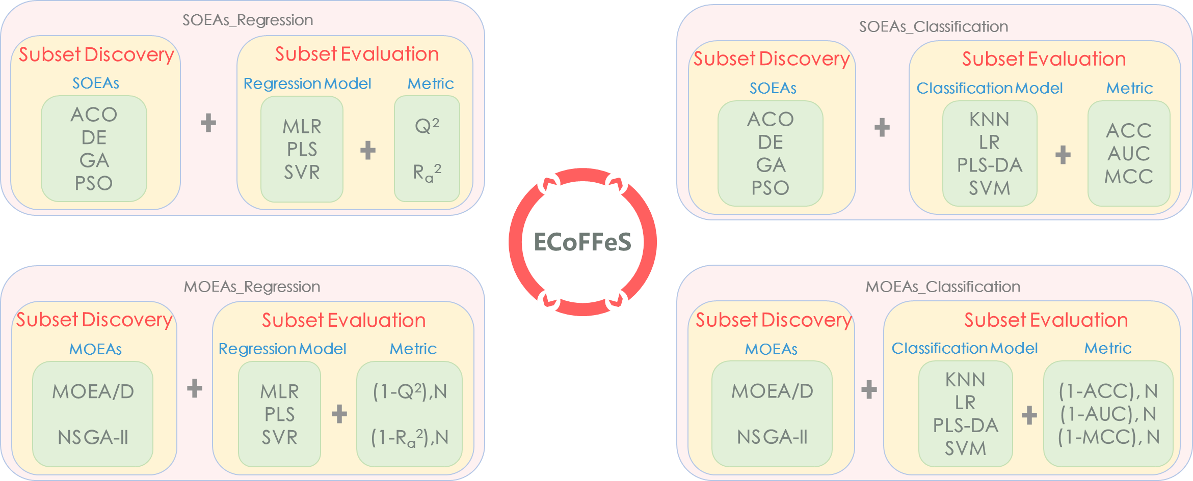
2
Features of ECoFFeS (4/7)
2.2
Internal Structure
Notes:
The internal structure of ECoFFeS, which consists of four main parts. It is evident that each part, which contains two key components, i.e., ‘Subset Discovery’ and ‘Subset Evaluation’, corresponds to a secondary interface.

Slide 13
2
Features of ECoFFeS (5/7)
2.2
Internal Structure – Subset Discovery
Subset Discovery is a search procedure to generate candidate feature subsets.
ECoFFeS involves two novel EAs (modified DE and modified MOEA/D proposed by the authors) and four existing state-of-the-art EAs, namely, ACO, GA, PSO, and NSGA-II.
Among these EAs, four are single-objective EAs (SOEAs) and two are multi-objective EAs (MOEAs).
SOEAs
A satisfactory feature subset can be sought out and the rankings of the important features can be obtained.
MOEAs
We can maintain a set of non-dominated feature subsets with a tradeoff between the number of features and the corresponding metric.

Slide 14
2
Features of ECoFFeS (6/7)
2.2
Internal Structure – Subset Evaluation
Subset Evaluation aims to assess the candidate feature subsets generated by Subset Discovery.
In ECoFFeS, 36 evaluation combinations are provided for users.
12 are the combinations of regression-based models and metrics
24 are the combinations of classification-based models and metrics
On the basis of Subset Discovery and Subset Evaluation, ECoFFeS is a generic tool to tackle feature selection in different types of applications.

Slide 15
2
Features of ECoFFeS (7/7)
2.3
Parallel Execution
ECoFFeS supports parallel execution which is a useful strategy to make full use of the processing ability of multi-core computers and to significantly reduce the computational time.

Slide 16
Central South University
03.Conclusion

Slide 17
3
Conclusion (1/1)
Conclusion
To cope with feature selection in the fields of bioinformatics and cheminformatics, we design a standalone software called ECoFFeS, which not only provides a user-friendly and easy-to-use graphical user interface, but also achieves an effective synergy of evolutionary algorithms and evaluation combinations.
We hope that it will lower the entry barrier for researchers to address feature selection problems at hand. In the future, we plan to incorporate more techniques (e.g., new EAs) into ECoFFeS and add more case studies to the User Manual.

Slide 18
Central South University
04.References

Slide 19
4
References (1/1)
[1] Danishuddin and Khan,A.U. (2016) Descriptors and their selection methods in QSAR analysis: paradigm for drug design. Drug Discov. Today, 21, 1291–1302.
[2] Deb,K. et al. (2002) A fast and elitist multiobjective genetic algorithm: NSGA-II. IEEE Trans. Evol. Comput., 6, 182–197.
[3] Dorigo,M. et al. (1996) The ant systems: optimization by a colony of cooperative agents. IEEE Trans. Man, Mach. Cybern. B, 26, 1–13.
[4] Eiben,A.E. and Smith,J. (2015) From evolutionary computation to the evolution of things. Nature, 521, 476–482.
[5] Holland,J.H (1992) Adaptation in natural and artificial systems : an introductory analysis with applications to biology, control, and artificial intelligence U Michigan Press.
[6] Kennedy,J. and Eberhart,R. (2002) Particle swarm optimization. In, Proceedings of IEEE International Conference on Neural Networks. Springer, pp. 1942–1948.
[7] Saeys,Y. et al. (2007) A review of feature selection techniques in bioinformatics. Bioinformatics, 23, 2507–2517.
[8] Storn,R. and Price,K. (1997) Differential Evolution -- a simple and efficient heuristic for global optimization over continuous spaces. J. Glob. Optim., 11, 341–359.
[9] Wang,L. et al. (2016) Feature selection methods for big data bioinformatics: a survey from the search perspective. Methods, 111, 21–31.
[10] Xue,B. et al. (2016) A survey on evolutionary computation approaches to feature selection. IEEE Trans. Evol. Comput., 20, 606–626.
[11] Zhang,Q. and Li,H. (2007) MOEA/D: a multiobjective evolutionary algorithm based on decomposition. IEEE Trans. Evol. Comput., 11, 712–731.

Slide 20
Central South University
Thank you for your attention!

