Slide 1


The 49th International Conference on Parallel Processing (ICPP 2020)
AMRT: Anti-ECN Marking to Improve Utilization of Receiver-driven Transmission
in Data Center
Jinbin Hu¹ , Jiawei Huang¹, zhaoyi Li¹, Jianxin Wang¹, Tian He²
¹Central South University, China
²University of Minnesota, USA

Slide 2
Outline
Introduction
Background
Motivation
AMRT Design
Evaluation
Summary

Slide 3
Outline
Introduction
Background
Motivation
AMRT Design
Evaluation
Summary

Slide 4
Introduction
Key idea:
Improve link utilization in receiver-driven transmission under multi-bottleneck and dynamic traffic scenarios.
Solution:
AMRT uses anti-ECN marked packets to notify the sender of link under-utilization and correspondingly increases sending rate to grab spare bandwidth.

Slide 5
Outline
Introduction
Background
Motivation
AMRT Design
Evaluation
Summary

Slide 6

Background
Data Center (DC)
Spine
Data Center Traffic
delay-sensitive flows
throughput-sensitive flows
10/100G
Leaf
Transport protocols
Sender-driven (DCTCP^{[1]}, D²TCP^{[2]}, pFabric^{[3]} , DCQCN^{[4]} ,Timely^{[5]})
Hosts
Receiver-driven (pHost^{[8]}, NDP^{[10]}, Homa^{[7]} , Aeolus^{[11]} )

Slide 7
Outline
Introduction
Background
Motivation
AMRT Design
Evaluation
Summary

Slide 8
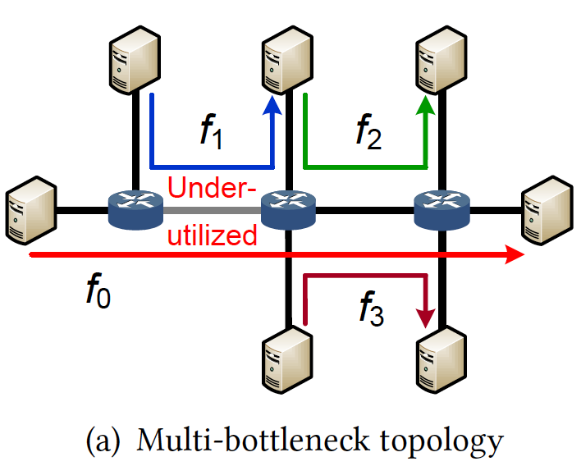
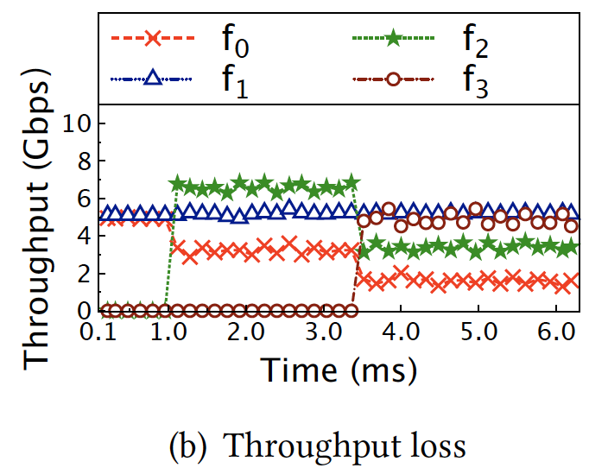
Motivation
Multiple bottlenecks scenario

Slide 9
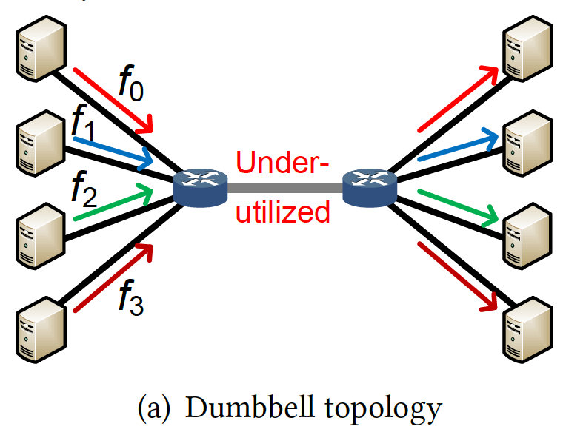
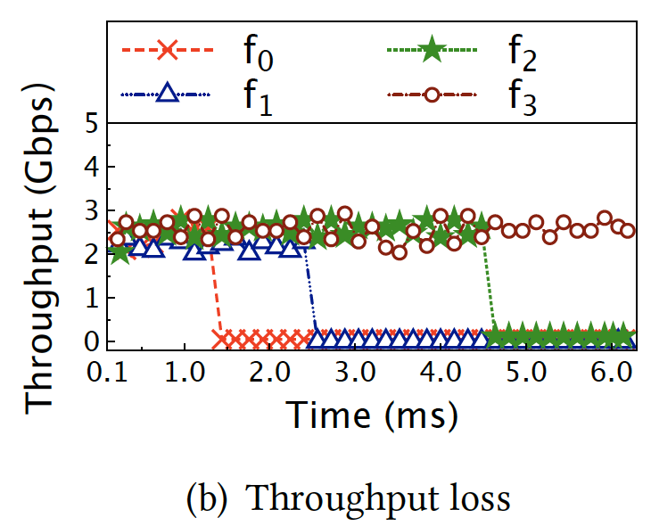
Motivation
Dynamic traffic scenario

Slide 10
Outline
Introduction
Background
Motivation
AMRT Design
Evaluation
Summary

Slide 11
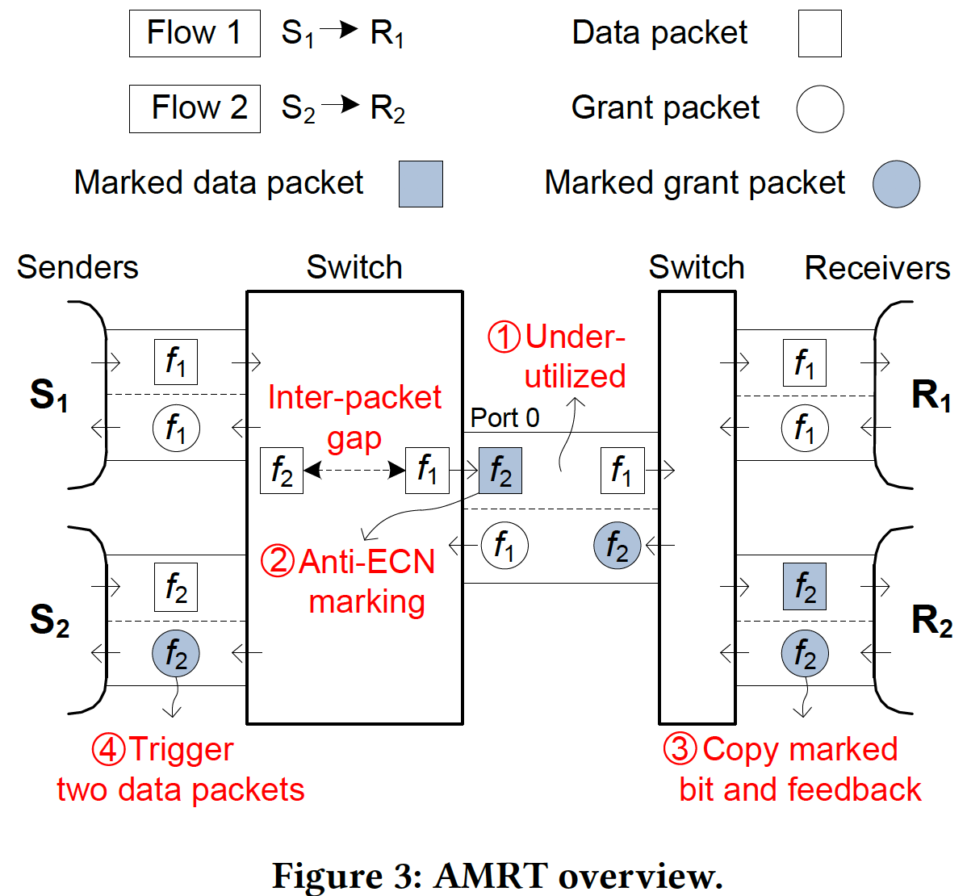
AMRT Overview
AMRT: Anti-ECN Marking Receiver-driven Transmission
At switch
At receiver
At sender

Slide 12
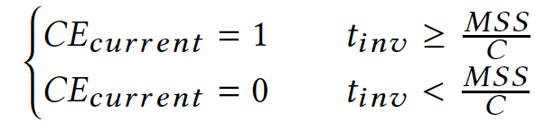



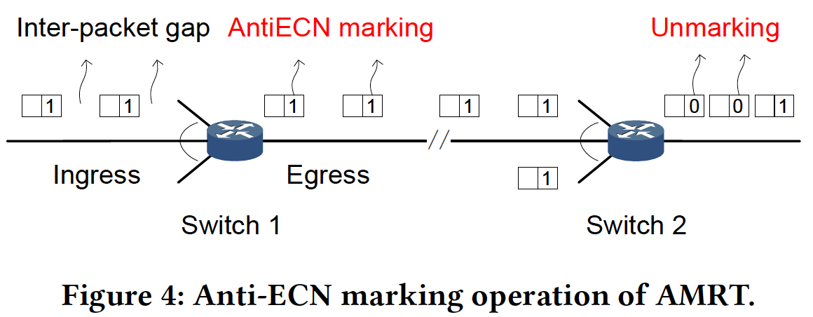
AMRT: Design Details
At switch
Packet Interval Estimation
Anti-ECN Marking

Slide 13
AMRT: Design Details
At receiver
Grant Generation
Explicit Feedback
At sender
Receiver-driven Rate Adjustment

Slide 14
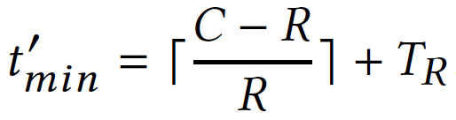
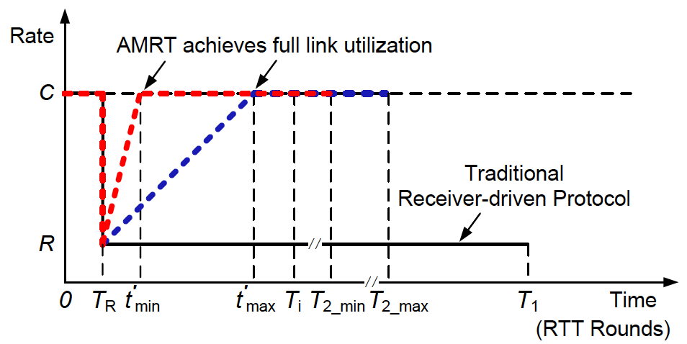



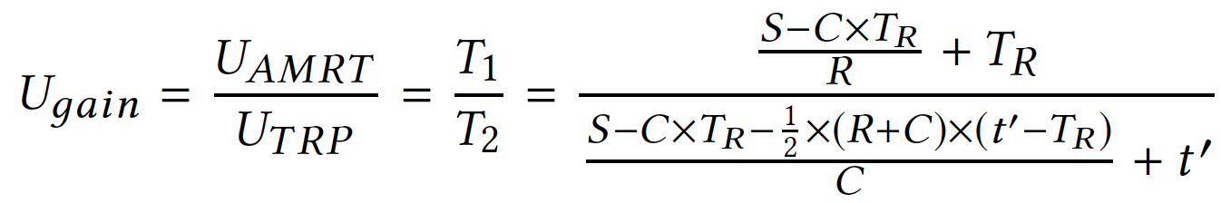

AMRT: Model Analysis

Slide 15
Outline
Introduction
Background
Motivation
AMRT Design
Evaluation
Summary

Slide 16
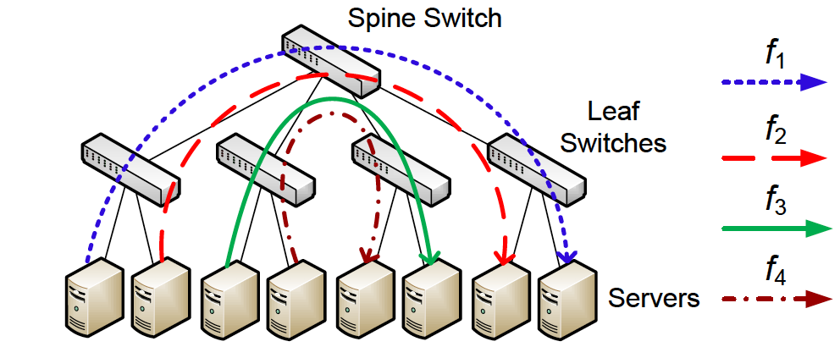
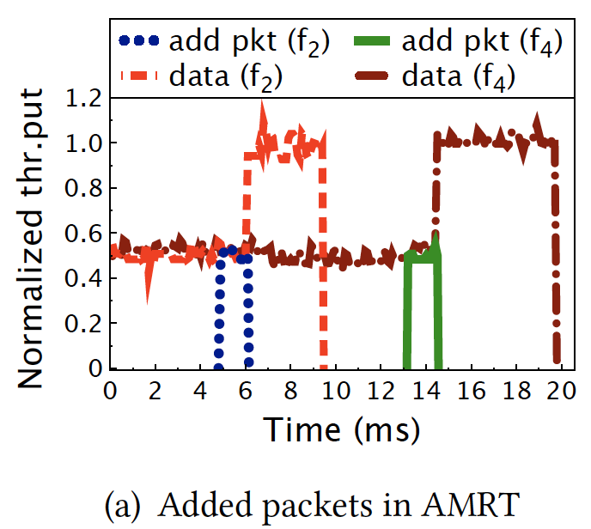
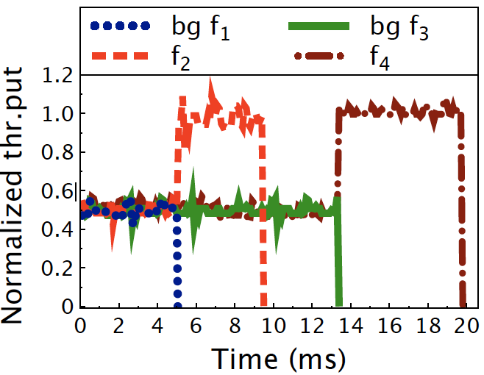
Testbed Results
Testbed settings
2-layer Leaf-spine topology;
1Gbps bottleneck link;

Slide 17
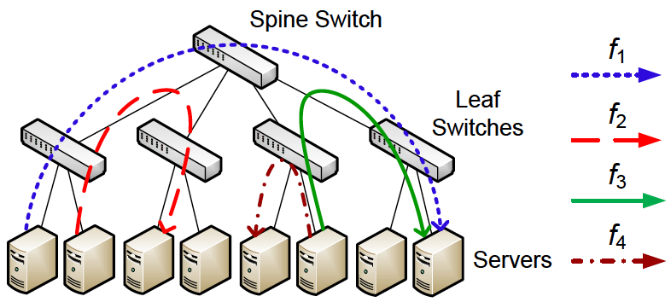
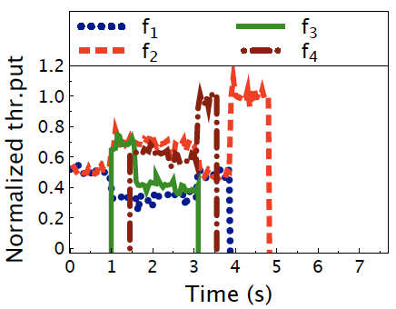
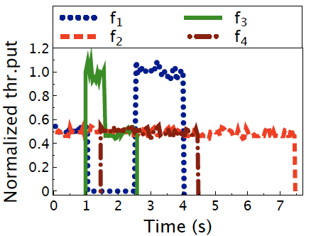
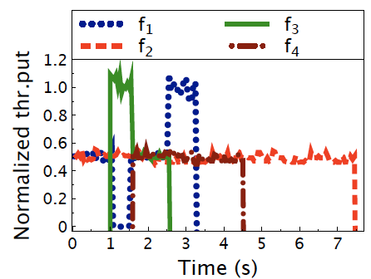
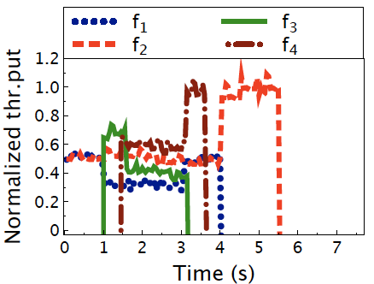



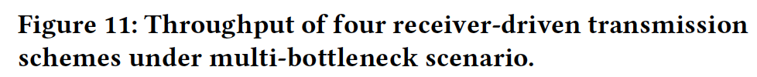
Testbed Results
Testbed settings
2-layer Leaf-spine topology;
1Gbps bottleneck link;

Slide 18


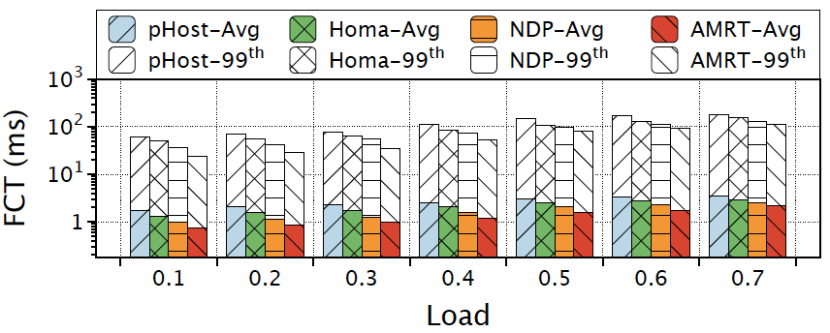
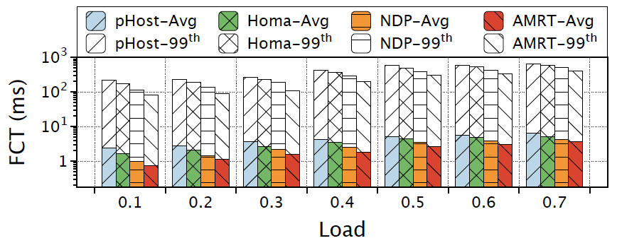
Larger-scale Simulations
Simulation settings
NS2 simulator; 2-layer Leaf-spine topology
10Gbps bottleneck link; 400 hosts, 10 ToR switches, 8 core switches
better
Reducing the AFCT up to ~49%
Reducing the 99th FCT up to ~56%

Slide 19
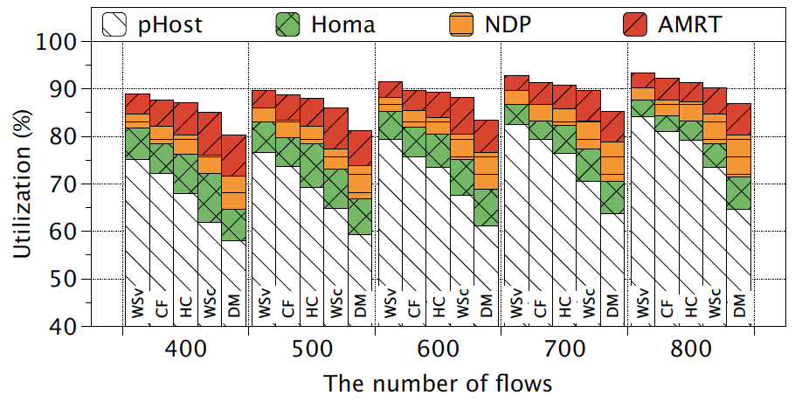
Larger-scale Simulations
Simulation settings
NS2 simulator; 2-layer Leaf-spine topology
10Gbps bottleneck link; 400 hosts, 10 ToR switches, 8 core switches
better
Improving the link utilization up to ~36%

Slide 20
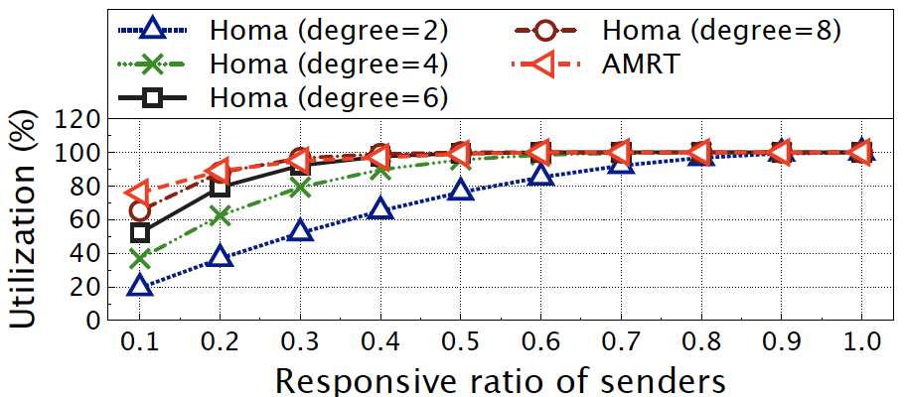
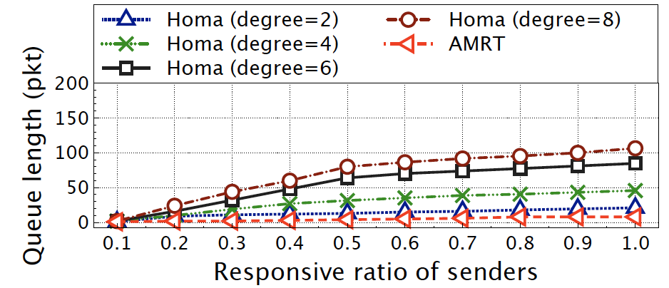


Larger-scale Simulations
Performance in Many-to-many Communications
better
Improving the link utilization up to ~60%
better

Slide 21
Outline
Introduction
Background
Motivation
AMRT Design
Evaluation
Summary

Slide 22
Summary
Conservative receiver-driven transmission
Under-utilization in Multiple bottlenecks scenario;
Under-utilization in Dynamic traffic scenario;
Challenges for AMRT
How to detect and feedback the under-utilization information to senders to improve link utilization and guarantee ultra low latency simultaneously?
Key points of AMRT
Packet Interval Estimation and Anti-ECN Marking at switches；
Grant Generation and Explicit Feedback at receivers;
Receiver-driven Rate Adjustment at senders.

Slide 23

Thank you !
Q&A

