Slide 1




The 29th IEEE International Conference on Network Protocols (ICNP 2021)
RPO: Receiver-driven Transport Protocol Using
Opportunistic Transmission in Data Center
Jinbin Hu¹ , Jiawei Huang¹, zhaoyi Li¹, Yijun Li¹, Jianxin Wang¹, Wenchao Jiang², Kai Chen³, Tian He⁴
¹Central South University; ²Singapore University of Technology and Design;
³Hong Kong University of Science and Technology; ⁴University of Minnesota

Slide 2
Outline
Introduction
Background
Motivation
RPO Design
Implementation
Evaluation
Summary

Slide 3
Outline
Introduction
Background
Motivation
RPO Design
Evaluation
Implementation
Summary

Slide 4
Introduction
Key idea :
Improve link utilization in receiver-driven transmission under the roundtrip time variation and highly dynamic traffic scenarios.
Solution:
RPO rationally uses low-priority opportunistic packets to grab the spare bandwidth without increasing the queueing delay of high-priority normal packets.
Notes:
the key idea of RPO. It improves link utilization in receiver-driven transmission under the roundtrip time variation and highly dynamic traffic scenarios.
To realize this idea, we proposed a new receiver-driven transport protocol RPO. Specifically, RPO rationally uses low-priority opportunistic packets to grab spare bandwidth without increasing the queueing delay of high-priority normal packets.

Slide 5
Outline
Introduction
Background
Motivation
RPO Design
Implementation
Evaluation
Summary

Slide 6

Background
Data Center (DC)
Spine
Data Center Traffic
delay-sensitive flows
throughput-sensitive flows
40/100G
Leaf
How to achieve the low latency and high throughput？
Hosts
Transport protocols
Sender-side (DCTCP^{[Sigcomm’10]}, pFabric^{[Sigcomm’13]} , DCQCN^{[Sigcomm’15]} ,Timely^{[Sigcomm’15]})
Receiver-driven (pHost^{[CoNEXT’15]}, NDP^{[Sigcomm’17]}, ExpressPass^{[Sigcomm’17]} , Homa^{[Sigcomm’18]})

Slide 7
Outline
Introduction
Background
Motivation
RPO Design
Implementation
Evaluation
Summary

Slide 8
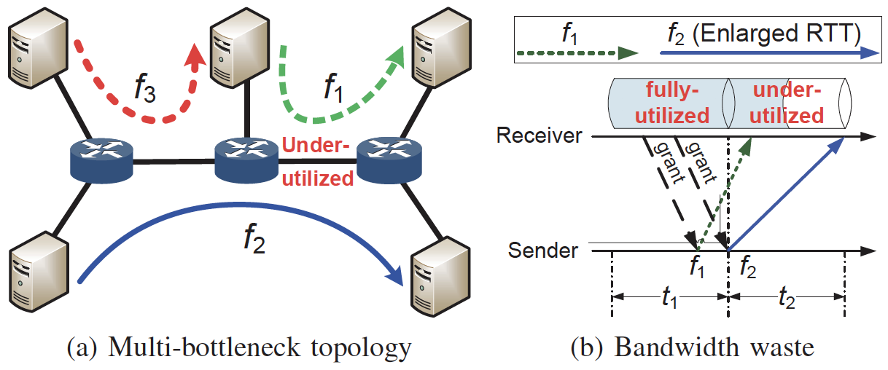
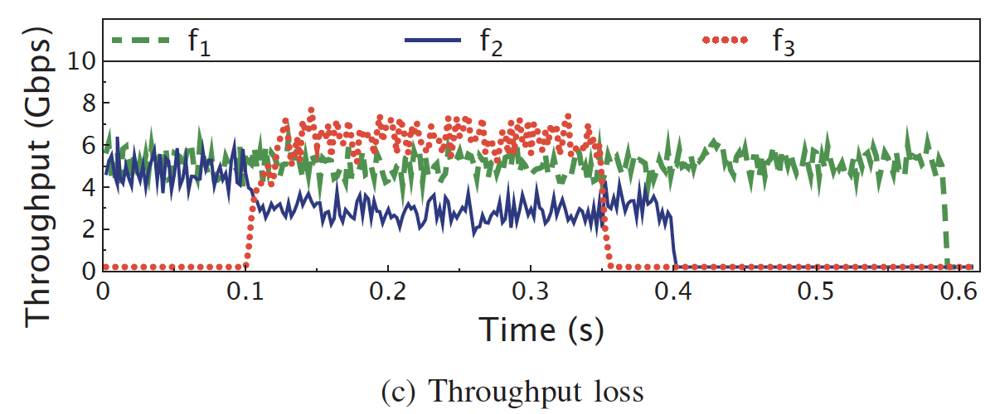
Motivation
Impact of RTT Variation
Testbed settings
10Gbps bottleneck link;
Dell PRECISION TOWER 5820；
Intel 10GbE 2P X520NICs；
Notes:
At the beginning, flow1 and flow2 fairly share the bottleneck link without queueing, but when the flow3 starts at the line rate, flow2 experiences congestion at the another bottleneck and its sending rate decreases to about 3Gbps. Gigabits per second
Since the flow1 is not able to increase its sending rate to grab the spare bandwidth released by the flow 2, this results in the link utilization of bottleneck shared by flow1 and flow2 to drop about 30%.

Slide 9
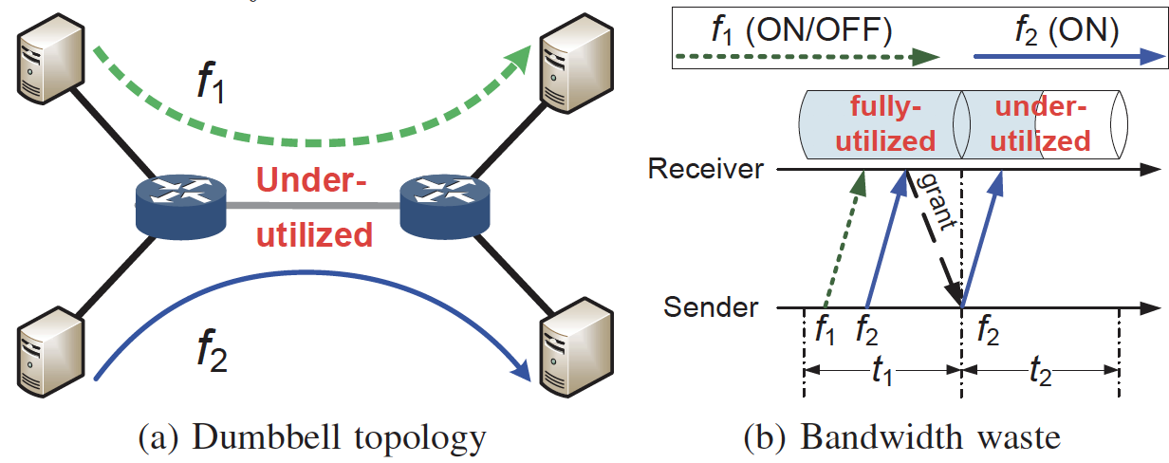
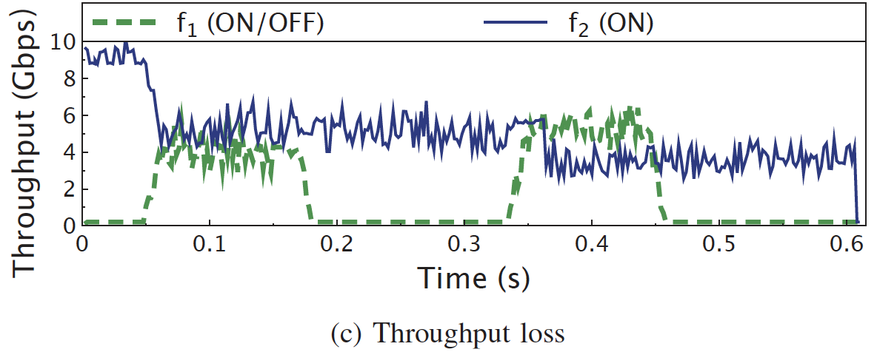
Motivation
Impact of ON/OFF Traffic
Testbed settings
10Gbps bottleneck link;
Dell PRECISION TOWER 5820；
Intel 10GbE 2P X520NICs；

Slide 10
Outline
Introduction
Background
Motivation
RPO Design
Implementation
Evaluation
Summary

Slide 11
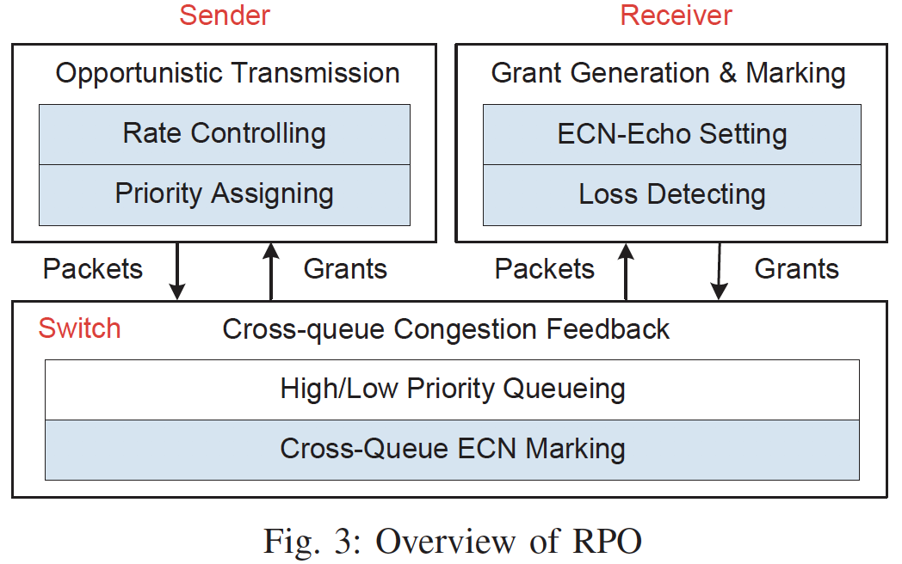
RPO Overview
RPO: Receiver-driven opPOrtunistic transmission
At sender
At switch
At receiver
Notes:
--- Firstly, Receiver-driven Opportunistic Transmission at the sender;
--- Secondly, Cross-queue Congestion Feedback at the switch;
--- Finally, Grant Generation and Marking at the receiver;

Slide 12
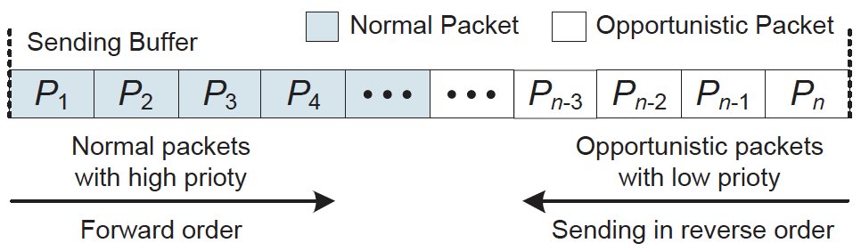
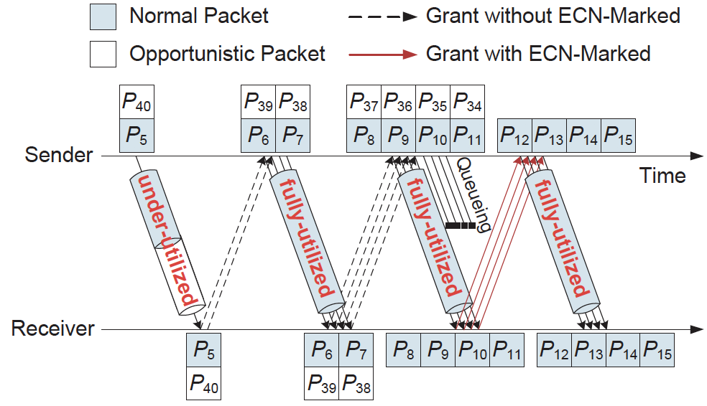
RPO: Design Details
At sender
Priority assignment
Receiver-driven Opportunistic Transmission

Slide 13
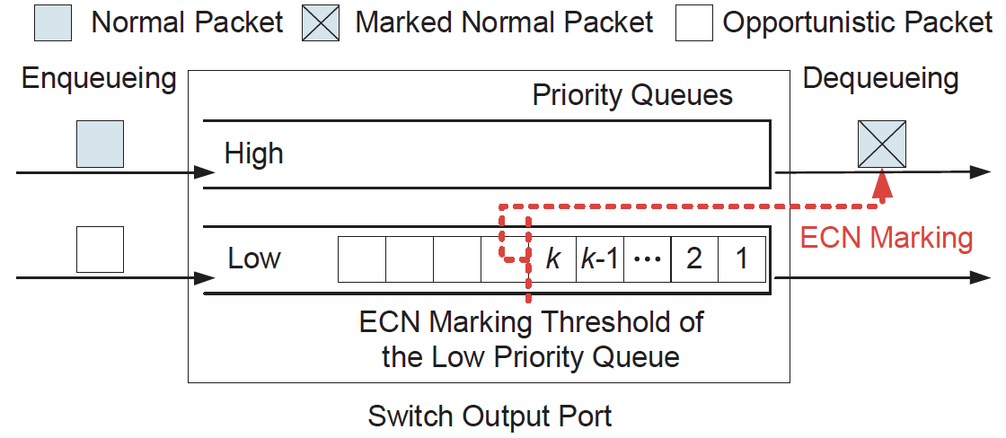
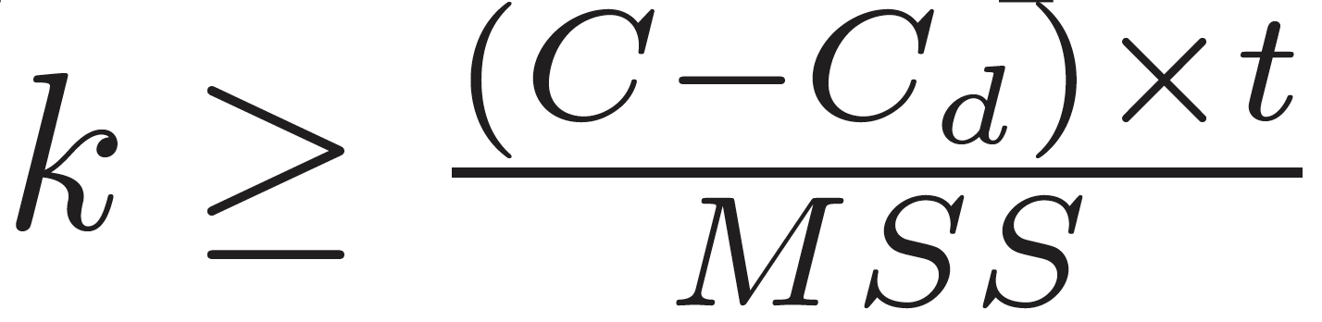
RPO: Design Details
At switch
Cross-queue ECN marking
At receiver
Grant Generation and Marking

Slide 14
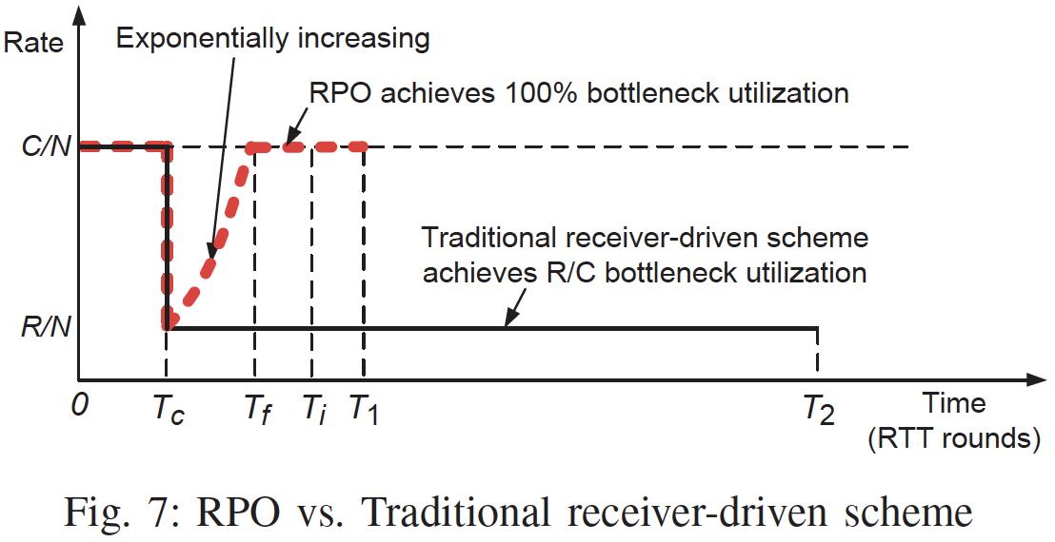
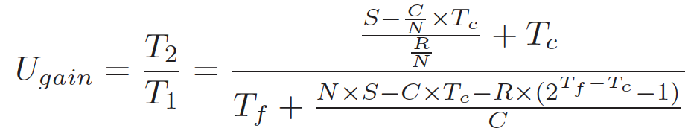

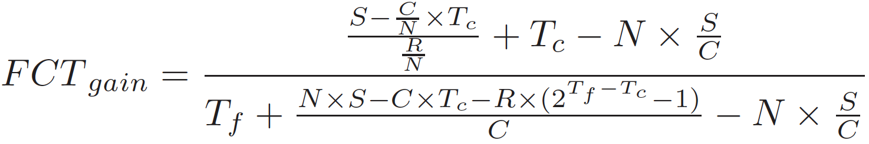
RPO: Model Analysis

Slide 15
Outline
Introduction
Background
Motivation
RPO Design
Implementation
Evaluation
Summary

Slide 16
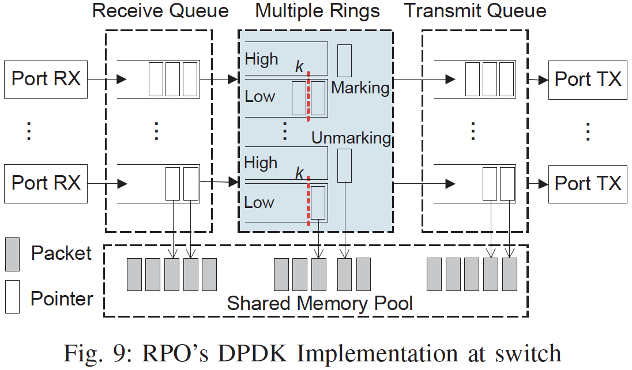
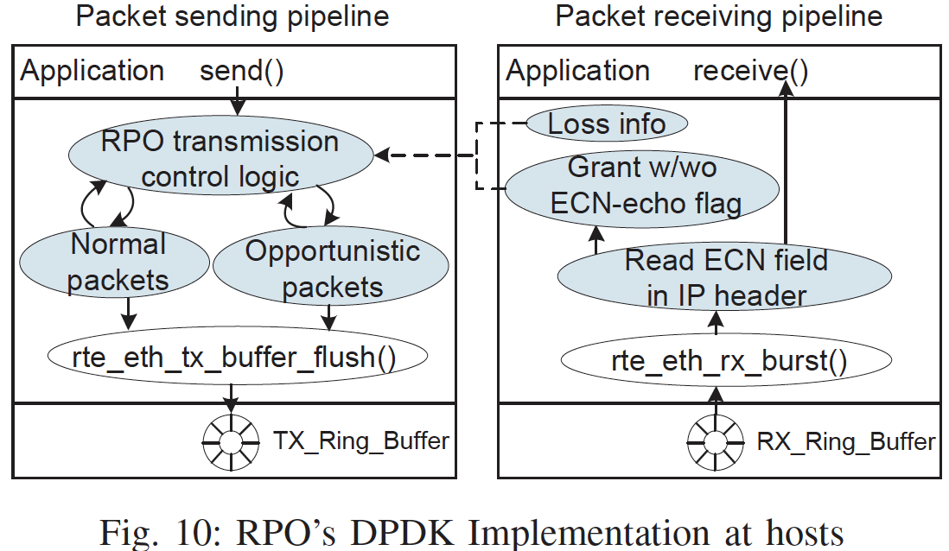
RPO: Implementation
At hosts
At switch
Notes:
We implement RPO based on Intel DPDK.

Slide 17
Outline
Introduction
Background
Motivation
RPO Design
Implementation
Evaluation
Summary

Slide 18
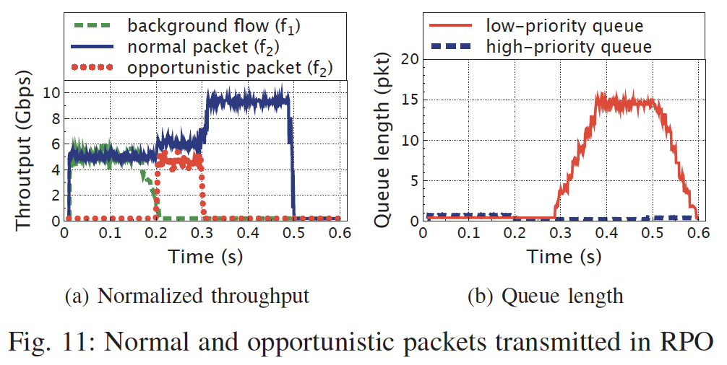
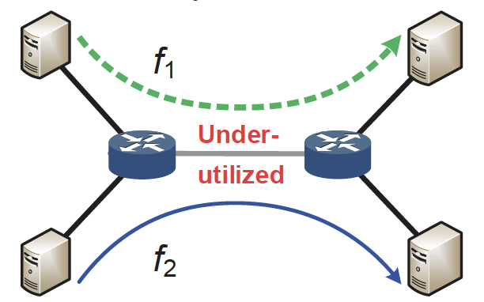
Testbed Results
Testbed settings
Dumbbell topology;
10Gbps bottleneck link;
Dell PRECISION TOWER 5820；
Intel 10GbE 2P X520NICs；

Slide 19
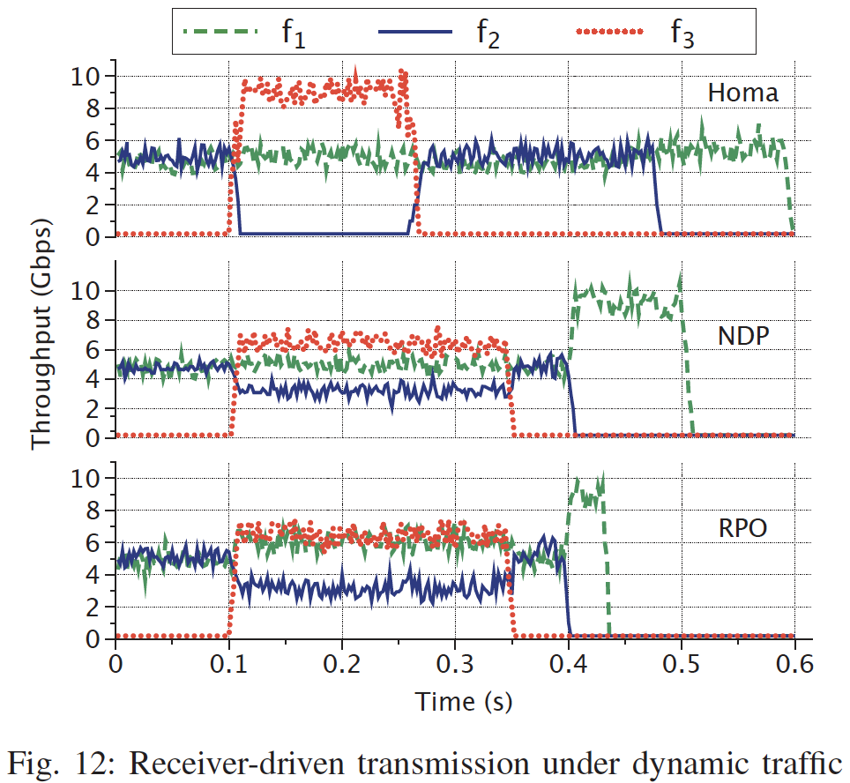
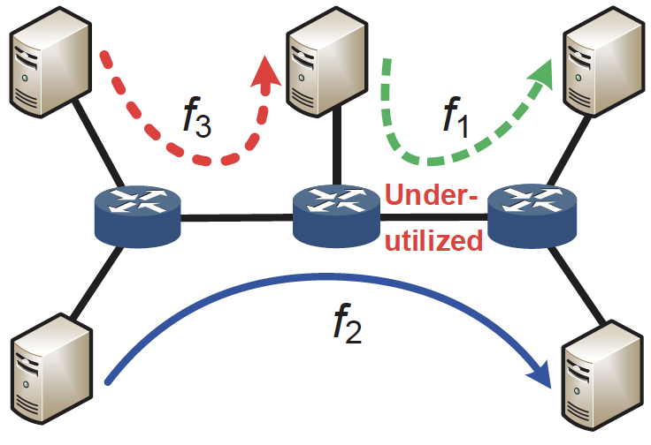
Testbed Results
Testbed settings
Multi-bottleneck topology;
10Gbps bottleneck link;
Dell PRECISION TOWER 5820；
Intel 10GbE 2P X520NICs；
opportunistic
packets

Slide 20

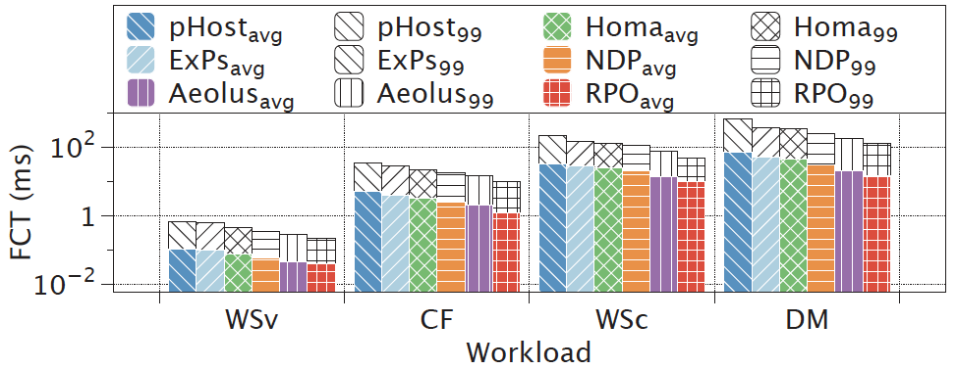
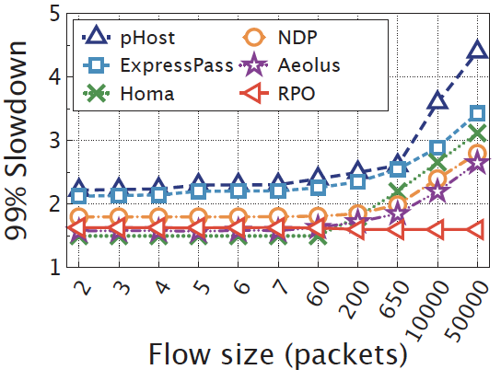
Larger-scale Simulations
Simulation settings
NS-2 simulator; 2-layer Leaf-spine topology；
40Gbps bottleneck link; 400 hosts / 10 Leaf switches / 8 Spine switches；
better
better
Reducing the AFCT up to ~52%
Reducing the 99th slowdown up to ~68%
Notes:
RPO reduces the average FCT and 99th percentile slowdown by up to about 52% and 68% under the data mining workload, respectively.

Slide 21
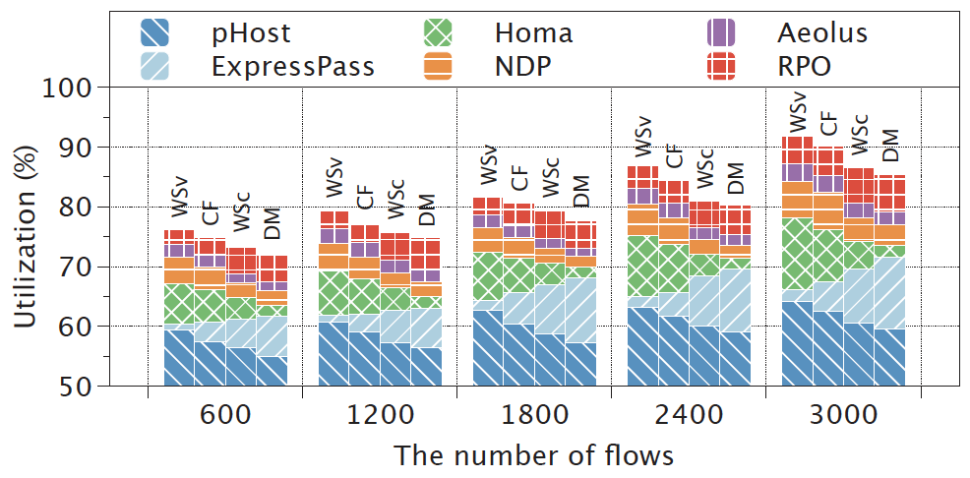
Larger-scale Simulations
Simulation settings
NS-2 simulator; 2-layer Leaf-spine topology；
40Gbps bottleneck link; 400 hosts, 10 Leaf switches, 8 Spine switches；
better
Improving the link utilization up to ~35%

Slide 22
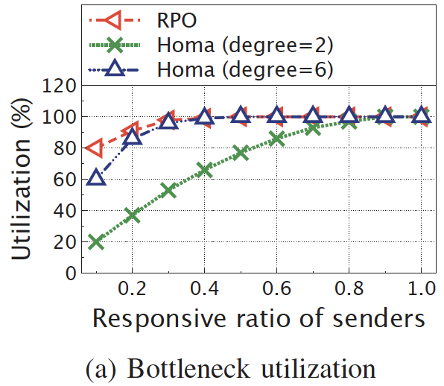
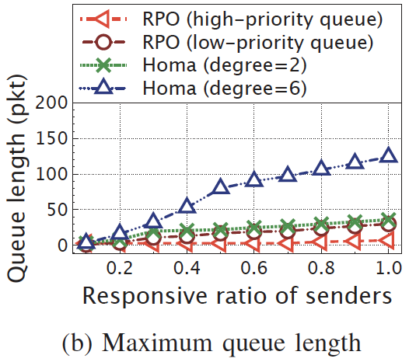
Larger-scale Simulations
Performance in Many-to-many Communications
better
better
Improving the link utilization up to ~60%

Slide 23
Outline
Introduction
Background
Motivation
AMRT Design
Implementation
Evaluation
Summary

Slide 24
Summary
Conservative receiver-driven transmission
Under-utilization in RTT variation scenario;
Under-utilization in dynamic ON/OFF traffic scenario;
Challenges for RPO
How to efficiently utilize the available bandwidth without increasing the queueing delay of normal packets?
Key points of RPO
Receiver-driven opportunistic transmission at senders；
Cross-queue congestion feedback at switches;
Grant generation and marking at receivers.

Slide 25

Thank you !
Q&A

