Slide 1


The 48th International Conference on Parallel Processing (ICPP 2019)
TLB: Traffic-aware Load Balancing with Adaptive Granularity in Data Center Networks
Jinbin Hu¹ , Jiawei Huang¹, Wenjun Lv¹, Weihe Li¹, Jianxin Wang¹, Tian He²
¹Central South University, China
²University of Minnesota, USA

Slide 2
Outline
Introduction
Background
Motivation
TLB Design
Evaluation
Summary

Slide 3
Outline
Introduction
Background
Motivation
TLB Design
Evaluation
Summary

Slide 4
Introduction
Key idea:
Let short and long flows reroute at the different granularities.
Solution:
Adaptively adjusts the rerouting granularity of long flows according to the load strength of short flows.
Notes:
The key idea of TLB is to let short and long flows reroute at the different granularities.
To realize this idea, we proposed a traffic-aware load balancing mechanism. Specifically, TLB adaptively adjusts the rerouting granularity of long flows according to the load strength of short flows.

Slide 5
Outline
Introduction
Background
Motivation
TLB Design
Evaluation
Summary

Slide 6

Background
Data Center Network (DCN)
DCN 's characteristics
High bandwidth, Low RTT
Small switch buffer
Multiple equal cost paths
DC’s mixed traffic
Heavy-tailed distribution
Low latency for short foreground flows
High throughput for long background flows
Spine
40/100G
Leaf
Hosts
Notes:
The datacenter network has the following characteristics:
High bandwidth and Low RTT. It has Small switch buffer and Multiple equal cost paths.
In data center, the mixed traffic is heavy-tailed distribution. That means, large number of short flows generated in delay-sensitive applications such as web search, social networking and retails. Usually the size of short flows is less than 100KB. They provide only about 10% of data with around 90% of TCP flows. These short flows are coexisting with the throughput-sensitive long flows. Long flows provide about 90% of data with only about 10% of TCP flows.

Slide 7
Outline
Introduction
Background
Motivation
TLB Design
Evaluation
Summary

Slide 8

Motivation
Load balancing with same granularity
Flow-based: Hedera(NSDI’10)、 FlowBender(CoNEXT’14)、karuna(Sigcomm’16)
tail latency, low link utilization
Flowlet-based: CONGA(Sigcomm’14)、
LetFlow(NSDI’17)、Flowtune(NSDI’17)
unflexible switching
Flowcell-based: Presto(Sigcomm’15)
packet reordering
Packet-based: RPS(Infocom’13)、 DRILL(Sigcomm’17)、Hermes(Sigcomm’17)
packet reordering
Notes:
Existing load balancing designs respectively uses the same granularity to switch path regardless of the flow type.
Flow-based load balancing may cause large tail latency and low link utilization due to hash collisions;
Flowlet-based load balancing can not switch path flexibly.
Flowcell and packet-based load balancing have severe out-of-order packets. That means the Later-sent packets are received ahead of earlier-sent ones

Slide 9
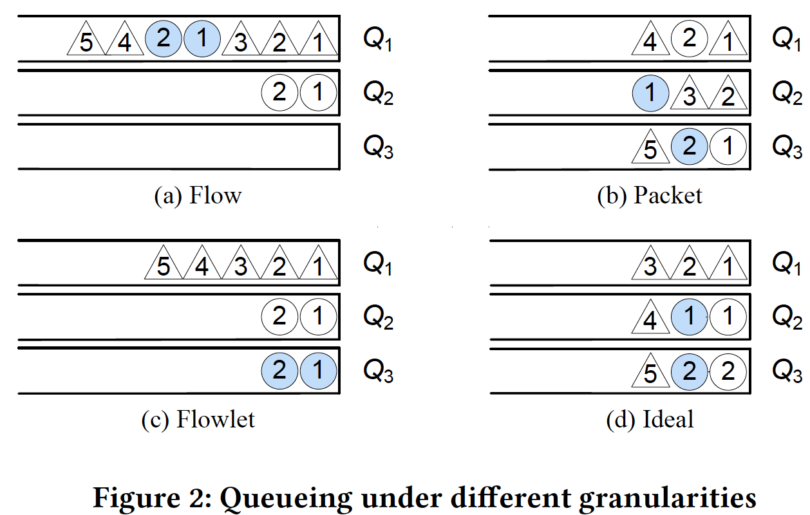
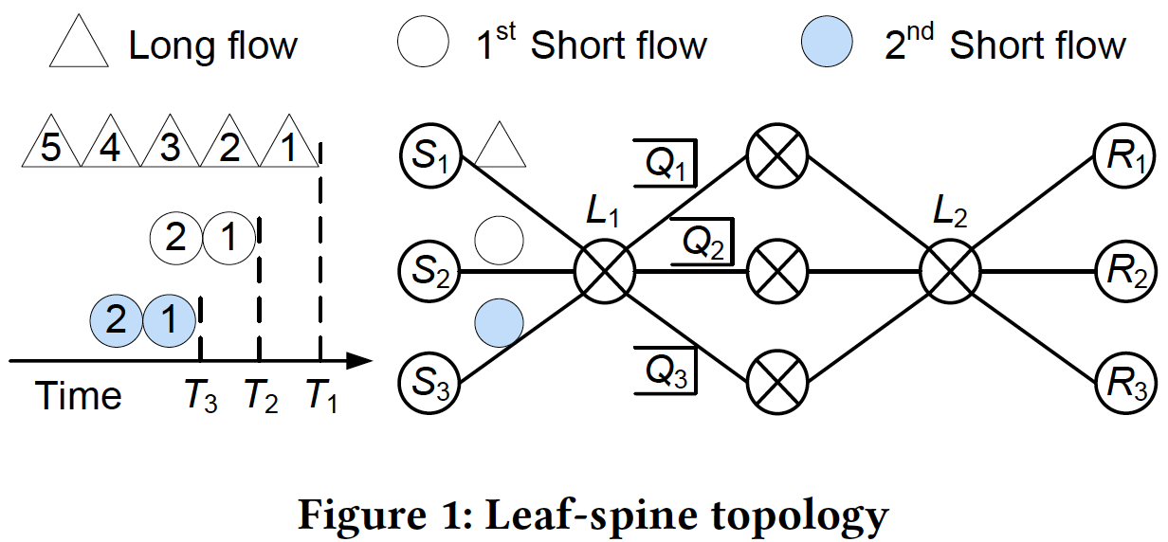
Motivation
Load balancing with same granularity
Notes:
We use a simple example to show the issues of typical load balancing schemes.
Please take a look at the left figure. There are three equal cost paths. One long flow and two short flows arrive at the different time.
We use four different granularities to reroute flows at the leaf switch.
The right Figure a shows the flow-level switching, two flows collide on the first path while the third path is empty.
Figure b shows the packet-level switching fully uses the three paths but there are some out-of-order packets.
Flowlet switching also has low link utilization problem.
The ideal switching in figure d achieves high link utilization and no out-of-order packets.

Slide 10
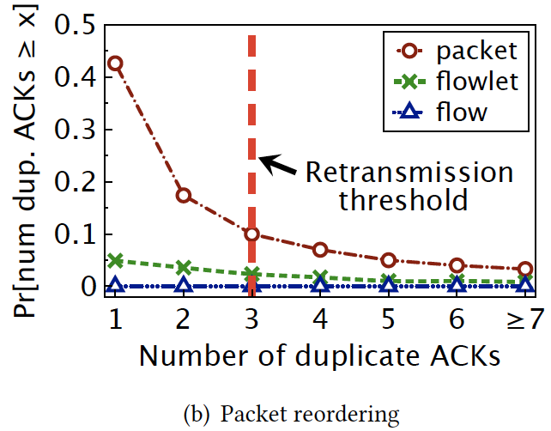
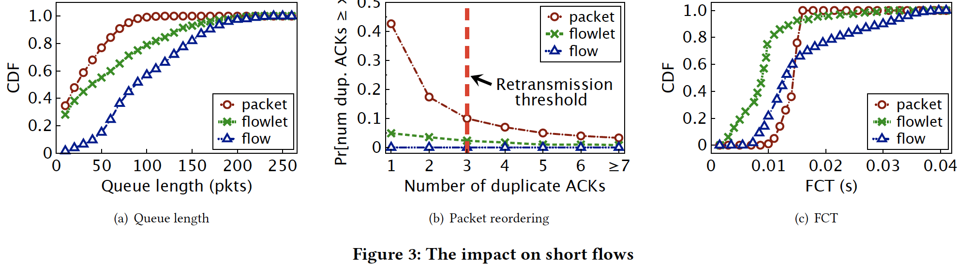
Motivation
The impact on short flows
Queueing delay
Packet reordering
Notes:
First, we test the impact on short flows.
Figure a clearly shows that the short flows experience large queueing delay with flow-based switching.
In Figure b, the packet-based switching has the most duplicate ACKs due to reordering.
So, all of them have large flow completion time as shown in figure c.

Slide 11
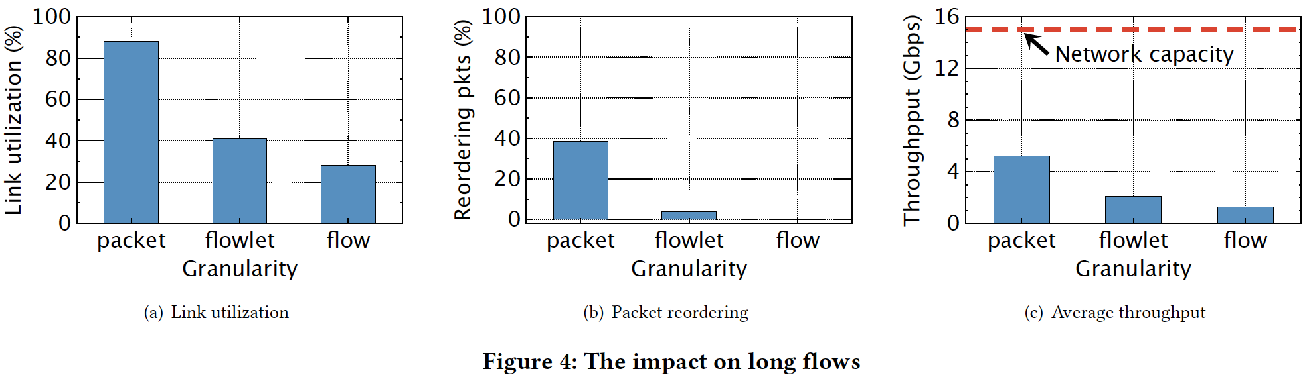
Motivation
The impact on long flows
Low link utilization
Packet reordering
Notes:
Now from Figure a, we can see the load balancing with large granularity causes low link utilization.
Figure b shows that, the packet switching introduces more out-of-order packets.
In short, due to the dilemma between the link utilization and packet reordering, as shown in figure c, the long flows only obtain the average throughput of less than 35% of the network capacity.
These... motivated us to tackle the above problems in designing TLB.

Slide 12
Outline
Introduction
Background
Motivation
TLB Design
Evaluation
Summary

Slide 13
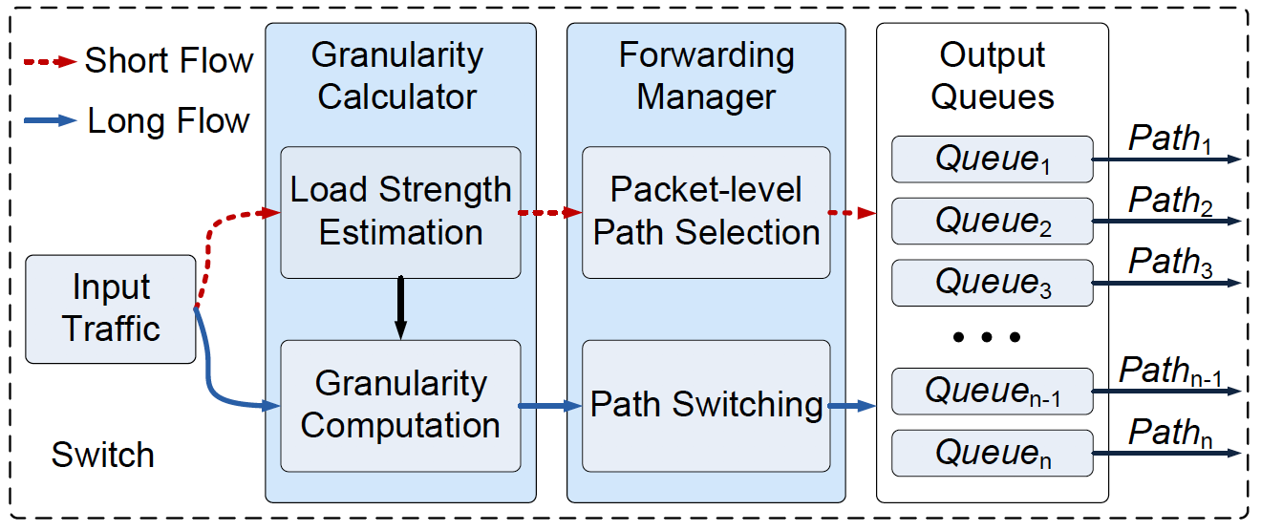
TLB Architecture
TLB: Traffic-aware Load Balancing
Notes:
the overview of TLB. two key modules.
The first one is Granularity calculator. At the switch, the load strength of short flows is estimated according to their arrival rate, and then the switching granularity of long flows is calculated to guarantee the short flows finish within their deadlines.
The second one is Forwarding Manager. For short flows, TLB forwards each arriving packet to the shortest queue; For long flows, if the current queue length reaches the switching threshold, TLB also forwards the arriving packet to the shortest queue. Otherwise, TLB forwards the arriving packet to the same queue as the last arrival packet in the same flow.
so we make no modifications at the end hosts.

Slide 14
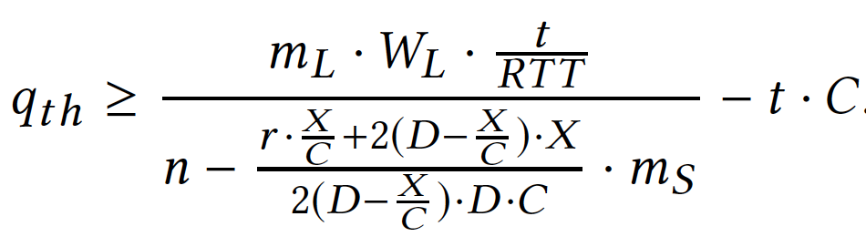
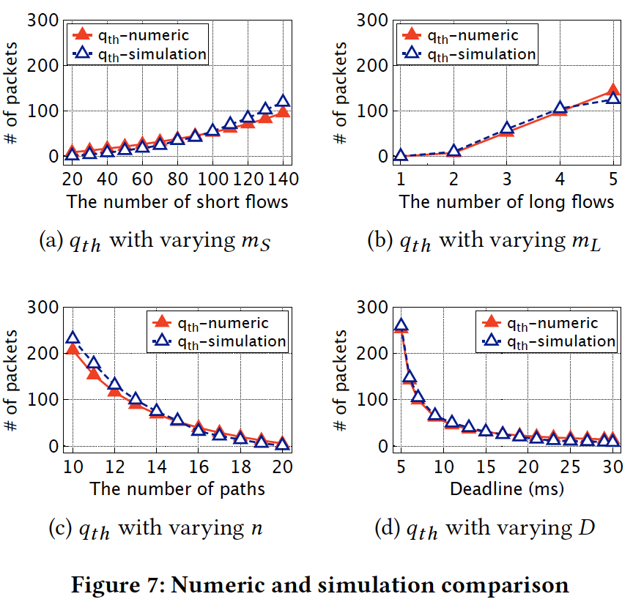
TLB: Adaptive switching granularity
Notes:
From this equation, we can obtain the switching granularity of long flows.
The left figure a and b in this slide shows that with the increase of short and long flows, larger switching granularity of long flows should be needed.
On the right two figures, with the increase of paths and deadline, the switching granularity of long flows becomes smaller.
In brief, the switching granularities of long flows in numerical analysis closely follow the corresponding simulation results.

Slide 15
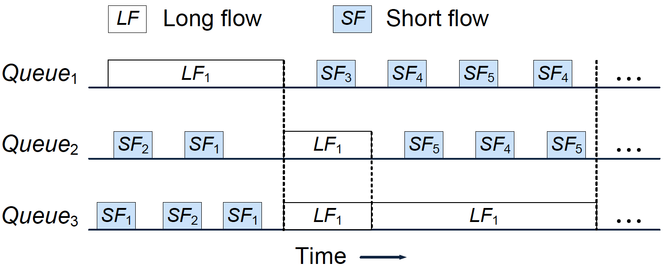
TLB: Queueing process
Load balancing with different granularity
Notes:
This figure shows the queueing process with adaptive switching granularity for short and long flows.
When the traffic load of short flows is high, the long flows are rerouted at the large granularity to leave more less-congested paths for short flows.
In contrast, with less short flows, the long flows are switched at the smaller granularity to make full use of the multiple path.

Slide 16
Outline
Introduction
Background
Motivation
TLB Design
Evaluation
Summary

Slide 17
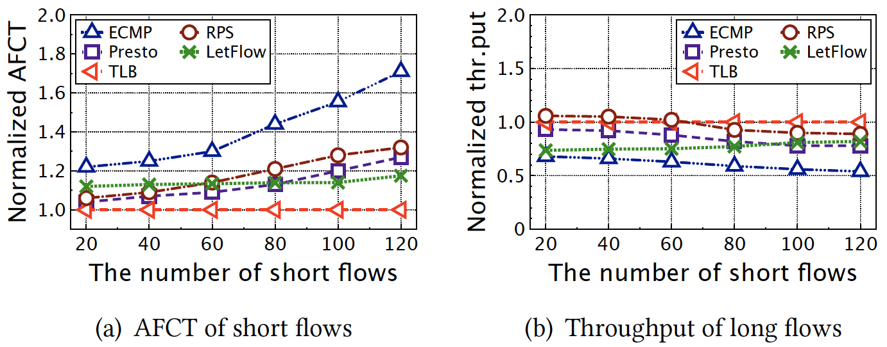
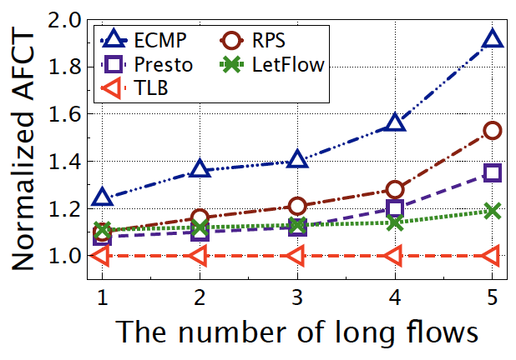
Testbed Results
Testbed settings
Mininet 2.3.0； P4₁₆ 1.0.；2-layer Leaf-spine topology
20Mbps bottleneck link; 56 hosts, 2 ToR switches, 10 core switches
Notes:
We implement TLB on Mininet based on Linux kernel.
Both figures show the average flow completion time is improved by TLB with increasing the number of short and long flows respectively.
TLB compared with four other schemes and achieves better performance.

Slide 18
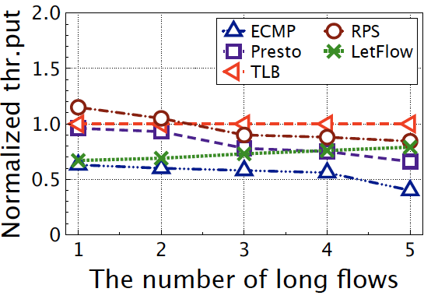
Testbed Results
Testbed settings
Mininet 2.3.0； P4₁₆ 1.0.；2-layer Leaf-spine topology
20Mbps bottleneck link; 56 hosts, 2 ToR switches, 10 core switches
Notes:
These two figures show the throughputs of long flows. They are improved about 50% over ECMP.
The reason is that ECMP employs only one path to transfer each long flow, resulting the low utilization on the multiple paths.
Presto and RPS work on the smaller granularity and flexibly reroute packets to all paths, they obtain the higher throughputs of long flows, but at the cost of reordering.

Slide 19
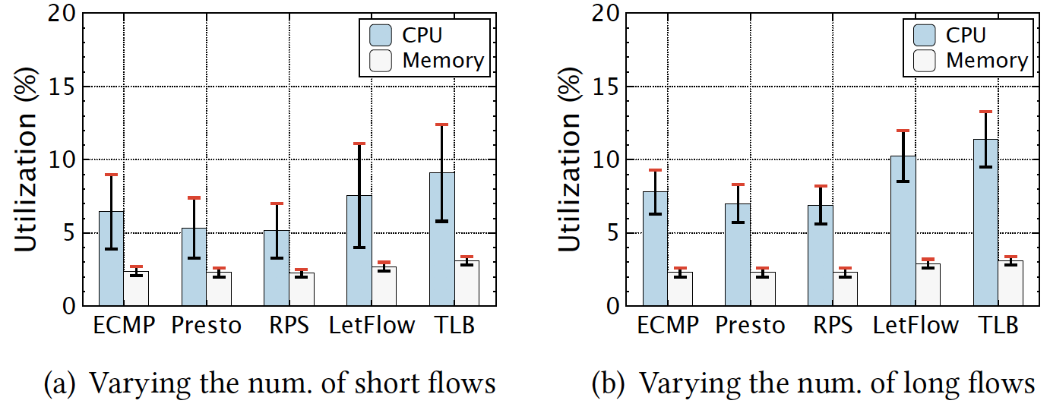
Testbed Results
Overhead of the leaf switch
Notes:
To evaluate the system overhead of TLB, we measure the CPU and memory utilization ratio at the leaf switch as shown in these two figures.
In short, since the calculation overhead of switching granularities only generates a tiny fraction of CPU load, TLB does not incur excessive CPU overhead and brings about negligible memory utilization compared with other schemes.

Slide 20
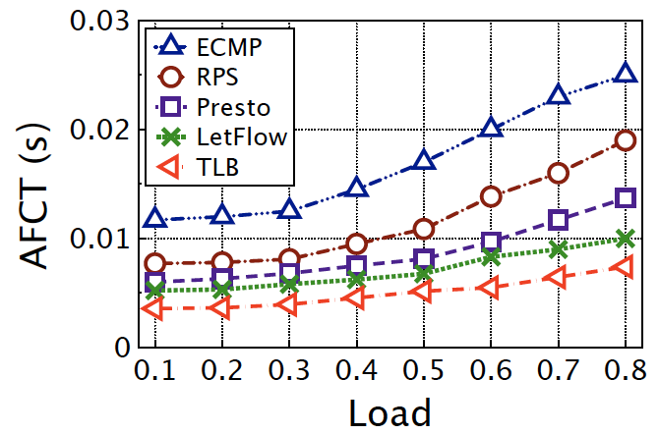
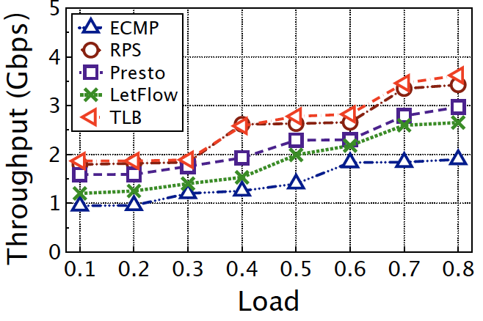
Larger-scale Simulations (web search)
Simulation settings
NS2 simulator; 2-layer Leaf-spine topology
1Gbps bottleneck link; 256 hosts, 8 ToR switches, 8 core switches
better
better
Reducing the AFCT up to ~60%
Improving the throughput up to ~55%
Notes:
To complement our small-scale testbed experiments, we further conduct large-scale NS2 simulations in the web search and data mining scenarios.
They are the typical workloads in datacenter.
These two figures are under the web search workload.
It reduces the AFCT of short flows by around 60% over ECMP. And TLB also improves the throughput of long flows compared to the large switching schemes.

Slide 21
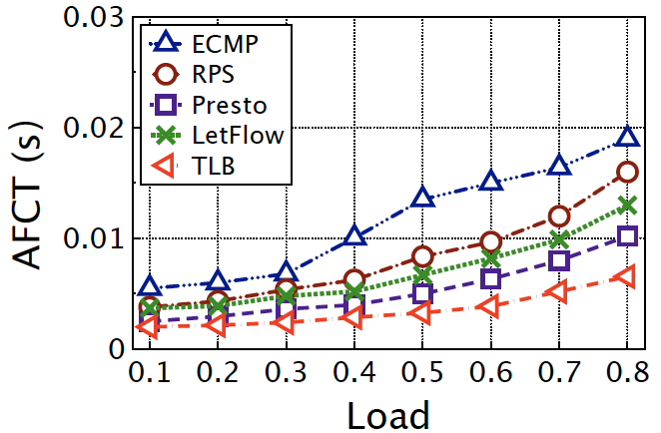
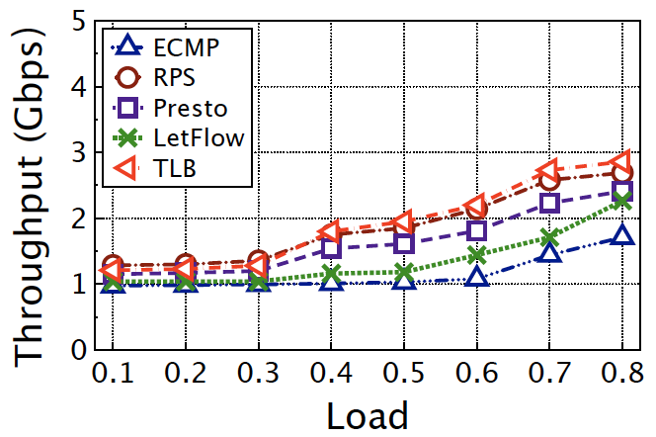
Larger-scale Simulations (data mining)
Simulation settings
NS2 simulator; 2-layer Leaf-spine topology
1Gbps bottleneck link; 256 hosts, 8 ToR switches, 8 core switches
better
better
Reducing the AFCT up to ~50%
Improving the throughput up to 50%

Slide 22
Outline
Introduction
Background
Motivation
TLB Design
Evaluation
Summary

Slide 23
Summary
Load Balancing with Same Granularity
Queueing delay and out-of-order for short flows;
Low link utilization and out-of-order for long flows;
Challenges for TLB
How to adjust switching granularity for short and long flows to reduce the FCT for short ones and guarantee the throughput for long ones?
Key points of TLB
Calculate the switching granularity of long flow；
Forward the short and long flows with different switching granularity.
Notes:
In the beginning, the impacts of the same switching granularity on short and long flows are explained. There are three key issues.
The first one is queueing delay caused by the large switching granularity, the second one is the out-of-order problem with the small switching granularity, and the last one is low link utilization.
Rerouting the short and long flows with different granularity is a very important issue.
TLB adaptively adjusts the switching granularity of long flows according to the load strength of short ones.
Therefore, the short flows have more opportunities to make use of the less-congested paths. And the long flows are also able to flexibly change path to improve their throughputs.
We evaluated TLB with simulations and small-scale testbed. Both achieve good performance.

Slide 24

Thank you !
Q&A

