Slide 1


Experiments with Data Center Congestion Control Research
Wei Bai
APNet 2017, Hong Kong

Slide 2
The opinions of this talk do not represent the official policy of HKUST and Microsoft

Slide 3
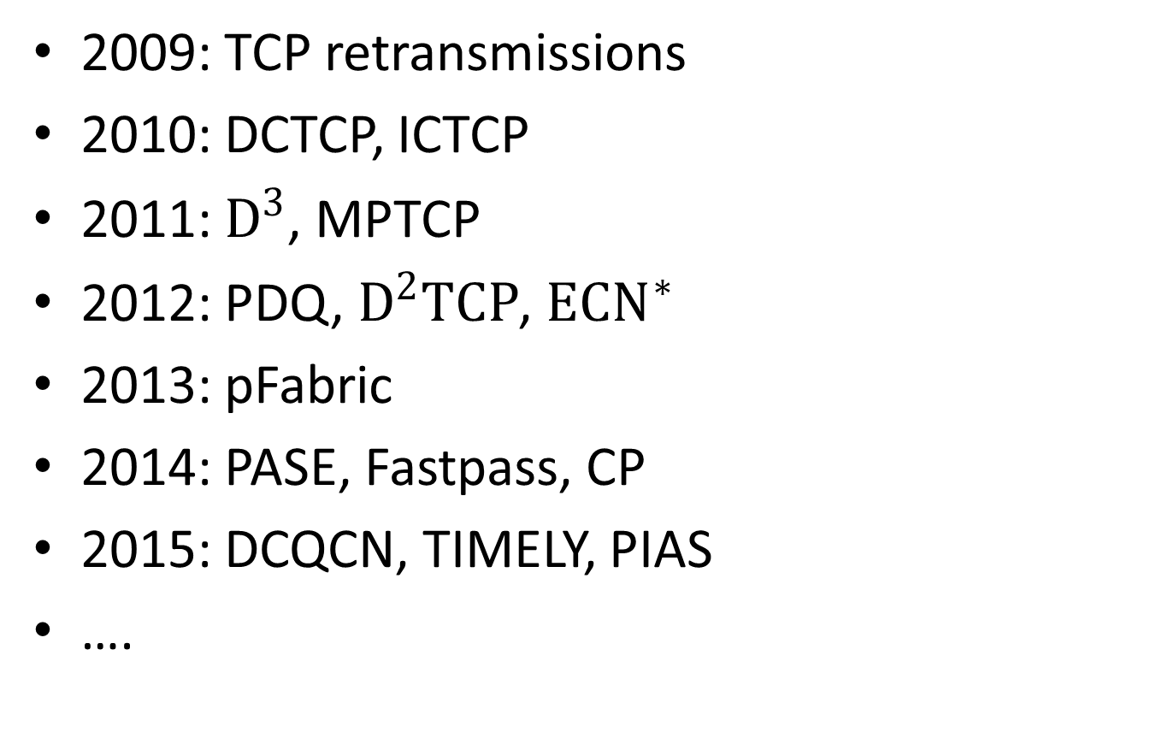
Data Center Congestion Control Research
2009: TCP retransmissions
2010: DCTCP, ICTCP
2011: $D^{3}$, MPTCP
2012: PDQ, $D^{2}TCP$, ${ECN}^{∗}$
2013: pFabric
2014: PASE, Fastpass, CP
2015: DCQCN, TIMELY, PIAS
….

Slide 4
Joint work with Li Chen, Kai Chen, Dongsu Han, Chen Tian, Hao Wang
HotNets 2014, NSDI 2015 and ToN 2017
This talk is about our experience on PIAS project.

Slide 5
Outline
PIAS mechanisms
Implementation efforts for NSDI submission
Efforts after NSDI
Takeaway from PIAS experience

Slide 6
Outline
PIAS mechanisms
Implementation efforts for NSDI submission
Efforts after NSDI
Takeaway from PIAS experience

Slide 7




Flow Completion Time (FCT) is Key
Data center applications
Desire low latency for short messages
App performance & user experience
Goal of DCN transport: minimize FCT
Notes:
Many data center applications, such as Web search, machine learning, database and cache, desire ultra low latency for these short messages. The reason is that the completion times of these short messages directly determine the user experience. Therefore, to improve the application performance, one of the most important design goal for data center transport is to minimize flow completion times, especially for short flows. To address this challenge, there are many flow scheduling proposals, [click]

Slide 8
PIAS Key Idea
PIAS performs Multi-Level Feedback Queue (MLFQ) to emulate Shortest Job First (SJF)
High
Priority 1
Priority 2
……
Low
Priority K
Notes:
The design rationale of PIAS is performing multi-level feedback queue to emulate shortest job first. As we can see, there are K priority queues in MLFQ. 1 is the highest priority while K is the lowest one. During a flow’s life time, its priority is gradually reduced. [click]

Slide 9
PIAS Key Idea
PIAS performs Multi-Level Feedback Queue (MLFQ) to emulate Shortest Job First (SJF)
Priority 1
Priority 2
……
Priority K
Notes:
For example, for this flow. The first packet is assigned to the priority 1. [click]. The second packet is demoted to priority 2. [click] For the third packet, its priority is further reduced. [click]. Eventually, if this flow is large enough, the last packet is assigned to the lowest priority. You can see that, the key idea of multi-level feedback queue is very simple and it does not require flow size information to do the scheduling.

Slide 10
PIAS Key Idea
PIAS performs Multi-Level Feedback Queue (MLFQ) to emulate Shortest Job First (SJF)
In general, PIAS short flows finish in higher priority queues while large ones in lower priority queues, emulating SJF, effective for heavy tailed DCN traffic.
Notes:
With MLFQ, small flows are more likely to finish in higher priority queues while large flows are more likely to finish in lower priority queues. Therefore, small flows are prioritized over large flows, thus emulating SJF, especially for heavy tailed DCN workloads.

Slide 11

How to implement MLFQ?
Implementing MLFQ at switch directly not scalable
Requires switch to keep per-flow state
Priority 1
Priority 2
……
Priority K
Notes:
However, MLFQ is not supported on commodity switches because it’s hard to track per-flow state on switches.

Slide 12
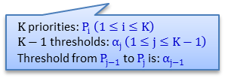
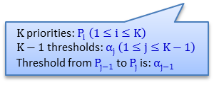
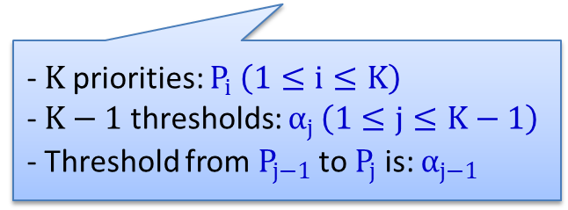
How to implement MLFQ?
Decoupling MLFQ
Stateless Priority Queueing at the switch (a built-in function)
Stateful Packet Tagging at the end host
Priority 1
- $K$priorities: $P_{i} \left(1≤i≤K\right)$
$\text{−} K−1$ thresholds: $α_{j }\left(1≤j≤K−1\right)$
- Threshold from $P_{j−1}$ to $P_{j}$ is: $α_{j−1 }$
Priority 2
……
Priority K
$K$priorities: $P_{i} \left(1≤i≤K\right)$
$K−1$ thresholds: $α_{j }\left(1≤j≤K−1\right)$
Threshold from $P_{j−1}$ to $P_{j}$ is: $α_{j−1 }$
$K$priorities: $P_{i} \left(1≤i≤K\right)$
$K−1$ thresholds: $α_{j }\left(1≤j≤K−1\right)$
Threshold from $P_{j−1}$ to $P_{j}$ is: $α_{j−1 }$
Notes:
To solve this problem, we decouple multi-level feedback queue. On the switch, we enable strict priority queueing [click]. At end hosts, we have a packet tagging module[click]. The logic of packet tagging module is quite simple. Assuming that they are K priorities and K-1 demotion thresholds correspondingly. Note that the P1 is the highest priority. The packet tagging module just maintains per-flow state and compare the bytes sent information with demotion thresholds. If a flow’s bytes sent value is exactly larger than Alpha[j-1], the following packet of this flow will be marked with Pj. For example, [click]

Slide 13
How to implement MLFQ?
Decoupling MLFQ
Stateless Priority Queueing at the switch (a built-in function)
Stateful Packet Tagging at the end host
i
Priority 1
- $K$priorities: $P_{i} \left(1≤i≤K\right)$
$\text{−} K−1$ thresholds: $α_{j }\left(1≤j≤K−1\right)$
- Threshold from $P_{j−1}$ to $P_{j}$ is: $α_{j−1 }$
Priority 2
……
Priority K
$K$priorities: $P_{i} \left(1≤i≤K\right)$
$K−1$ thresholds: $α_{j }\left(1≤j≤K−1\right)$
Threshold from $P_{j−1}$ to $P_{j}$ is: $α_{j−1 }$
$K$priorities: $P_{i} \left(1≤i≤K\right)$
$K−1$ thresholds: $α_{j }\left(1≤j≤K−1\right)$
Threshold from $P_{j−1}$ to $P_{j}$ is: $α_{j−1 }$
Notes:
解释例子

Slide 14

Threshold vs Traffic Mismatch
DCN traffic is highly dynamic
Threshold fails to catch traffic variation → mismatch
10MB
Ideal, threshold = 20KB
10MB
High
Low
Too small, 10KB
ECN
20KB
Too big, 1MB
Notes:
To determine demotion thresholds for MLFQ, we build a simple queueing theory model to analyze it and derive demotion thresholds based on flow size distributions. However, traffic is highly dynamic in data centers (across both time and space), so the mismatch between traffic and demotion thresholds is unavoidable. We need to handle the mismatch problem in order keep PIAS effective in highly dynamic data center networks? [click] 解释例子

Slide 15
PIAS in 1 Slide
PIAS packet tagging
Maintain flow states and mark packets with priority
PIAS switch
Enable strict priority queueing and ECN
PIAS rate control
Employ Data Center TCP to react to ECN
Notes:
Now, we summarize the design of PIAS in 1 slide. PIAS has 3 components. The first one is packet tagging module at end hosts. It tracks per-flow state and mark packets with priority. At the switch, PIAS needs to enable strict priority queueing and ECN marking. PIAS leverages DCTCP for rate control. This is the whole system of PIAS.

Slide 16
Outline
Key idea of PIAS
Implementation efforts for NSDI submission
Efforts after NSDI
Takeaway from PIAS experience

Slide 17
Implementation Stages
ECN-based transport
DCTCP at the end host
ECN marking at the switch
MLFQ scheduling
Packet tagging module at the end host
Priority queueing at the switch
Evaluation
Measure FCT using realistic traffic
Notes:
We divide the implementation efforts into three stages. In this first stage …… [click] In the second stage … [click] In the third stage ….

Slide 18
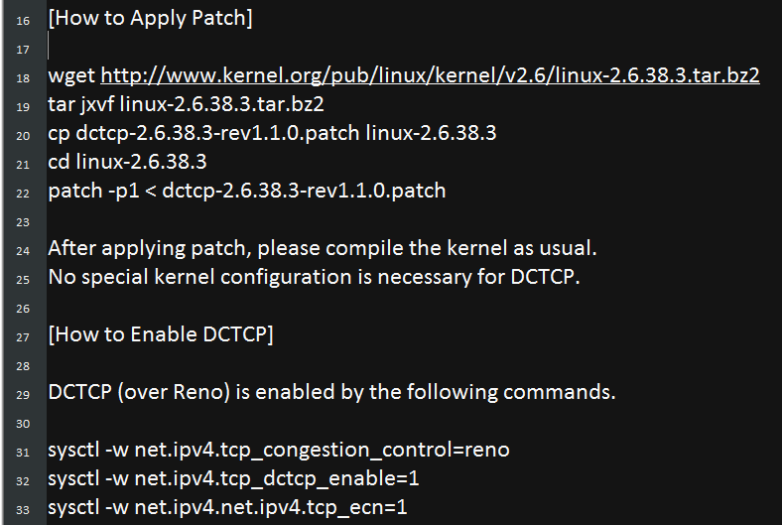
Integrate DCTCP into Linux Kernel
DCTCP was not integrated into Linux in 2014
Linux patch provided by the authors

Slide 19
Integrate DCTCP into Linux Kernel
DCTCP was not integrated in Linux in 2014
Linux patch provided by the authors
PASS
Notes:
So it is very easy to build a kernel with DCTCP algorithm.

Slide 20
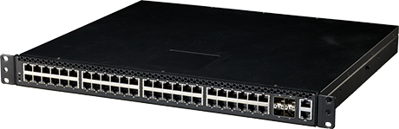

ECN Marking at the Switch
Switch hardware: Pica8 P-3295 1G switch
Switch OS: PicOS 2.1.0
Notes:
After that, we need to configure ECN marking at the switch. The switch I used is Pica8 P-3295 switch. It has 48 1G ports. The OS verion is PicOS 2.1.0. 看上去，配置ECN标记很容易，我们只需要在手册里找到命令并且输入命令就好了

Slide 21
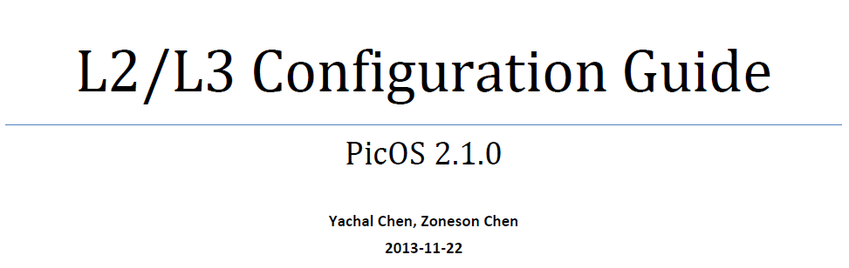
ECN Marking at the Switch
Switch hardware: Pica8 P-3295 1G switch
Switch OS: PicOS 2.1.0
No “ECN” and “RED” in this document
Why our switch does not support ECN?
Notes:
[click] 找不到ECN和RED
[click]为什么我的交换机不支持ECN呢，DCTCP论文不是这么说的
给pica8的人发信问，人家表示交换机芯片有这个能力，但是我们还没有做这个feature

Slide 22
ECN Marking at the Switch
Switch model (down to top)
Switching chip hardware
Switching chip interfaces (all hardware features)
Switch OS (some hardware features)
Solution (with help from Dongsu)
Use Broadcom shell to configure ECN/RED
Notes:
在研究了交换机model之后，我终于理解了这个回答的意思. Our switch actually has three layers. The bottom layer is hardware switching chip. Note that many switch vendors do not have their own switching chips. They buy switching chips from some chip vendors, such as Broadcom and Barefoot. On the top of hardware, chip vendors also provide some switching chip abstraction interfaces to configure the hardware. These interfaces can control all hardware features. [click] The highest layer is switch OS. Switch companies develop their switch OS based on chip interfaces. Due to the time limitation and customer requirement, they will also expose control interfaces to some hardware features.

Slide 23

DCTCP Performance Validation
TCP incast experiment
TCP RTOmin: 200ms
Static switch buffer allocation
Expected results
DCTCP greatly outperforms TCP
Actual results
DCTCP delivers similar / worse performance
Some flows experience 3s timeout delays

Slide 24
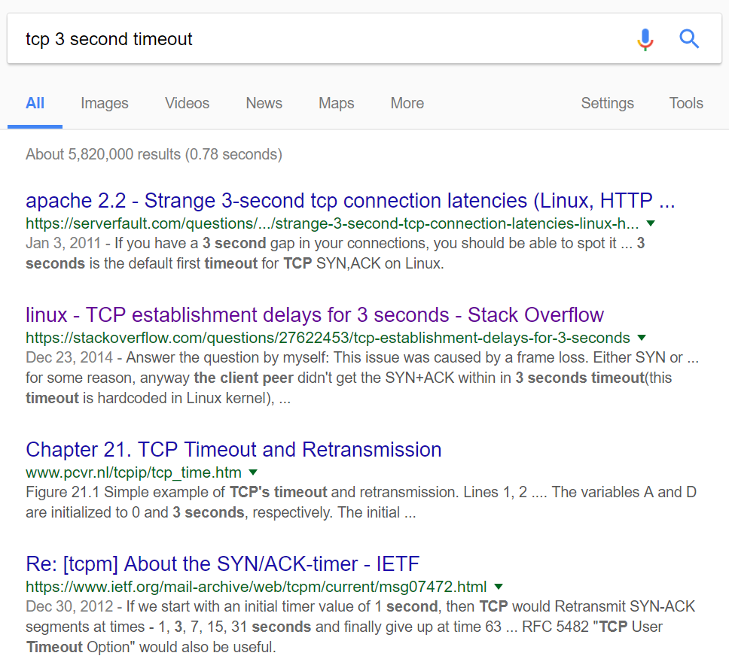
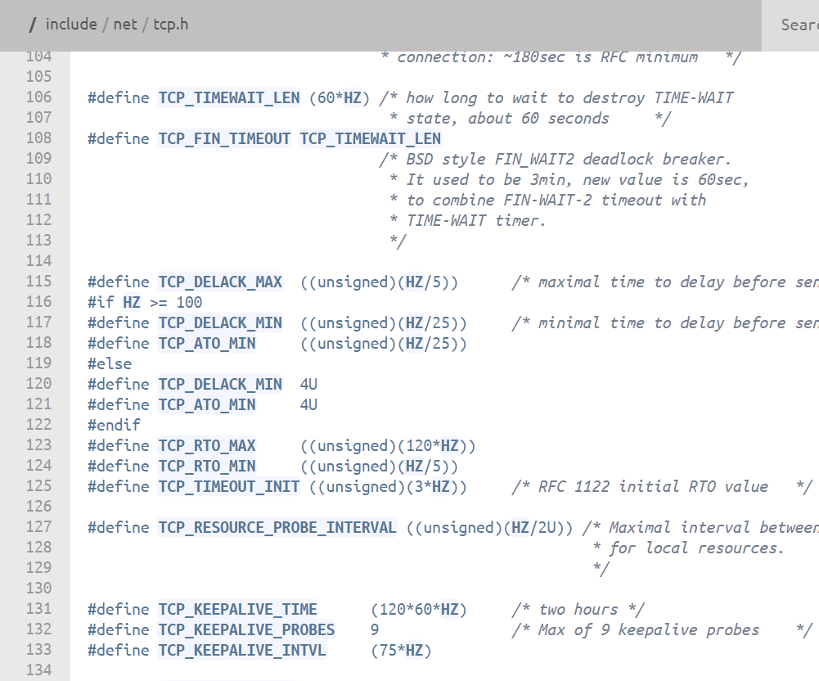
Result Analysis
Why flows experience 3s timeouts?
HZ = 1second

Slide 25
Result Analysis
Why flows experience 3s timeouts?
Many SYN packets get dropped
ECN bits of SYN packets are 00 (Non-ECT)
Root cause
Non-ECT packets: SYN, FIN, pure ACK packets
The switch drops Non-ECT packets if the queue length exceeds the marking threshold
Solution
Modify all TCP packets to ECT using iptables

Slide 26
Packet Tagging Module
A loadable kernel module
Shim layer between TCP/IP and Qdisc
Application
User Space
TCP
IP
Packet Tagging
Kernel Space
Qdisc
NIC Driver

Slide 27
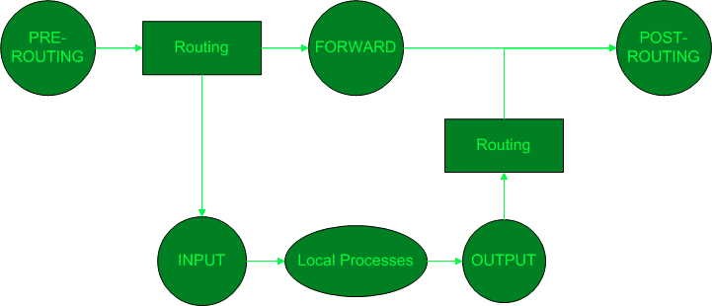
Packet Tagging Module
A loadable kernel module
Shim layer between TCP/IP and Qdisc
Netfilter hooks to intercept packets

Slide 28
Packet Tagging Module
A loadable kernel module
Shim layer between TCP/IP and Qdisc
Netfilter hooks to intercept packets
Keep per-flow state in a hash table with linked lists
Linked List 1
Flow 1
Flow 4
Linked List 2
Linked List 3
Flow 2
Flow 5
Linked List 4
Linked List 5
Flow 3

Slide 29
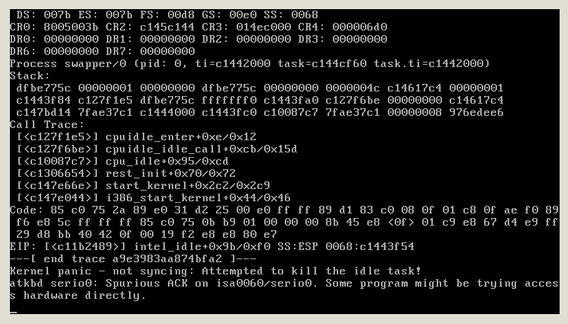
Kernel Programming
Likely to cause kernel panic

Slide 30
Kernel Programming
After implementing a small feature, test it!
Use printk to get some useful information
Common errors
Spinlock functions (e.g., spin_lock_irqsave and spin_lock)
vmalloc and kmalloc (different types of memory)
Pair programming

Slide 31
Priority Queueing at Switch
Easy to configure using PicOS / Broadcom shell
Undesirable interaction with ECN/RED
Each queue is essentially a link with the varying capacity -> dynamic queue length threshold
Existing ECN/RED solutions (queue/port/shared buffer pool) only support static thresholds
Our choice: per-port ECN/RED
Cannot preserve the scheduling policy

Slide 32
Evaluation
Flow Completion Time (FCT)
T(receive the last ACK) – T(send the first packet)
The TCP sender does not know the time to receive the last ACK in practice
Measure FCT at the receiver side
The receiver sends a request to the sender to get the desired amount of data
T(receive the all response) – T(send the request)

Slide 33
Outline
Key idea of PIAS
Implementation efforts for NSDI submission
Efforts after NSDI
Takeaway from PIAS experience

Slide 34
Implementation Efforts
Improve traffic generator
Use persistent TCP connections
Better user interfaces
Used in other papers (e.g. , ClickNP)
Improve packet tagging module
Identify message boundaries in TCP connections
Monitor TCP send buffer occupancy using jprobe hooks
Evaluation on Linux kernel 3.18

Slide 35
Some Research Questions
How to do ECN marking with multiple queues?
Our solution (per-port ECN/RED) violates the scheduling policy for good throughput and latency
How does switch mange its buffer?
Incast only happens with static buffer allocation

Slide 36
Research Efforts
ECN marking with multiple queues (2015-206)
MQ-ECN [NSDI’16]: dynamically adjust per-queue queue length thresholds
TCN [CoNEXT’16]: use sojourn time as the signal
Buffer management (2016-2017)
BCC [APNet’17]: buffer-aware congestion control for extremely shallow-buffered data centers
One more shared buffer ECN/RED configuration

Slide 37
Outline
Key idea of PIAS
Implementation efforts for NSDI submission
Efforts after NSDI
Takeaway from PIAS experience

Slide 38
Takeaway
Start to do implementation when you start a project.
A good implementation not only makes the paper stronger, but also unveils many research problems.

Slide 39
Cloud & Mobile Group at MSRA
Research Area:
Cloud Computing, Networking, Mobile Computing
We are now looking for full-time researchers and research interns
Feel free to talk to me or send emails to my manager Thomas Moscibroda

Slide 40
Thank You

