Slide 1
Computer Architecture 计算机体系结构
School of Computer and Information Technology Beijing Jiaotong Univeristy
Yi Tian

Slide 2
Chapter 4. Memory Hierarchy 存储体系

Slide 3
Chapter 4 Memory Hierarchy
4.1 Introduction
4.2 The Basic of Caches
4.3 Measuring and Improving Cache Performance
4.4 Virtual Memory
4.5 A Common Framework for Memory Hierarchies

Slide 4

4.1 Introduction
Example:
Reading books in library.
Library -> shelves -> desk -> books.
several books are needed in desk, but not on topics you want. Back to shelves for additional book, find one.
good possibility the topics you need can be found in the books on desk, saves time.
The same principle allows us to create the illusion of a large and fast memory.

Slide 5
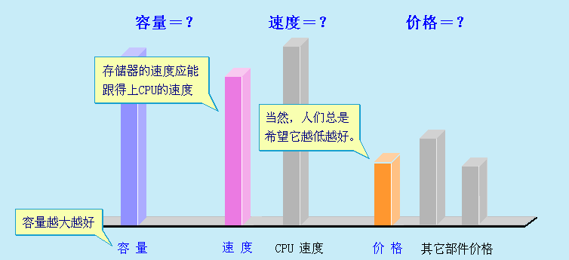
4.1 Introduction
The topics focus on: aiding programmers by creating the illusion of unlimited fast memory.

Slide 6
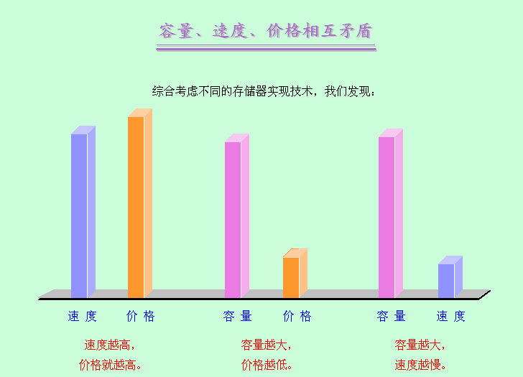
4.1 Introduction

Slide 7
4.1 Introduction
Memory Hierarchy
A memory hierarchy consists of multiple levels of memory with different speeds and sizes.
faster memories -> more expensive -> smaller
slower memories -> cheaper -> bigger.
CPU
M1
M2
Mn
…

Slide 8
4.1 Introduction
Memory Hierarchy
A memory hierarchy consists of multiple levels of memory with different speeds and sizes.
faster memories -> more expensive -> smaller
slower memories -> cheaper -> bigger.
Three primary technologies building memory hierarchies:
SRAM (Static random access memory静态随机访问存储器) : implement caches
DRAM (Dynamic random access memory动态随机访问存储器): implement main memory
Magnetic disk (磁盘)

Slide 9
4.1 Introduction
Figure 4.1 : Differences in cost and access time
Goal: present user with as much as memory as is the cheapest technology, while providing access speed offered by the fastest memory. 给用户: 最便宜的价格下尽量多的存储容量, 以及最快的存储访问速度
Memory technology | Typical access time | $ per Mbyte in 1997
SRAM | 5-25 ns | $100-$250
DRAM | 60-120 ns | $5-$10
Magnetic disk | 10-20 million ns | $0.10-$0.20

Slide 10
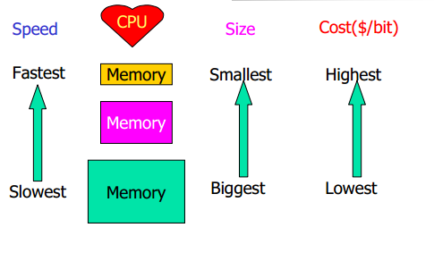
4.1 Introduction
Figure 4.2: The basic structure of a memory hierarchy

Slide 11
4.1 Introduction
Memory hierarchy
level closer to processor is a subset of any level further away, and all data is stored at lowest level. 最靠近处理器的层次是其它更低层次的子集, 所有数据都存储在最低层次
can consist of multiple levels, but data is copied between only two adjacent levels at a time. 数据只能在相邻层次间拷贝
upper level is smaller and faster than lower level. 上层比下层容量小, 但速度快
The minimum unit of information that can be present/no-present in the two-level hierarchy is a called a block, as shown in Figure 4.3. 层次中信息的最小单位, 称为块

Slide 12
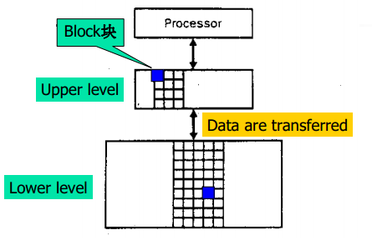
4.1 Introduction
Figure 4.3: Every pair of levels in the memory hierarchy can be thought of as having an upper and lower level

Slide 13
4.1 Introduction
The principle of locality: the programs access a relatively small portion of address space at any instant of time. 程序在任意时刻都是访问地址空间的一小部分
Two types of locality: 时间局部性和空间局部性
Temporal locality (locality in time): If an item is referenced, it will tend to be referenced again soon. 如果一个数据项被访问, 则其倾向于很快被再次访问
Spatial locality (locality in space): If an item is referenced, items whose addresses are close by will tend to be referenced soon. 如果一个数据项被访问, 则其临近地址的数据项倾向于很快被访问

Slide 14
4.1 Introduction
The principle of locality
Temporal:
Most programs contain loops, so instructions and data are likely to be addressed repeatedly. 多数程序包含循环, 所以指令和数据可能被重复访问
Spatial:
instructions are normally accessed sequentially. 指令通常顺序被访问
accesses to elements of an array or a record. 访问数组、记录的元素
We take advantage of the principle of locality by implementing the memory of a computer as a memory hierarchy

Slide 15

4.1 Introduction
相关基本概念
Hit: data requested appears in some block in upper level. 命中: 需要的数据出现在高层某块中
Miss: data is not found in upper level. lower level is then accessed to retrieve the block containing the requested data. 缺失: 数据在高层未找到. 需要访问底层来寻找包含所需数据的块
Hit rate, or hit ratio: the fraction of accesses found in upper level; 命中率:数据在高层找到的比率
Miss rate: the fraction of accesses not found in upper level. 缺失率: 数据在高层找不到的比率
N1
N2

Slide 16
4.1 Introduction
相关基本概念
Hit time: the time to access upper level of the memory hierarchy, includes the time needed to determine whether the access is a hit or a miss. 命中时间: 访问高层的时间,包括确定该访问是命中还是缺失所需时间
Miss penalty: the time to replace a block in upper level with corresponding block from lower level, plus time to deliver the block to processor. 缺失惩罚
CPU
M1
M2
Mn

Slide 17
4.1 Introduction
Example:
两层存储体系，M1, M2。M1命中率H1，M1命中时间T_{A1} ，M2命中时间T_{M} ，求平均访问时间T_{A。}
A：T_{A1}＋(1－H1 )T_{M} ；B：H1×T_{A1}＋(1－H1 )T_{M}
C：T_{A1}＋T_{M} ； D：H1×T_{A1}＋T_{M}
Answer：
平均访问时间TA
T_{A}＝T_{A1}＋(1－H1 )T_{M} 或 T_{A}＝T_{A1}＋F T_{M}
T_{A1} ── 命中时间
T_{M} ── 失效开销

Slide 18
4.1 Introduction
Memory hierarchy influence the performance
All programs spend much time accessing memory, so memory system is a major factor in determine performance. 所有程序都花费大量时间访问存储器, 所以存储系统是决定性能的主要因素
Programmers need to know how memory hierarchies work to get good performance. 程序员需要知道存储层次如何工作以得到好的性能
Designers have developed sophisticated mechanisms for improving the performance of memory system. 设计者已设计出复杂的机制来提高存储系统的性能

Slide 19
4.1 Introduction
Figure 4.4: This diagram show the structure of a memory hierarchy: as the distance from the CPU increases ,so does the size.

Slide 20
4.1 Introduction
A memory hierarchy is shown in Figure 4.4.
take advantage of temporal locality by keeping more recently accessed data items closer to the processor. 利用时间局部性: 将最近访问数据项放到接近处理器的地方
take advantage of spatial locality by moving blocks consisting of multiple contiguous words in memory to upper levels of the hierarchy. 利用空间局部性: 将包含多个连续数据的块移到高层
hit in highest level can be processed quickly. miss will go to lower level (larger but slower).
If hit rate is high enough, the access time will close to that of highest (and fastest) level and size will equal to that of lowest (largest) level.如果命中率足够大, 则访问时间接近最高层, 大小相当于最低层

Slide 21
4.2 The Basic of Caches
Cache 高速缓冲存储器: the level of memory hierarchy between CPU and main memory. CPU与主存之间的层次
Virtually all general-purpose machines today, from the fastest to the slowest, include a cache. 事实上现今所有的通用机器, 从最快到最慢的, 都有cache
Figure 4.5 shows a simple cache.
Before, cache contains recent references X1, X2, … , Xn-1, processor requests Xn, not in cache.
This request results in a miss, and the word Xn is brought from memory to cache.

Slide 22
4.2 The Basic of Caches
Figure 4.5: The cache just before and just after a reference to a word Xn that is not initially in the cache.
X4
X1
Xn-2
Xn-1
X2
X3
X4
X1
Xn-2
Xn-1
X2
Xn
X3
Miss
a. Before the reference to Xn
b. After the reference to Xn

Slide 23

4.2 The Basic of Caches
How do we know whether a data item is in the cache?
If a data item is in the cache, how do we find it?
The simplest way to assign a location in the cache for each word in memory is to assign the cache location based on the address of the word in memory
This cache structure is called direct mapped(直接映象), since each memory location is mapped to exactly one location in the cache.

Slide 24
4.2 The Basic of Caches
Direct mapped: 直接映象
Each memory location is mapped to exactly one location in the cache. 每个存储器位置精确地映射到cache中的一个位置
typical mapping is usually simple. For example:
对于主存的第i 块，若它映象到Cache的第j块，则:
j＝i mod (M ) （M为Cache的块数）
If the number of entries in the cache is a power of two, the modulo can be computed simply by using only the low-order log2(cache size in blocks) bits of the address.
(Memory block address) modulo (Number of cache blocks in the cache)

Slide 25
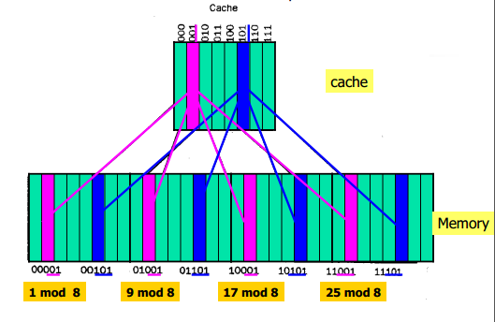
4.2 The Basic of Caches
Direct mapped: 直接映像
Figure 4.6: A direct-mapped cache with eight entries showing the addresses of memory words between 0 and 31 that map to the same cache location

Slide 26
4.2 The Basic of Caches
How do we know whether a requested word is in the cache or not?
Tag
added to cache, indicating whether the data in cache corresponding to a requested word.
Upper portion of the memory address
A valid bit
Indicate whether an entry contains valid information
If the bit is not set, there cannot be a match for this block
Data
Index
The bits corresponding to the index are used to select the unique entry in the cache corresponding to the supplied address.
Lower portion of the memory address

Slide 27
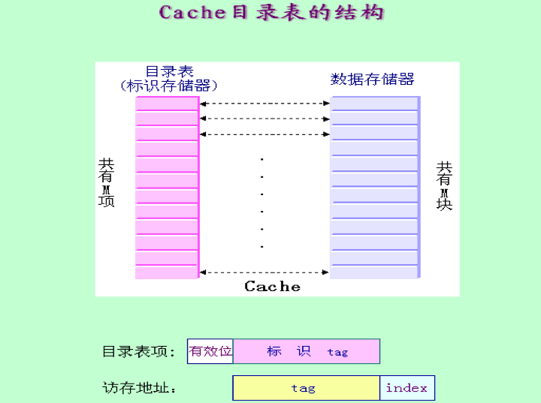
4.2 The Basic of Caches

Slide 28
4.2 The Basic of Caches
Figure 4.7: Memory Address (10110)two
Index | V | Tag | Data
000 | N
001 | N
010 | N
011 | N
100 | N
101 | N
110 | Y | 10TWO | Memory(10110TWO)
111 | N
Cache

Slide 29
4.2 The Basic of Caches
Accessing a Cache 访问Cache
Figure 4.8: shows contents of an 8-word direct-mapped caches as it responds to a series of requests from the processor.
Decimal address of reference | Binary address of reference | Hit or miss in cache | Assigned cache block(where found or placed)
22 | 10110two | miss | (10110twomod 8)=110two
26 | 11010two | miss | (11010two mod 8)=010two
22 | 10110two | hit | (10110two mod 8)=110two
26 | 11010two | hit | (11010two mod 8)=010two
16 | 10000two | miss | (10000twomod 8)=000two
3 | 00011two | miss | (00011two mod 8)=011two
16 | 10000two | hit | (10000twomod 8)=000two
18 | 10010two | miss | (10010two mod 8)=010two

Slide 30
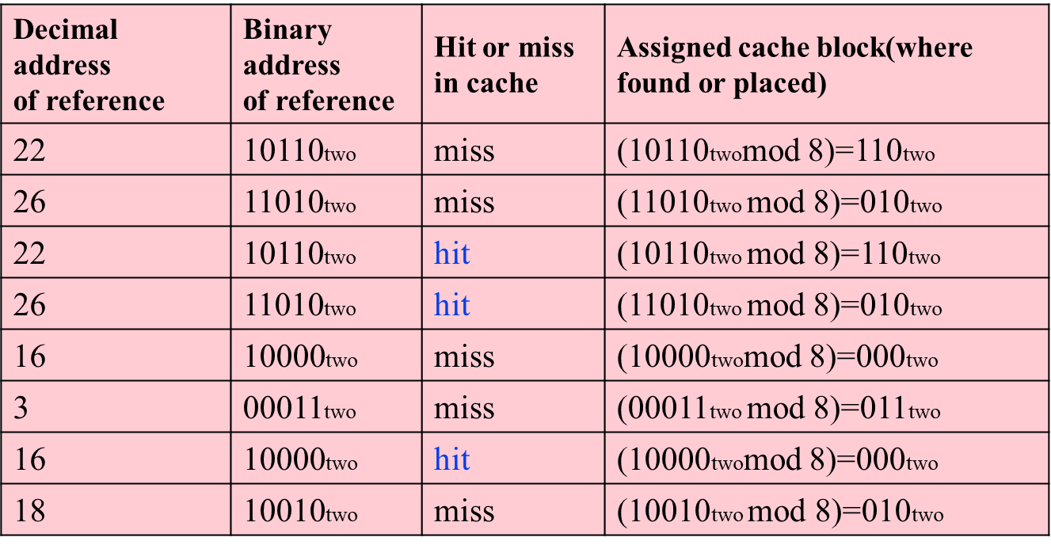
4.2 The Basic of Caches
Figure 4.9: The each contents are shown after each reference request that misses, with the index and tag fields shown in binary.
Index | V | Tag | Data
000 | N
001 | N
010 | N
011 | N
100 | N
101 | N
110 | N
111 | N
Index | V | Tag | Data
000 | N
001 | N
010 | N
011 | N
100 | N
101 | N
110 | Y | 10_{TWO} | Memory(10110_{TWO})
111 | N
a. The initial state of the cache after power-on
b. After handling a miss of an address(10110_{TWO}=22)

Slide 31
4.2 The Basic of Caches
Figure 4.9: The each contents are shown after each reference request that misses, with the index and tag fields shown in binary.
Index | V | Tag | Data
000 | N
001 | N
010 | N
011 | N
100 | N
101 | N
110 | Y | 10_{TWO} | Memory(10110_{TWO})
111 | N
Index | V | Tag | Data
000 | N
001 | N
010 | Y | 11_{TWO} | Memory(11010_{TWO})
011 | N
100 | N
101 | N
110 | Y | 10_{TWO} | Memory(10110_{TWO})
111 | N
b. After handling a miss of an address(10110_{TWO}=22)
C. After handling a miss of an address(11010_{TWO}=26)

Slide 32
4.2 The Basic of Caches
Figure 4.9: The each contents are shown after each reference request that misses, with the index and tag fields shown in binary.
Index | V | Tag | Data
000 | N
001 | N
010 | Y | 11_{TWO} | Memory(11010_{TWO})
011 | N
100 | N
101 | N
110 | Y | 10_{TWO} | Memory(10110_{TWO})
111 | N
Index | V | Tag | Data
000 | Y | 10_{TWO} | Memory(10000_{TWO})
001 | N
010 | Y | 11_{TWO} | Memory(11010_{TWO})
011 | N
100 | N
101 | N
110 | Y | 10_{TWO} | Memory(10110_{TWO})
111 | N
C. After handling a miss of an address(11010_{TWO}=26)
D. After handling a miss of an address(10000_{TWO}=16)

Slide 33
4.2 The Basic of Caches
Figure 4.9: The each contents are shown after each reference request that misses, with the index and tag fields shown in binary.
Index | V | Tag | Data
000 | Y | 10_{TWO} | Memory(10000_{TWO})
001 | N
010 | Y | 11_{TWO} | Memory(11010_{TWO})
011 | N
100 | N
101 | N
110 | Y | 10_{TWO} | Memory(10110_{TWO})
111 | N
Index | V | Tag | Data
000 | Y | 10_{TWO} | Memory(10000_{TWO})
001 | N
010 | Y | 11_{TWO} | Memory(11010_{TWO})
011 | Y | 00_{TWO} | Memory(00011_{TWO})
100 | N
101 | N
110 | Y | 10_{TWO} | Memory(10110_{TWO})
111 | N
D. After handling a miss of an address(10000_{TWO}=16)
e. After handling a miss of an address(00011_{TWO}=3)

Slide 34
4.2 The Basic of Caches
Figure 4.9: The each contents are shown after each reference request that misses, with the index and tag fields shown in binary.
Index | V | Tag | Data
000 | Y | 10_{TWO} | Memory(10000_{TWO})
001 | N
010 | Y | 11_{TWO} | Memory(11010_{TWO})
011 | Y | 00_{TWO} | Memory(00011_{TWO})
100 | N
101 | N
110 | Y | 10_{TWO} | Memory(10110_{TWO})
111 | N
Index | V | Tag | Data
000 | Y | 10_{TWO} | Memory(10000_{TWO})
001 | N
010 | Y | 10_{TWO} | Memory(1010_{TWO})
011 | N | 00_{TWO} | Memory(00011_{TWO})
100 | N
101 | N
110 | Y | 10_{TWO} | Memory(10110_{TWO})
111 | N
e. After handling a miss of an address(00011_{TWO}=3)
f. After handling a miss of an address(10010_{TWO}=18)

Slide 35
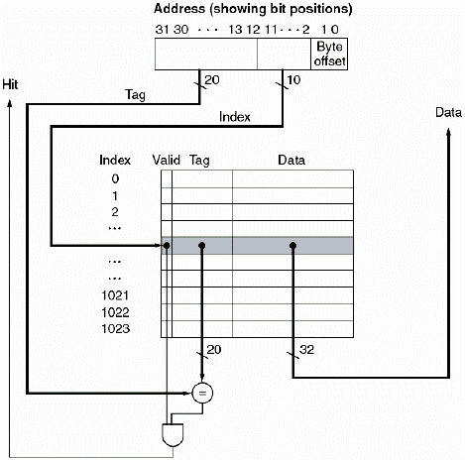
4.2 The Basic of Caches
Figure 4.10: For this cache, the lower portion of the address is used to select a cache entry consisting of a data word and a tag
地址
tag位数
索引位数

Slide 36
4.2 The Basic of Caches
Figure 4.10: An Cache illustration
The lower portion of address is used to select a cache entry. 地址的低部分用来选择cache入口
tag from cache is compared with upper portion of address to determine whether the entry in cache corresponds to requested address. cache的tag与地址高部分比较, 用来确定该cache入口是否对应于所需的地址
cache has 2¹⁰(1024) words, block size is 1 word, 10 bits index cache, leaving 32-10-2=20bits to be compared against tag. Cache有2¹⁰个字, 块大小为一个字. 10位用来索引cache, 剩下的32-10-2位就用来与tag比较
If tag and upper 20 bits are equal and valid bit is on, then the request hits, and the word is supplied to processor. Otherwise, a miss occurs. 如果tag与高20位相等, 则命中, 能取得数据到CPU; 否则, 缺失.

Slide 37
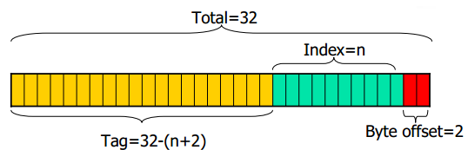
4.2 The Basic of Caches
The total number of bits needed for a cache is a function of the cache size and the memory address size .
Assuming the 32-bit byte address, a direct-mapped cache of size 2^{n} words with one-word(4-byte) blocks will require a tag field whose size is 32-(n+2) bits. The total number of bits in a direct-mapped cache is
2^{n}×(block size + tag size + valid field size).
So, the number of bits in such a cache is
2^{n}×(32+(32-n-2)+1)=2^{n}×(63-n)

Slide 38
4.2 The Basic of Caches
Example: How many total bits are required for a direct-mapped cache with 64KB of data and 1-word blocks, assuming a 32-bit address?
Answer:
64KB =16K-words = 2¹⁴ words, and with a block size of 1 word, 2¹⁴ blocks. Each entry has 32 bits of data plus a tag, which is 32-14-2 bits, plus a valid bit. Thus the total cache size is: 2¹⁴个字(块), 每个入口有32位数据, 加上tag(32-14-2), 再加上1位valid
2¹⁴ ×(32 + (32-14-2)+1) = 2¹⁴ ×49 = 784Kbits = 98KB

Slide 39
4.2 The Basic of Caches
Handling Cache Misses 处理Cache缺失问题
The control unit (CU) must detect a miss and process the miss by fetching the data from memory. 必须检测出缺失, 并通过从memory取数据来解决问题
Basic approach:
stall CPU, freezing contents of all the registers. 阻塞CPU, 冻结所有寄存器的内容
A separate controller handle the cache miss, fetching data into the cache from memory. 从存储器中取来数据放到cache中
Once data is present, execution is restarted at the cycle that caused the cache miss. 重新在导致缺失的地方开始执行

Slide 40
4.2 The Basic of Caches
We can now define the steps to be taken on an instruction cache miss (data cache miss is similar to instruction cache miss )
① Send the original PC value (current PC- 4) to the memory. 将原来的PC值(当前PC-4)送到存储器
② Instruct main memory to perform a read and wait for the memory to complete its access. 执行存储器读操作
③ Write cache entry, putting data from memory in data portion of the entry, writing upper bits of address into tag field, and turning valid bit on. 写入cache: 将从存储器读来的数据送到数据部分, 高位地址送到tag域, 将valid置位。
④ Restart instruction execution at first step, will refetch instruction, and find it in cache. 重新执行指令, 重取指, 并在cache中能找到

Slide 41
Computer Architecture 计算机体系结构
School of Computer Science and Technology Beijing Jiaotong Univeristy
Yi Tian

Slide 42
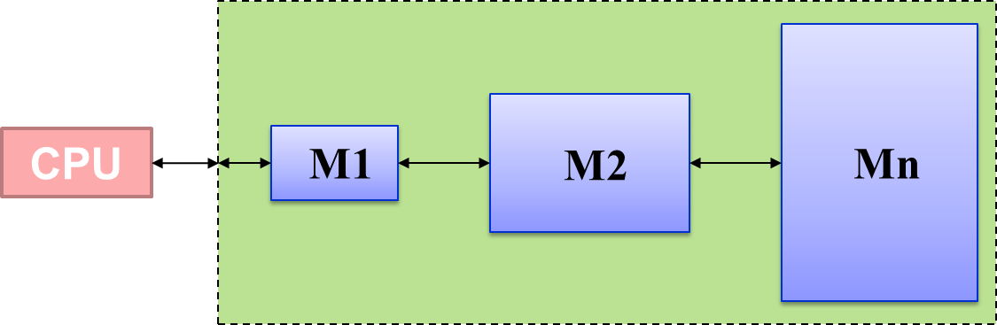
4.1 Introduction
The principle of locality: the programs access a relatively small portion of address space at any instant of time. 程序在任意时刻都是访问地址空间的一小部分
Two types of locality: 时间局部性和空间局部性
Temporal locality (locality in time): If an item is referenced, it will tend to be referenced again soon. 如果一个数据项被访问, 则其倾向于很快被再次访问
Spatial locality (locality in space): If an item is referenced, items whose addresses are close by will tend to be referenced soon. 如果一个数据项被访问, 则其临近地址的数据项倾向于很快被访问

Slide 43
4.2 The Basic of Caches
How do we know whether a requested word is in the cache or not?
Tag
added to cache, indicating whether the data in cache corresponding to a requested word.
Upper portion of the memory address
A valid bit
Indicate whether an entry contains valid information
If the bit is not set, there cannot be a match for this block
Data
Index
The bits corresponding to the index are used to select the unique entry in the cache corresponding to the supplied address.
Lower portion of the memory address

Slide 44
4.2 The Basic of Caches

Slide 45
4.2 The Basic of Caches
An Example Cache: The DECStation 3100
The DECStation 3100 was a workstation, use MIPS R2000 processor, a very simple cache implementation.
processor has a pipeline similar in Chap. 3. When operating at peak speed, requests both an instruction word and a data word on every clock. Separate instruction and data caches are used.
Figure 4.11 shows the organization of the DECStation 3100 data cache.
It contains 16K blocks, one word per block. So, index is 14 bits, tag contains 16 bits.

Slide 46
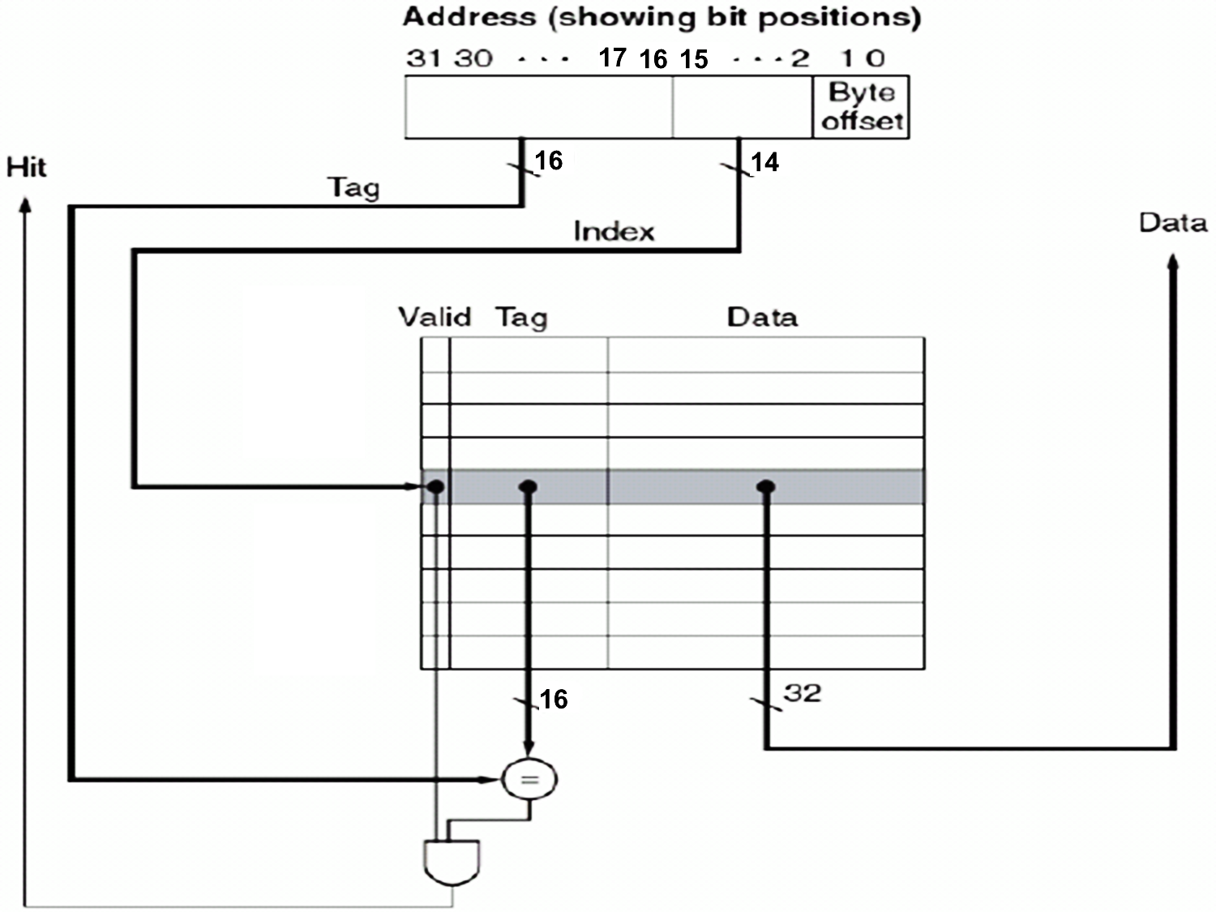
4.2 The Basic of Caches
Figure 4.11: The cache in the DECStation 3100 each contain 16K blocks with one word per block.
16K entries

Slide 47
4.2 The Basic of Caches
Reads work.
Read requests: separate control signals are needed to read and write each cache. 读的要求: 每个cache的读和写需要不同的控制信号
Steps for a read :
① Send address to cache. The address comes either from the PC (for an instruction read) or from the ALU (for a data access). 将地址送到cache(对于读指令). 地址或者来自PC, 或者来自ALU(对于访问数据)
② If the cache signals hit, requested word is available on the data lines. If miss, we send address to main memory. When memory returns data, write it into cache.命中: 得到所需要的字; 缺失: 将地址送到存储器, 取来数据, 写入cache

Slide 48
4.2 The Basic of Caches
Write work.
Suppose on a store instruction, we wrote the data into only the data cache (without changing main memory); then, after the write into the cache, memory would have a different value from that in the cache. In such a case, the cache and memory are said to be inconsistent. 在向cache写后, 存储器与cache中值不一致
Write-through(写直达法)
Write-back(写回法)
Write-through (写直达法): always write the data into both the memory and the cache. 通写: 总是将数据同时写入存储器和cache

Slide 49
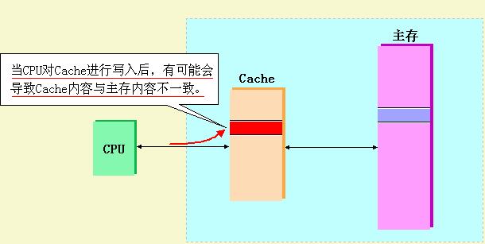
4.2 The Basic of Caches
Write work.

Slide 50
4.2 The Basic of Caches
Write work.
Write Miss: not a problem
We do not need to consider whether a write hits or misses in the DECStation 3100 cache, which use write-through.
This observation leads to the following simple scheme for processing writes , used on the DECStation 3100:
① Index cache using bits 15-2 of the address. 用地址的15-2位索引cache
② Write bits 31-16 of address into tag, write the data word into data portion, set the valid bit. 将地址的31-16位写入tag, 将数据字写入到数据部分, 将valid位置位
③ Also write the word to main memory. 也将字写入主存

Slide 51
4.2 The Basic of Caches
Write work.
Disadvantage of write-through:
Although handles writes very simply, would not provide very good performance. 虽然处理简单, 但效率不高
Every write causes the data to be written to main memory. It will take a long time and slow down the machine considerably. 每次写cache都同时导致数据写入主存. 写主存需要长时间, 大大减慢机器速度

Slide 52
4.2 The Basic of Caches
Write work.
Write buffer 写缓冲器 : stores the data while it is waiting to be written to memory.
After writing into cache and into write buffer, processor can continue execution. 在写入cache和buffer后,处理器能继续执行
When write to main memory completes, the entry in write buffer is freed. 当写存储器完成后, 就释放写缓冲器的相应入口
If write buffer is full and processor reaches a write, must stall for empty position. 如果buffer满, 而处理器又要写, 则必须阻塞以得到空位置
If the rate memory can complete writes is less than the rate processor is generating writes, no amount of buffering can help. 如果处理器完成写的比率低于处理器产生写的比率, 多少缓冲器也不够用
Even not slow, stalls may still occur (when writes occur in bursts). 即使存储器不慢, 突发写产生阻塞
So, increase the depth of the write buffer. The DECStation 3100 write buffer is 4 words deep.

Slide 53
4.2 The Basic of Caches
Write work.
Write-back (写回法):
When a write occurs, the new value is written only to the block in the cache. 当发生写时, 新值只写入cache块
The modified block is written to lower level when it is replaced. 被修改的块只有在被替换时才被写入低层
Can improve performance, especially when processors can generate write as fast or faster than the writes can be handled by main memory. 当处理器生成写的速度等于或快于主存处理写的速度时, 尤能提高性能
A write-back scheme is more complex to implement than write-through. 写回比通写实现起来更复杂

Slide 54
4.2 The Basic of Caches
Taking advantage of Spatial Locality
利用空间局部性
In the past, we assume each word in a block.
To take advantage of spatial locality, we want to have a cache block that is larger than one word in length.
When a miss occurs, we will then fetch multiple words that are adjacent and carry a high probability of being needed shortly. 当缺失时, 取多个相邻的字. 这些字很可能很快就用到

Slide 55
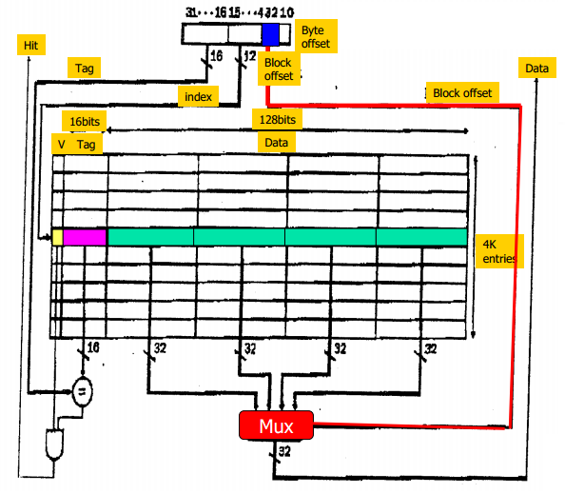
4.2 The Basic of Caches
Figure 4.12: A 64-KB cache using four-word block.
A cache that holds 64KB of data, but with blocks of four words(16 bytes) each.
tag field: 16bits,
index field: 12 bits,
index block field: 2-bit (bit 3-2),
select word: 4-to-1 multiplexor.

Slide 56
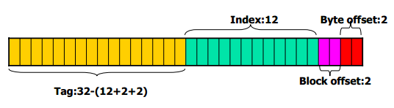
4.2 The Basic of Caches
An extra block index field is used to control the multiplexor (多路选择器), which selects the requested word from the four words in the indexed block.
The total number of tags and valid bits in the cache with a multiword block is smaller because each tag and valid is used for four words.

Slide 57
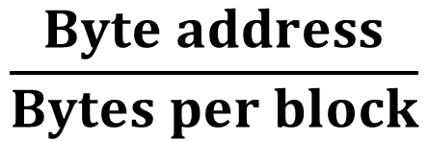
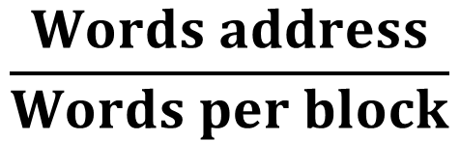
4.2 The Basic of Caches
The cache block number for a particular memory address:
Can use the same mapping that used for a cache with a 1-word block:
(Block address) modulo (number of cache blocks)
(块地址) modulo (cache中块数量)
block address is simply the word address divided by the number of words in the block.
$$\frac{Byte address}{Bytes per block}$$
$$\frac{Words address}{Words per block}$$

Slide 58
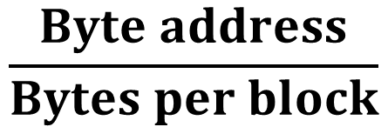
4.2 The Basic of Caches
Example: a cache with 64 blocks and a block size of 16 bytes. What block number does byte address 1200 map to?
Answer:
The block is given by:
(Block address) modulo (Number of cache blocks)
Where the address of block is:
$$\frac{Byte address}{Bytes per block}$$

Slide 59

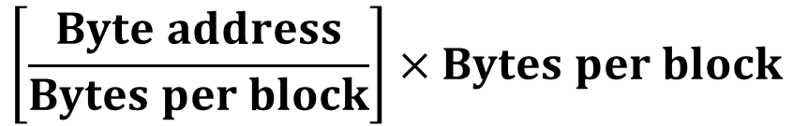
4.2 The Basic of Caches
Answer:
Thus, with 16 bytes per block, byte address 1200 is block address:
Which maps to block number (75 modulo 64) = 11
This block address is the block containing all addresses between
$$\left[\frac{1200}{16}\right]=75$$
$$\left[\frac{Byte address}{Bytes per block}\right]×Bytes per block$$
and
$$\left[\frac{Byte address}{Bytes per block}\right]×Bytes per block+(Bytes per block−1)$$

Slide 60
4.2 The Basic of Caches
Read and write cache with a multiword block:
Read hits: select the word from the block using X-to-1 multiplexor and read the word.
Read misses: will require reading the entire block from memory and write it on the cache entry line.
Write hits: select the word from the block using X-to-1 multiplexor and write the word on the cache entry line.
Write misses: will require reading the entire block from memory and write the word on the cache entry line.

Slide 61
4.2 The Basic of Caches
Assume there are two memory addresses X and Y that both map to cache block C:
 |  | word1 | word2 | word3 | word4
V | Tag_Y | Y~Y+3 | Y+4~Y+7 | Y+8~Y+11 | Y+12~Y+15
C
error
 |  | word1 | word2 | word3 | word4
V | Tag_X | X~X+3 | Y+4~Y+7 | Y+8~Y+11 | Y+12~Y+15
C
Memory addresses X and Y, both map to cache block C (4-word block), currently contains Y. 存储地址X,Y都映射到cache块C. cache目前存的是Y
Now write to X by overwriting data and tag in C. 现在用X覆写C的数据和tag
After write, C will have tag for X, but data portion of C will contain 1 word of X and 3 word of Y. 写完后, C就将有X的tag, 但C的数据部分包含一个字的X和3个字的Y.

Slide 62
4.2 The Basic of Caches
For write-through cache by writing the data while performing a tag comparison:
If the tag of the address and the tag in the cache entry are equal, we have a write hit and can continue.如果地址tag和cache入口tag相等, 则命中,可继续
If the tags are unequal ,we have a write miss and must fetch the block from memory. 如果不相等, 则是写缺失,必须从存储器中取回整个块
After the block is fetched and placed into the cache, we can rewrite the word that caused the miss into the cache block. 然后再重写导致缺失的字到cache

Slide 63
4.2 The Basic of Caches
 |  | word1 | word2 | word3 | word4
V | Tag_Y | Y~Y+3 | Y+4~Y+7 | Y+8~Y+11 | Y+12~Y+15
C
right
 |  | word1 | word2 | word3 | word4
V | Tag_X | X~X+3 | X+4~X+7 | X+8~X+11 | X+12~X+15
C

Slide 64
4.2 The Basic of Caches
Increasing the block size (take advantage of spatial locality)
In general, the miss rate falls when we increase the block size.
The miss rate may actually go up if the block size becomes a significant fraction of the cache size because the number of blocks that can be held in the cache will become small, and there will be a great deal of competition for those blocks. (a block will be bumped out of the cache)
A more serious problem associated with just increasing the block size is that the cost of a miss increases.

Slide 65
4.2 The Basic of Caches
Increasing the block size
The miss penalty (失效代价) is determined by the time required to fetch the block from the next lower level of the hierarchy and load it into the cache.
two parts: latency to transfer first word and transfer time for the rest of block. 分成两部分: 传输第1个字的时间, 传输块的其余部分的时间
transfer time increase as block size grows. 传输时间随块增大而增加
improvement in miss rate starts to decrease as block become larger. 块增加得较大时, 缺失率的改进开始减小
result: increase in miss penalty overwhelms decrease in miss rate for large blocks. 结果就是缺失惩罚的增加淹没了大块所降低的缺失率

Slide 66
4.2 The Basic of Caches
Designing the Memory System to Support Caches
设计存储系统来支持Cache
Although it is difficult to reduce the latency to fetch the first word from memory, we can reduce the miss penalty if we increase the bandwidth from the memory to the cache. 降低取第一个字的时间是困难的, 但可通过提高存储器到cache的带宽来降低缺失惩罚
This reduction allows larger block sizes to be used while still maintaining a low miss penalty similar to that for a smaller block

Slide 67
4.2 The Basic of Caches
Designing the Memory System to Support Caches
设计存储系统来支持Cache
Let’s define a set of hypothetical memory access times:
1 clock cycle to send the address.
15 clock cycles for each DRAM access initiated.
1 clock cycle to send a word of data

Slide 68
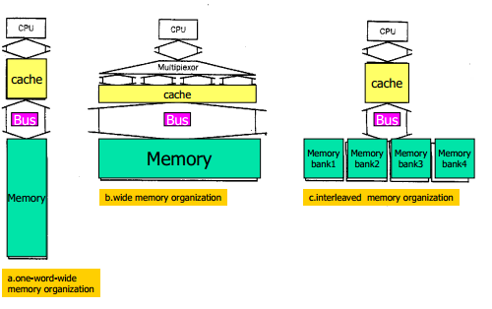
4.2 The Basic of Caches
Figure 4.13: The primary method of achieving higher memory bandwidth is to increase the physical or logical width of the memory system.
1字宽
宽存储
交差存储

Slide 69
4.2 The Basic of Caches
① one-word-wide memory organization
First, a cache block of four words and a one-word-wide bank of DRAMs
The miss penalty =1+4×15+4×1=65(clock cycles)
The number of bytes transferred per clock cycle for a single miss
=(4 words×4 bytes / word)/65 clock cycles
=0.25 bytes / clock cycle

Slide 70
4.2 The Basic of Caches
② wide memory organization
The second option increases the bandwidth to memory by widening the memory and the buses between processor and memory. Assume a main memory width of four words:
The miss penalty =1+1×15+1×1=17 (clock cycles)
The number of bytes transferred per clock cycle for a single miss =16/17=0.94 bytes / clock cycle

Slide 71
4.2 The Basic of Caches
③ interleaved memory organization
The third option increases the bandwidth by widening the memory but not the interconnection bus, which is called interleaving. Assume with four banks:
The miss penalty= 1+1×15+4×1=20 (clock cycles)
The number of bytes transferred per clock cycle for a single miss =16/20=0.80 bytes / clock cycle

Slide 72
4.3 Measuring and Improving Cache Performance
Measuring Cache Performance
度量Cache的性能
CPU time division
The clocks cycles that the CPU spends executing the program
The clock cycles that the CPU spends waiting for the memory system
Assume: the cost of cache accesses that are hits are part of the normal CPU execution cycles
CPU time =
(CPU execution clock cycles + Memory-stall clock cycles)×Clock cycle time

Slide 73
4.3 Measuring and Improving Cache Performance
Assume: the cost of cache accesses that are hits are part of the normal CPU execution cycles
The memory stall clock cycles come primarily from cache misses
CPU time =
(CPU execution clock cycles + Memory-stall clock cycles)×Clock cycle time
Memory –stall clock cycles = Read –stall cycles + Write –stall cycles
Read –stall cycles = (Reads/Program) × Read miss rate × Read miss penalty

Slide 74
4.3 Measuring and Improving Cache Performance
Writes are more complicated
For a write-through scheme, we have two sources of stalls:
Write misses, which usually require that we fetch the block before continuing the write. 写缺失: 通常要取来块后再继续写
Write buffer stalls, which occur when the write buffer is full when a write occurs. 写缓冲器阻塞: 写发生时写缓冲器已满
Thus, cycles stalled for writes equals:
If systems have: (1) reasonable write buffer depth. (2) memory fast enough. Write buffer stalls can be safely ignored.
Write –stall cycles =( (Writes/Program) × Write miss rate × Write miss penalty) + Write buffer stalls

Slide 75
4.3 Measuring and Improving Cache Performance
In most write-through cache organization, the read and write miss penalties are the same (the time to fetch the block from memory), assume that the write buffer stalls are negligible, we can combine the reads and write by using a single miss rate and the miss penalty.
We can also write this as:
Memory–stall clock cycles =
(Memory accesses/Program) × Miss rate × Miss penalty
Memory–stall clock cycles =
(Instructions/Program) × (Misses/Instruction) × Miss penalty

Slide 76
4.3 Measuring and Improving Cache Performance
Memory–stall clock cycles =
(Memory accesses/Program) × Miss rate × Miss penalty
Example: calculating cache performance.
Assume for gcc, instruction cache miss: 2%, data cache miss rate: 4%. 假设对于gcc: 指令cache缺失2%, 数据cache缺失4%
If a machine, CPI = 2 without any memory stalls, miss penalty = 40 cycles for all misses. 如果没有存储器阻塞时CPI=2, 所有缺失的惩罚都是40个周期(Frequency of all loads and stores in gcc is 36%. )
How much faster a machine would run with a perfect cache that never missed.

Slide 77

4.3 Measuring and Improving Cache Performance
Answer:
The number of memory miss cycles for instruction in terms of the instruction count(I) is:
Instruction miss cycle = I × 2% × 40 = 0.80 × I
frequency of all loads and stores in gcc is 36%. the number of memory miss cycles for data:
Data miss cycles = I × 36% × 4% × 40 = 0.56 × I
The total number of memory-stall cycles is: 0.80I + 0.56I = 1.36I. Accordingly, the CPI with memory stalls is: 2 + 1.36 = 3.36.
Since no change in instruction count or clock rate, the ratio of CPU execution time is:
So, the performance with the perfect cache is better by 3.36/2=1.68

Slide 78
4.3 Measuring and Improving Cache Performance
Answer:
If the processor is made faster, but the memory system stays the same, suppose CPI from 2 to 1 without changing the clock rate, which might be done with an improve pipeline。
The performance with the perfect cache is
(1+1.36)/1=2.36 times faster
The amount of execution time spent on memory stalls would have risen from 1.36/3.36=41% to 1.36/2.36=58%

Slide 79
4.3 Measuring and Improving Cache Performance
Example: Cache Performance with Increased Clock Rate.
Suppose we increase the performance of the machine in the previous example by doubling its clock rate. Since the main memory speed is unlikely to change, assume that the absolute time to handle a cache miss does not change .
How much faster will the machine be with the faster clock, assuming the same miss rate as the previous example？

Slide 80
4.3 Measuring and Improving Cache Performance
Answer:
The new miss penalty will be 80 clock cycles.
Total miss cycles per instruction:
(2%×80)+36%×(4%×80)=2.75
The faster machine with cache misses will have a CPI:
2+2.75=4.75

Slide 81

4.3 Measuring and Improving Cache Performance
Answer:
The relative performance is:
The machine with the faster clock is about 1.4 times faster rather than 2 times faster, which it would have been without the increase effect of cache misses
$$\frac{Performanc with fast clock}{Performanc with slow clock}=\frac{execution tiome with slow clock}{execution tiome with fast clock} \\ =\frac{IC×{CPI}_{slow}×Clock cycle}{IC×{CPI}_{fast}×\frac{Clock cycle}{2}} \\ =\frac{3.36}{\frac{4.75}{2}}=1.41$$

Slide 82
4.3 Measuring and Improving Cache Performance
Answer:
同时改进时钟频率和CPI会如何？
if a machine improves both clock rate and CPI, it suffers a double hit:
1. lower CPI -> more impact of stall cycles. 较低的CPI意味着阻塞周期影响更大
2. if memories of two machines have same access time, higher CPU rate leads to larger miss penalty. 如果存储器访问时间不变, 更高的CPU频率导致更大的缺失惩罚
Thus the importance of cache performance for both low CPI and high clock rates is greater. 因此, 对于低CPI和高时钟频率, cache性能更重要

Slide 83
Computer Architecture 计算机体系结构
School of Computer Science and Technology Beijing Jiaotong Univeristy
Yi Tian

Slide 84
4.2 The Basic of Caches
Taking advantage of Spatial Locality
利用空间局部性
In the past, we assume each word in a block.
To take advantage of spatial locality, we want to have a cache block that is larger than one word in length.
When a miss occurs, we will then fetch multiple words that are adjacent and carry a high probability of being needed shortly. 当缺失时, 取多个相邻的字. 这些字很可能很快就用到

Slide 85
4.2 The Basic of Caches
Figure 4.12: A 64-KB cache using four-word block.
A cache that holds 64KB of data, but with blocks of four words(16 bytes) each.
tag field: 16bits,
index field: 12 bits,
index block field: 2-bit (bit 3-2),
select word: 4-to-1 multiplexor.

Slide 86
4.2 The Basic of Caches
Read and write cache with a multiword block:
Read hits: select the word from the block using X-to-1 multiplexor and read the word.
Read misses: will require reading the entire block from memory and write it on the cache entry line.
Write hits: select the word from the block using X-to-1 multiplexor and write the word on the cache entry line.
Write misses: will require reading the entire block from memory and write the word on the cache entry line.

Slide 87
4.2 The Basic of Caches
Designing the Memory System to Support Caches
设计存储系统来支持Cache
Let’s define a set of hypothetical memory access times:
1 clock cycle to send the address.
15 clock cycles for each DRAM access initiated.
1 clock cycle to send a word of data

Slide 88
4.2 The Basic of Caches
Figure 4.13: The primary method of achieving higher memory bandwidth is to increase the physical or logical width of the memory system.
1字宽
宽存储
交差存储

Slide 89
4.3 Measuring and Improving Cache Performance
Two different techniques for improving cache performance
One focuses on reducing the miss rate by reducing the probability that two different memory blocks will contend for the same cache location. 通过降低两个存储块竞争同一个cache位置的概率来降低缺失率。
The second technique reduces the miss penalty by adding an additional level to the hierarchy (called multilevel caching) 通过向层次结构中再增加额外的层次来降低缺失惩罚, 称为多级cache。

Slide 90
4.3 Measuring and Improving Cache Performance
Reducing Cache Misses by More Flexible Placement of Blocks 通过更灵活的块布局来降低Cache缺失
Direct mapped (one extreme): where a block can be placed in exact one location in cache. 一个极端是直接映像: 一个块只能置于cache中一个位置
Fully associative (other extreme): a block in memory may be associated with any entry in cache. 另一个极端是全相联: 存储器中的块可放置于cache中任何位置
To find a block, must search all entries in cache.
To make practical, it is done in parallel with a comparator associated with each cache entry.
So, increase hardware cost, practical only for caches with small number of blocks.

Slide 91
4.3 Measuring and Improving Cache Performance
Set associative (组相联): there are a fixed number of locations (at least two) where each block can be placed.
n-way set-associative cache: consists of a number of sets, each consists of n blocks. n-路组相联: 一些组, 每组n个块
Each block in memory maps to a unique set in cache given by the index field, and can be placed in any element of that set. 每个模块只能放到cache中唯一一组中, 但可放到该组的任何位置中
So, is combination of direct-mapped and fully associative: block directly mapped to a set, then all the blocks in the set are searched. 是直接映像和全相联的结合: 块直接映像到一组中, 然后搜索组中所有块

Slide 92
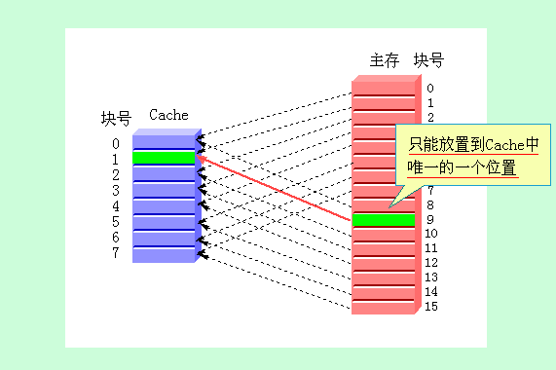
4.3 Measuring and Improving Cache Performance
Direct mapped (one extreme)

Slide 93
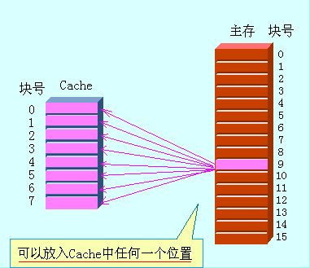
4.3 Measuring and Improving Cache Performance
Fully associative (other extreme)

Slide 94
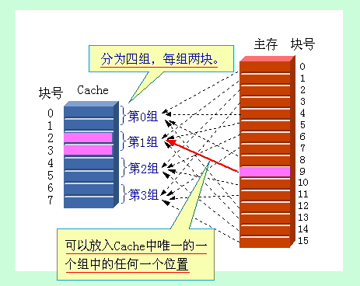
4.3 Measuring and Improving Cache Performance
Set associative

Slide 95
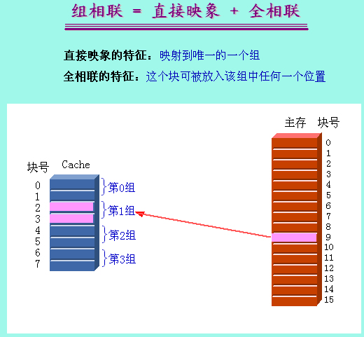
4.3 Measuring and Improving Cache Performance
Set associative

Slide 96
4.3 Measuring and Improving Cache Performance
A memory block calculated.
Direct-mapped cache: 直接映像
(Block number) modulo (Number of cache blocks)
(块号) modulo (cache中块数)
Set-associative cache: 组相联
the set is given by:
(Block number) modulo (Number of sets in cache)
(块号) modulo (cache中组数)
若主存第 i 块映象到第 k 组，则:
k＝i mod（G） （G为Cache的组数）
设G＝2^{g}，则当表示为二进制数时，k 就是 i的低 g 位
then all elements of the set are searched.
Fully associative cache: 全相联
all the blocks in cache must be searched.

Slide 97
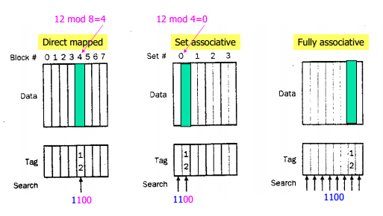
4.3 Measuring and Improving Cache Performance
Figure 4.14: The location of a memory block whose address is 12 in a cache. With eight blocks varies for direct-mapped, set associative, and fully associative placement

Slide 98
4.3 Measuring and Improving Cache Performance
Comparisons:
We can think of every block placement strategy as a variation on set associativity.
A direct-mapped cache is simply a one-way set associative cache: each cache entry holds one block and forms a set with one element. 直接映像就是1-路组相联
A fully associative cache with m entries is simply an m-way set associative cache: it has one set with m blocks ,and an entry can reside in any block within that set. 带m个位置的全相联就是m-路组相联
n (路数)
G (组数)
全相联
M
1
直接映象
1
M
组相联
1＜n＜M
1＜G＜M

Slide 99
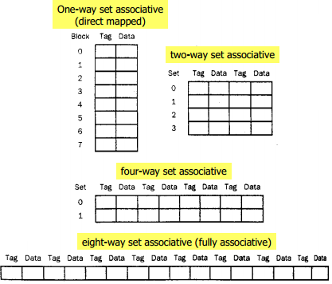
4.3 Measuring and Improving Cache Performance
Figure 4.15: An eight-block cache configured as direct mapped, two-way set associative, four-way set associative, and fully associative.

Slide 100
4.3 Measuring and Improving Cache Performance
Figure 4.15:
The total size of cache in blocks is equal to the number of sets times the associativity. Cache的大小等于组数乘以相联性
So, for fixed cache size, increasing associativity decreases the number of sets. 因此, 若cache大小固定, 增加相联性就会减少组数
The advantage of increasing associability is: usually decreases miss rate. 增加相联性的好处是: 通常降低缺失率
The main disadvantage is increase in hit time. 坏处是: 增加了命中时间

Slide 101
4.3 Measuring and Improving Cache Performance
Example: There are three small caches, each consisting of four one-word blocks.
One cache is fully associative,
A second is two-way set associative,
And the third is direct-mapped.
Find the number of misses for each cache organization given the following sequence of the block addresses:0, 8, 0, 6, 8

Slide 102
4.3 Measuring and Improving Cache Performance
Answer:
Direct-mapped cache: the number of misses is 5
Memory block address | Cache block
0 | (0 modulo 4)=0
6 | (6 modulo 4)=2
8 | (8 modulo 4)=0
Address of memory block accessed | Hit or miss | Contents of cache blocks after reference
 |  | 0 | 1 | 2 | 3
0 | miss | Memory[0]
8 | miss | Memory[8]
0 | miss | Memory[0]
6 | miss | Memory[0] |  | Memory[6]
8 | miss | Memory[8] |  | Memory[6]

Slide 103
4.3 Measuring and Improving Cache Performance
Answer:
Two-way set-associative :
The two-way set-associative cache has two sets (with indices 0 and 1) with two elements per set.
Because we have a choice of which entry in a set to replace on a miss ,we need a replacement rule (替换规则).
Set-associative caches usually replace the least recently used (LRU:近期最少使用替换算法) block within a set; that is, the block that was used furthest in the past is replaced.

Slide 104
4.3 Measuring and Improving Cache Performance
Answer:
Two-way set-associative: the number of misses is 4.
Memory block address | Cache Set
0 | (0 modulo 2)=0
6 | (6 modulo 2)=0
8 | (8 modulo 2)=0
Address of memory block accessed | Hit or miss | Contents of cache blocks after reference
 |  | 0 | 1 | 2 | 3
0 | miss | Memory[0]
8 | miss | Memory[0] | Memory[8]
0 | hit | Memory[0] | Memory[8]
6 | miss | Memory[0] | Memory[6]
8 | miss | Memory[8] | Memory[6]

Slide 105
4.3 Measuring and Improving Cache Performance
Answer:
Fully associative cache: has four cache blocks (in a single set); any memory block can be stored in any cache block. the number of misses is 3.
Address of memory block accessed | Hit or miss | Contents of cache blocks after reference
 |  | Block 0 | Block 1 | Block 2 | Block 3
0 | miss | Memory[0]
8 | miss | Memory[0] | Memory[8]
0 | hit | Memory[0] | Memory[8]
6 | miss | Memory[0] | Memory[8] | Memory[6]
8 | hit | Memory[0] | Memory[8] | Memory[6]

Slide 106
4.3 Measuring and Improving Cache Performance
Locating a Block in the Cache 在Cache中定位块
How find a block in a cache that is set associative?
Each block in a set-associative cache includes an address tag that gives the block address.
The tag of every cache block within the appropriate set is checked to see if it matches the block address from the CPU.
Example: The portions of a memory address in a set-associative
Tag | Index (set) | Block Offset

Slide 107
4.3 Measuring and Improving Cache Performance
The index value is used to select the set containing the address of interest.
The tags of all the blocks in the selected set must be searched in parallel to choose the block. Index用于选择包含所需地址的组, 该组中所有模块的tag都必须被搜索。速度最重要,因此对所选择组中的所有tag要并行搜索。
The block offset is the address of the desired data within the block.
Tag | Index (set) | Block Offset

Slide 108
4.3 Measuring and Improving Cache Performance
If the total size of cache is kept the same (block number), increasing the associativity increases the number of blocks per set , which is the number of simultaneous compares needed to perform the search in parallel: each increase by a factor of two in associativity doubles the number of blocks per set, and halves the number of sets.
Each factor-of-two increase in associativity decreases the size of the index by 1 bit and increases the size of the tag by 1 bit.

Slide 109
4.3 Measuring and Improving Cache Performance
In a fully associative cache, there is no index, all the blocks must be checked in parallel, we search the entire cache without any indexing. 全相联, 一个组, 所有块并行检测, 没有index, 全部地址(除了block offset)与每个block的tag比较
In a direct-mapped cache, only a single comparator is needed, because the entry can be in only one block, we access the cache simply by indexing. 直接映像, 只需一个比较器, 只用index访问cache
In a four-way set-associative cache, shown in Figure 4.16, four comparators are needed, together with a 4-to-1 multiplexor to choose among the four potential members of the selected set. 4-路组相联: 4个比较器, 4到1多路选择器, cache访问包括对组进行索引并搜索组中的块

Slide 110
4.3 Measuring and Improving Cache Performance
Figure 4.16: The implementation of a four-way set-associative cache requires four comparators and a 4-to-1 multiplexor.
Memory address
Tag
Index

Slide 111
4.3 Measuring and Improving Cache Performance
Example: Size of Tags versus Set Associativity.
Assuming a cache of 4K blocks and a 32-bit address, find the total number of sets and the total number of tag bits for caches that are direct-mapped, two-way and four-way set associative, and fully associative.
这里隐含一个块是一个字节
Answer:
Direct-mapped cache
sets = blocks, hence log₂(4K)=12 bits of index.
The total number of sets is 4K
The total number of tag bits is (32-12) ×1 ×4K = 80K

Slide 112
4.3 Measuring and Improving Cache Performance
2-way set-associative cache
The total number of sets is 4K/2=2K; index=log₂2K.
The total number of tag bits is (32-11)×2×2K=84K
4-way set-associative cache
The total number of sets is 4K/4=1K ; index=log₂1K.
The total number of tag bits is (32-10)×4×1K=88K
Fully associative cache
The total number of sets is 1 ; index=log₂1.
the total number of tag bits is (32-0)×4K×1=128K
So, increasing associativity requires more comparators, as well as tag bits per cache block.

Slide 113
4.3 Measuring and Improving Cache Performance
Choosing Which Block to Replace
选择替换的块
When a miss occurs:
In a direct-mapped cache, the request block can go in exactly one position.
In a fully associative cache, all blocks are candidates for replacement.
In a set-associative cache ,we must choose among the blocks in the selected set
Least recently used (LRU): block replaced is the one that has been unused for longest time. LRU: 被替换的块是最久未使用的块
LRU is implemented by keeping track of relatively when each element in a set was used. 必须跟踪块的使用情况
As associativity increases, implementing LRU gets harder. 相联性越增加, 实现越困难

Slide 114
4.3 Measuring and Improving Cache Performance
Two different techniques for improving cache performance
One focuses on reducing the miss rate by reducing the probability that two different memory blocks will contend for the same cache location. 通过降低两个存储块竞争同一个cache位置的概率来降低缺失率。
The second technique reduces the miss penalty by adding an additional level to the hierarchy (called multilevel caching) 通过向层次结构中再增加额外的层次来降低缺失惩罚, 称为多级cache。

Slide 115
4.3 Measuring and Improving Cache Performance
Reducing Miss Penalty Using Multilevel Caches
采用多级cache来降低缺失惩罚
To close the gap between fast microprocessor and the long time required to access DRAMs, high performance microprocessors support an additional level of caching.
This second-level cache (二级高速缓冲存储器), often is off-chip in a separate set of SRAMs, is accessed whenever a miss occurs in primary cache.
If second-level cache hits, the miss penalty will be the access time of the second-level cache, much less than that of main memory.
If neither the primary nor secondary cache hits, a main memory access is required.

Slide 116
4.3 Measuring and Improving Cache Performance
Example: Performance of Multilevel Caches.
Suppose: base CPI=1.0, clock rate=500MHz, main memory access time=200ns (including all miss handling), miss rate at primary cache is 5%.
If add a secondary cache, has 20ns access time for either hit or miss, large enough to reduce miss rate to main memory to 2%.
How much faster will machine be ?

Slide 117
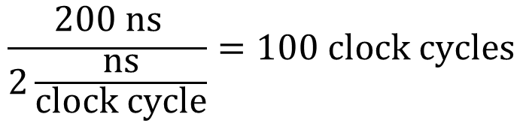
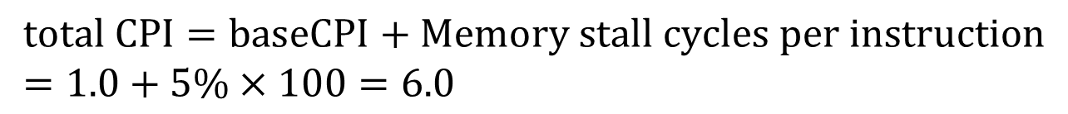
4.3 Measuring and Improving Cache Performance
Answer:
The miss penalty to main memory is:
$$\frac{200 ns}{2\frac{ns}{clock cycle}}=100 clock cycles$$
The effective CPI with one-level of caching is given by:
$$total CPI=baseCPI+Memory stall cycles per instruction \\ =1.0+5\%×100=6.0$$

Slide 118
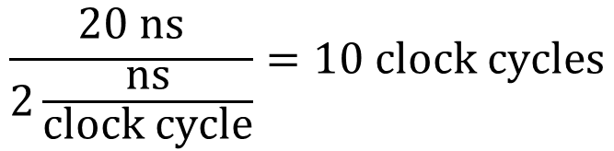
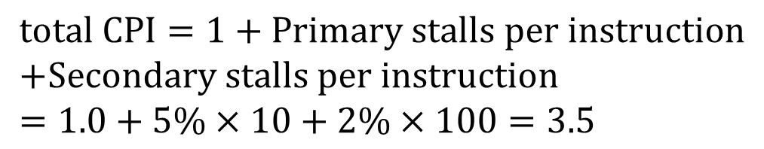
4.3 Measuring and Improving Cache Performance
Answer:
With two levels of cache, the miss penalty for an access to the second–level cache is:
$$\frac{20 ns}{2\frac{ns}{clock cycle}}=10 clock cycles$$
$$total CPI=1+Primary stalls per instruction \\ +Secondary stalls per instruction \\ =1.0+5\%×10+2\%×100=3.5$$
So, the machine with the secondary cache is faster by 6.0/3.5=1.7

Slide 119
4.3 Measuring and Improving Cache Performance
The design consideration of 2-level caches:
Significantly different, because the presence of other cache changes the optimal choice.
Allows primary to focus on minimizing hit time, secondary to focus on miss rate to reduce penalty. 初级专注于最小化命中时间, 二级专注于命中率(以降低惩罚)
Primary: miss penalty is significantly reduced, allowing primary to be smaller and have a higher miss rate. 初级: 由于缺失惩罚大幅降低, 使得初级cache可以更小, 有更高的缺失率
Secondary: access time becomes less important, since it affects miss penalty of primary, rather than directly affecting primary hit time. 二级: 访问时间变得不重要, 因为它影响初级的缺失惩罚, 而不是直接影响初级的命中时间

Slide 120
4.3 Measuring and Improving Cache Performance
The effect of changes:
In comparison to single-level cache, the primary cache is often smaller. 与单级cache相比, 初级cache通常较小
Primary cache often uses a smaller block size, with smaller cache size and reduced miss penalty. 初级cache通常采用较小的块, 较小的cache, 以及较低的缺失惩罚
Secondary be larger than in single-level cache, since access time of secondary is less critical. 二级cache较大, 因为二级的访问时间较不重要
With larger total size, the secondary cache often will use larger block size than a single-level cache. 由于二级较大, 所以采用较大块(比单级)

Slide 121
Computer Architecture 计算机体系结构
School of Computer Science and Technology Beijing Jiaotong Univeristy
Yi Tian

Slide 122
4.3 Measuring and Improving Cache Performance
Reducing Cache Misses by More Flexible Placement of Blocks 通过更灵活的块布局来降低Cache缺失
Direct mapped (one extreme): where a block can be placed in exact one location in cache. 一个极端是直接映像: 一个块只能置于cache中一个位置
Fully associative (other extreme): a block in memory may be associated with any entry in cache. 另一个极端是全相联: 存储器中的块可放置于cache中任何位置
To find a block, must search all entries in cache.
To make practical, it is done in parallel with a comparator associated with each cache entry.
So, increase hardware cost, practical only for caches with small number of blocks.

Slide 123
4.3 Measuring and Improving Cache Performance
Set associative (组相联): there are a fixed number of locations (at least two) where each block can be placed.
n-way set-associative cache: consists of a number of sets, each consists of n blocks. n-路组相联: 一些组, 每组n个块
Each block in memory maps to a unique set in cache given by the index field, and can be placed in any element of that set. 每个模块只能放到cache中唯一一组中, 但可放到该组的任何位置中
So, is combination of direct-mapped and fully associative: block directly mapped to a set, then all the blocks in the set are searched. 是直接映像和全相联的结合: 块直接映像到一组中, 然后搜索组中所有块

Slide 124
4.3 Measuring and Improving Cache Performance
Reducing Miss Penalty Using Multilevel Caches
采用多级cache来降低缺失惩罚
To close the gap between fast microprocessor and the long time required to access DRAMs, high performance microprocessors support an additional level of caching.
This second-level cache (二级高速缓冲存储器), often is off-chip in a separate set of SRAMs, is accessed whenever a miss occurs in primary cache.
If second-level cache hits, the miss penalty will be the access time of the second-level cache, much less than that of main memory.
If neither the primary nor secondary cache hits, a main memory access is required.

Slide 125
4.4 Virtual Memory
Virtual memory: main memory acts as “cache” for the secondary storage, usually implemented with magnetic disks. 虚拟存储器: 主存做为二级存储的“cache”, 二级存储通常用磁盘实现
Two major motivations for virtual memory:
① allow efficient and safe sharing of memory among multiple programs
② allow a single user program to exceed the size of the primary memory

Slide 126
4.4 Virtual Memory
① Allow efficient and safe sharing of memory among multiple programs.
Main memory need contain only the active portions of the many programs. 主存仅载入很多程序的活跃部分
A cache contain only the active portion of one program
A program can only read and write the portions of main memory that have been assigned to it (protection). 程序之间必须互相保护, 确保一个程序只能读写主存分配给它的区域
Virtual memory implements the translation of a program’s address space to physical addresses.

Slide 127
4.4 Virtual Memory
② Allow a single user program to exceed the size of the primary memory. Remove programming burdens of a small, limited amount of main memory
Overlays: Formerly, program too large for memory -> programmer to make it fit -> divided programs into pieces -> identified the pieces mutually exclusive. 以前: 程序过大时, 程序员将持续分成片段, 要辨别出互相独立的片段
Virtual memory: which was invented to relieve programmers of this difficulty, automatically manages the two levels of the memory hierarchy represented by main memory (sometime called physical memory to distinguish it from virtual memory) and secondary storage. 虚拟存储器: 自动管理2级存储层次(主存和次级存储)

Slide 128
4.4 Virtual Memory
Different terminology from caches in virtual memory.
A virtual memory block is called a page, and a virtual memory miss is called a page fault. 虚拟存储器的块称为页, 虚拟存储器缺失称为页故障
CPU produces a virtual address, which is translated to a physical address, used to access main memory. CPU产生虚拟地址, 并翻译成物理地址, 用来访问主存储器
Page(页) — block(块)
Page fault (miss) 页故障 — block fault (miss)
A virtual address — a memory address
A physical address — a cache address

Slide 129
4.4 Virtual Memory
Figure 4.17: In virtual memory, blocks of memory (called pages) are mapped from one set of addresses (called virtual addresses) to another set (called physical addresses)—memory mapping or address translation.
虚拟地址
物理地址
地址转换
磁盘地址

Slide 130
4.4 Virtual Memory
Figure 4.17:
The processor generates virtual addresses while the memory is accessed using physical addresses. 处理器产生虚拟地址, 而存储器用物理地址访问
Both virtual memory and physical memory are broken into pages. 虚拟存储器和物理存储器都划分成页
Possible: a virtual page to be absent from main memory and not be mapped to a physical address. 虚拟页可能不在主存中, 就不映射到物理地址
Physical pages can be shared: by having 2 virtual addresses point to same physical address.物理页可共享: 两个虚拟地址可指向同一个物理地址

Slide 131
4.4 Virtual Memory
Virtual memory simplifies loading the program for execution by providing relocation (重定位).
Relocation maps the virtual addresses used by a program to different physical addresses before the addresses are used to access memory.
This relocation allows us to load the program into any location in main memory. (fully associative)

Slide 132
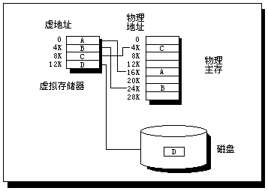
4.4 Virtual Memory

Slide 133
4.4 Virtual Memory
In virtual memory, the virtual address is broken into a virtual page number and a page offset
Physical address includes physical page number and page offset
Number of bits in the page offset field determines the page size
Figure 4.18: Mapping from a virtual to a physical address.
虚拟地址
虚拟页号
页偏移
转换
物理页号
页偏移
物理地址

Slide 134
4.4 Virtual Memory
Figure 4.18: Mapping from a virtual to a physical address.
page size is 2¹² = 4KB.
physical pages allowed in memory is 2¹⁸.
main memory 1GB, virtual space is 4GB.
Physical address: physical page number constitutes upper portion, page offset constitutes lower portion. 物理地址=物理页号+页偏移
The number of bits in the page offset field determines the page size. 页偏移的位数决定了页的大小

Slide 135
4.4 Virtual Memory
A page fault will take millions of cycles to process. Dominated by time to get first word, leading to key decisions: 页故障需要百万周期来处理, 决定了如下决策:
Pages should be large enough to amortize the high access time. 16K, 32K, 64K. 页应足够大, 分摊处理时间
Organizations that reduce the page fault rate are attractive. example: fully associative. 降低页故障率的设计更有吸引力: 如采用全相联
Page faults can be handled in software because the overhead will be small, and software can afford to use clever algorithms. 采用软件解决页故障, 因为开销小, 且能采用巧妙的算法
Write-through will not work, since take too long. virtual memory systems use write back. 通写不可行, 因为需要时间太长. 虚拟存储系统采用写回

Slide 136
4.4 Virtual Memory
Placing a Page and Finding It Again
页的布局和寻找
high page fault penalty -> reduce the number of page faults by optimizing page placement. 由于页故障惩罚高,需要采用优化的页布局来降低页故障次数
Use fully associative: 采用全相联
Can use clever, flexible replacement scheme. Also reduces the page fault rate.

Slide 137
4.4 Virtual Memory
Page table: used by virtual memory to locate pages, is a full table that indexes memory. 页表:用来定位页,是一个索引存储器的全表
Resides in memory, indexed with page number from virtual address and contains corresponding physical page number. 驻留在内存中,用虚拟地址的页号索引, 并包含相应的物理页号
Each program has its own page table, maps the virtual address space to main memory. 每个程序都有自己的页表, 将虚地址映射到主存
To indicate the location of the page table in memory. Hardware includes a register that points to start of page table; called page table register. 页表寄存器: 指向页表的起始地址
The page table may contain entries for pages not present in memory.

Slide 138
4.4 Virtual Memory
Page table: A page table for a program(程序的页表)
Virtual page number | Valid bit | Physical page number | Use bit | Dirty bit | Protection bit | Other

Slide 139
4.4 Virtual Memory
Figure 4.19: The page table is indexed with the virtual page number to obtain the corresponding portion of the physical address
页表寄存器
虚拟地址
虚拟页号
页偏移
物理页号
页表
为0则页
不在主存
物理页号
页偏移
物理地址

Slide 140
4.4 Virtual Memory
Figure 4.19:
The starting address of the page table is given by page table register. 页表的起始地址由页表寄存器给出
The page size is 2¹² bytes, or 4KB. 页大小=4KB
Virtual address space is 2³² bytes (4GB), physical address space is 2³⁰ bytes (1GB). 虚拟地址空间是4GB, 物理地址空间是1GB
The number of entries in page table is then 2²⁰. 页表入口数即为2²⁰
Valid bit indicates whether the mapping is legal. Valid位指明映射是否合法

Slide 141
4.4 Virtual Memory
Figure 4.19:
A valid bit is used in each page table entry. 每个页表入口有一个有效位
If is off, page is not present in main memory and a page fault occurs. 如果off,则页不在存储器中,就是发生了页故障
If is on, page is valid and the entry contains the physical page number. 如果on,该入口包含物理页号
Because page table contains a mapping for every possible virtual page, no tags required. 由于页表对每一个虚页都包含一个映射,因此不需要tag

Slide 142
4.4 Virtual Memory
Example:
With a 32-bit virtual address, 4KB size pages and 4 bytes per page table entry, how many bytes the total page table size is?
Answer:
Number of page table entries=2³²/2¹²=2²⁰
Size of page table=2²⁰ page table entries × 2²(bytes/page table entry)=4MB

Slide 143
4.4 Virtual Memory
Page Faults 页故障
If the valid bit for a virtual page is off, a page fault occurs. The OS must be given control. The operating system gets control, it must find the page in the next level of the hierarchy and decide where to place the requested page in main memory. 如果某虚拟页的valid位为off, 则发生页故障, OS必须接管
We must keep track of the location on disk of each page in the virtual address space
The OS creates a data structure to record where each virtual page is stored on disk.创建一个数据结构来记录每个虚拟页存储在磁盘的哪里
This data structure may be part of the page table or may be an auxiliary data structure indexed in the same way as the page table.

Slide 144
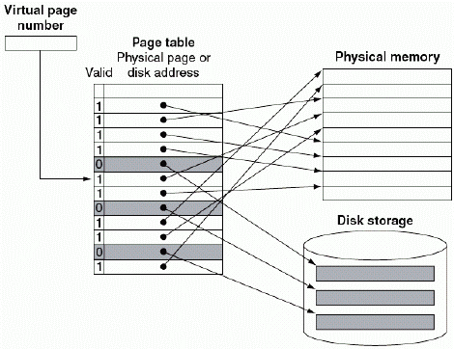
4.4 Virtual Memory
Figure 4.20: The page table maps each pages in virtual memory to either a page in main memory or a page stored on disk, which is the next level in the hierarchy

Slide 145
4.4 Virtual Memory
Figure 4.20:
Virtual page number is used to index page table. 虚拟页号用于索引页表
If valid bit is on, page table supplies the physical page number. 如果valid为on,页表提供的是物理页号
If valid bit is off, page currently resides on disk. 如果valid为off, 页目前在磁盘中
In many systems, the table of physical page addresses and disk page addresses is stored in two separate data structures. 在很多系统中, 物理页地址的和磁盘页地址的表存储在两个不同的数据结构中

Slide 146
4.4 Virtual Memory
When page fault occurs, if all pages in main memory are in use, OS must choose a page to replace. 当发生页故障时,如果存储器中的所有页都在使用中,则OS必须选择一个页来替换
OS follows LRU scheme. OS采用近期最少使用方案
suppose the most recent page references were 10, 12, 9, 7, 11, 10, and then we referenced page 8, which was not present in memory.
The LRU page is 12; we would replace 12 with 8. 最近最少使用的页是12
If the next reference is also a page fault, then replace 9. 下次就该是9

Slide 147
4.4 Virtual Memory
What about writes?
In a virtual memory system, writes to the next level of the hierarchy(disk) take millions of processor clock cycles. Write through (with write buffer) would be completely impractical. 向磁盘写需要数百万个时钟周期,因此,通写(带写缓冲器)完全不现实
Virtual memory systems must use write-back (copy back), performing the individual writes into the page in memory and copying the page back to disk when it is replaced in the memory. 虚拟存储系统必须采用写回, 即在向存储器写页时, 并且在页在存储器中被替换时写回磁盘

Slide 148
4.4 Virtual Memory
Example:
01001 001

Slide 149
4.4 Virtual Memory
Making Address Translation Fast: The TLB
加快地址转换：快表
Page tables are stored in main memory ->, every access take twice as long: one obtain physical address and one to get the data. 页表存储在主存储器中,每个访问需要两次: 一次获得物理地址, 一次获得数据
The key to improving access performance is to rely on locality of reference to page table. 提高访问性能的关键是依赖于页表访问的局部性
When a translation is used, it will probably be needed again in near future: for the references to words on that page have both temporal and spatial locality. 当一个转换被使用时, 它可能在近未来还需要, 因为对页中字的访问既有空间局部性又有时间局部性

Slide 150
4.4 Virtual Memory
Modern machines include a special cache that keeps track of recently used translations, called a translation-lookaside buffer (TLB). 现代计算机包括一个特殊的cache,用来保存最近使用的转换的情况,称为转换旁路缓冲器(TLB)
A TLB is a cache that holds only page table mappings. TLB是只保存页表映射的cache
Thus, each tag entry in TLB holds a portion of the virtual page number, and each data entry of the TLB holds a physical page number. TLB中每个tag入口保存虚拟页号的一部分,每个数据入口保存物理页号
TLB need to include other bits, such as the reference and the dirty bit. TLB还需要包括其他的位,如访问位和脏位

Slide 151
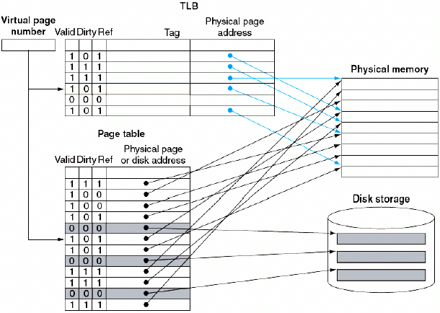
4.4 Virtual Memory
Figure 4.21: The TLB acts as a cache on the page table for the entries that map to physical page only
虚拟页号
物理页地址
页表
物理页或
磁盘地址

Slide 152
4.4 Virtual Memory
Figure 4.21:
TLB contains a subset of virtual-to-physical mappings in the page table. TLB包含了页表中虚-实映射的一个子集
TLB mappings are shown in color. TLB映射用颜色呈现
Because TLB is a cache, it must have a tag field. 因为TLB是cache, 所以必有tag域
If there is no matching entry in TLB for a page, the page table must be examined. TLB中没有匹配的入口, 就必须在页表中找
The page table either supplies a physical page number for the page (which can then be used to build a TLB entry) or indicates that a page fault occurs. 页表或者提供一个物理页号(并用于建立一个TLB入口),或者提示页故障
Since page table has an entry for every virtual page (it is not a cache), no tag field is needed. 由于页表对于每个虚拟页都有入口(不是cache), 所以不需要tag域

Slide 153
4.4 Virtual Memory
On every reference, we look up virtual page number in TLB. 先在TLB查找虚拟页号
If hit:
Physical page number is used to form address, correspond reference bit is turned on. 如果命中,物理页号用来构成地址, Ref位置位
If performing write, dirty bit is also turned on. 如果执行写, dirty位也置位

Slide 154
4.4 Virtual Memory
On every reference, we look up virtual page number in TLB. 先在TLB查找虚拟页号
If miss,
TLB miss but not a page fault (CPU can handle the TLB miss by loading the translation from the page table into TLB and trying the reference again.)
TLB miss and a page fault (CPU invokes the OS using an exception)
TLB misses can be handled either in hardware or software. In practice, there is little performance difference between the two approaches .

Slide 155
4.4 Virtual Memory
After a TLB miss occurs and the missing translation has been retrieved from the page table, we will need to select a TLB entry to replace.
Because the reference and dirty bits are contained in the TLB entry, we need to copy these bits back to the page table entry when we replace an entry. These bits are the only portion of the TLB entry that can be changed.
实现硬件的LRU过于昂贵。由于TLB缺失比页故障频繁得多,适用于页故障的,代价大的软件算法不可行。因此,很多系统为随机选择一项进行替换的策略提供一些支持
Using a write-back strategy (that is ,copying these entries back at miss time rather than whenever they are written) is very efficient.

Slide 156
Computer Architecture 计算机体系结构
School of Computer Science and Technology Beijing Jiaotong Univeristy
Yi Tian

Slide 157
4.4 Virtual Memory
Page table: used by virtual memory to locate pages, is a full table that indexes memory. 页表:用来定位页,是一个索引存储器的全表
Resides in memory, indexed with page number from virtual address and contains corresponding physical page number. 驻留在内存中,用虚拟地址的页号索引, 并包含相应的物理页号
Each program has its own page table, maps the virtual address space to main memory. 每个程序都有自己的页表, 将虚地址映射到主存
To indicate the location of the page table in memory. Hardware includes a register that points to start of page table; called page table register. 页表寄存器: 指向页表的起始地址
The page table may contain entries for pages not present in memory.

Slide 158
4.4 Virtual Memory
Figure 4.19: The page table is indexed with the virtual page number to obtain the corresponding portion of the physical address
页表寄存器
虚拟地址
虚拟页号
页偏移
物理页号
页表
为0则页
不在主存
物理页号
页偏移
物理地址

Slide 159
4.4 Virtual Memory
Making Address Translation Fast: The TLB
加快地址转换：快表
Page tables are stored in main memory ->, every access take twice as long: one obtain physical address and one to get the data. 页表存储在主存储器中,每个访问需要两次: 一次获得物理地址, 一次获得数据
The key to improving access performance is to rely on locality of reference to page table. 提高访问性能的关键是依赖于页表访问的局部性
When a translation is used, it will probably be needed again in near future: for the references to words on that page have both temporal and spatial locality. 当一个转换被使用时, 它可能在近未来还需要, 因为对页中字的访问既有空间局部性又有时间局部性

Slide 160
4.4 Virtual Memory
Figure 4.21: The TLB acts as a cache on the page table for the entries that map to physical page only
虚拟页号
物理页地址
页表
物理页或
磁盘地址

Slide 161
4.4 Virtual Memory
The MIPS R2000 TLB
This TLB is simple but exhibits most of the characteristics in more recent TLBs.
4-KB pages, 32bit address space, thus virtual page number is 20 bits.
The physical address is the same size as the virtual address.
contains 64 entries, is fully associative, and shared between instruction and data references.
Each entry is 64 bits wide and contains a 20-bit tag (the virtual page number for that entry), the physical page number (also 20 bits), a valid bit, a dirty bit, and several other bookkeeping bits

Slide 162
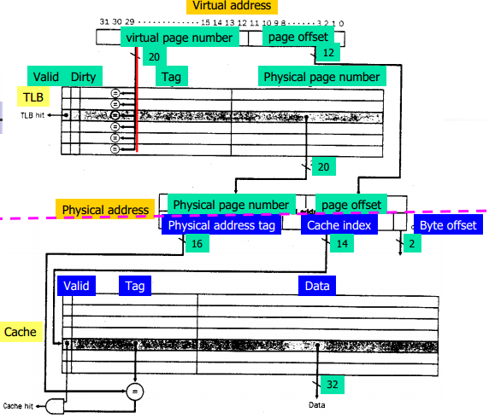
4.4 Virtual Memory
Figure 4.22: The TLB and cache implement the process of going from a virtual address to a data item in the DECStation 3100

Slide 163
4.4 Virtual Memory
Figure 4.22:
TLB hit:
If the TLB generates a hit, the cache can be accessed with the resulting physical address. 当发生TLB命中时,可用得到的物理地址来访问cache
If the operation is a write, the cache entry is overwritten and the data is sent to the write buffer. 若该操作是写,则cache入口被覆写,并将数据送入写缓冲器
For a read, the cache generates a hit or miss and supplies the data or causes a stall while the data is brought from memory. 对于读,cache产生: 命中: 得到数据。缺失: 从存储器取来数据,并导致阻塞。

Slide 164
4.4 Virtual Memory
Figure 4.22:
TLB miss:
When a TLB miss occurs, the MIPS hardware saves the page number in a special register and generates an exception. 当发生TLB缺失时,产生一个异常
The exception invokes the OS, which handles the miss in software. 该异常调用操作系统来处理缺失
To find the physical address for the missing page, the TLB miss routine indexes the page table using the page number of the virtual address and the page table register, which indicates the starting address of the active process page table. 用虚拟地址的页号和页表寄存器索引页表.

Slide 165
4.4 Virtual Memory
Figure 4.22:
TLB miss:
Using a special set of system instructions that can update the TLB, the OS places the physical address from the page table into the TLB. 更新TLB, 即OS将来自页表的物理地址放入TLB
A true page fault occurs if the page table entry does not have a valid physical address. 当页表没有有效的物理地址时, 是真正的页故障
A TLB miss can take as few as 10 cycles, but on average takes 16 cycles. TLB缺失少则需要10个周期,平均需要16个周期
Hardware maintains an index that indicates the recommended entry to replace; the recommended entry is chosen randomly. 替换采用随机策略

Slide 166
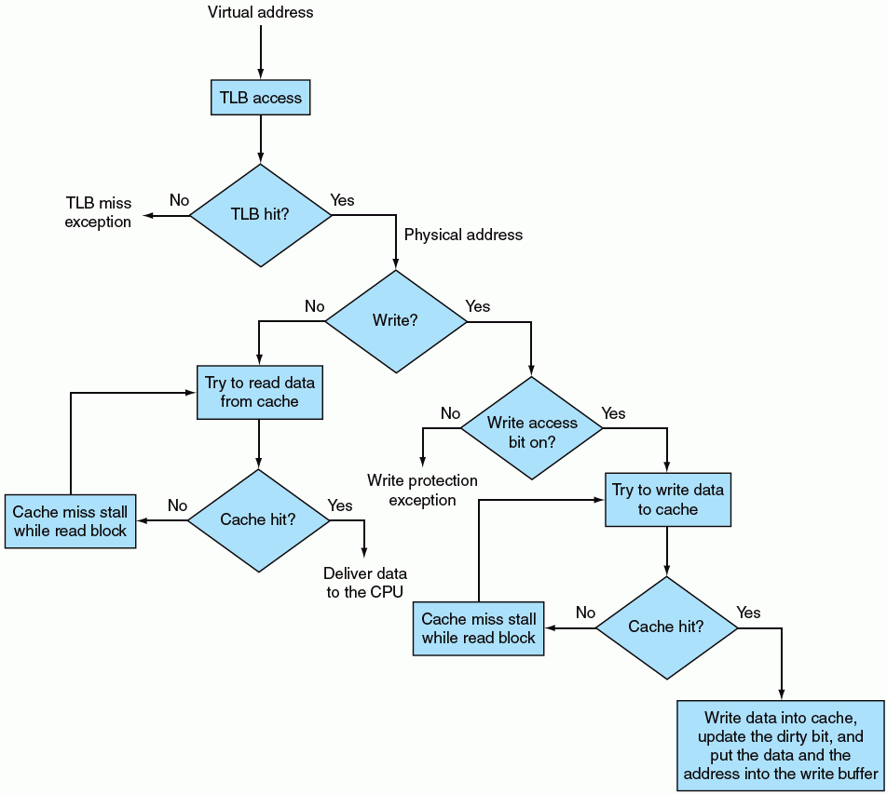
4.4 Virtual Memory

Slide 167
4.4 Virtual Memory
Integrating Virtual Memory, TLBs, and Caches
The best of circumstances: a virtual address is translated by the TLB and sent to the cache where the appropriate data is found, retrieved ,and sent back to the CPU.
The worst case :a reference can miss in all three components of the memory hierarchy: the TLB, the page table, and the cache.

Slide 168
4.4 Virtual Memory
Integrating Virtual Memory, TLBs, and Caches
Example: Overall Operation of Memory Hierarchy
Memory reference can encounter 3 types of misses: cache miss, TLB miss, page fault. 3类缺失: cache缺失, TLB缺失, 页故障
Consider all combinations of these three events with one or more occurring (seven possibilities).
For each possibility, state whether this event can actually occur and under what circumstances.
Figure 4.23 shows the possible circumstances and whether they can arise in practice or not.

Slide 169
4.4 Virtual Memory
Figure 4.23: assume that all memory address are translated to physical address before the cache is accessed.
Cache | TLB | Virtual memory | Possible? if so, under what circumstance?
Miss | Hit | Hit
Hit | Miss | Hit
Miss | Miss | Hit
Miss | Miss | Miss
Miss | Hit | Miss
Hit | Hit | Miss
Hit | Miss | Miss
Possible, although the page table is never really checked if TLB hits.
Possible, TLB misses ,but entry found in page table; after retry, data is found in cache.
Possible, TLB misses, but entry found in page table; after retry, data misses in cache.
Possible, TLB misses and is followed by a page fault; after retry, data must miss in cache
Impossible: cannot have a translation in TLB if page is not present in memory
Impossible: cannot have a translation in TLB if page is not present in memory
Impossible: data cannot be allowed in Cache if the page is not in memory

Slide 170
4.4 Virtual Memory
Implementing Protection with Virtual Memory
用虚拟存储器实现保护
One of the most important functions for virtual memory is to allow sharing of a single main memory by multiple processes, while providing memory protection among these processes and the operating system.
Protection mechanism ensure: one process cannot write into the address space of another process or OS. 保护机制要确保: 一个进程不能写其它进程或OS的地址空间
The write access bit in TLB can protect a page from being written. TLB的写访问位能保护一个页不被写
We also want to prevent one process from reading the data of another process. 也想确保一个进程不能读另一个进程的数据

Slide 171
4.4 Virtual Memory
Each process has its own virtual space. If the page tables is organized so that independent virtual pages map to disjoint physical pages, one process would not access another’s data. 每个进程有其自己虚拟空间.如果页表组织成不相关的虚拟页映射到不连接的物理页,则一个进程就不能访问另一个进程的数据
OS can assure safety if it prevents the user process from modifying its own page tables. 通过避免让用户修改自己的页表,OS可确保安全性
Yet OS must be able to modify page tables. OS能修改页表
Placing page tables in address space of OS satisfies both requirements. 将页表置于OS的地址空间能满足这两个要求

Slide 172
4.4 Virtual Memory
Handling page Faults and TLB Misses
处理页故障和TLB缺失
TLB miss has two possibilities: TLB缺失的两种可能性
The page is present in memory, we need only create the missing TLB entry. 页在存储器中, 我们只需生成缺失的TLB
The page is not in memory, need to transfer control to OS to deal with a page fault. 页不在存储器中, 需要将控制转交给OS来处理这个页故障
How to know which occurred?
When TLB miss, look for a page table entry. 当TLB缺失时,在页表中寻找
If matching page table entry has a valid bit that is turned off, then page fault. 如果匹配入口的valid位off,则是页故障
If valid bit is on, retrieve physical page number from page table entry and create TLB entry. 如果是on,就从相应页表入口找到物理页号并生成TLB

Slide 173
4.4 Virtual Memory
A TLB miss can be handled in software or hardware because it requires only a short sequence of operations to copy a valid page table entry from memory into the TLB. TLB缺失可用软件或硬件处理,因为只需要小段操作将有效的页表入口从内存拷贝到TLB中
Handling page fault requires using exception mechanism to interrupt the active process, transferring control to OS, and later resuming. 处理页故障要用异常机制来中断活动进程,将控制移交给OS,之后再恢复
To restart the instruction after page fault is handled, the PC of the instruction that caused page fault must be saved. Exception program counter (EPC) is used to hold this value. 要在处理完页故障后重新启动指令,就必须保存导致页故障指令的PC,异常程序计数器(EPC)就用来保存此值

Slide 174
4.4 Virtual Memory
Once OS knows the virtual address that caused the page fault, it must complete 3 steps:
Step1: Look up page table entry using virtual address and find location of the referenced page on disk. 用虚拟地址找到页表入口,并在磁盘上找到被引用页的地址
Step2: Choose a physical page to replace; if chosen page is dirty, it must be written out to disk before we bring a new virtual page into the physical page. 选择要替换的物理页.如果选择的页脏,就必须先写回磁盘.
Step3: Start a read to bring the referenced page from disk into the chosen physical page. 将该页从磁盘读到选择的物理页中
The last step will take millions of clock cycle; so OS will usually select another process to execute until disk access completes. 最后一个步骤需要数百万个周期, 所以OS通常选择另一个进程执行直至磁盘访问完成.

Slide 175
4.4 Virtual Memory
When read from disk is complete, OS restore state of process that caused page fault and execute instruction that returns from exception. 从磁盘读完后,OS恢复导致页故障进程的状态,执行从异常返回的指令.
The user process then re-executes the instruction that faulted, accesses the requested page successfully, and continues execution. 用户进程重新执行故障的指令, 成功地访问所需的页, 并继续执行.

Slide 176
4.5 A Common Framework for Memory Hierarchies
We will discuss the common operational aspects of memory hierarchies and how these determine their behavior.
We will examine these policies as a series of four questions that apply between any two levels of a memory hierarchy.
Where can a block be placed?
How is a block found?
Which block should be replaced on a cache miss?
What happens on a write?

Slide 177
4.5 A Common Framework for Memory Hierarchies
Where Can a Block Be Placed?
Block placement in the upper level of the hierarchy can use a range of schemes, from direct mapped to set associative to fully associative. 一系列的方案: 从直接映像,到组相联,到全相联
is variations on a set-associative: the number of sets and the number of blocks per set varies. 都是组相联的变形: 组数和每组内块数变化
Scheme name | Number of sets | Blocks per set
Direct mapped | Number of blocks in cache | 1
Set associative | Number of blocks in cache associativity | Associativity (typically 2-8)
Fully associative | 1 | Number of blocks in the cache

Slide 178
4.5 A Common Framework for Memory Hierarchies
Where Can a Block Be Placed?
The advantage of increasing the degree of associativity is that it usually decrease the miss rate.提高相联性的优势是通常降低缺失率
miss rate improvement comes from reducing misses that compete for the same location.缺失率的改进来自于对同一位置竞争引起的缺失降低

Slide 179
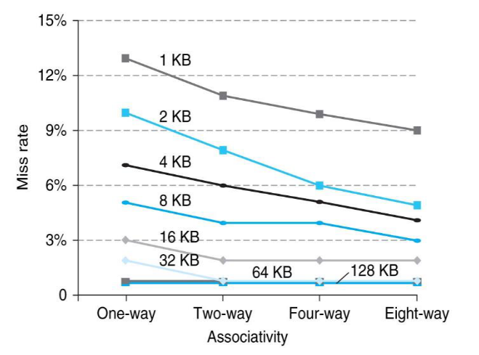
4.5 A Common Framework for Memory Hierarchies
Where Can a Block Be Placed?
As cache sizes grow, improvement from associativity is constant or increases slightly; 随着cache大小增加,来自相联性的改进是恒定的或者略微增加
The potential disadvantages of associativity are increased cost and slower access time.相联性的潜在劣势是成本增加和访问时间变慢

Slide 180
4.5 A Common Framework for Memory Hierarchies
How Is a Block Found?
Choice of how we locate a block depends on the block placement scheme.
Associativity | Location method | Comparisons required
Direct mapped | index | 1
Set associative | Index the set, search among elements | Degree of associativity
Full | Search all cache entries | Size of the cache
 | Separate lookup table | 0

Slide 181
4.5 A Common Framework for Memory Hierarchies
Virtual memory systems always use fully associative placement.
The choice of full associativity and the extra table is motivated by four facts:
Full associativity is beneficial, since misses are very expensive. 缺失处理非常昂贵
Full associativity allows software to use sophisticated replacement schemes that are designed to reduce the miss rate. 能实现复杂的替换方案
The full map can be easily indexed with no extra hardware and no searching required. 索引,无需硬件和搜索
The large page size means the page table size overhead is relatively small. 由于页很大,页表大小开销相对小

Slide 182
4.5 A Common Framework for Memory Hierarchies
Caches and TLBs: often use Set-associative, where access combines indexing and search of a small set. 通常采用组相联：结合了索引和搜索(在一小组内)的技术
Many recent systems used direct-mapped, for its advantage in access time and simplicity.最近的系统采用直接映像, 因其在访问时间和简单性上的优势
design choices depend on many details of the implementing. 设计决策取决于实现的细节

Slide 183
4.5 A Common Framework for Memory Hierarchies
Which Block Should be Replace
on a Cache Miss?
Miss occurs, decide which block to replace.
In fully associative, all blocks are candidates. 对于全相联,所有块都是候选者
For set associative, choose among blocks in set.对于组相联,在一个组中选择块
Direct-mapped, only one candidate. 直接映像,只有一个候选者

Slide 184
4.5 A Common Framework for Memory Hierarchies
Which Block Should be Replace
on a Cache Miss?
The two primary strategies for replacement in set-associative or fully associative caches:
Random (随机) :Candidate blocks are randomly selected, possibly using some hardware assistance
Least recently used(LRU): The block replaced is the one that has been unused for the longest time
In practice, LRU is too costly to implement for hierarchies with more than a small degree of associativity (two to four, typically), since tracking the information is costly

Slide 185
4.5 A Common Framework for Memory Hierarchies
Which Block Should be Replace
on a Cache Miss?
LRU is too costly to implement for hierarchies with more degree of associativity (2-4, typically), since tracking information is costly. 对于高相联性,LRU实现成本高,因为跟踪信息成本高
Even for 4-way set associativity, LRU is often approximated. 即使对4-路组相联,LRU也经常近似实现
For larger associativity, LRU is either approximated or random replacement is used. 对于更大相联性,或者采用近似LRU,或者采用随机替换
In caches, the replacement algorithm is in hardware, which means the scheme should be easy to implement. cache的替换算法在硬件中,意味着方案应易于实现

Slide 186
4.5 A Common Framework for Memory Hierarchies
Which Block Should be Replace
on a Cache Miss?
Random replacement is simple to build in hardware. 随机替换的硬件实现简单
As caches become larger, miss rate for both replacement strategies falls, and the absolute difference becomes small. 随着Cache增大,两种替换策略的缺失率都下降,则绝对差异变小
In fact, random replacement is sometimes better than simple LRU approximations that can be easily implemented in hardware. 事实上, 随机替换有时比简单的近似LRU还好
In virtual memory, LRU is always approximated as a tiny reduction in the miss rate can be important when the cost of a miss is great.

Slide 187
4.5 A Common Framework for Memory Hierarchies
What Happens On a Write?
Write-through: The information is written to both the block in the cache and to the block in the lower level of the memory hierarchy(main memory for a cache).
Write-back (also called copy back):the information is written only to the block in the cache. The modified block is written to the lower level of the hierarchy only when it is replaced.
Both write-back and write-through have their advantages.

Slide 188
4.5 A Common Framework for Memory Hierarchies
The key advantages of write-back are the following:
Individual words can be written by the processor at the rate that the cache, rather than the memory, can accept them
Multiple writes within a block require only one write to the lower level in the hierarchy
When blocks are written back, the system can make effective use of a high bandwidth transfer, since the entire block is written
Write-through has these advantages:
Misses are simpler and cheaper because they never require a block to be written back to the lower level
Write-through is easier to implement than write-back, although to be practical in a high-speed system, a write-through cache will need to use a write buffer

Slide 189
4.5 A Common Framework for Memory Hierarchies
In virtual memory, only write-back is practical because of the long latency of a write to disk. 在虚拟存储器中, 只有回写是现实的, 因为向磁盘写所用时间长
As CPUs continue to increase in performance at a faster rate than main memory, the rate at which writes are generated by processor will exceed the rate at which the memory system can process them. 当CPU性能持续增加时, 处理器产生写的速率超过了存储系统能处理的速度
As a consequence, more and more caches are using or will use a write-back strategy. 因此,cache也越来越多地用写回

Slide 190
4.5 A Common Framework for Memory Hierarchies
Three Cs: An Intuitive Model for
Understanding the Behavior of Memory Hierarchies
All misses are classified into one of three categories:
Compulsory misses: these are cache misses caused by the first access to a block that has never been in the cache. These are also called cold-start misses.
Capacity misses: these are cache misses caused when the cache cannot contain all the blocks needed during execution of a program. Capacity misses occur because of blocks being replaced and later retrieved when accessed.
Conflict misses: These are cache misses that occur in set-associative or direct-mapped caches when multiple block compete for the same set. These cache misses are also called collision misses.

Slide 191
4.5 A Common Framework for Memory Hierarchies
Three Cs: An Intuitive Model for
Understanding the Behavior of Memory Hierarchies
These miss sources can be directly attacked by changing some aspect of cache design.
Conflict misses:
Since conflict misses arise from contention, increasing associativity can reduces them. 由于冲突缺失由竞争引起,可通过增加相联性来降低
However, this may slow access time, leading to lower overall performance. 但这种方法减慢了访问时间, 导致整体性能降低

Slide 192
4.5 A Common Framework for Memory Hierarchies
Three Cs: An Intuitive Model for
Understanding the Behavior of Memory Hierarchies
Capacity misses:
Capacity misses can easily be reduced by enlarging the cache. 可通过加大cache来降低
But also increase access time, leading to lower performance. 但也加大了访问时间
Compulsory misses:
generated by first reference to a block, so primary way to reduce it is to increase block size. 主要方法是增大块尺寸
It will reduce number of references required to access blocks because the program will consist of fewer cache blocks. 这将降低访问次数, 因为模块数少了
but, can have negative effect on performance because of increase in miss penalty. 但是, 但对性能有负面作用, 因为缺失惩罚增加了

Slide 193
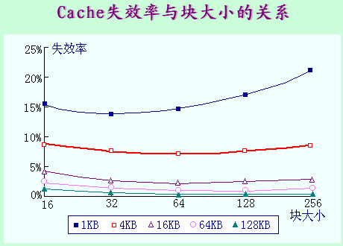
4.5 A Common Framework for Memory Hierarchies
Three Cs: An Intuitive Model for
Understanding the Behavior of Memory Hierarchies

Slide 194
4.5 A Common Framework for Memory Hierarchies
Three Cs: An Intuitive Model for
Understanding the Behavior of Memory Hierarchies
实际情况:
many of design choices interact, changing one characteristic will often affect several components of miss rate. 很多设计选择相互作用,改变一个特性通常影响缺失的若干个因素
challenge in designing memory hierarchies is that every change that potentially improves the miss rate can also negatively affect overall performance, as Figure 4.31 summarizes. 挑战: 每个能潜在地改进缺失率的改变, 也对整体性能有负面影响

Slide 195
4.5 A Common Framework for Memory Hierarchies
Design change | Effect on miss rate | Possible negative performance effect
Increase cache size | Decreases capacity misses | May increase access time
Increase associativity | Decrease miss rate due to conflict misses | May increase access time
Increase block size | Decreases miss rate for a wide range of block sizes | May increase miss penalty. Very large block could increase miss rate.

Slide 196
4.2 Consider a virtual memory system with the following properties:
40-bit virtual byte address
16-KB pages
36-bit physical byte address
(1) what is the total size of the page table for each process on this machine, assuming that the valid, protection, dirty, and use bits take a total of 4bits and that all the virtual pages are in use? (Assume that disk addresses are not stored in the page table)
(2) Assume that the virtual memory system is implemented with a two-way set-associative TLB with a total of 256 TLB entries. Show the virtual-to-physical mapping with a figure. Make sure to label the width of all fields and signals.

Slide 197
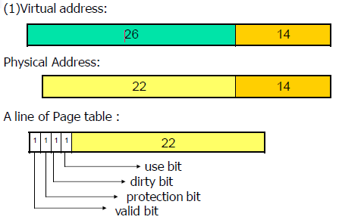
4.2 Consider a virtual memory system with the following properties:
40-bit virtual byte address
16-KB pages
36-bit physical byte address
(1) what is the total size of the page table for each process on this machine, assuming that the valid, protection, dirty, and use bits take a total of 4bits and that all the virtual pages are in use? (Assume that disk addresses are not stored in the page table)
So, the total size of the page table for each process on this machine is:
2⁽⁴⁰⁻¹⁴⁾ ×(4+(36-14))bit=2²⁶×26bit=208M(Byte)

Slide 198
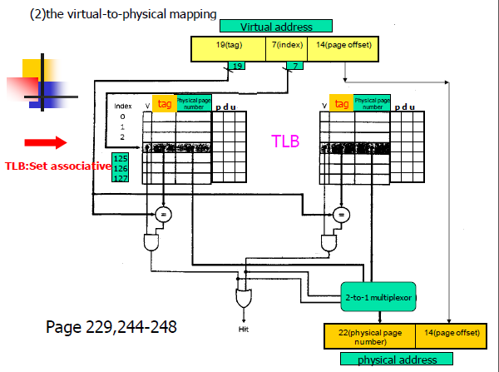
4.2 Consider a virtual memory system with the following properties:
40-bit virtual byte address
16-KB pages
36-bit physical byte address
(2) Assume that the virtual memory system is implemented with a two-way set-associative TLB with a total of 256 TLB entries. Show the virtual-to-physical mapping with a figure. Make sure to label the width of all fields and signals.

