Slide 1
Homework:
1.1 Three enhancements with the following speedups are proposed for a new architecture :
Speedup1=30 Speedup2=20 Speedup3=15
Only one enhancement is usable at a time.
A. If enhancements 1 and 2 are each usable for 25% of the time, what fraction of the time must enhancement 3 be used to achieve an overall speedup of 10? 增强1和增强2各占25%, 增强3占多大才能使总体加速比为10？（多部分注意是相加）
B. Assume the enhancements can be used 25%, 35% and 10% of the time for enhancements 1,2,and 3,respectively. For what fraction of the reduced execution time is no enhancement in use? 假设增强1, 增强2, 增强3分别占25%、35%、10%，没改进的时间占改进后总时间的百分比？
C. Assume, for some benchmark, the possible fraction of use is 15% for each of enhancements 1 and 2 and 70% for enhancement 3. We want to maximize performance. If only one enhancement can be implemented, which should it be ? If two enhancements can be implemented, which should be chosen? 可能的三种增强分别占15%,15%,70%，如果只要一种增强, 应该用哪种? 如果要用两种增强, 应该用哪两种？

Slide 2
Answer:
(1) Assume: the fraction of the time enhancement 3 must be used to achieve an overall speedup of 10 is x. 设增强3这个未知变量为x
So , x=45%

Slide 3
(2) Assume:The total execution time before the three enhancements can be used is Time_{before}（没有改进前的总运行时间），The execution time for no enhancement is Time_{no}（没有改进部分的时间）.
Time_{no} =（1-25%-35%-10%）× Time_{before}
The total execution time after the three enhancements can be used is Time_{after}（改进后的总运行时间）
Time_{after}= Time_{no}+（25%/30）×Time_{before}
+ （35%/20）×Time_{before}
+ （10%/15）×Time_{before}
So，
Time_{no}/ Time_{after}=90.2%（没改进的时间占改进后总时间的百分比）

Slide 4
(3)By
If only one enhancement can be implemented：
So, we must select enhancement 3 to maximize performance.

Slide 5
By
If two enhancements can be implemented ：
So，we must select enhancement 1 and 3 to maximize performance.

Slide 6
1.2 Suppose there is a graphics operation that accounts for 10% of execution time in an application, and by adding special hardware we can speed this up by a factor of 18. In further, we could use twice as much hardware, and make the graphics operation run 36 times faster. Give the reason of whether it is worth exploring such an further architectural change?

Slide 7
Answer:
So，It is not worth exploring such an further architectural change. 不值得

Slide 8
1.3 In many practical applications that demand a real-time response, the computational workload W is often fixed. As the number of processors increases in a parallel computer, the fixed workload is distributed to more processors for parallel execution. Assume 20 percent of W must be executed sequentially, and 80 percent can be executed by 4 nodes simultaneously. What is a fixed-load speedup?

Slide 9
Answer:
So，a fixed-load speedup is 2.5.

Slide 10
Homework
2.1 There is a model machine with nine instructions, which frequencies are ADD(0.3), SUB(0.24), JOM(0.06), STO(0.07), JMP(0.07), SHR(0.02), CIL(0.03), CLA(0.2), STP(0.01), respectively. There are several GPRs in the machine. Memory is byte addressable, with accessed addresses aligned. And the memory word width is 16 bit. Suppose the nine instructions with the characteristics as following : 9条指令的特点
Two operands instructions 两个操作数
Two kinds of instruction length 两种指令长度
Extended coding 扩展编码
Shorter instruction operands format:R(register)-R(register)
Longer instruction operands format:R(register)-M(memory)
短指令操作数格式:R-R，长指令操作数格式:R-M
With displacement memory addressing mode 位移寻址模式

Slide 11
A. Encode the nine instructions with Huffman-coding, and give the average code length.
B. Designed the practical instruction codes, and give the average code length.
C. Write the two instruction word formats in detail.
D. What is the maximum offset for accessing memory address?

Slide 12
ANSWER
（A）Huffman tree
1.00
0
1
0.56
0.44
0
1
0
1
0.26
1
0.30
0.20
0.24
0
ADD
CLA
SUB
0.12
0.14
0
1
0
1
0.06
0.06
0.07
0.07
0
1
JOM
JMP
STO
0.03
0.03
0
1
CIL
0.01
0.02
STP
SHR

Slide 13
Huffman coding by Huffman tree
ADD 30% 01
SUB 24% 11
CLA 20% 10
JOM 6% 0001
STO 7% 0011
JMP 7% 0010
SHR 2% 000001
CIL 3% 00001
STP 1% 000000
So，the average code length is

Slide 14
（B）Two kinds of instruction length extended coding
ADD 30% 01
SUB 24% 11
CLA 20% 10
JOM 6% 11000
STO 7% 11001
JMP 7% 11010
SHR 2% 11011
CIL 3% 11100
STP 1% 11101
So， the average code length is

Slide 15
（C）
Shorter instruction format☹（不太懂）
Longer instruction format:
（D）The maximum offset for accessing memory address is 32 bytes.
Opcode 2bits | Register 3bits | Register 3bits
opcode 5bits | Register 3bits | Register 3bits | offset 5bits
Notes:
（-16到15个字节）

Slide 16
Homework
3.1 Identify all of the data dependences in the following code .Which dependences are data hazards that will be resolved via forwarding? 在下面的代码中辨别出所有的数据相关. 哪些相关是用前送解决的数据冒险?
ADD R2,R5,R4
ADD R4,R2,R5
SW R5,100(R2)
ADD R3,R2,R4

Slide 17
Answer:
ADD R2,R5,R4
ADD R4,R2,R5
SW R5,100(R2)
ADD R3,R2,R4

Slide 18
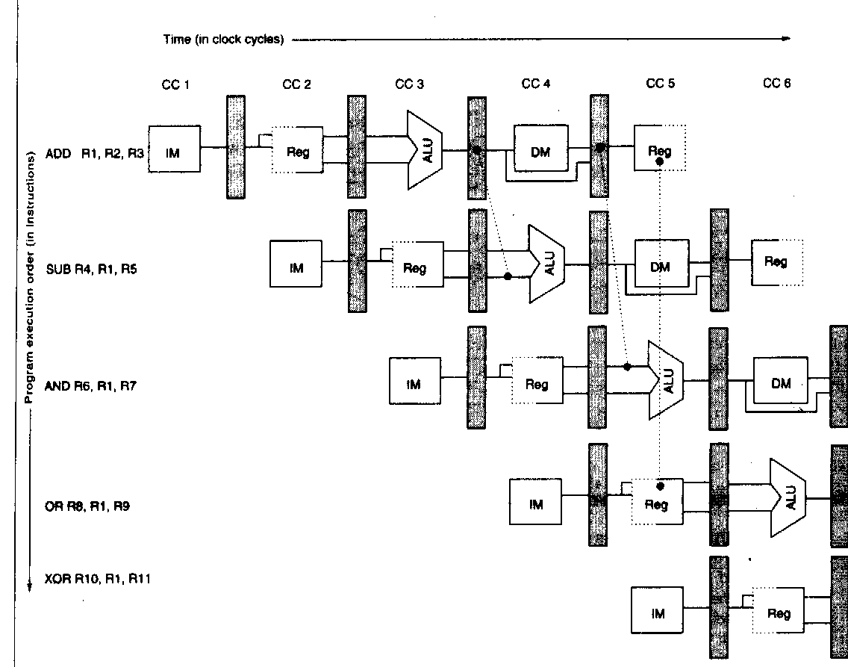
ADD R2,R5,R4
ADD R4,R2,R5
SW R5,100(R2)
ADD R3,R2,R4
Page84 Figure 3.10

Slide 19
3.2 How could we modify the following code to make use of a delayed branch slot?
如何修改下面代码,来利用一个延迟槽？
Loop: LW R2,100(R3)
ADDI R3,R3,#4
BEQ R3,R4,Loop

Slide 20
Answer:
LW R2,100(R3)
Loop: ADDI R3,R3,#4
BEQ R3,R4,Loop
Delayed branch slot
LW R2,100(R3)

Slide 21
3.4 Using the following code fragment:
Loop: LW R1, 0(R2); load R1 from address 0+R2
ADDI R1, R1, #1; R1=R1+1
SW 0(R2), R1; store R1 at address 0+R2
ADDI R2, R2, #4; R2=R2+4
SUB R4, R3, R2; R4=R3-R2
BNEZ R4, Loop; Branch to loop if R4!=0
Assume that the initial value of R3 is R2+396.
Throughout this exercise use the classic RISC five-stage integer pipeline and assume all memory access take 1 clock cycle.

Slide 22
A.
Show the timing of this instruction sequence for the RISC pipeline without any forwarding or bypassing hardware but assuming a register read and a write in the same clock cycle “forwards” through the register file. Assume that the branch is handled by flushing the pipeline. If all memory references take 1 cycle, how many cycles does this loop take to execute?

Slide 23
B.
Show the timing of this instruction sequence for the RISC pipeline with normal forwarding and bypassing hardware. Assume that the branch is handled by predicting it as not taken. If all memory reference take 1 cycle, how many cycles does this loop take to execute?
显示出带有正常的前送和旁路情况下的时序情况。假设对分支的预测是不转移。如果存储访问需要一个周期，这个循环需要多少个周期完成？

Slide 24
C.
Assume the RISC pipeline with a single-cycle delayed branch and normal forwarding and bypassing hardware. Schedule the instructions in the loop including the branch delay slot. You may reorder instructions and modify the individual instruction operands, but do not undertake other loop transformations that change the number or opcode of the instructions in the loop. Show a pipeline timing diagram and compute the number of cycles needed to execute the entire loop.
假设RISC流水线有单周期的分支延迟和正常的前送和旁路. 对包括延迟槽的循环中的指令进行调度. 你可以重排指令和修改指令的操作数, 但不能做其它改变如改变指令数量和操作码. 显示出流水线时序图并计算执行这个循环所需的周期数。

Slide 25
Answer:
A.
The loop iterates 396/4=99 times. 循环99次
Go through one complete iteration of the loop and the first instruction in the next iteration. 看一下一个迭代直到下一次迭代第一条语句的情况
Total length=the length of iterations 0 through 97(The first 98 iterations should be of the same length) +the length of the last iteration. 总长度=前98次长度+最后一次的长度
We have assumed the version of DLX described in Figure 3.21(Page 97) in the book,which resolves branches in MEM.
标准流水线(书97页图), 在MEM阶段才能解决转移问题
From this Figure, the second iteration begin 17 clocks after the first iteration and the last iteration takes 18 cycles to complete. 在图中, 第二次迭代开始于第一次迭代的17周期之后, 最后一次迭代需要18个周期
Total length=17×98+18=1684 clock cycles 共需1684个周期

Slide 26
For A
Instruction | Clock cycle
 | 1 | 2 | 3 | 4 | 5 | 6 | 7 | 8 | 9 | 10 | 11 | 12 | 13 | 14 | 15 | 16 | 17 | 18 | 19 | 20 | 21 | 22
LW R1,0(R2) | IF | ID | EX | ME | WB
ADDI R1,R1,#1 |  | IF | St | St | ID | EX | ME | WB
SW 0(R2),R1 |  |  | St | St | IF | St | St | ID | EX | ME | WB
ADDI R2,R2,#4 |  |  |  |  |  | St | St | IF | ID | EX | ME | WB |  | 为什么 | 不用 | stall
SUB R4,R3,R2 |  |  |  |  |  |  |  |  | IF | St | St | ID | EX | ME | WB
BNEZ R4,Loop |  |  |  |  |  |  |  |  |  | St | St | IF | St | St | ID | EX | ME | WB
LW R1,0(R2) |  |  |  |  |  |  |  |  |  |  |  |  | St | St | IF | St | St | IF | ID | EX | ME | WB
Figure 3.21(Page 97) in the book
Three clock cycles

Slide 27
B.
From this Figure, the second iteration begin 10 clocks after the first iteration and the last iteration takes 11 cycles to complete. 从图中看到，第二次迭代开始于第一次迭代的10周期后，而最后一次迭代需要11个周期。
Total length=10×98+11=991 clock cycles
总共需要991个周期。

Slide 28
Instruction | Clock cycle
 | 1 | 2 | 3 | 4 | 5 | 6 | 7 | 8 | 9 | 10 | 11 | 12 | 13 | 14 | 15 | 16 | 17 | 18 | 19 | 20 | 21 | 22
LW R1,0(R2) | IF | ID | EX | ME | WB
ADDI R1,R1,#1 |  | IF | ID | St | EX | ME | WB
SW 0(R2),R1 |  |  | IF | St | ID | EX | ME | WB
ADDI R2,R2,#4 |  |  |  | St | IF | ID | EX | ME | WB
SUB R4,R3,R2 |  |  |  |  |  | IF | ID | EX | ME | WB
BNEZ R4,Loop |  |  |  |  |  |  | IF | ID | EX | ME | WB
Next instruction1 |  |  |  |  |  |  |  | IF | ID | EX | ME | WB
Next instruction2 |  |  |  |  |  |  |  |  | IF | ID | EX | ME | WB
Next instruction3 |  |  |  |  |  |  |  |  |  | IF | ID | EX | ME | WB
LW R1,0(R2) |  |  |  |  |  |  |  |  |  |  | IF | ID | EX | ME | WB
For B
Figure 3.21(Page 97) in the book

Slide 29
C.
Loop: LW R1,0(R2); load R1 from address 0+R2
ADDI R1,R1,#1; R1=R1+1
SW 0(R2),R1; store R1 at address 0+R2
ADDI R2,R2,#4; R2=R2+4
SUB R4,R3,R2; R4=R3-R2
BNEZ R4,Loop; Branch to loop if R4!=0
Reorder instructions to :
Loop: LW R1,0(R2); load R1 from address 0+R2
ADDI R2,R2,#4; R2=R2+4
SUB R4,R3,R2; R4=R3-R2
ADDI R1,R1,#1; R1=R1+1
BNEZ R4,Loop; Branch to loop if R4!=0
SW -4(R2),R1; store R1 at address 0+R2
From Figure the second iteration begin 6 clocks after the first iteration and the last iteration takes 10 cycles to complete.
从图中看出, 第二次迭代开始于第一次迭代的第6个周期后, 最后一次迭代需要10个周期完成。
Total length=6×98+10=598 clock cycles 总共需要598个周期
Notes:
Loop: LW R1,0(R2); load R1 from address 0+R2
ADDI R2,R2,#4; R2=R2+4
ADDI R1,R1,#1; R1=R1+1
SUB R4,R3,R2; R4=R3-R2
BNEZ R4,Loop; Branch to loop if R4!=0
SW -4(R2),R1; store R1 at address 0+R2

Slide 30
Loop: LW R1, 0(R2); load R1 from address 0+R2
stall
ADDI R1, R1, #1; R1=R1+1
SW 0(R2), R1; store R1 at address 0+R2
ADDI R2, R2, #4; R2=R2+4
SUB R4, R3, R2; R4=R3-R2
stall
BNEZ R4, Loop; Branch to loop if R4 != 0
stall

Slide 31
Loop: LW R1, 0(R2); load R1 from address 0+R2
(stall) ADDI R2, R2, #4; R2=R2+4
ADDI R1, R1, #1; R1=R1+1
SW -4(R2), R1; store R1 at address 0+R2
SUB R4, R3, R2; R4=R3-R2
stall
BNEZ R4, Loop; Branch to loop if R4!=0
stall

Slide 32
Loop: LW R1, 0(R2); load R1 from address 0+R2
(stall) ADDI R2, R2, #4; R2=R2+4
SUB R4, R3, R2; R4=R3-R2
(stall) ADDI R1, R1, #1; R1=R1+1
BNEZ R4, Loop; Branch to loop if R4!=0
(stall) SW -4(R2), R1; store R1 at address 0+R2

Slide 33
For C
Instruction | Clock cycle
 | 1 | 2 | 3 | 4 | 5 | 6 | 7 | 8 | 9 | 10 | 11 | 12 | 13 | 14 | 15 | 16 | 17 | 18 | 19 | 20 | 21 | 22
LW R1,0(R2) | IF | ID | EX | ME | WB
ADDI R2,R2,#4 |  | IF | ID | EX | ME | WB
SUB R4,R3,R2 |  |  | IF | ID | EX | ME | WB
ADDI R1,R1,#1 |  |  |  | IF | ID | EX | ME | WB
BNEZ R4,Loop |  |  |  |  | IF | ID | EX | ME | WB
SW -4(R2),R1 |  |  |  |  |  | IF | ID | EX | ME | WB
LW R1,0(R2) |  |  |  |  |  |  | IF | ID | EX | ME | WB
Figure 3.22(Page 98) in the book

Slide 34
ADDI R1,R0,#400
Loop: LW R2, 0(R1); load R1 from address 0+R2
stall
ADDI R4, R2, #30; R1=R1+1
SW 0(R1), R4; store R1 at address 0+R2
SUBI R1, R1, #4; R2=R2+4
stall
BNEZ R1, Loop; Branch to loop if R4 != 0
stall

Slide 35
ADDI R1,R0,#400
Loop: LW R2, 0(R1); load R1 from address 0+R2
stall SUBI R1, R1, #4
ADDI R4, R2, #30; R1=R1+1
SW +4(R1), R4; store R1 at address 0+R2
BNEZ R1, Loop; Branch to loop if R4 != 0
stall

Slide 36
Homework
4.1 The following C program is run (with no optimizations) on a machine with a cache that has four-word(16-byte)blocks and holds 256 bytes of data:
int i, j, c, stride, array[256];
…
for (i=0; i<10000; i++)
for (j=0; j<256; j=j+stride)
c=array[j]+5;
if we consider only the cache activity generated by references to the array and we assume that integers are words, what is the expected miss rate when the cache is direct-mapped and stride=132? How about if stride=131? Would either of these change if the cache were two-way set associative?

Slide 37
Page 201、211
Answer:
If stride=132 and the cache is direct-mapped
如果stride=132且cache是直接映像的
The number of blocks in the cache is 256/16=16 cache中的块数=16
For array[0]: 对于array[0]
* The block number = 0/4 =0 块号=0
* it maps to cache number = 0 mod16 = 0, tag=0/16=0 映射到cache的入口号=0
For array[132]: 对于array[132]
* The block number = 132/4 =33 块号=33
* it maps to cache number : 33 mod 16=1, tag=33/16=2 映射到cache的入口号=1
So, 2 compulsory misses on the first iteration of i, and 9999*2 hits thereafter, and the miss rate =2/(2×10000)=1/10000 所以, i的头一个迭代是两次强迫缺失, 然后是9999×2次的命中,所以缺失率是1/10000.

Slide 38
If stride=131 and the cache is direct-mapped
The block number of the cache is 256/16=16
For array[0]:
* The block number = 0/4 =0
* It maps to cache number = 0 mod16= 0, tag=0/16=0
For array[131]:
* The block number = 131/4 = 32
* It maps to cache number = 32 mode 16 =0, tag=32/16=2
So, 1 compulsory miss and 1 conflict miss on the first iteration, and 2 conflict misses on every following iterations, and the miss rate=1.
Page 201、211

Slide 39
If stride=132 and the cache is two-way set associative
The block number of the cache is 256/16=16
The number of sets is: 16/2=8
Each set contains 2 blocks
For array[0]:
* The block number = 0/4 =0
* It maps to set number = 0 mod 8 =0, Tag=0/8=0
* It can be placed in block 0 of set 0.
For array[132]:
* The block number = 132/4 =33
* It maps to set number = 33 mod 8 = 1, tag=33/8=4
* It can be placed in block 0 of set 1
So, The block address of array[132] = 132×4/16 =33
So, 2 compulsory misses on the first iteration of i, and 9999*2 hits thereafter, and the miss rate =2/(2×10000)=1/10000
Page 224-227、211

Slide 40
If stride=131 and the cache is two-way set associative
The block number of the cache is 256/16=16
The number of sets is: 16/2=8
Each contains 2 blocks
For array[0]:
* The block number = 0/4 =0
* It maps to set number = 0 mod 8 =0, Tag=0/8=0
* It can be placed in block 0 of set 0.
For array[131]:
* The block number = 131/4 = 32
* It maps to set number = 32 mod 8, Tag=32/8=4
* It can be placed in bock 1 of set 0
So, 2 compulsory misses on the first iteration of i, and 9999*2 hits thereafter, and the miss rate =2/(2×10000)=1/10000
Page 224-227、211

Slide 41
4.2 Consider a virtual memory system with the following properties: 一个虚拟存储系统有如下特性
40-bit virtual byte address 40位虚拟字节地址
16-KB pages 16KB页大小
36-bit physical byte address 36位物理字节地址
(1)what is the total size of the page table for each process on this machine, assuming that the valid, protection, dirty, and use bits take a total of 4 bits and that all the virtual pages are in use?(Assume that disk addresses are not stored in the page table) 求页表大小(用4个其他bit, 假设不存储磁盘地址)
(2) Assume that the virtual memory system is implemented with a two-way set-associative TLB with a total of 256 TLB entries. Show the virtual-to-physical mapping with a figure. Make sure to label the width of all fields and signals. 假设虚拟存储系统用2-路组相联TLB实现,这个有256个TLB入口.画出虚-实映射图.

Slide 42
Answer:
(1)Virtual address:
Physical Address:
A line of Page table :
26 | 14
22 | 14
1 | 1 | 1 | 1 | 22
use bit
dirty bit
protection bit
valid bit

Slide 43
So,the total size of the page table for each process on this machine is:
2⁽⁴⁰⁻¹⁴⁾ × (4+(36-14))bit=2²⁶×26bit=208M(Byte)

Slide 44
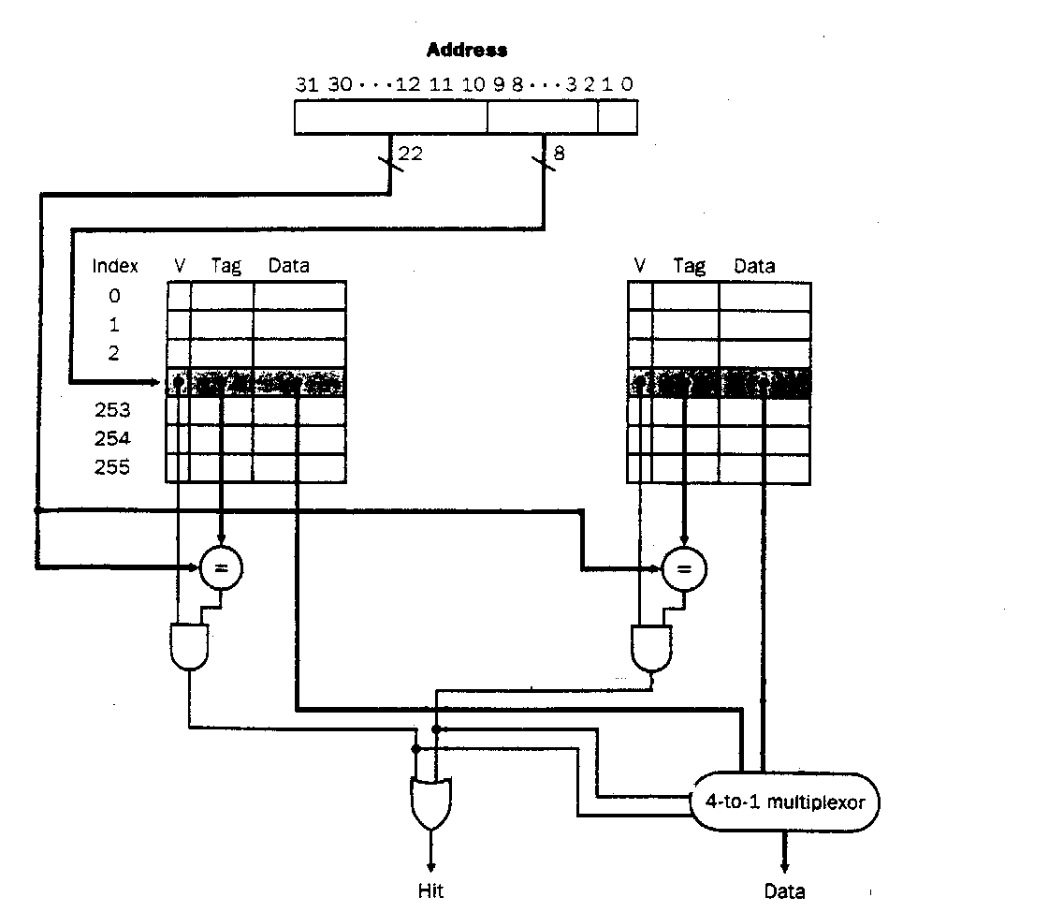
(2)the virtual-to-physical mapping
Virtual address
19(tag) | 7(index) | 14(page offset)
19
7
tag
Physical page
number
p d u
tag
Physical page
number
p d u
TLB
TLB:Set associative
125
126
127
2-to-1 multiplexor
Page 229,244-248
22(physical page number) | 14(page offset)
physical address
Notes:
为什么是128？

