Slide 1
3-parameter SHAM model vs 2-parameter model
Jiaxi Yu
24.08.2020

Slide 2
Comparison: Vpeak from the halo catalogue
No smearing (master thesis):
Vpeak scattering (sigma) and largest-end truncation (Vcut)
Select the N-th largest value
SHAM 2PCF calculation
Vz smearing (3-parameter model):
Vpeak scattering (sigma) and largest-end truncation (Vceil)
Select the N-th largest value
Gaussian smearing Vz (Vsmear) for the selected halos
SHAM 2PCF calculation

Slide 3
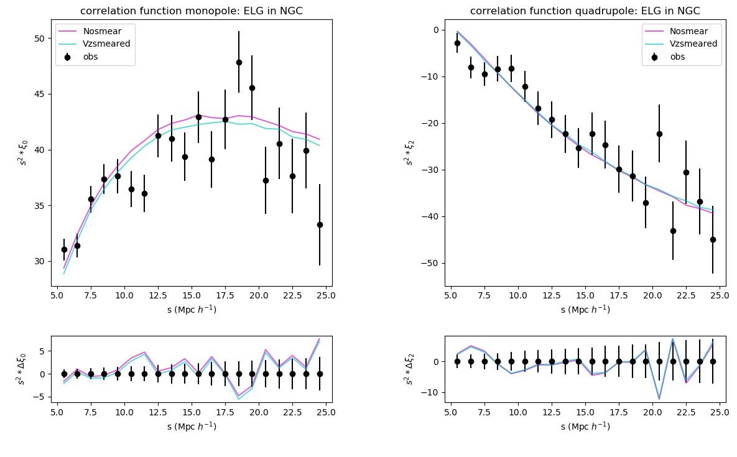
ELG NGC 2PCF
σ | Vceil (km/s) | V_{smear} (km/s) | χ² | Reduced χ²
 |  | -

Slide 4
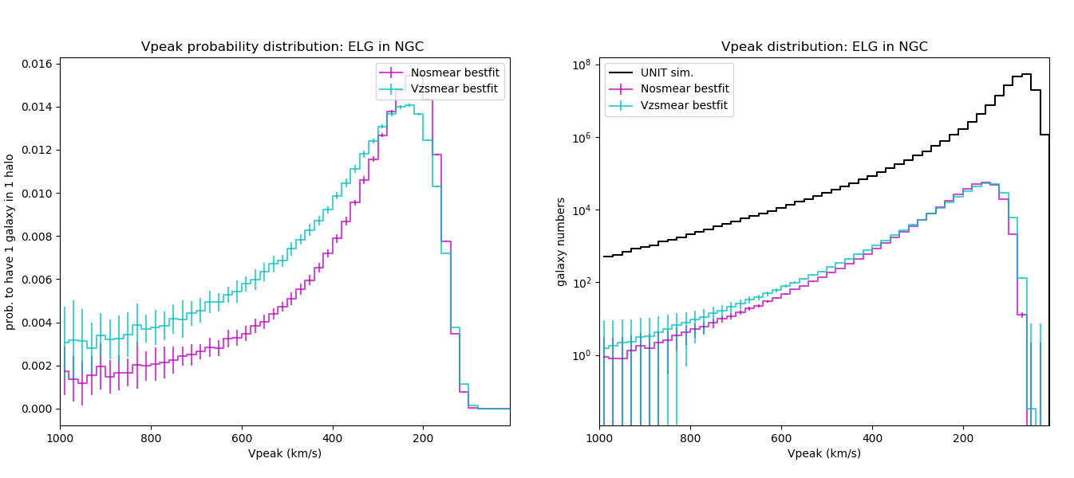
ELG NGC Prob. Distri. Func.
σ | Vceil (km/s) | V_{smear} (km/s) | χ² | Reduced χ²
 |  | -

Slide 5
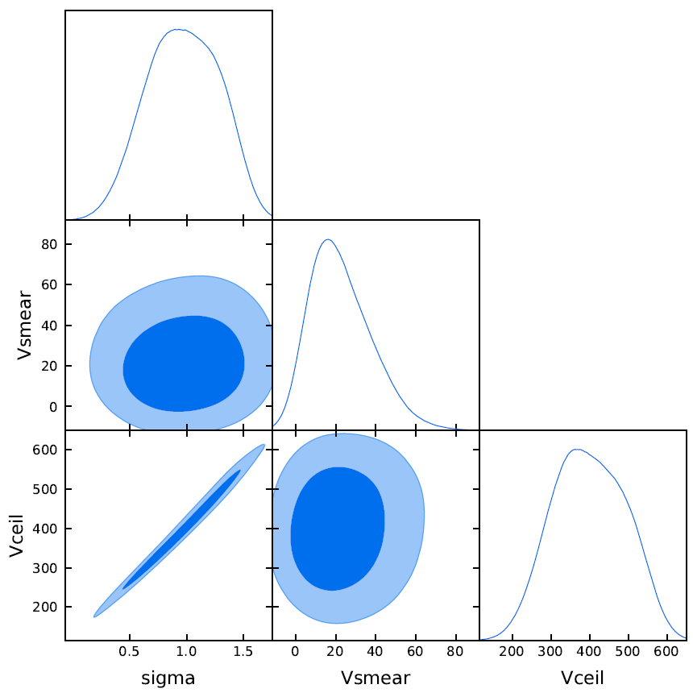
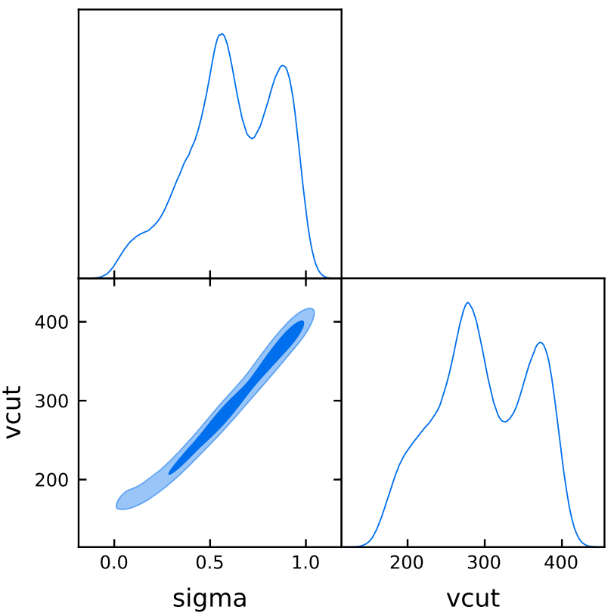
ELG NGC Posterior
σ | Vceil (km/s) | V_{smear} (km/s) | χ² | Reduced χ²
 |  | -
(Vcut ==Vceil)

Slide 6
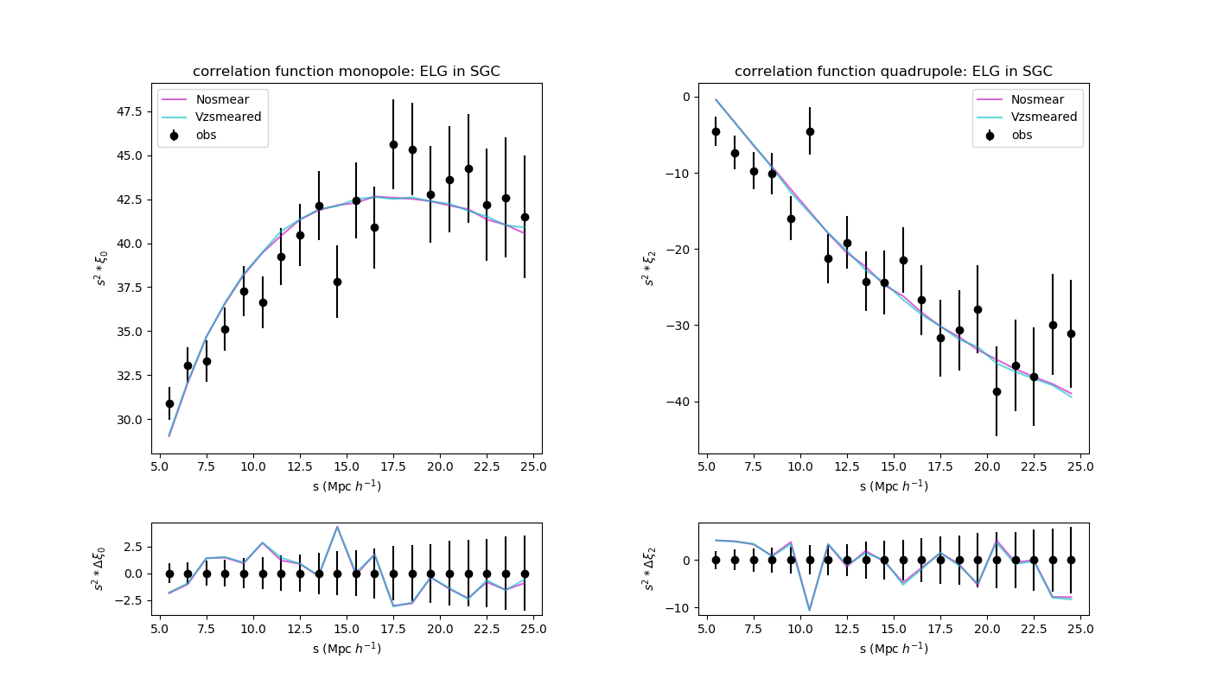
ELG SGC 2PCF
σ | Vceil (km/s) | V_{smear} (km/s) | χ² | Reduced χ²
 |  | -

Slide 7
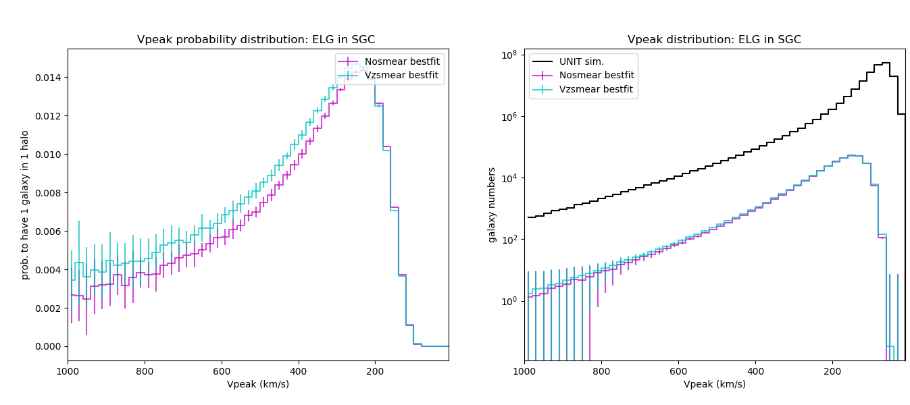
ELG SGC Prob. Distri. Func.
σ | Vceil (km/s) | V_{smear} (km/s) | χ² | Reduced χ²
 |  | -

Slide 8
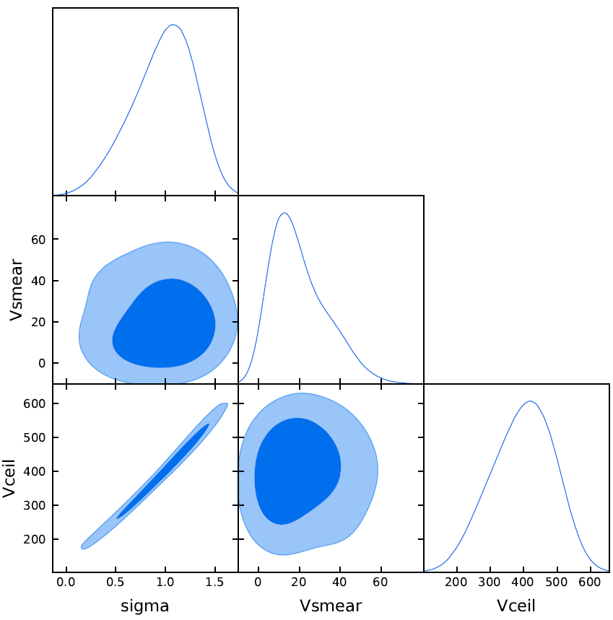
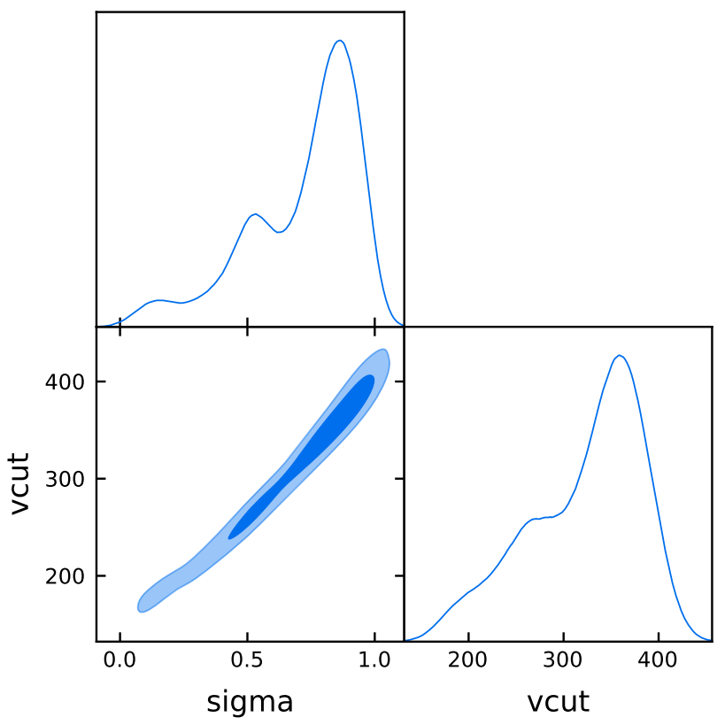
ELG SGC Posterior
σ | Vceil (km/s) | V_{smear} (km/s) | χ² | Reduced χ²
 |  | -
(Vcut ==Vceil)

Slide 9
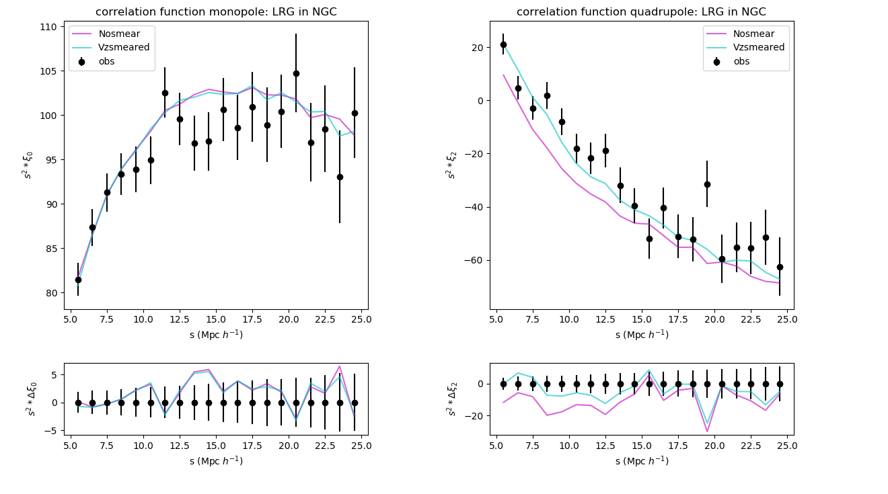
LRG NGC 2PCF
σ | Vceil (km/s) | V_{smear} (km/s) | χ² | Reduced χ²
 |  | -

Slide 10
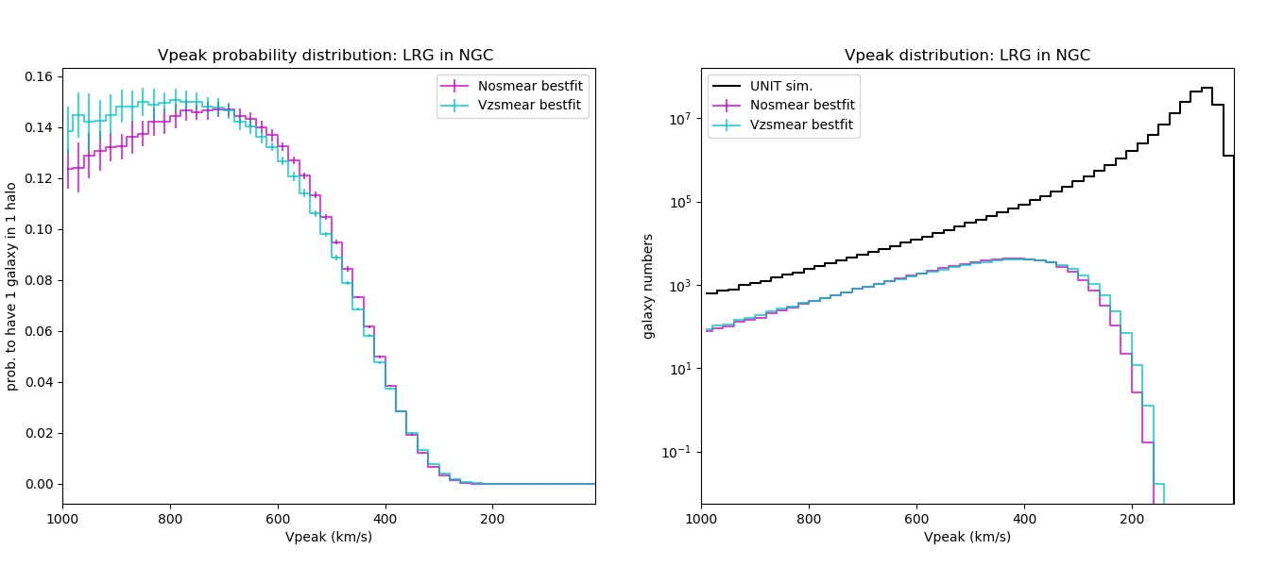
LRG NGC Prob. Distri. Func.
σ | Vceil (km/s) | V_{smear} (km/s) | χ² | Reduced χ²
 |  | -

Slide 11
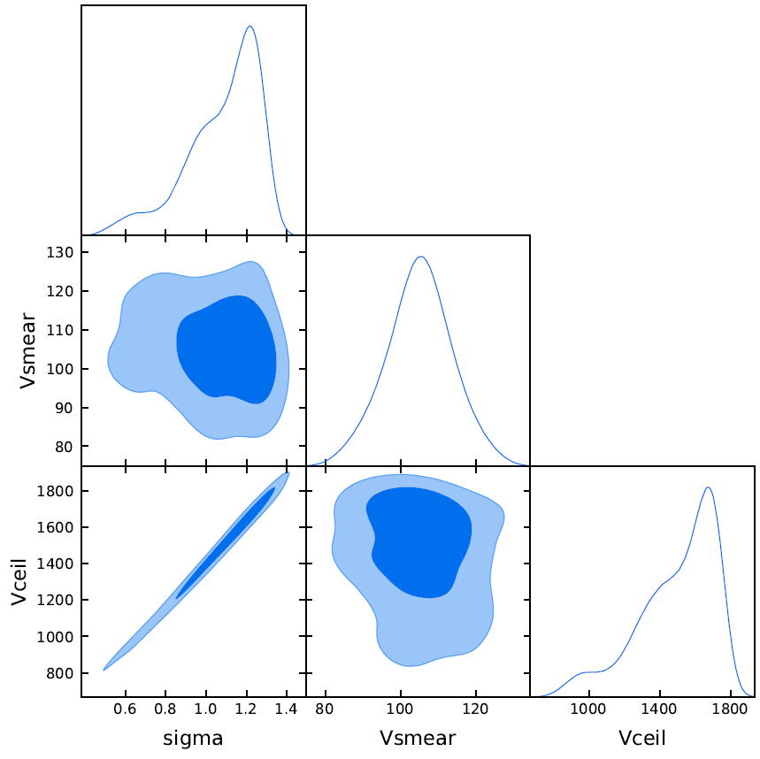
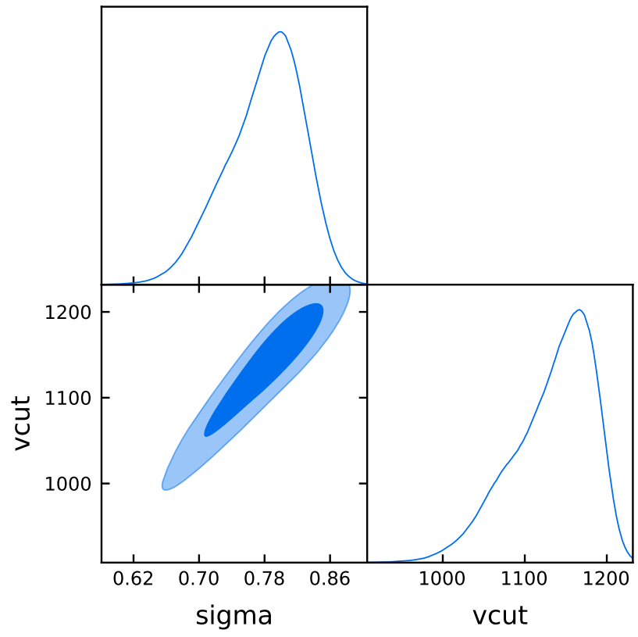
LRG NGC Posterior
σ | Vceil (km/s) | V_{smear} (km/s) | χ² | Reduced χ²
 |  | -
(Vcut ==Vceil)

Slide 12
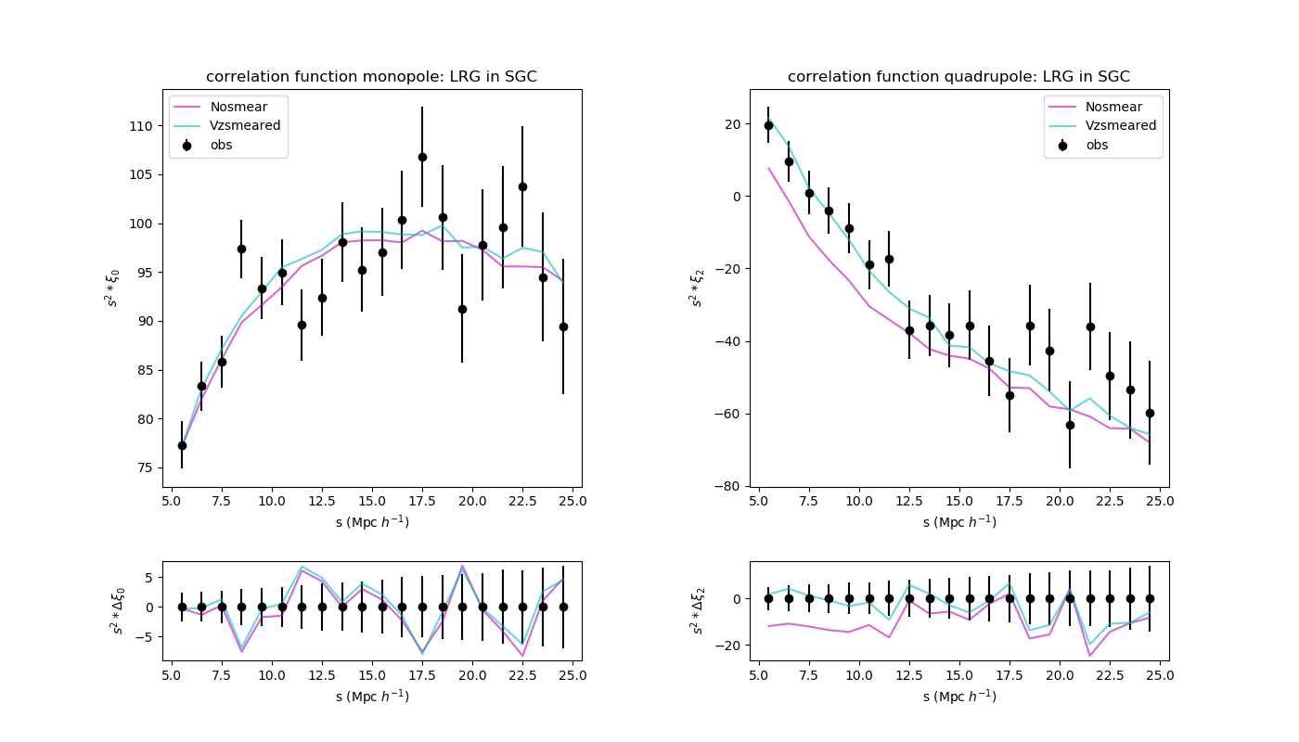
LRG SGC 2PCF
σ | Vceil (km/s) | V_{smear} (km/s) | χ² | Reduced χ²
 |  | -

Slide 13
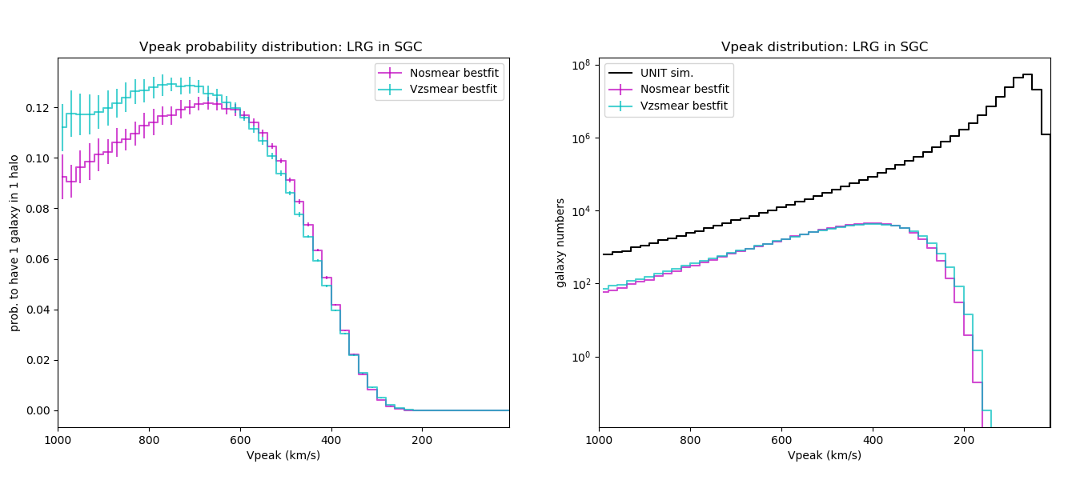
LRG SGC Prob. Distri. Func.
σ | Vceil (km/s) | V_{smear} (km/s) | χ² | Reduced χ²
 |  | -

Slide 14
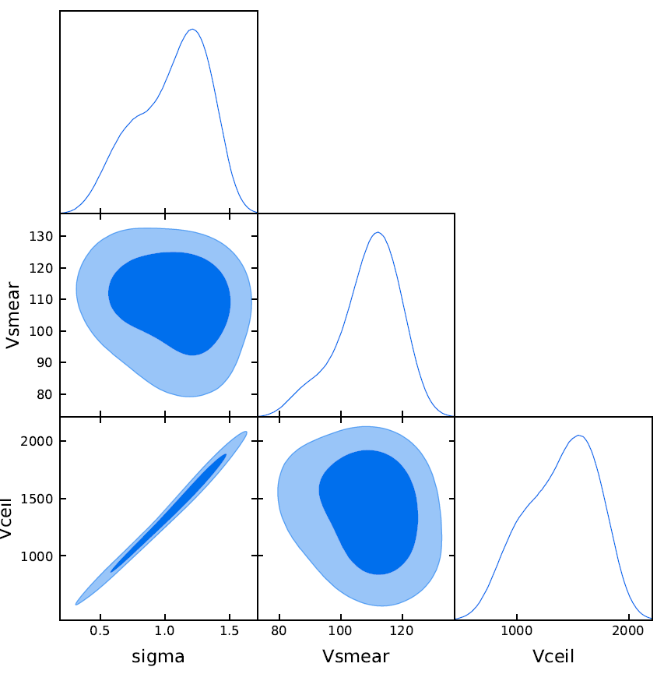
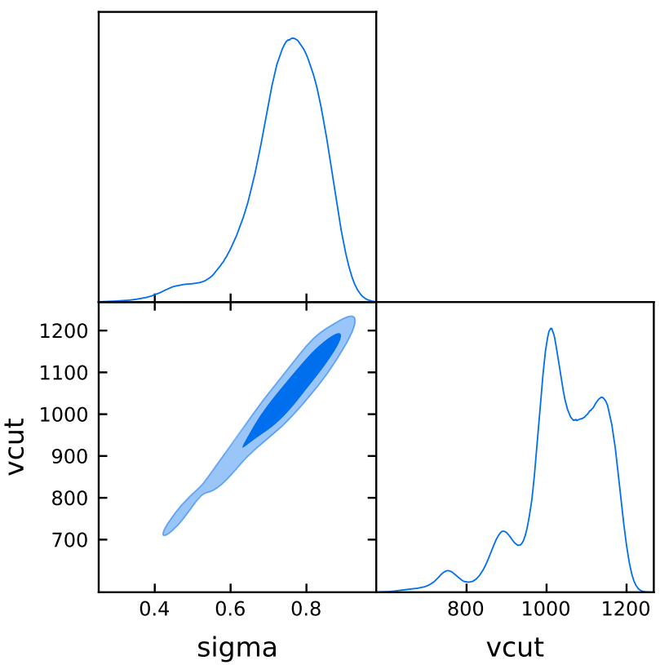
LRG SGC Posterior
σ | Vceil (km/s) | V_{smear} (km/s) | χ² | Reduced χ²
 |  | -
(Vcut ==Vceil)

Slide 15
Conclusions:
no smear | σ | Vcut (km/s) | V_{smear} (km/s) | χ² | Reduced χ²
ELG NGC |  |  | -
ELG SGC |  |  | -
LRG NGC |  |  | -
LRG SGC |  |  | -
Vz smeared | σ | Vceil (km/s) | V_{smear} (km/s) | χ² | Reduced χ²
ELG NGC
ELG SGC
LRG NGC
LRG SGC
Vz smearing works for SHAM LRG, improve the quadrupoles
but has risk of overfitting according to the reduced χ² value

Slide 16
Conclusions:
no smear | σ | Vcut (km/s) | V_{smear} (km/s) | χ² | Reduced χ²
ELG NGC |  |  | -
ELG SGC |  |  | -
LRG NGC |  |  | -
LRG SGC |  |  | -
Vz smeared | σ | Vceil (km/s) | V_{smear} (km/s) | χ² | Reduced χ²
ELG NGC
ELG SGC
LRG NGC
LRG SGC
? Vz smearing doesn't work for SHAM ELG, and even gets worse
? possible explanation: erroneously introduce the z uncertainty, because their real z uncertainty is very small

Slide 17
Outlooks:
Reliable eBOSS LRG & ELG SHAM models
Robust SHAM models
Reduce the statistical fluctuation with 60 realisations
Implement SHAM models with σ_{pec}
ELG&LRG stellar mass w.r.t scattered halo mass (V_{peak})
C-SHAM scripts
SHAM LRG and ELG in the same redshift bins
Multi-tracer SHAM
Generate multiple tracers simultaneously
Cross-Correlation Studies

Slide 18
Difficulties:
Generate multiple tracers simultaneously
Single-tracer tests completed in different redshift
LRG and ELG has different sigma to scattering Vpeak
Vz smearing only works for LRG, but not ELG

Slide 19
Prerequisite tests for multi-tracer SHAM:
LRG and ELG single-tracer tests in the same redshift bins:
is it necessary?
The simplest multi-tracer implementation(5 parameters in total):
scattering & cut & select & vz smearing for SHAM LRG
remove LRG halos
scattering & cut & select for SHAM ELG from the remaining halos

Slide 20
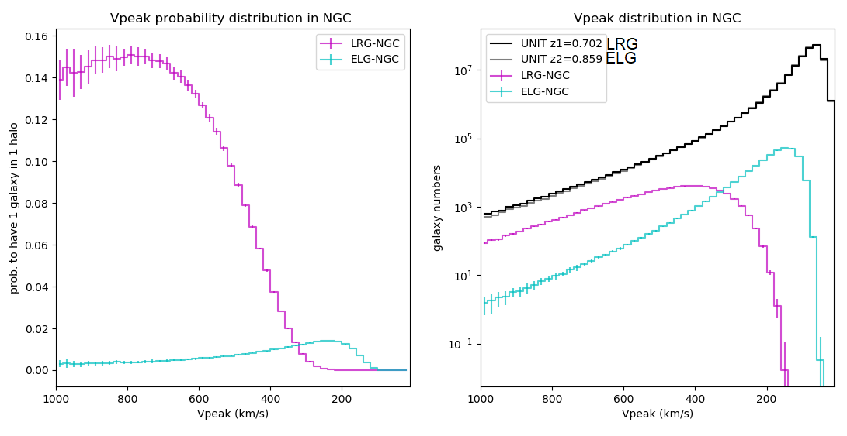
NGC Prob. Distri. Func.

Slide 21
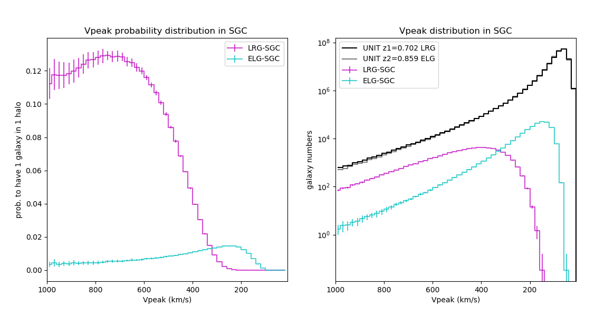
SGC Prob. Distri. Func.

Slide 22
Prerequisite tests for multi-tracer SHAM:
The simplest multi-tracer implementation:
LRG first or ELG first may need a physical explanation
Seen from the single-tracer probability distributions, LRG and ELG only occupies a small amount of halos, so the probability for two types of galaxy residing in one halo is small, i.e., we don't have to worry about the overlapped LRG and ELG probability distribution.

Slide 23
Thank you !

