Slide 1
HAM iminuit & Multinest Results
Jiaxi
25 May

Slide 2
NOTE：
The parameters are sigma for scattering Vpeak; vcut for cutting large scattering Vpeak end
Multinest results are parameter.mean, errors are parameter.err
Multinest errors are considered instead of iminuit (a minimiser) because all iminuit results are not converged (Hesse error meaningless)
Vpeak distribution functions present 10 realisations with the best fitting results

Slide 3
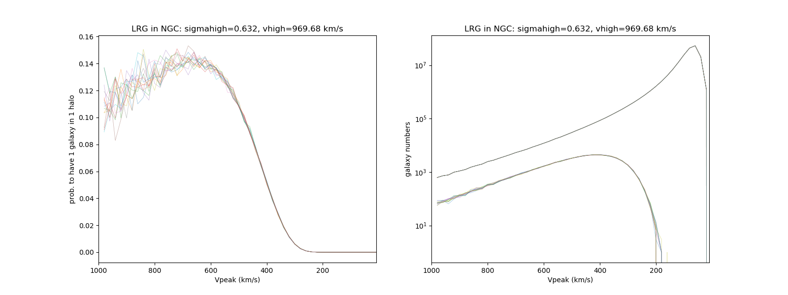
NOTE：
The parameters are sigma for scattering Vpeak; vcut for cutting large scattering Vpeak end
Multinest results are parameter.mean, errors are parameter.err
Multinest errors are considered instead of iminuit because all iminuit results are not converged (Hesse error meaningless)
Galaxy distribution functions present 10 realisations with the best fitting results
UNIT Vpeak distr.
best-fit Vpeak distr.
UNIT Vpeak distr.
best-fit Vpeak distr.

Slide 4
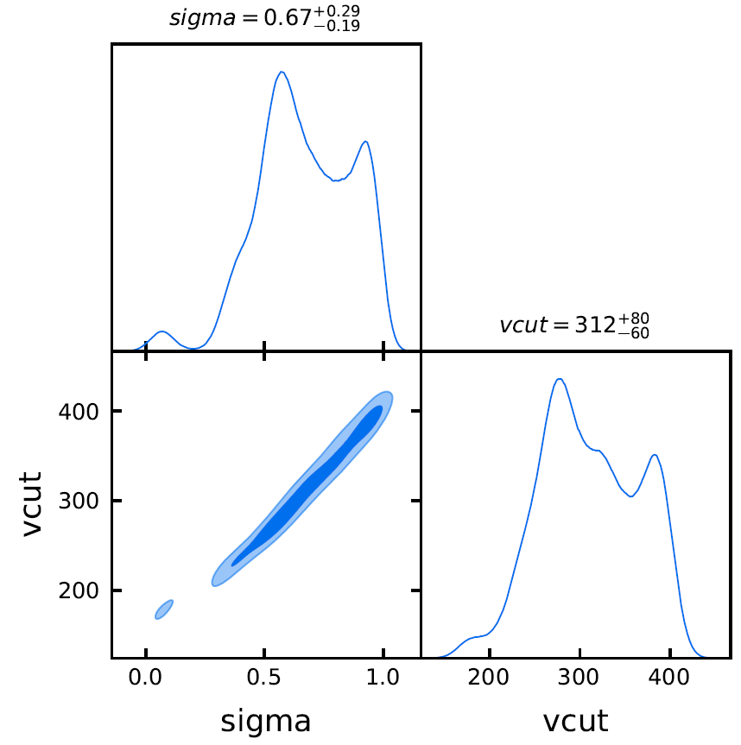
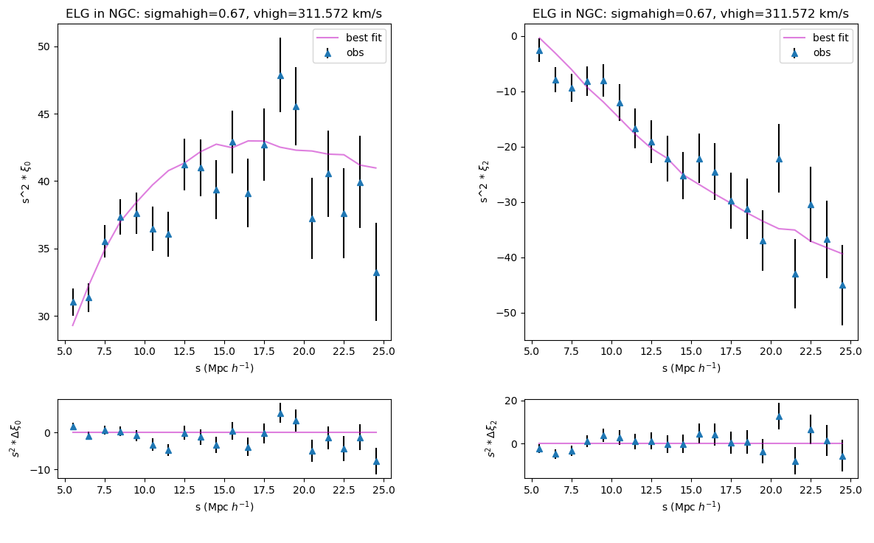
ELG NGC: multinest

Slide 5
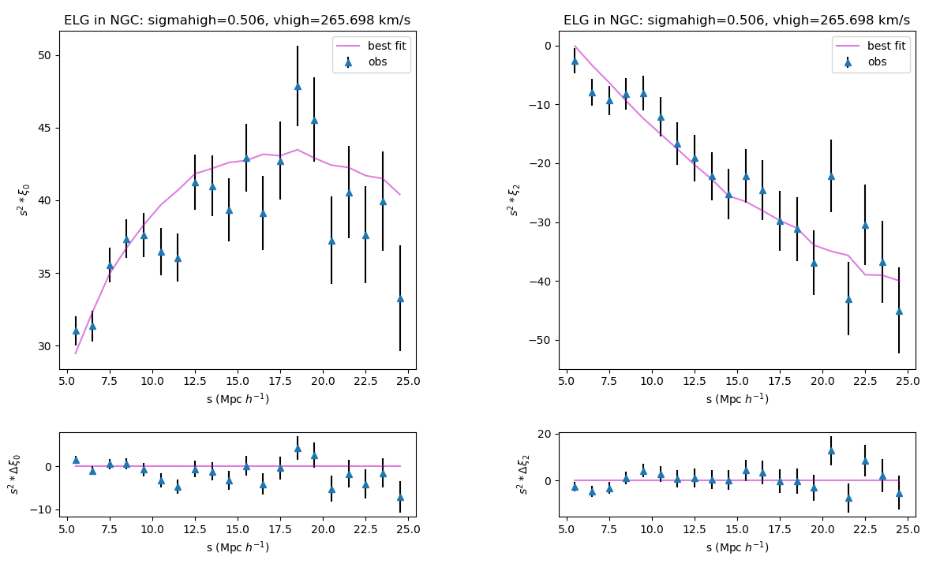
ELG NGC: iminuit(error meaningless)
consistent

Slide 6
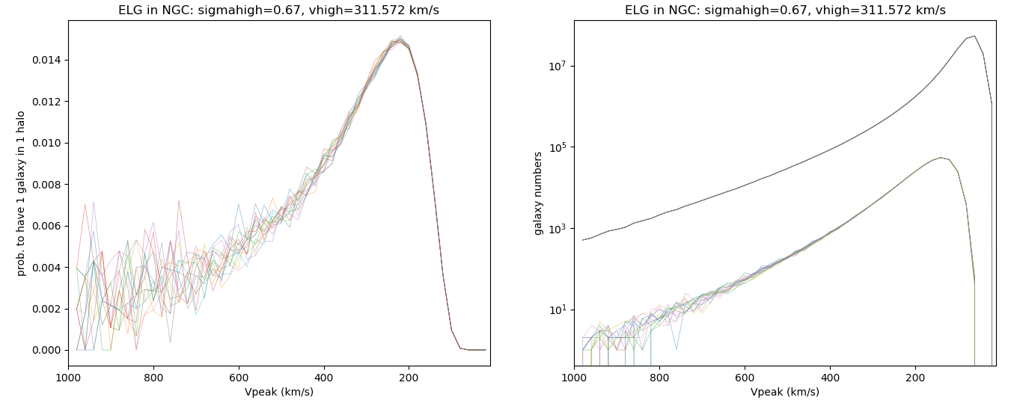
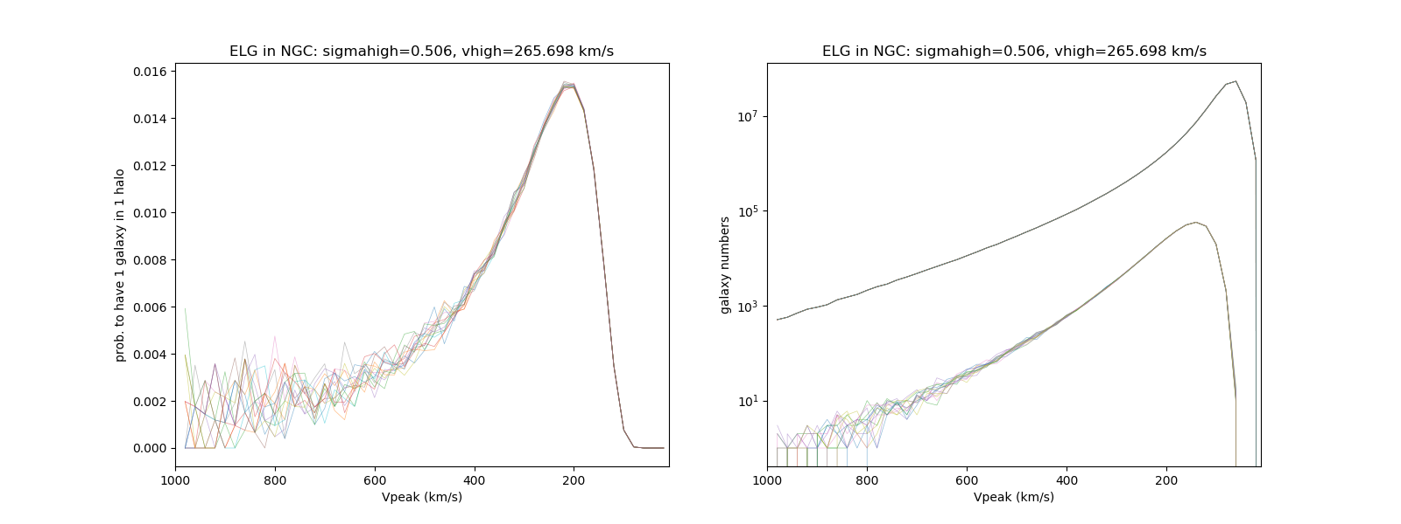
ELG NGC:
Multinest
iminuit

Slide 7
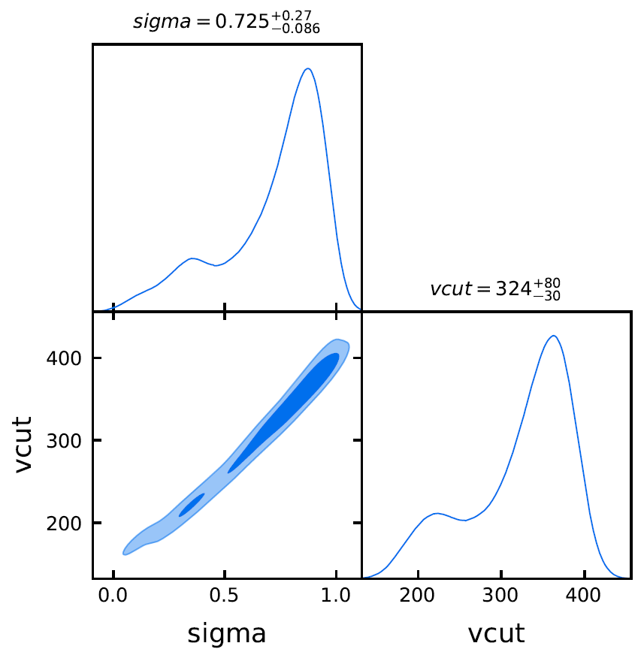
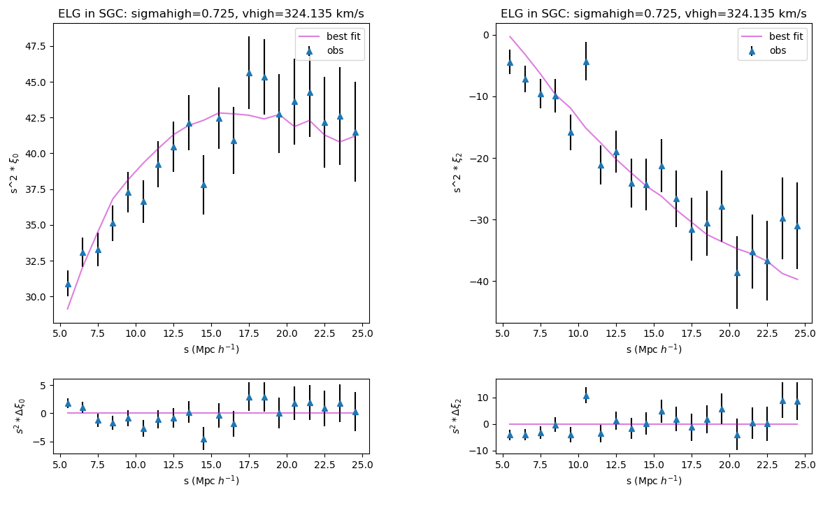
ELG SGC: multinest

Slide 8
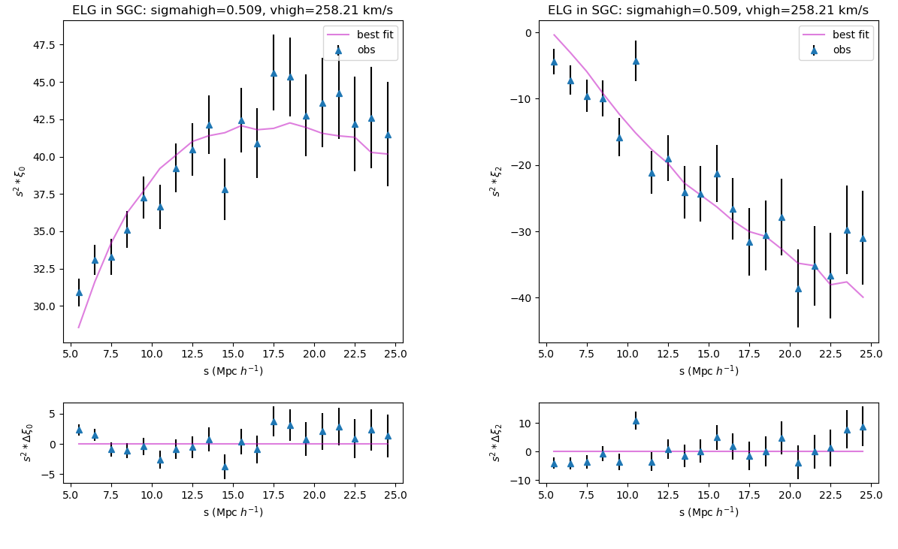
ELG SGC: iminuit(error meaningless)
inconsistent

Slide 9
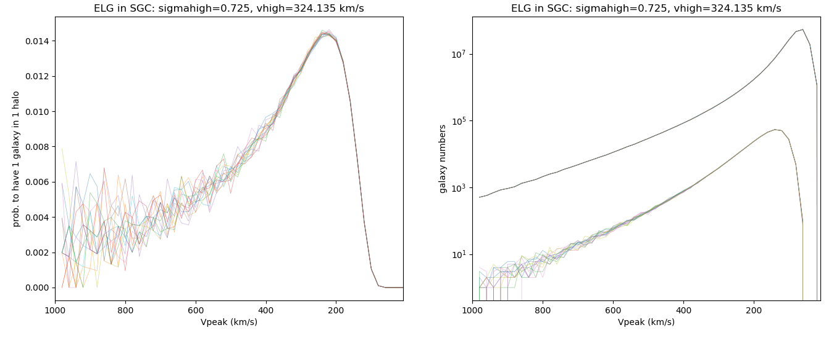
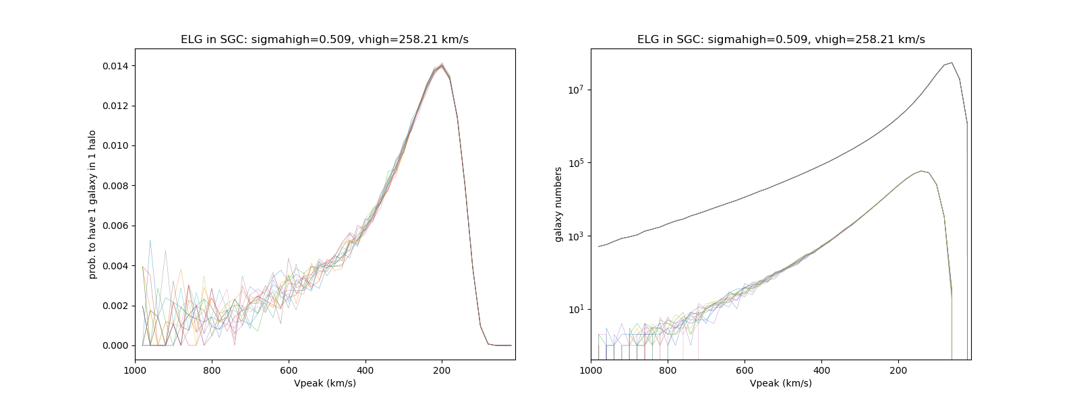
ELG SGC:
Multinest
iminuit

Slide 10
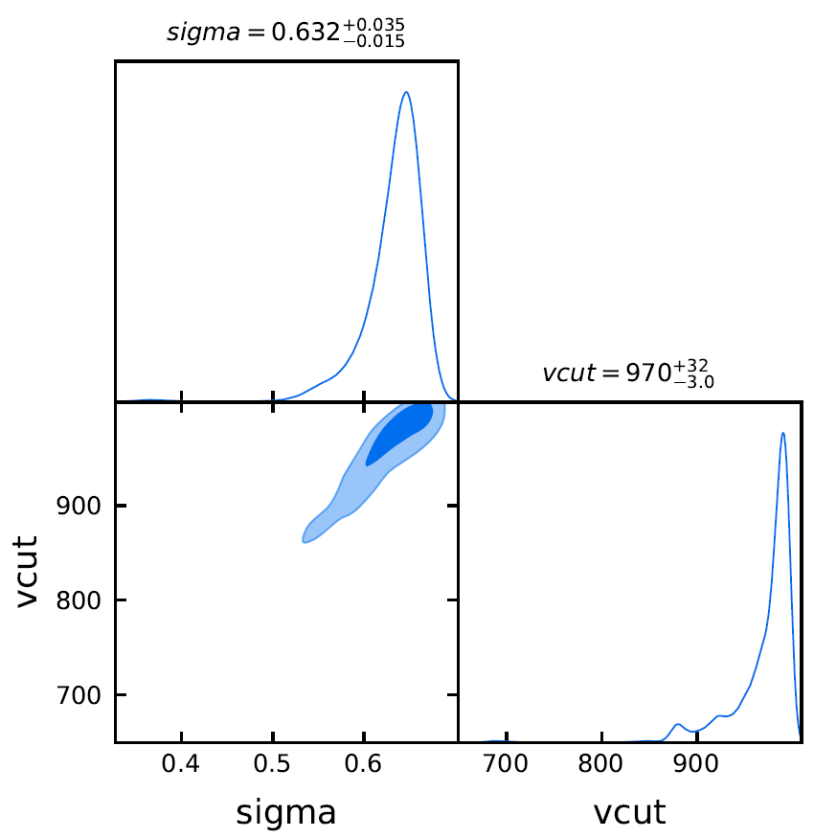
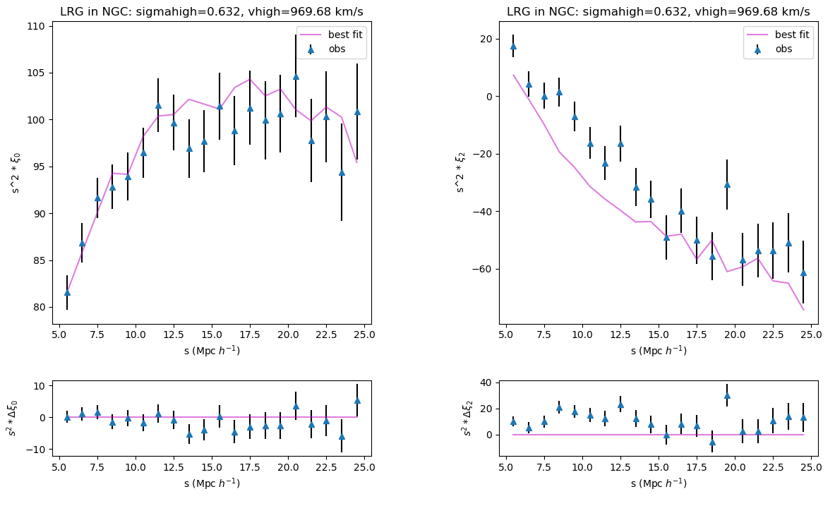
LRG NGC: multinest

Slide 11
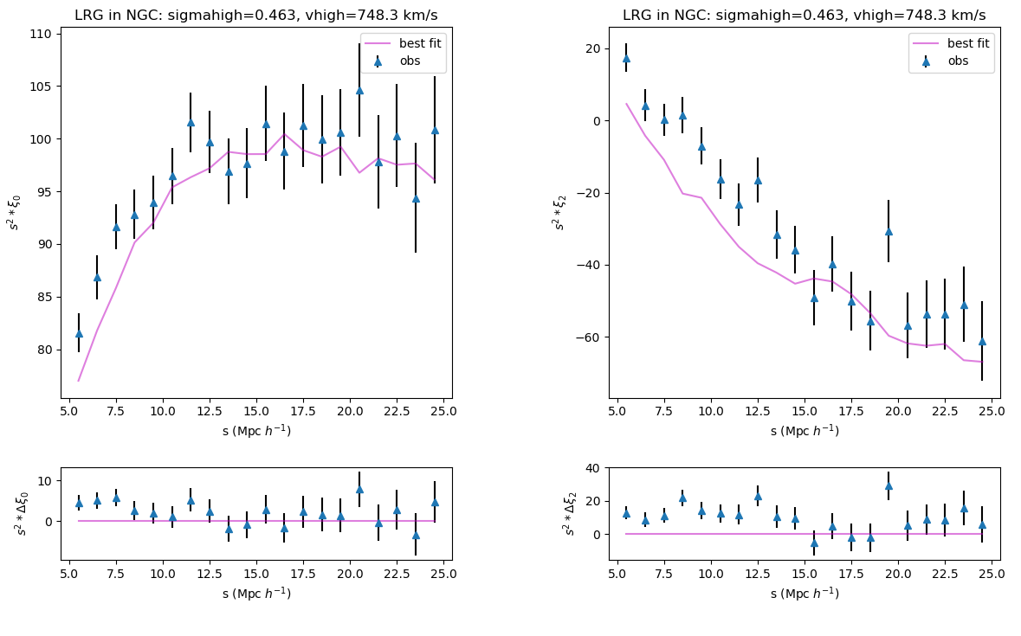
LRG NGC: iminuit(error meaningless)
inconsistent

Slide 12
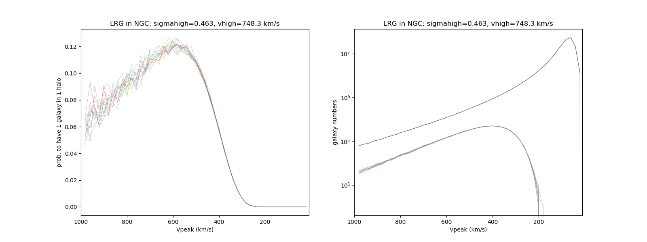
LRG NGC:
Multinest
iminuit

Slide 13
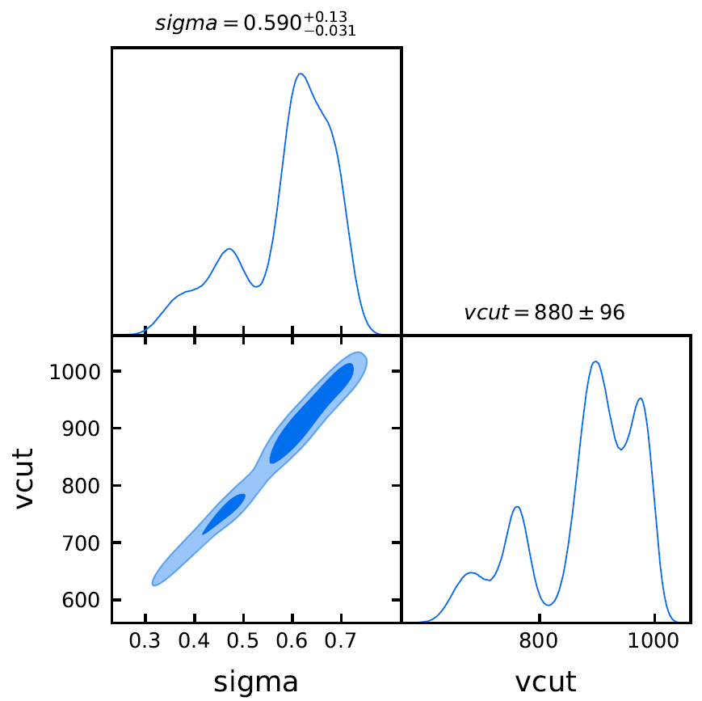
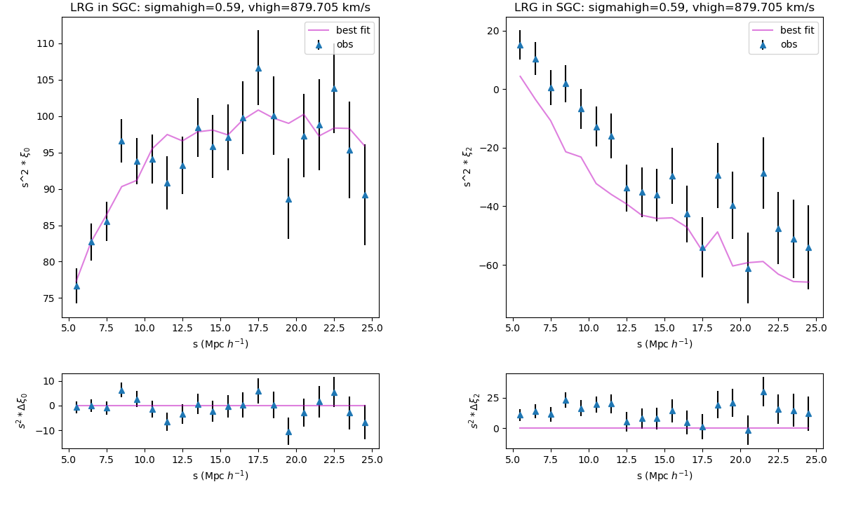
LRG SGC: multinest

Slide 14
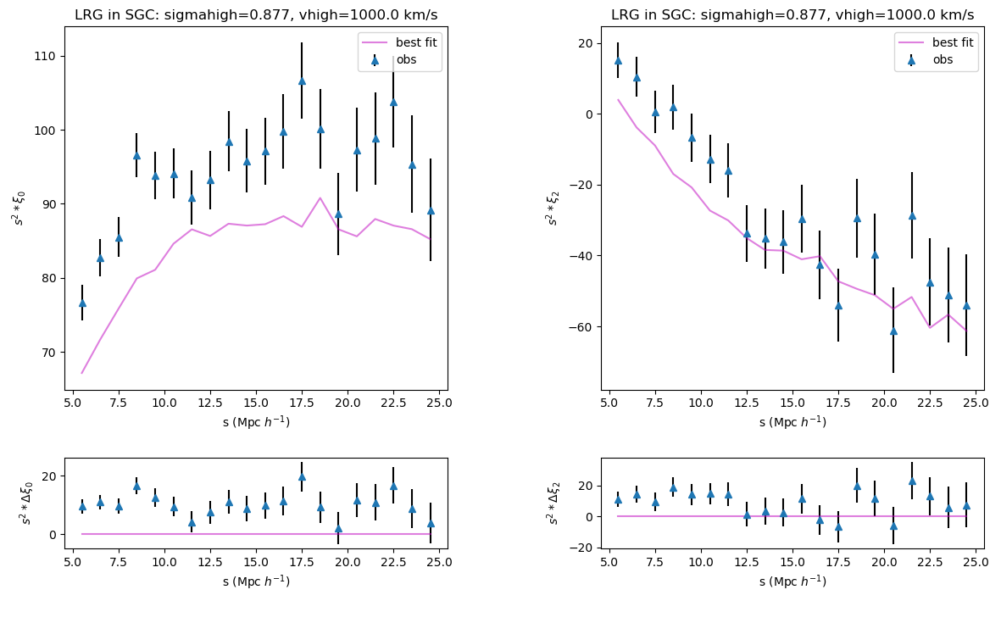
LRG SGC: iminuit(error meaningless)
inconsistent

Slide 15
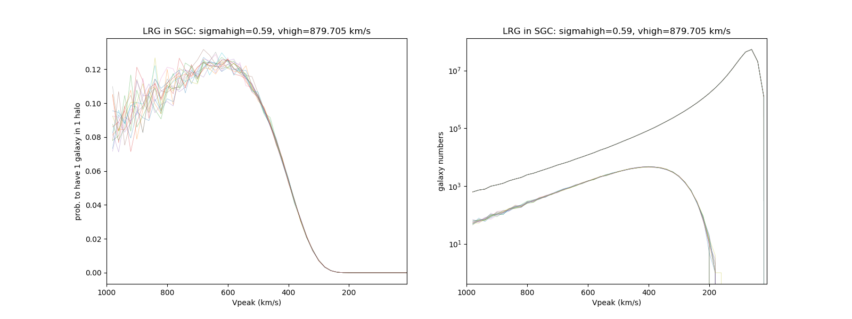
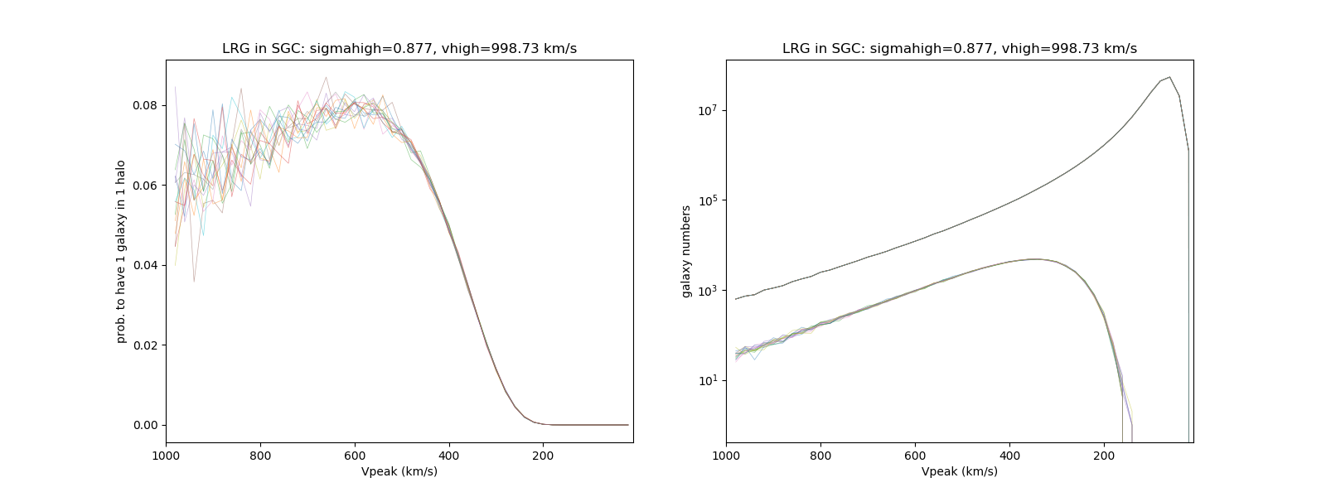
LRG SGC:
Multinest
iminuit

Slide 16
Conclusions：
Monopoles are sensitive to parameters while quadrupoles are not
Multinest & iminuit results are not consistent except the ELG NGC result.
iminuit LRG SGC results seems unrealiable because it hits the boundary
Due to the non-Guassian shape posterior, may be it is not appropriate to determine results as parameter.mean, errors as parameter.err

