Slide 1
HAM iminuit & Multinest Results
Jiaxi
26 May

Slide 2
NOTE：
The parameters are sigma for scattering Vpeak; vcut for cutting large scattering Vpeak end; prior: sigma [0.2,1]; vcut [500,1200]
A comparison of fitting for raw galaxy catalogue (left panel) and PIP weighed catalogue (right panel)
Multinest results are analyzer.get_bestfit()['parameters'], errors are not provided because they are not reliable
Vpeak distribution functions present the average of 15 realisations with the best fitting results

Slide 3
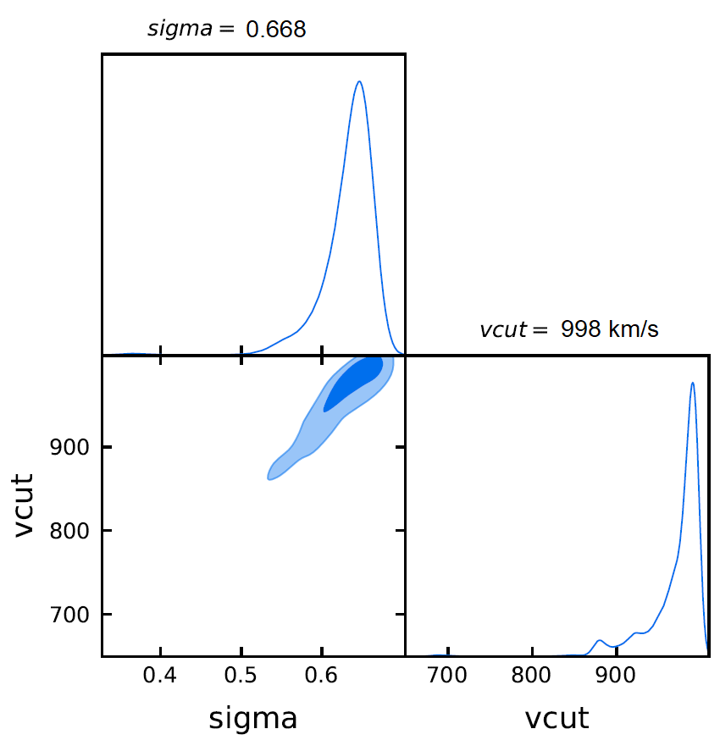
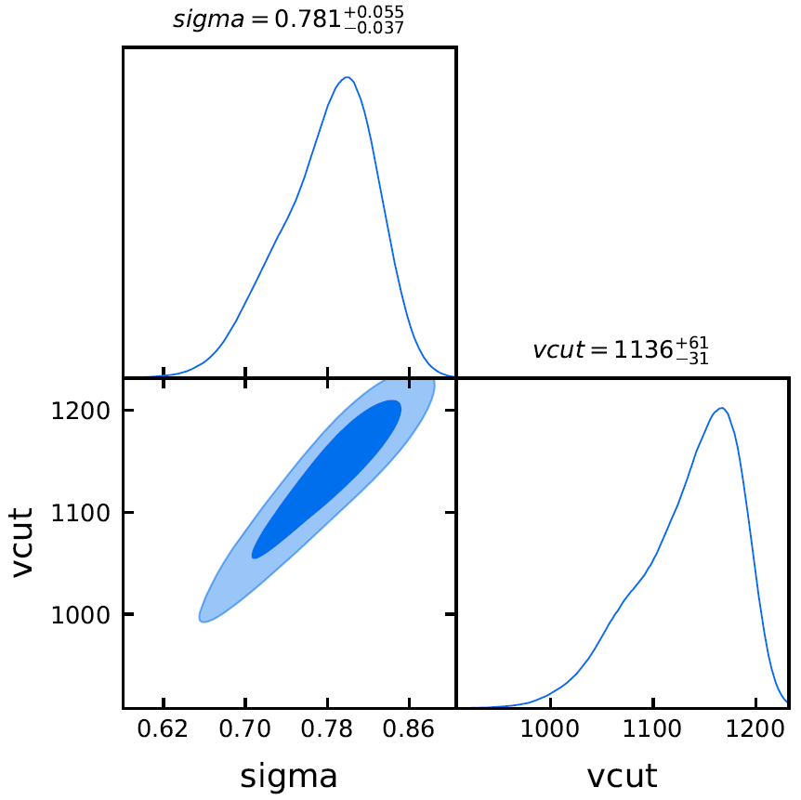
LRG NGC:(left: no PIP obs; right: PIP obs)
Multinest
chi2 =71.38
Multinest
chi2 =72.78
0.800
iminuit
chi2 = 93.145
sigma = 0.463
vcut = 748km/s
iminuit
chi2 = 85.98
sigma = 0.550
vcut = 870km/s
1168 km/s

Slide 4
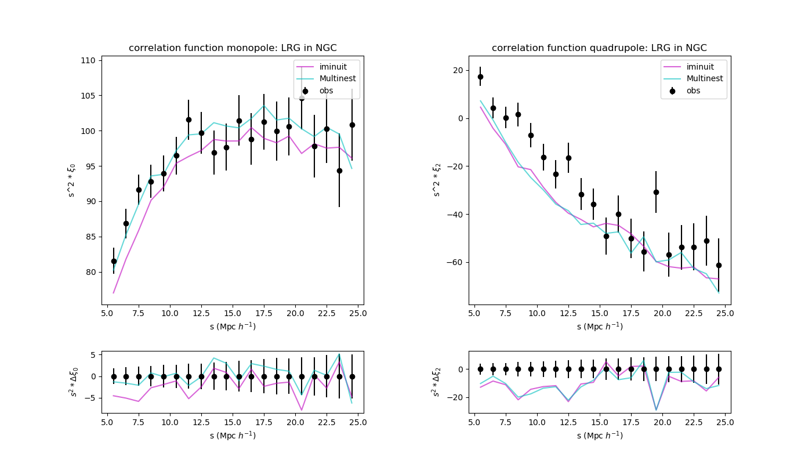
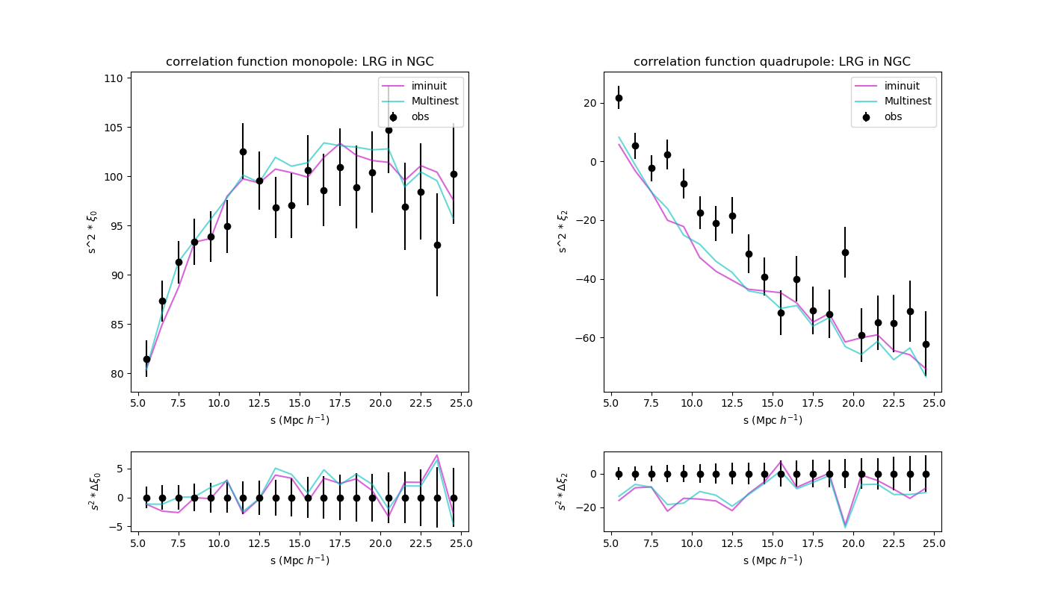
LRG NGC: correlation function monopole
no PIP PIP corrected

Slide 5
LRG NGC: correlation function
no PIP PIP corrected

Slide 6
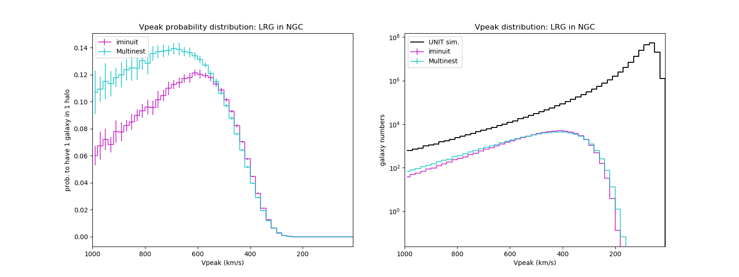
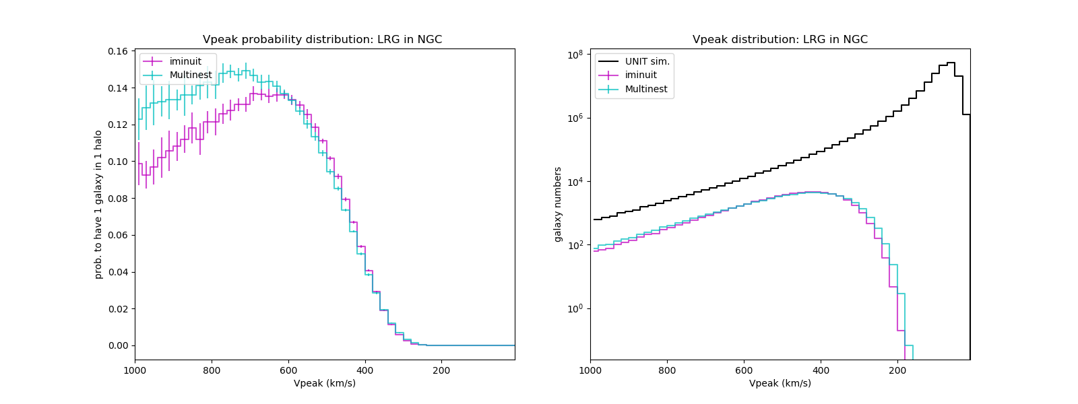
LRG NGC: Vpeak distribution
no PIP PIP corrected

Slide 7
LRG NGC: Vpeak distribution
no PIP PIP corrected

Slide 8
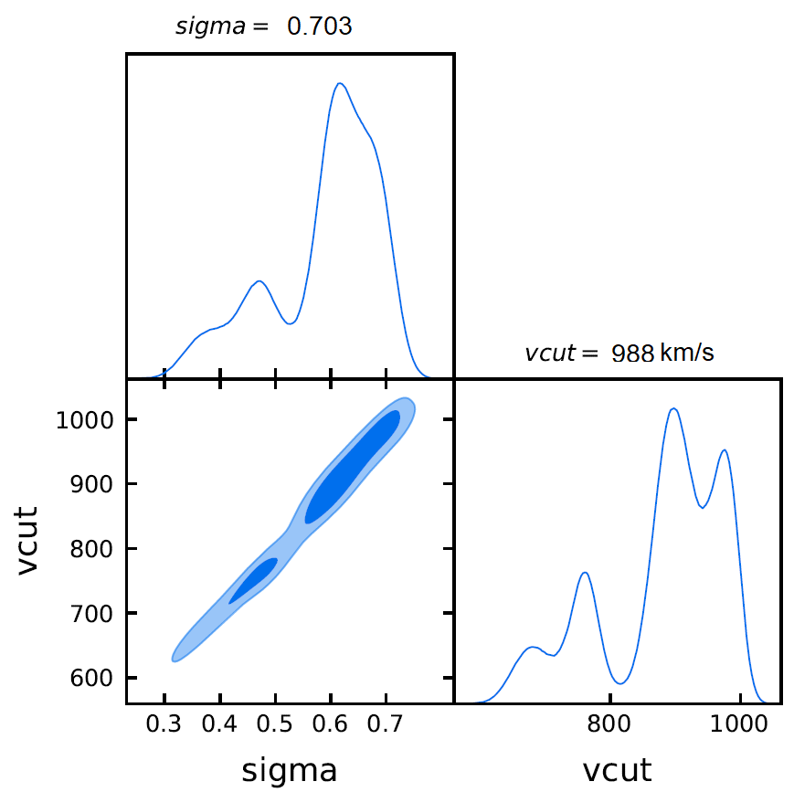

LRG SGC: (left: no PIP obs; right: PIP obs)
Multinest
chi2=63.194
0.710
Multinest
chi2=54.593
iminuit
chi2 = 130.777
sigma = 0.877
vcut=998km/s
iminuit
chi2 = 59.068
sigma = 0.566
vcut= 861 km/s
994 km/s

Slide 9
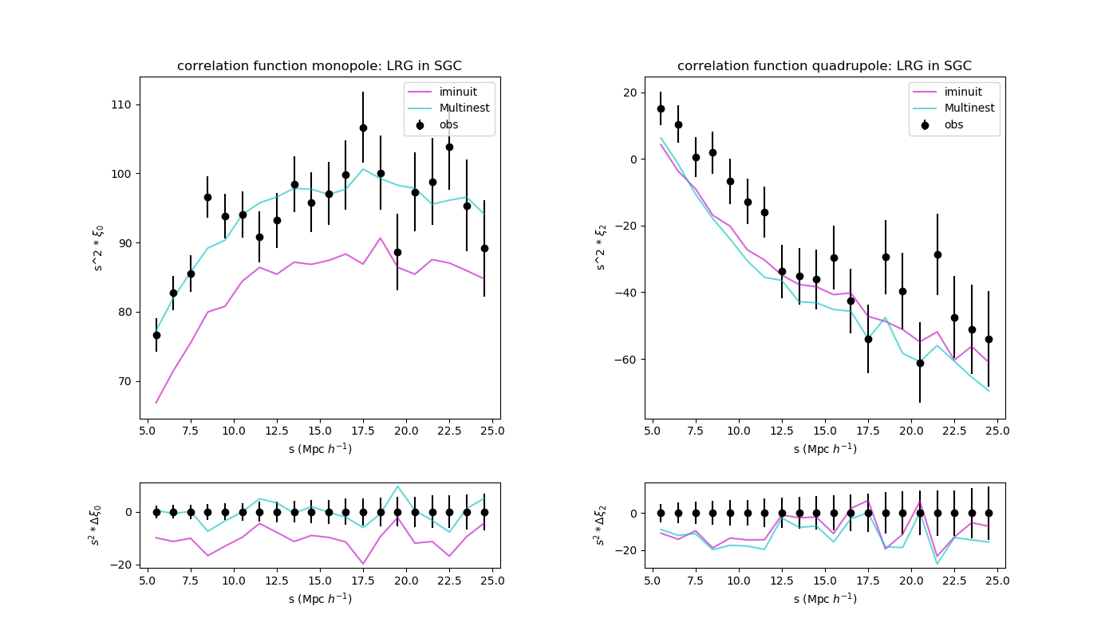
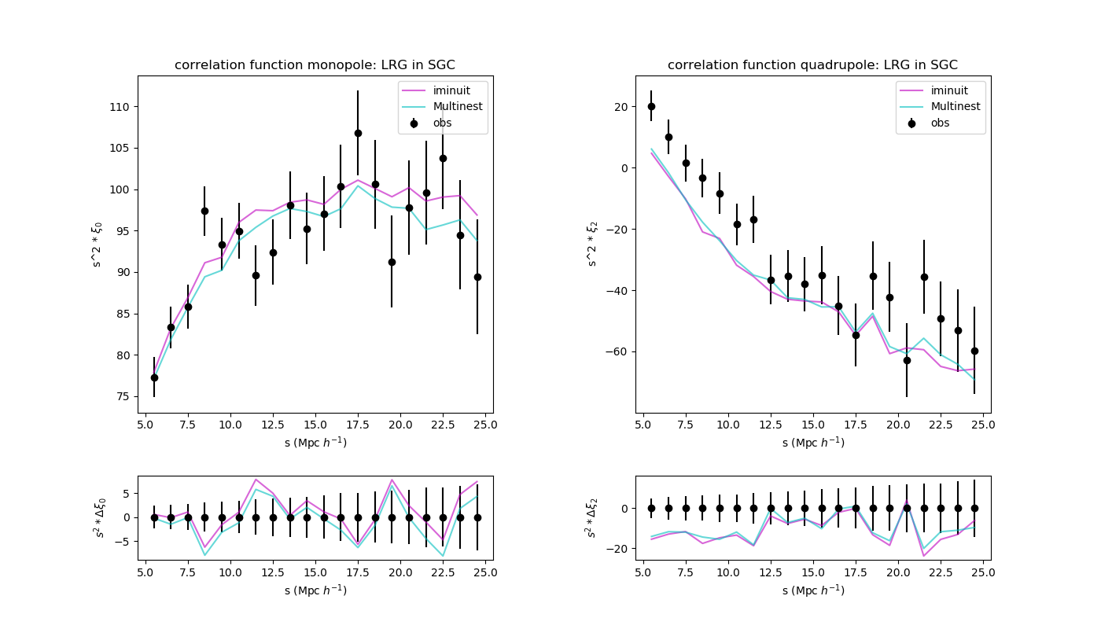
LRG SGC: correlation function
no PIP PIP corrected

Slide 10
LRG SGC: correlation function
no PIP PIP corrected

Slide 11
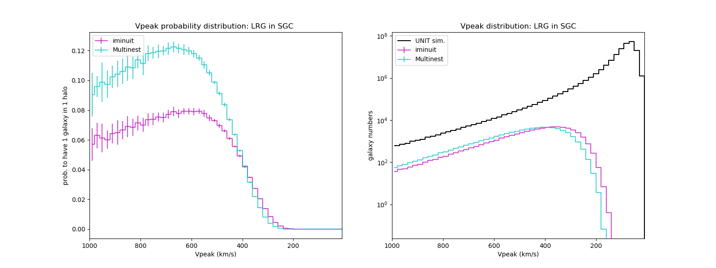
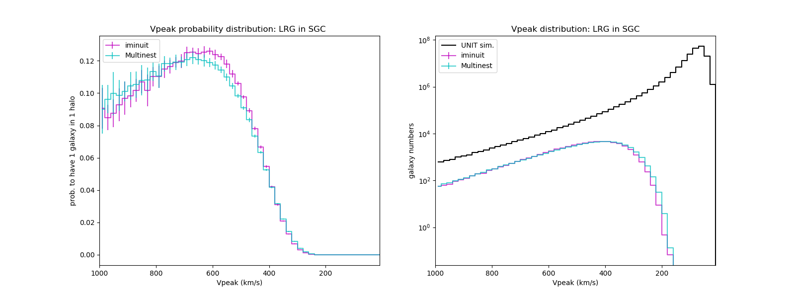
LRG SGC: Vpeak distribution
no PIP PIP corrected

Slide 12
LRG SGC: Vpeak distribution
no PIP PIP corrected

Slide 13
Conclusions：
PIP corrected observation didn't help to make a good quadrupole fit
PIP + change of prior help iminuit to have a better fit but it is still not as good as Multinest in terms of chi2
PIP +change of prior didn't help multinest that much in terms of chi2, but the posterior seems better (not that noisy)
the getdist 1-sigma error is still not equal to multinest analyzer 1-sigma error

