Slide 1
Halo Abundance Matching for eBOSS Galaxies
Jiaxi Yu
May 12, 2020

Slide 2
Background:
Study the Universe:
Theories : the framework - LCDM
Observations : in the redshift space
Simulations : in the real space

Slide 3
Why do we need HAM?
self-consistent framework
? reliable
parameters
? reliable link
Theories:
DM + Galaxy Bias =Galaxy
validate
Simulations

Slide 4
Why do we need HAM?
self-consistent framework
framework
parameters
? reliable link
Theories:
DM + Galaxy Bias Galaxy
validate
constrain
Simulations
Observations

Slide 5
Why do we need HAM?
self-consistent framework
? meaninful
parameters
Theories:
DM + Galaxy Bias =Galaxy
validate
constrain
Simulations
Observations

Slide 6
Why do we need HAM?
self-consistent framework
meaningful
parameters
reliable link
Theories:
DM + Galaxy Bias =Galaxy
constrain
Observations

Slide 7
Why do we need HAM?
self-consistent framework
meaningful
parameters
reliable link
Theories:
DM + Galaxy Bias =Galaxy
test
constrain
HAM
Observations

Slide 8
What is Halo Abundance Matching?
A method to test the galaxy bias models
By investigating galaxy distribution in DM halos
density contrast:
correlation function:
linear galaxy bias:

Slide 9
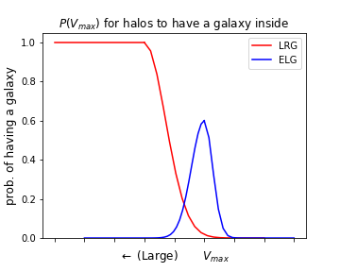
What is Halo Abundance Matching?
Select halos that can host a galaxy so that:
Selected halos (i.e., galaxies) match empirical distribution
Galaxy correlation functions match the observation
Mhalo
Fig 1. Galaxy P.D.F. for halos

Slide 10
How to use HAM?
prob. of having a galaxy inside
1
Mhalo
Mlow_cut
0

Slide 11
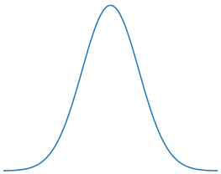
How to use HAM?
prob. of having a galaxy inside
1
Mhalo
Mlow_cut
0
Scattering with
Mhalo

Slide 12
How to use HAM?
prob. of having a galaxy inside
1
Scattering & Mhigh_cut
Mhalo
Mlow_cut
0
Scattering with
Mhalo

Slide 13
Progress:
Thesis topic:
Test the galaxy bias models with HAM
The specific question:
How do galaxies distribute in DM haloes?
Solutions:
Select halos to assign galaxies (HAM)
Fit the galaxy to observations to get bias models (test)

Slide 14
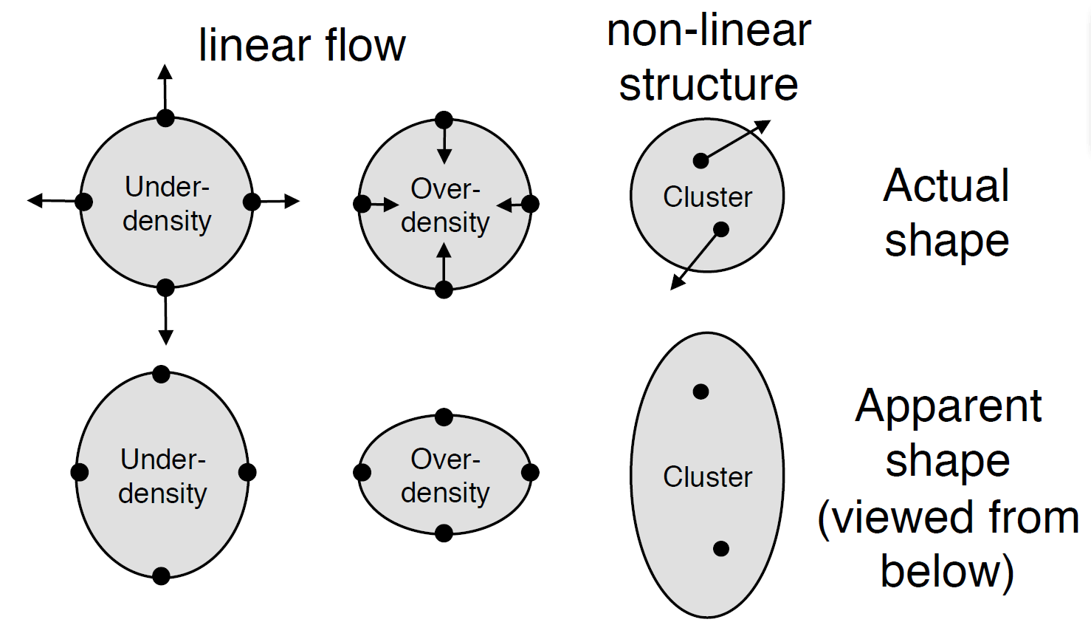
Progress:
the Redshift Space Distortion effect (fitting in the redshift space)
Simulations
in the real space
Observations
in the redshift space
Large scales
Small scales
Fig 2. The Redshift Space Distortion effects (diagrams from Jean-Paul's AstroIV slides)

Slide 15
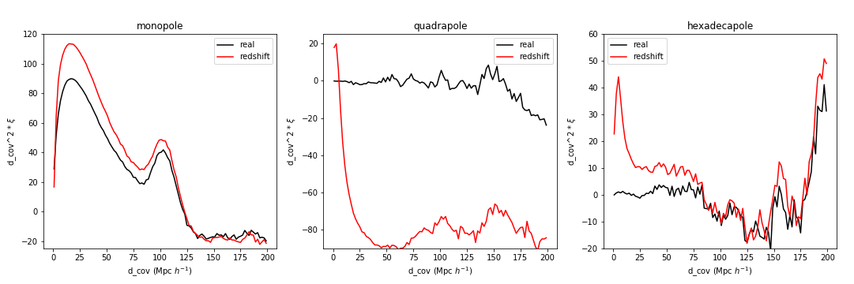
Progress:
the Redshift Space Distortion effect (fitting in the redshift space)
(P_{n} (μ) is the Legendre polynomials)
Fig 3. The correlation function multipoles of DM halo simulations in the real space (black) and in the redshift space (red)

Slide 16
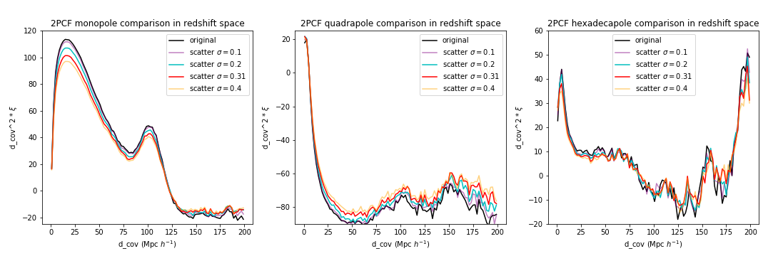
Progress:
Redshift Space Distortion effect
Parameters' effects on and galaxy distributions
Fig 4. The correlation function multipoles for different scattering parameters

Slide 17
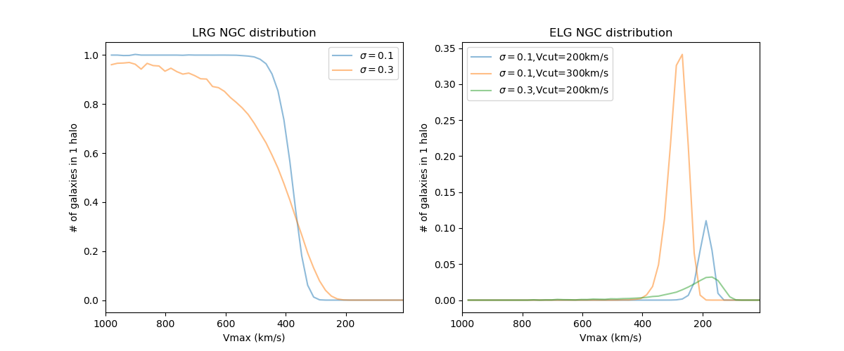
Progress:
Redshift Space Distortion effect
Parameters' effects on and galaxy distributions
Fig 5. The galaxy P.D.F for different model parameters

Slide 18
Progress:
Redshift Space Distortion effect
Parameters' effects on and galaxy distributions
minimisation for mono+quadru -poles
scripts
statistical instability of HAM in

Slide 19
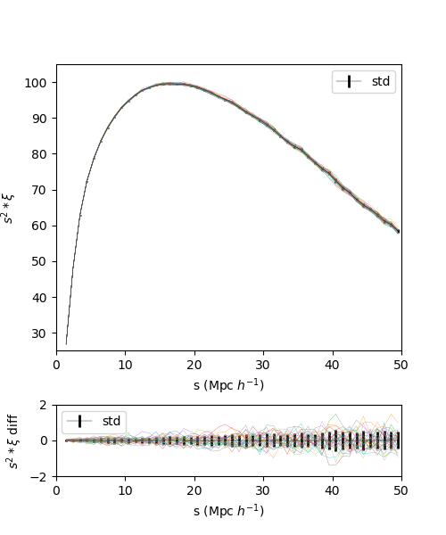
Progress:
Redshift Space Distortion effect
Parameters' effects on and galaxy distributions
minimisation for mono+quadru -poles
scripts
statistical instability of HAM in
Fig 6. Correlation multipoles with the same scattering parameters but different random seeds

Slide 20
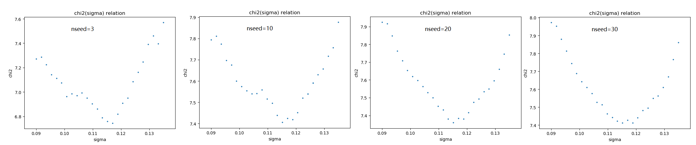
Progress:
Redshift Space Distortion effect
Parameters' effects on and galaxy distributions
minimisation for mono+quadru -poles
scripts
statistical fluctuations of HAM in
Fig 7. chi2-sigma relations with different number of random seeds being averaged

Slide 21
Progress:
Redshift Space Distortion effect
Parameters' effects on and galaxy distributions
minimisation for mono+quadru -poles
scripts
statistical fluctuations of HAM in
To do:
Remove the fluctuation completely with more seeds
Use MCMC sampler to get reliable parameter errors

Slide 22
Outlook:
Reliable LRG & ELG bias models
Multi-tracer HAM
'generate' multiple tracers simultaneously
difficulty: overlapped distribution function
Cross-Correlation between tracers

Slide 23
Thanks!

