Slide 1
SubHalo Abundance Matching for eBOSS Galaxies
Jiaxi Yu
Supervisors: Prof. Dr. Jean-Paul Kneib
Dr. Cheng Zhao
July 7th, 2020

Slide 2

Contents:
Introductions
SHAM Implementation
Results
Conclusions and Outlooks
Galaxy Bias
SubHalo Abundance Matching Method
Two-point Correlation Function

Slide 3
Introductions: Galaxy Bias
self-consistent framework
? reliable
parameters
? reliable link
Theories:
DM + Galaxy Bias =Galaxy
validate
N-body Simulations

Slide 4
Introductions: Galaxy Bias
self-consistent framework
? meaninful
parameters
? reliable link
Theories:
DM + Galaxy Bias Galaxy
validate
constrain
Simulations
Observations

Slide 5
Introductions: Galaxy Bias
self-consistent framework
? meaninful
parameters
Theories:
DM + Galaxy Bias =Galaxy
validate
constrain
Simulations
Observations

Slide 6
Introductions: Galaxy Bias
self-consistent framework
meaningful
parameters
reliable link
Theories:
DM + Galaxy Bias =Galaxy
validate
constrain
Simulations
Observations

Slide 7
Introductions: Galaxy Bias
self-consistent framework
meaningful
parameters
reliable link
Theories:
DM + Galaxy Bias =Galaxy
validate
calibrate
constrain
Simulations
SHAM
Observations

Slide 8
Introductions: Galaxy Bias Models
Halo/Subhalo
N-body Simulations
ELG/LRG
Observations

Slide 9
Introductions: Galaxy Bias Models
HOD
P(N|M_{halo})
SHAM
P(M_{(sub)halo})

Slide 10
Introductions: SHAM Method
Select halos (i.e., galaxies) so that they:

Slide 11
Introductions: SHAM Method
Select halos (i.e., galaxies) so that they:
Have the same number density as observations

Slide 12
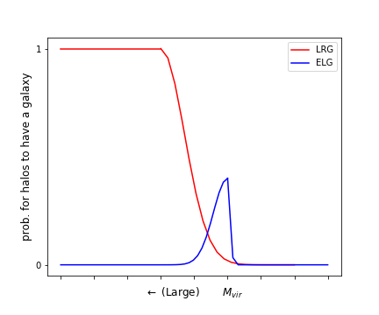
Introductions: SHAM Method
Select halos (i.e., galaxies) so that they:
Have the same number density as observations
Match the galaxy probability distribution function (P.D.F)
selected
total
Fig 1. The ideal probability distribution function for halos with a certain mass to have a galaxy inside

Slide 13
Introductions: SHAM Method
The most massive halos: all have an LRG, no one hosts an ELG
Fig 1. The ideal probability distribution function for halos with a certain mass to have a galaxy inside

Slide 14
Introductions: SHAM Method
The lightest halos: no galaxy
Fig 1. The ideal probability distribution function for halos with a certain mass to have a galaxy inside

Slide 15
Introductions: SHAM Method
Intermediate halos: smooth transition in between
Fig 1. The ideal probability distribution function for halos with a certain mass to have a galaxy inside

Slide 16
Introductions: SHAM Method
Select halos (i.e., galaxies) so that they:
Have the same number density as observations
Match the galaxy probability distribution function (P.D.F)
Agree with the observed two-point correlation functions (2PCF) on small scales
Fig 1. The ideal probability distribution function for halos with a certain mass to have a galaxy inside

Slide 17
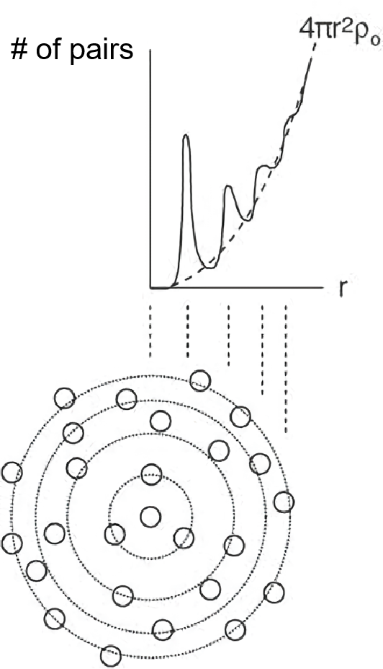
Introductions: 2PCF
Figure from LASTRO Tea-Time Talk: Cosmology with large-scale structures

Slide 18
Introductions: 2PCF
For SHAM galaxies:
(Peebles & Hauser 1974)
For eBOSS galaxies:
(Landy & Szalay 1993)
Figure from LASTRO Tea-Time Talk: Cosmology with large-scale structures
Ref 1. Peebles, P. J. E., & Hauser, M. G. 1974, The Astrophysical Journal Supplement Series, 28, 19
Ref 2. Landy, S., & Szalay, A. 1993, the astropysical journal, 412, 64

Slide 19
Introductions: 2PCF(b) with RSD
density contrast in the real space:
peculiar velocity's effect
density contrast in the redshift space:
(Kaiser 1987)
the linear galaxy bias in the real space:
Ref 1. Kaiser, N. 1987, Monthly Notices of the Royal Astronomical Society, 227, 1

Slide 20
Introductions: 2PCF(b) with RSD
density contrast in the real space:
peculiar velocity's effect
density contrast in the redshift space:
(Kaiser 1987)
the linear galaxy bias in the real space:
correlation function in the redshift space:
stronger bias impacts
on the monopoles
(Hamilton 1992)
Ref 1. Kaiser, N. 1987, Monthly Notices of the Royal Astronomical Society, 227, 1
Ref 2. Hamilton, A. J. S. 1992, The Astrophysical Journal, 385, L5

Slide 21
Contents:
Introductions
SHAM implementation
Results
Conclusions and Outlooks
Galaxy Bias: the link of DM and galaxies
SHAM: select halos with bias models and calibrate them
2PCF = 2PCF(bias,v_{pec})

Slide 22
Contents:
Introductions
SHAM Implementation
Results
Conclusions and Outlooks
Data Descriptions
SHAM using V_{peak}
SHAM model Calibration

Slide 23
SHAM Implementation: Data Description
the (Sub)Halo catalogue:
the UNIT simulation
Box size: 1³ (Gpc/h)³
Employed snapshots z=0.859 and z=0.702
V_{peak}: the peak maximum circular velocity over the mass accretion history

Slide 24
SHAM Implementation: Data Description
the (Sub)Halo catalogue:
the UNIT simulation
Box size: 1³ (Gpc/h)³
Employed snapshots z=0.859 and z=0.702
V_{peak}: the peak maximum circular velocity over the mass accretion history
eBOSS observations:
PIP+ANG weighted galaxy pair counts (Mohammad et al. (2020))
ELGs at 0.6<z<1.1, z_{eff} =0.845, n_{eff} = 2.93e⁻⁴ (Gpc/h)⁻³
LRGs at 0.6<z<1.0, z_{eff} =0.698, n_{eff} = 6.26e⁻⁵ (Gpc/h)⁻³

Slide 25
SHAM Implementation: Data Description
the (Sub)Halo catalogue:
the UNIT simulation
Box size: 1³ (Gpc/h)³
Employed snapshots z=0.859 and z=0.702
V_{peak}: the peak maximum circular velocity over the mass accretion history
eBOSS observations:
PIP+ANG weighted galaxy pair counts (Mohammad et al. (2020))
ELGs at 0.6<z<1.1, z_{eff} =0.845, n_{eff} = 2.93e⁻⁴ (Gpc/h)⁻³
LRGs at 0.6<z<1.0, z_{eff} =0.698, n_{eff} = 6.26e⁻⁵ (Gpc/h)⁻³
Covariance matrices:
EZmocks
1000 realisations for one tracer in one galactic cap

Slide 26
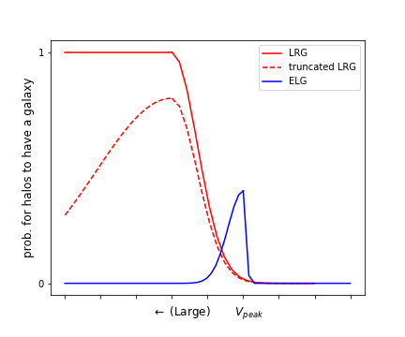
SHAM Implementation: SHAM using V_{peak}
Massive Truncation: probable absence of eBOSS heavy galaxies
Fig 2. The eBOSS galaxy P.D.F compared with the ideal one

Slide 27
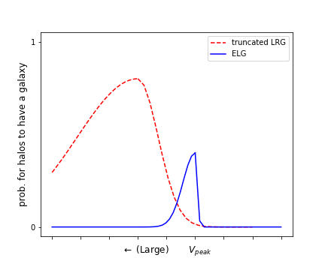
SHAM Implementation: SHAM using V_{peak}
the same SHAM model for eBOSS LRGs and ELGs
Fig 3. The eBOSS galaxy P.D.Fs

Slide 28
SHAM Implementation: SHAM using V_{peak}
prob. of having a galaxy inside
Simply Cut at V_{cut}
Ngal
Vpeak
Vcut
0

Slide 29
SHAM Implementation: SHAM using V_{peak}
prob. of having a galaxy inside
Simply Cut at V_{cut}
Ngal
Vpeak
Vcut
0
prob. of having a galaxy inside
Scattering with N (0, σ²)
Massive-end cut at V_{cut}
Ngal
Vpeak
Vcut
0

Slide 30
SHAM Implementation: SHAM using V_{peak}
SHAM processes:
Scatter V_{peak} by = V_{peak}(1+N(0,σ²))
Truncate the massive end of at V_{cut}
Assign N_{gal}-th galaxies to the remaining halos that have the largest

Slide 31
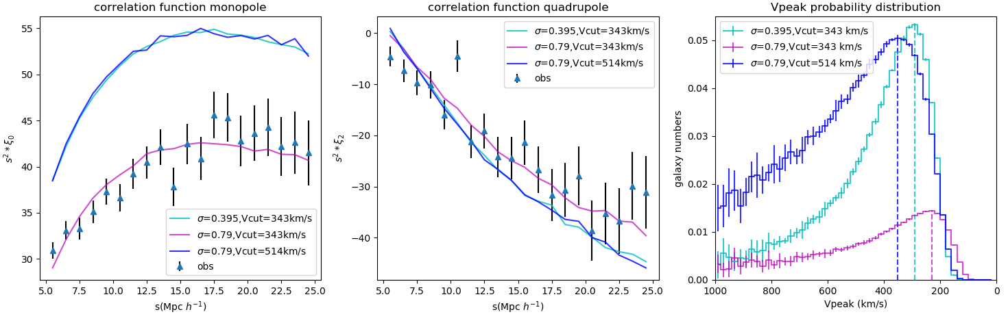
SHAM Implementation: SHAM using V_{peak}
(Sub)Halos
SHAM selection (σ, V_{cut})
SHAM galaxy catalogue & 2PCF
Fig 4. The impacts of σ and Vcut on the 2PCF monopole (left), quadrupole (right) and the Vpeak PDF (the next page)

Slide 32
SHAM Implementation: SHAM using V_{peak}
Fig 4. The impacts of σ and Vcut on the Vpeak PDF

Slide 33
SHAM Implementation: Calibration
(Sub)Halos
SHAM selection (σ, V_{cut})
SHAM galaxy catalogue & 2PCF

Slide 34
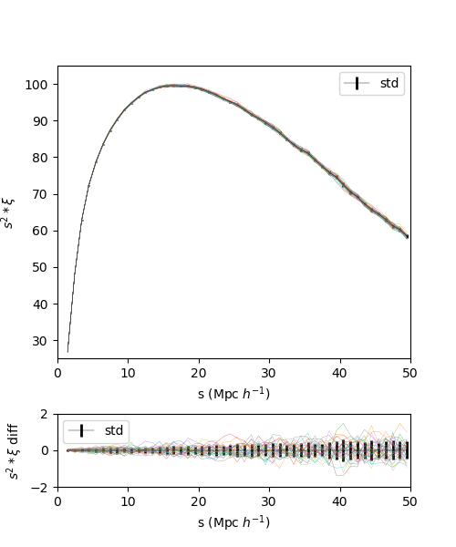
SHAM Implementation: Calibration
(Sub)Halos
SHAM selection (σ, V_{cut})
SHAM galaxy catalogue & 2PCF

Slide 35
SHAM Implementation: Calibration
(Sub)Halos
SHAM selection (σ, V_{cut})
SHAM galaxy catalogue & 2PCF
Reduce the statistical fluctuation from N(0,σ²)
Average over the 2PCFs of 20 catalogues for a single (σ, V_{cut})

Slide 36
SHAM Implementation: Calibration
(Sub)Halos
SHAM selection (σ, V_{cut})
SHAM galaxy catalogue & 2PCF
Reduce the statistical fluctuation from N(0,σ²)
Average over the 2PCFs of 20 catalogues for a single (σ, V_{cut})
calculate χ² with the observations
Monte-Carlo Nested Samping (Multinest) to obtain the best parameters
(iminuit as a contrast)

Slide 37
Contents:
Introductions
SHAM Implementation
Results
Conclusions and Outlooks
Data: UNIT, eBOSS galaxies, EZmocks
SHAM: scattering, massive cut, assign galaxies
Calibration: averaged SHAM, Monte-Carlo Sampling

Slide 38
Contents:
Introductions
SHAM Implementation
Results
Conclusions and Outlooks
SHAM Models for ELGs
SHAM Models for LRGs
LRG Improvement: the Redshift Uncertainty

Slide 39
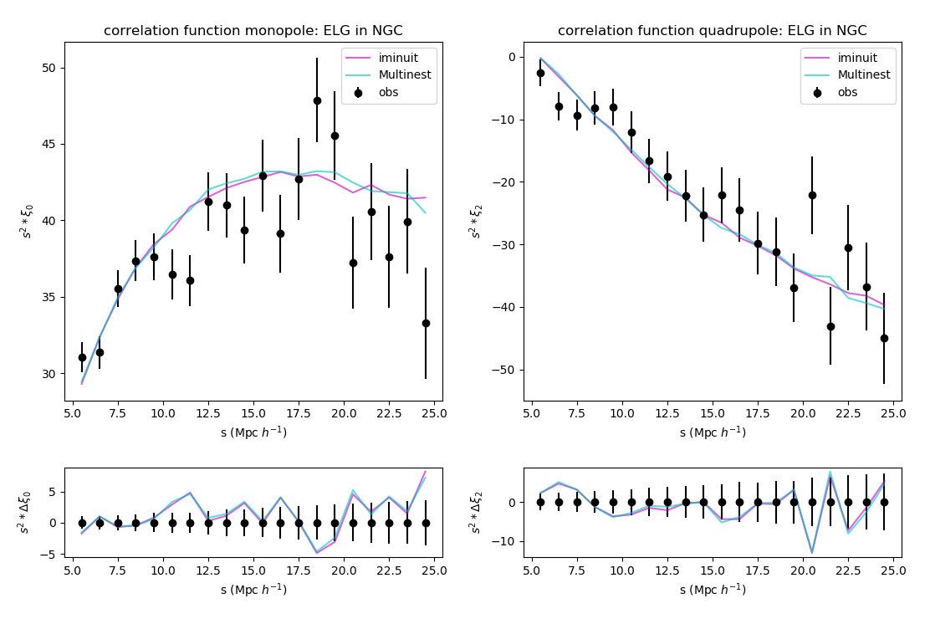
Results: ELG NGC 2PCF
σ | Vcut (km/s) | χ² | Reduced χ²
Fig 5. The correlation functions of eBOSS SHAM ELGs in NGC

Slide 40
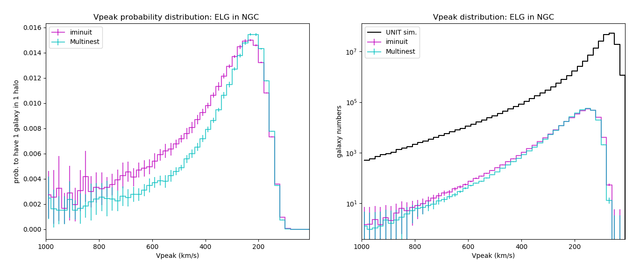
Results: ELG NGC P.D.F
σ | Vcut (km/s) | χ² | Reduced χ²
Fig 6. The probability distribution function of eBOSS SHAM ELGs in NGC

Slide 41
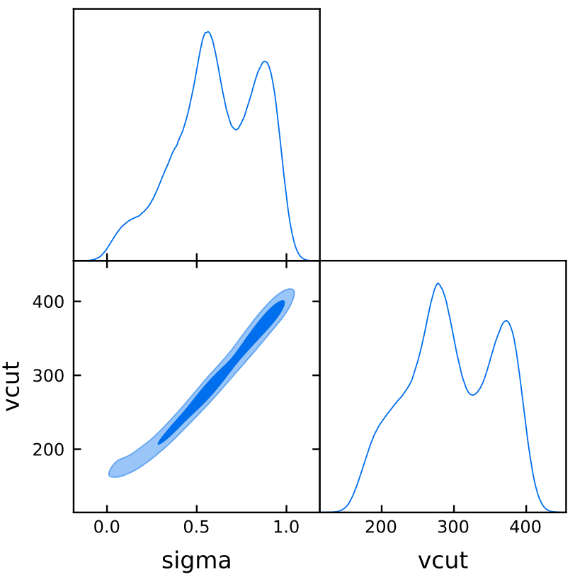
Results: ELG NGC Posterior
σ | Vcut (km/s) | χ² | Reduced χ²
Fig 7. The posterior distributions of eBOSS SHAM ELGs in NGC

Slide 42
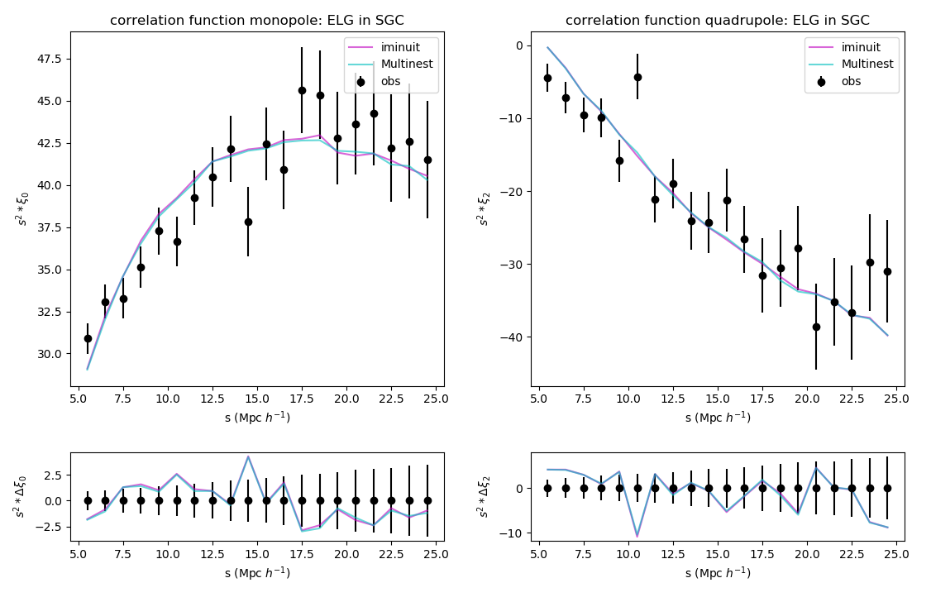
Results: ELG SGC 2PCF
σ | Vcut (km/s) | χ² | Reduced χ²
Fig 8. The correlation functions of eBOSS SHAM ELGs in SGC

Slide 43
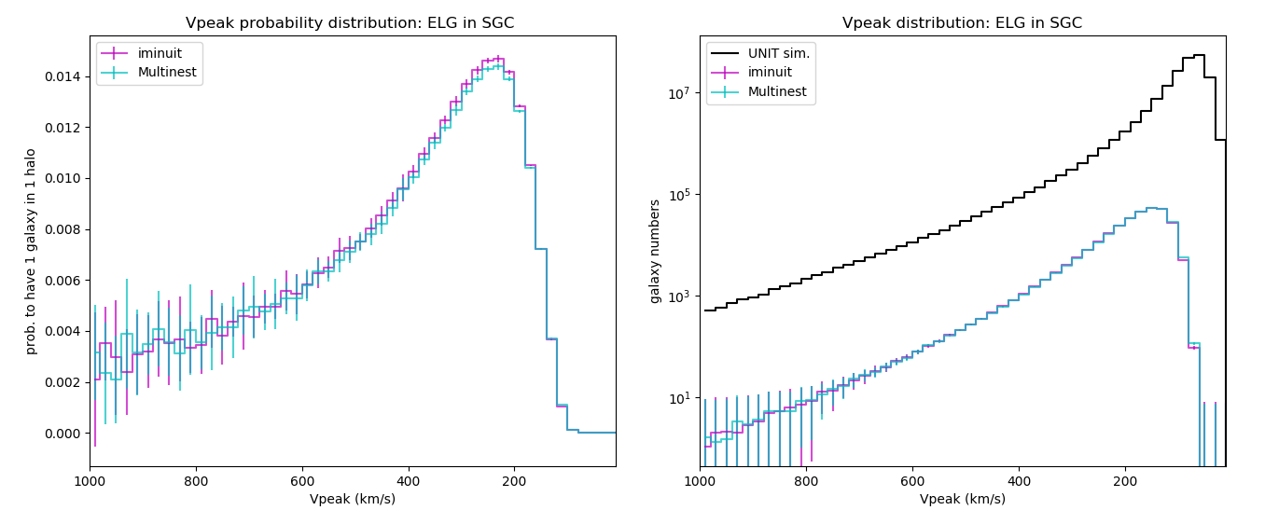
Results: ELG SGC P.D.F
σ | Vcut (km/s) | χ² | Reduced χ²
Fig 9. The probability distribution function of eBOSS SHAM ELGs in SGC

Slide 44
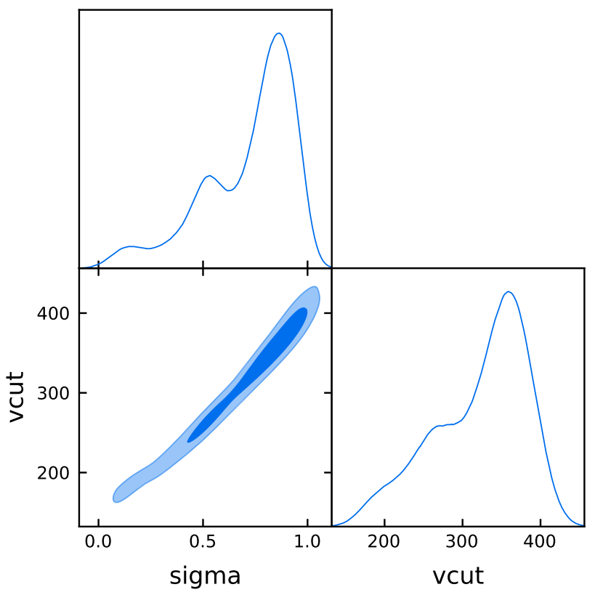
Results: ELG SGC Posterior
σ | Vcut (km/s) | χ² | Reduced χ²
Fig 10. The posterior distributions of eBOSS SHAM ELGs in SGC

Slide 45
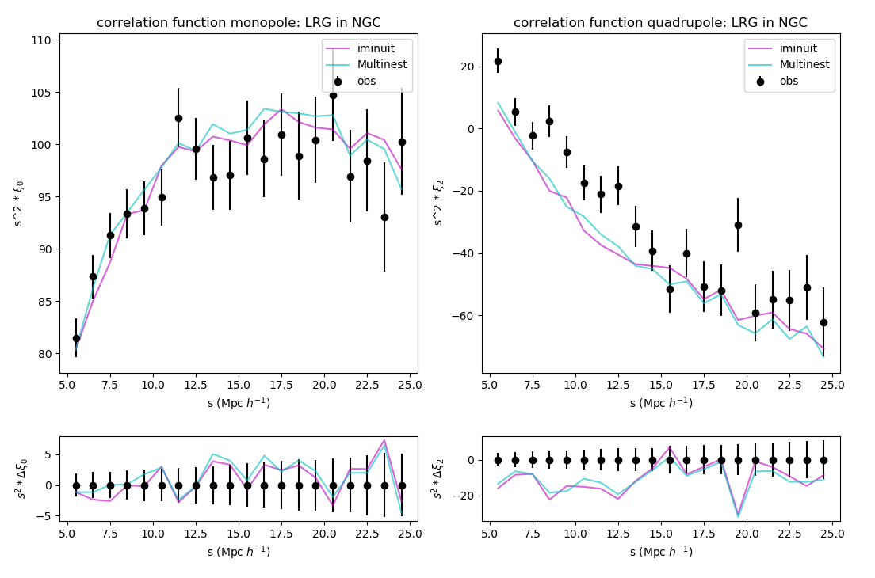
Results: LRG NGC 2PCF
σ | Vcut (km/s) | χ² | Reduced χ²
Fig 11. The correlation functions of eBOSS SHAM LRGs in NGC

Slide 46
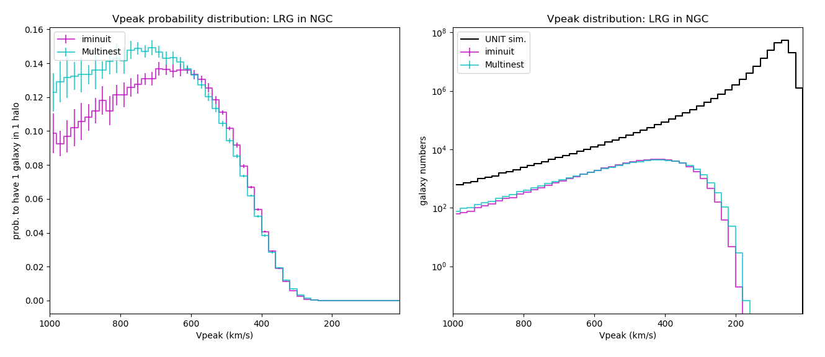
Results: LRG NGC P.D.F
σ | Vcut (km/s) | χ² | Reduced χ²
Fig 12. The probability distribution function of eBOSS SHAM LRGs in NGC

Slide 47
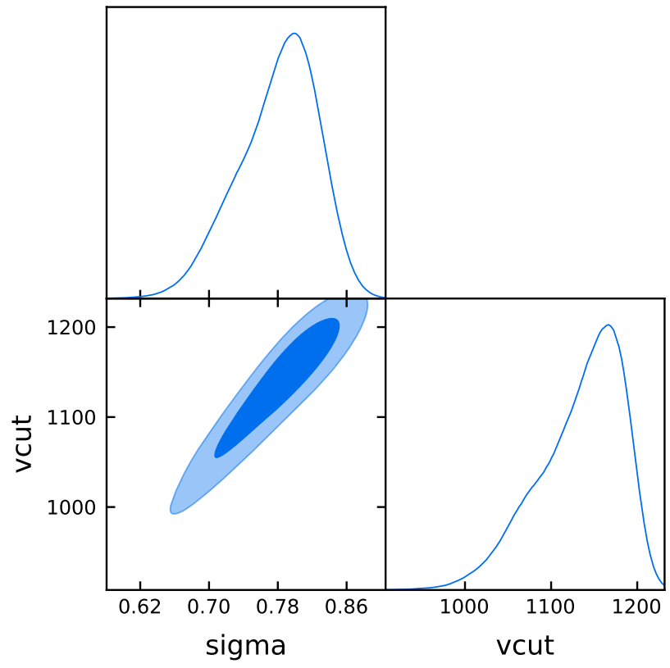
Results: LRG NGC Posterior
σ | Vcut (km/s) | χ² | Reduced χ²
Fig 13. The posterior distributions of eBOSS SHAM LRGs in NGC

Slide 48
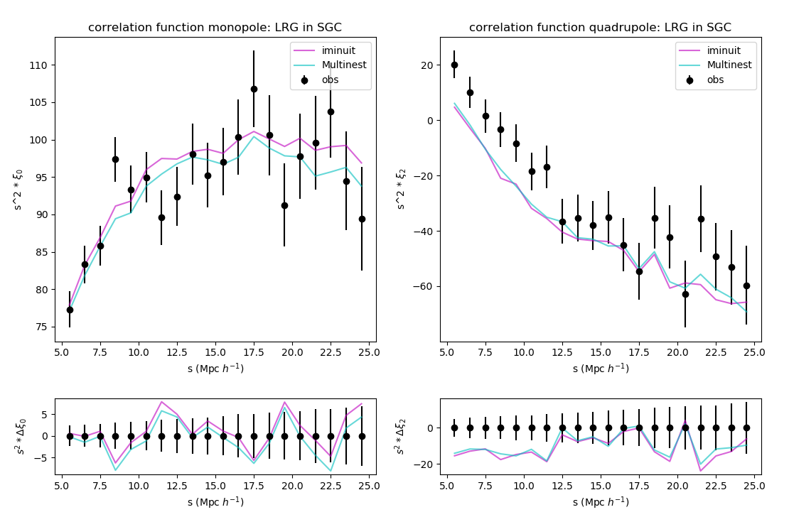
Results: LRG SGC 2PCF
σ | Vcut (km/s) | χ² | Reduced χ²
Fig 14. The correlation functions of eBOSS SHAM LRGs in SGC

Slide 49
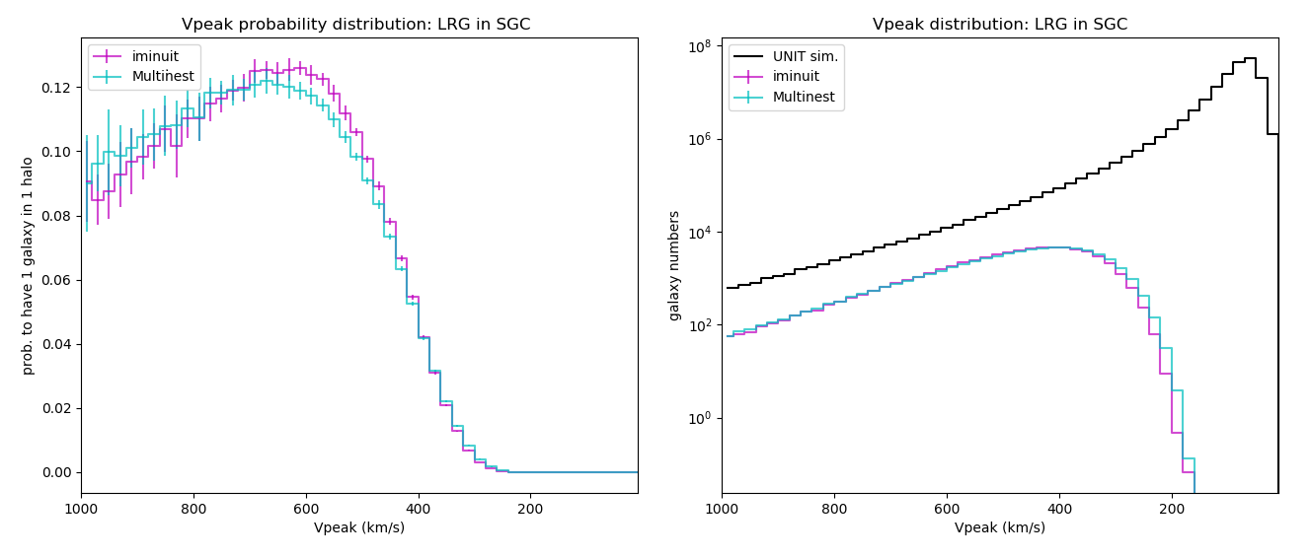
Results: LRG SGC P.D.F
σ | Vcut (km/s) | χ² | Reduced χ²
Fig 15. The probability distribution function of eBOSS SHAM LRGs in SGC

Slide 50
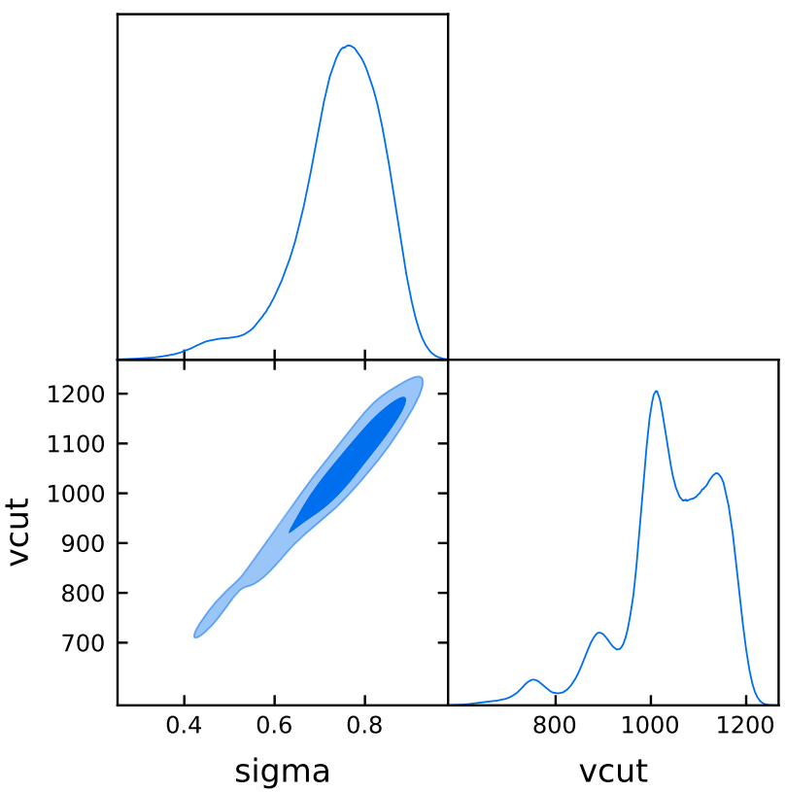
Results: LRG SGC Posterior
σ | Vcut (km/s) | χ² | Reduced χ²
Fig 16. The posterior distributions of eBOSS SHAM LRGs in SGC

Slide 51
Results: LRG SHAM Improvement
the Ideal effect:
Quadrupole on small scales increases
Quadrupole on large scales and monopole have minor shifts
A Reminder:
2PCF = 2PCF(bias,v_{pec})

Slide 52
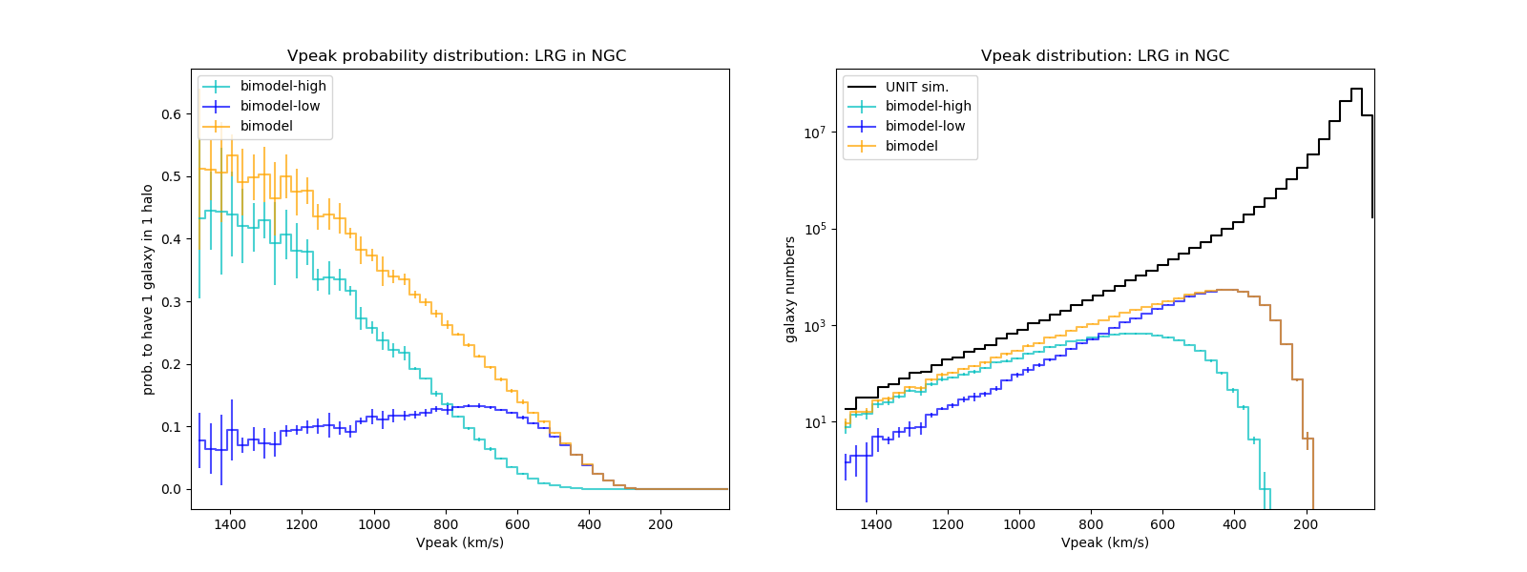
Results: LRG Improvement -- Bias
Fig 17. The PDF of a dual-population model

Slide 53
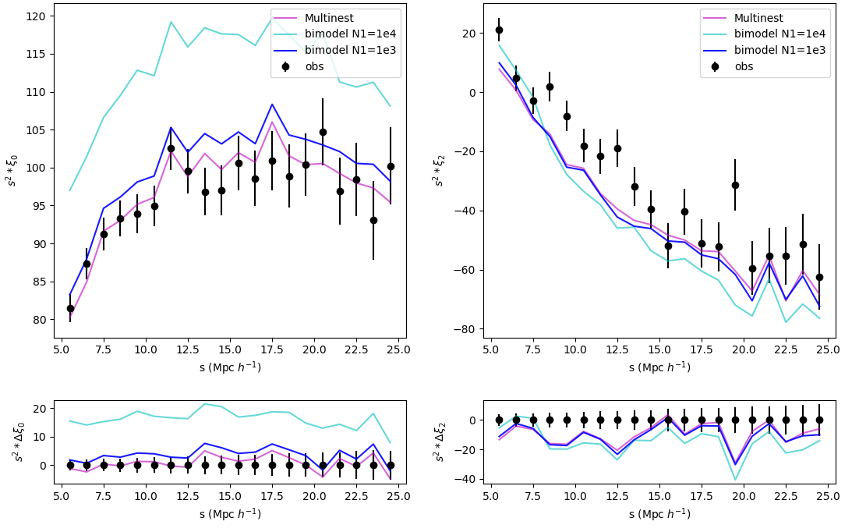
Results: LRG Improvement -- Bias
Fig 18. The dual-model's parameter impact on the monopole (left) and quadrupole (right)

Slide 54
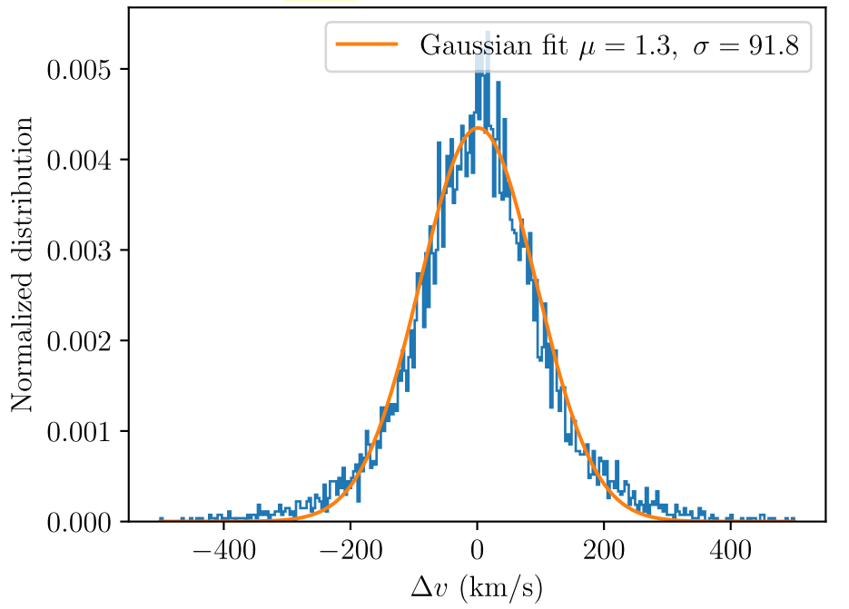
Results: LRG Improvement -- v_{pec}
Fig 18. The redshift uncertinty of eBOSS LRG pairs, Figure 2 of Ross et al. (2020)

Slide 55
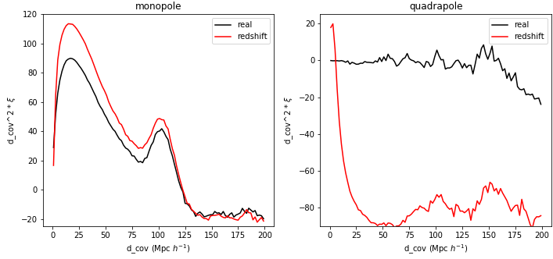
Results: LRG Improvement -- v_{pec}
Δv modelled by a Gaussian smearing N(0, 91.8²) on the peculiar velocity
➩Quadrupole shifts larger than the monopole shift
Fig 19. The peculiar velocity's effect on the correlation function monopole (left) and quadrupole (right)

Slide 56
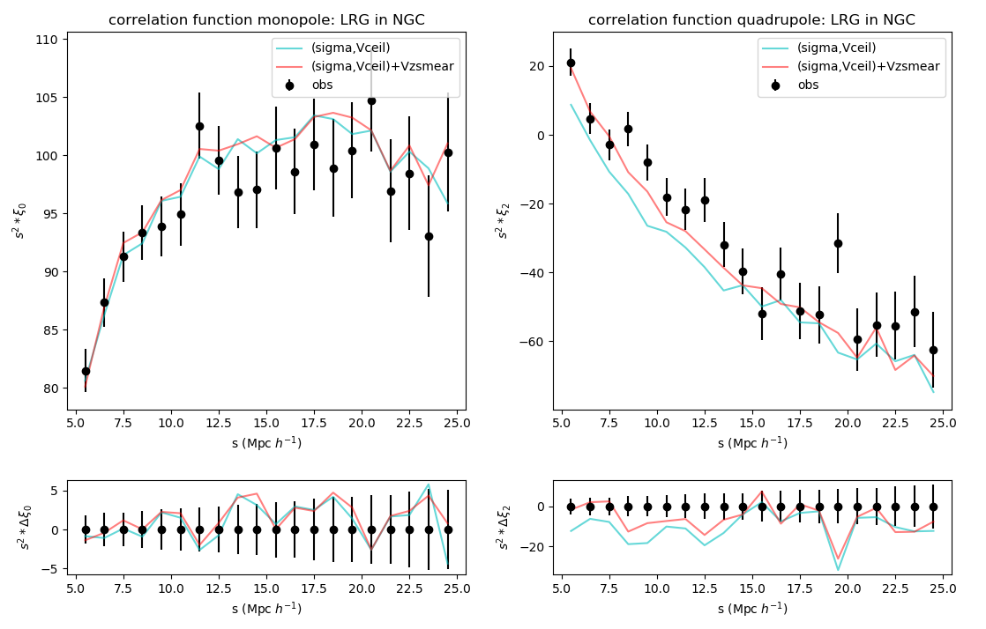
Results: LRG Improvement -- v_{pec}
σ | Vcut (km/s) | χ² | Reduced χ²
Fig 20. The peculiar-velocity-smeared SHAM LRG in NGC

Slide 57
Contents:
Introductions
SHAM Implementation
Results
Conclusions and Outlooks
ELGs: good! degeneracy found
LRGs: quadrupole discrepancy on small scales
Improvement: the peculiar velocity smearing

Slide 58
Contents:
Introductions
SHAM Implementation
Results
Conclusions and Outlooks

Slide 59
Conclusions:
Applied SHAM on UNIT (sub)halo catalogue

Slide 60
Conclusions:
Applied SHAM on UNIT (sub)halo catalogue
Reproduced the 2PCF of eBOSS LRG and ELG respectively
 | σ | Vcut (km/s) | χ² | Reduced χ²
ELG NGC
ELG SGC
LRG NGC
LRG SGC

Slide 61
Conclusions:
Applied SHAM on UNIT (sub)halo catalogue
Reproduced the 2PCF of eBOSS LRG and ELG respectively
Improved the LRG SHAM by adding the redshift uncertainty effect
 | σ | Vcut (km/s) | χ² | Reduced χ²
ELG NGC
ELG SGC
LRG NGC
LRG SGC

Slide 62
Outlooks:
Reliable eBOSS LRG & ELG SHAM models
Robust SHAM models
More averaged realisations
Implement SHAM models with σ_{pec}
Test the new model in different redshift bins

Slide 63
Outlooks:
Reliable eBOSS LRG & ELG SHAM models
Robust SHAM models
More averaged realisations
Implement SHAM models with σ_{pec}
Test the new model in different redshift bins
Multi-tracer SHAM
Generate multiple tracers simultaneously
Difficulty: overlapped P.D.F
Cross-Correlation Studies

Slide 64
Thanks!

Slide 65
SHAM Implementation: Data Description
the (Sub)Halo catalogue:
the UNIT simulation
Box size: 1³ (Gpc/h)³
Employed snapshots z=0.859 and z=0.702
V_{peak}: the peak maximum circular velocity over the mass accretion history
eBOSS observations:
PIP+ANG weighted galaxy pair counts (Mohammad et al. (2020))
fibre 1
separation > 62''
fibre collision region
fibre 2
ANG correction
PIP correction
Ref 1: Mohammad, F. G., Percival, W. J., Seo, H.-J., et al. submitted

