Slide 1

SubHalo Abundance Matching for eBOSS Galaxies
Jiaxi Yu
Supervisors: Prof. Dr. Jean-Paul Kneib
Dr. Cheng Zhao
July 22, 2020

Slide 2
How do galaxies distribute in DM halos? (bias model)
SHAM
P(M_{(sub)halo})
Fig 1. The principle of the Subhalo Abundance Matching

Slide 3
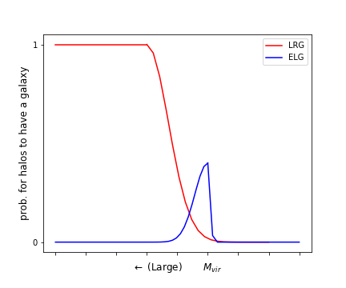
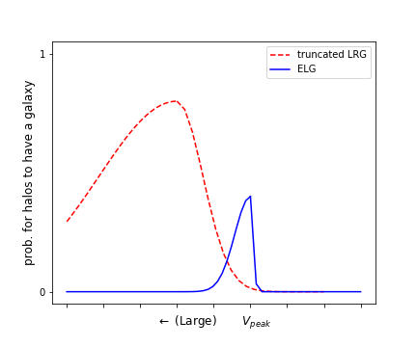
How do galaxies distribute in DM halos?
P(M_{(sub)halo})
Fig 2. The ideal galaxy probability distribution function (left) and the realistic eBOSS galaxy distribution function (right)

Slide 4
How do galaxies distribute in DM halos?
Select (sub)halos and assign galaxies inside
Scattering & Cut of V_{peak};
Galaxies in remaining halos with N_{th} largest V_{peak,selection}

Slide 5
How do galaxies distribute in DM halos?
Select (sub)halos and assign galaxies inside
Scattering & Cut of V_{peak};
Galaxies in remaining halos with N_{th} largest V_{peak,selection}
Observed 2PCFs (Mohammad et al. (2020) to calibrate the real P(M_{(sub)halo})

Slide 6
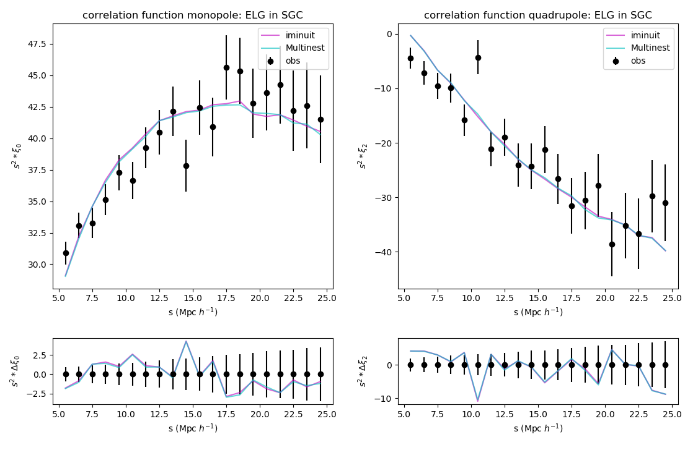
Results: SHAM ELG in SGC
σ | Vcut (km/s) | χ² | Reduced χ²
Fig 3. The correlation functions of eBOSS SHAM ELGs in SGC

Slide 7
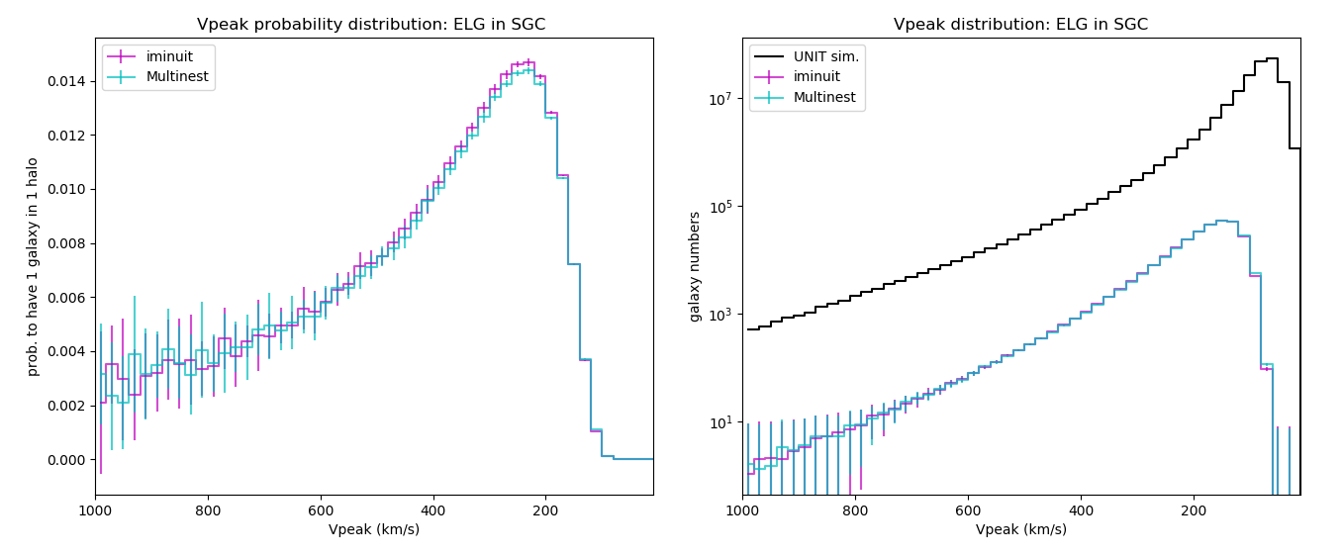
Results: SHAM ELG in SGC
σ | Vcut (km/s) | χ² | Reduced χ²
Fig 4. The probability distribution function of eBOSS SHAM ELGs in SGC

Slide 8
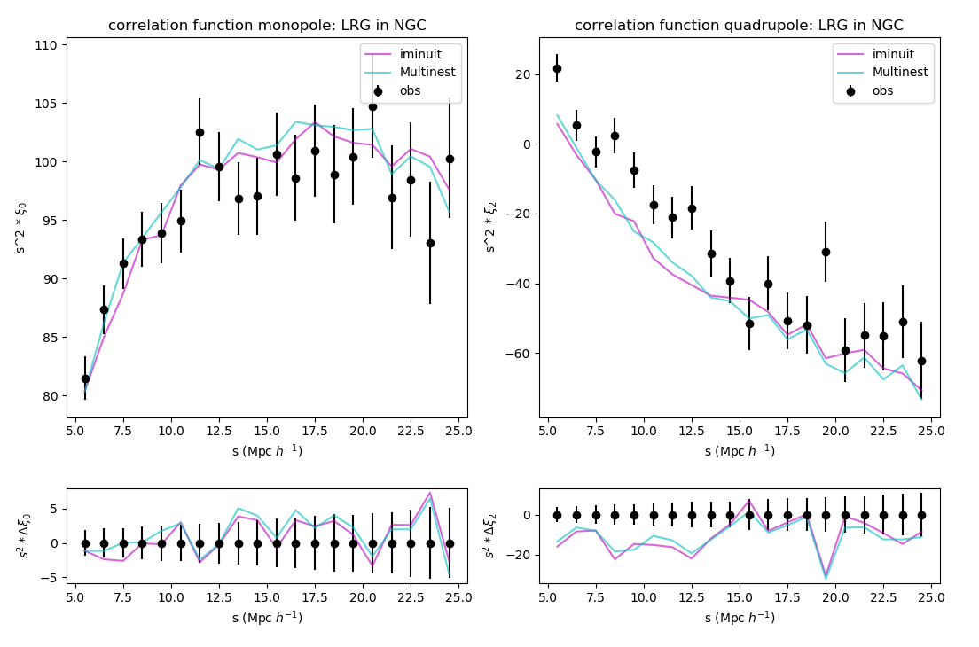
Results: SHAM LRG in NGC
σ | Vcut (km/s) | χ² | Reduced χ²
Fig 5. The correlation functions of eBOSS SHAM LRGs in NGC

Slide 9
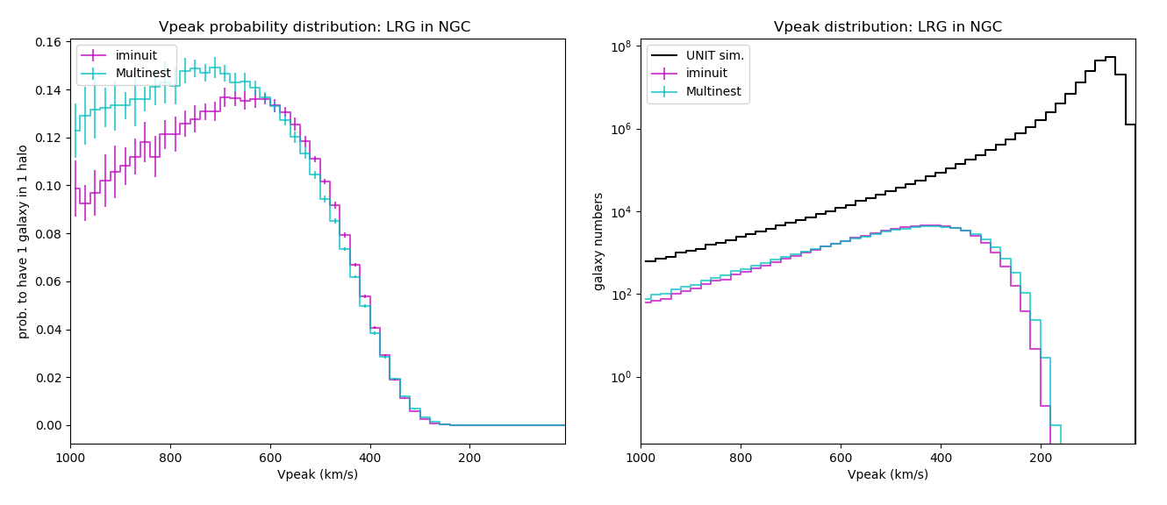
Results: SHAM LRG in NGC
σ | Vcut (km/s) | χ² | Reduced χ²
Fig 6. The probability distribution function of eBOSS SHAM LRGs in NGC

Slide 10
Results: SHAM LRG in NGC
Fig 5. The correlation functions of eBOSS SHAM LRGs in NGC

Slide 11
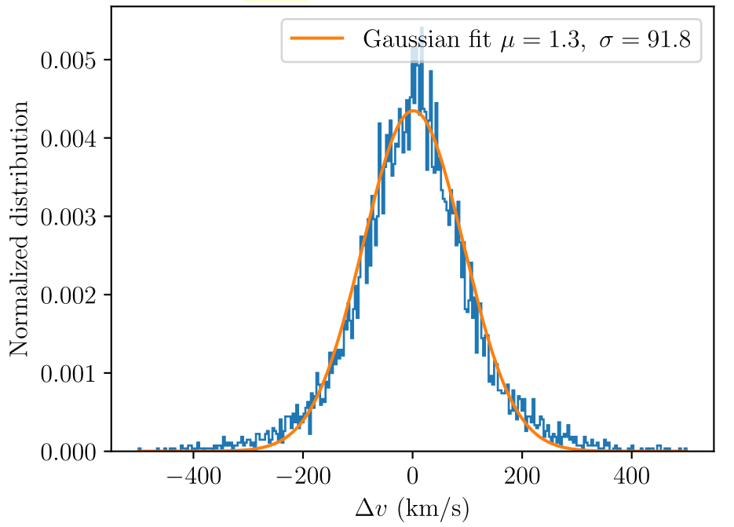
Improvement: LRG z uncertainty
Fig 7. The redshift uncertinty of eBOSS LRG pairs, Figure 2 of Ross et al. (2020)

Slide 12
Improvement: LRG z uncertainty
➩ v_{pec} Gaussian Smearing
(Smith et al. 2020)
Fig 7. The redshift uncertinty of eBOSS LRG pairs, Figure 2 of Ross et al. (2020)

Slide 13
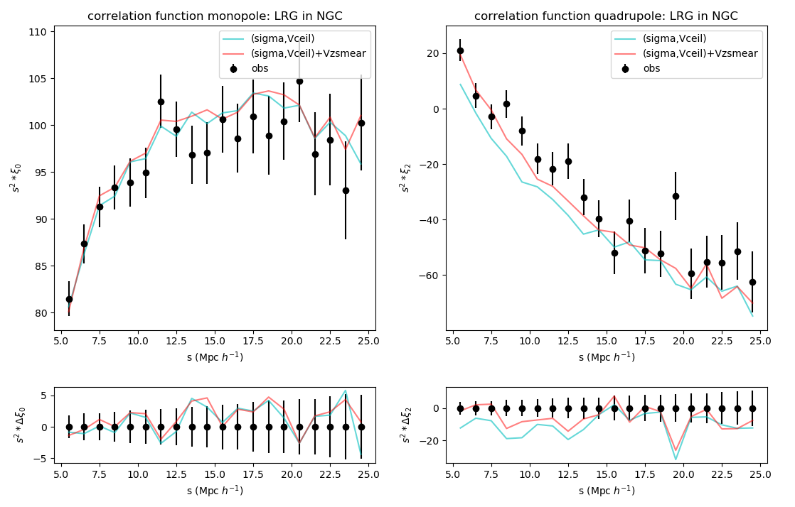
Improvement: LRG z uncertainty
σ | Vcut (km/s) | χ² | Reduced χ²
Fig 8. The peculiar-velocity-smeared SHAM LRG in NGC

Slide 14
Results: SHAM
Reproduced the 2PCF of eBOSS galaxies with SHAM
Improved the LRG SHAM by adding the redshift uncertainty
Robust SHAM models
Reduce the statistical fluctuations
3-parameter models
Multi-tracer SHAM
Cross-Correlation Studies

Slide 15
Thanks!

