Slide 1



Team LoaderMaster
Challenge #3
Underground Loader Optimisation
Unearthed Hackthon
Melbourne, 2017

Slide 2
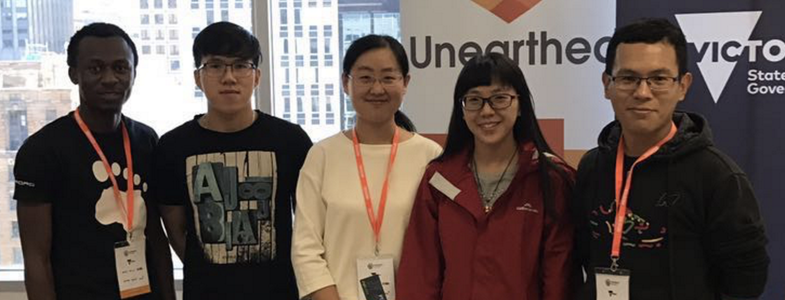
Meet the Loader – Masters Data Hackers from Swinburne University of Technology
Humphrey Obie – Computer Science
Ngoc Tran – Computer Science
Shuo Li – Physics
Kai Zhu – Image Processing
Jiaxi He – Image Processing

Slide 3
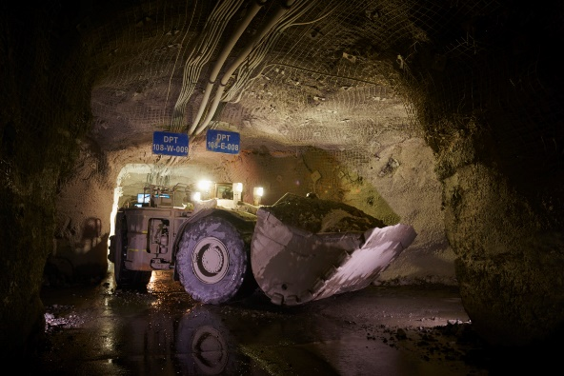
Challenge #3 Underground Loader Optimisation
What is the most efficient way to run these machines?
How could operator performance be improved?
Make productive autonomous loaders?

Slide 4
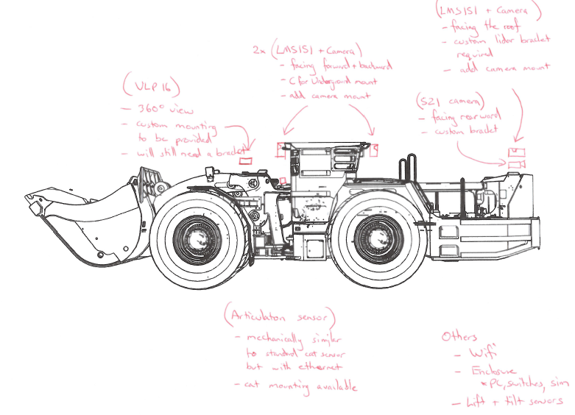
1. Understand the challenge: Catalog the measurement
Vehicle information: speed, fuel, gear,…
Position information: bucket, accelerators…
Surrounding information: road condition, traffic…
Loading information: Bucket, Coarse location…

Slide 5
1. Understand the challenge: Catalog the measurement
Vehicle information: speed, fuel, gear,…
Position information: bucket, accelerators…
Surrounding information: road condition, traffic…
Loading information: Bucket, Coarse location…

Slide 6


2. Understand the data
24 months log
60+ Operators
15+ sensors on 1 loader
Measure every 3 seconds
20GB+ data

Slide 7
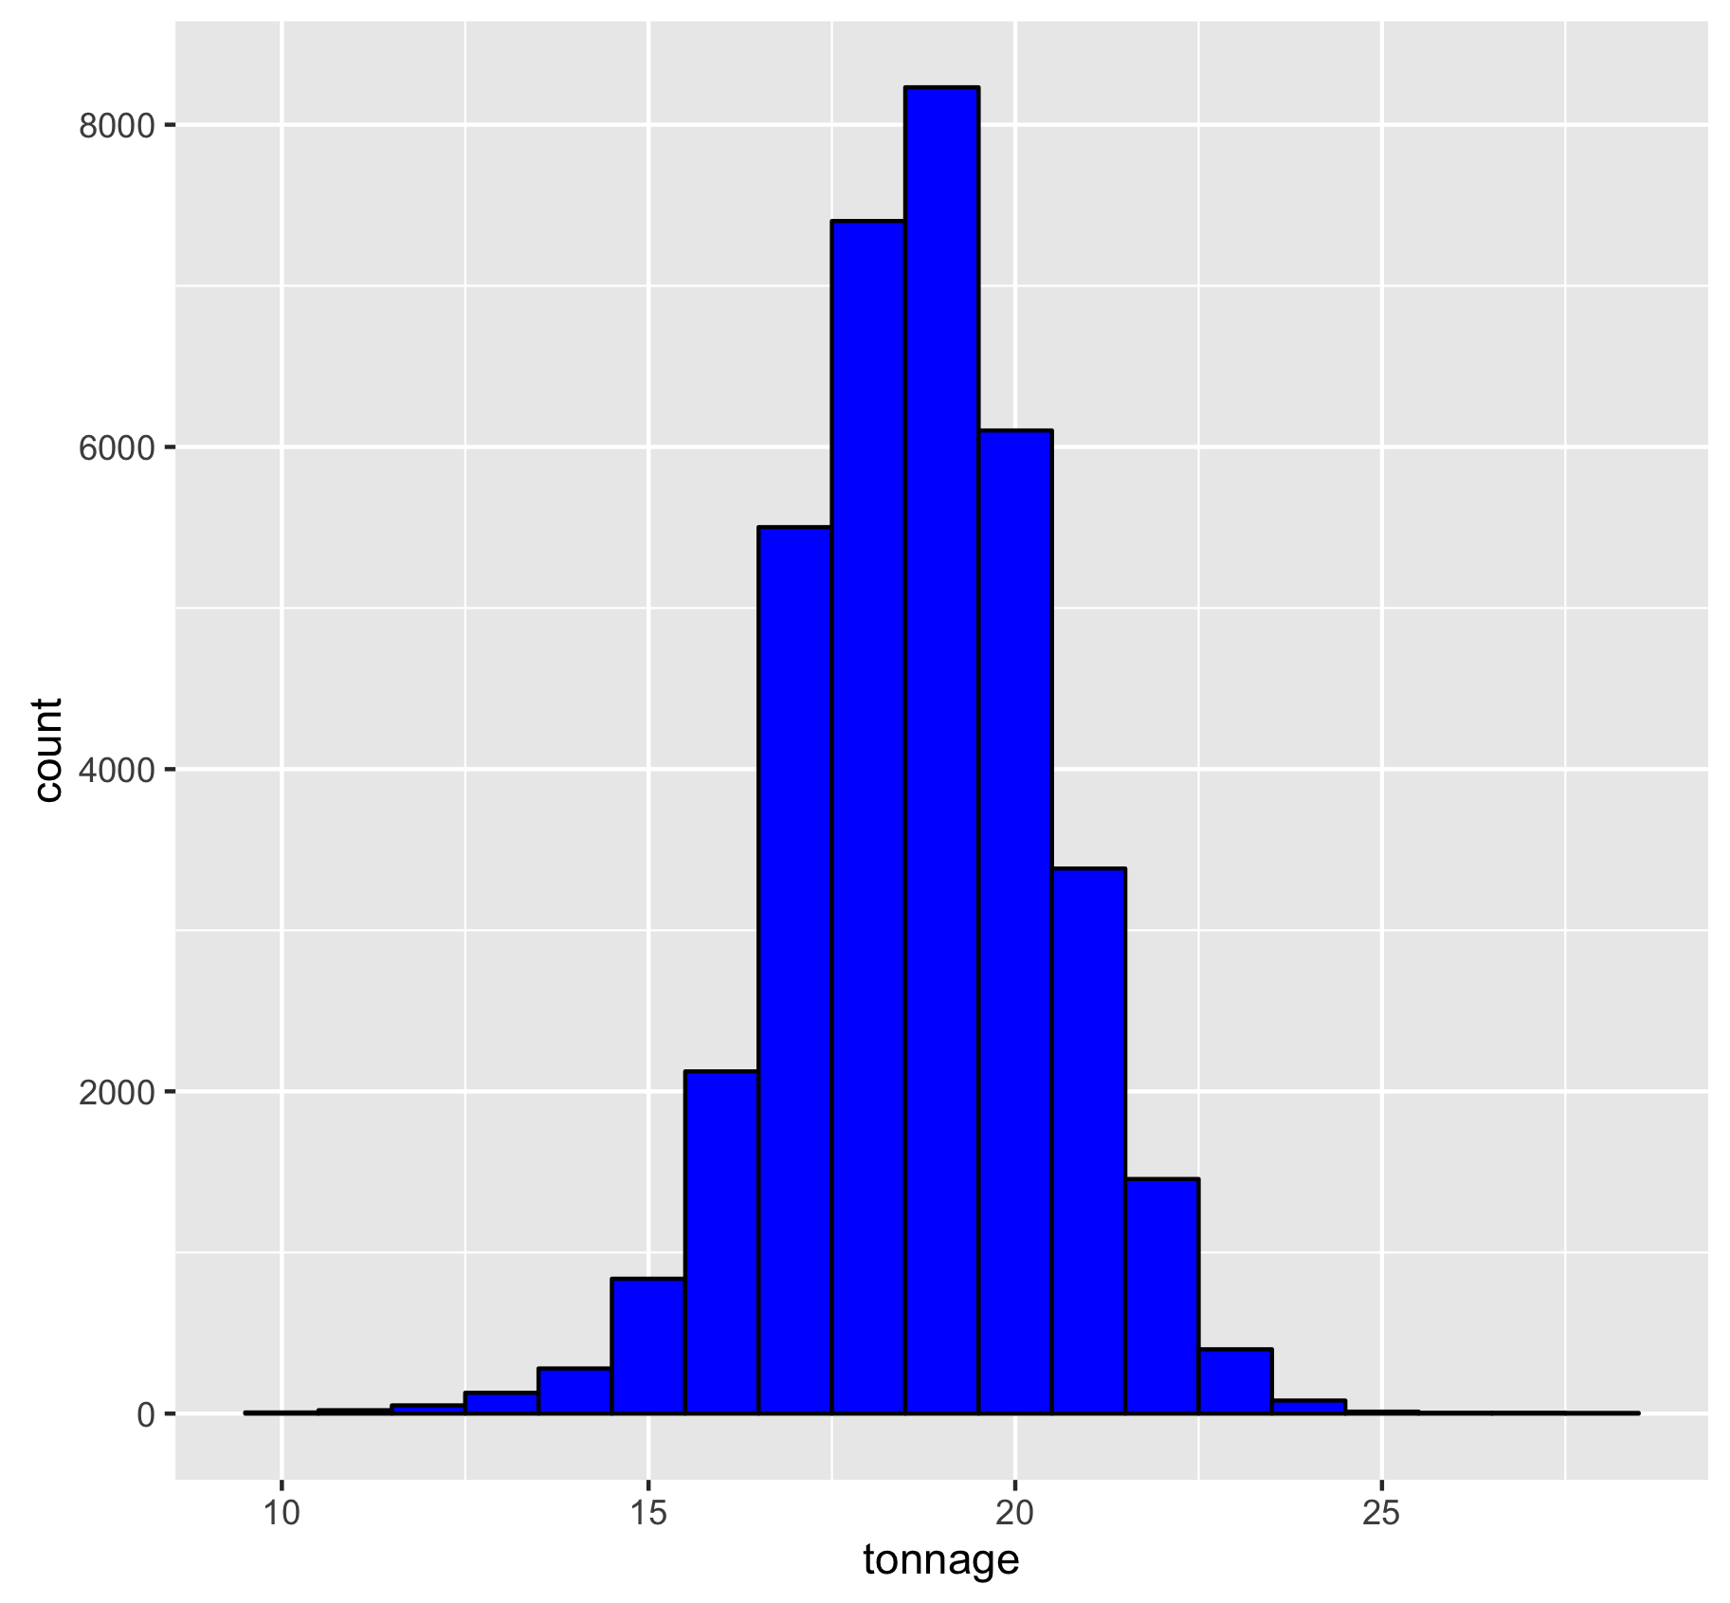
What is a good bogger?

Slide 8
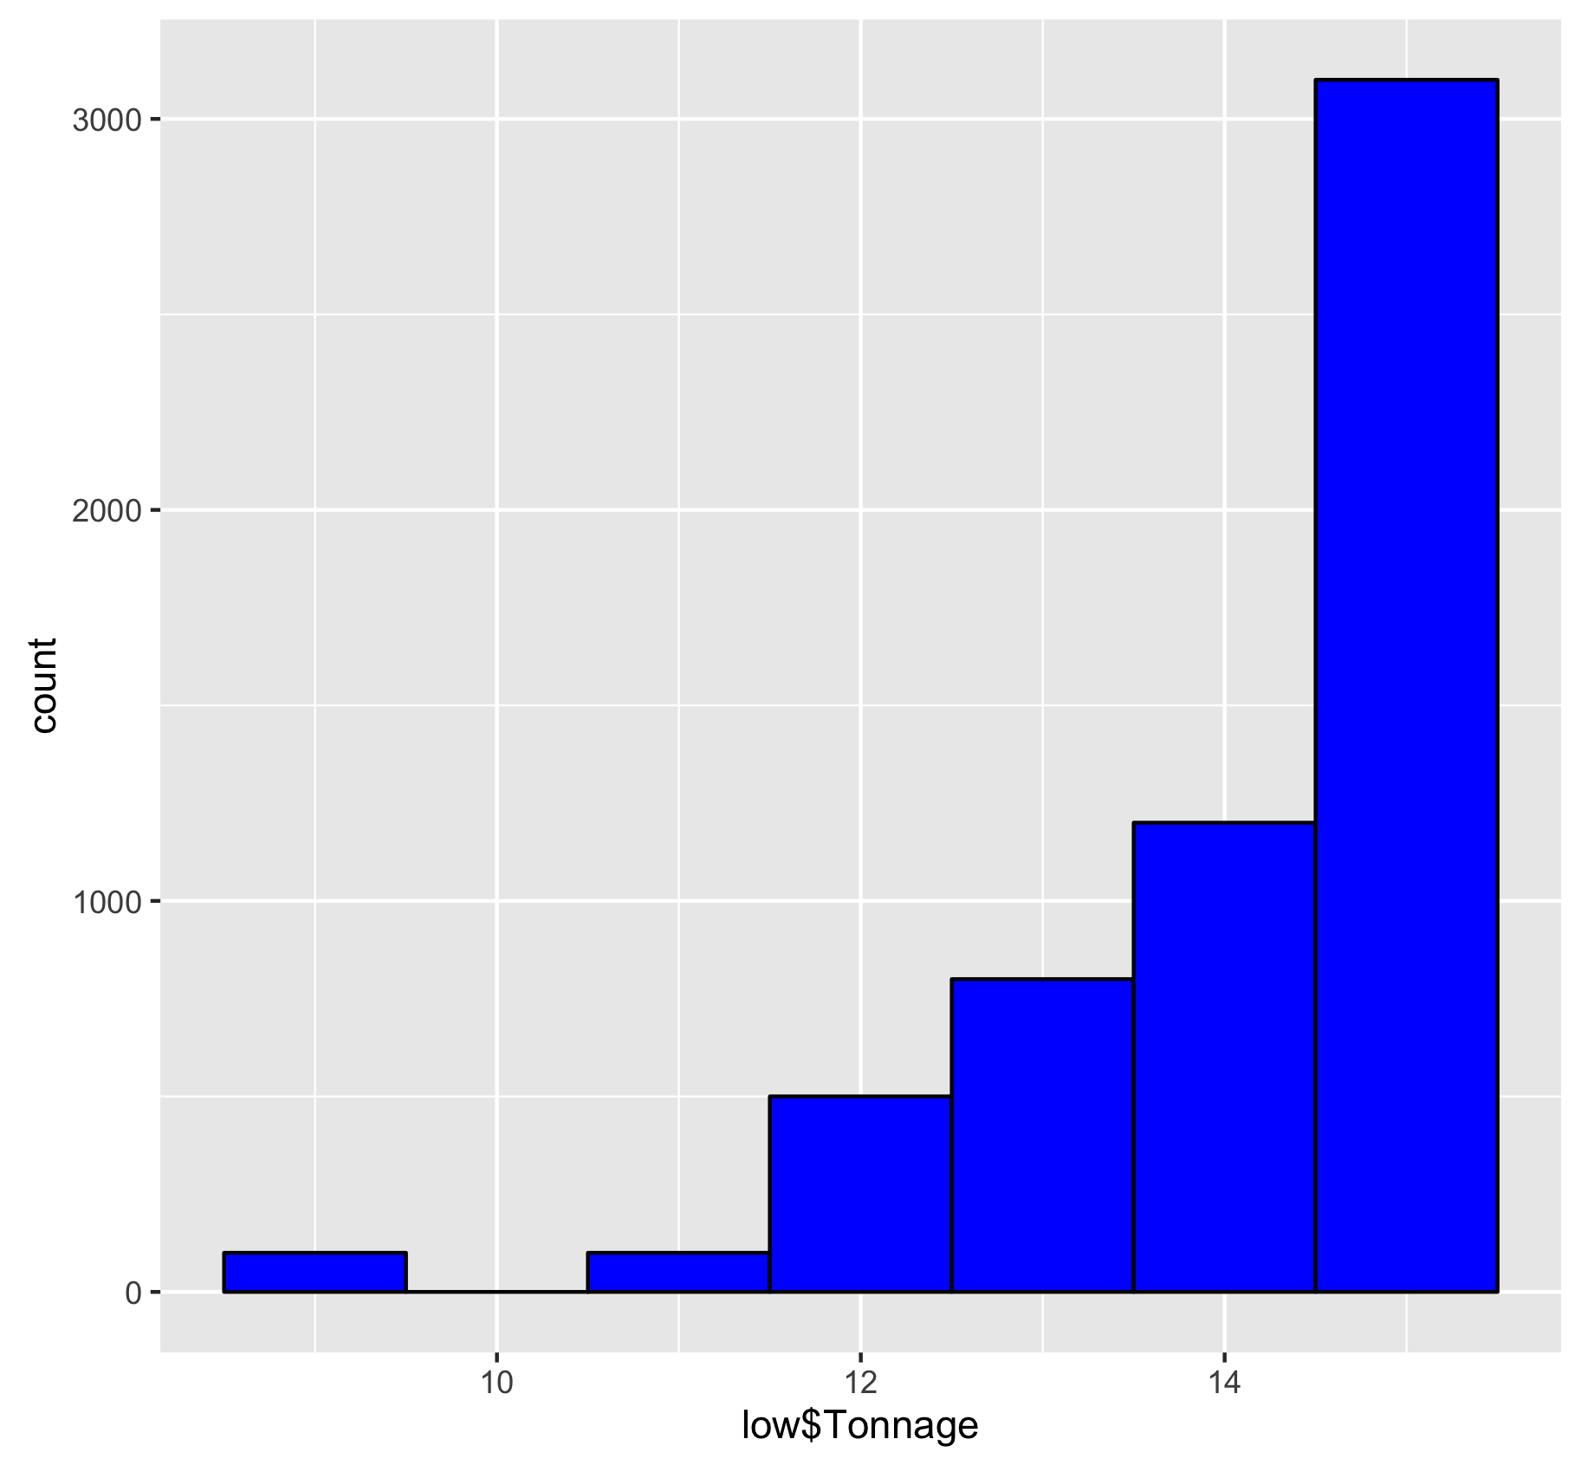
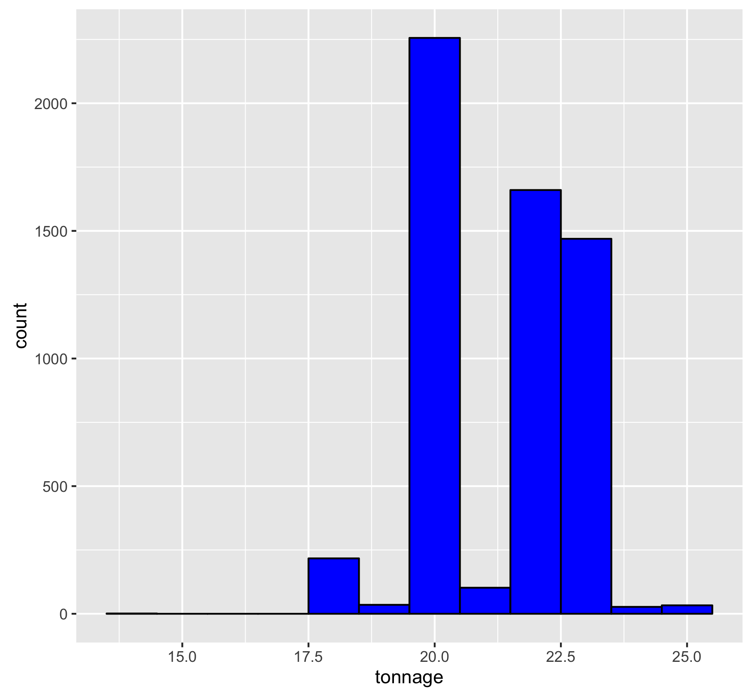

Slide 9



3. Process the data: Match & Merge
Catalog the measurement
Matching data (productivity → sensor data)
Sampling data
Model training (key variables)
Statistic analysis
Verification

Slide 10
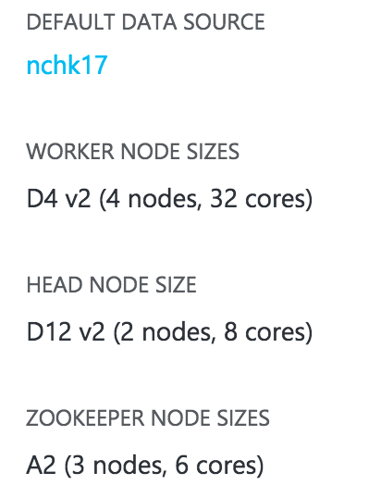
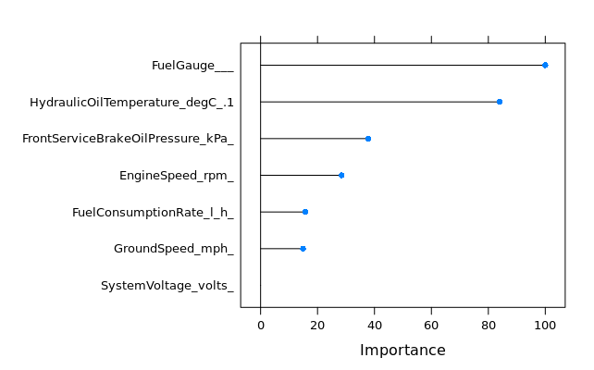

4. Build Machine Learning Platform
Using RandomForest, we have:
Identify 6 critical factors that possibly affect tonnage
Build the model that can predict how many tonnage a loader can do in a run with 86% accuracy.

Slide 11
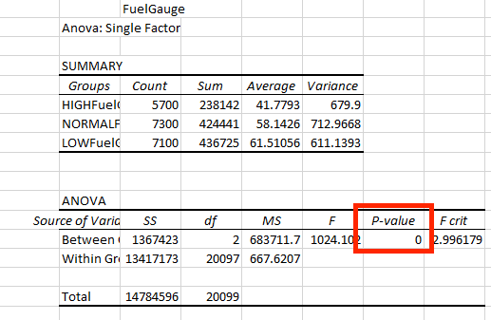
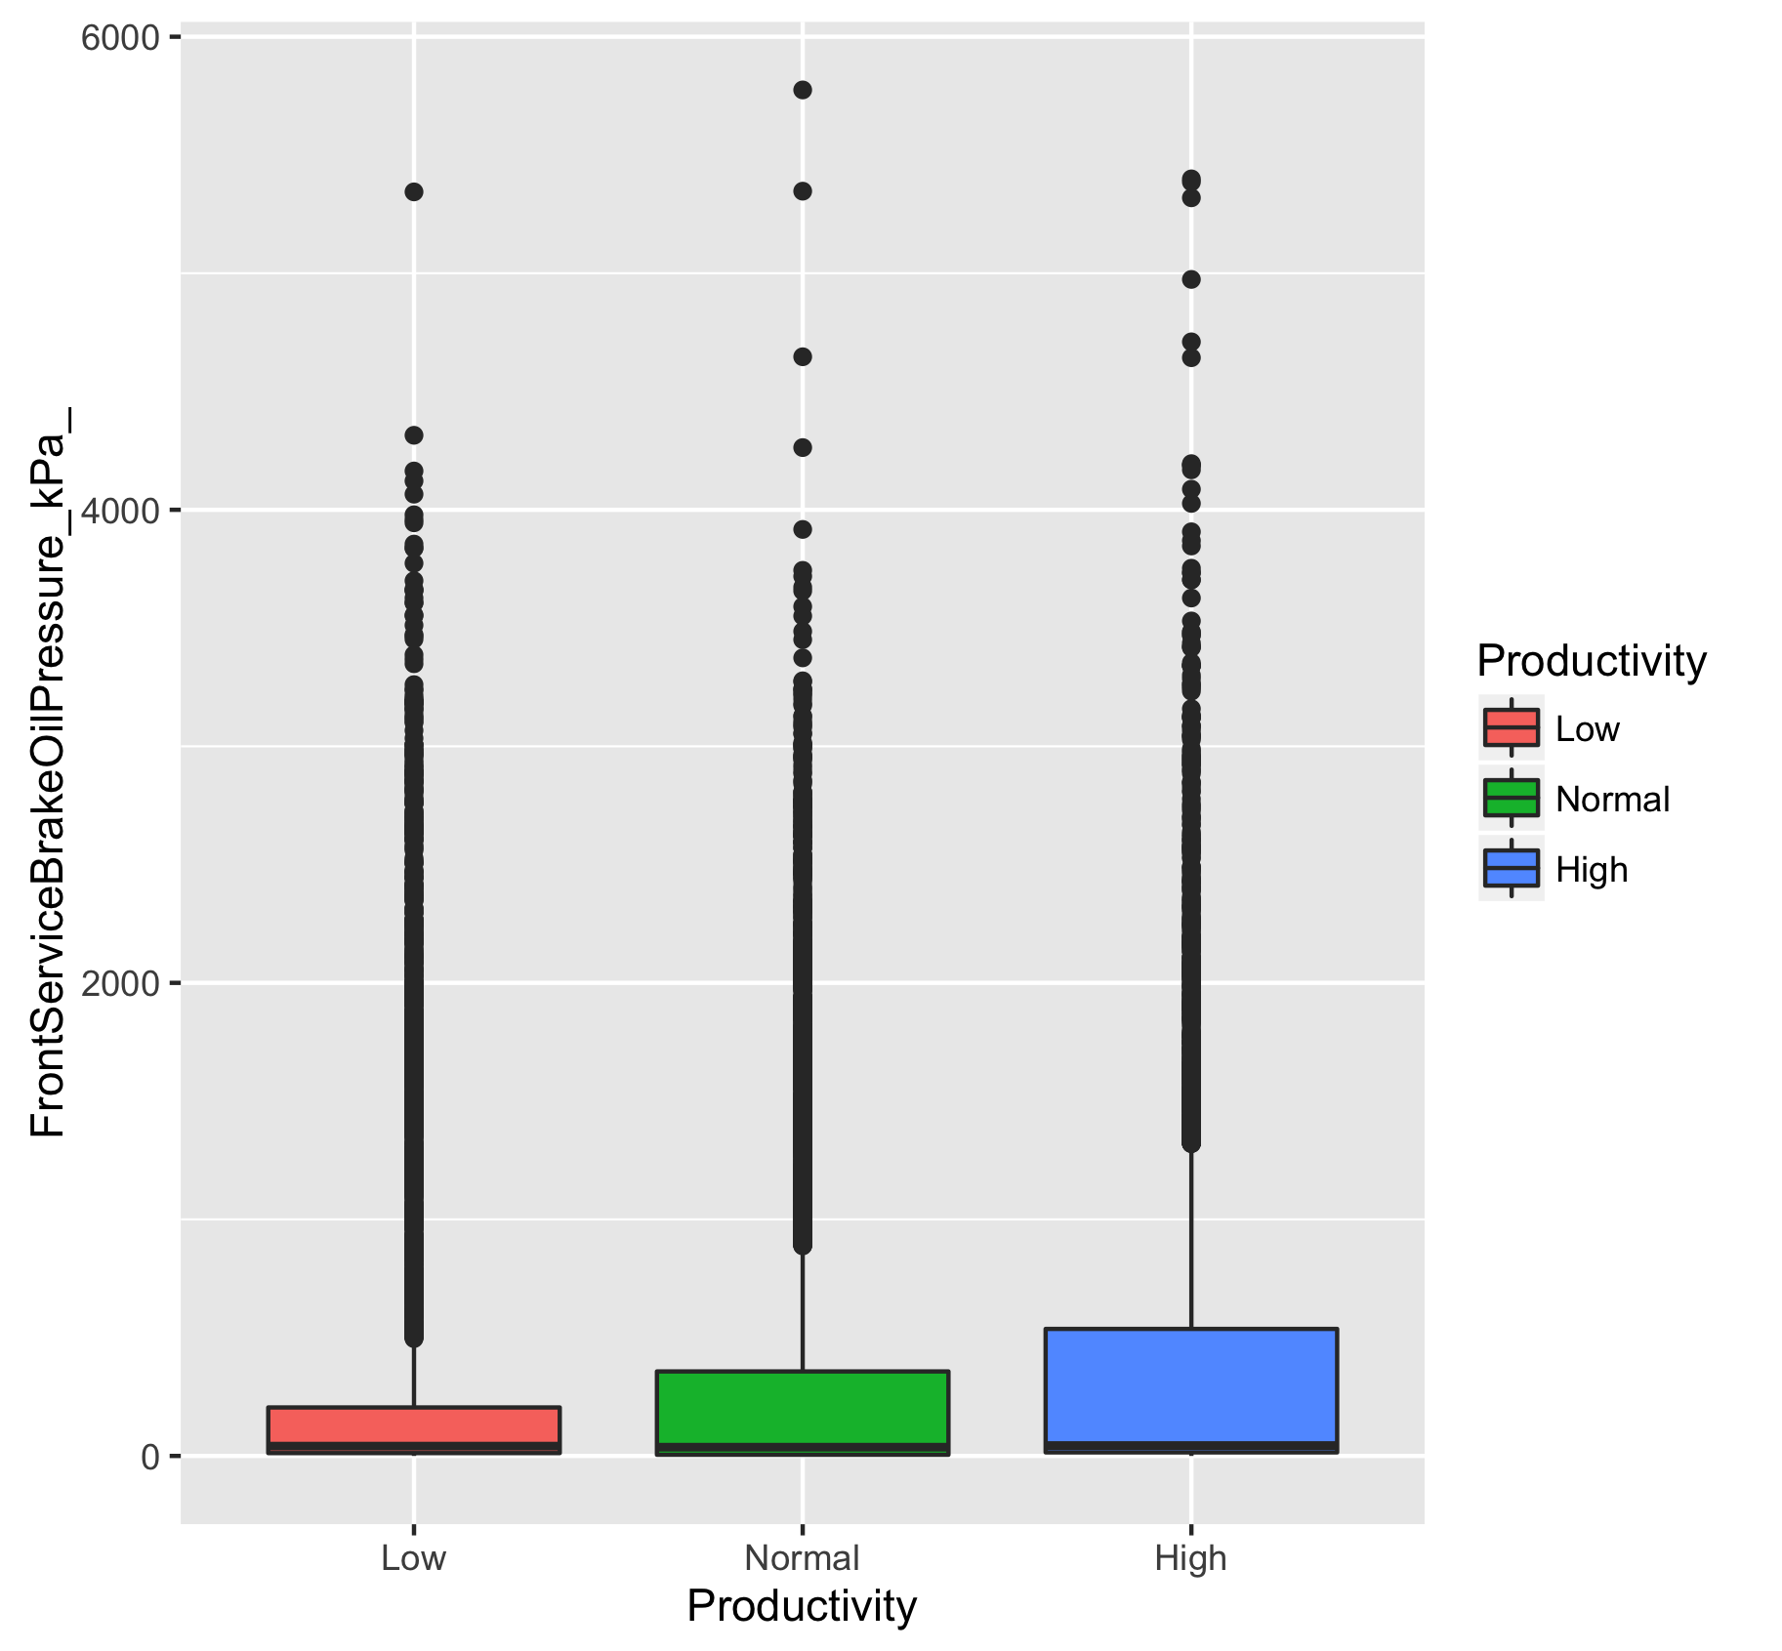
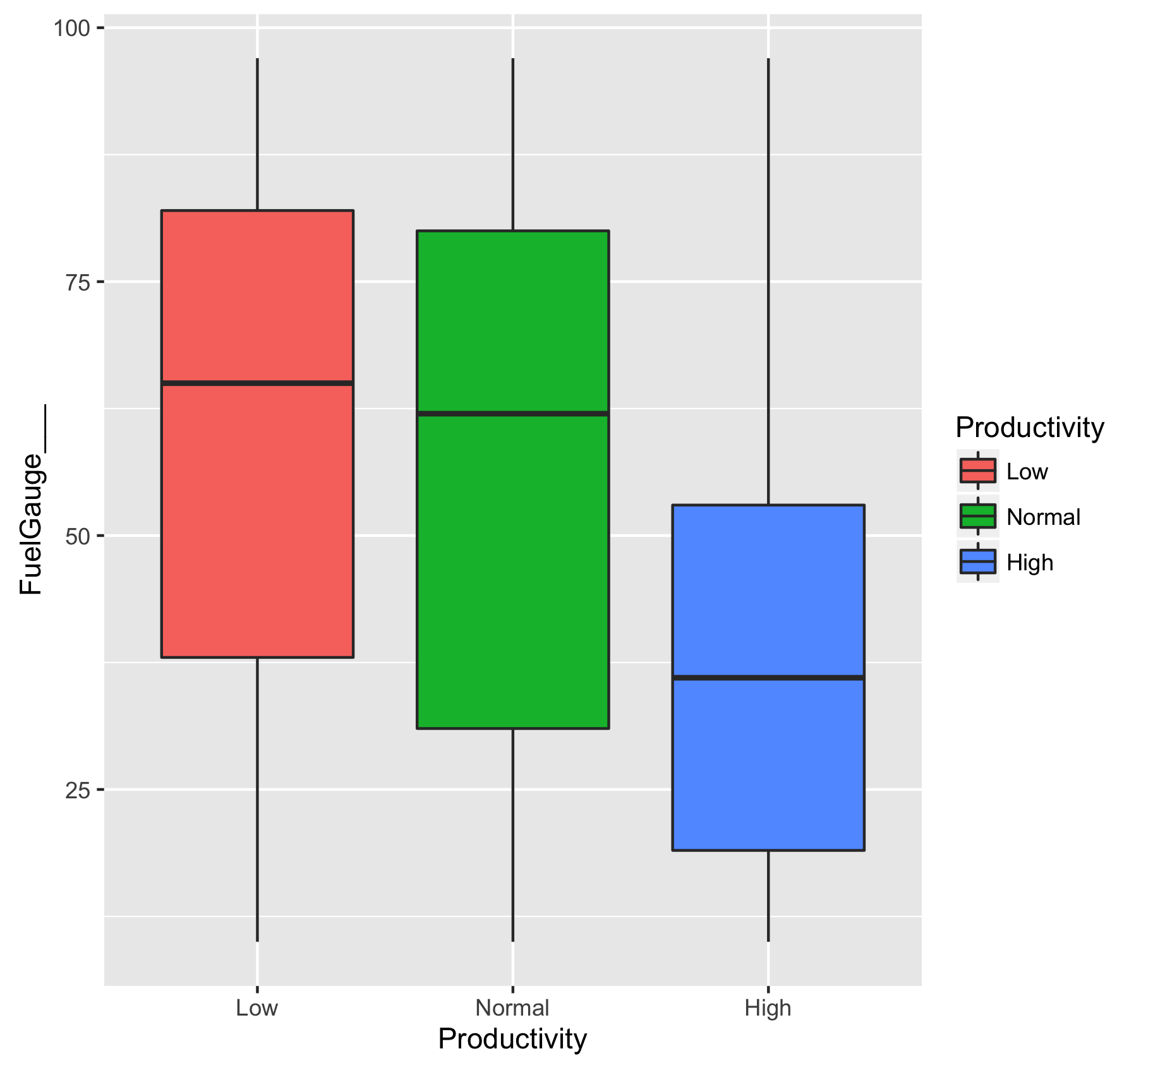
5. Verify our model

Slide 12




Platforms
Rstudio
Matlab
Python
Microsoft Azure
SPSS

Slide 13
Results
Given the conditions of the loader, we can tell how much tonnage to expect in real-time.
Predict when the loaders need to be maintained
Reduced waiting time.
Maximize tonnage output.

Slide 14
Real Time
Tonnage
8
Predicted Tonnage
15
Real Time
Tonnage
15
Predicted Tonnage
8
Take more this time
Let engine cool down

Slide 15

Business Potential
Improve
Predict the max capability of the loader. Take actions to carry more tonnage before delivery
Potential
Potential to bring another 4-5% tonnage/day/loader
More profit
Potential to develop more efficient operation pattern for autonomous loaders

Slide 16
Thank you
Organizers
Mentors
Sponsors
Participants

