Slide 1
SMARTINvest A Smart Platform Creating Value for Retail investors
By
Sofiene Omri Oussama Ben Brahem & Ahmed Ouderni

Slide 2
Outlines
The Robo-Advisory Market
SMARTINvest: An overview
Target customers
SWOT Analysis
Competitive edge
Risks & potential problems
Proof of Concept & Performance

Slide 3
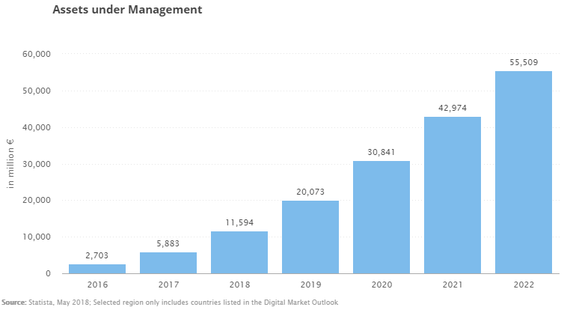
The Robo-Advisory Market

Slide 4
The Robo-Advisory Market
France
Europe
Assets under Management in the "Robo-Advisors" segment amounts to €286m in 2018.
Assets under Management are expected to show an annual growth rate (CAGR 2018-2022) of 39.8% resulting in the total amount of €1,095m in 2022.
In the "Robo-Advisors" segment, the number of users is expected to amount to 0.06m by 2022.
The average assets under management per user in the "Robo-Advisors" segment amounts to €14,310.84 in 2018.
Assets under Management in the "Robo-Advisors" segment amounts to €11,594m in 2018.
Assets under Management are expected to show an annual growth rate (CAGR 2018-2022) of 47.9% resulting in the total amount of €55,509m in 2022.
In the "Robo-Advisors" segment, the number of users is expected to amount to 3.4m by 2022.
The average assets under management per user in the "Robo-Advisors" segment amounts to €12,113.27 in 2018.

Slide 5
SMARTINvest: An overview
The fast growth of computing technology in the recent years (2018 International CES) made it rather easy to access financial market data sources over the internet
SMARTINvest is an efficient financial advisory and monitoring platform
SMARTINvest analyze an investor portfolio and recommend the most efficient stocks based on machine learning algorithms
SMARTINvest uses Artificial intelligence technology (Multi-Agent systems) to scrap various financial information in a timely manner and provide insights to clients through a recommendation system

Slide 6
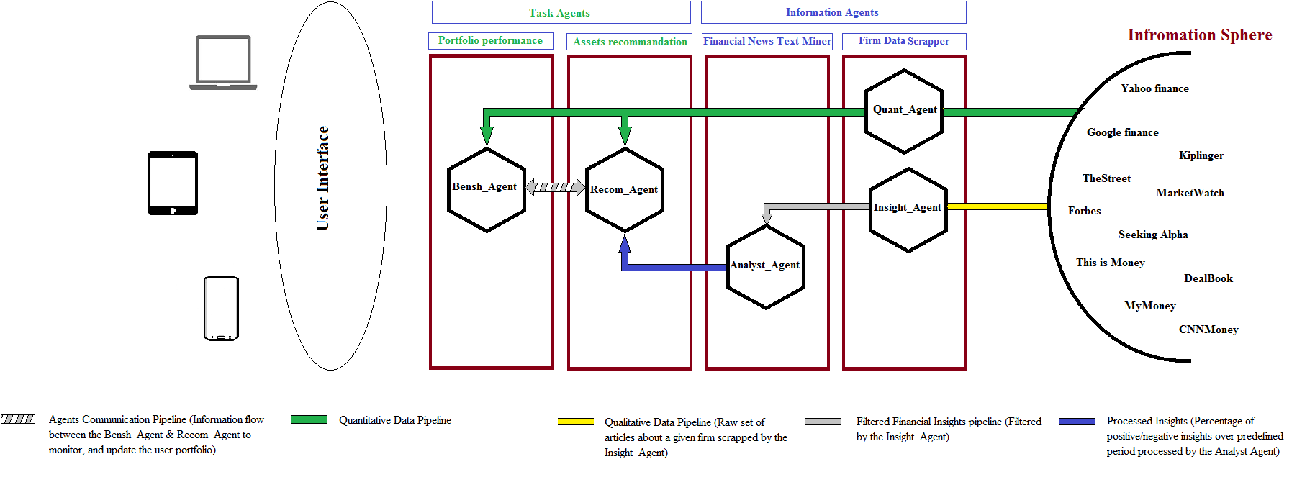
SMARTINvest: An overview

Slide 7








SMARTINvest: An overview
Client SmartIN
Backend & Front Développement
Data Storage
Deep Learning
Machine Learning

Slide 8
Target customers
SMARTINvest intends to target primarily individual investors
Geographic Segmentation
Demographic Segmentation
As a startup SMARTINvest will target European markets starting from the Paris exchange, London and Frankfurt then expanding throughout Europe.
Age: we can easily target various age groups but our main focus will be on the younger and adults’ investors as they are more interested in technological solution
Income and occupation: this segmentation would help us better target people with relatively medium to high disposal income by providing convenient services for low prices (Bottom of the Pyramid kind of business)

Slide 9
SWOT Analysis
Strength
Weakness
Ability to collect and process huge amount of structured/unstructured data in a timely efficient matter
Machine learning and more specifically deep learning provide the advantage of fast learning through the existing financial reports and market data.
Capacity to evolve and adapt its learning capacity
Various well-coordinated agents that communicate to efficiently collect and process data
Lower cost to use automated smart agents instead of hiring various financial analysts
Ability to provide aggregated insights instead of the classic huge amount of indicators
New brand with limited recognition
Access to valuable data to teach the set of agents

Slide 10
SWOT Analysis
Opportunity
Threats
The huge amount of dynamically changing financial information that comes in various and mostly unstructured format
High cost to hire various analysts to go through the various reports, news and quantitative data.
The high volume and variety of data and indicators that should be used in financial assessments and monitoring (Technical reports, financial news, financial statements and reports, market data, mathematical models etc.…)
Market volatility and environment uncertainty that requires continuous monitoring through processing huge amount of data in real time
Timeliness and criticality of financial information that require fast processing.
Even though they provide classic services and tools like assets evaluation, market data, and financial news, the existing platform that target individuals remains a well-established threat
Financial industries remains one of the main businesses that resist technological advancements (individual might not trust insights from automated smart agents)

Slide 11
Competitive edge
SMARTINvest competitive edge will be their easy-to-use website and a fee-based pricing fostering trust with our clients
The website design will be a competitive advantage because research indicates that an easy-to-use website and transparency about the advisory procedure fosters customer loyalty
SMARTINvest other competitive edge over existing robo-advisors might be its superior mix of deep learning algorithms and classic mathematical model through a well-structured multi-agent system to capture and analyze high quality financial information to monitor portfolios.

Slide 12
Risks & potential problems
Relatively little differentiation: Robo-advisors can be easily replicated in term of business model and services making it hard for startups to differentiate their services.
High fixed costs: For deep learning algorithms to be efficient a powerful IT infrastructure is required.

Slide 13
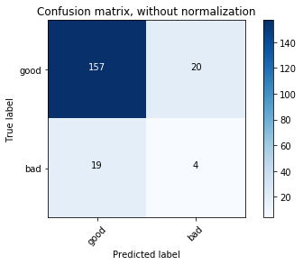
Proof of Concept & Performance
A deep learning algorithm
The model is composed by 2 convolutional layers and 2 Dense layer
Each portfolio is a 3D tensor
23 938 parameters are treated at each epoch

Slide 14
Thank you

