Slide 1
Habits
John Doe

Slide 2
In the morning

Slide 3
Getting up
  Turn off alarm
  Get out of bed

Slide 4
Breakfast
  Eat eggs
  Drink coffee

Slide 5
In the evening

Slide 6
Dinner
  Eat spaghetti
  Drink wine

Slide 7
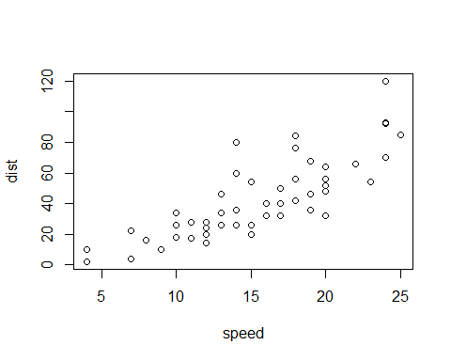
A scatterplot.

Slide 8
Going to sleep
  Get in bed
  Count sheep

Slide 9
Multi-column layout
Content of the left column.
Content of the right column.

